Slide 1
Enhancement of Wind Stress and Hurricane Waves Simulation
Fall 2015 Group Meeting
Yingjian Chen
2015.12.11

Slide 2
CONTENTS
1
Introduction
2
Method
3
Case Study
4
Future Work

Slide 3
Introduction
Atmospheric flow
momentum
Wind Stress
Ocean
Evaluation Methods:
Bulk formula
Notes:
A large number of ocean hydrodynamic processes are significantly affected by the atmospheric flow. And the flow plays its role primarily through transferring momentum into the ocean water. This intensity of momentum transfer is equivalent to a shear stress called wind stress. Look at this formula here, it is the momentum equation of ocean dynamics and the stress term is shown here. It can be estimated by the following formula. Cd is the wind drag coefficient, once it is given, the wind stress can then be known. There are two methods to estimate Cd. The first one is to relate Cd only with u10 and derive the relationship from field observations or experiments. The second one is to calculate the roughness height first and then Cd through the wind speed profile.

Slide 4
Introduction
Problems:
Most formulas show a monotonically increasing tendency with the increase of the wind speed
Neglected the sea state effect
The direct field measurements indicated that Cd does not increase or even decreases beyond a certain level (e.g., Powell et al., 2003; Jarosz et al., 2007)
Notes:
But some problems exist for the above methods. Since most of the existing formulas usually fit the field or laboratory data under moderate wind conditions, they show a monotonically increasing tendency with the increase of the wind speed, but the direct field measurements indicated that Cd does not increase or even decreases beyond a certain level. Some modifications have been made by authors in recent years. But they also vary to large extent under high wind conditions. And another problem is the bulk formulas are only related to the wind speed, they all neglect the sea state effect. My previous work is to propose a method that solve these two problems.

Slide 5
Method
The atmospheric wave boundary layer
Momentum
Turbulent stress
Viscous stress
Wave-induced stress
Energy
TKE production
Viscous dissipation rate
Vertical transport
Energy dissipation due to stratification of the sea spray
Notes:
Our method is to solve the momentum and energy equation in the atmospheric wave boundary layer. The shear stress within the wave boundary layer can be written as the combination of turbulent stress, wave-induced stress and viscous stress. On the other hand, the energy conservation in this layer are expressed in this form. Each term in the left hand side denotes…. Iterate these two equations using some specific technique, we can obtain the total stress, that is wind stress. Note that the wave-induced stress is related to the wave spectrum, so if we calculate the wind stress, the wave model should be calculated first to provide the wave information.

Slide 6
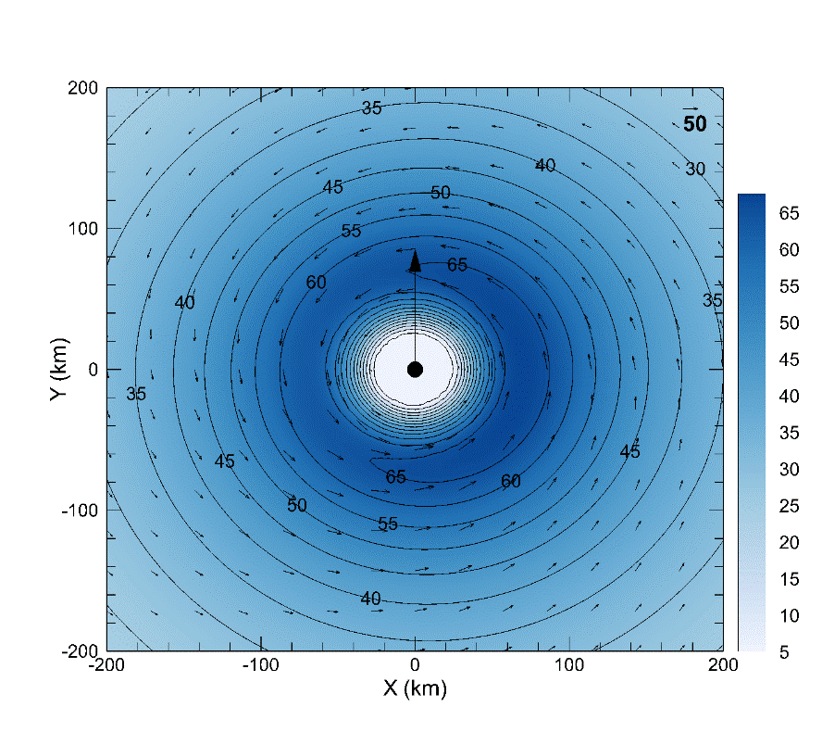
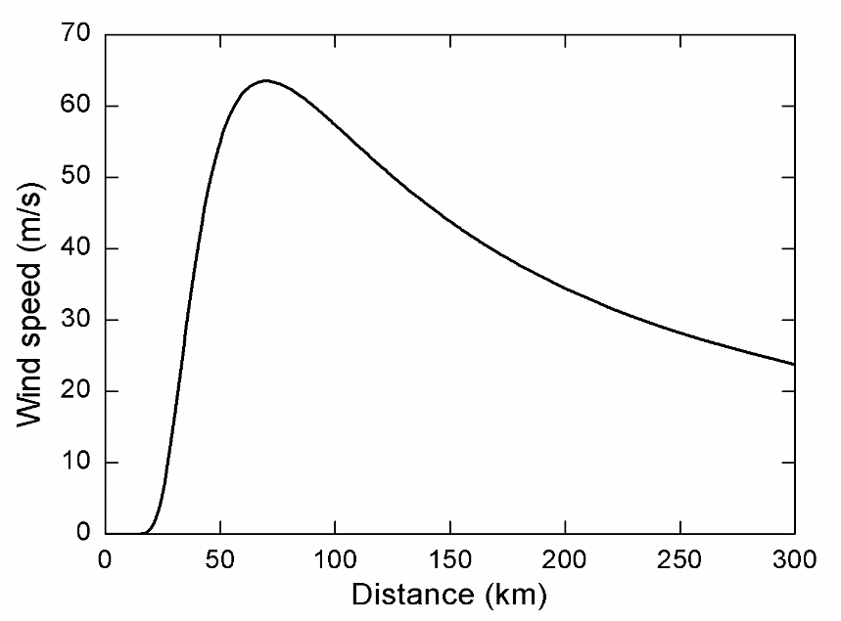
Method
Ideal Wind Field (Holland, 1980)
Center pressure: 95 kPa
Radius of maximum wind speed: 70 km
Translation speed: 5 m/s
Notes:
I run an ideal case using the Holland wind field. The first figure is the wind profile and the second one is the wind speed distribution in the plane. Some hurricane parameters is set as follows. Once the wind field is input, we can calculate the wave field using wave model. Then using the outcome wave spectrum to evaluate the wind stress.

Slide 7
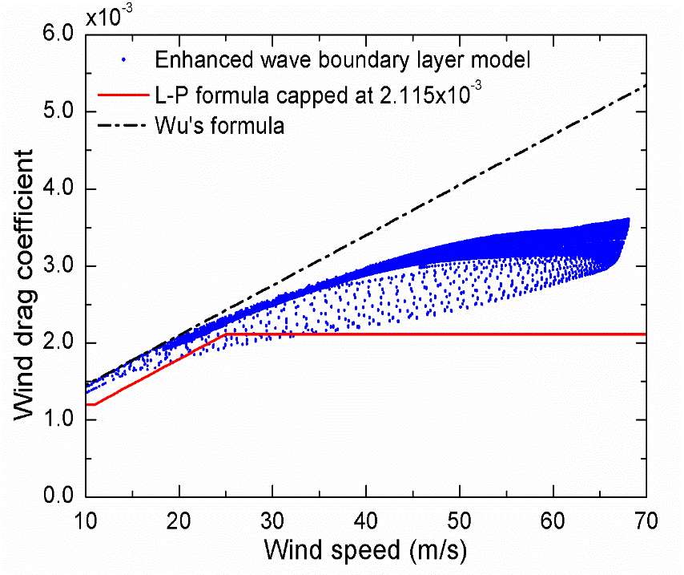
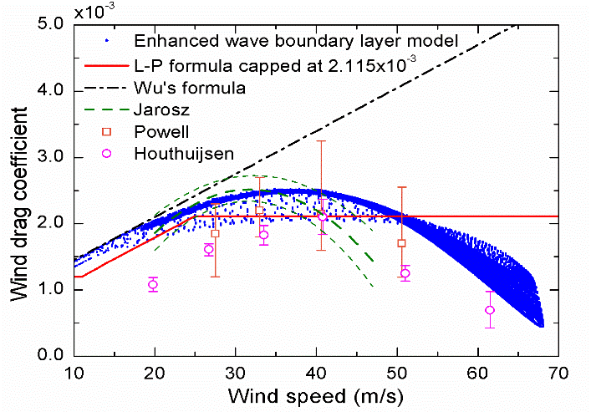
Results
Without sea spray effect:
With sea spray effect:
Notes:
This two figures are the results. The horizontal axis is wind speed and the vertical one is wind drag coefficient. Without the sea spray effect shown in the last term in the energy equation, the drag coefficient still increase with the increasing wind speed. But after consideration of sea spray, the drag coefficient levels off and then decrease. The scatters and the dash lines are the observational measurements. We can see that they are in a good agreement. The variance of drag coefficient under same wind speed is due to the different sea state.

Slide 8
Case Study
Hurricane waves simulation-Katrina
Notes:
After I obtain the evaluation method of wind stress, I use it to simulate the hurricane waves. I choose Katrina because it has the extreme wind speed.

Slide 9
Case Study
Land boundary: GSHHG
Bathymetry: ETOPO1 (1’ⅹ1’)
Elements：193362
Nodes：98262
Wind Field: H*wind+FNL

Slide 10
Case Study
Sea surface wave model – SWAVE
Unstructured grid - fix the complex irregular geometry in coastal regions
second-order upwind finite-volume scheme
Shallow water wave model

Slide 11
Case Study
Validation – significant wave height
Notes:
Zeroth moment of energy density

Slide 12
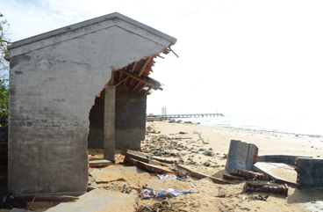
Future Work
Storm surge simulation
Sea level rise in the coastal regions when a tropical cyclone passes
Atronamical tide
Stress-induced
Storm surge
Ocean model
pressure-induced
wave-induced
Notes:
They devastate the offshore structures and flood the coastal cities, leading to severe death and destruction.

Slide 13
Future Work
Storm surge simulation
FVCOM (Oceandynamic model)
B.C.

Slide 14
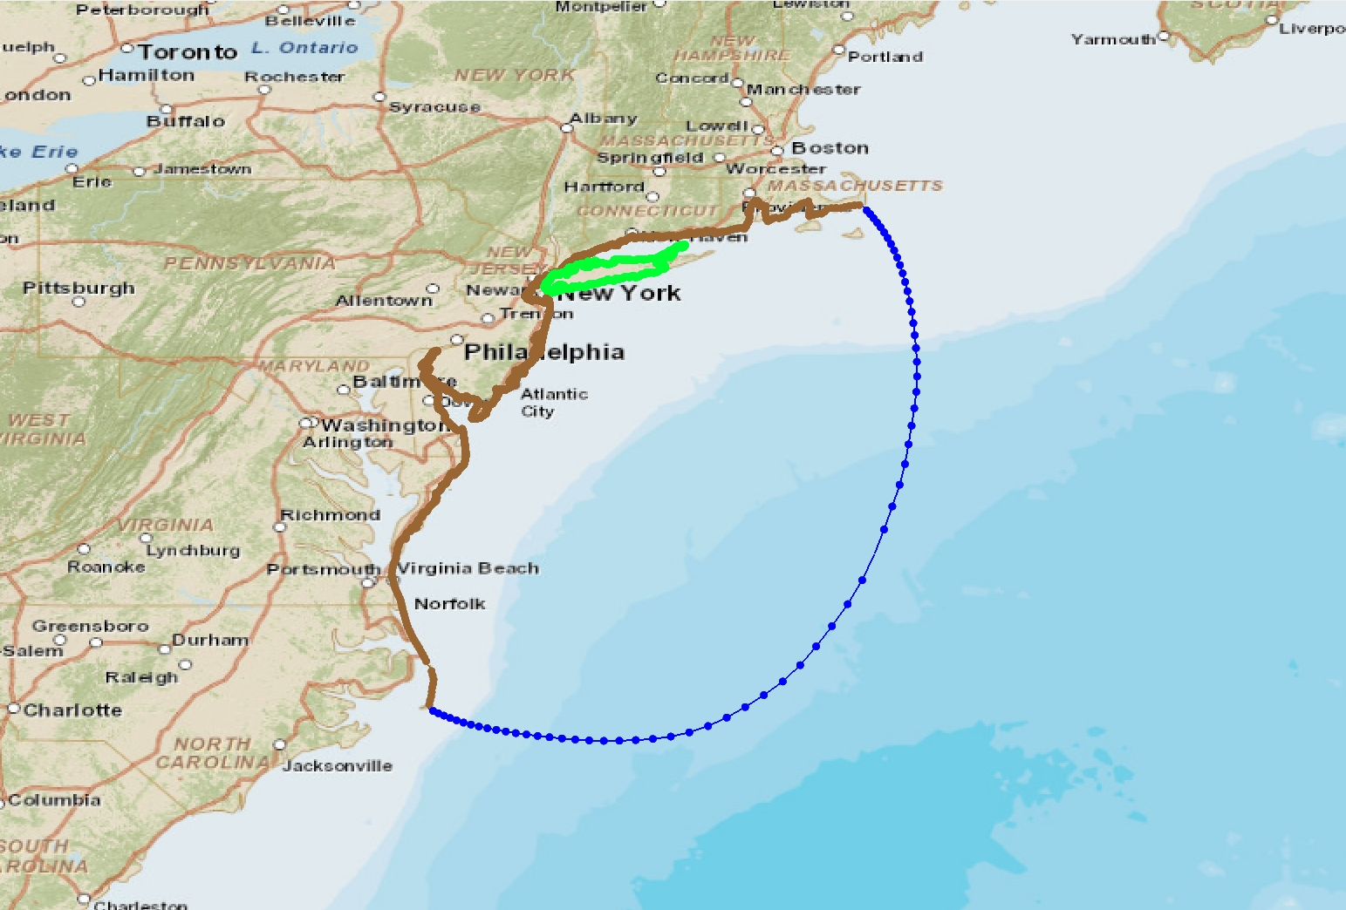
Future Work
Storm surge simulation – Sandy (2012)

Slide 15
Future Work

Slide 16
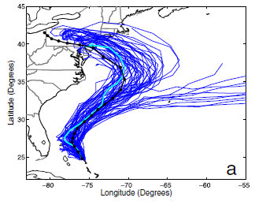
Future Work
PSU WRF-EnKF
Hindcast using H*wind
Forecast using PSU WRF-EnKF
Coupling of ocean currents and surface waves
Validation of wind stress evaluation method
Comparisons…
Discussions…
(Munsell and Zhang, 2014)

Slide 17
Thank you!
Notes:
我的开题报告讲完了，请各位老师批评指正

