Slide 1
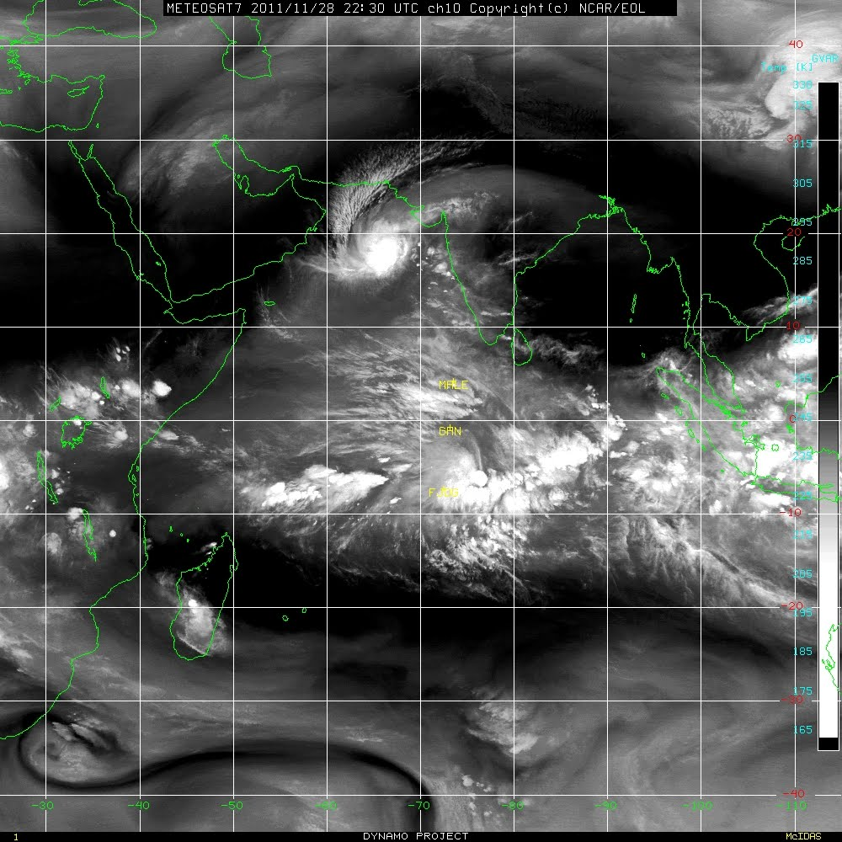
Initiation and Propagation of MJO in a high resolution model: Local vs. Remote effect
Sourav Taraphdar¹
Collaborators:
¹ Fuqing Zhang, Yonghui Weng, Michael (Yue) Ying
² Shuguang Wang
³ Juan Fang
¹ Department of Meteorology, The Pennsylvania State University, PA, USA
² Department of Applied Physics and Applied Mathematics, Columbia University, NY, USA
³ Department of Atmospheric Sciences, Nanjing University, Nanjing, China

Slide 2
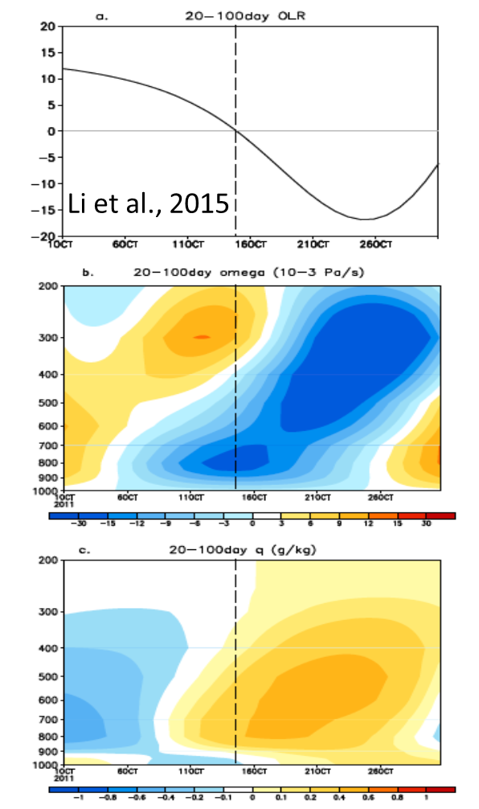
How MJO is initiated over western Indian Ocean (WIO)?
Circumnavigation of a proceeding MJO event that travels around the global tropics (Lau & Peng, 1987; Wang and Li, 1994; Seo and Kim, 2003; Matthews 2008)
Local tropical forcing's in addition to extratropical forcing's (Ray et al., 2009; Zhao et al., 2013)
A marked increase of low level moisture in association with warmer temperature and anomalous ascending motion appeared 5 – 10 days prior to the convection initiation
Increase of moisture was caused primarily by the horizontal advection of the mean specific humidity by anomalous flows induced due to downstream Rossby wave response to a preceding suppressed phase MJO over the eastern IO

Slide 3
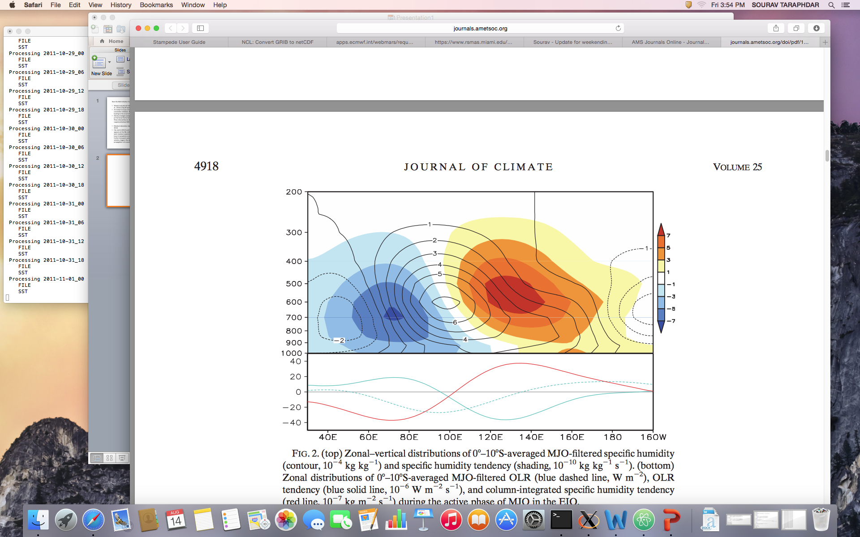
Moisture dynamics responsible for the eastward propagation of MJO (Hsu and Li, 2012; Li 2014)
A positive moisture anomaly appears at the PBL (1000 – 700 hPa) to the east of the MJO convection
Mid tropospheric heating associated with MJO convection induces a baroclinic free atmosphere response, with Kelvin (Rossby) wave response to the east (west) of convection center
Anomalous low pressure at the top of PBL associated with Kelvin wave response may induce a convergence in the boundary layer, while PBL divergence may occur to the west between two Rossby wave gyres
Warm SST anomaly to the east of the convection helps to trigger a fresh convection to the east of the current convection
Hsu and Li, 2012

Slide 4
What primarily causes MJO initiation ? is it causes by local effects and/or circumnavigating signals (remote effects)?
What are the role of equatorial Rossby waves and Kelvin waves in preconditioning the IO for MJO propagation using high resolution model with waves separation techniques?
Control Simulation:
WRF model at 9km horizontal resolution following the experimental design of Wang et al., (2015)
Experimental design: Identify the MJO signals into the forcing's data sets
  Experiment 1: Removes MJO related signals only from initial condition
  Experiment 2: Similar to “1” but removes MJO from boundary conditions
  Experiment 3: Removes both from initial and boundary conditions
Events: Oct 2013 during DYNAMO/CINDY 2013 field campaign
ERA-Interim is adopted to construct initial, bottom and lateral boundary conditions for regional simulations
Model simulations start from 1 Oct 2013, with spectral nudging of horizontal winds for the first 3 days

Slide 5
Hovmoller diagram of daily rainfall from TRMM and WRF clearly shows the MJO event, starting from ~60E and propagating eastward
Eastward propagation of precipitation is disrupted near the Maritime Continents (100º E) in both model and observation
Rainfall associated with MJO is not collocated with the westerly wind maximum but occurs mostly in the leading edge of the westerly regime bordering the easterlies

Slide 6
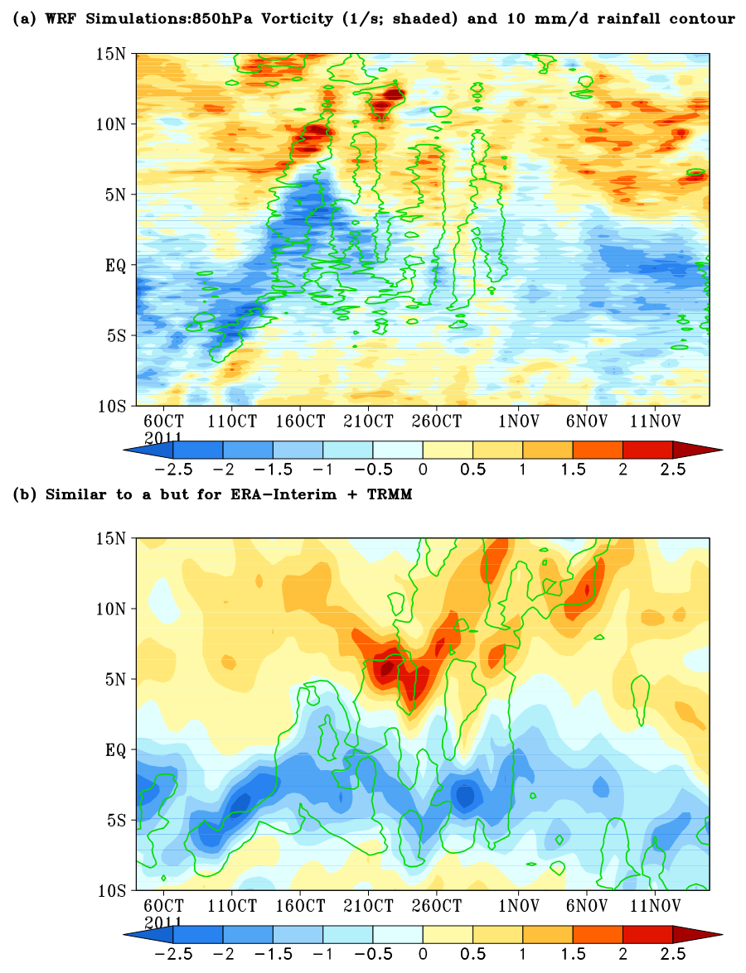
Large scale precipitation maxima migrate northward slowly
Precipitation generally coincides with low level cyclonic relative vorticity anomalies during the active MJO phases, might evolve into tropical cyclones in some events

Slide 7
Vertical motion in both the model and observation shows the top heavy first baroclinic mode structure during active phases of MJO
Changes of westerly to easterly at lower troposphere (600 – 800 hPa) prior to MJO event, and turns back to westerlies during MJO active phases (late Oct to early Nov)
A classical structure of tilted positive temperature anomaly prior to MJO rainfall peak followed by a negative temp anomaly
Dryness of lower troposphere during suppressed phases of MJO, followed by gradual lower level moistening prior to MJO event, when low level wind is easterly and temperature anomaly is positive

Slide 8
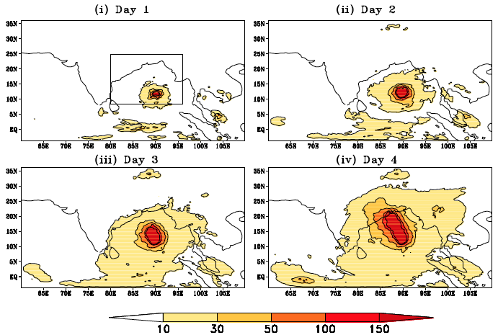

The Role of Moist Processes in the Intrinsic Predictability of Indian Ocean Cyclone
Objective
Identify the predictability limit and the mechanism for the error cascades across spatial scales for Indian Ocean tropical cyclones
Approach
Simulate four tropical cyclones in the Bay of Bengal using WRF v3.4 at 30km, 10km and 1.1km horizontal resolutions
Perform identical twin perturbation experiments at the three resolutions to quantify the model errors at each resolution
Estimate the predictability using the “error doubling time”
Analyze and elucidate the error cascades across spatial scales using different techniques such as power spectrum and scale separation and using numerical experiments
Error growth starts from the region of convection on Day 1 and cascades to significant larger scale errors on Day 4
Impact
Found that buoyancy associated with moist convection plays a major role in intrinsic error growth that limits the intrinsic predictability of tropical cyclones
Demonstrated that errors start to build up from regions of convection and ultimately affects the larger scales through upscale cascades of errors
Taraphdar, S., P. Mukhopadhyay, L. R. Leung, F. Zhang, S. Abhilash and B.N. Goswami. 2014. “The role of moist processes in the intrinsic predictability of Indian ocean cyclone”, J. Geophys. Res. Atmos., 119, 8032 – 8048, doi:10.1002/2013JD021265.

Slide 9
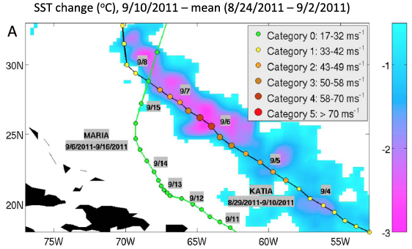
Cyclone-Cyclone Interactions through the Ocean Pathway
Objective
Study how the lingering cold wake from one tropical cyclone may influence the intensity of a later cyclone that passes over the cold wake
Systematically quantify the frequency and impacts of these cyclone-cyclone interactions on mean cyclone intensification rates in the three most active cyclone basins
Approach
Performed data analysis and numerical modeling of two cyclones, Katia and Maria, as a representative case study of cyclone-cyclone interactions in the North Atlantic
Analyzed observational data from 1984–2011 to quantify the frequency of occurrence of cyclone-cyclone interactions and their impacts on basin mean cyclone intensification rates in the North Atlantic, eastern Pacific, and northwestern Pacific
Interaction of cyclones Katia and Maria in the North Atlantic (September 2011). The SST cooling (ºC) induced by Katia is shown in the background with the tracks of cyclones Katia and Maria overlaid.
Impact
Cyclones have, on average, ∼10% chance to interact with wakes and such interactions reduce the mean intensification rates for cyclones by 3%–6% on average, and by ∼12%–15% during the most active years
Identified and quantified “Cyclone-cyclone interactions” as a mechanism through which tropical cyclones may self-regulate their activity to an extent on intraseasonal time scales, with potential implications for future cyclone activities in a warmer climate.
Balaguru K, S Taraphdar, LR Leung, GR Foltz, and JA Knaff. 2014. “Cyclone-cyclone Interactions through the Ocean Pathway.” Geophys. Res. Lett., 41, 6855 – 6862. DOI:10.1002/2014GL061489.

Slide 10
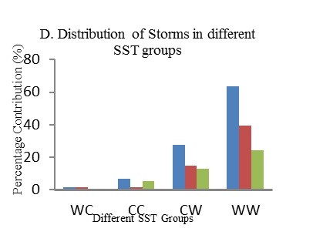
Linkage of remote SST and Atlantic tropical cyclone activity mediated by the African monsoon
Strong minus weak monsoon years
Objective
Systematically analyze the relationship between North Atlantic & Mediterranean (NAMED) SST and Atlantic Hurricane activity through their linkages to the African monsoon rainfall (AMR)
Approach
Analyzed several observational data for a 30-years (1984 - 2013) period including NHC TC track data, NOAA OI and UKMO Had SST, ERA and NCEP reanalysis data set
Establish the dynamical linkages and statistical relationships
A. NOAA OISST
B. NCEP 700hPA Wind
C. NCEP MSE (KJ/Kg)
Total
Hurricane
Tropical Storms
Composite spatial distribution of A. NOAA OISST (deg C), B. 700hPa Wind (m/s), C. Lower level MSE (KJ/Kg) between strong and weak monsoon years. Panel D depicts the distribution of all storms (blue) including hurricanes (brown) and tropical storms (green) under different SST conditions
Impact
Warmer NAMED SST is positively linked to hurricane frequency east of 45W through its influence on AMRs activity, with more prominent correlation in the latter half of summer (August, September)
NAMED SST can explains about 8% on interannual variability of Atlantic TC Frequency
Taraphdar, S., LR. Leung and Samson Hagos. 2015 “Linkage of remote Sea surface temperatures and Atlantic tropical cyclone activity mediated by the African monsoon”, Geophys. Res. Lett., 42, 572–578, doi:10.1002/2014GL062600.

