Slide 1
Radius Dependence of Roll Vortices in the Tropical Cyclone Boundary Layer
Eric DeShong

Slide 2
Objective
Investigate relationship between roll characteristics and radius.
Data set: WRF-LEP Hurricane Katrina Simulation Resolution: 200m
Methods
Locate Rolls: Examine vertical wind velocity to look for stretches of adjacent positive and negative velocities.
Must hold its “shape” through multiple levels.
Approximate depth to find a central level.
Use Fourier decomposition to eliminate noise and find a wavelength (diameter)
Repeat steps 1-3 increasing radius by 20 km (within + or – 5 km)

Slide 3
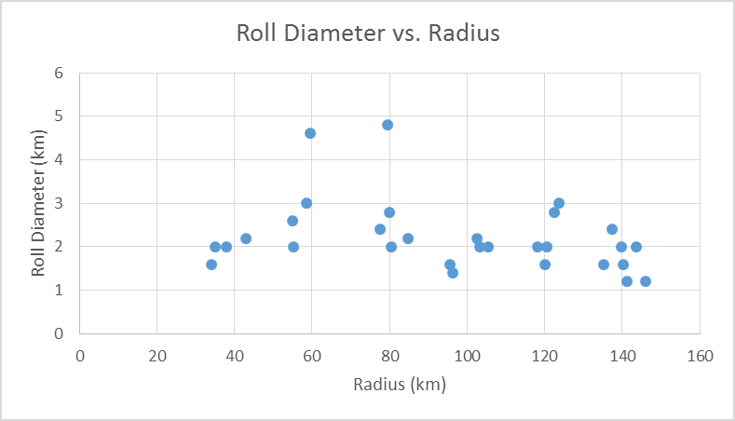
Results

Slide 4
Analysis and Conclusion
Results show no perceivable correlation between radius and roll diameter.
Note: Two statistical outliers were close in proximity.
Future Research
Link between velocity and roll diameter?
TC conditions surrounding rolls?

Slide 5
Questions?
Thank you for your time and attention.

