Slide 1
Progress Reporting @
1) PSU hurricane realtime;
2) NASA HIWRAP Assimilating
Yonghui Weng
Group Meeting @ 08/18/2015

Slide 2
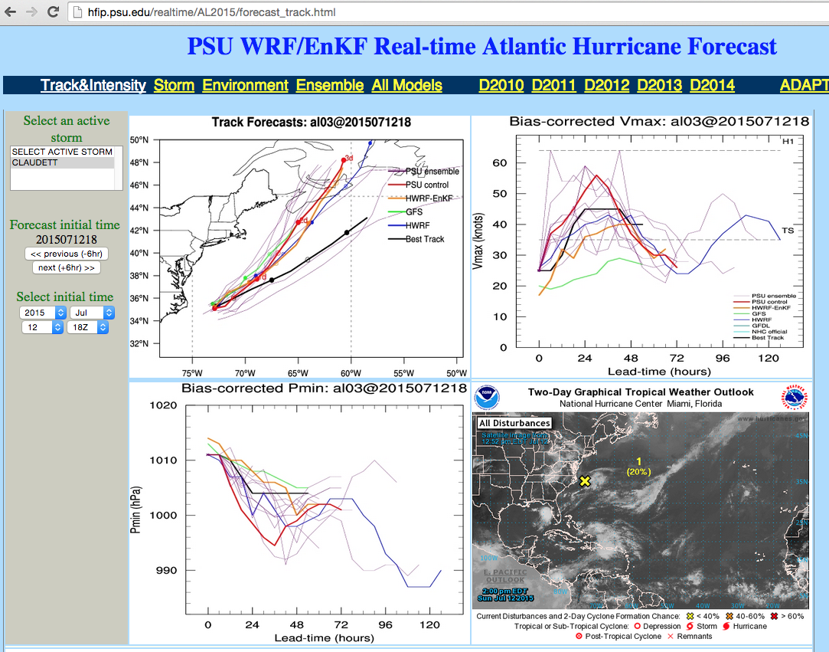
1) PSU Atlantic Hurricane Real-time
2 systems:
  APSU (ARW-EnKF) : GFS + WRFDA random perturbation as initial ensemble
  HPSU (HWRF-EnKF): GDAS-EnKF 80 members as initial ensemble
Started real-time for storm Claudett, retrospective runs for storms Ana and Bill.

Slide 3
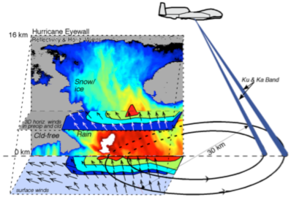
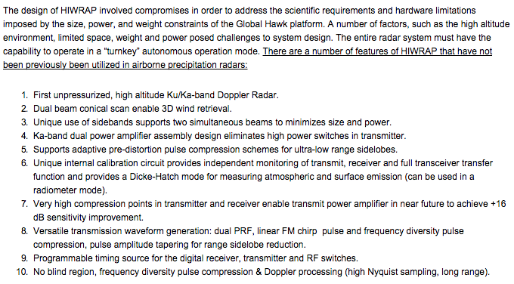
2) HIWRAP Assimilation
HIWRAP: Hight-altitude Imaging Wind and Rain Airborne Profiler
HIWRAP measurement concept
http://har.gsfc.nasa.gov/index.php?section=13

Slide 4
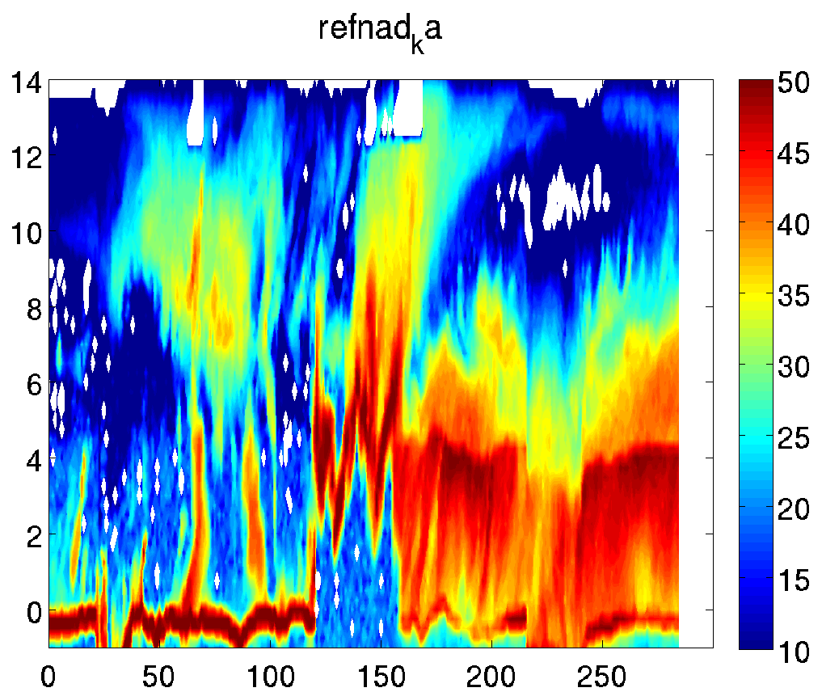
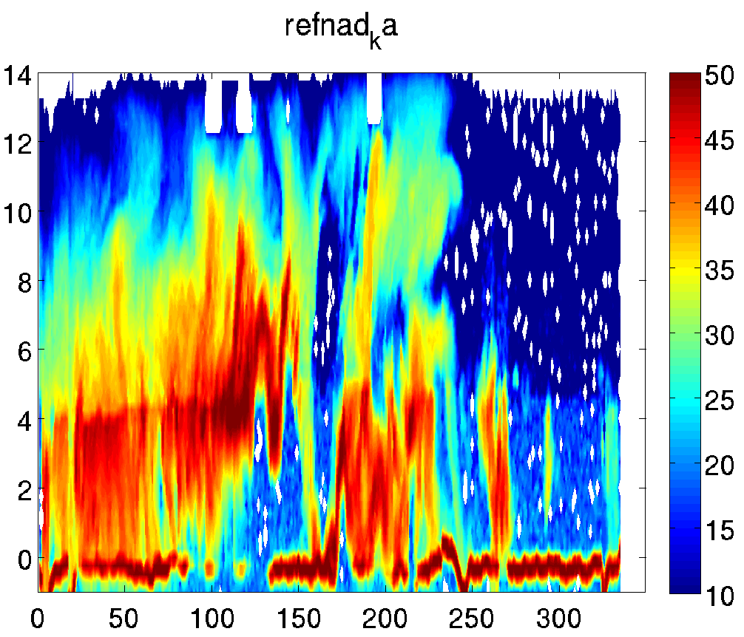
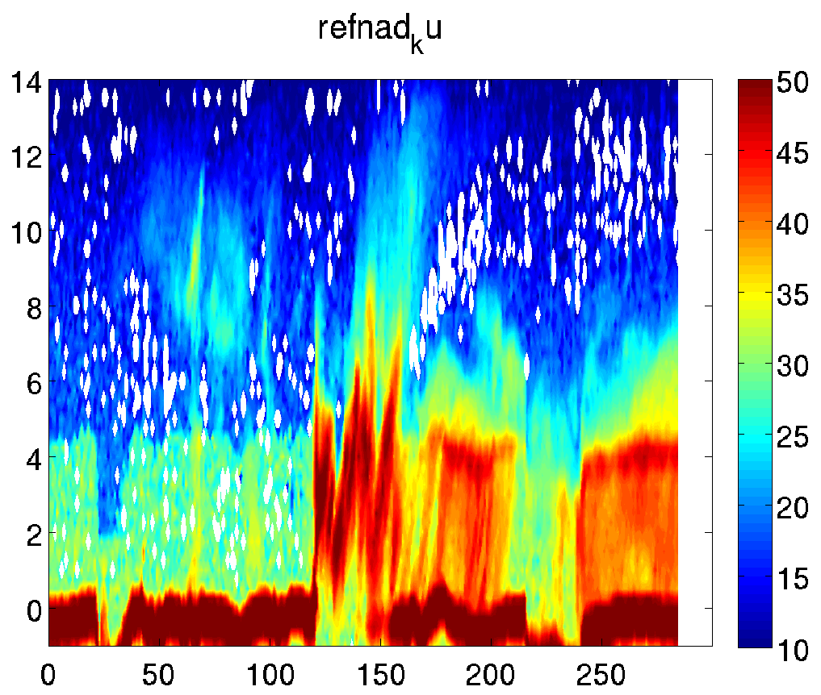
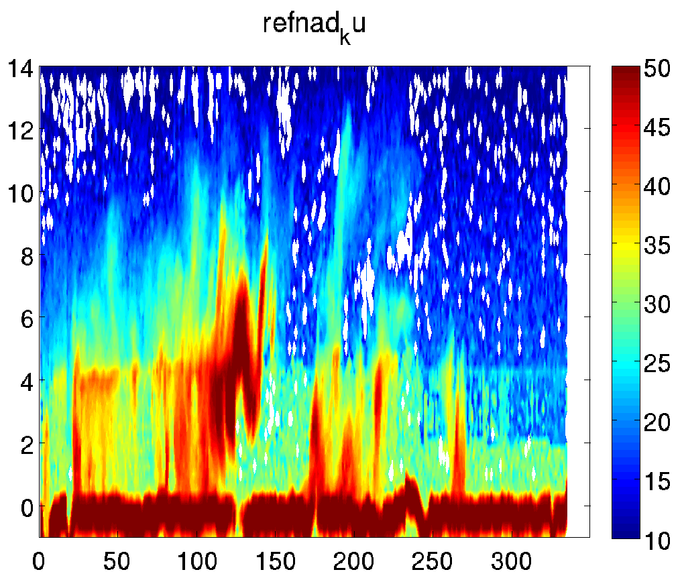
Raw Reflectivity
Ka
Ku
Inner
Outer
http://har.gsfc.nasa.gov/index.php?section=56

Slide 5
Vr SO method
Remove raw observations lower than 100m or higher than 19 km;
Remove the raw velocity observations when the reflectivity value is smaller than 15 dbZ or larger than 75 dbZ;
any raw velocity observations with values smaller than 2 m s⁻¹ or larger 75 m s⁻¹ will be discounted;
Split the scan into separated volume (360⁰ scan); and combine 3-continued volumes into one new volume;
The new volumes into smaller SO bins with 0.5 km radial distance and 5.0 azimuth deg;
removing SO bins whose standard deviation (STD) is larger than the STD of the whole volume;
removing SO bins whose valid observations are less than 4;
removing observations whose bias are twice larger than the STD of the bin;
correcting reflectivity for attenuation – (Journal of Meteorological Society of Japan, 1989, TRMM attenation of Ku band);
calculated fallspeed by assuming liquid below 5100m, solid above 7000m, and linearly interpolating between the two levels. (Marks and Houze, 1987);
using the median of the valid observation in the bin to represent the SO;
assigning a 3 m s⁻¹ error to the resulting SO.
Further thinning and random sorting of the SOs is applied depending on the resolution of the model, and an observation that creates an innovation magnitude greater than 15 m s⁻¹ is disregarded.

Slide 6
Vr SO processing
Ka Outer
Ku Outer

Slide 7
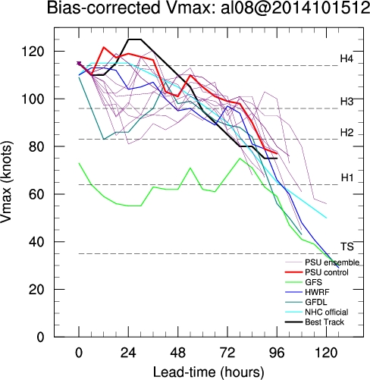
Hourly assimilation
Divergence started @ 19Z15: 1830 SOs are assimilated; only @ 19Z and 20Z;
Wrong P-V relationship at 20Z
Realtime
APSU for hurricane Gonzalo

Slide 8
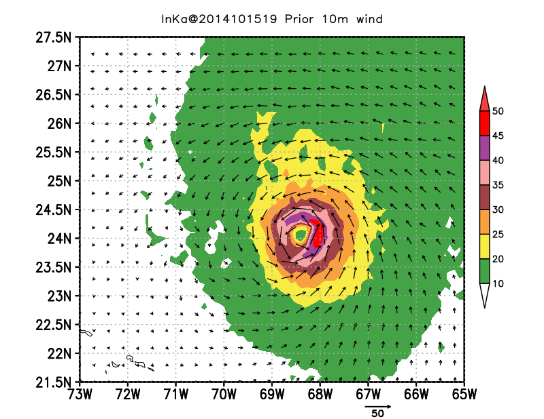
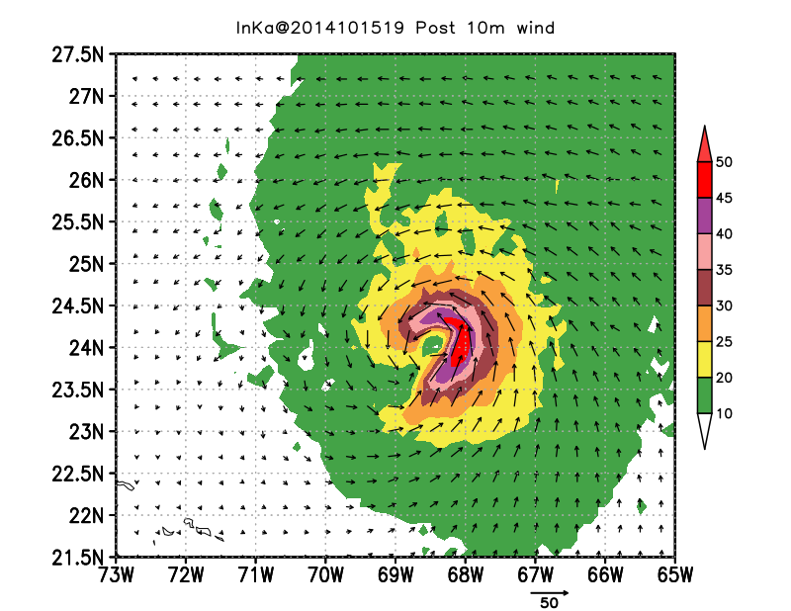
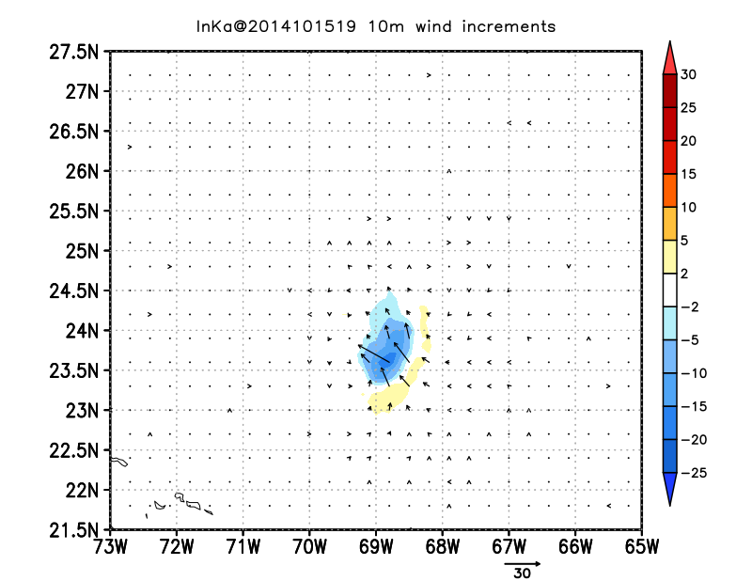
10m winds @ 19Z
Prior
Analysis
19Z 10m Winds
Increment

Slide 9
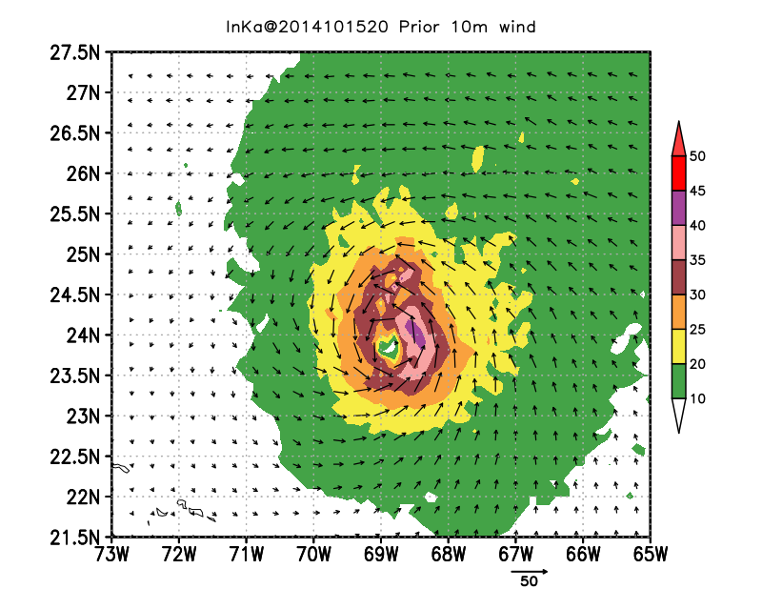
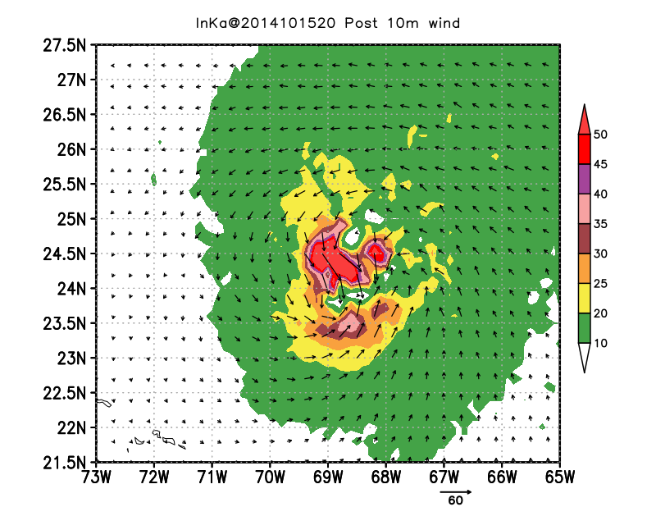
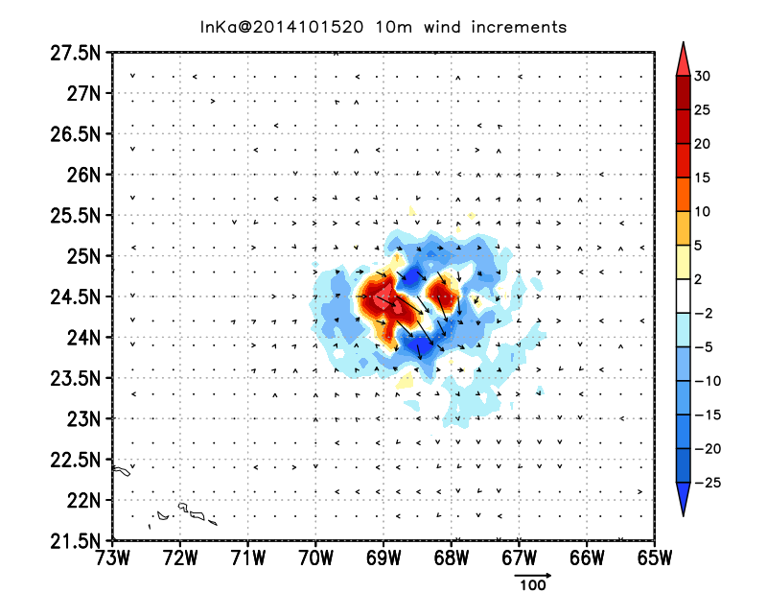
10m Winds @ 20Z
Prior
Analysis
20Z 10m Winds
Increment

Slide 10
TC intensity
TCVitals intensity of prior, and analysis, and spread of 60-members.

Slide 11
XB and Obs
19Z
20Z
Prior
Analysis
Obs

Slide 12
Spread
19Z
20Z
Prior
Posterior

Slide 13
Computing resources in our group
Wave, wall, and wind.met.psu.edu
  Each linux computer has an external IP address: 192.5.158.32; 192.5.158.33; and 192.5.158.34
  For transferring data from out-of-EMS to the group:
  i.e., stampede:~$ rsync –avzP aaa.pptx yxw25@192.5.158.32:/wave/s1/yxw25/.
Sftp server:
  psuftp@wave.met.psu.edu
  Passwd: mail to yhweng@psu.edu
File sharing on http
  /wave/s5/www/html/YOUR-PSU-ACCOUNT
  Web: http://hfip.psu.edu/YOU-PSU-ACCOUNT/your-file
  i.e., http://hfip.psu.edu/dvt5076/defense.pdf

