Slide 1
A High-Impact Extreme Weather Event
The Record-breaking Heavy Rainfall and Tornado
on 21 July 2012 in Beijing, China
Zhiyong Meng Dan Yao Huizhen Yu
Department of Atmospheric and Oceanic Department
School of Physics, Peking University
PSU 18 Aug. 2015
Notes:
Good morning. So what I intend to talk about is a very high-impact extreme weather event that happened in Beijing China on July the 21 in 2012. The extremeness of this weather event is two folds : it brought a record breaking heavy rainfall. And spawned the first ever documented tornado in Beijing area. This work was done by myself and my graduate student Dan Yao.

Slide 2
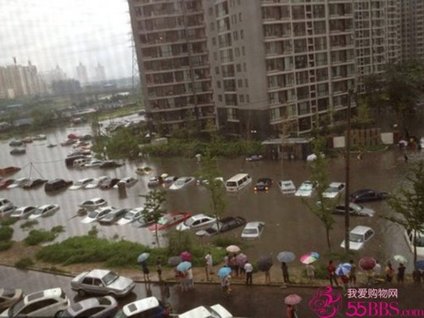
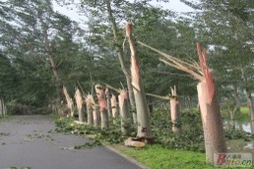
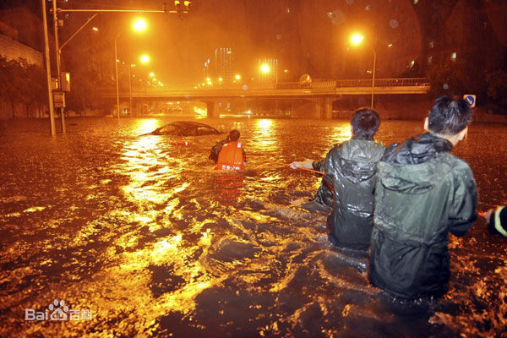
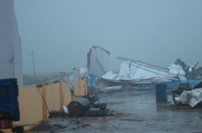
Extreme weather event: Beijing 21July 2012
Extreme Rainfall
Extreme Wind
Notes:
On July 21, 2012. Beijing was devastated by a widespread heavy rainfall. In the meantime, severe wind damages happened in seven villages in the southeastern area.

Slide 3
Questions to answer
How was the operational forecast?
What were the key factors mostly associated with the happening of heavy rainfall?
What kind of system caused the local severe wind damage?
How did the tornado evolve ?

Slide 4
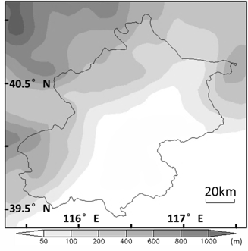
Topography of Beijing
Topography of China
Topography of Beijing
South
Korea
Beijing
(116°E, 40 ° N)
Notes:
Generally speaking, extreme weathers are those that happen in less than 5% of time, or with three standard deviation beyond normal. As a well-known fact, the frequency of extreme weathers is increasing in the past decade globally. The same is true in Beijing area especially in terms of very heavy rainfall in summer time. First, let me give you a general idea of the location and topography of Beijing. Beijing is located near 116 E and 40 N on the eastern edge of Taihang Mountain. Here is a blow-up of the topography in Beijing area.

Slide 5
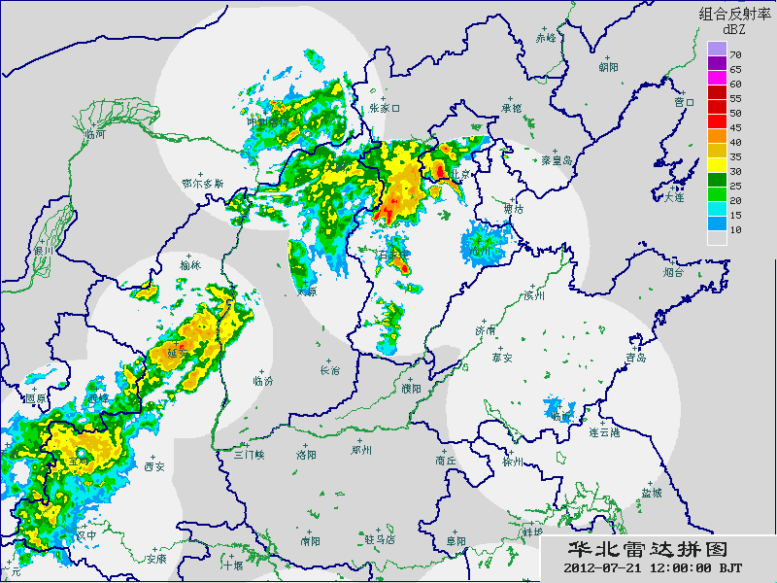
Rainfall: Animation of Composite Z_{H}
Notes:
Caused this quasi-stationary back-building train echo, which directly resulted in the severe flooding in southwestern area of Beijing.

Slide 6
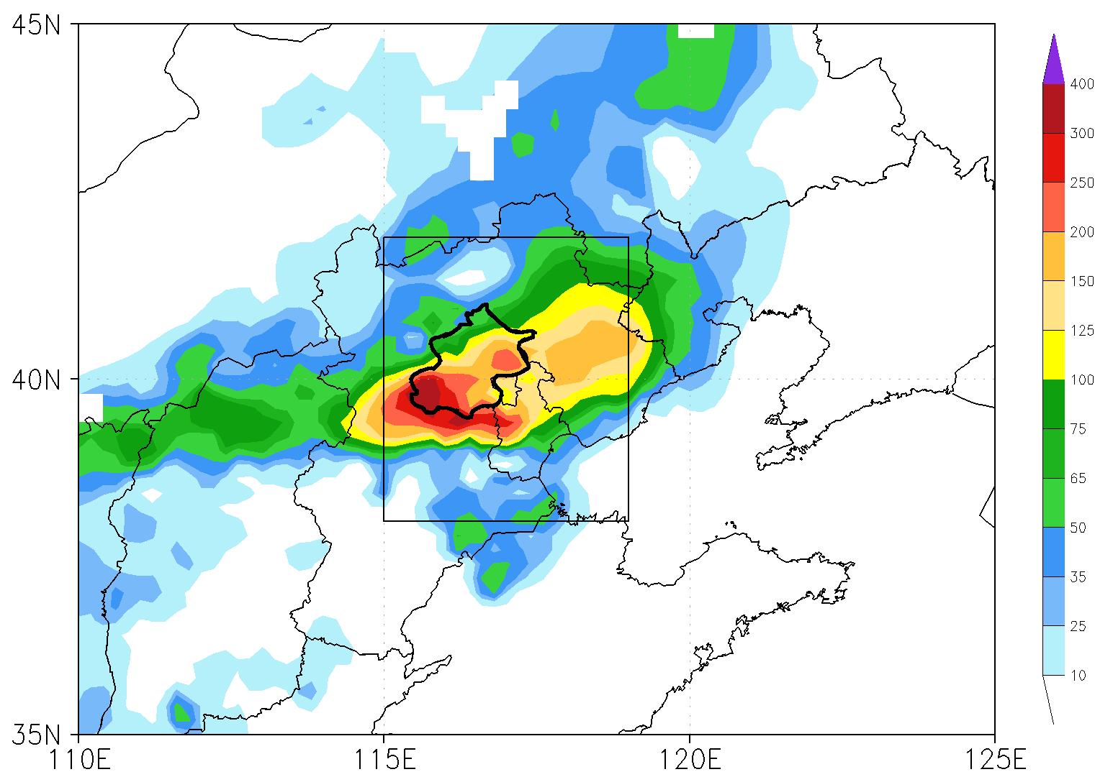
Background
24h precipitation: 21/00z-22/00z July 2012
90% Beijing area >100mm(3.9inch)
Mean ~190mm(7.5inch)
Maximum ~460mm(18.1inch)
Fatality: 79
Direct economic loss: ~$1.9Billion

Slide 7
Question 1
How was the operational forecast?

Slide 8
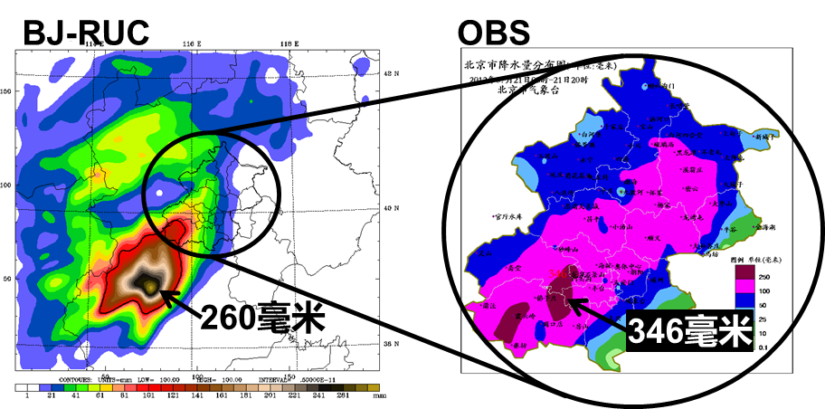
NWP: Regional model
12 h 08-20 LST 21 July
Notes:
20日16时北京市气象台的预报如下：“21日傍晚到夜间有暴雨，并伴有雷电，预计过程累积降雨量为40～80毫米，局地降雨量可能超过100毫米，降雨开始阶段可能伴有雷雨大风”。预报的雨量偏小300多毫米，时间偏晚6个小时， 降水前还出现了龙卷风。我们知道， 业务预报的一个重要参考依据是数值天气预报， 数值预报是把初值随时间的变化写成计算机程序通过时间积分得到预报。

Slide 9
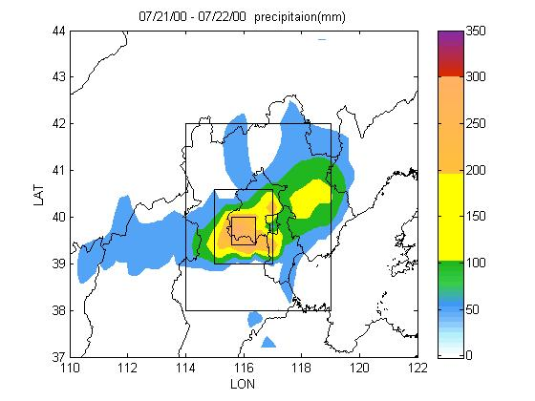
NWP: Global Models
TIGGIE
ECMWF
NCEP
CMA
D03>100mm
D02 >200mm
D01 >300mm

Slide 10
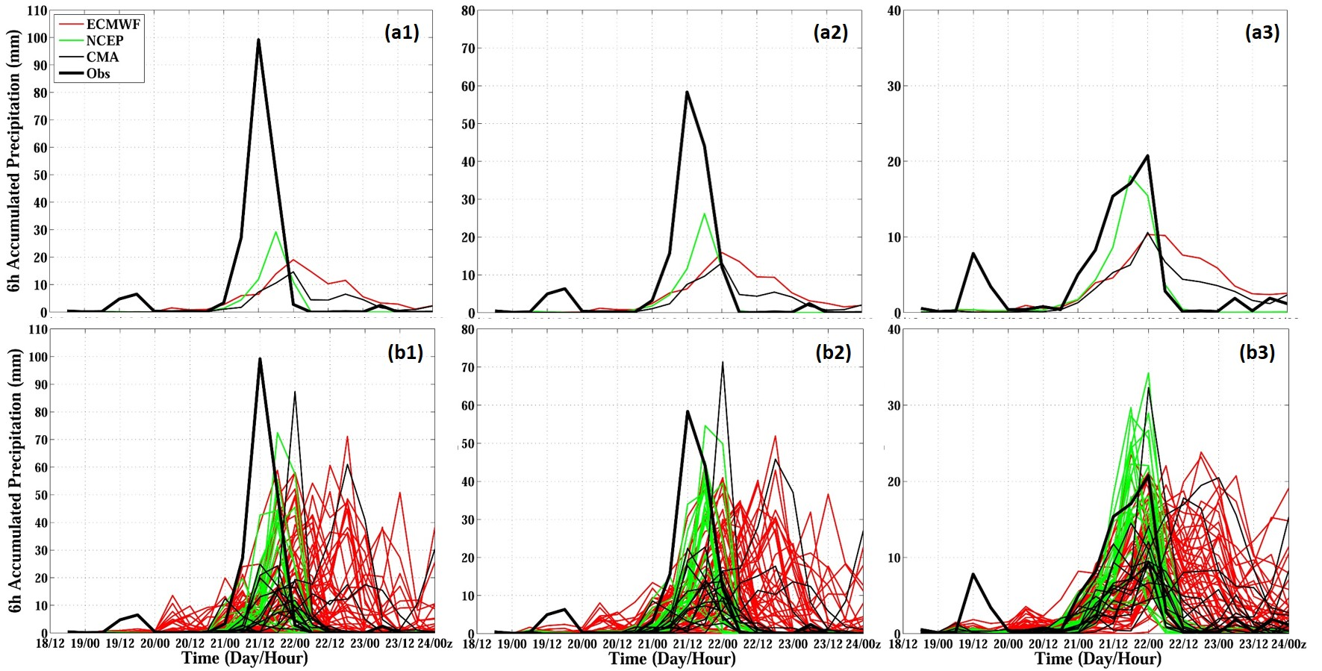
NWP: Global Models
Evolution of domain averaged 6-h rainfall
>300 mm
>200 mm
>100 mm
EF mean
EF members

Slide 11
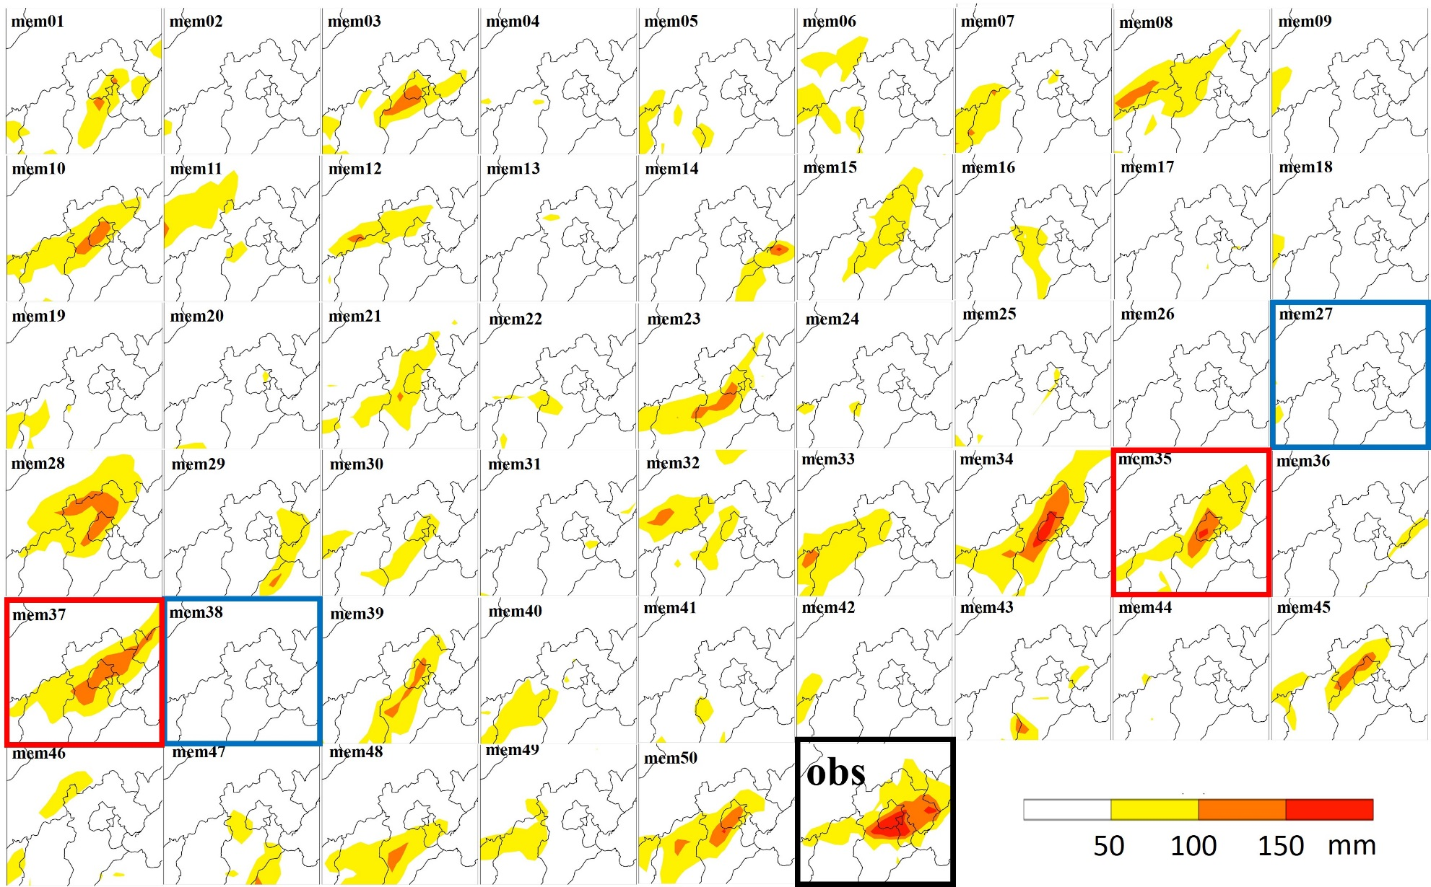
ECMWF ensemble forecast result
24h precipitation
Bad members
Good members

Slide 12
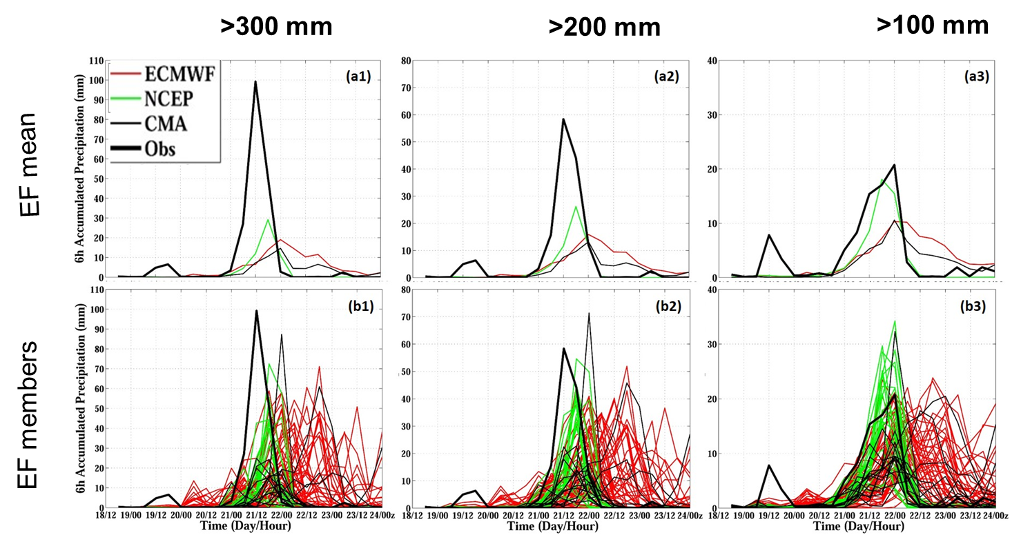
Question 2
What were the key factors mostly associated with the happening of the heavy rainfall?
84 mems

Slide 13
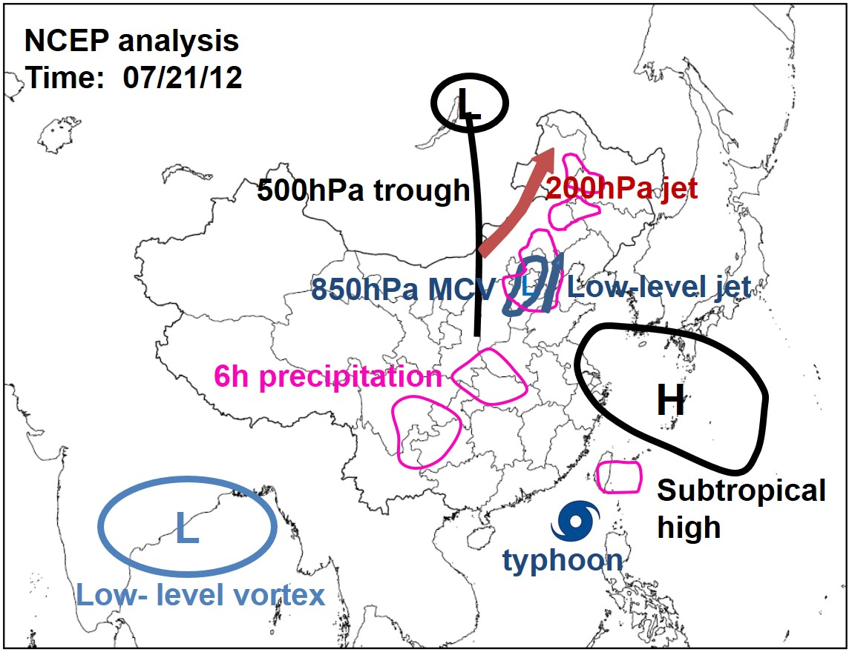
Synoptic analysis
Chen et al., 2012
Sun et al., 2012
Yu 2012
Notes:
850hPa vortex 与6-h precipitation 的线颜色太相近

Slide 14
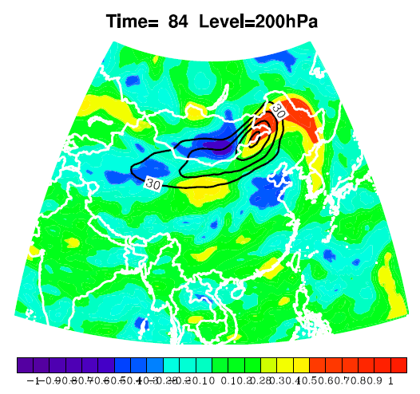
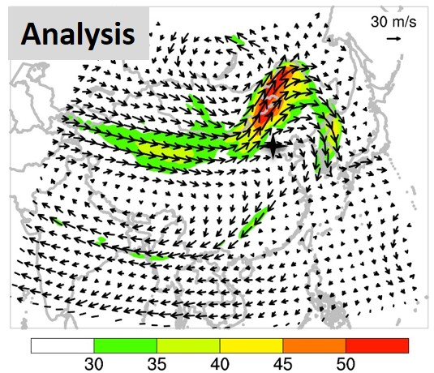
Correlation coefficient (shaded)
20 LST 21 July
Wind speed
-0.28
99% confidence level
0.28
99% confidence level

Slide 15
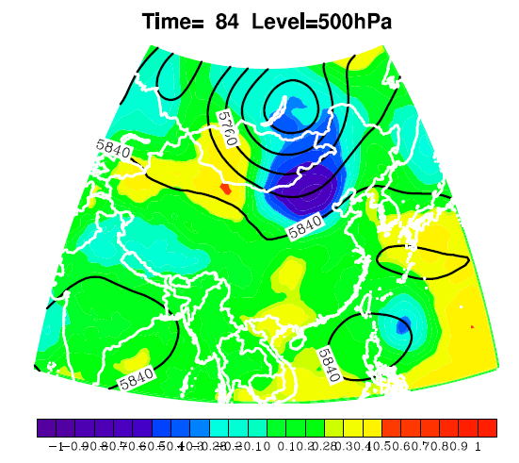
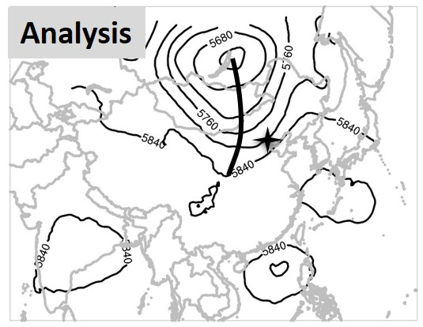
Correlation coefficient (shaded)
Geopotential Height
-0.28
99% confidence level
0.28
99% confidence level

Slide 16
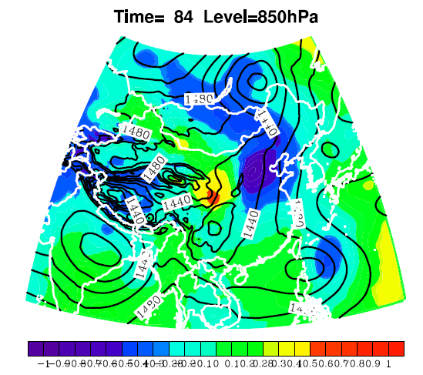
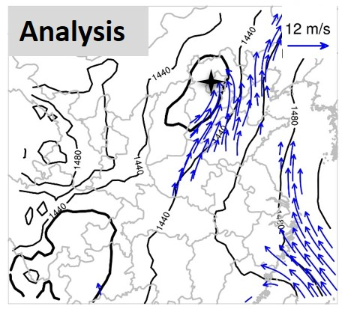
Correlation coefficient (shaded)
Geopotential Height
-0.28
99% confidence level
0.28
99% confidence level

Slide 17
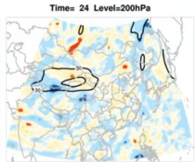
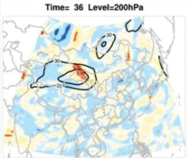
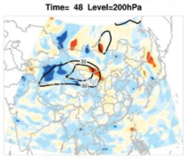
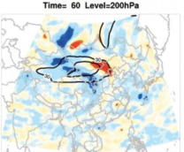
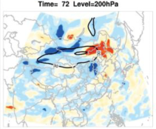
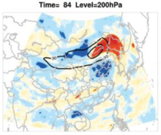
Time-lag correlation

Slide 18
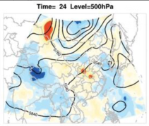
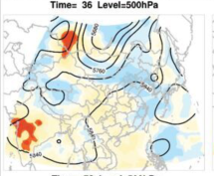
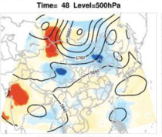
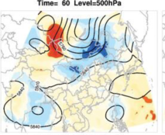
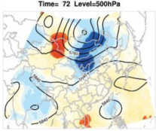
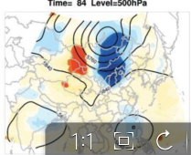
Time-lag correlation

Slide 19
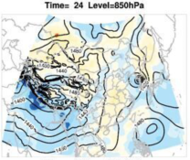
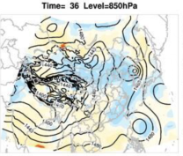
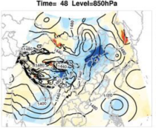
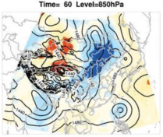
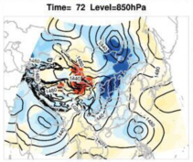
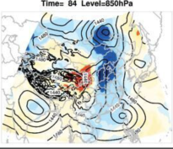
Time-lag correlation

Slide 20
Sensitive area – CNOP
Correlation

Slide 21
Question 3
What kind of system caused the local severe wind damage?

Slide 22
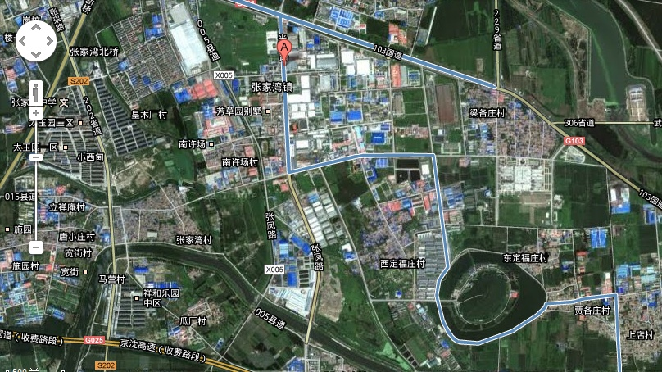
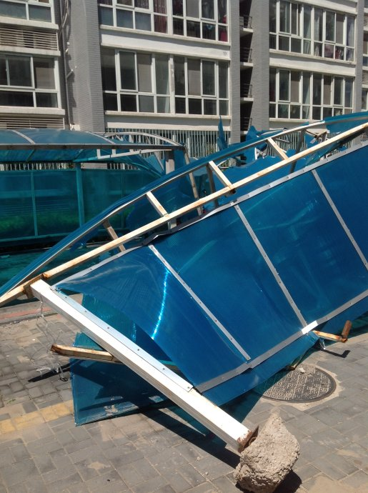
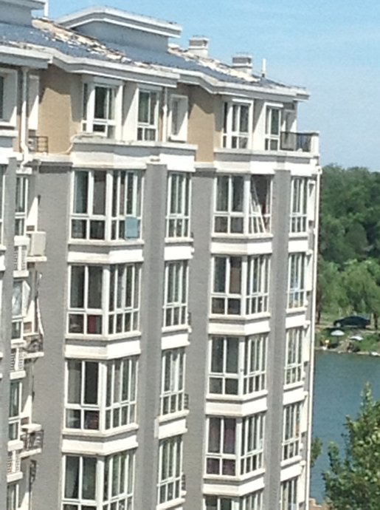
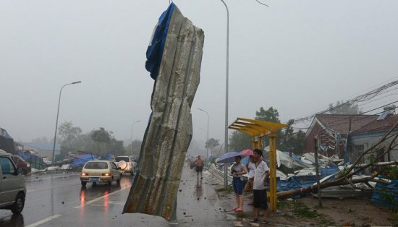
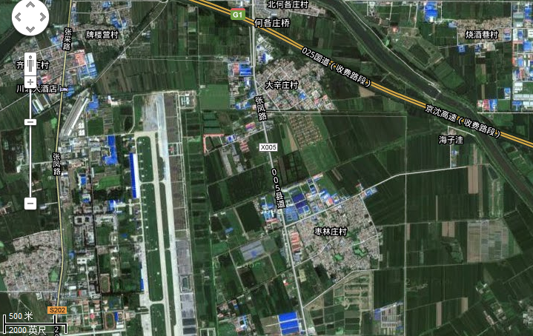
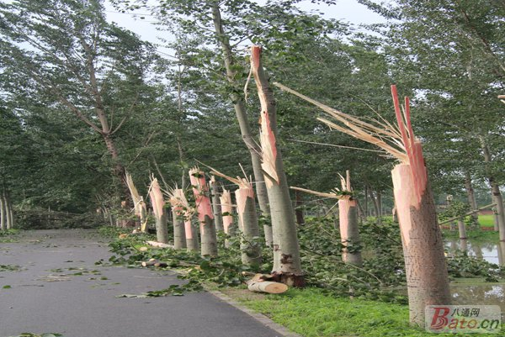
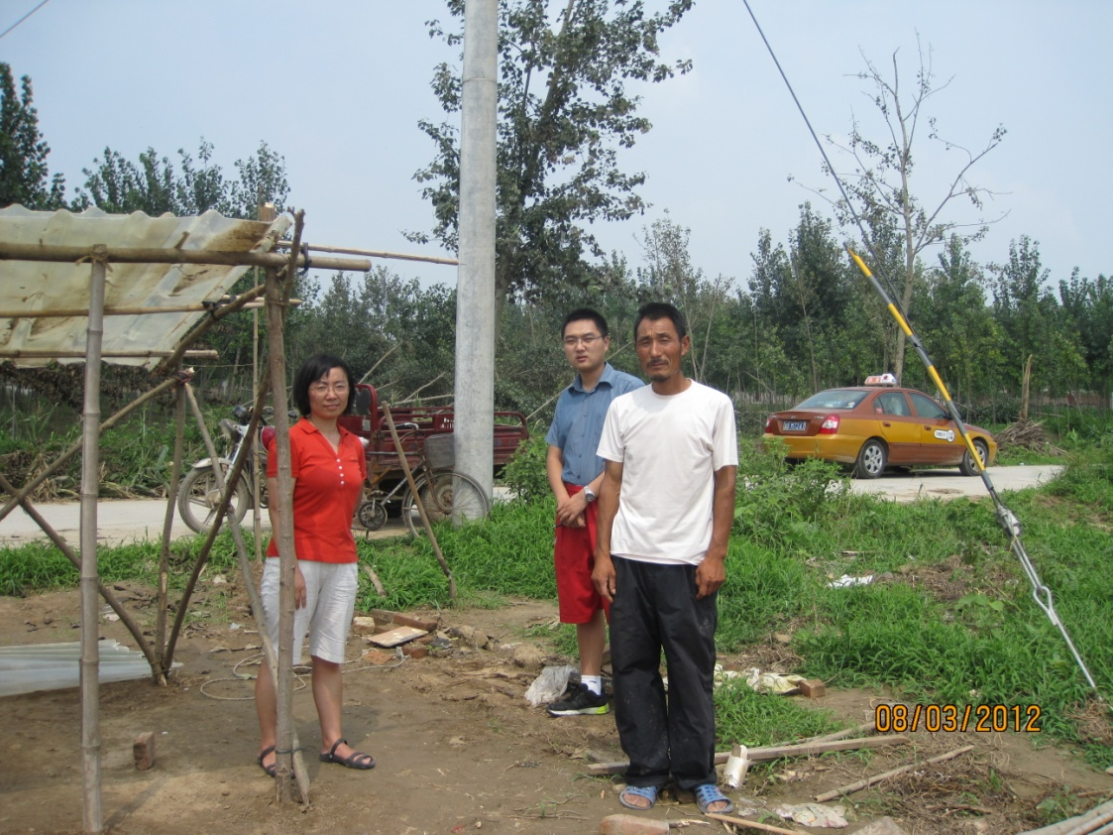
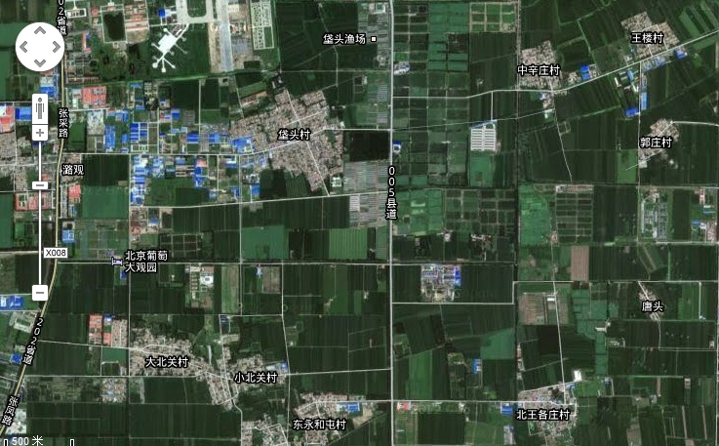
(km)
Zhangjiawan Town
9
What caused the wind damage?
8
XDFZ
1) Inconsistent witness information
2) No photograph evidence
3) Tornado has never been reported or documented in Beijing
7
SJX
6
DXZ
5
ZLZ
4
3
FT
2
DBG
XBG
1
N
W
E
S
0
HT
0
1
2
3
4
5
(km)
Notes:
The other aspect of the extremeness of this weather event is the severe wind damage experienced in the seven villages in Zhangjiawan town in southeast suburb of Beijing. Trees were snapped, warehouse was totally destructed, here is where the two fatalities occurred. In steel reinforced concrete building, roof were partially pealed, and some windows were totally pushed inside. What caused the wind damage was a quite hard question to answer at that time because the witness information were inconsistent, some one saw a tornado, while some other people didn’t think so. Though every body has a camera-ready cell phone nowadays, not a single picture of the tornado was taken. More importantly, there has never been tornado record in Beijing. So, out of curiosity, we rent a taxi and performed a very detailed damage survey. After talking to more than 20 witnesses and examining all available damage pictures on the internet.

Slide 23
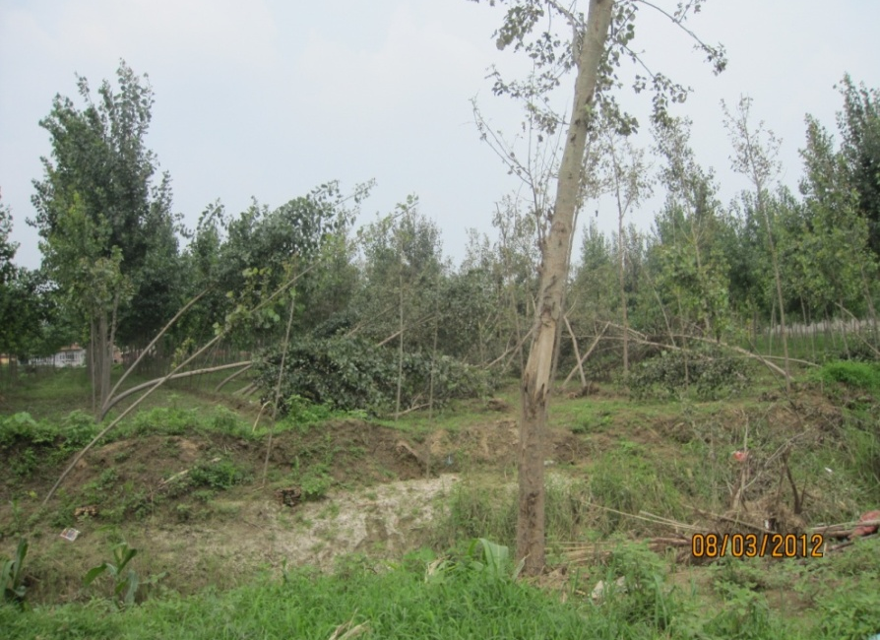
(km)
9
(a) Tornado track & damages
EF0
EF1
EF2
Tornado: Evidences
8
XDFZ
A narrow damage swath
Surface convergent wind
7
SJX
6
DXZ
5
ZLZ
4
3
FT
2
Tornado
Track &
Damage
swath
DBG
XBG
1
500m
N
Google map
W
E
S
0
HT
0
1
2
3
4
5
(km)
Notes:
We found two tale-telling tornado signatures, One is the narrow damage swath, the other is apparent surface convergent wind indicated by the trees falling toward each other at multiple places along the track. For examples, up here, on the left of the tornado track, trees fell to the right, while on the right, trees fell to the left. Downhere, trees were also observed falling towards each other. With these evidences, we are pretty sure that the wind damages were caused by a tornado. I guess some of you are wondering how strong was the tornado.

Slide 24
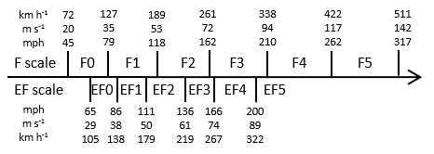
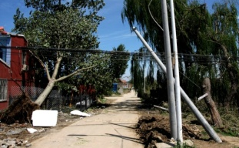
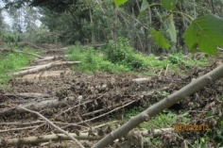
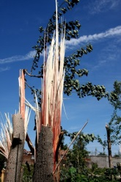
(km)
9
(a) Tornado track & damages
Tornado: Rate
EF0
EF1
EF2
EF3
13
12
8
XDFZ
Peeled roof
Windows pushed inside
7
8
7
JH
SJX
11
EF3
6
10
DXZ
ZF
5
6
9
ZLZ
4
4
5
3
FT
1
3
2
Tornado
track &
damage
swath
DBG
XBG
1
2
N
500m
Google map
W
E
S
0
HT
0
1
2
3
4
5
(km)
Notes:
We estimated the tornado damages of 24 damage indicators using the enhanced Fujita scale, as listed in this table and shown by the colored area on the left. Black is EF0, blue is EF1, orange is EF2, and red is EF3. Clearly, it was an EF3 tornado. Now let’s get rid of the map,

Slide 25
(km)
Tornado: Track and damage intensity variation
9
8
XDFZ
7
SJX
6
DXZ
1354LST
Re-intensification
5
ZLZ
ZLZ
4
1348LST
Weakened
3
FT
1342LST
2
Genesis
DBG
1
XBG
N
W
E
S
0
HT
0
1
2
3
4
5
(km)
Notes:
to show more clearly the tornado track and the variation of the damage intensity along the track.
We can see the tornado rapidly developed into an EF3 shortly after its genesis. Leaving Fatou, it weakened a little bit. It reintensified when it passed ZLZ and caused the most extensive damage in Daxinzhuang before dissipation. Concerning the track of the tornado, it was quasilinear in the earlier stage and became sinusoildal later on. In the next several slices, you will see that these features were closely associated with the evolution of radar signatures.

Slide 26
Parent system: Squall-Line-Spawned Supercell
1348LST
Bejing S-band Radar
S
Notes:
The tornado was spawned by a supercell that developed at the southern tip of a squall line. If we blow up the radar reflectivities at 2.4 elevation angle in the black box, what we see is a quite classic super cell with a beautiful hook echo. Down here in the corresponding Doppler velocity field, you see a mesocyclone indicated by the couplet of inbound and outbound radial velocity maxima.

Slide 27
Radar signature: Mesocyclone
Vs. the tornado track
Intensity variation
Contour: 40 dBZ Z_{H} at 2.4°
1356 LST
1350 LST
m
1344 LST
Tornado
Track
39.8 ° N
5km
116.6 ° E
116.8 ° E
Notes:
If we plot the mesocyclone during the tornado lifetime together with the tornado track, we can see the mesocyclone was quite small in early stage when the tornado had a linear track, it substantially expanded later on when the tornado started to move in a sinusoidal way. Considering the possible steering impact of the mesoscylone on the tornado, the variation in the tornado track was likely caused by the size variation of its parent mesocyclone. On the right is the time height cross section of the intensity of the mesocyclone, it clearly shows that the tornado lifetime was well overlapped with the period when the mesocyclone was the strongest.

Slide 28
Radar signature: TVS
Vs. the tornado track
Intensity variation
Contour: 40 dBZ Z_{H} at 2.4°
1356 LST
1350 LST
m
1344 LST
Tornado
Track
39.8 ° N
5km
116.6 ° E
116.8 ° E
Notes:
Tornado vortex signatures were also detected during the lifecycle of the tornado as shown by these inverted triangles. On the time-height cross section of the TVS intensity, we can see the TVS was the strongest at the very beginning of the tornado lifetime. More importantly, if you look at the TVS variation at the lowest elevation angle, you can see the TVS was first detected near the surface when the first tornado damage was observed. In the next scan corresponding to the weakening of tornado damage, the vortex circulation failed to meet the TVS criteria of 20 m/s. Then in the next scan, the TVS was once again detected near the surface at a stronger intensity, which was perfectly associated with the re-intensification and expansion of the tornado damage.

Slide 29
Radar signature: DRC & TDS
-16 min
-10 min
-4 min
+2 min
+8 min
+14 min
Notes:
Interestingly, descending reflectivity core and tornado debris signature were also detected in our radar analysis. Looking at the supercell from right to left at the highlighted view angle, we can see a DRC showed up about 16 minutes before the tornadogenesis. It descended to near the surface in the next scan. An interesting phenomenon is that the inner core of the DRC shrunk upward approaching tornadogenesis. At tornadogenesis, only the 40 dbz column remained near the ground. Another interesting feature is a new DRC developed before the tornado reintensified. This second DRC was much stronger and wider than the first one. At this time, a tornado debris signature was also detected as shown here by an echo dot near the surface likely due to the extensive debris lifted by the tornado.

Slide 30
Question 4
How did the tornado evolve ?

Slide 31
Model Configuration
Model
George Bryan’s Cloud Model (CM1), designed for LES
Domain
Grid spacing: 100 m horizontally, 20 m vertically below 1km AGL
Domain size: 100 km by 100 km by 18 km, 118 levels vertically
Domain motion: u = 2.5 m/s, v = 10 m/s
Initiation
Warm bubble on homogenous background from Rawinsonde
Near-surface information revised by AWS records
Physics
Moisture: Morrison double moment; Surface: free-slip
No topography; No radiation
(Settings based on Weisman and Rotunno 2000, J. Atmos. Sci.)

Slide 32
Beijing Rawinsonde at 1400 LST

Slide 33
Supercell
Basic Reflectivity at 2.4°
t-8’ t-2’ t+4’ t+10’ t+16’
Observed
Simulated
Morphology
Motion
Smaller

Slide 34
DRC
3D Isosurfaces of Reflectivity
Observed
Simulated
Captured: weak echo region & descending reflectivity core
Difference: ~30% shorter than observation

Slide 35
Tornado
Tornadogenesis
Re-intensification
t
t+9’
updraft
cold pool
cloud
vorticity
Maturity
Demise
t+15’
t+20’
cloud: 0.1 g/kg cloud water mixing ratio updraft: 15 m s⁻¹ vertical velocity
cold pool: -1 K potential temperature perturbation vorticity: 0.1 & 0.15 s⁻¹

Slide 36
Simulated Tornado Lifespan
3D Isosurfaces of:
Updraft
Downdraft
Vorticity
Pressure Perturbation
(Time interval: 30 sec)

Slide 37
Vorticity Development
Vertical Velocity
15 m s⁻¹
10 m s⁻¹
Vertical Vorticity
top-down
0.1 s⁻¹
0.05 s⁻¹
1. Weaker rotation developed top-down
2. Rotation intensified touching the ground
3. Stronger rotation grew bottom-up
bottom-up
intensified

Slide 38
Stage 1: Tornadogenesis
(Time interval: 30 sec)

Slide 39
Stage 2: Re-intensification
(Time interval: 1 min)

Slide 40
Stage 3: Tornado Maturity
(Time interval: 30 sec)

Slide 41
Stage 4: Tornado Demise
(Time interval: 1 min)

Slide 42
Vorticity Replacement
Occlusion downdraft
#1 & Tornadogenesis #2 & Re-intensification #3 & Tornado Demise
Low-level downdraft occluded into the lower part of the tornado,
though the midlevel updraft was intensified, not weakened.
(Occlusion downdraft was also discussed in Wicker and Wilhelmson 1995, J. Atmos. Sci.)

Slide 43
Answers to the Questions
How was the operational forecast?
large magnitude and timing error
What were the key factors closely associated with the happening of the heavy rainfall?
Jet stream, westerly trough, MCV
3. What kind system caused the local severe wind damage?
An EF3 tornado
4. How did the tornado evolve ?
Stretched by the mesocyclone, near-surface vorticity cycling

Slide 44
Works to do
Heavy rainfall
How did the error grow?
How predictable was the situation?
How comes the extremely high magnitude of rainfall?
Tornado
How did the DRC form?
Relationship between the DRC and the tornadogenesis?
Predictability?

Slide 45
Summary
Tornadogenesis
Maintenance
Tornado Demise
Suction
Suction
Suction
Top-down
Occlusion
Downdraft
Bottom-up
#1
#1
#2
#2
#3
Intensified when
touching the ground
Successful
vorticity replacement
Unsuccessful
vorticity replacement

Slide 46
Model Configuration (CM1)
------ Based on Weisman and Rotunno, 2000, JAS
Stretch Grid
Coordinate Motion
(u=1.85m/s, v=9.44m/s)
Explicit Moisture Scheme
Morrison double-moment scheme
Uniform Background Using Rawinsonde
06Z UTC, 21-07-2012 at 54511
Initialization: Warm bubble (r=10km, h=1km, ΔT=4K)
Integration: 2h
Domain: 120km / 120km / 18km
Grid size:100m → 700m
100m → 500m
Domain: 40km / 40km / 3km
Grid size: 100m / 100m / 100m
40km
120km

Slide 47
Target observation – experiment design
Model | MM5
Resolution | 120km
Grids | 46*51*21
Physical parameterizations:
IMOIST | no explicit moisture
IBLTYP | multi-level Blackadar PBL
ICUPA | Anthes-Kuo scheme

Slide 48
Descending Reflectivity Core
t-16’ t-14’ t-11’ t-9’ t-1’ t t+1.5’
Falling
Rotating
Shrinking

Slide 49
Rainfall: Distribution
24-h rainfall
08 LST 21-08 LST 22
Notes:
Here is the distribution of 24h rainfall between 8 local standard time the 21 to 08 LST the 22. The mean 24-h rainfall over the whole Beijing area was 190.3 mm, which is the greatest during the past 61 years. Six meteorological stations down here experienced record-breaking 24-h rainfall. A hydrology station here observed the greatest 24-h rainfall of 460 mm, which is about 80% of the annual mean precipitation in Beijing. A total of 79 people were killed in Beijing in this event. The first two deaths were actually due to the tornado downhere.

Slide 50
mem03
mem37
mem17
mem27
mem38
mem14

Slide 51
Supercell: Comparison to US climatology
Energy Helicity Index (0-1km)
(EHI1)
Significant tornado
Parameter (STP)
(Rasmussen & Erik 2003)
(Thompson et al. 2003)
Beijing case
Notes:
We compared the energy-helicity index from zero to 1 kilometer and significant tornado parameter of this case to U.S. climatology. We chose these two parameters because they are quite distinguishbale between tornadic and nontornadic supercells. We can see the values of Beijing case are located between the 50th and 75th percentiles of nontornadic supercell and below the 50th percentile of the supercell with significant tornadoes. That could be why in the 21 observed supercell, only one was associated with a tornado.

Slide 52
Rainfall: Synoptic Environment
08 LST
14 LST
PW: Shaded
(Peak: 77.1 cm, 4σ above normal)
Contour: H
Qv: shaded
Contour: H
Vector: LLJ
Water vapor flux 6σ above normal
L
L
Notes:
The occurrence of the extreme rainfall was probably a result of a complex muti-scale interaction. The synoptic environment was quite favorable. Beijing is right in front of a 500 hPa trough with intensifying rich moisture supply from the south. The moisture was extremely high. Precipitable water peaked at 77.1 cm, up to +4σ above normal, Water vapor flux at 850 hPa was about +6σ above normal. From mesoscale point of view, a mesoscale convective vortex moved gradually towards Beijing from the southwest, shifting the low-level wind in Beijing from southwesterly to southeasterly, which was more perpendicular to Taihang Mountain. The rich moisture together with the terrain lifting

Slide 53
Official forecast
By Beijing Weather Bureau at 1600 LST on 20 July :
From early evening to midnight on 21 July, there would be 40-80 mm rainfall with the possibility of beyond 100 mm at some local area.
OBS：> 100 mm in > 90% of Beijing area with a maximum of 460 mm
Notes:
20日16时北京市气象台的预报如下：“21日傍晚到夜间有暴雨，并伴有雷电，预计过程累积降雨量为40～80毫米，局地降雨量可能超过100毫米，降雨开始阶段可能伴有雷雨大风”。预报的雨量偏小300多毫米，时间偏晚6个小时， 降水前还出现了龙卷风。我们知道， 业务预报的一个重要参考依据是数值天气预报， 数值预报是把初值随时间的变化写成计算机程序通过时间积分得到预报。

Slide 54
Methodology
Ensemble based analysis – ECMWF, NCEP and CMA (84 mem) provided by TIGGE
Linear correlation between 24-h rainfall and various variables
Targeted observation analysis
Conditional Nonlinear Optimal Perturbation(CNOP; Mu, Duan 2003)
Perturbations that satisfies a certain physical constraint, and has the largest nonlinear evolution at a future time.
Notes:
增加一张片子，给出ECMWF的预报效果。

Slide 55
1981-1993
(courtesy of Yu Xiaoding)

Slide 56
Skew-T diagrams
08 LST
14 LST
Notes:
Here are the skew T diagrams of Beijing at 08 and 14 local stand time. We can see the surface based CAPE increased from 1625 to 2737 J/kg. The CIN decreased from 28 to zero J/kg. The LCL decreased from 450 to 230 meters above the ground level. The hodograph shows that the low-level vertical shear substantially increased with a more apparently veering curvature. So the environment is becoming more favorable for the development of supercells. As a result, during the whole process of this weather event, about 21 supercells were detected. Though the environment was quite favorable for the supercell formation, it however turns out to be not very favorable for tornadogenesis.

Slide 60
Sensitive area – CNOP

