Slide 1
Progress on assimilation of reconnaissance data
Yudong Gao

Slide 2
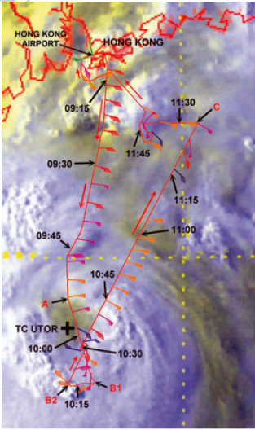
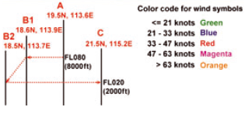
1 observational data analysis
Pictures are from P. W. Chan et al. (2014)

Slide 3
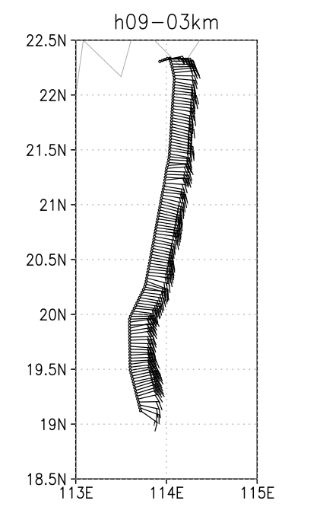
Left figure is the reconnaissance data from 9:06 to 9:59 UTC, which is thinning at 3km.

Slide 4
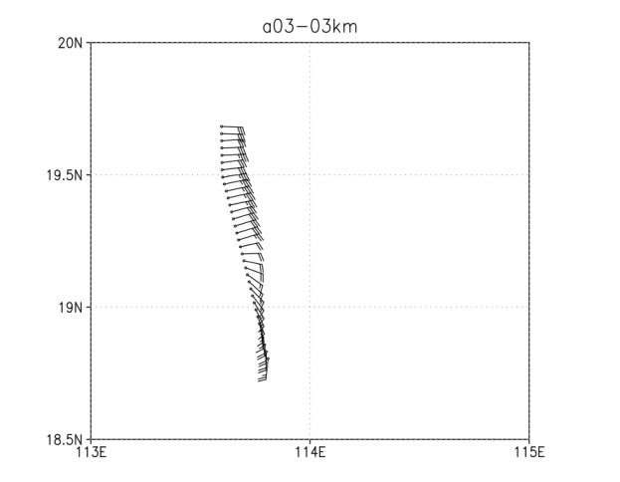
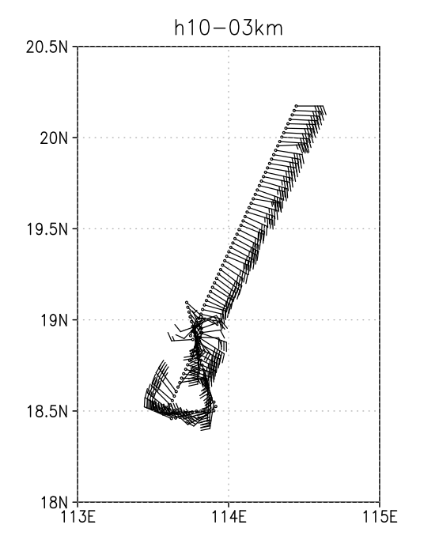
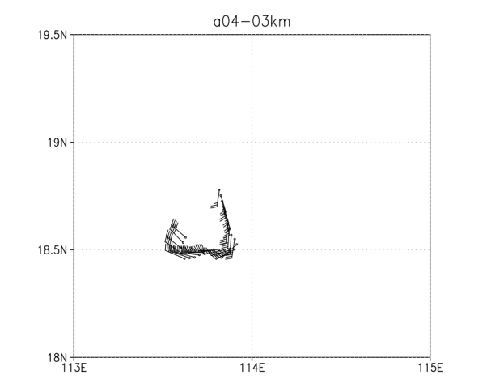
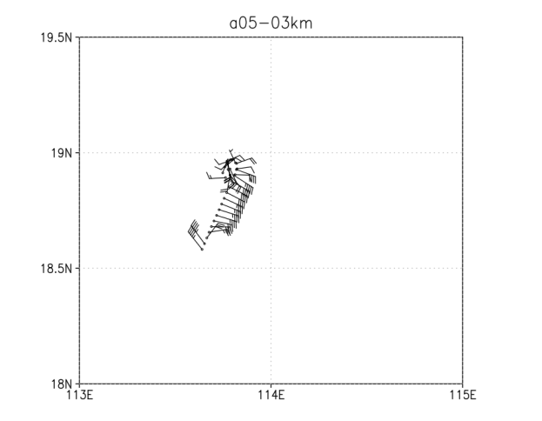
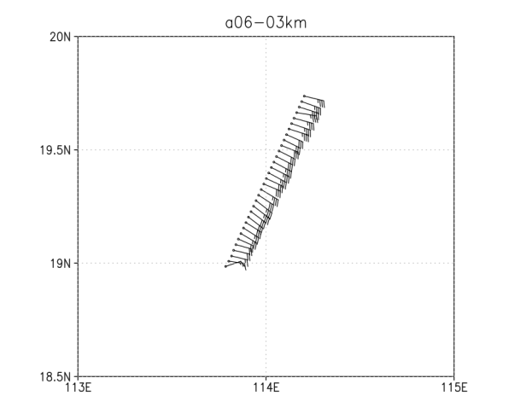
Notes:
This data is from 10:00 to 10:59 UTC. The quality of data is not good as 9:00 UTC when flight was near to the hurricane eye and flight was turning direction. I enlarged four legs of flight path highlighted by the red cycles on the left picture. As the top one (a03-3km) showing, the wind increasingly was switching east wind to south wind, which was opposite to the direction of flying. The data of reconnaissance can not reflect the hurricane circulation when the flight was turning, which is described by a04-3km and a05-3km. However, it was considered as a secondary circulation center in P.W. Chan’s paper. Meanwhile, I didn’t find dominated information about hurricane eye in the data sets, which was in P.W. Chan’s paper.

Slide 5
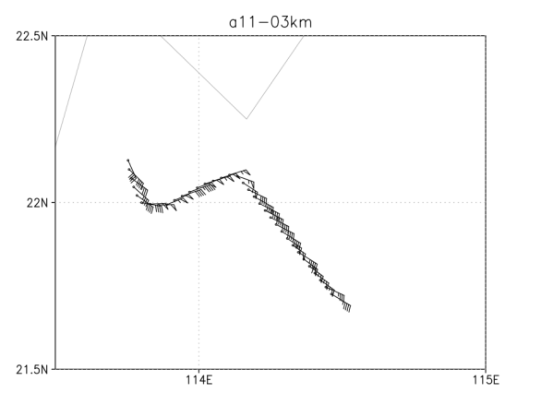
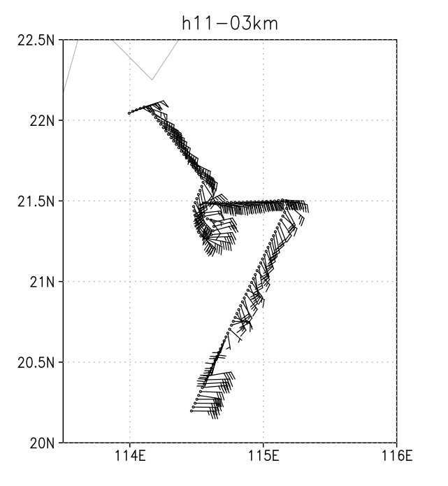
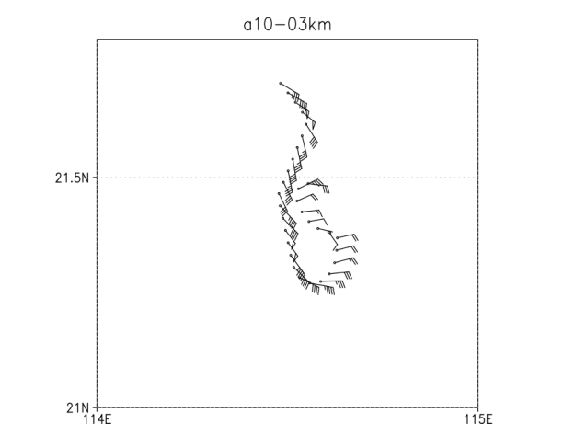
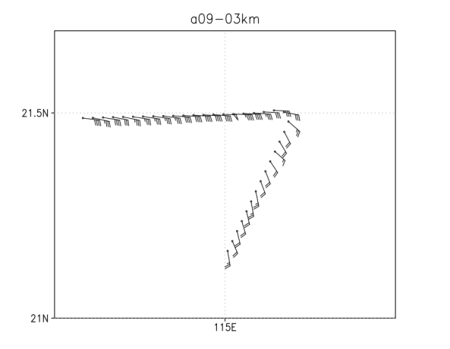
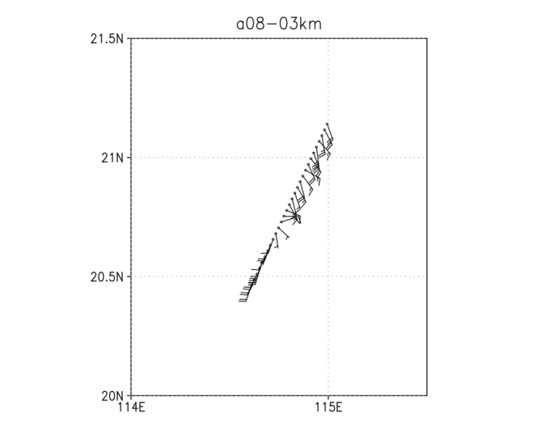
Notes:
The data sets from 11:00 UTC to 11:59 UTC have very low quality. The wind observed by flight can not represent the circulation of hurricane except a short and discontinued flight path.

Slide 6
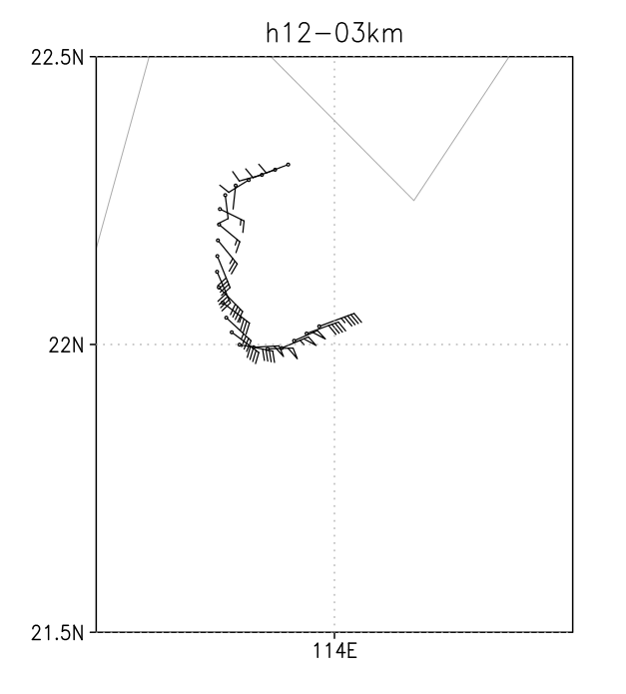
data from 12:00 to 12:12 UTC. The direction of wind was changing as the flight direction.

Slide 7
Conclusion:
1 The data sets of reconnaissance only have limited value to be assimilated in NWP.
2 The quality of data is low when the flight is turning direction or near to the eye of hurricane.

Slide 8
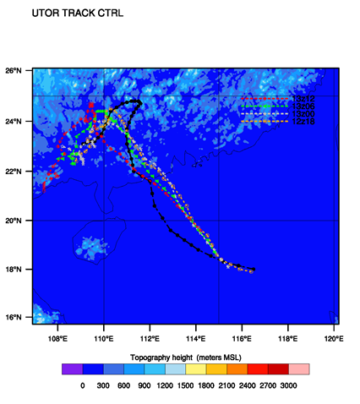
2 Assimilation experiments
Data used in assimilation cycle:
Hong Kong flight level data is assimilated at 3km and 15km for different assimilation windows

Slide 9
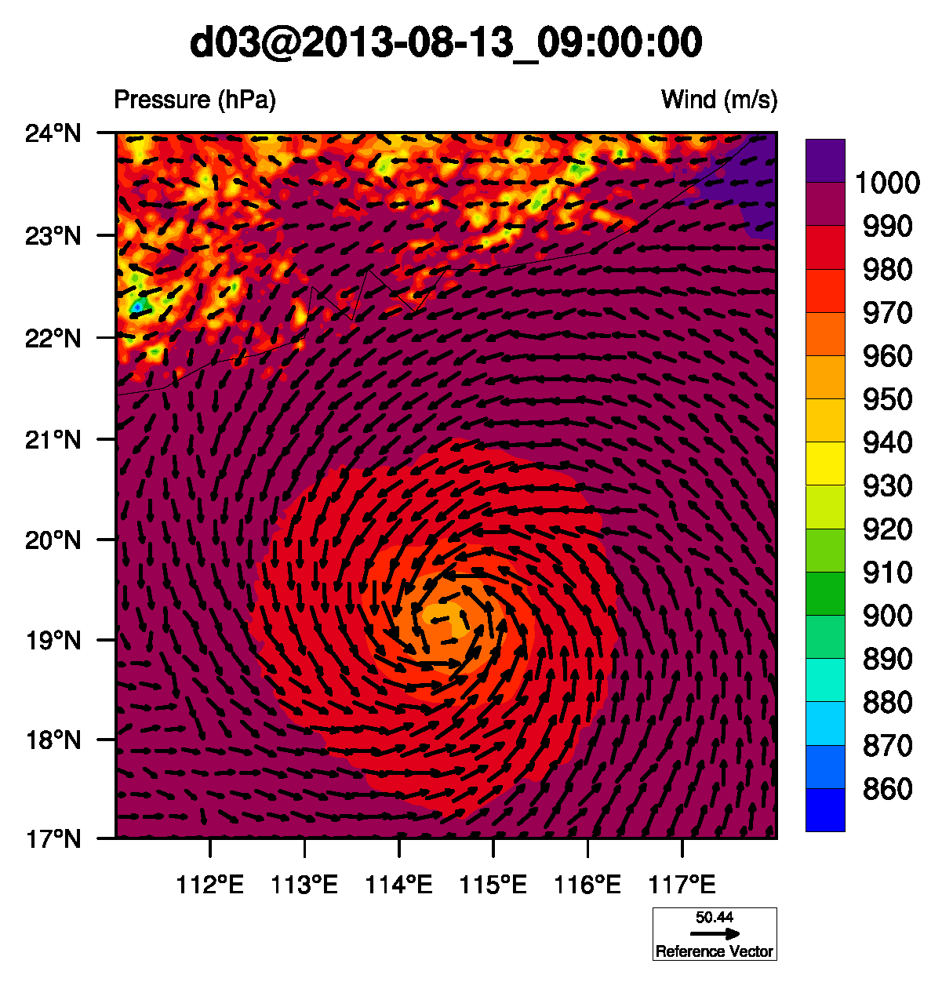
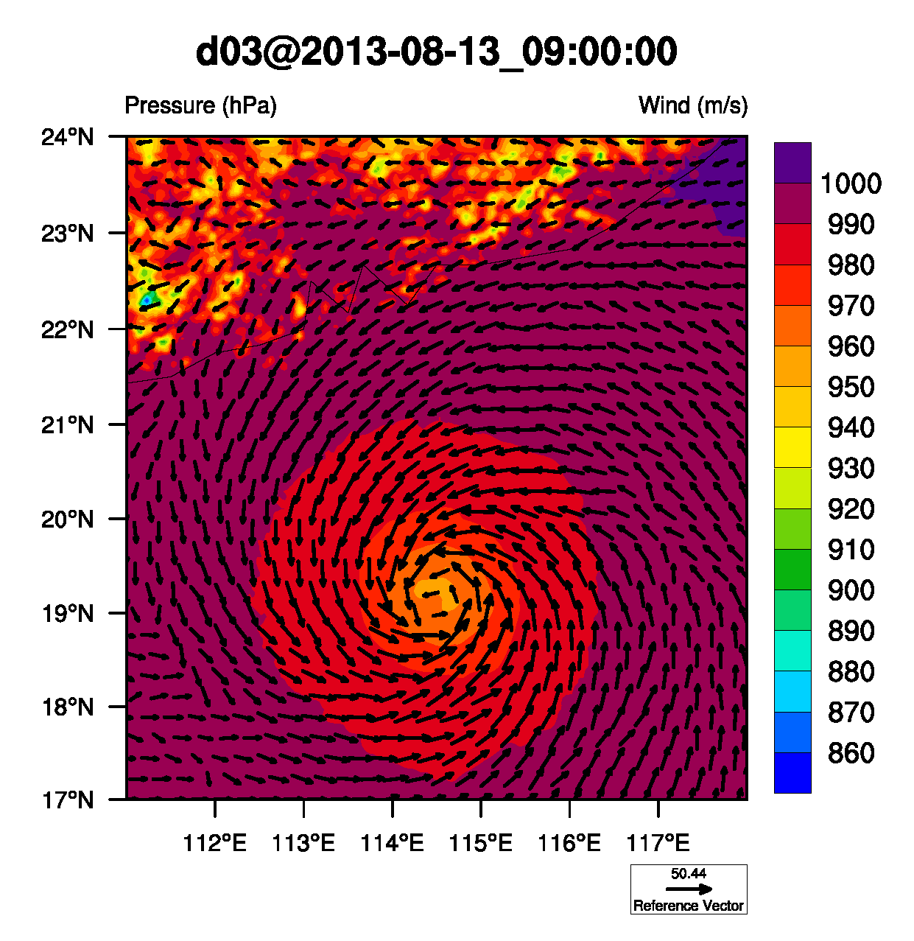
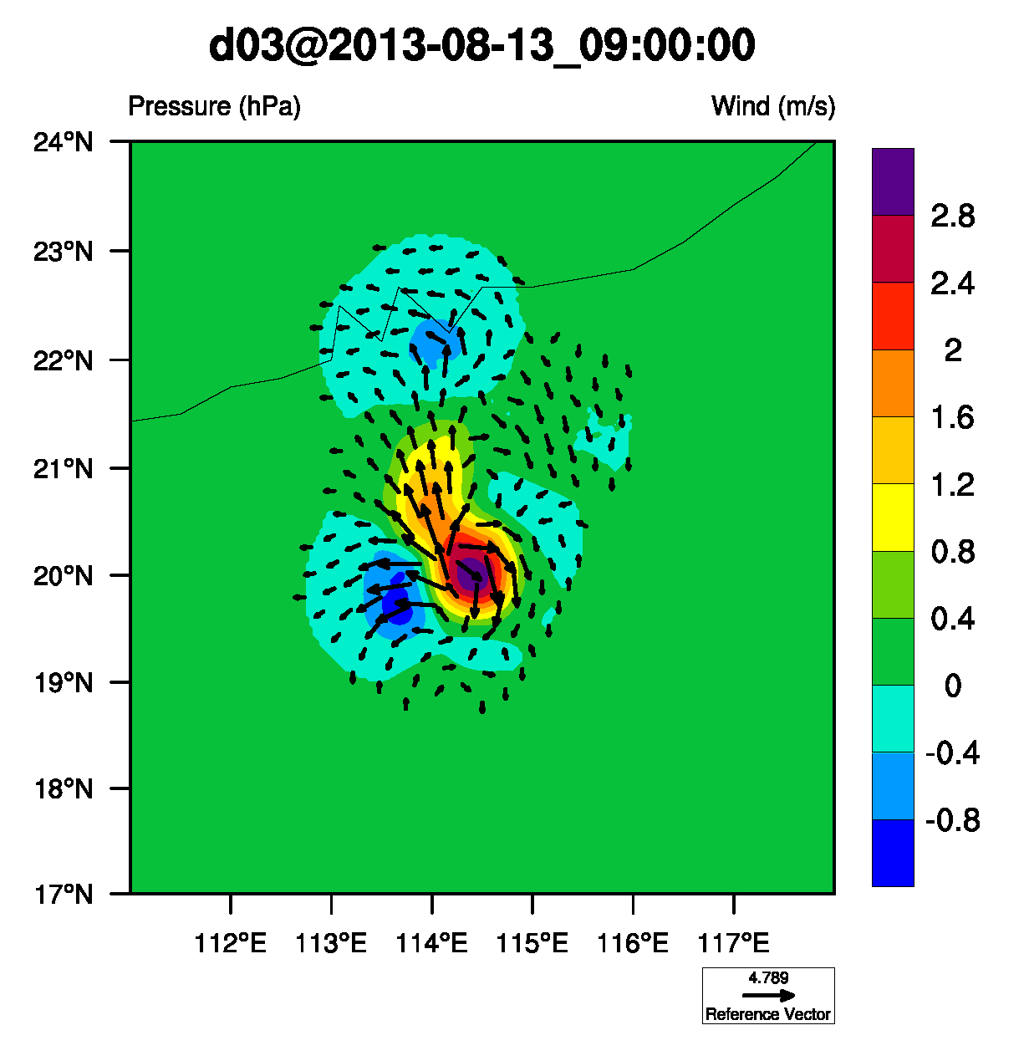
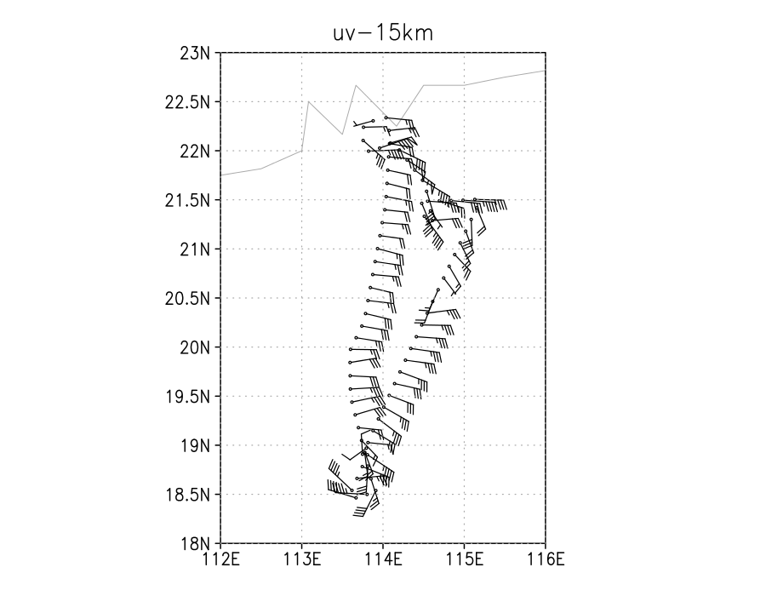
Observation is thinned at 15km
XA
XB
Increment
OBS
Notes:
There are only 160 data including u and v after the data thinning at 15km. The increment is very small compared with the background and analysis field. It is obvious that a south wind is added on the background wind at the point (20N, 114E). The observation is easterly corresponding to northeasterly on background field. So, the southerly is dominant information on increment.

Slide 10
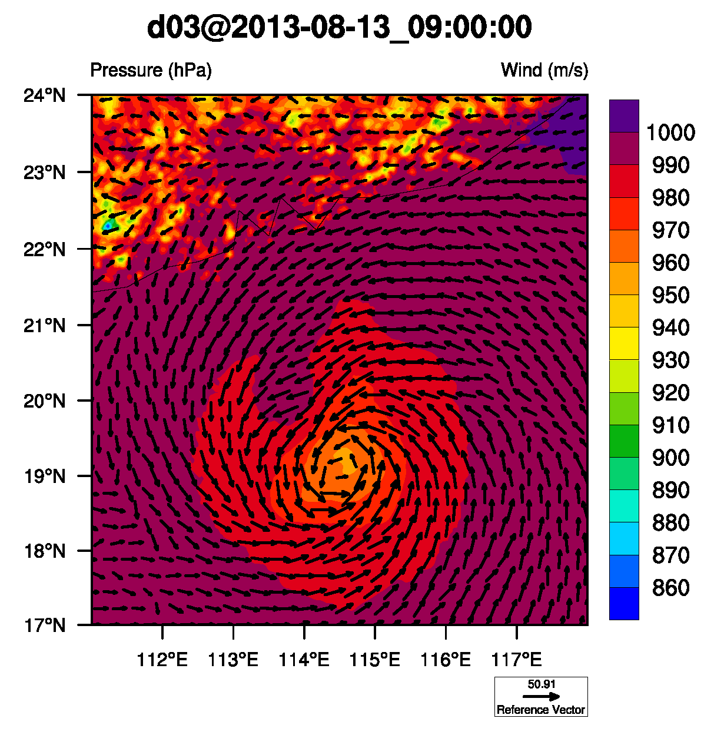
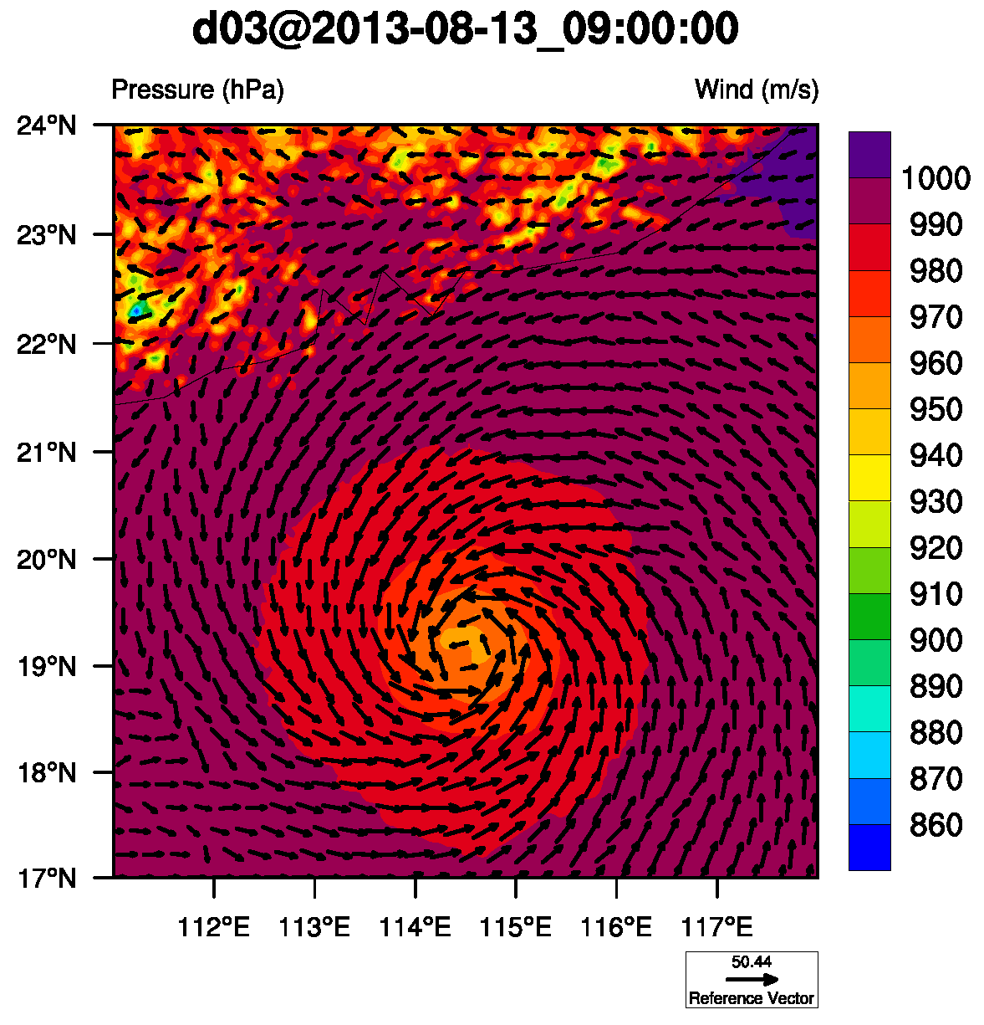
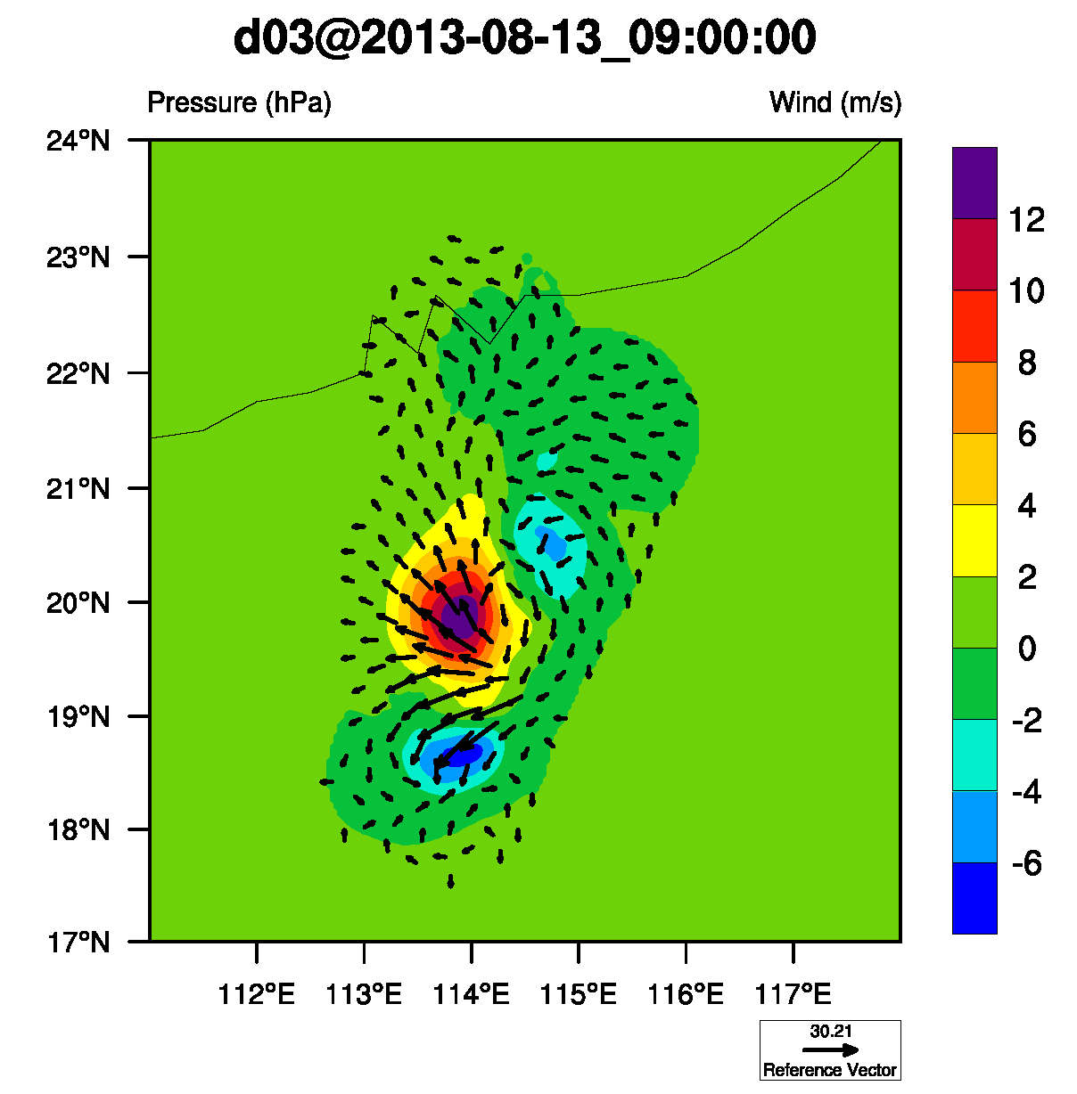
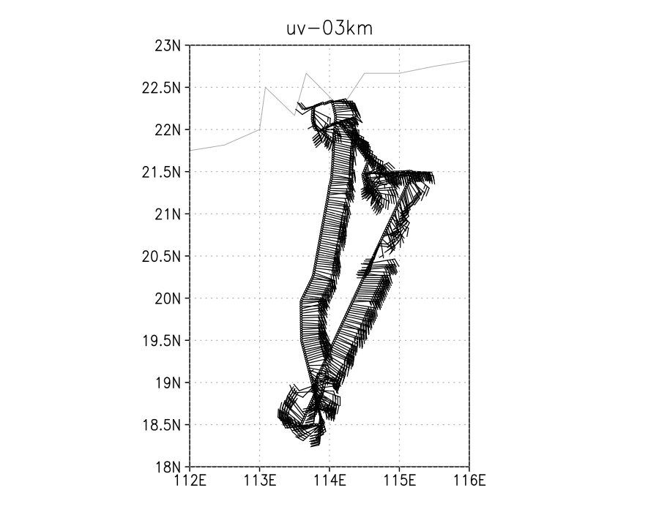
Observation is thinned at 3km
XA
XB
Increment
OBS
Notes:
The data contained more details after being thinned at 3km. The high pressure on increment field is generated by the easterly. The south low pressure is generated by the cyclone which is described as a secondary circulation by P.W. Chan. The north low pressure is intrigued by the turning point of flight path.

Slide 11
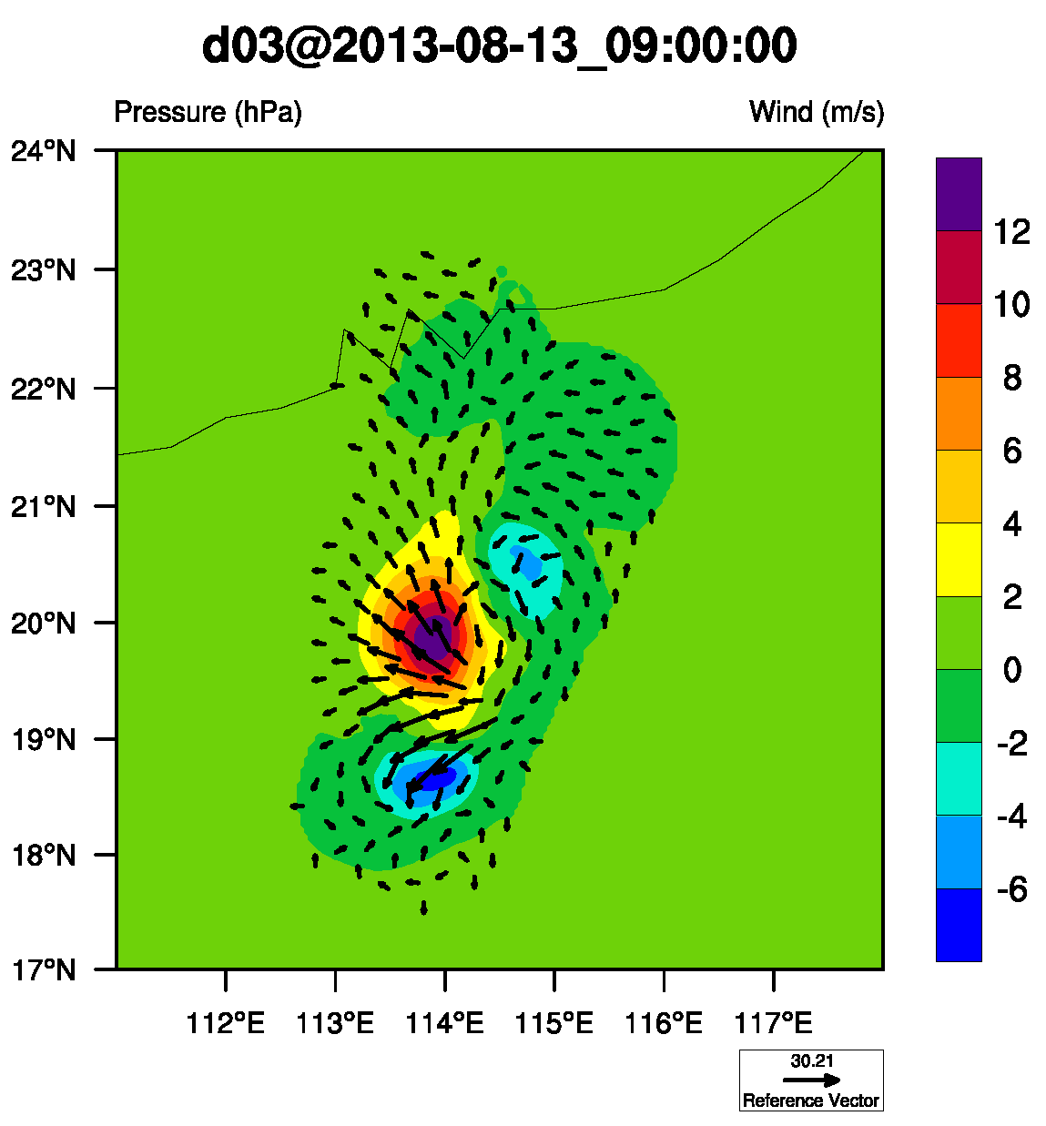
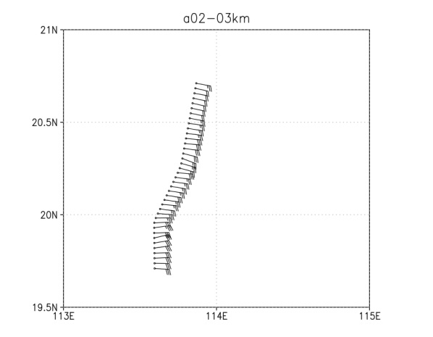
Assimilation window from 9:00 UTC to 11:30 UTC

Slide 12
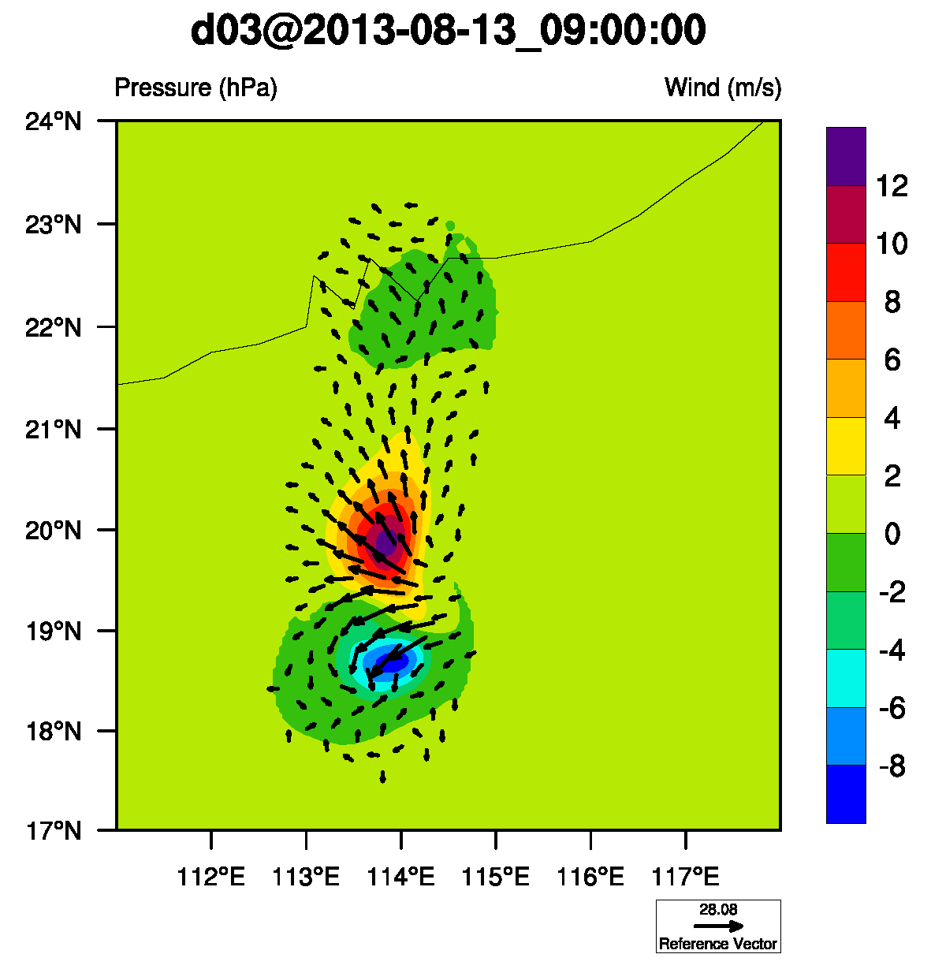
Assimilation window from 9:00 UTC to 10:30 UTC

Slide 13
To use this sparse and contaminative data, we probably utilize the schur product to filter noises of the data. The ROI is enlarged to 90 grids in the following experiment.

Slide 14
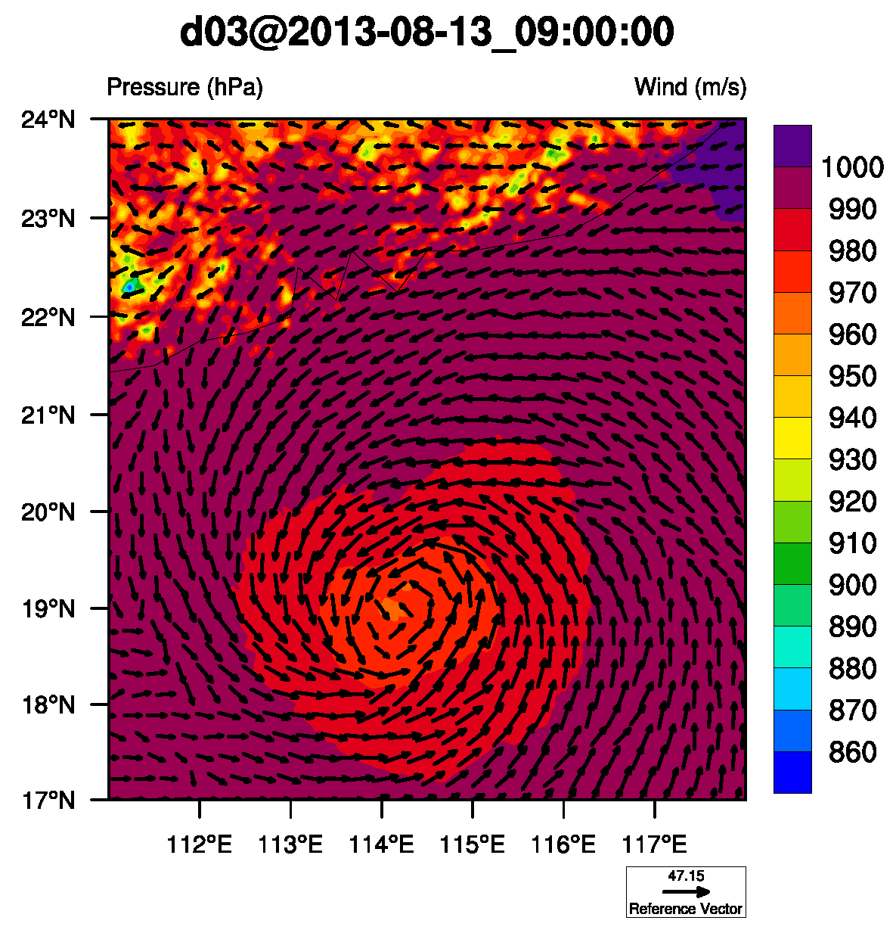
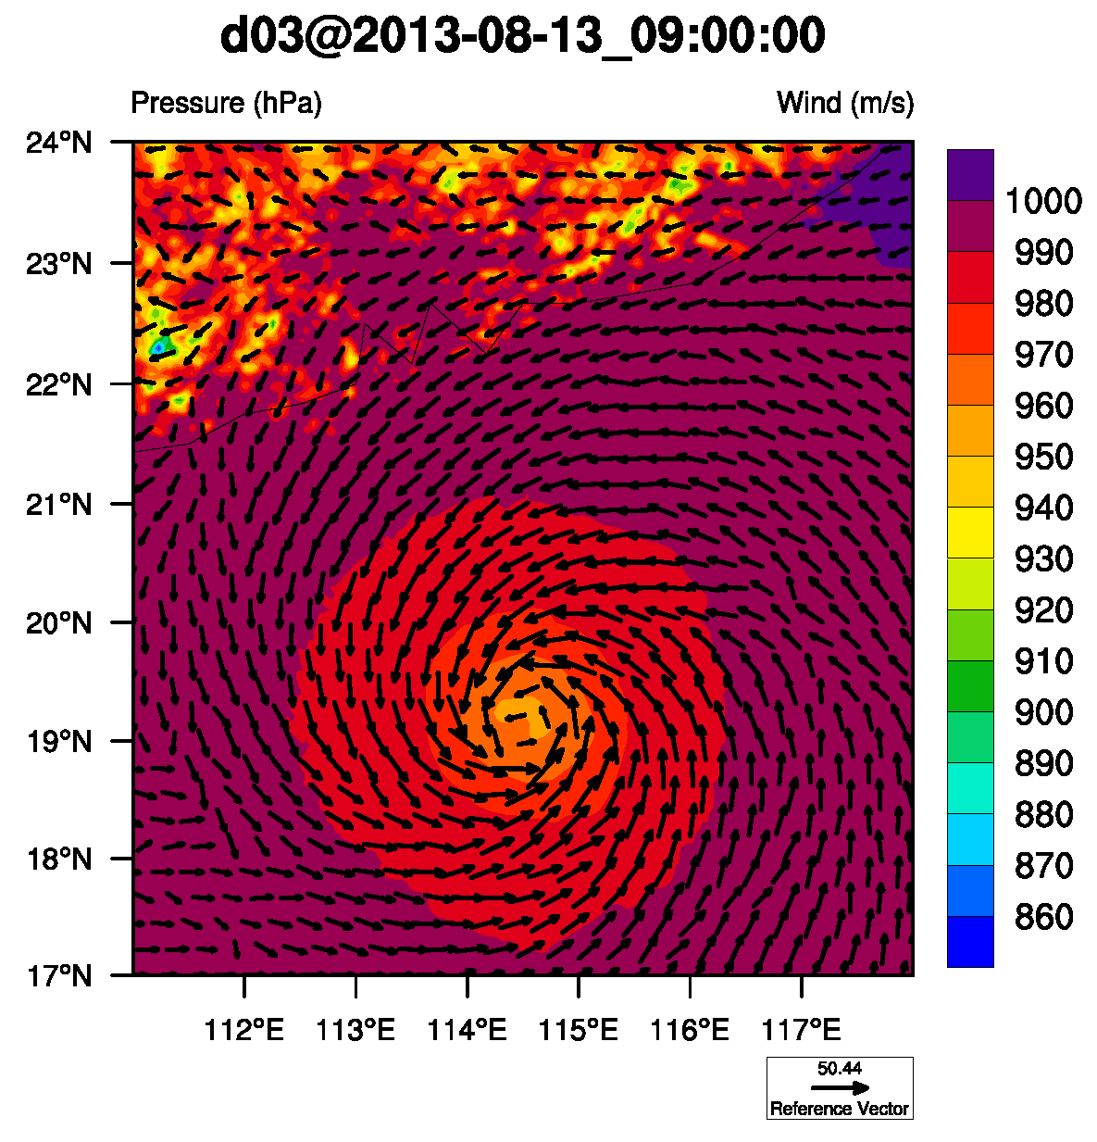
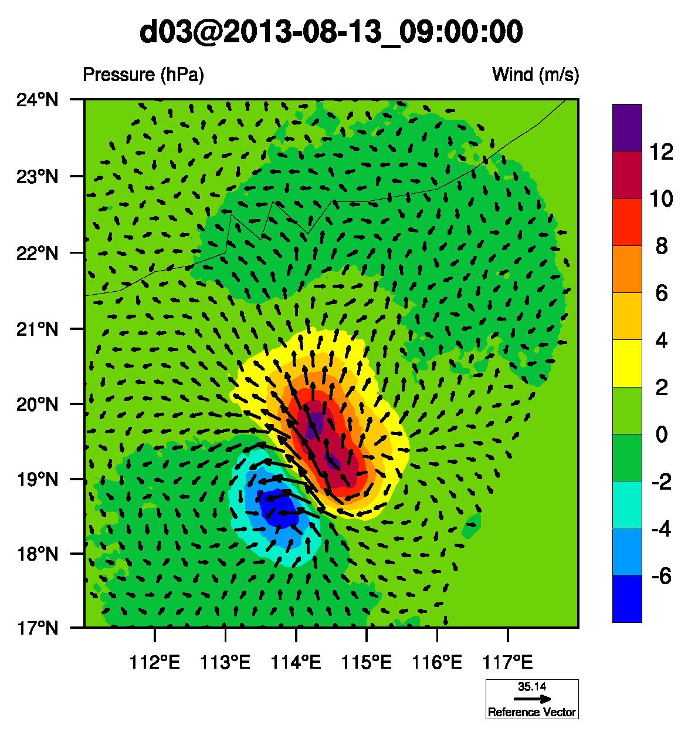
XA
XB
Smoothed by schur product
Increment
Notes:
The increment field is smoothed by schur product. However, the main information extracted from observation is still wrong. The low pressure is intrigued by the turning point of flight path or the so called secondary circulation. It isn’t intrigued by the hurricane center information. The high pressure is generated by the northerly stream.

Slide 15
Conclusion:
1, the quality control is not good enough to be assimilated. It is clearly that the wind direction changes with flight path, especially when the flight is turning.
2, the model error have to be decreased by relocation mothed. The southerly stream and high pressure is generated by the error of hurricane center between forecast and observation.

Slide 16
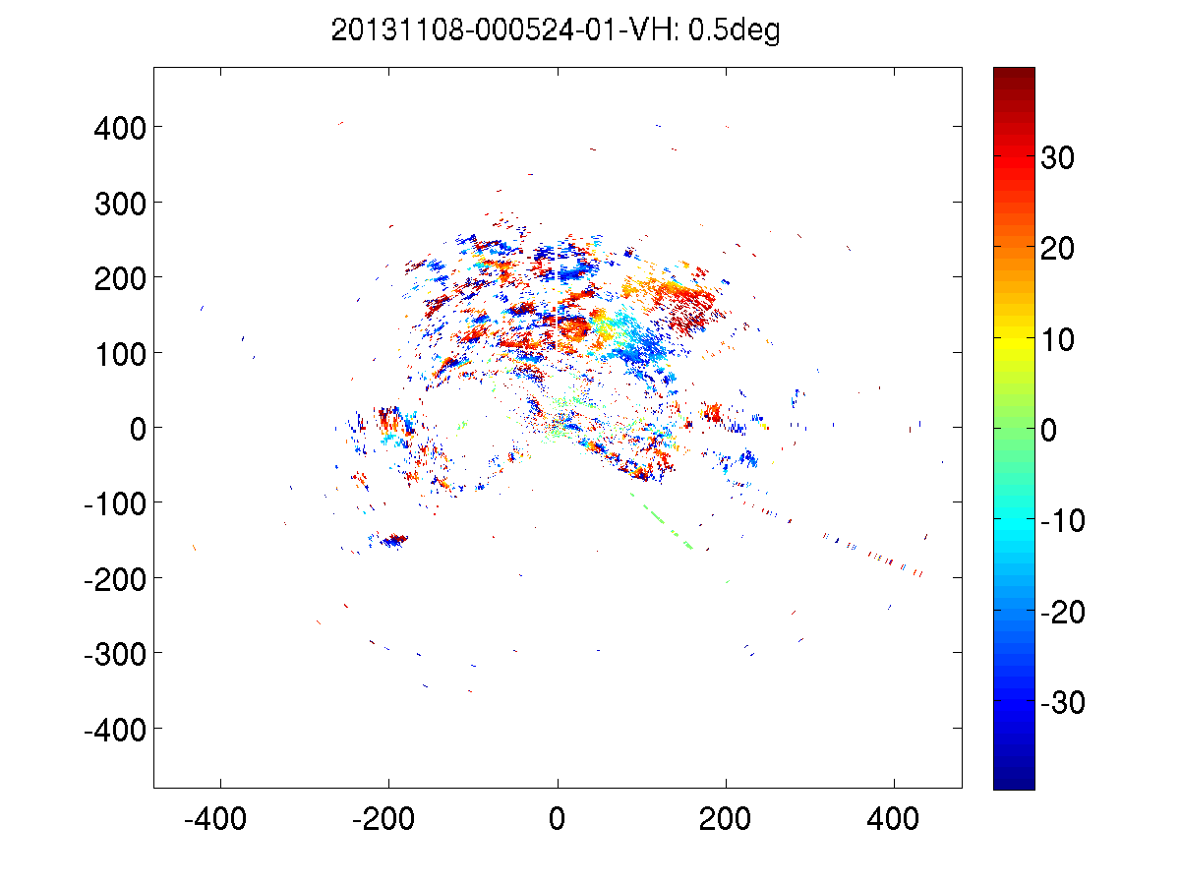
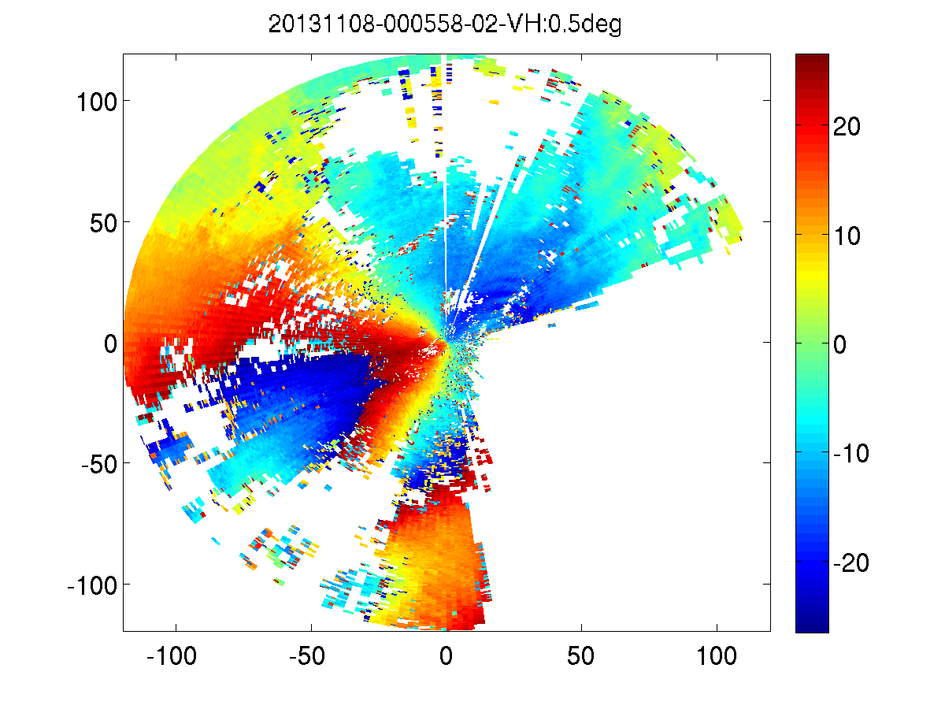
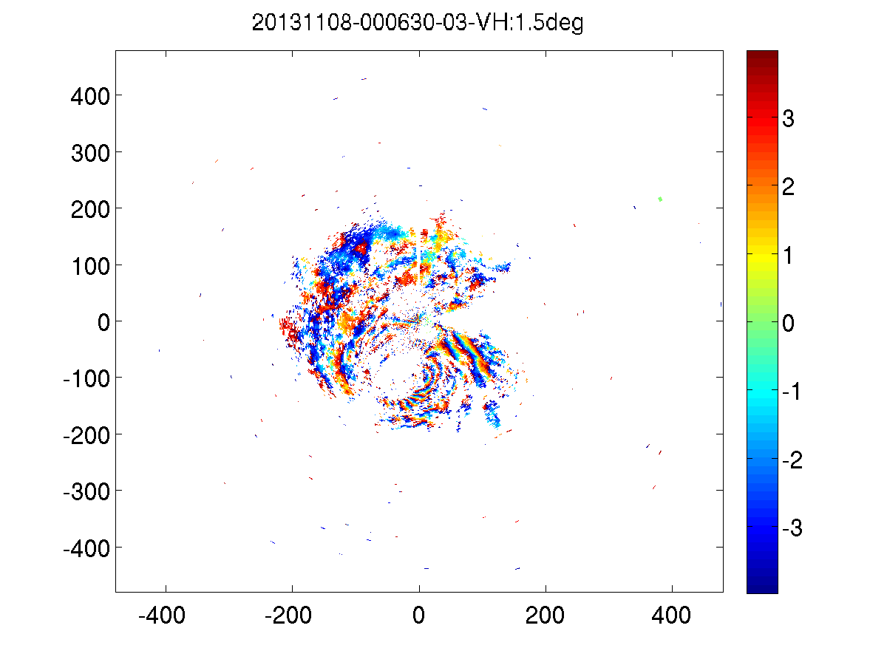
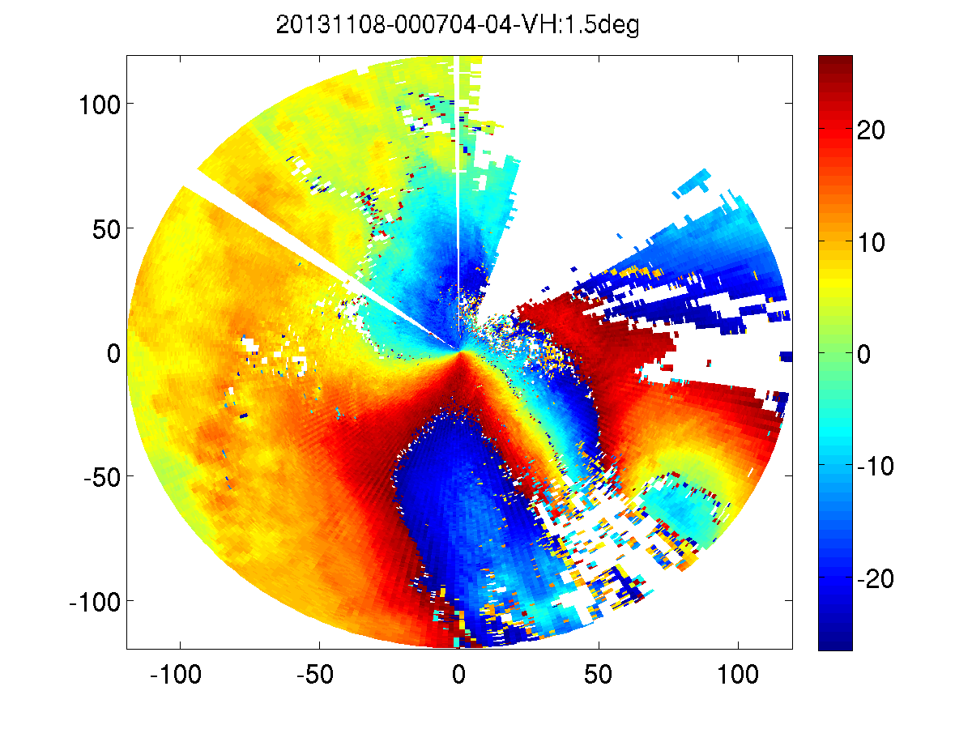
3 Radar from Cebu, Philippines

Slide 17
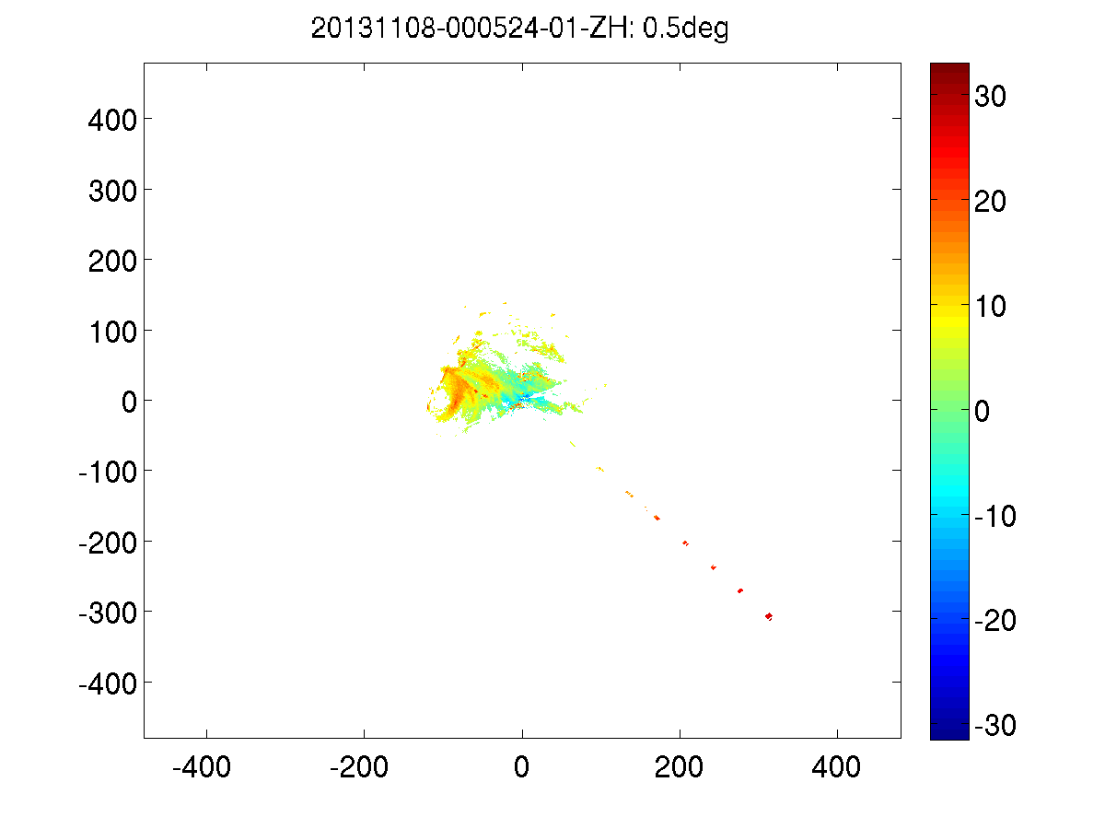
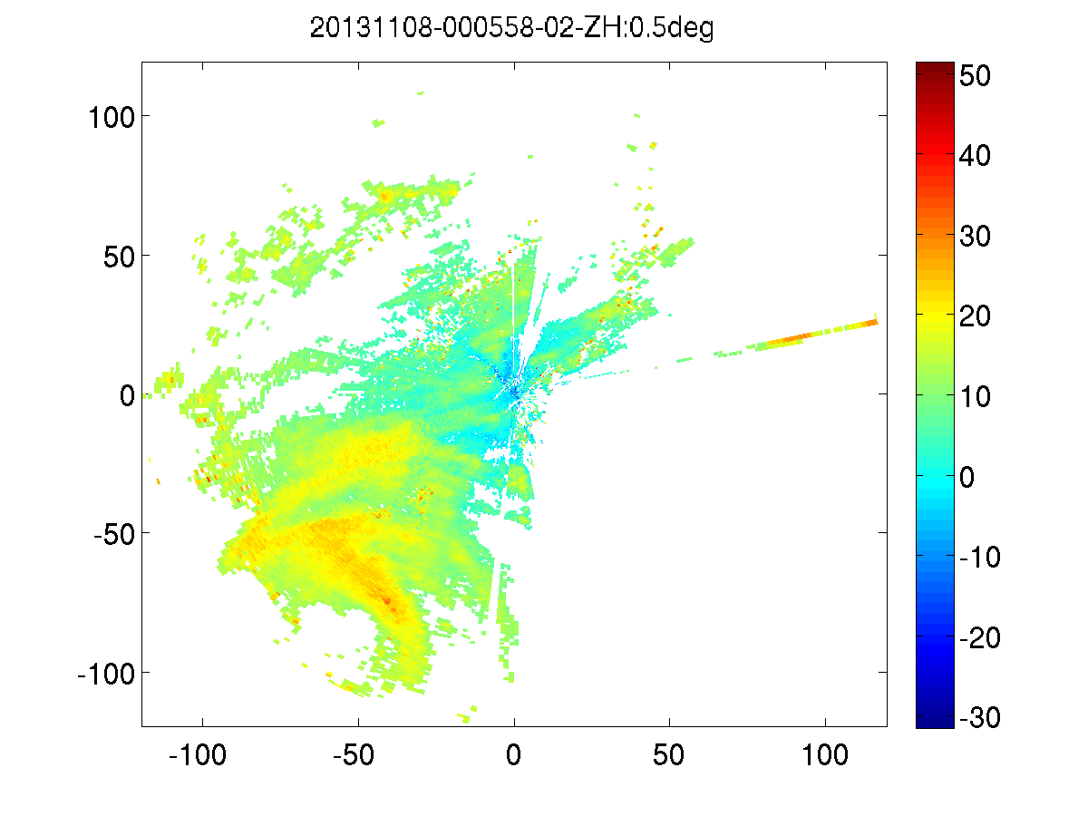
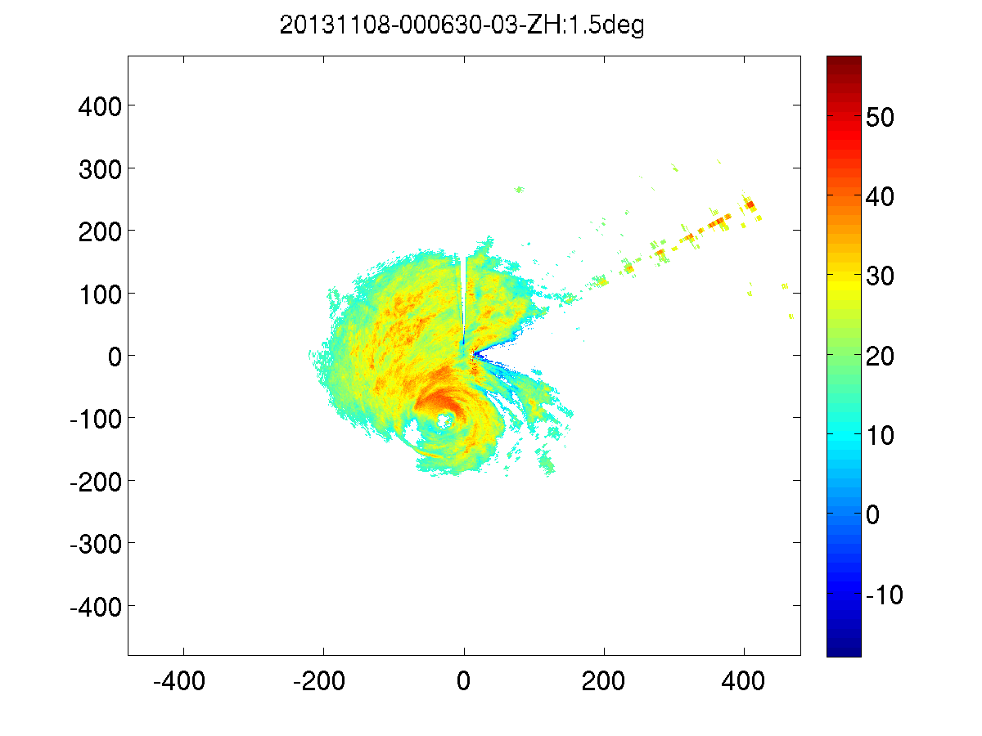
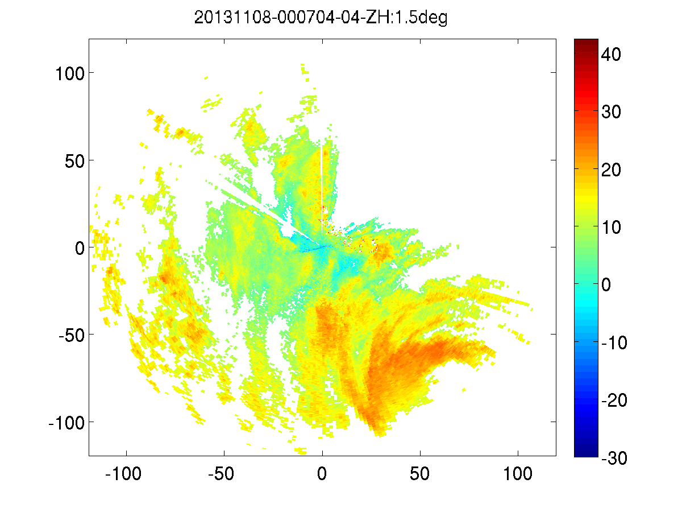

Slide 18
Thank you

