Slide 1


All-Sky Microwave Radiative Transfer Modeling for DA: Advancing the CRTM to Microphysics-Consistent Cloud Optical Properties
18 August 2015
Scott Sieron, Fuqing Zhang,
Eugene Clothiaux, Lu Yinghui

Slide 2
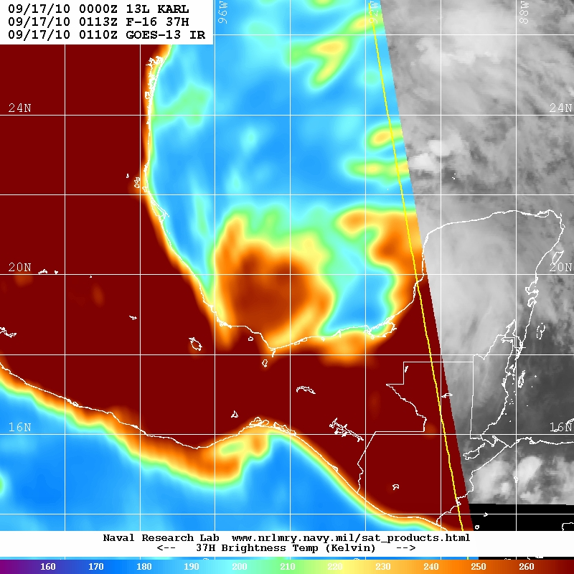
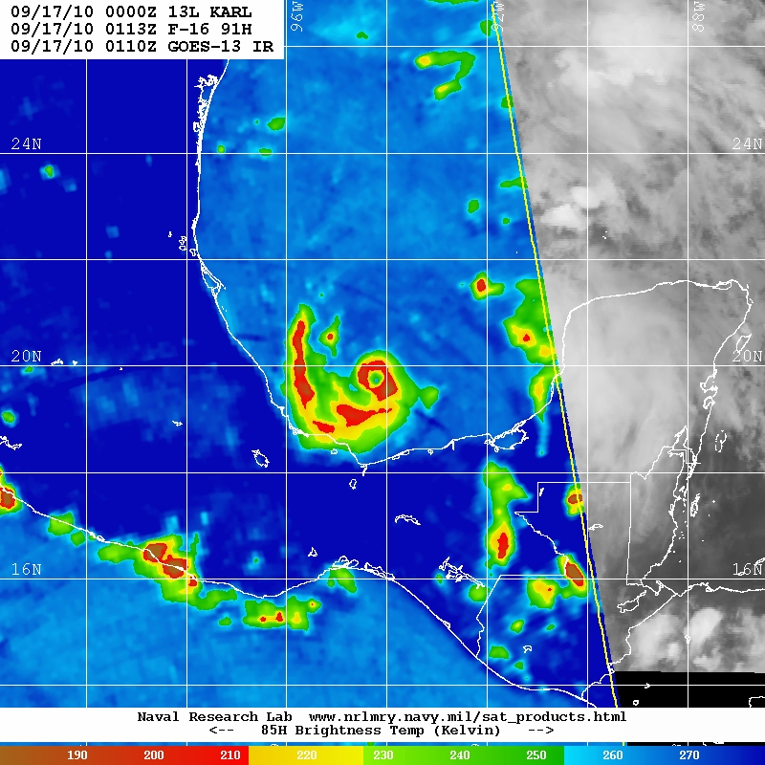
Low-mid frequency (37 GHz)
High-mid frequency (91 GHz)
160
180
200
220
240
260
190
210
230
250
270
COLD
WARM
COLD
WARM
Hurricane Karl 09/17/10 0113Z
SSMIS (image courtesy NRL)
Hurricane Karl 09/17/10 0113Z
SSMIS (image courtesy NRL)

Slide 3
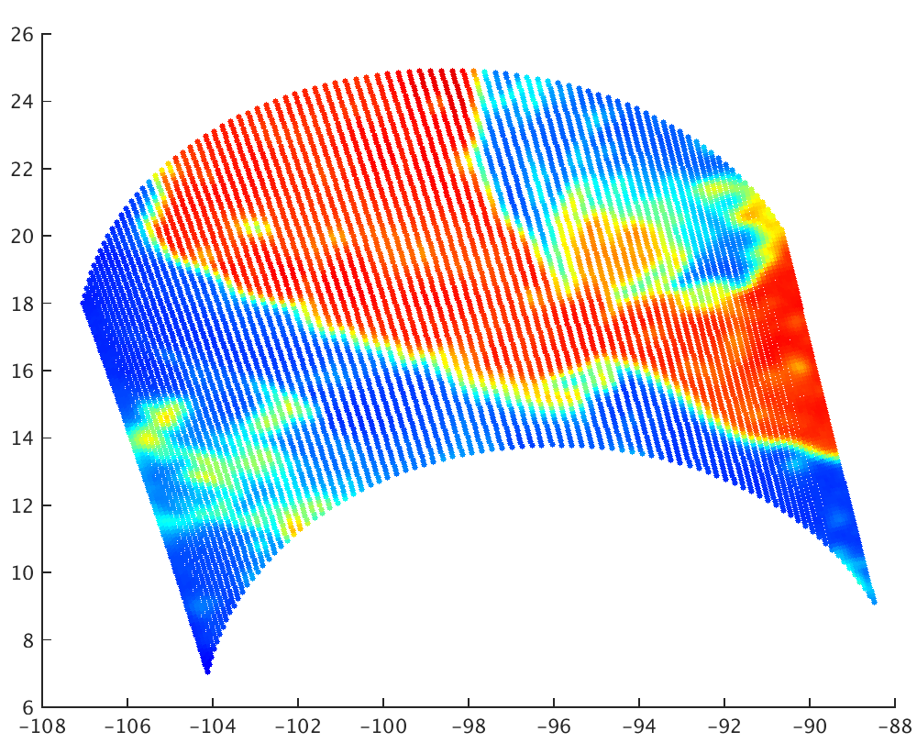
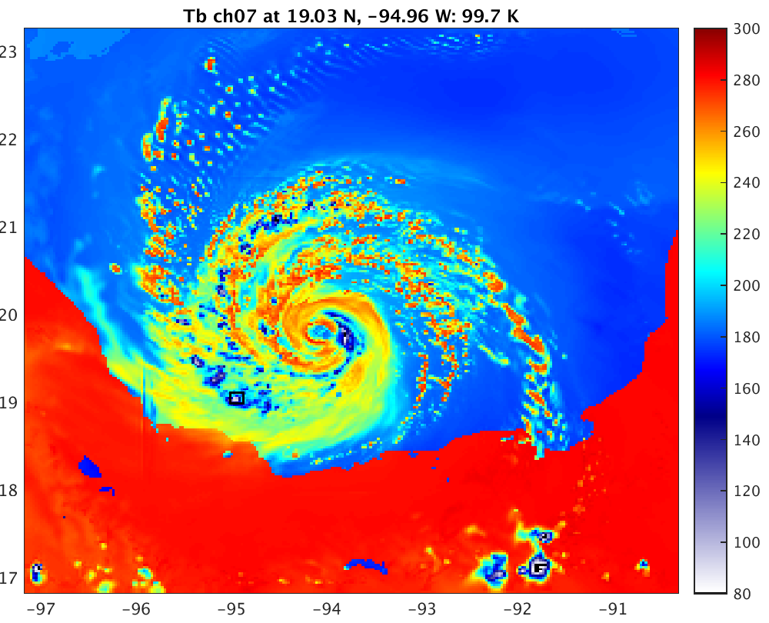
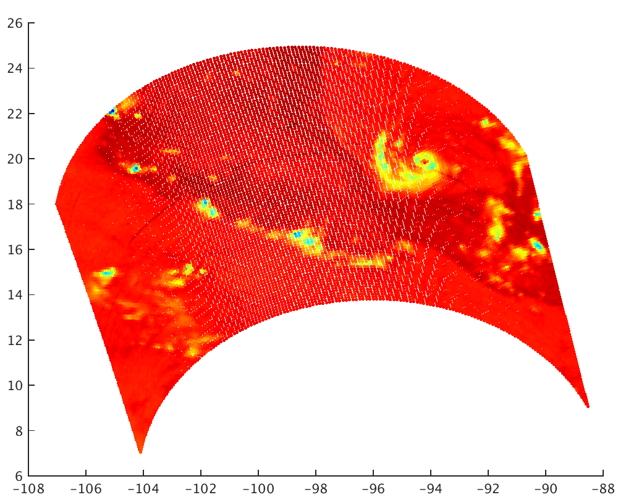
Low-mid frequency (37 GHz)
High-mid frequency (91 GHz)
Hurricane Karl 09/17/10 0113Z
SSMIS
Hurricane Karl 09/17/10 0113Z
SSMIS

Slide 4
Microwave and Precipitation
Hydrometeor size is very important in microwave:
  When [particle radius] < ~1/6 wavelength, scattering increases by ~[particle mass]²
    Rayleigh scattering of a homogenous sphere
  Considering spherical solid particle of ever-increasing size: scattering per mass growth slows, oscillates, then declines
    Mie scattering of a homogenous sphere
These MW wavelengths are only several millimeters
  Largest precipitation particles exceed ~1 mm radius and are removed from well-behaved scattering regime
Mass extinction (thick solid), scattering (dashed) and absorption (thin solid) coefficients (m² g⁻¹) of solid ice spheres as a function of radius for three imaging channels. Wavelength and 1/6-wavelength demarked.

Slide 5
CRTM All-sky Microwave
Create new cloud optical property lookup tables
  Model properties of single particles as specified by MP scheme
    Maxwell-Garnett mixing formula for ice dielectric constants (Turner et al., in prep)
    Product of the Henyey-Greenstein and Rayleigh scattering phase functions, and Legendre coefficients thereof, as specified by Liu and Weng (2006)
  Calculate per-mass optical properties of clouds constructed with particle size distribution as specified by MP scheme
MP scheme will be perfectly and natively interfaced with CRTM
  (Though both the MP schemes and CRTM remain independent sources of error)

Slide 6
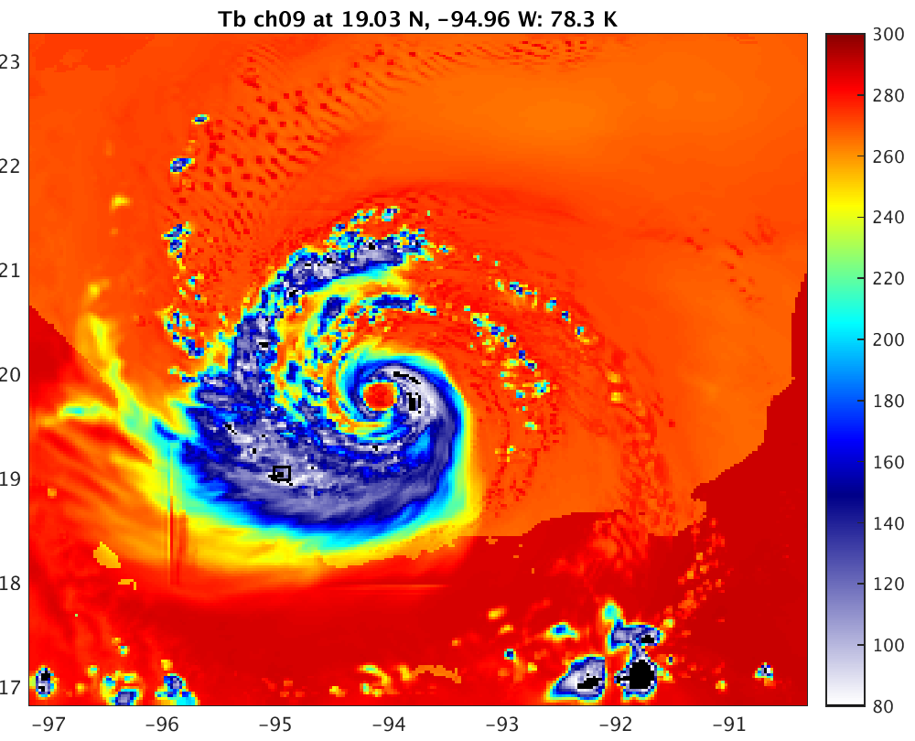
WSM6, New Lookup Tables,
Karl
36.5 GHz
89 GHz

Slide 7
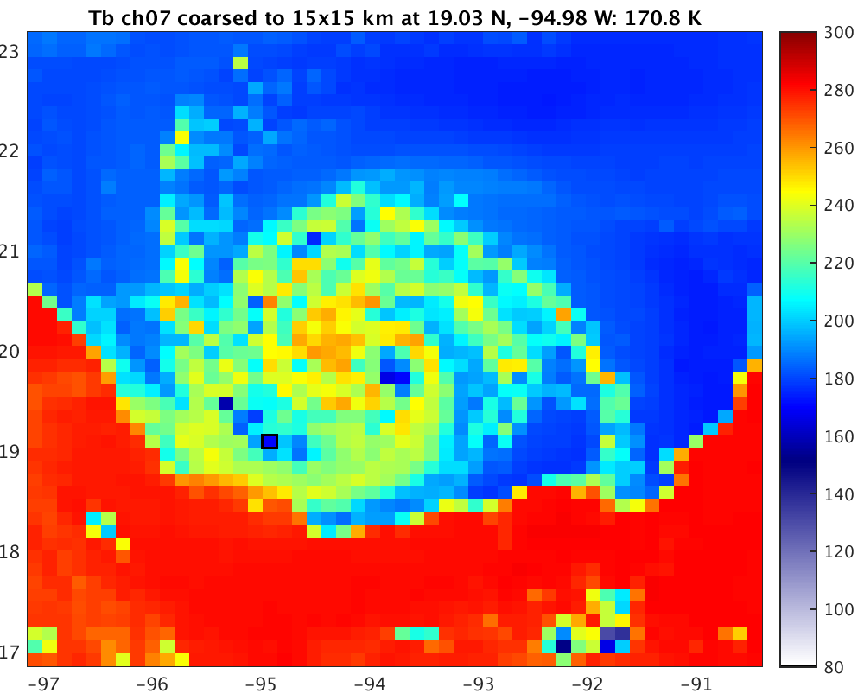
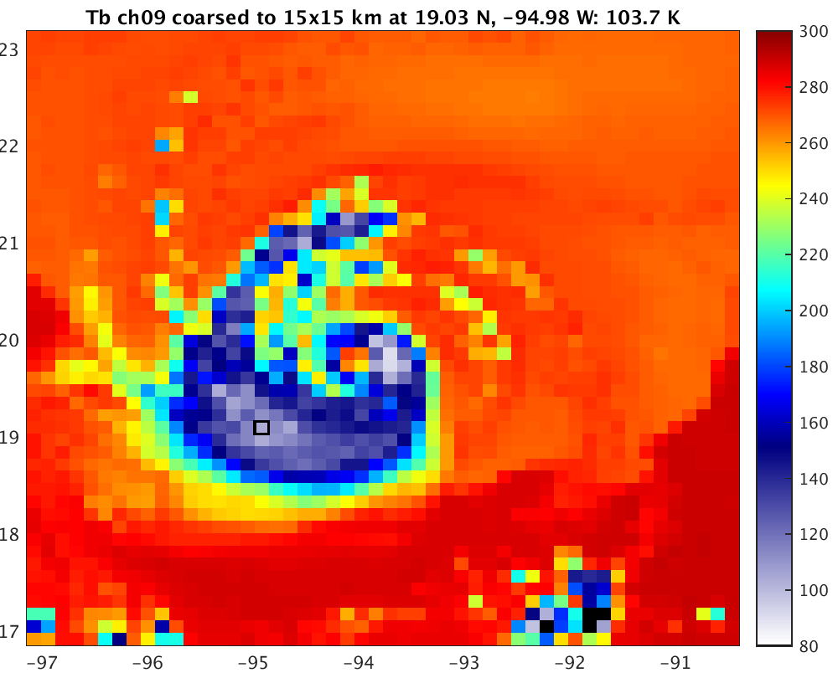
WSM6, New Lookup Tables
Coarsened to 15x15 km, Karl
36.5 GHz
89 GHz

Slide 8
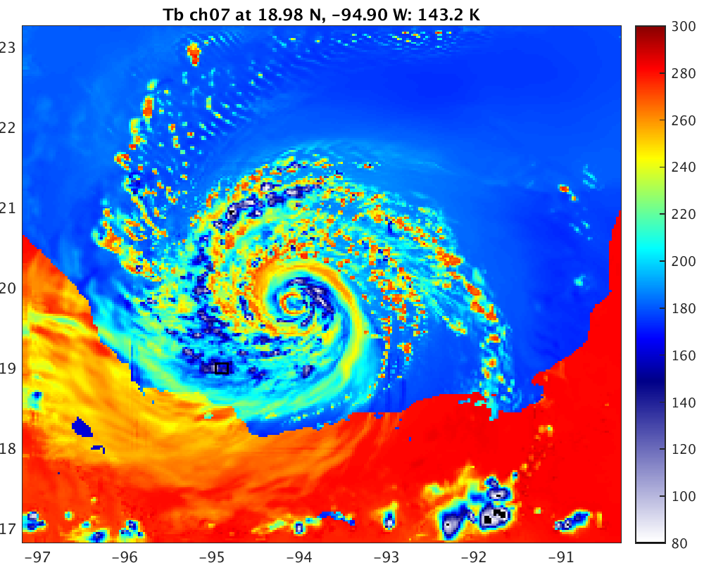
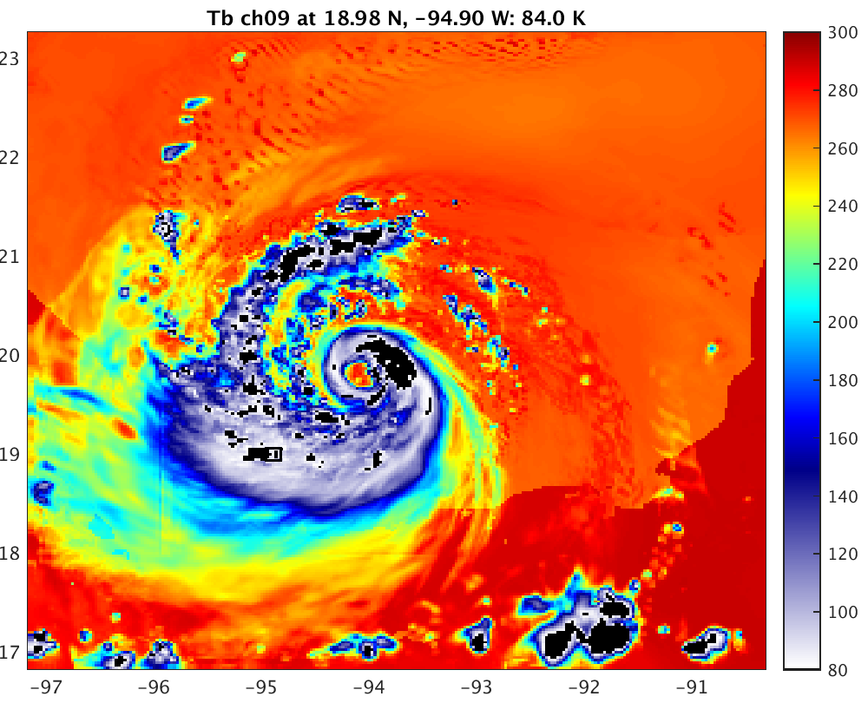
Goddard, New Lookup Tables,
Karl
36.5 GHz
89 GHz

Slide 9
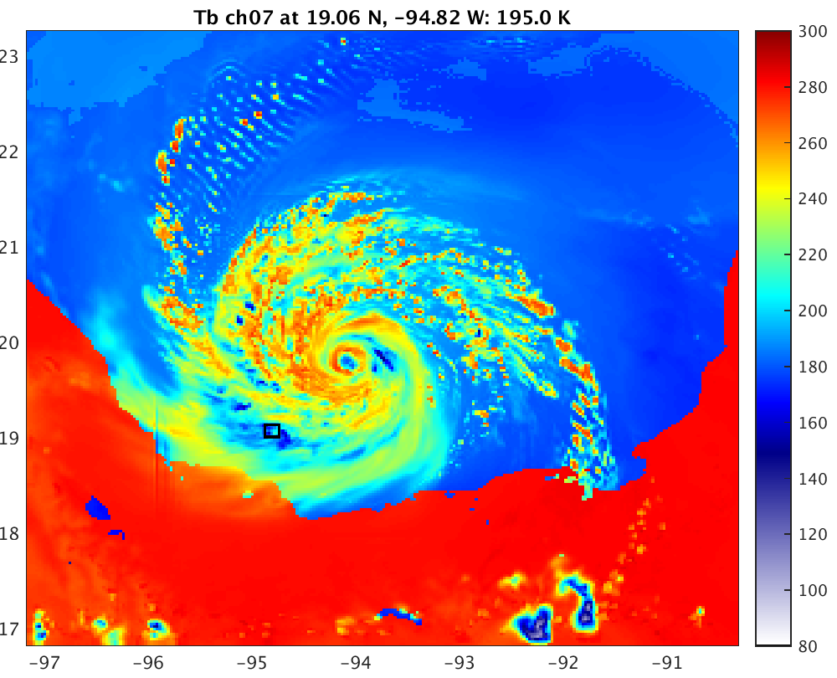
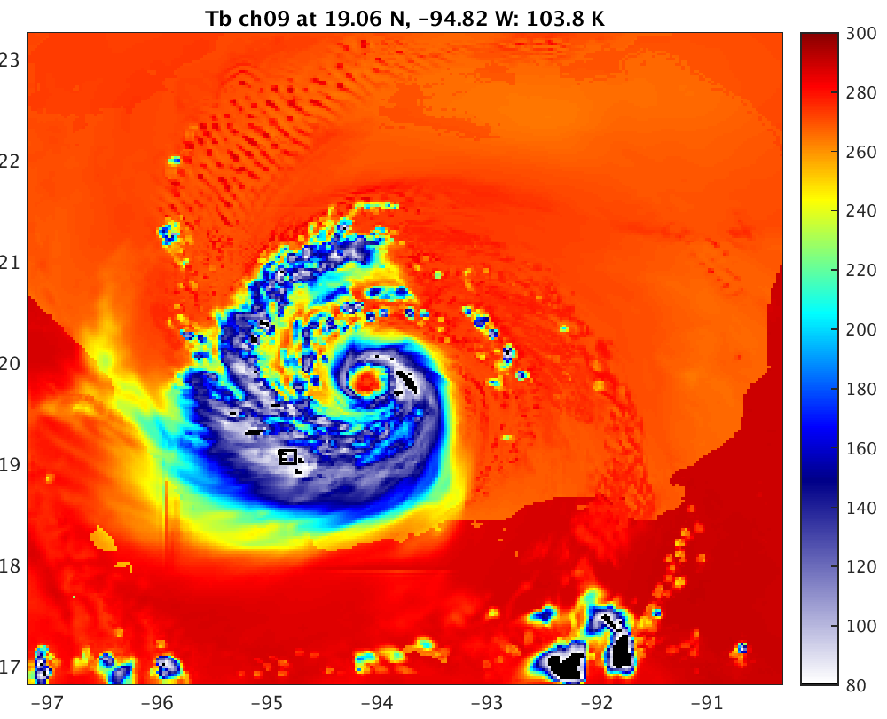
Morrison, New Lookup Tables,
Karl
36.5 GHz
89 GHz

Slide 10
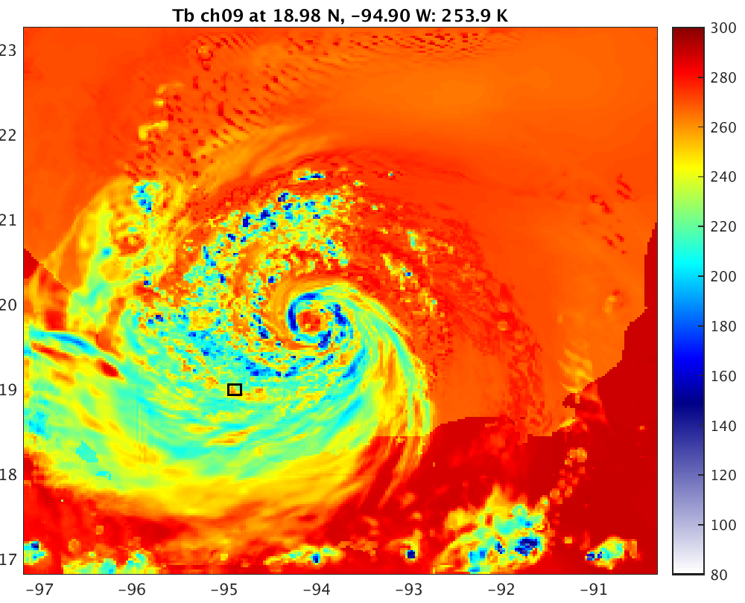
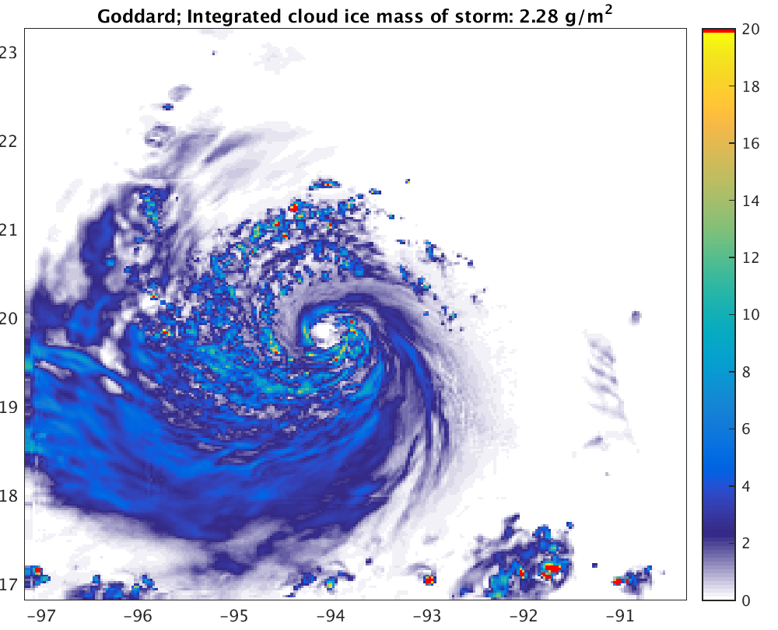
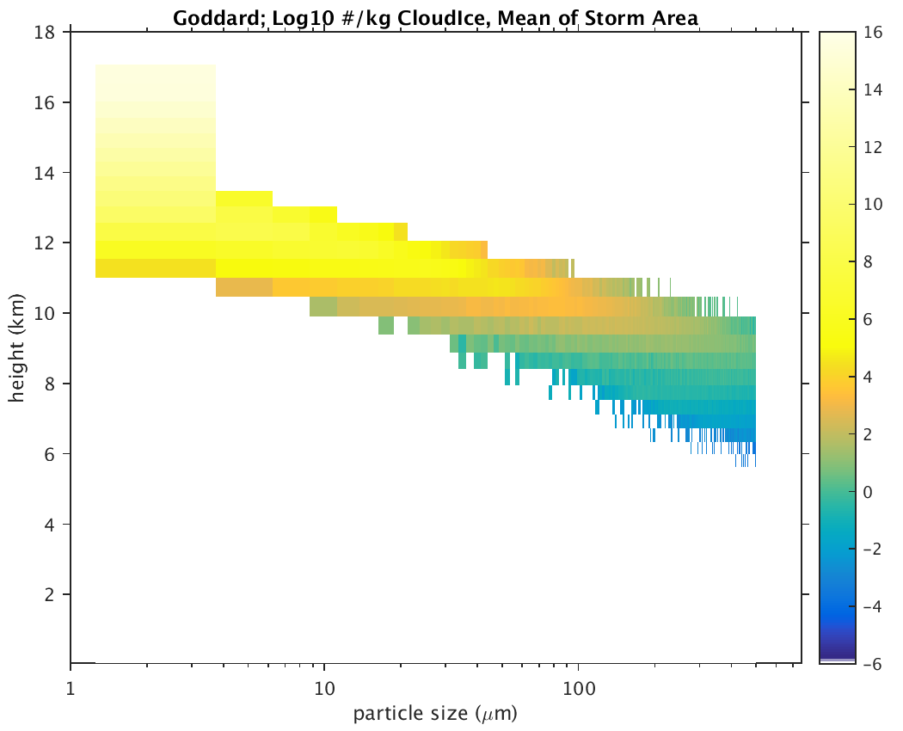
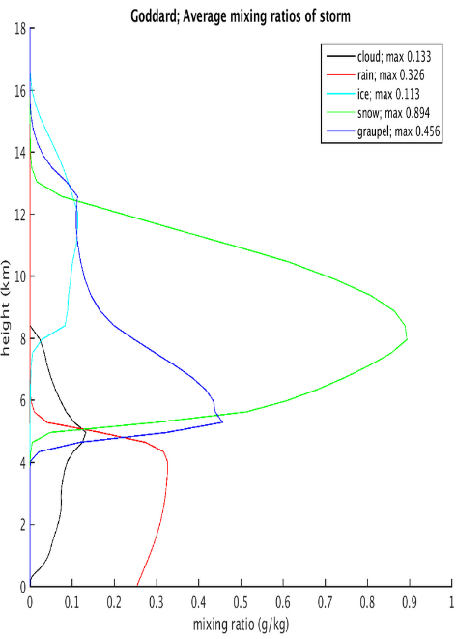
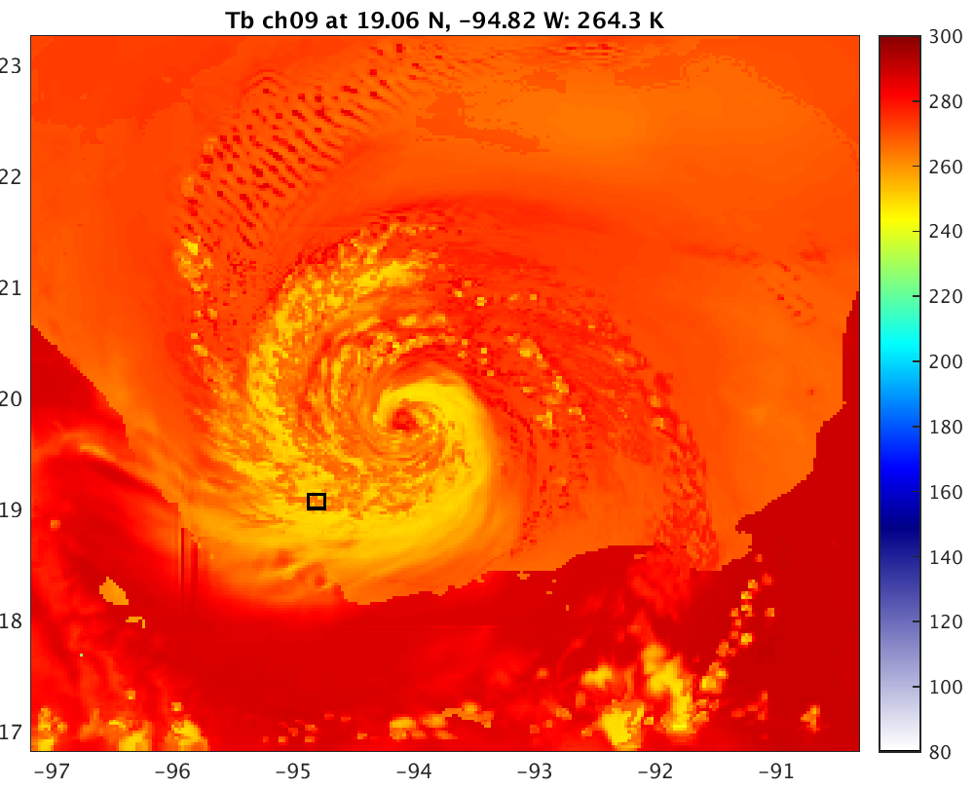
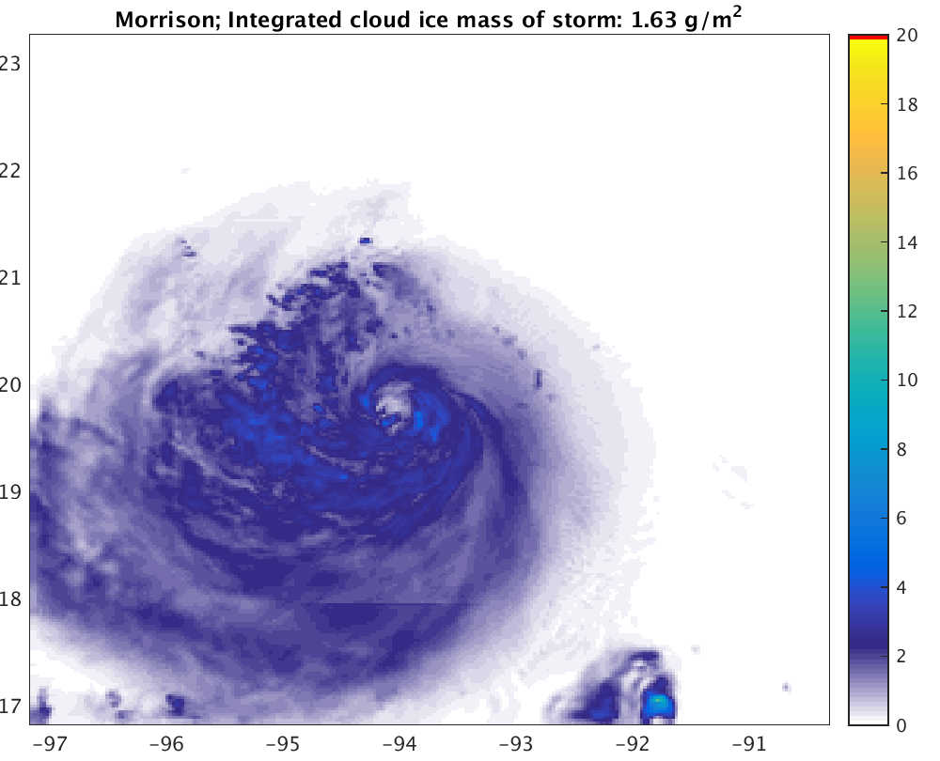
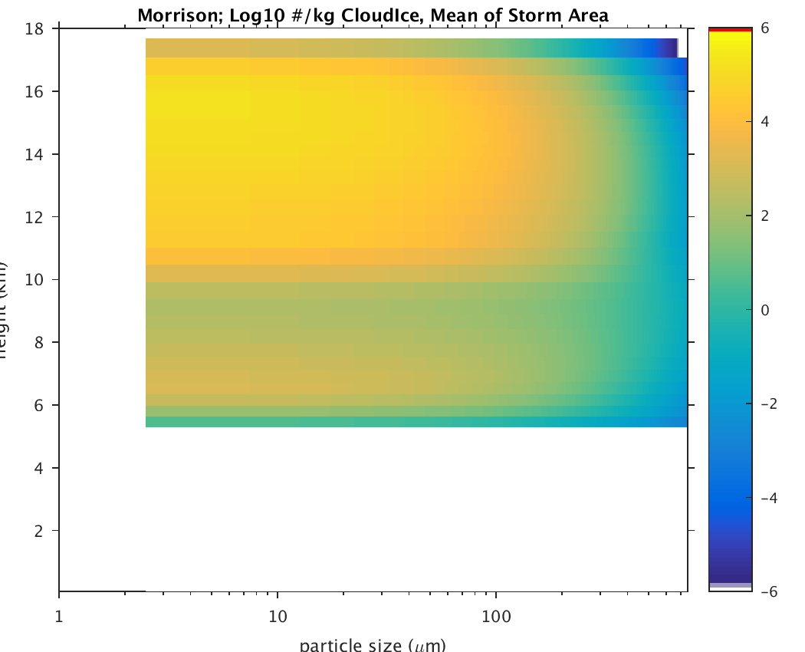
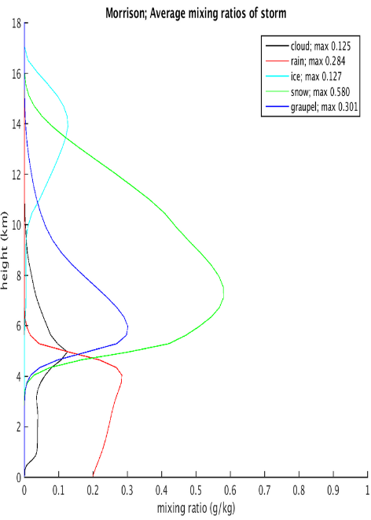
Cloud Ice
Goddard
Morrison

Slide 11
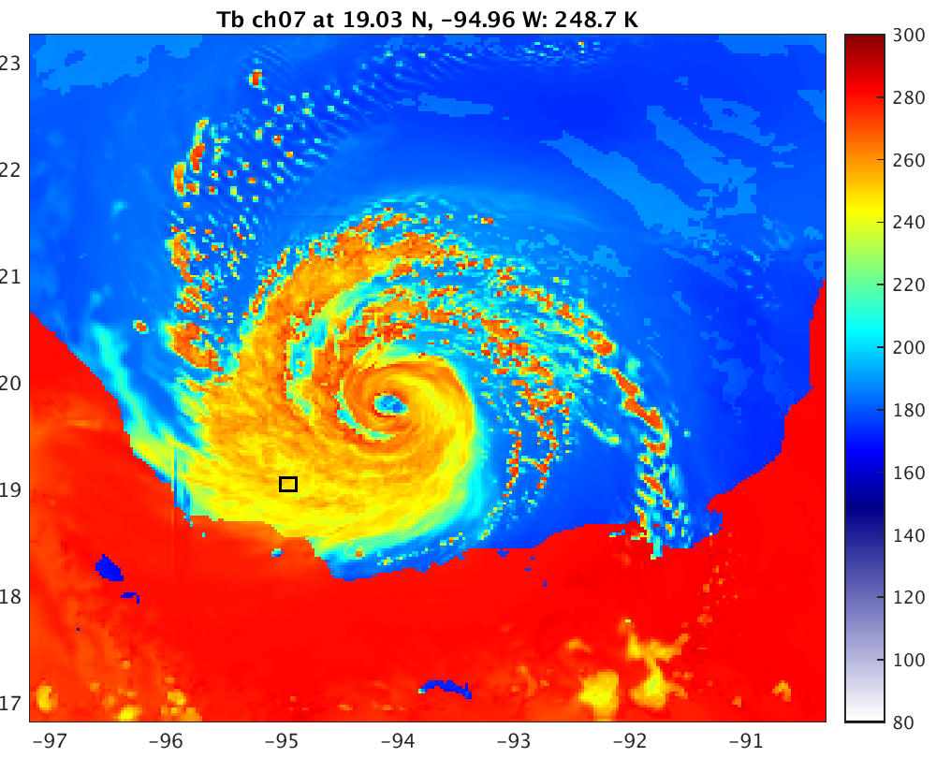
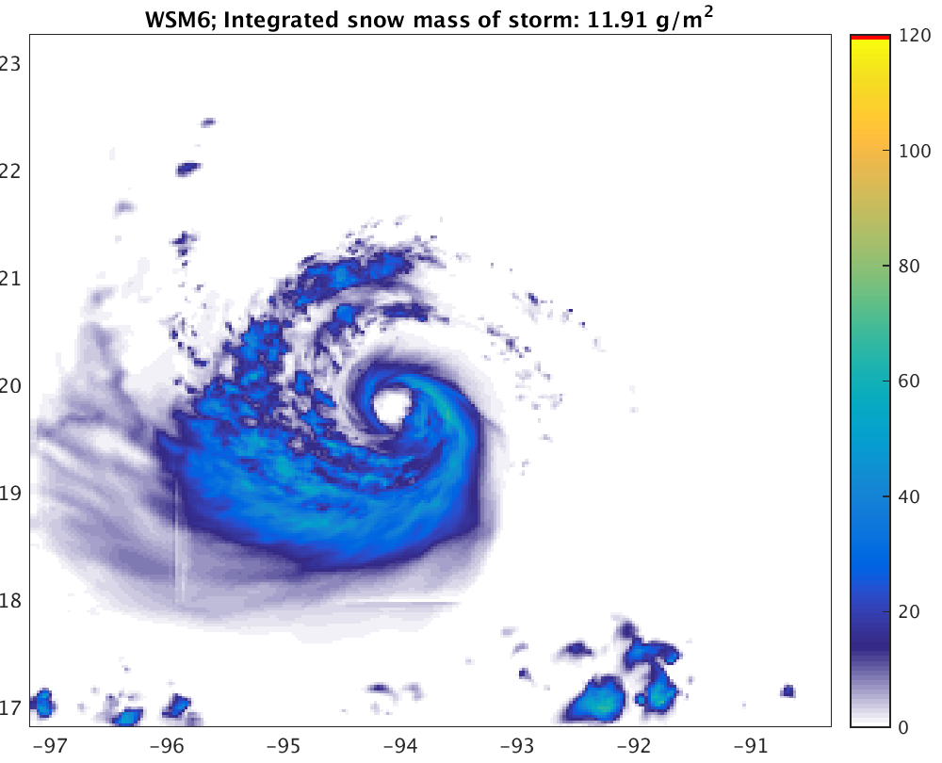
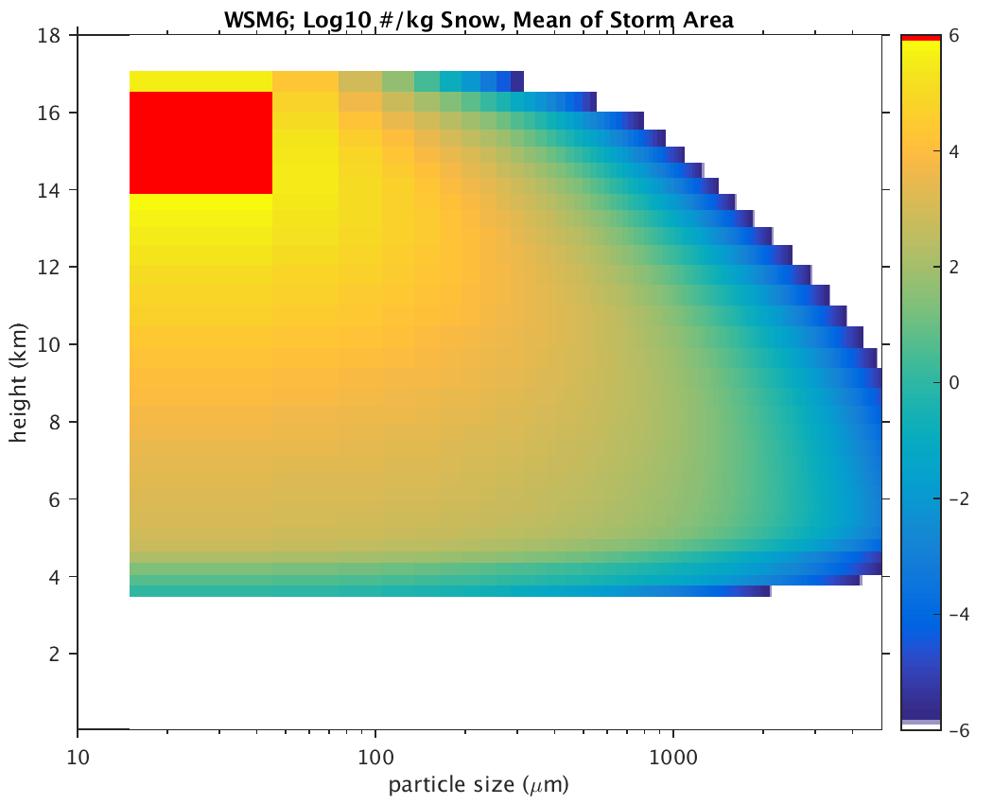
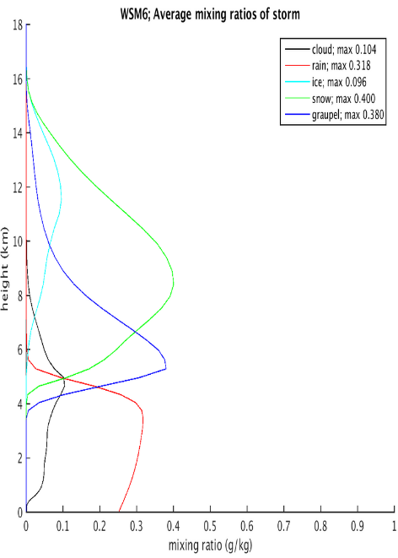
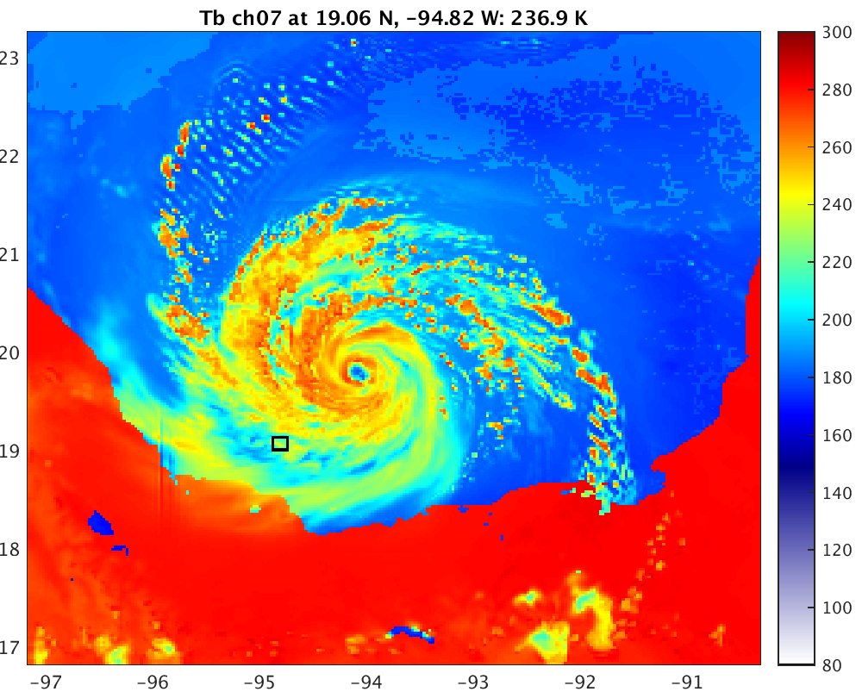
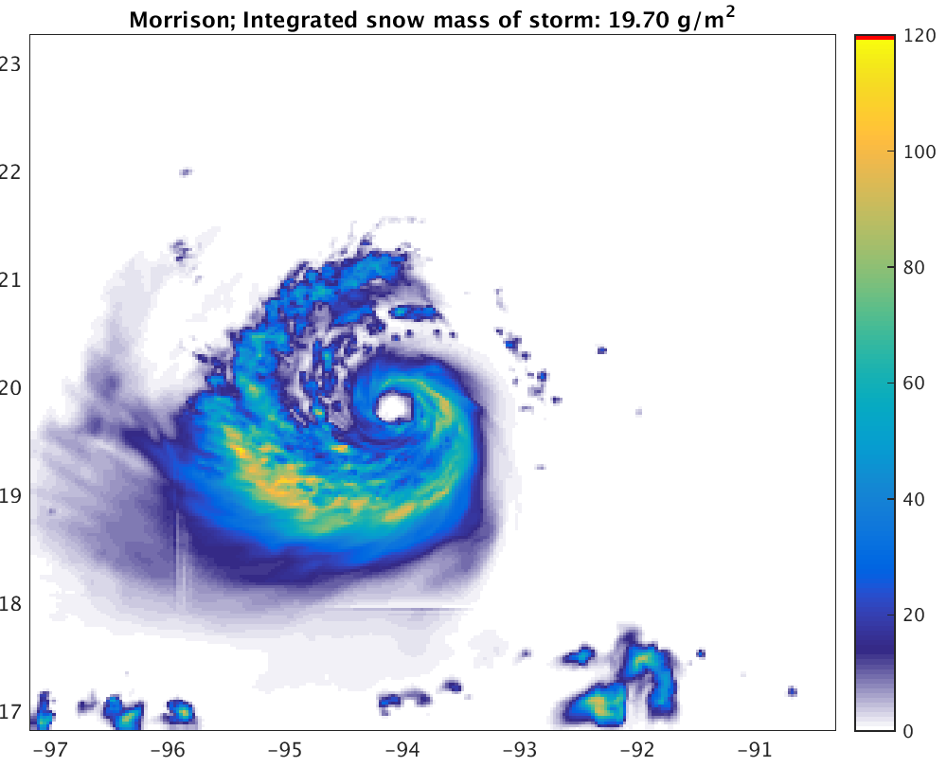
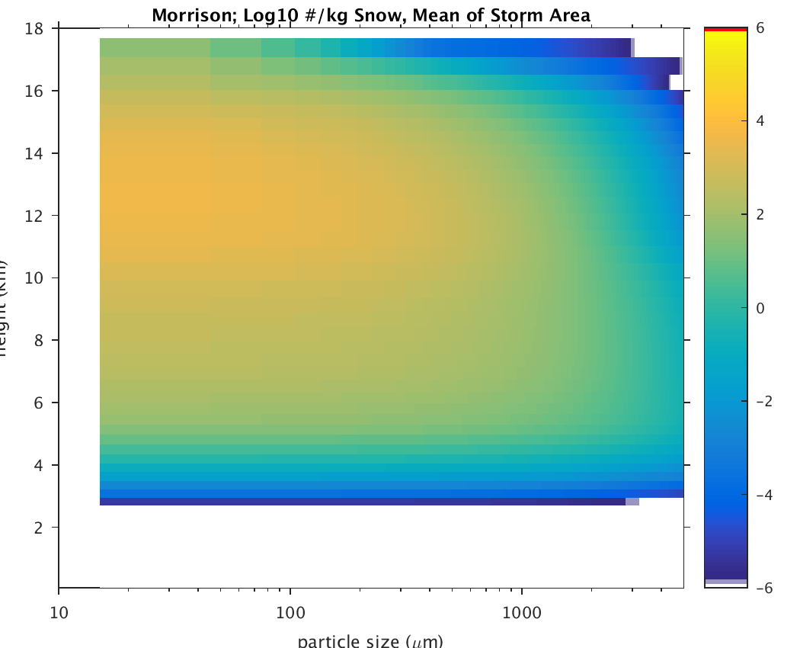
Snow
WSM6
Morrison

Slide 12
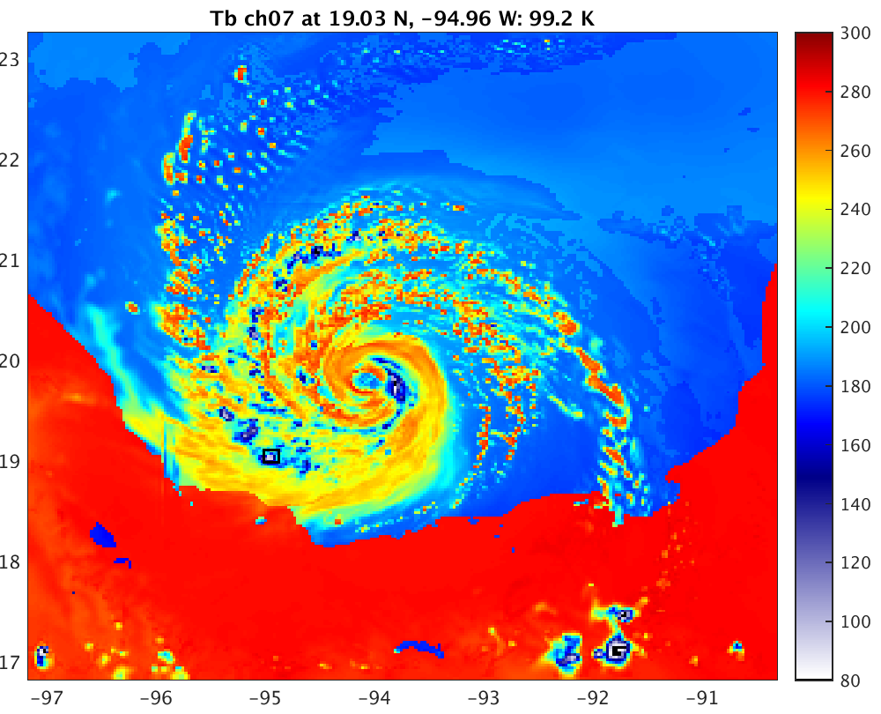
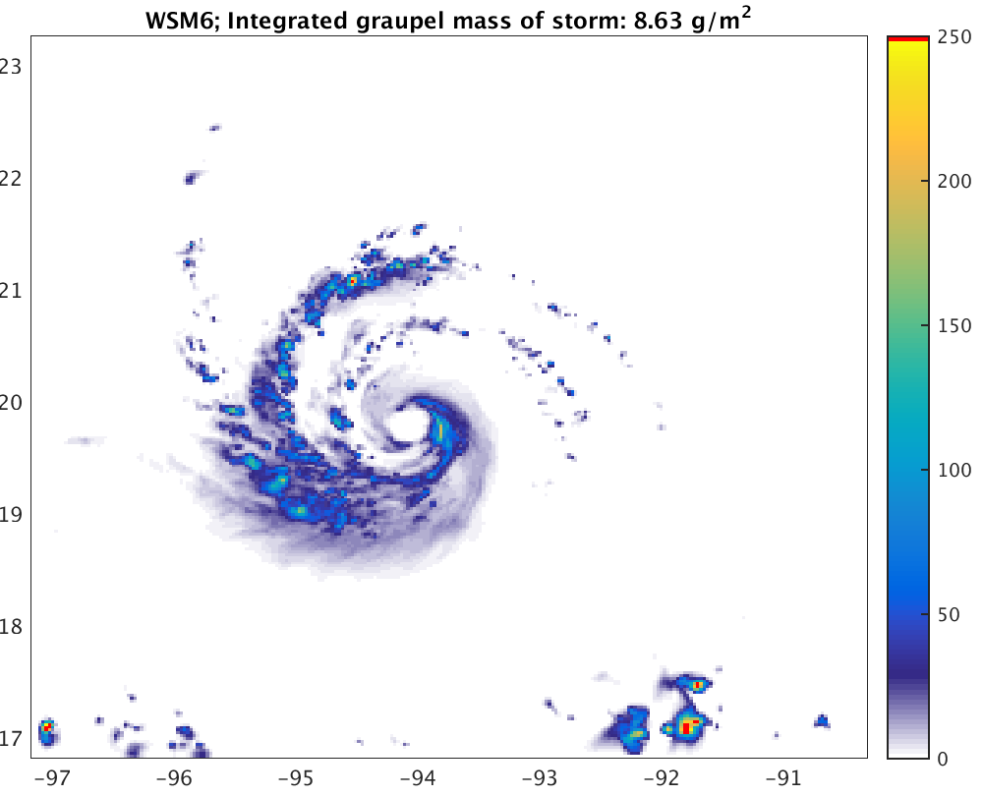
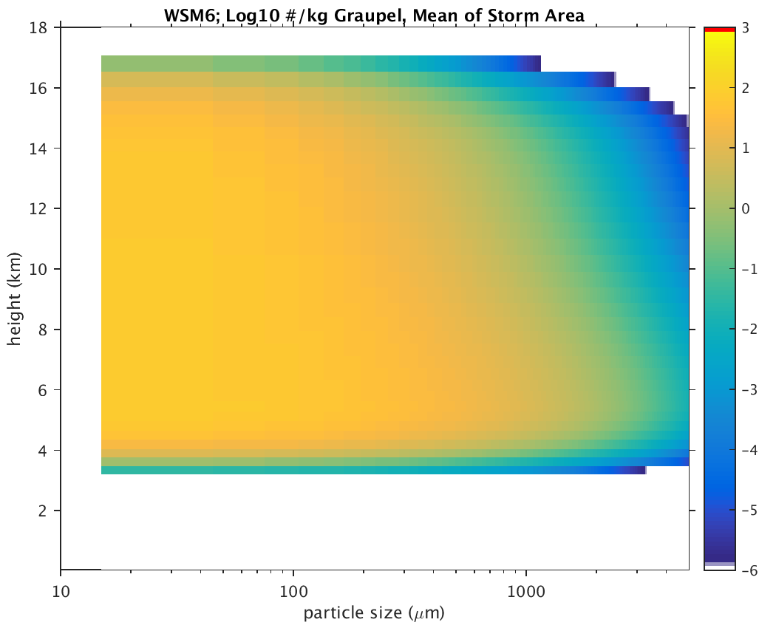
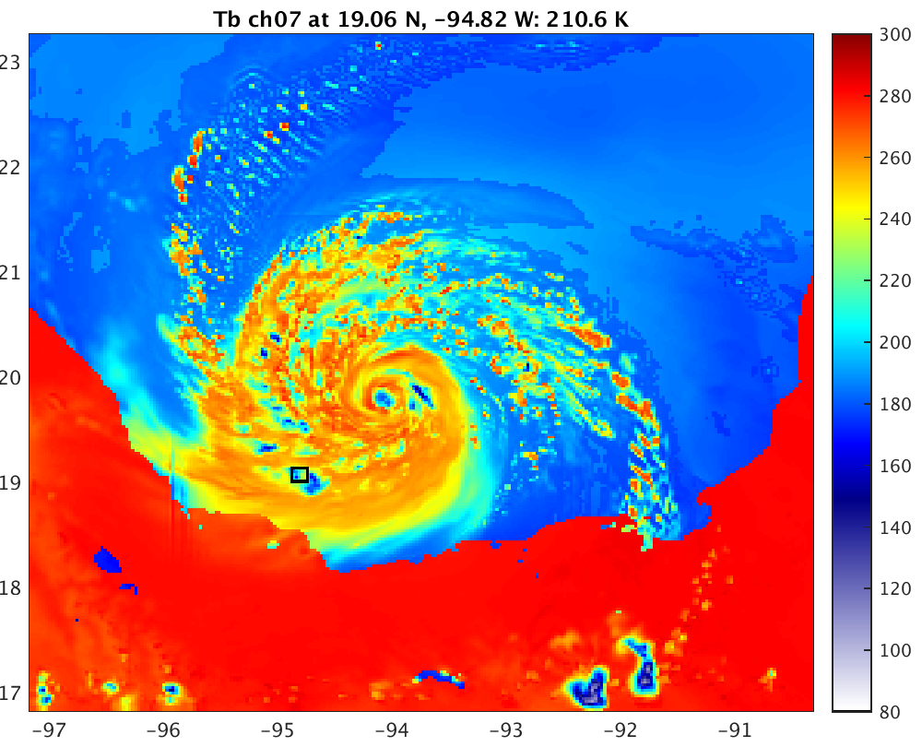
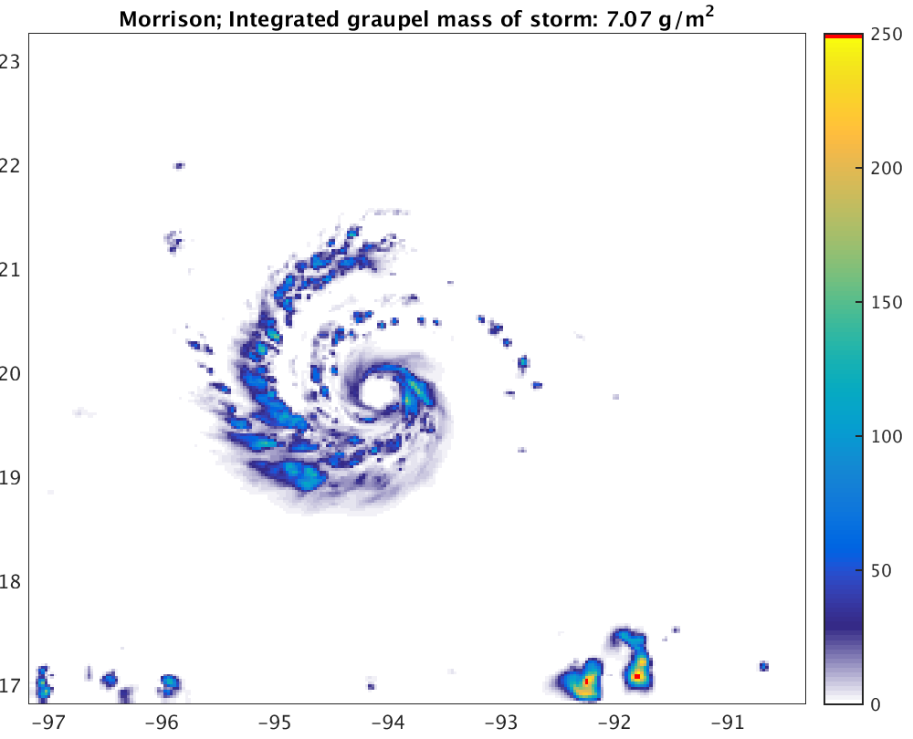
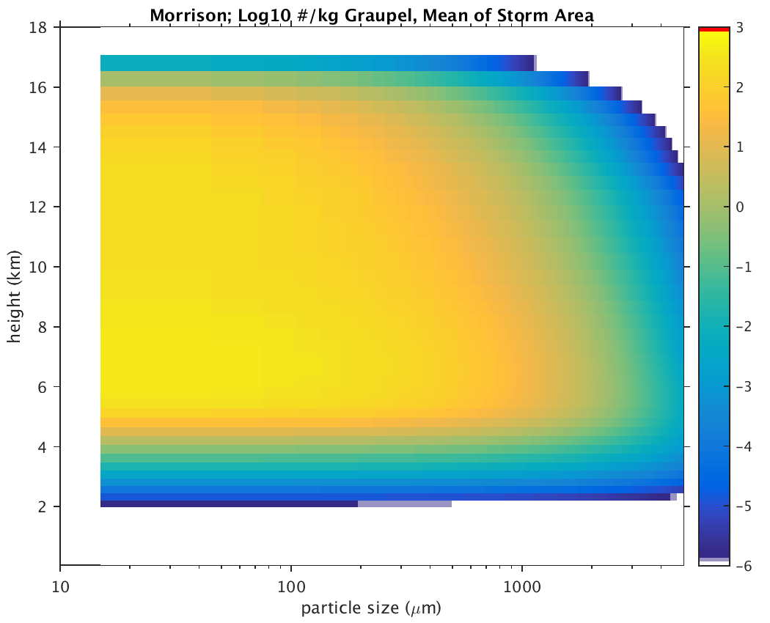
Graupel
WSM6
Morrison

Slide 13
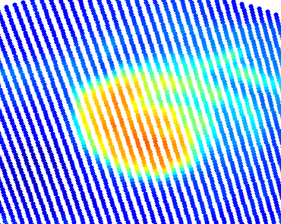
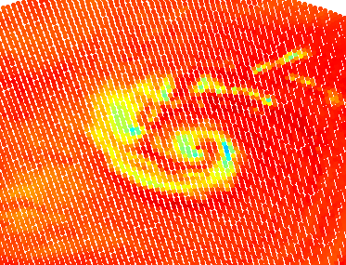
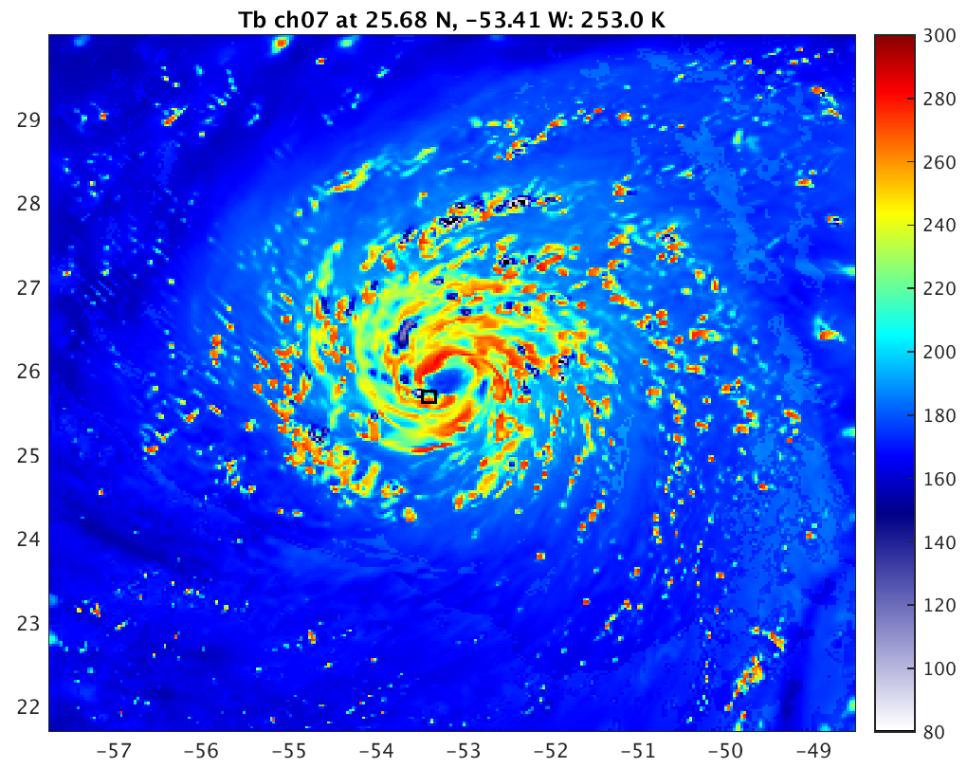
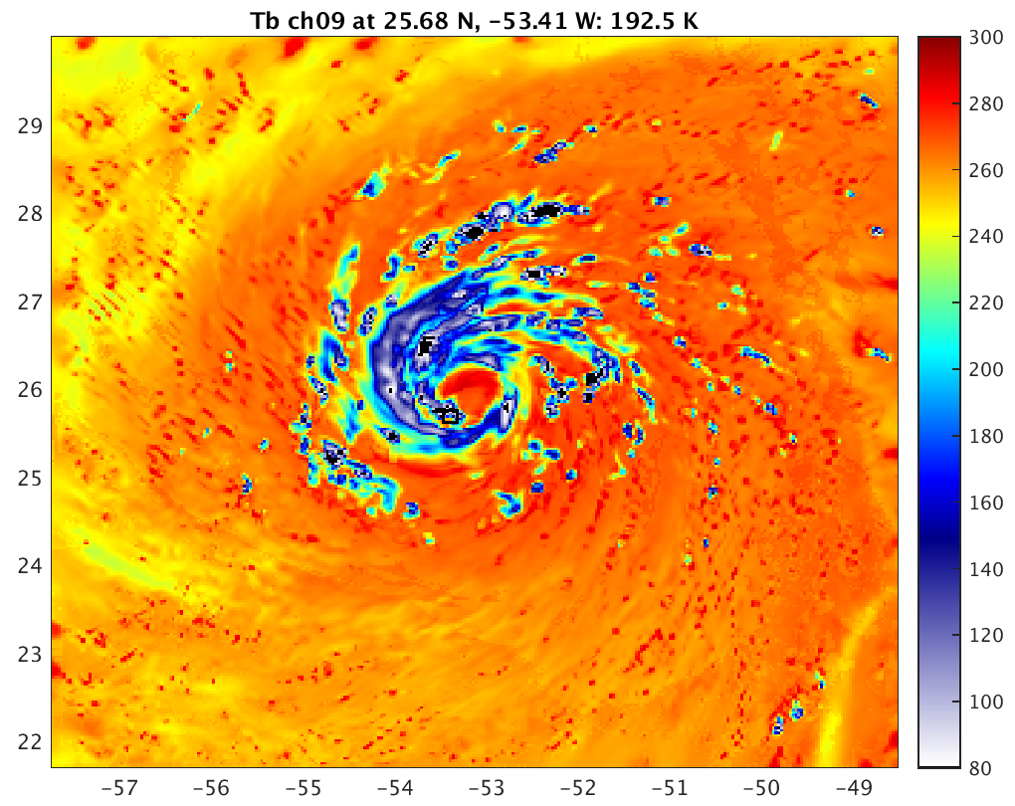
WSM6, New Lookup Tables, Edouard
36.5 GHz
89 GHz

Slide 14
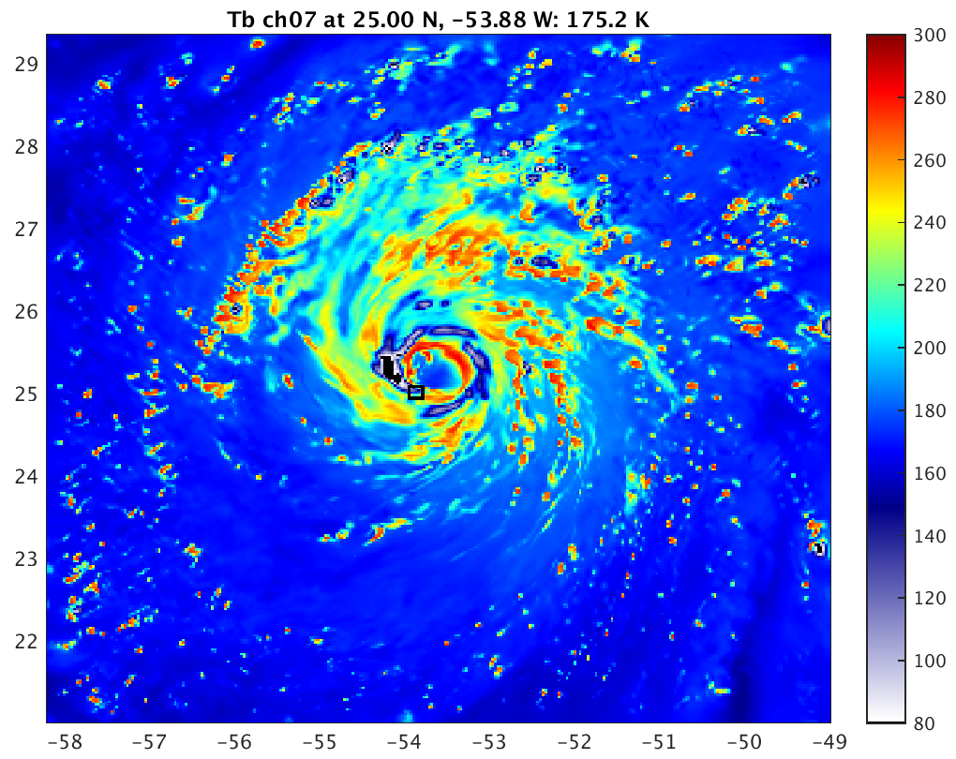
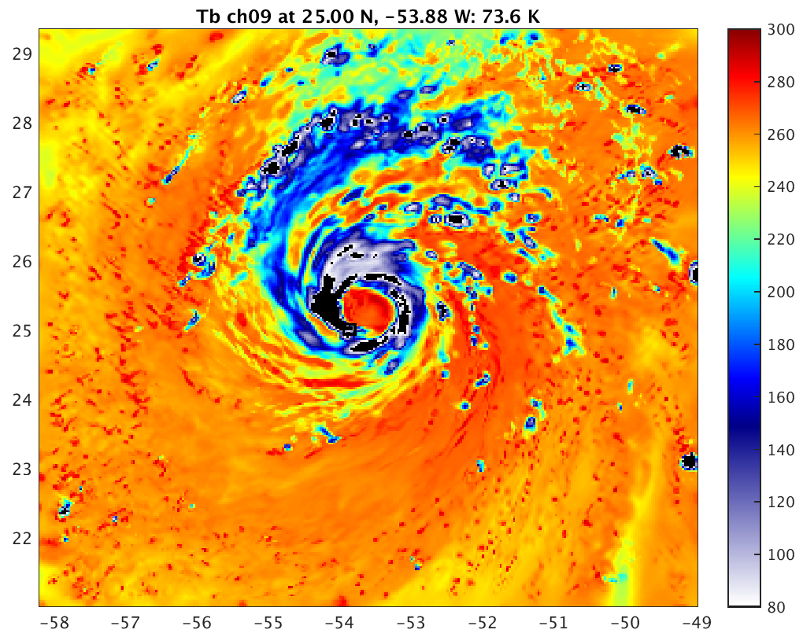
Goddard, New Lookup Tables, Edouard
36.5 GHz
89 GHz

Slide 15
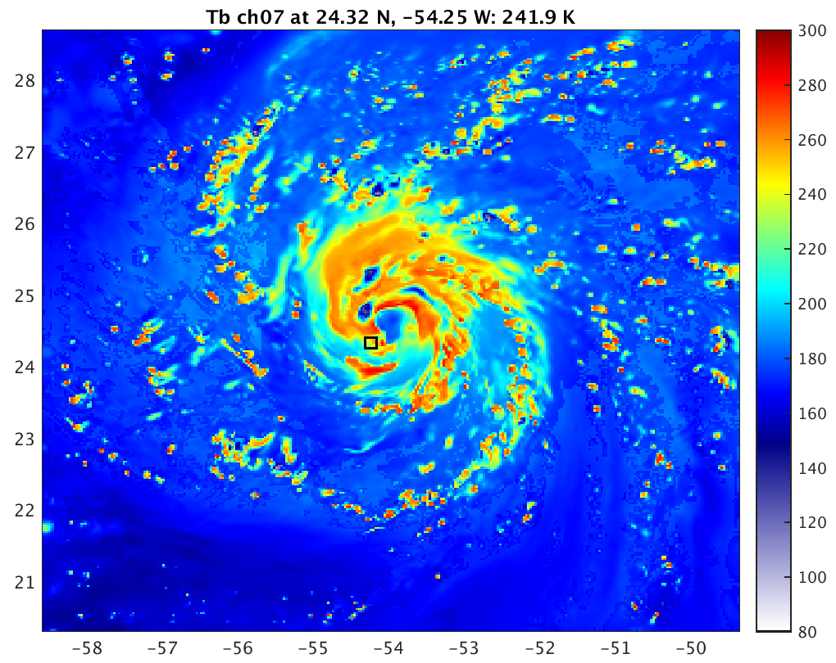
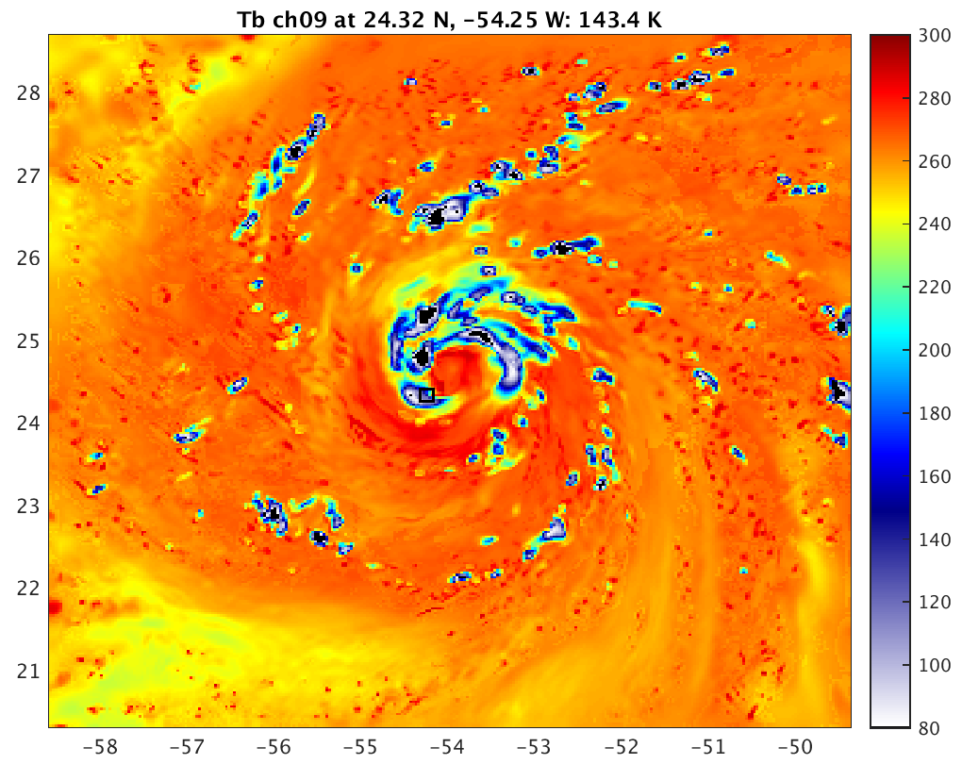
Morrison, New Lookup Tables, Edouard
36.5 GHz
89 GHz

Slide 16
Results and Discussion
Scheme-specified cloud optical properties: too cold, too much scattering
  Consistent with many studies involving radar, and passive microwave using the simpler Goddard-SDSU radiative transfer solver [Zupanski et al. 2011; Zhang et al. 2013; Han et al. 2013; Chambon et al. 2014]
    Conclusion: too much or too big of snow and/or graupel in upper troposphere
Goddard has most snow and graupel, also has substantial cloud ice scattering
Morrison is heavier on snow, lighter on graupel
WSM6 is lighter on snow, heavier on graupel
  Graupel stays near convective cells, creates very cold splotches
  Snow spreads out

Slide 17
Extra Slides

Slide 18
References
Chambon, P., S. Q. Zhang, A. Y. Hou, M. Zupanski, and S. Cheung, 2014: Assessing the impact of pre-GPM microwave precipitation observations in the Goddard WRF ensemble data assimilation system. Quart. Jour. Roy. Meteor. Soc., 140, 1219–1235.
Han, M., S. A. Braun, T. Matsui, and C. R. Williams, 2013: Evaluation of cloud microphysics schemes in simulations of a winter storm using radar and radiometer measurements. J. Geophys. Res. Atmos., 118, 1401–1419.
Liu, Q., and F. Weng, 2006: Advanced doubling-adding method for radiative transfer in planetary atmospheres. J. Atmos. Sci., 63, 3459‒3465.
Skamarock, W. C., J. B. Klemp, J. Dudhia, D. O. Gill, D. M. Barker, M. G. Duda, X.-Y. Huang, W. Wang, and J. G. Powers, 2008: A description of the Advanced Research WRF version 3. NCAR Technical Note 475, http://www.mmm.ucar.edu/wrf/users/docs/arw_v3.pdf.
Weng, Y., and F. Zhang, 2012: Assimilating Airborne Doppler Radar Observations with an Ensemble Kalman Filter for Convection-permitting Hurricane Initialization and Prediction: Katrina (2005). Mon. Wea. Rev., 140, 841-859.
Wong, V., and K. A. Emanuel, 2007: Use of cloud radars and radiometers for tropical cyclone intensity estimation, Geophys. Res. Lett., 34, L12811, doi:10.1029/2007GL029960.
Zhang, S. Q., M. Zupanski, A. Y. Hou, X. Lin, and S. H. Cheung, 2013: Assimilation of Precipitation-Affected Radiances in a Cloud-Resolving WRF Ensemble Data Assimilation System. Mon. Wea. Rev.,141, 754–772.
Zhang, F., Y. Weng, J. A. Sippel, Z. Meng, and C. H. Bishop, 2009: Cloud-resolving Hurricane Initialization and Prediction through Assimilation of Doppler Radar Observations with an Ensemble Kalman Filter. Mon. Wea. Rev., 137, 2105-2125.
Zupanski, D., S. Q. Zhang, M. Zupanski, A. Y. Hou, and S. H. Cheung, 2011: A Prototype WRF-Based Ensemble Data Assimilation System for Dynamically Downscaling Satellite Precipitation Observations. J. Hydrometeor., 12, 118–134.

Slide 19
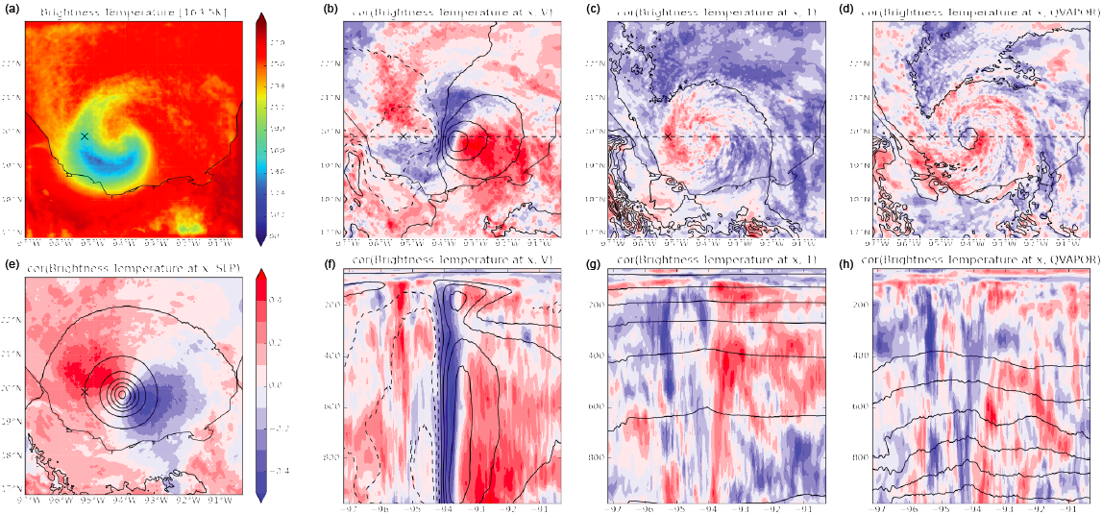

Slide 20
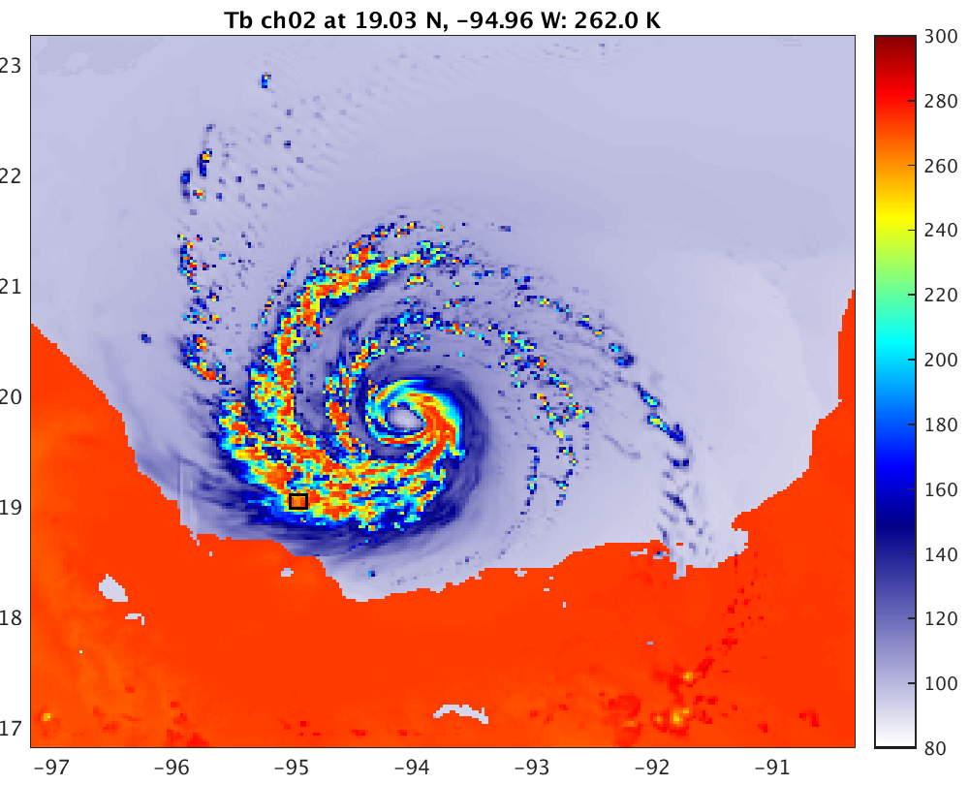
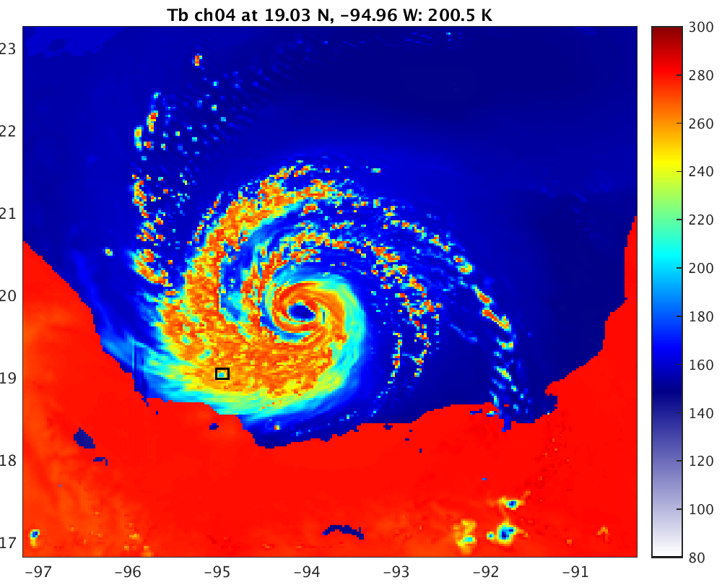
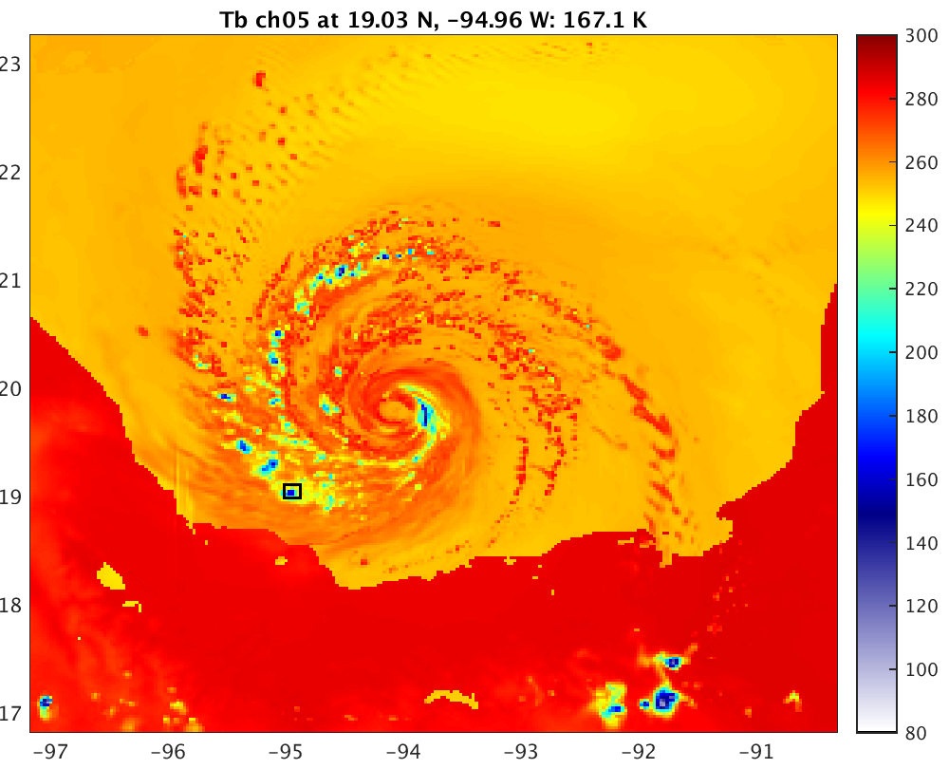
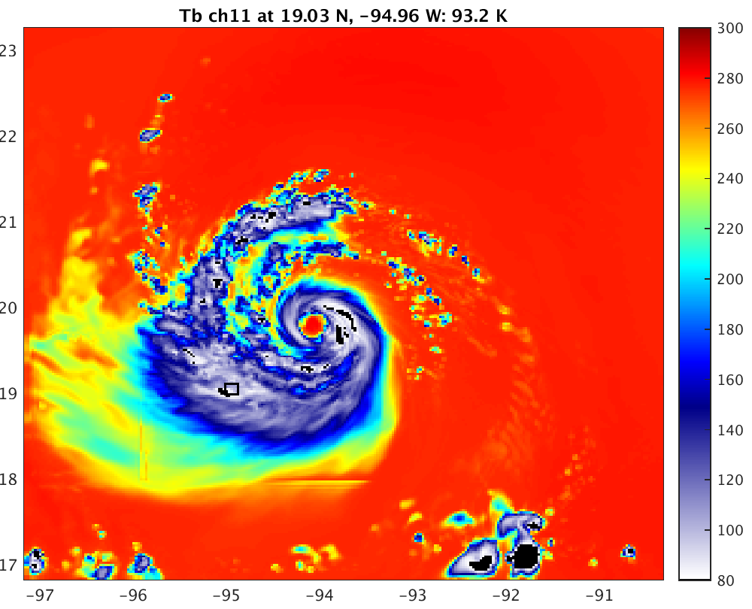
WSM6
10.65-H
18.7-H
23.8-V
36.5-H
89.0-H
165.5-H

Slide 21
Testing the CRTM, All-sky Microwave DA –
WRF Simulations
Hurricane Karl, initialized at 21Z 16 Sept. from EnKF analysis after assimilating airborne Doppler radar radial velocities
  Same as Masashi’s experiments
    WRF version 3.6.1 (Skamarock et al. 2008)
    PSU WRF-EnKF: Zhang et al. (2009); Weng and Zhang (2012)
    Ensemble size: 60
  WSM6 microphysics (5 species, 1 moment)
  3 hour forecast

Slide 22
CRTM Results, prescribed and uniform hydrometeor radii
37 GHz
  cloud field should be even warmer -> there is too much scattering
  too many instances of convective cells producing an anomaly of low temperatures
89 GHz
  cloud field should not be that cold -> there is too much scattering
  many instances of much too low brightness temperatures (~50 K)

Slide 23
CRTM Results, Effective Radii == Scheme Particle Size Distribution (PSD) mean
37 GHz
  cloud field is too warm -> insufficient scattering everywhere
89 GHz
  sufficient/excessive scattering in areas of strongest convection
  most of cloud field is too warm, insufficient scattering

Slide 24
Why didn’t these simulations work well?
Pre-specified radii: unacceptable
  Simply not representing enough physics to be used comfortably in DA or evaluating microphysics scheme
Mean radius: too warm, too little scattering
  Mean particle radius of a cloud < effective scattering particle radius of a cloud b/c scattering is dominated by the large particles
Mean of transformed distribution would produce better results, but…
  It often exceeds the CRTM lookup table effective radius dimension (1500 μm)
  At these high frequencies, D⁶ relationship breaks down for large particles

Slide 25
What else have we tried?
Analytically determining effective particle radii from microphysics (MP) scheme particle size distributions (PSD) for the scattering-dominated frozen hydrometeors
  Assume all particles do Rayleigh scattering (problematic)
  Result: multiply previous radius estimates by 4.9
  This would put most graupel, snow > 1000 μm; CRTM results would have too much scattering

