Slide 1
Mesoscale energy spectra for a simulated squall line
Fuqing Zhang
Rich Rotunno
Y. Qiang Sun
Groupmeeting 20150817

Slide 2
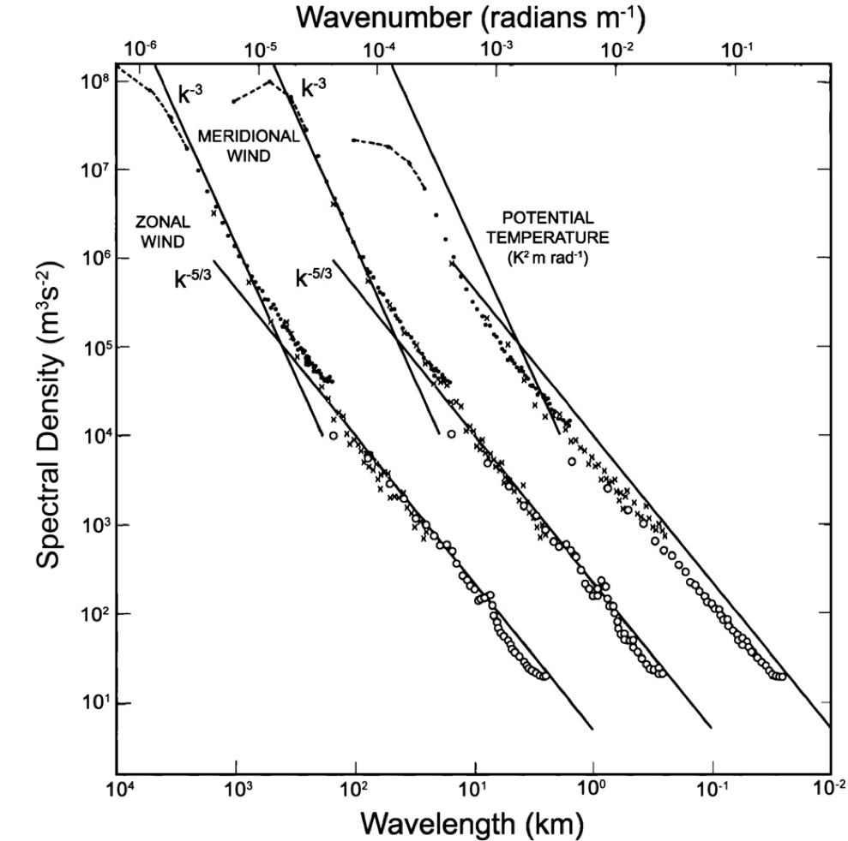
Where the work starts
Wavelength (km)
K⁻³
K^{-5/3}
With the inclusion of moisture, the horizontal kinetic energy spectrum transited from a steep -3 slope to -5/3 at wavelength around 400km.
Nastrom and Gage 1985

Slide 3
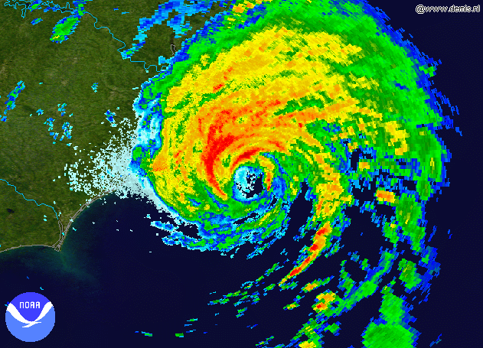
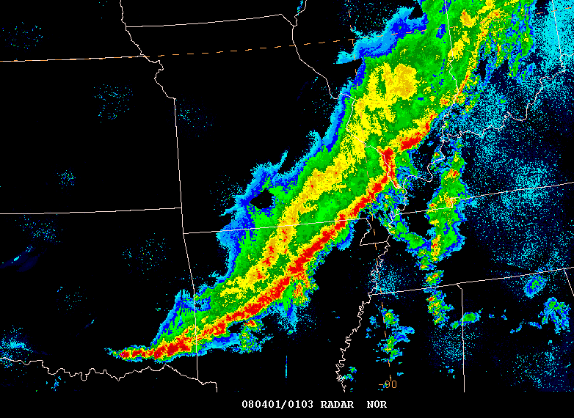
Convection systems develop a -5/3 slope at mesoscale
Hurricane
Squall line
It means a lot, in the predictability sense!
Limited Predictability
Unlimited Predictability
Rotunno and Snyder 2008

Slide 4
Proposed Hypotheses to explain the slope:
Signature of sharp temperature fronts at tropopause
Tulloch and Smith 2006
Stratified turbulence
Linborg 2006
2D Inverse cascade of energy injected at small scales
Gage 1979 ; Lilly 1983; etc
Dominated by inertia–gravity waves
Callies et al 2014;
Of course, all these hypotheses do not solve the problem!
Thus it is interesting to check how the slope develop using a simple model !

Slide 5
Experiment design:
Keep it simple!
WRF idealized simulation for supercell:
NO f
2 km resolution
600km x 600km domain
Physics scheme:
Morries microphys
YSU pbl
NO radiation
Output every 30 seconds

Slide 7
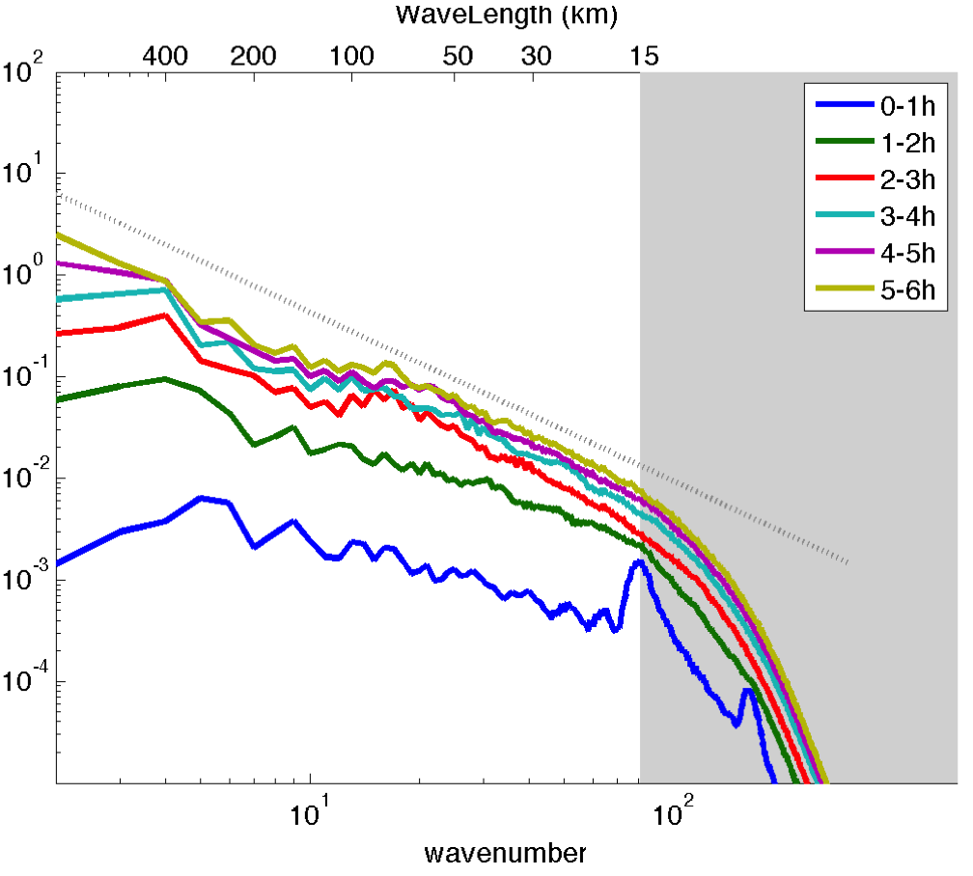
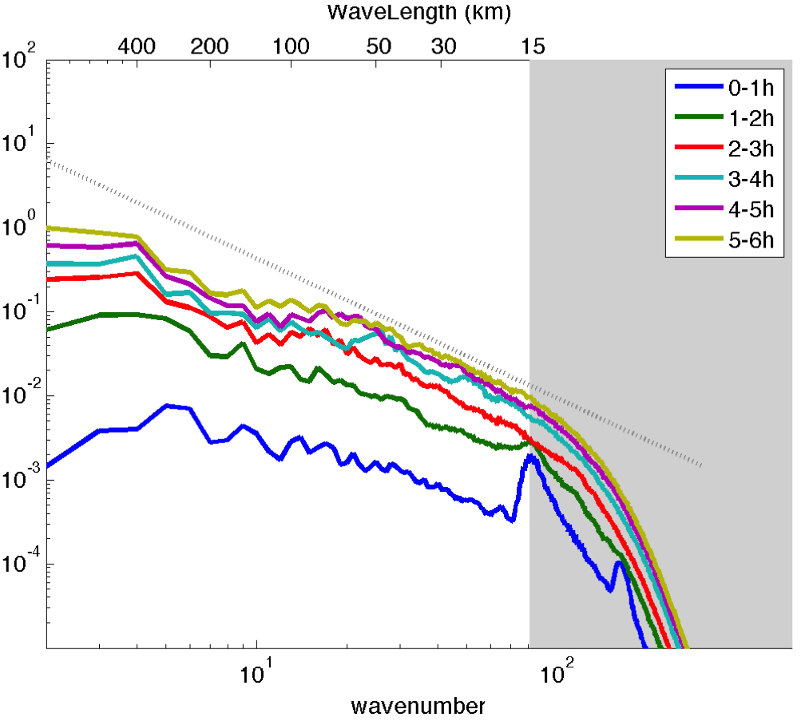
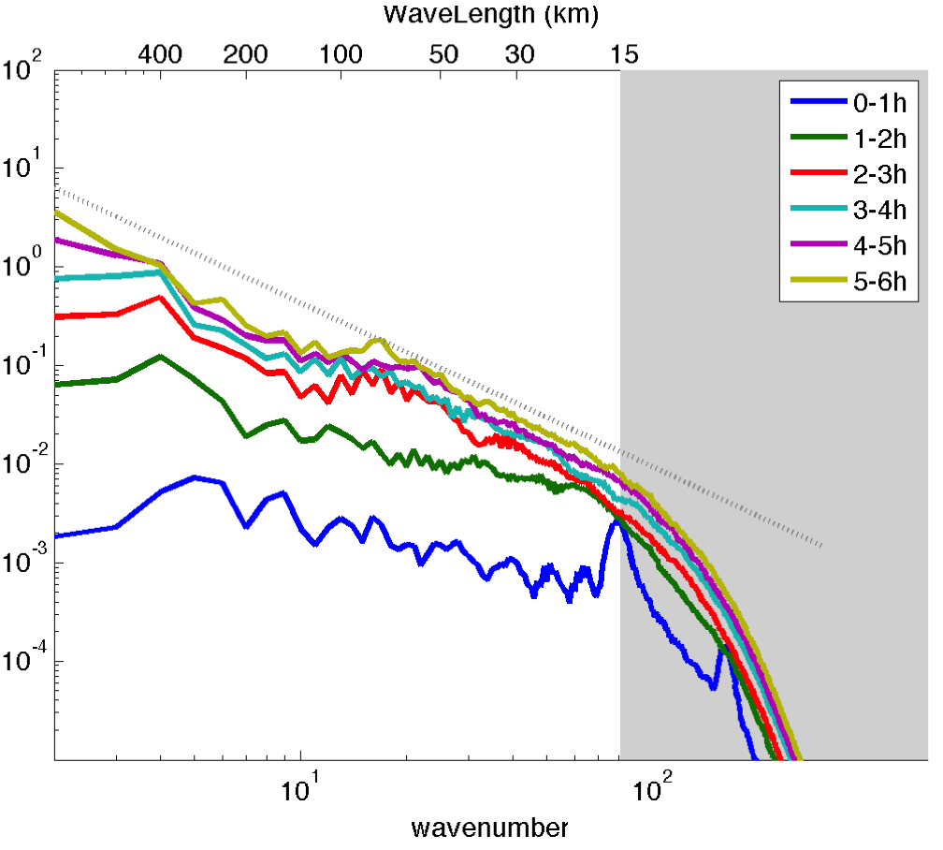
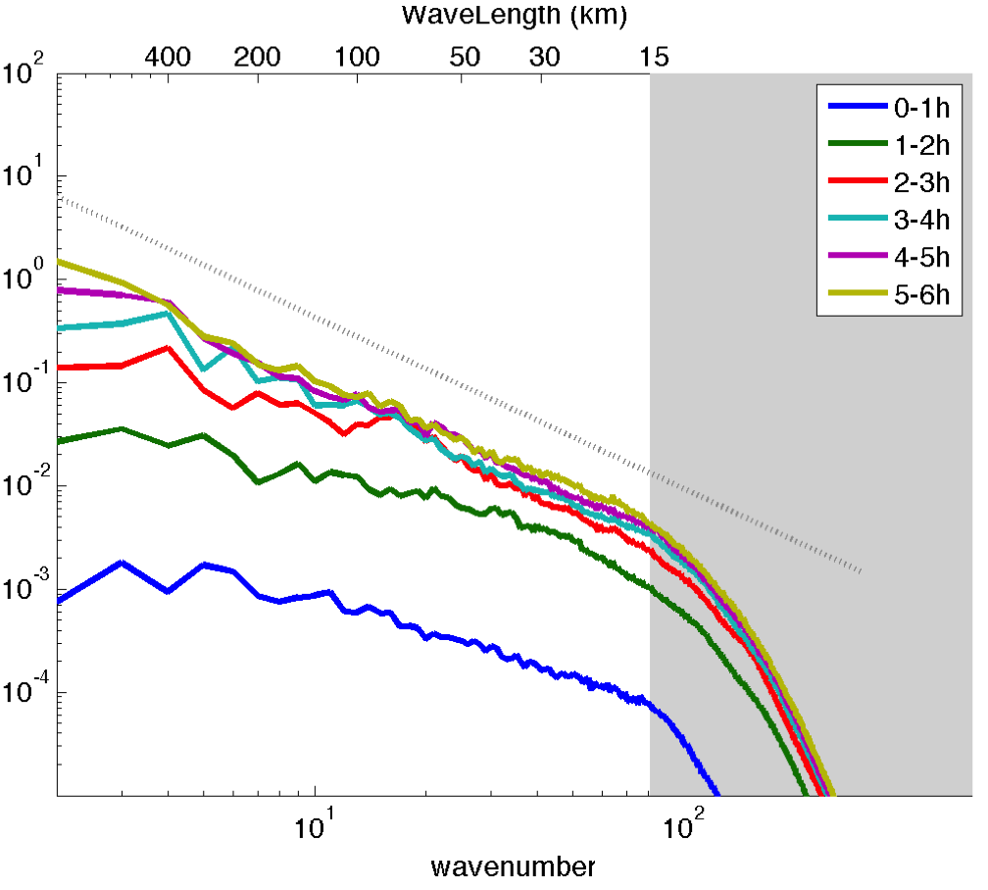
Evolution of the slope
Lower level (0-5 km)
Upper level (5-10 km)
Lower Stratosphere (12-15km)

Slide 8
Momentum Equation
At each level, Advection term contains energy transfer process between different scales and energy Flux divergence from other height levels.
Pressure term contains buoyancy term and energy Flux divergence from other height levels.

Slide 9
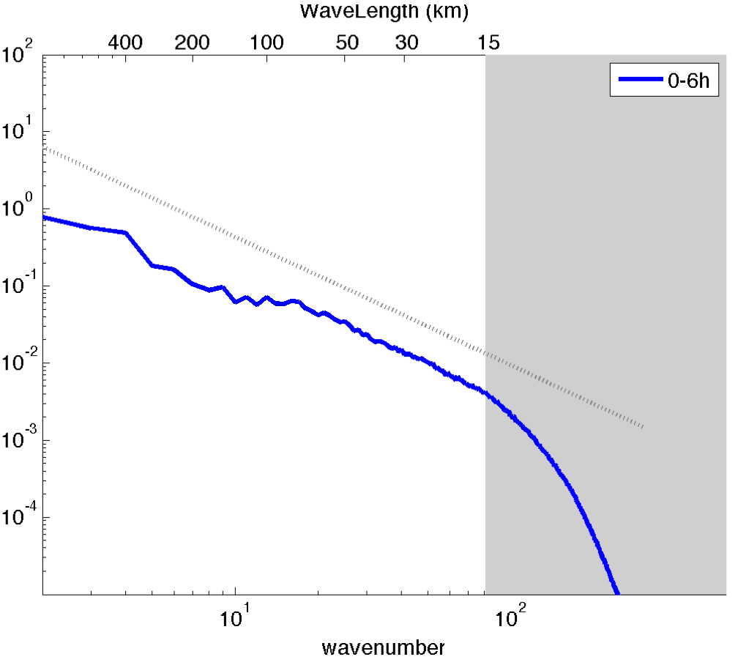
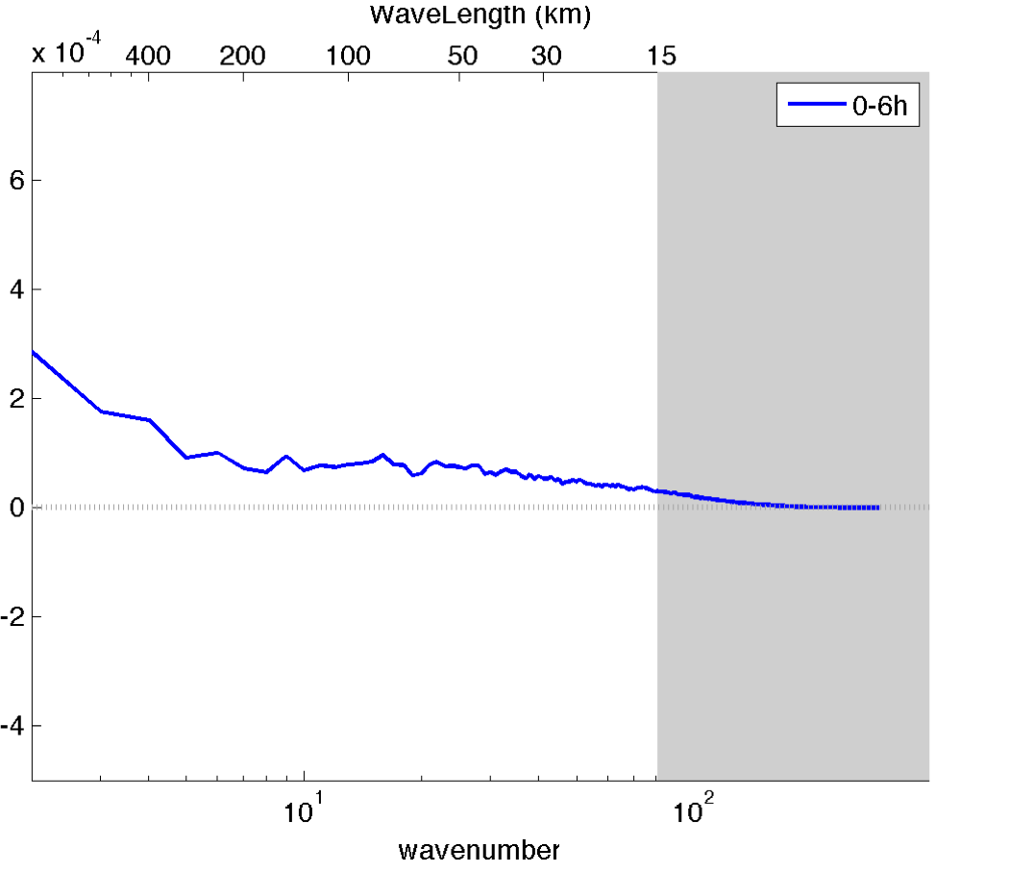
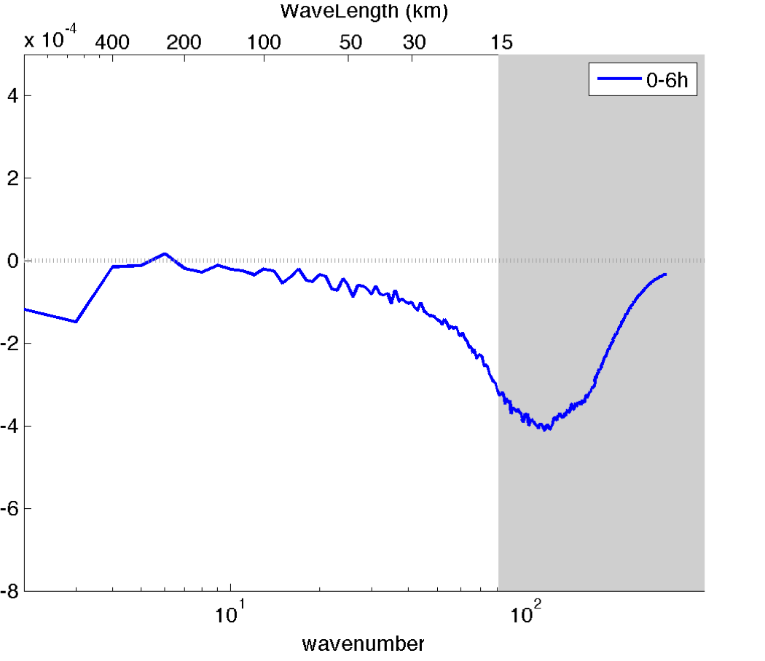
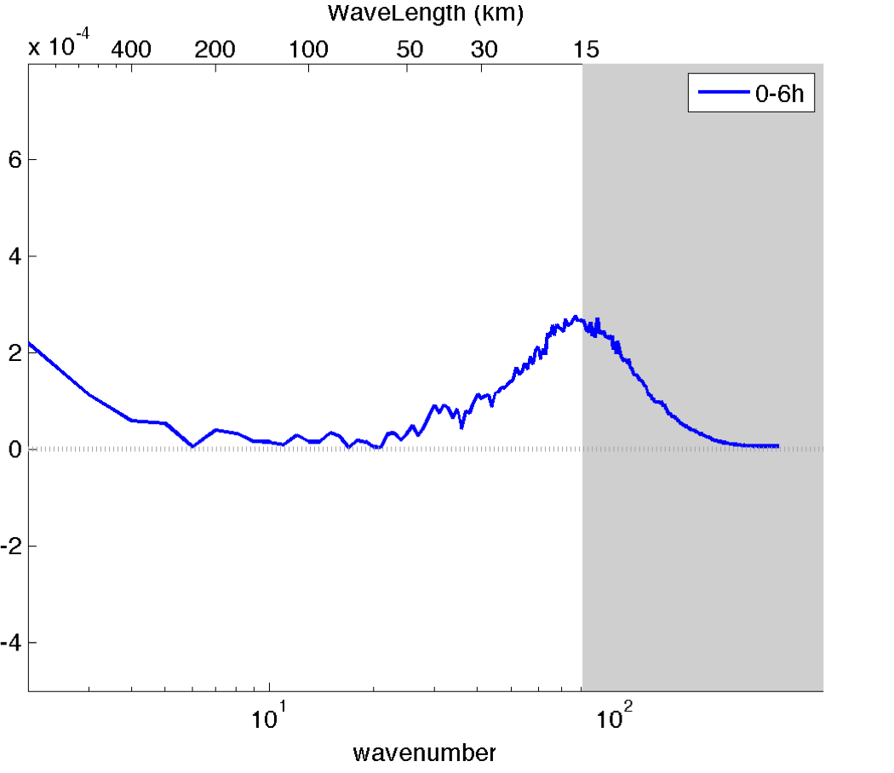
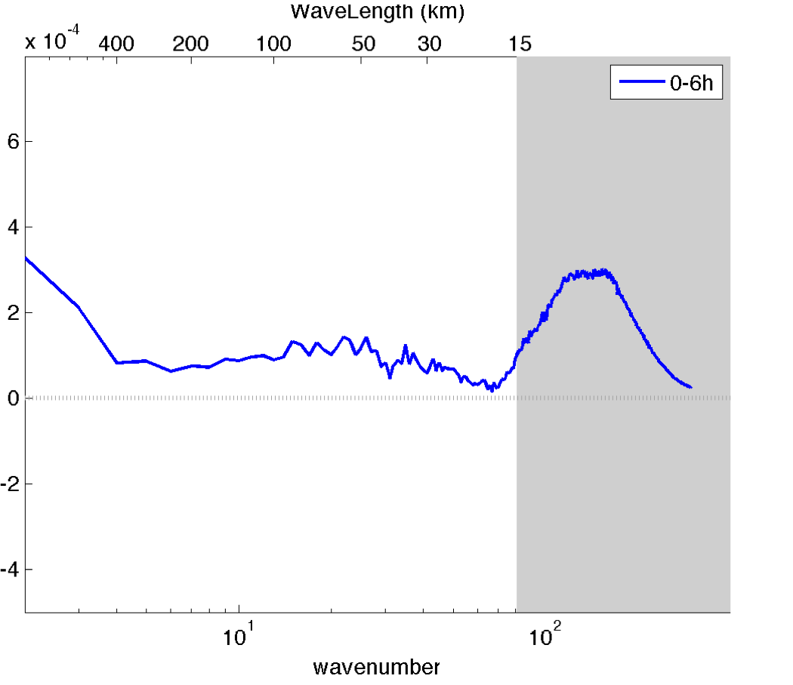
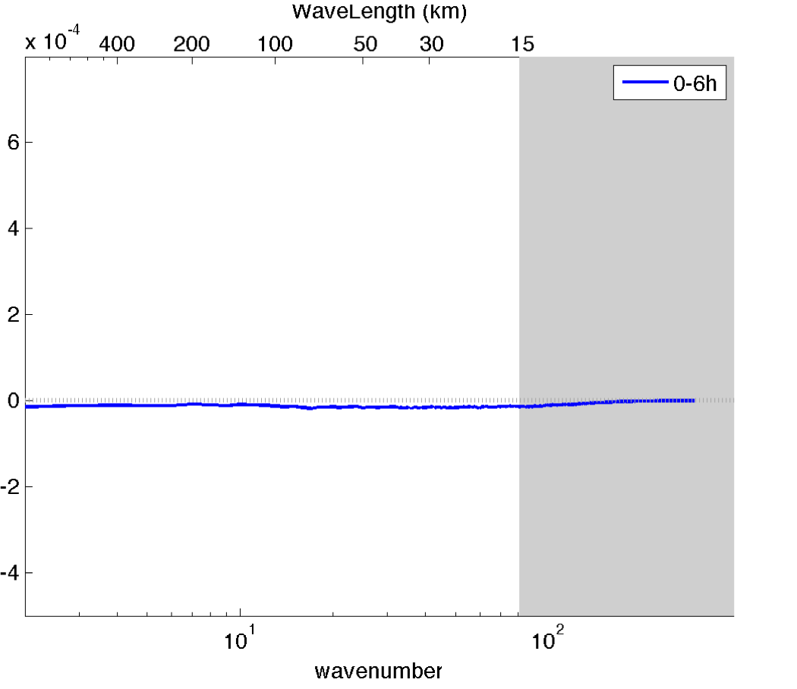
Spectral budget : domain integrated
E(k)
dE(k)/dt
D(k)
B(k)
T(k)
F(k)

Slide 10
Schematic for Spectral budget : domain integrated
dE(k)/dt
B(k)
T(k)
500
50
Wavelength (km)
D(k)
Flux has no contribution.
T(k) generally greater than 0 for each wavenumber, meaning kinetic energy is transferred from mean flow to each wavenumber.
B(k) is strongest at smallest resolved scales, also have some contribution at system scale.

Slide 11
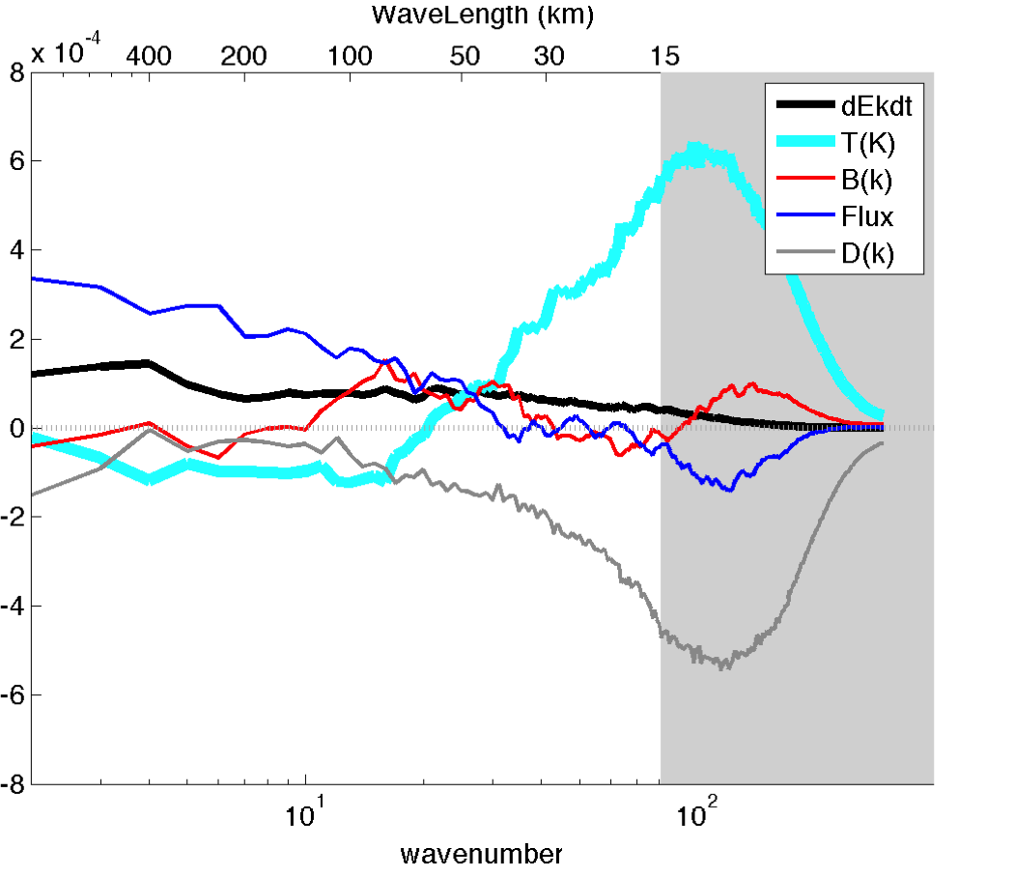
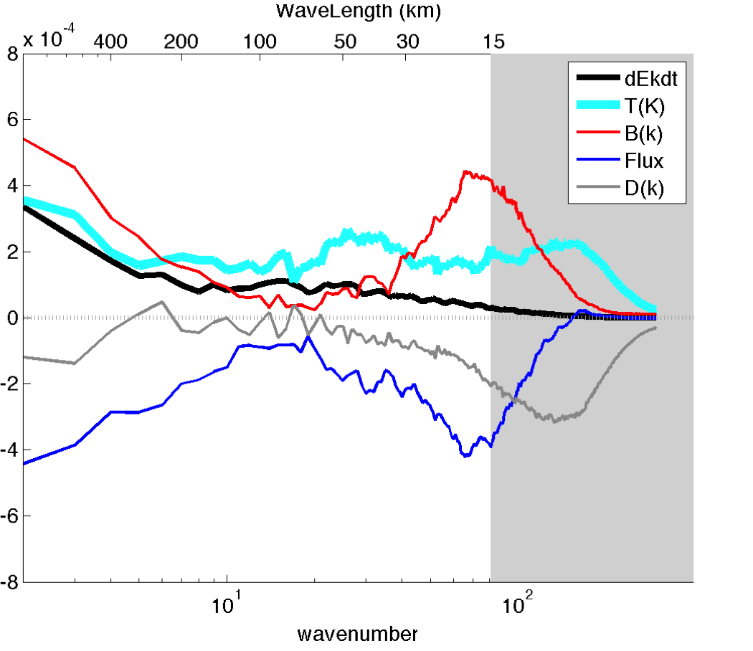
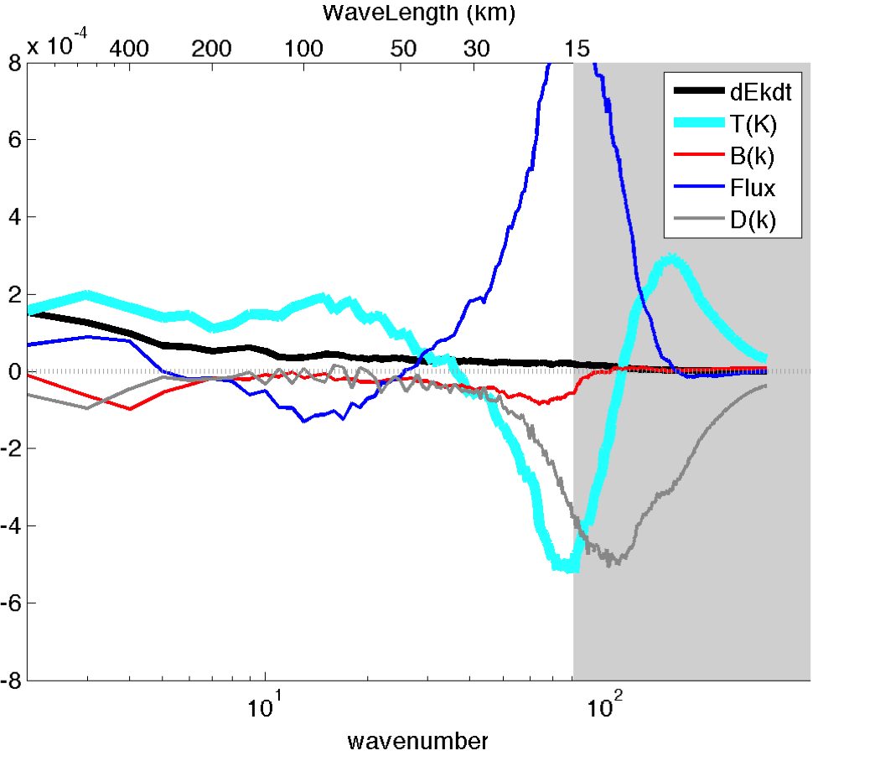
Schematic for Spectral budget : At different levels
Lower level (0-5 km)
Upper level (5-10 km)
Lower Stratosphere (12-15km)
Downscale
Upscale
Similar slope at each level, yet very different process.
Upscale process in the Lower Stratosphere.
Downscale process in the Lower troposphere.
Energy transfer from mean flow to the eddies in the Upper troposphere

Slide 12
Change of mean flow

Slide 13
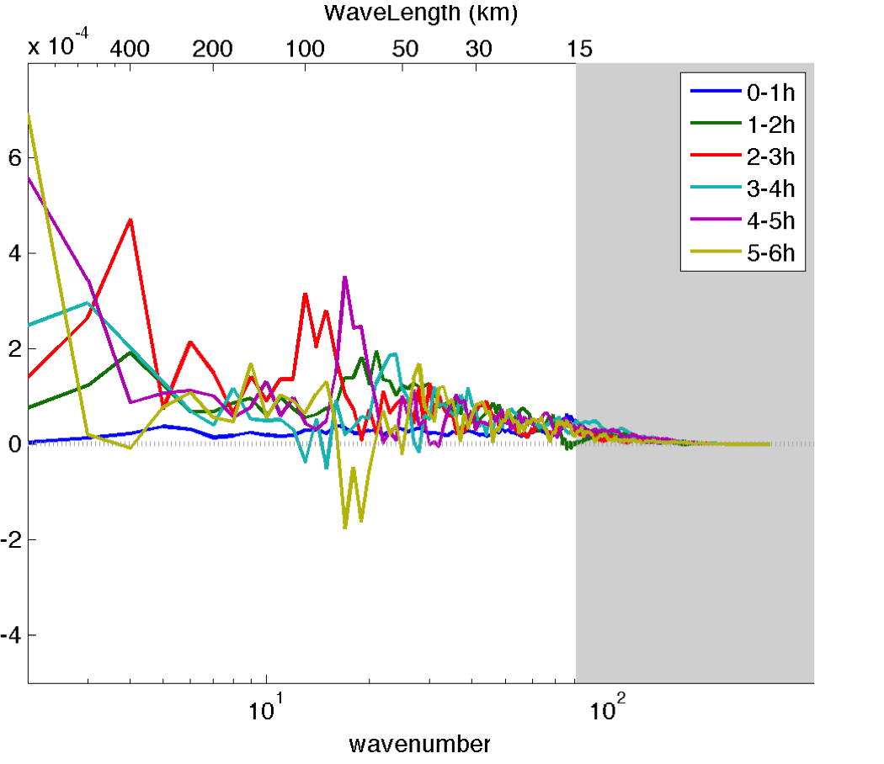
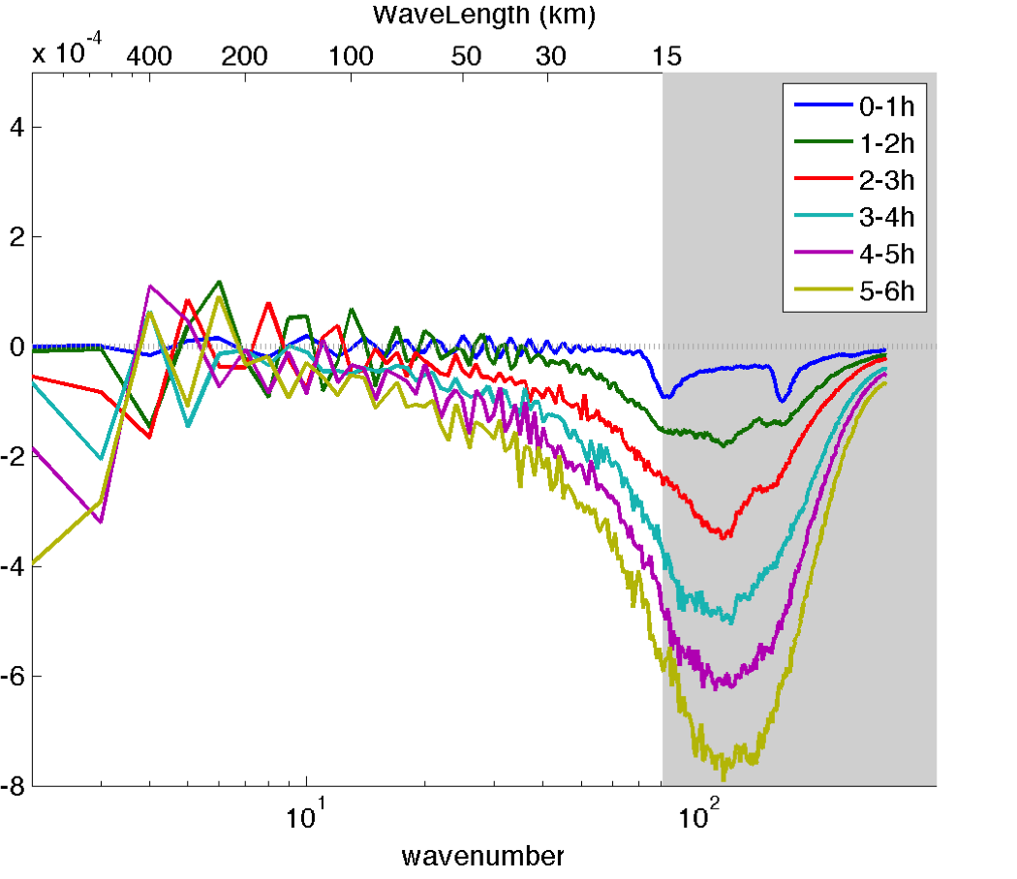
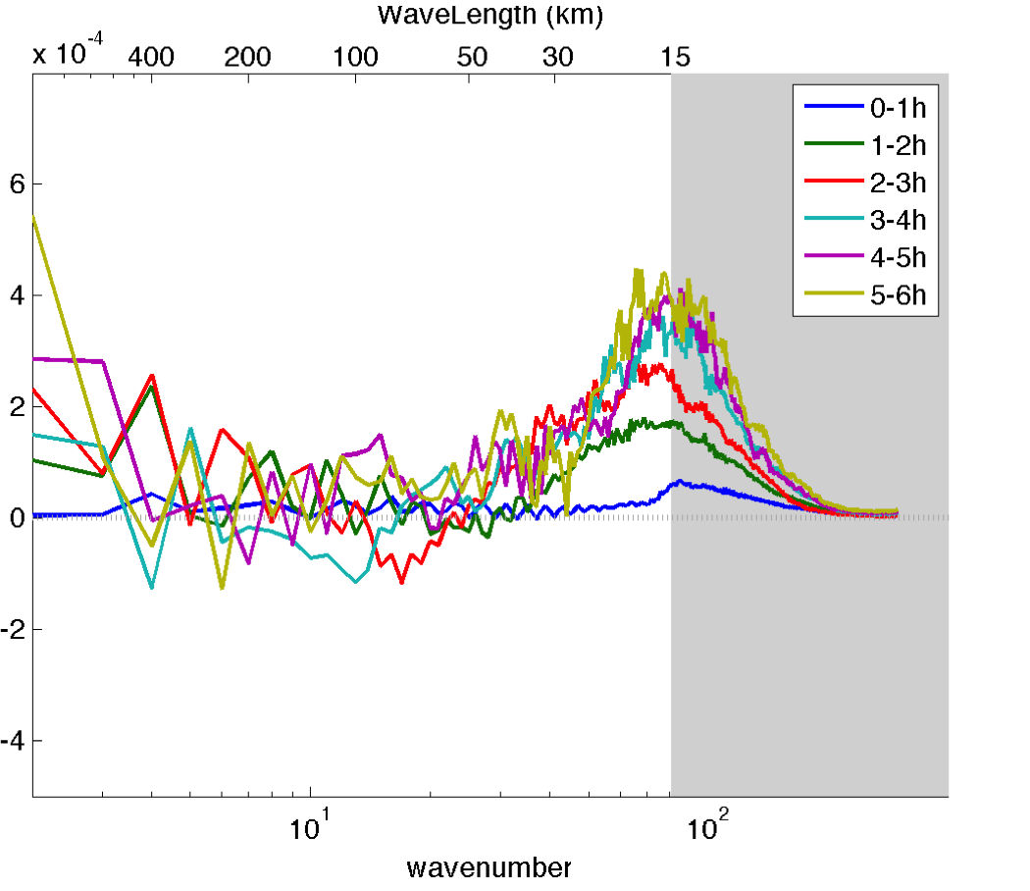
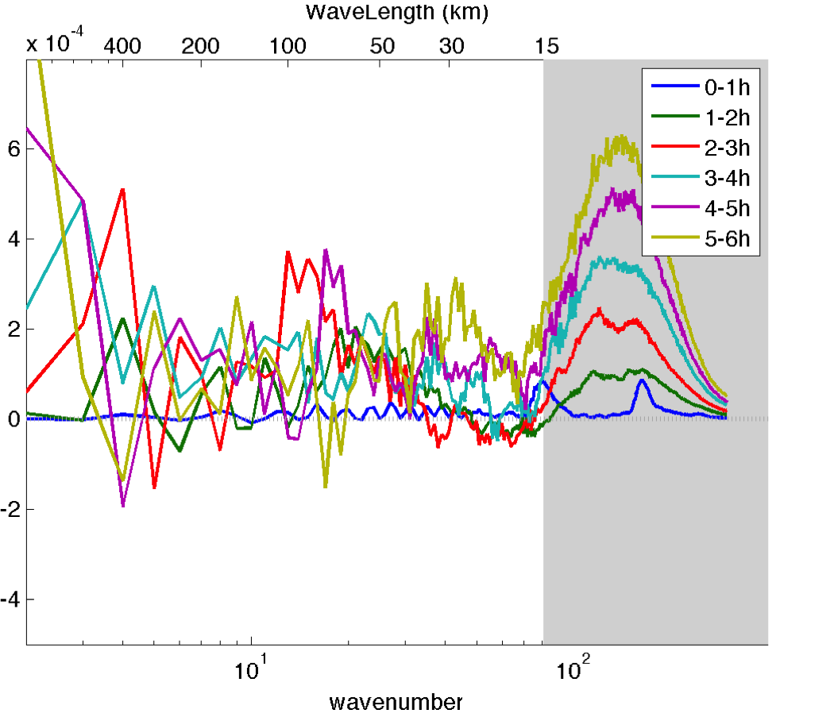
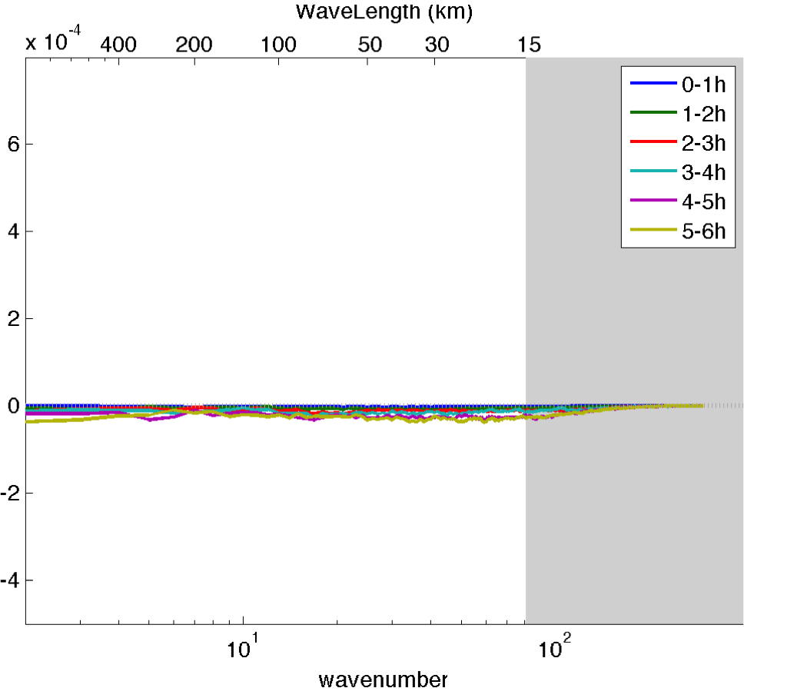
Remaining Problems: Noisy
E(k)
dE(k)/dt
D(k)
B(k)
T(k)
F(k)

Slide 14
Remaining Problems: Wind Profile
What happens if mean wind is 0 in the upper troposphere?

Slide 15
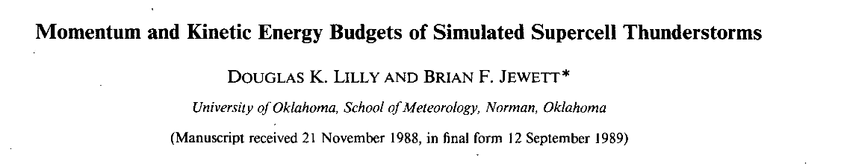
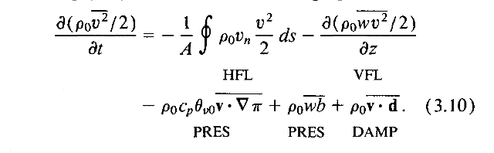
Remaining Problems: Boundary Condition Concern

Slide 16
Thank you !

Slide 17
Schematic for Spectral budget : At different levels
Lower level (0-5 km)
Upper level (5-10 km)
Lower Stratosphere (12-15km)
Downscale
Upscale
Similar slope at each level, yet very different process.
Upscale process in the Lower Stratosphere.
Downscale process in the Lower troposphere.
Energy transfer from mean flow to the eddies in the Upper troposphere

