Slide 1
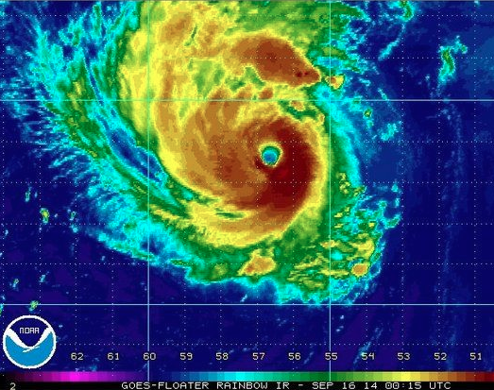

Dynamics and predictability of the rapid intensification of Hurricane Edouard (2014)
Erin Munsell
Summer 2015 Group
Meeting
August 17th, 2015

Slide 2
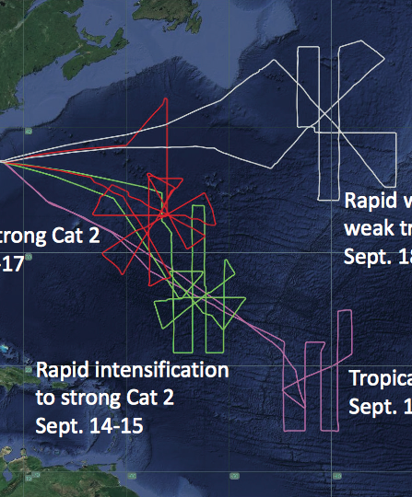
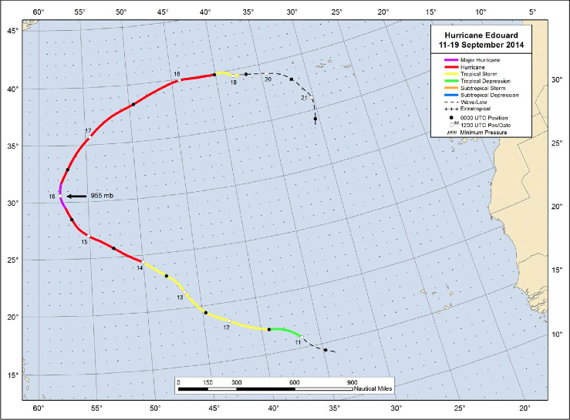
Edouard Best Track & HS3 Flights
PSU WRF-EnKF initialized at 12Z on Sept 11th – TD 6 designation
Simulation ends on 18Z on Sept 16th – just after peak intensity (major hurricane, 1st of HS3!)
2 HS3 flights performed during simulation window – 11-12 Sept and 14-15 Sept (18-27 h and 72-93 h)

Slide 3
Relative humidity vertical profile comparisons (in a storm-relative framework) between the HS3 dropsondes (black) and the GOOD (blue) composite group for the first Edouard flight
FH 18
FH 21
FH 24
FH 27

Slide 4
Zonal wind vertical profile comparisons (in a storm-relative framework) between the HS3 dropsondes (black) and the GOOD (blue) composite group for the first Edouard flight
FH 18
FH 21
FH 24
FH 27

Slide 5
700-hPa relative humidity composite of GOOD at FH 21 (filled contours) with HS3 dropsondes from first Edouard flight overlaid (markers)
500-hPa relative humidity composite of GOOD at FH 21 (filled contours) with HS3 dropsondes from first Edouard flight overlaid (markers)

Slide 6
950-hPa tangential winds composite of GOOD at FH 21 (filled contours) with HS3 dropsondes from first Edouard flight overlaid (markers)

Slide 7
Ensemble Tracks classified by performance
SST’s contoured (constant amongst members)
Maximum 10-m Wind Speed (kts) classified by performance
Best Track – Black
GOOD – Blue
GOOD_EARLY – Green
GOOD_LATE – Magenta
POOR – Red

Slide 8

Summary of Sensitivity on Inner-core vs. Environment
Environment
✓✓ - RI at 48 h
✓ - RI at 72 h
✗ - No RI
 | GOOD_EARLY | GOOD | POOR
GOOD_EARLY
GOOD
POOR
Inner-Core

Slide 9
Initial azimuthally-averaged tangential winds for the composite GOOD vortex (contours, m/s) and the differences between the GOOD_EARLY, GOOD and POOR vortex (filled contours, m/s)
“GOOD_EARLY” – “GOOD”
“GOOD” – “POOR”

Slide 10
Summary of Sensitivity on Inner-core vs. Environment
Environment
✓✓ - RI at 48 h
✓ - RI at 72 h
✗ - No RI
 | GOOD_EARLY | GOOD | POOR
GOOD_EARLY
GOOD
POOR
Inner-Core

Slide 11
Sensitivity Experiments – Set #4
Assessing the radii at which the POOR environment becomes detrimental
Radius (km) | EnvGoodTcPoor | EnvPoorTcGood
250 | ✓ | ✗
500 | ✓ | ✗
600 | ✓ | ✗
700 | ✗ | ✗
800 | ✓ | ✗
900 | ✗ | ½✓
1100 | ✗ | ✓

Slide 12
Maximum radar reflectivity (dBZ; filled contours), 700-hPa relative humidity (%; red to blue contours), surface pressure (contours), 10-m surface winds (vectors), shear (red) and tilt (magenta) vector for the GOOD and POOR environmental sensitivity experiments of Edouard – 0 h
EnvPoorTcGood800 EnvPoorTcGood900
Differences
EnvGoodTcPoor800 EnvGoodTcPoor900

Slide 13
Maximum radar reflectivity (dBZ; filled contours), 700-hPa relative humidity (%; red to blue contours), surface pressure (contours), 10-m surface winds (vectors), shear (red) and tilt (magenta) vector for the GOOD and POOR environmental sensitivity experiments of Edouard – 48 h
EnvPoorTcGood800 EnvPoorTcGood900
Differences
EnvGoodTcPoor800 EnvGoodTcPoor900

Slide 14
Summary and Conclusions
12 UTC 11 Sept ensemble initialization of Hurricane Edouard provides an excellent framework to assess the predictability of RI
HS3 observations compare favorably with GOOD members
Sensitivity experiments reveal that:
  GOOD and GOOD_LATE groups may be indistinguishable
  GOOD_EARLY vortex is initially stronger
  POOR environment is less favorable for development
    Sensitive region is somewhere between 800-km and 900-km
    Differences between simulations are smaller than typical observation errors – may limit predictability
    Mid-level dry air advects towards inner-core – impacts on subsequent development?
    Working on trajectory analysis to further investigate the differences in the sensitivity experiments

