Slide 1
Diurnal cycle of CONVECTIVE precipitation over the Pearl River Delta during Mei-Yu Season
Xingchao Chen
Key Laboratory for Mesoscale Severe Weather/MOE and School of Atmospheric Science, Nanjing University

Slide 2
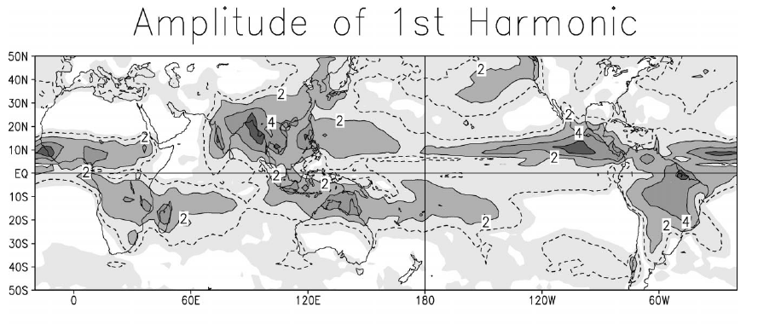
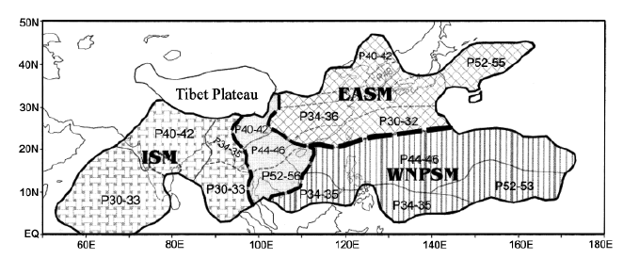
Background
Janowick and Xie (2003)
Indian summer monsoon (ISM)
western North Pacific summer monsoon (WNPSM)
the East Asian summer
monsoon (EASM)
Ding and Chan (2005)

Slide 3
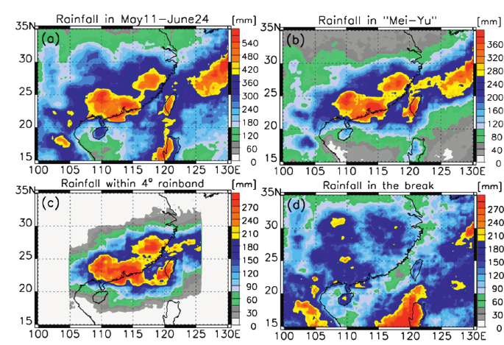
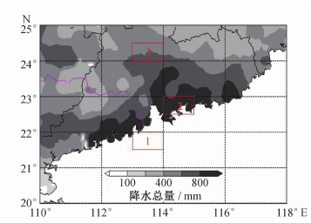
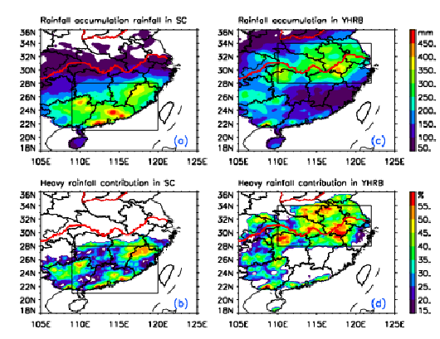
Background
Xu et al, 2009
Zhu et al, 2010
There has three convective rainfall centers over South China during warm season
Pearl River Delta (PRD) has the most precipitation in these three centers
Limited to the temporal and spatial resolutions of surface and satellite data, detailed characteristics of convection over PRD are still unclear
Luo et al, 2012

Slide 4
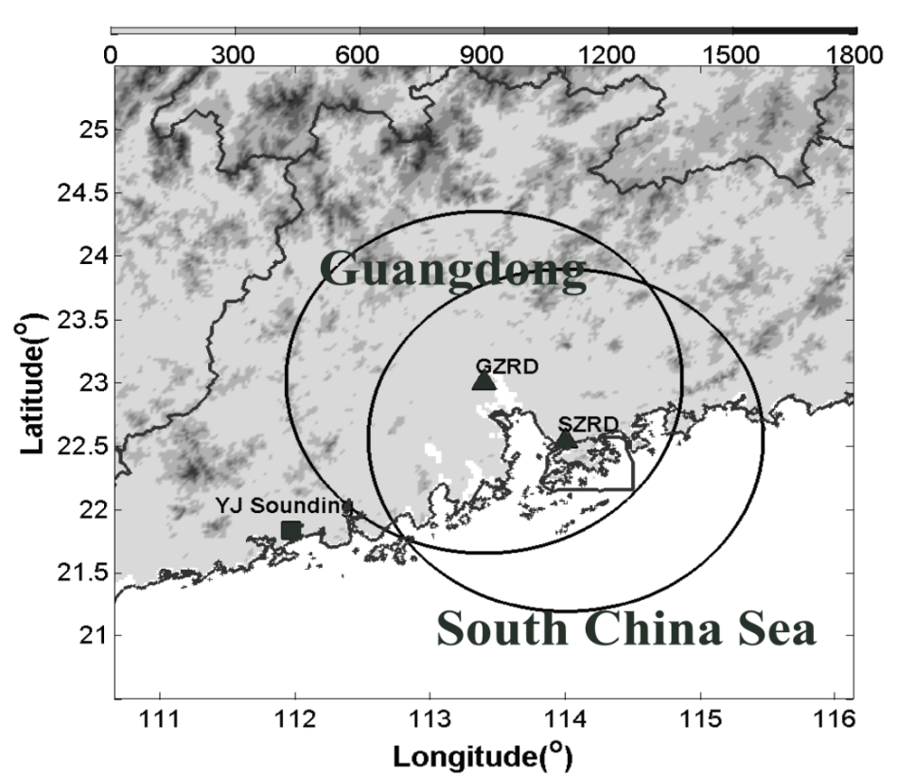
Data and Method
Radar Raw Data
Quality Control
Classification of convective feature
（Steiner 1995）
VAD wind profiler
spatial
temporal
3-D
Guangzhou Radar：2007-2009 warm seasons (May-September)
Shenzhen Radar：Case study
Initiation of coastal convection
Surface and reanalysis data
Low Level Jet
（Chen et al 2014, JGR）

Slide 5
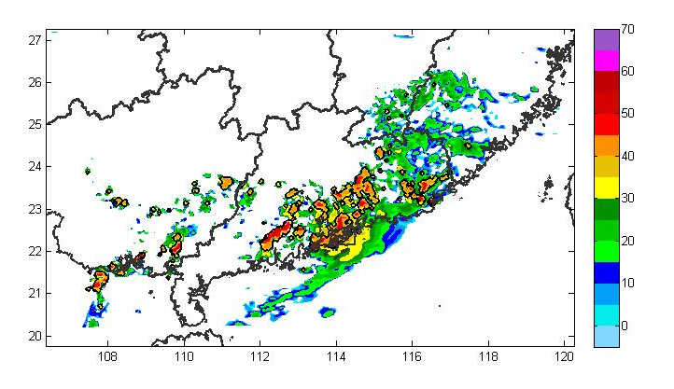
Example: Convective Feature
12:00 June 6, 2008

Slide 6
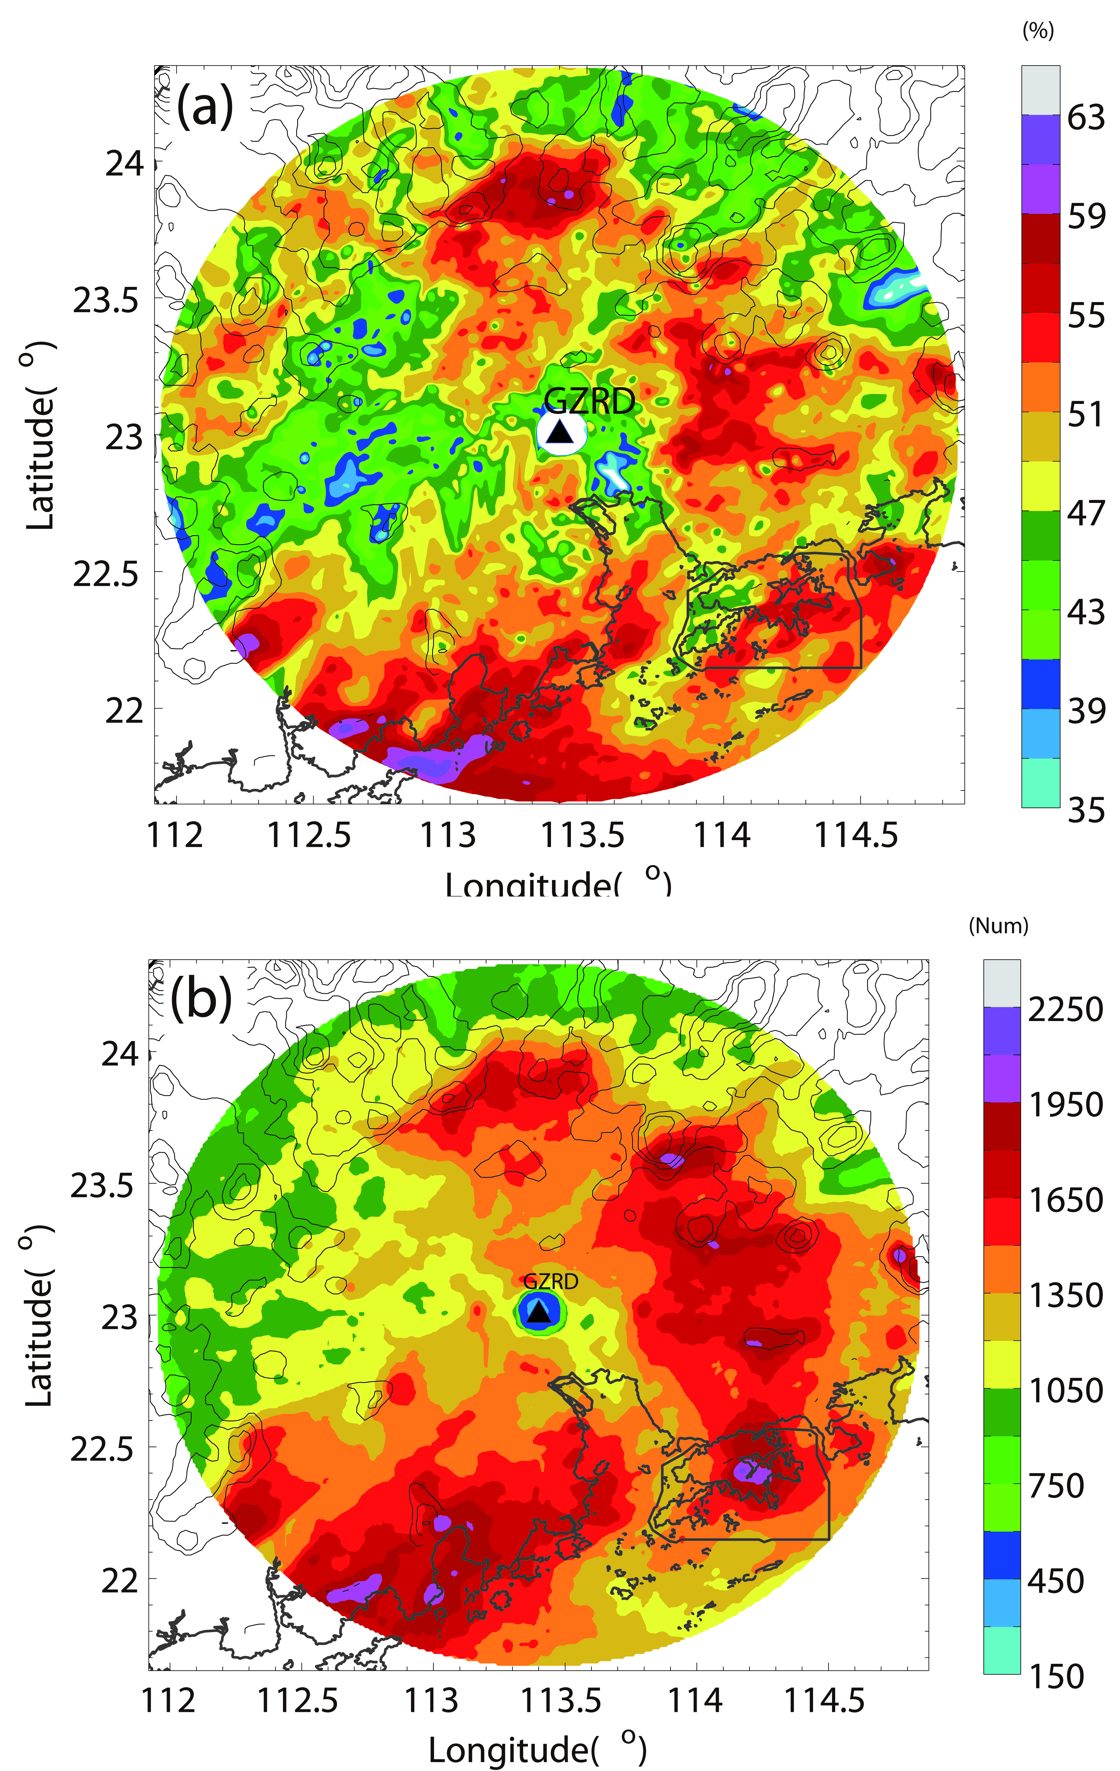
Spatial Distributions of convection
Satellite
Contribution
Of
Convective
rainfall
Spatial
Distribution
Of
Convective
features
Two convective centers:
（1）windward slope of mountains
（2）coastal area
（Chen et al 2014, JGR）

Slide 7
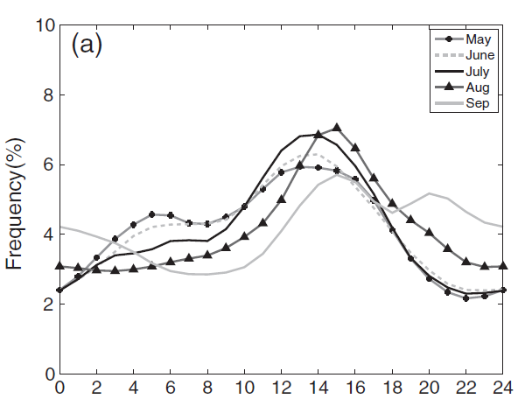
Monthly Variations of Diurnal Cycle
Diurnal cycles of convection
in different months
In the summer (July and August), convection occurs most frequently during early afternoon due to the solar heating effect.
In the Mei-Yu season (May and June), there has an obvious secondary early morning peak besides the early afternoon peak

Slide 8
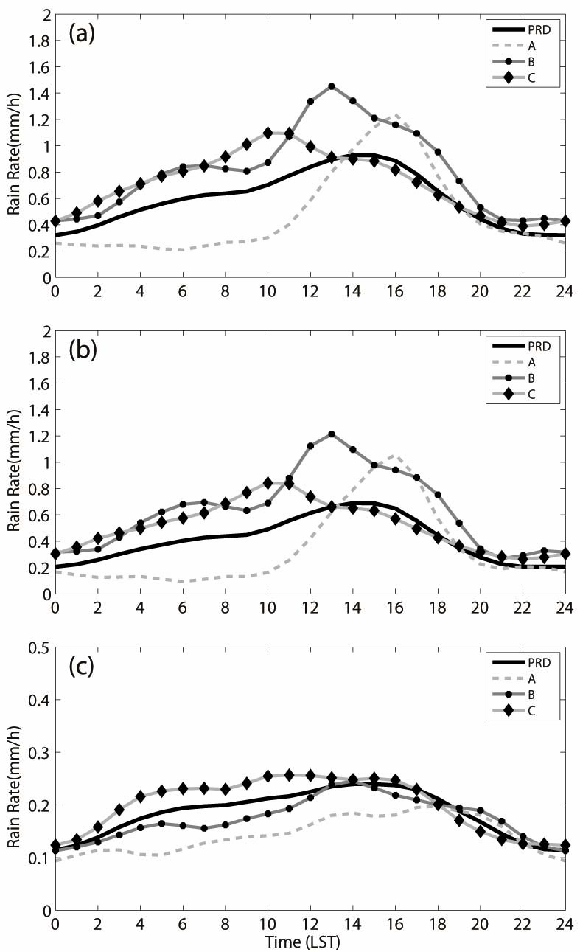
Diurnal cycles of precipitation
Total
Spatial distribution of convection
During Mei-Yu seasons
convective
stratiform

Slide 9
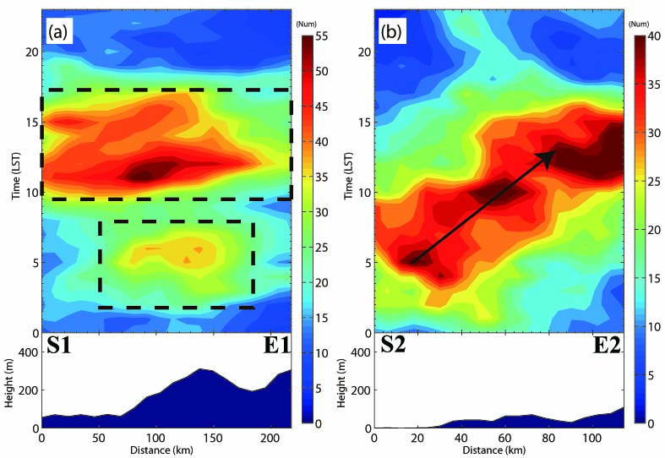
propagations of convection
Convection on the windward slope of eastern mountains has a double-peaks diurnal feature;
Convection begin to be initiated along the coastline from night and propagate to inland area than.

Slide 10
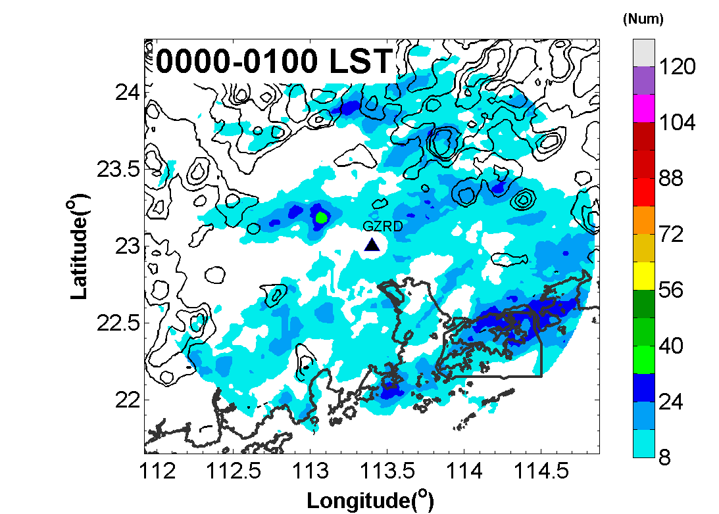
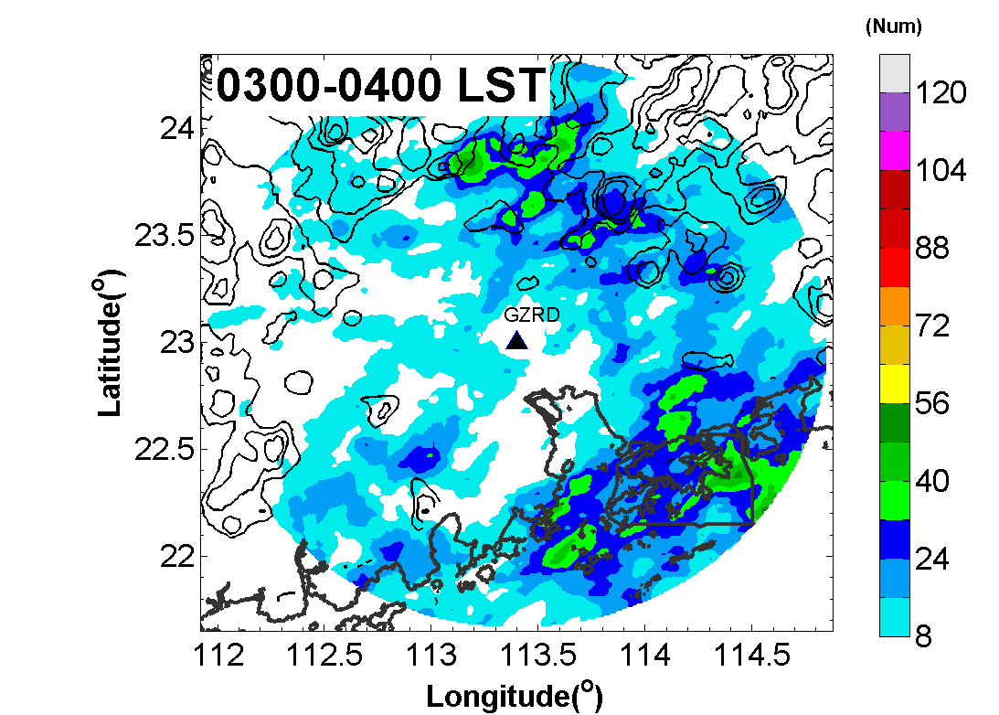
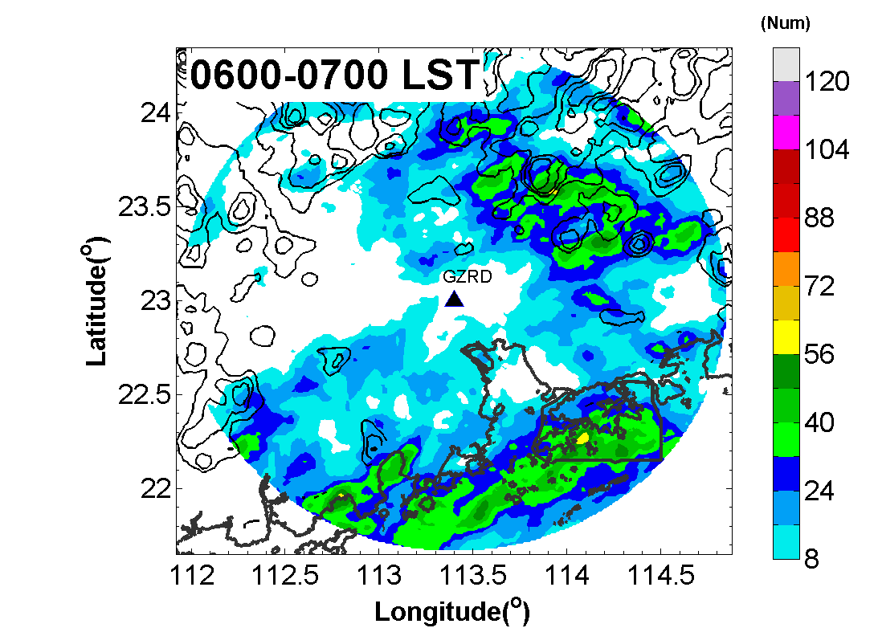
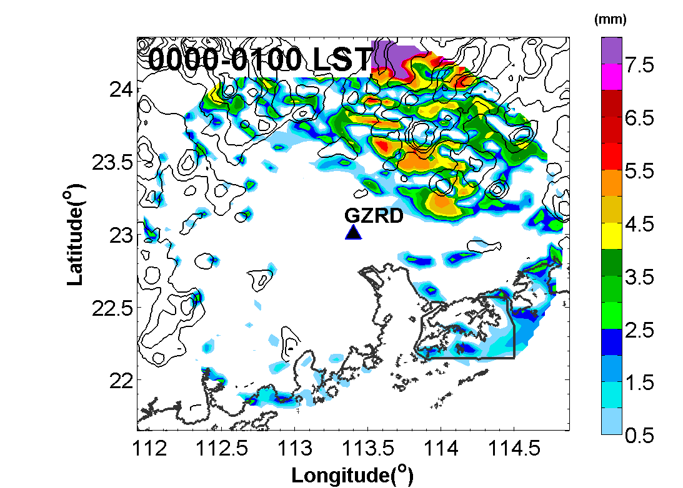
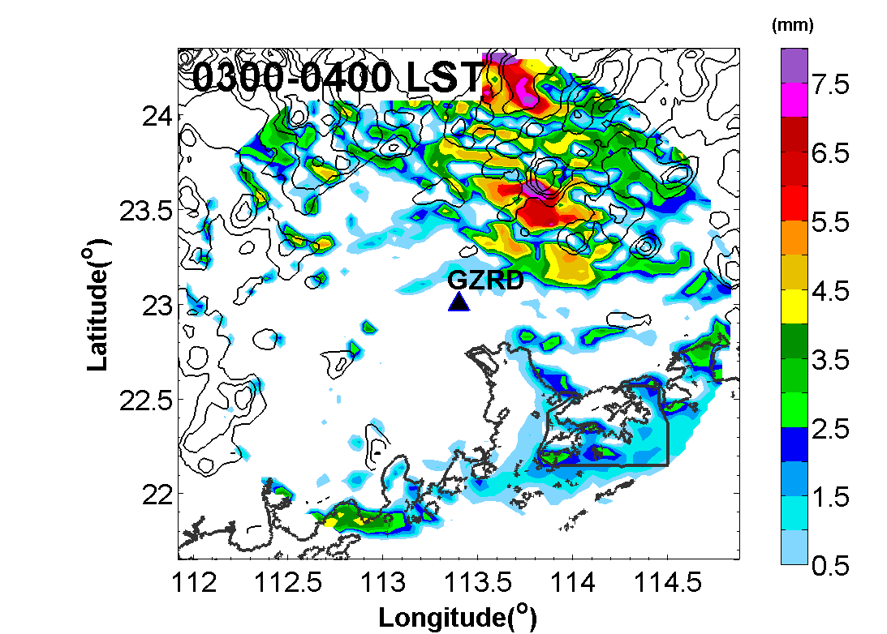
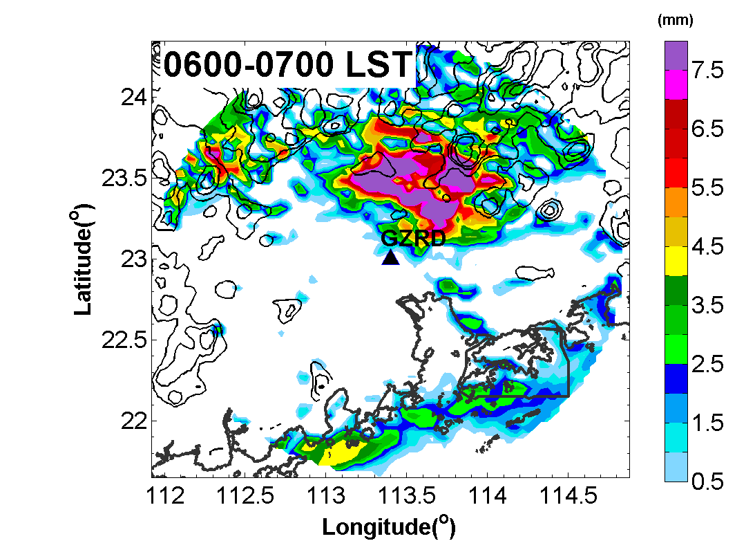
OB
WRF
This forecast experiment is a 10-days simulation which used the 135-day averaged (07-09 Mei-Yu seasons) global analysis at 0000 UTC as the initial condition and the 135-day averaged global analysis every 6 h as lateral boundary conditions (with diurnal variations only).

Slide 11
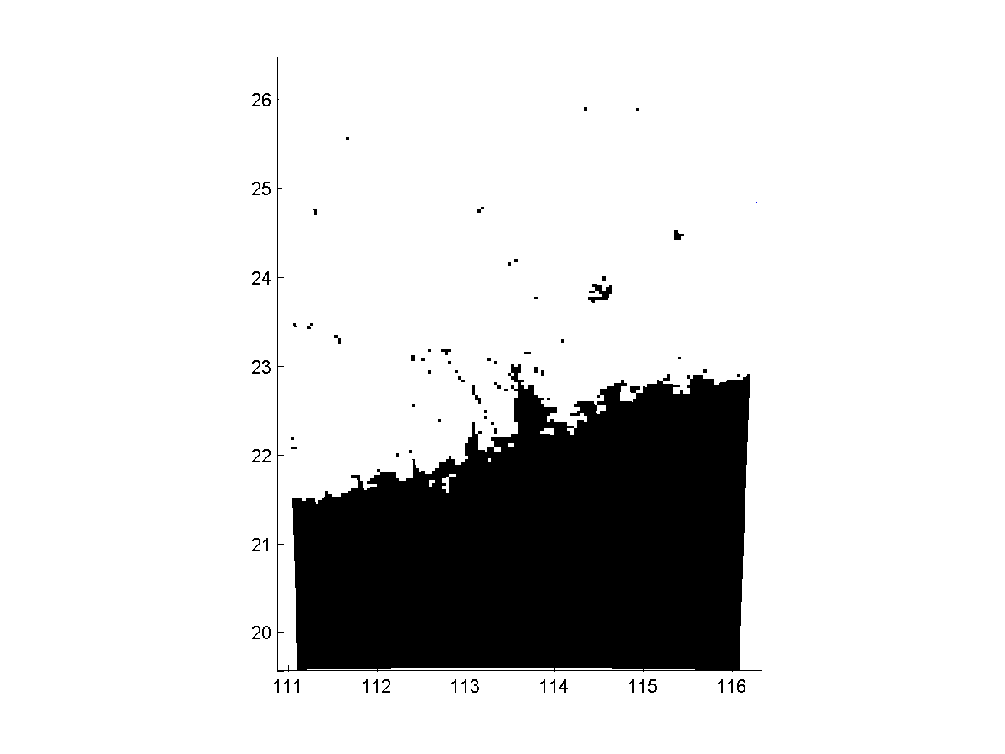
Mechanisms of convection initiation and propagation
CONTROL
IDEAL
Idealized experiment (exclude the effect of bay, simplify the effect of under laying surface):
(1) coastline is smoothed by two space dimensions filter
(2) LU-IDEX, LANDUSEF, LANDMASK and HGT are all modified followed (1)
(3) The surface types are prescribed as water over the ocean and Evergreen Broadleaf over land

Slide 12
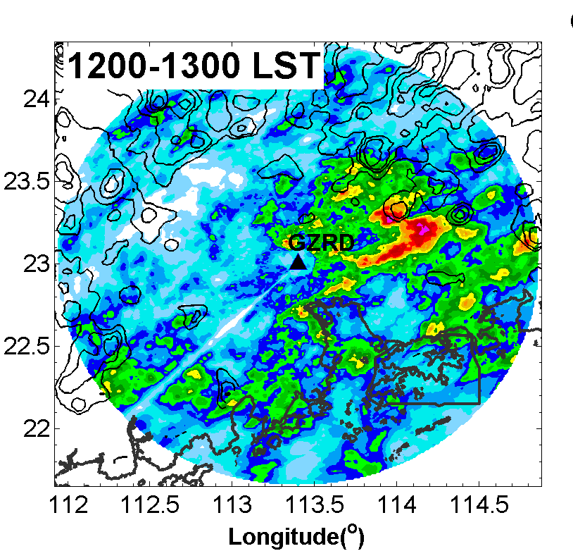
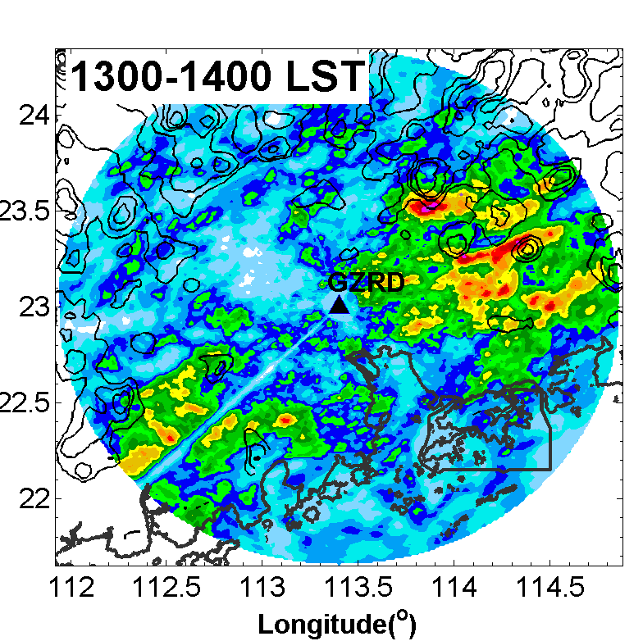
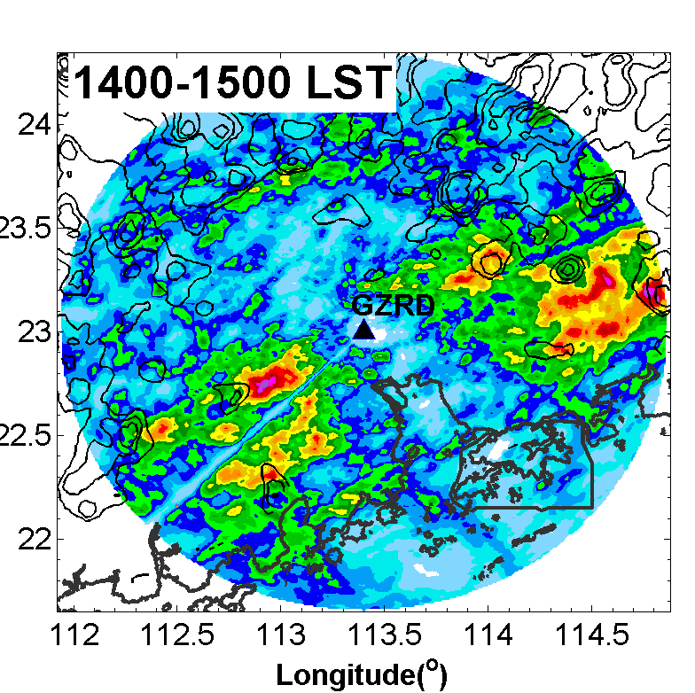
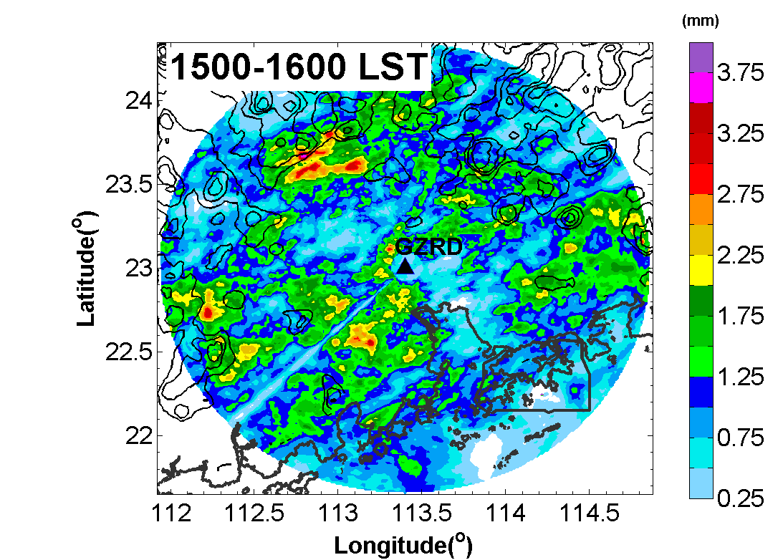
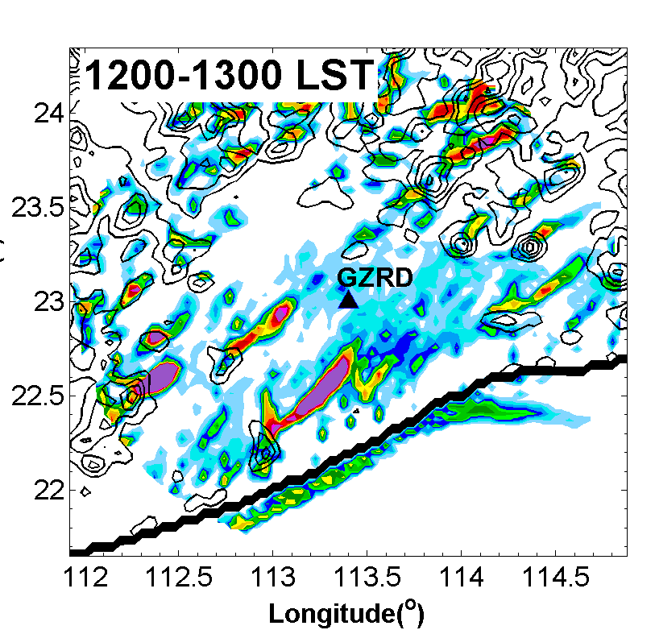
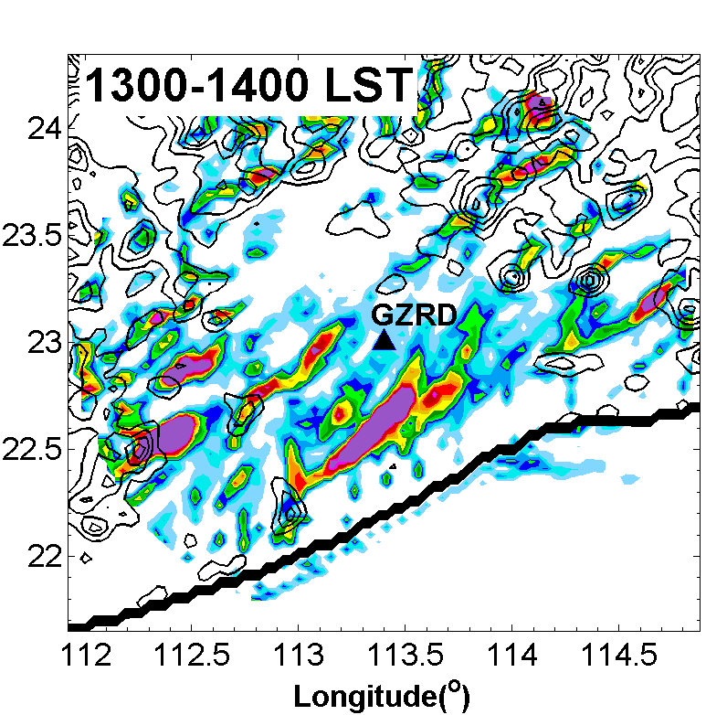
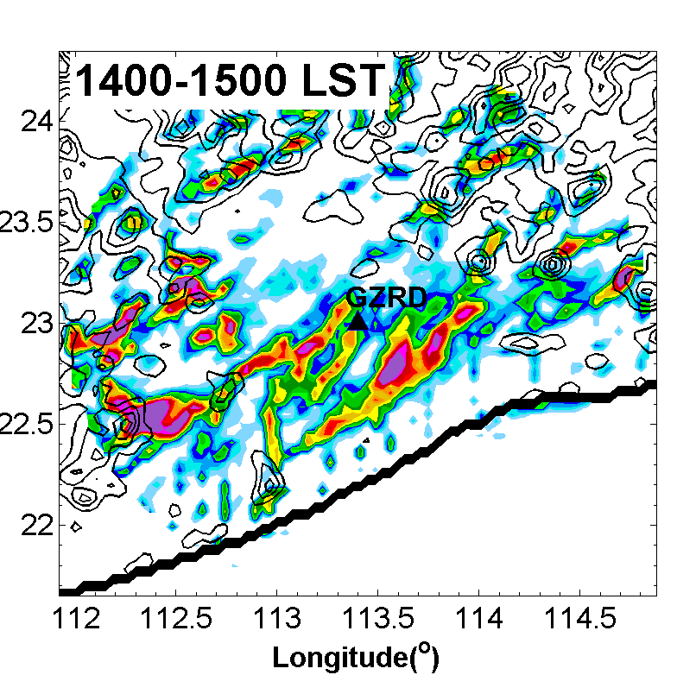
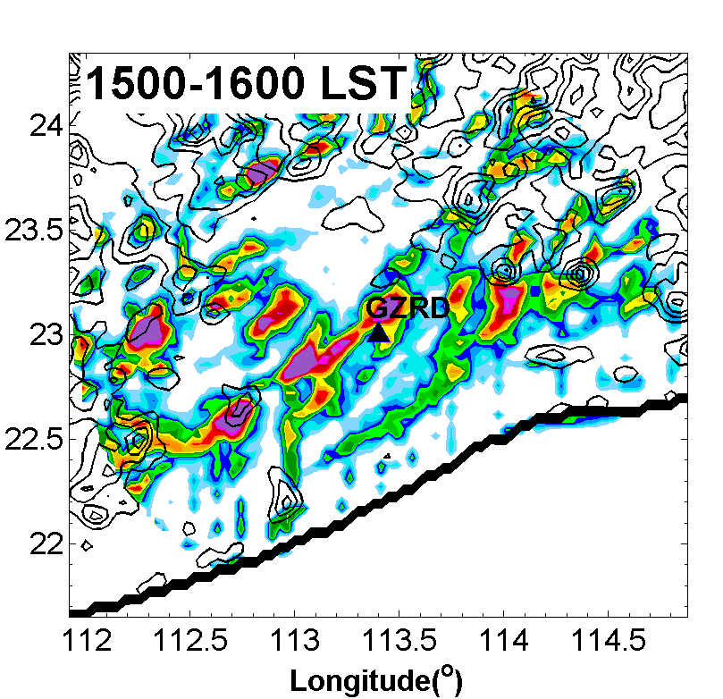
Mechanisms of convection initiation and propagation
OB
WRF

Slide 13
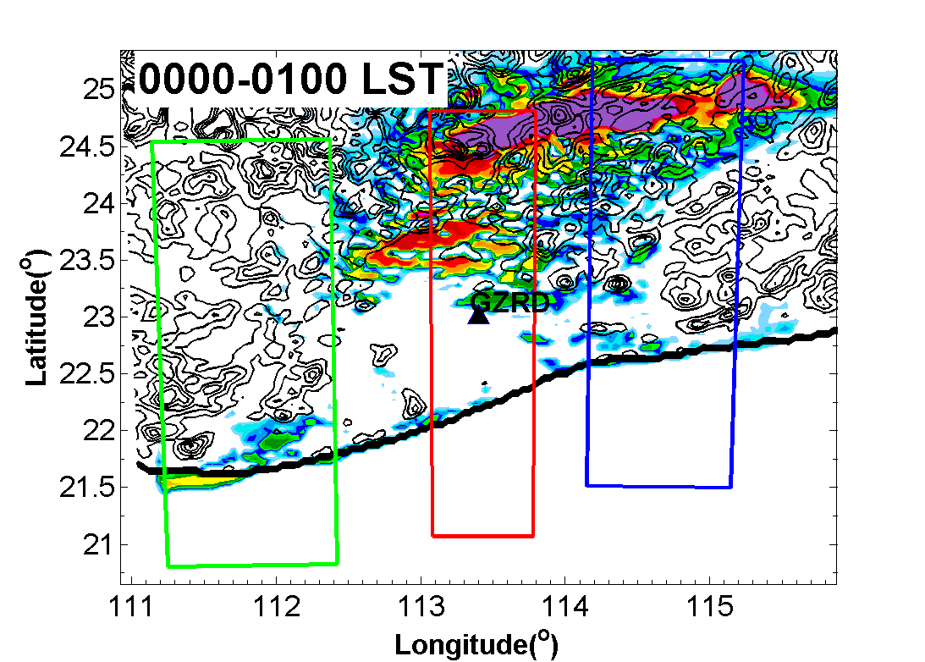
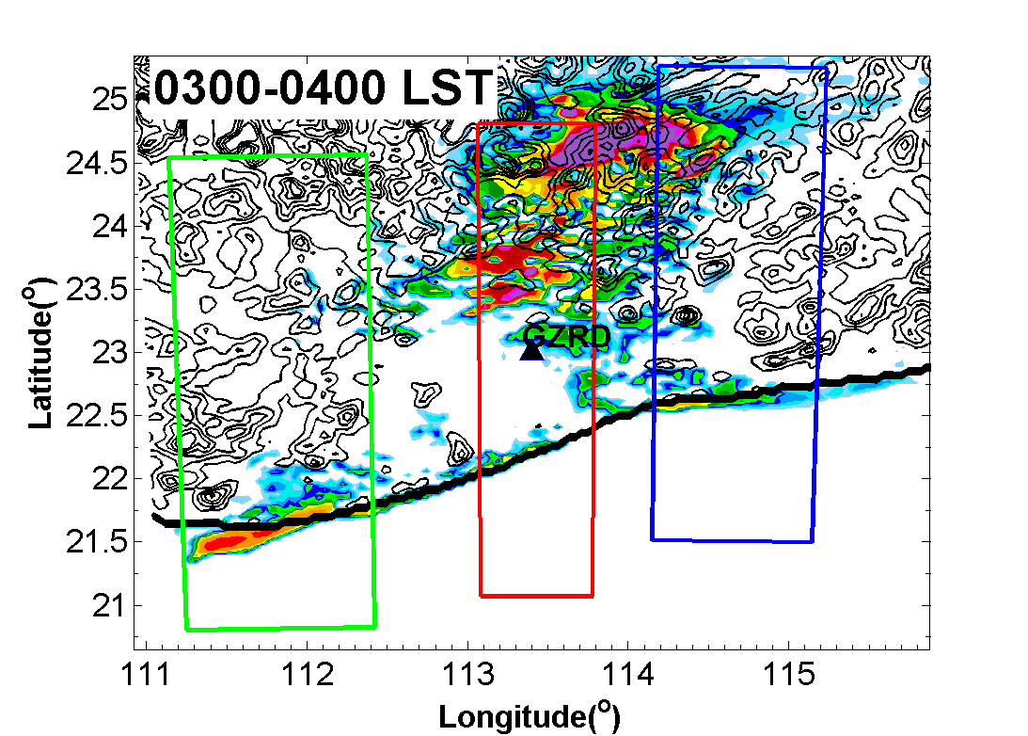
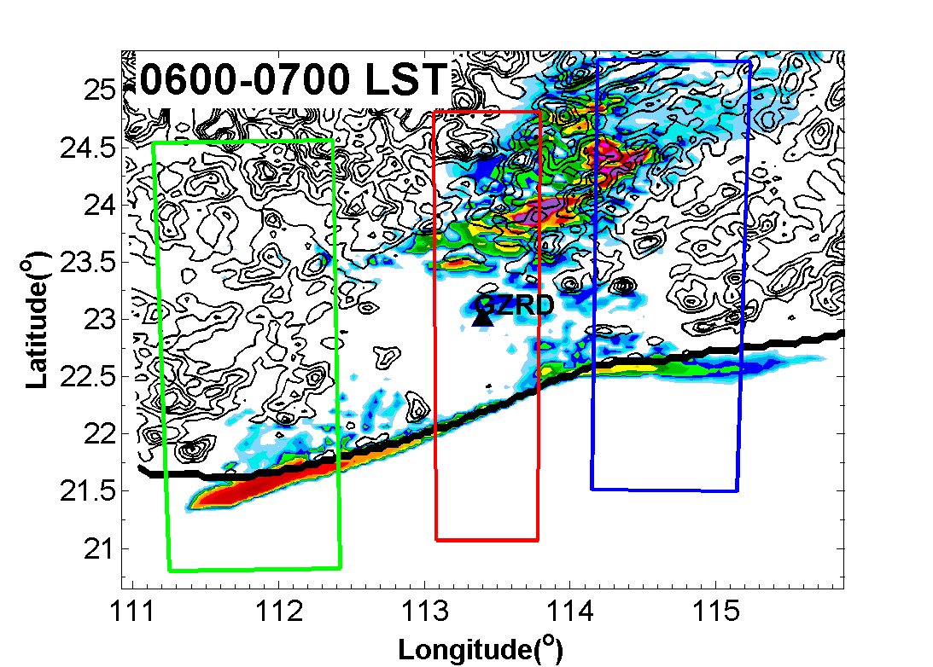
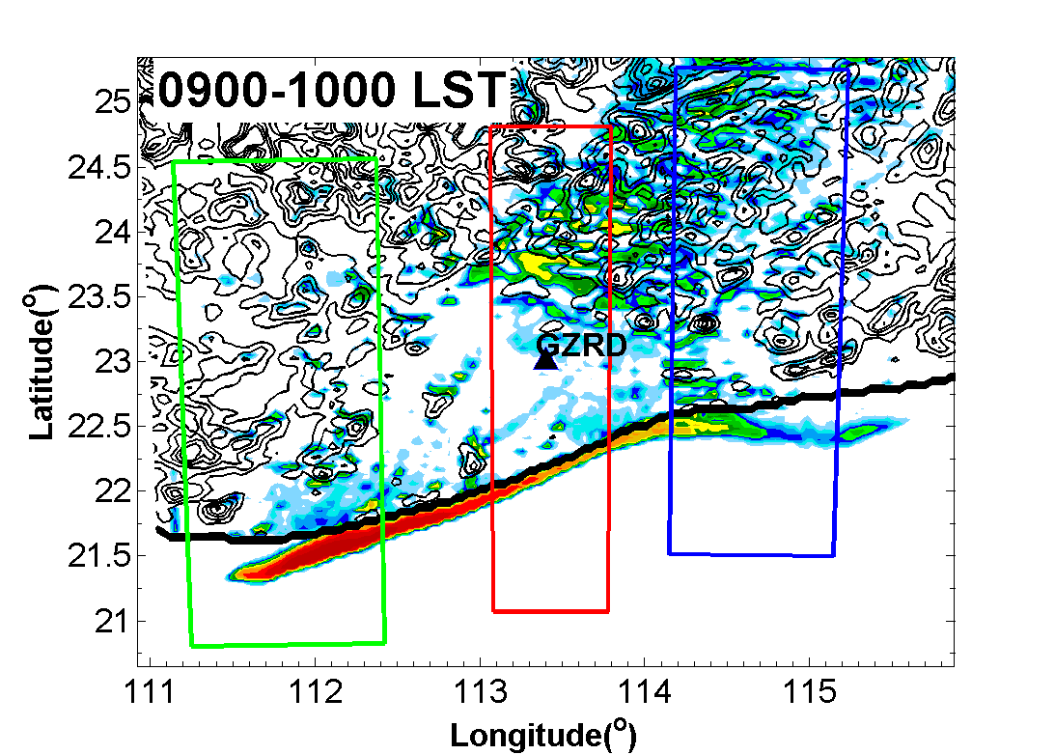
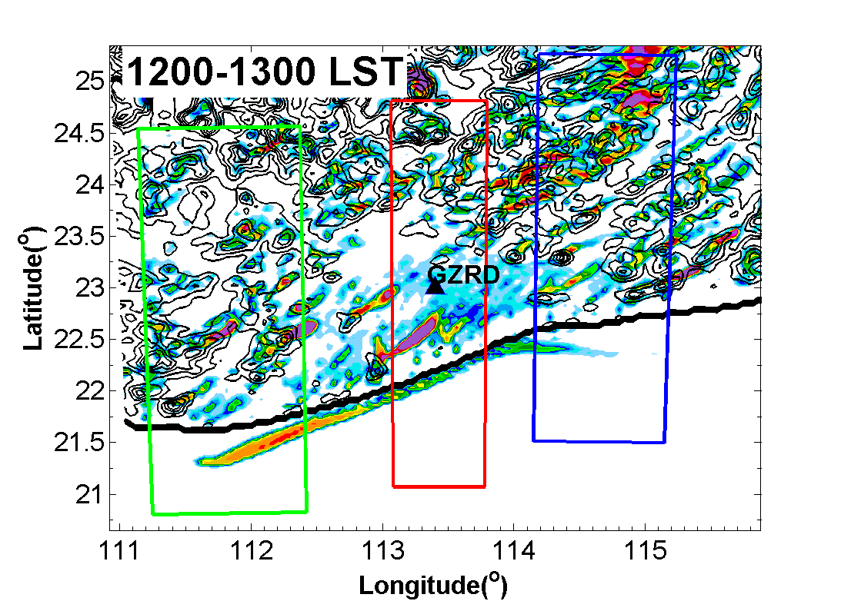
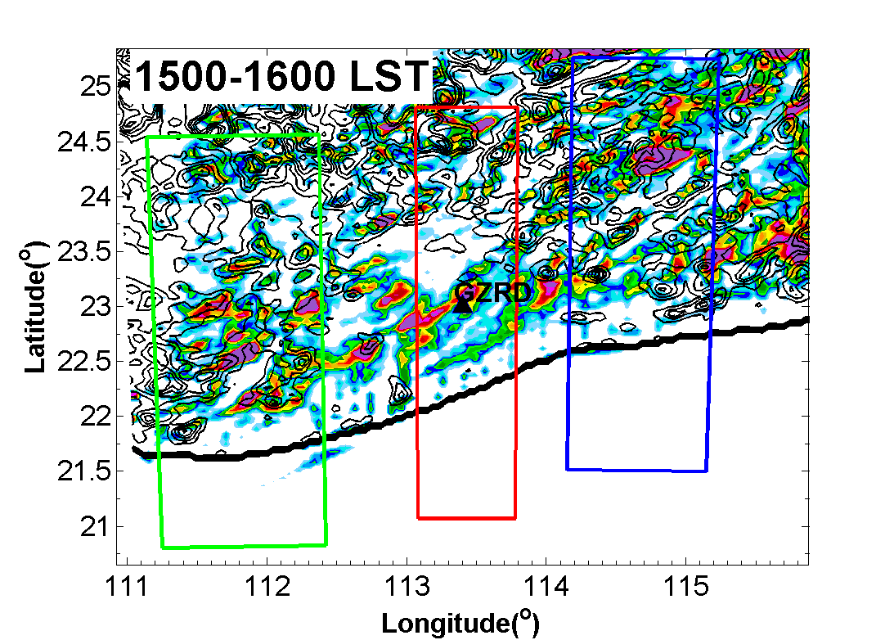
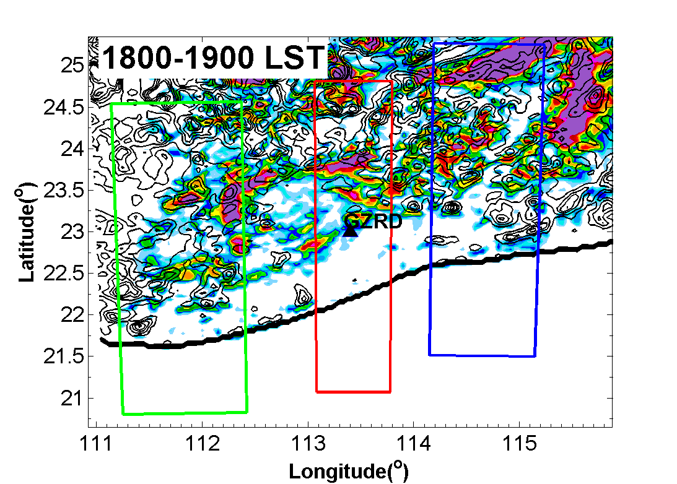
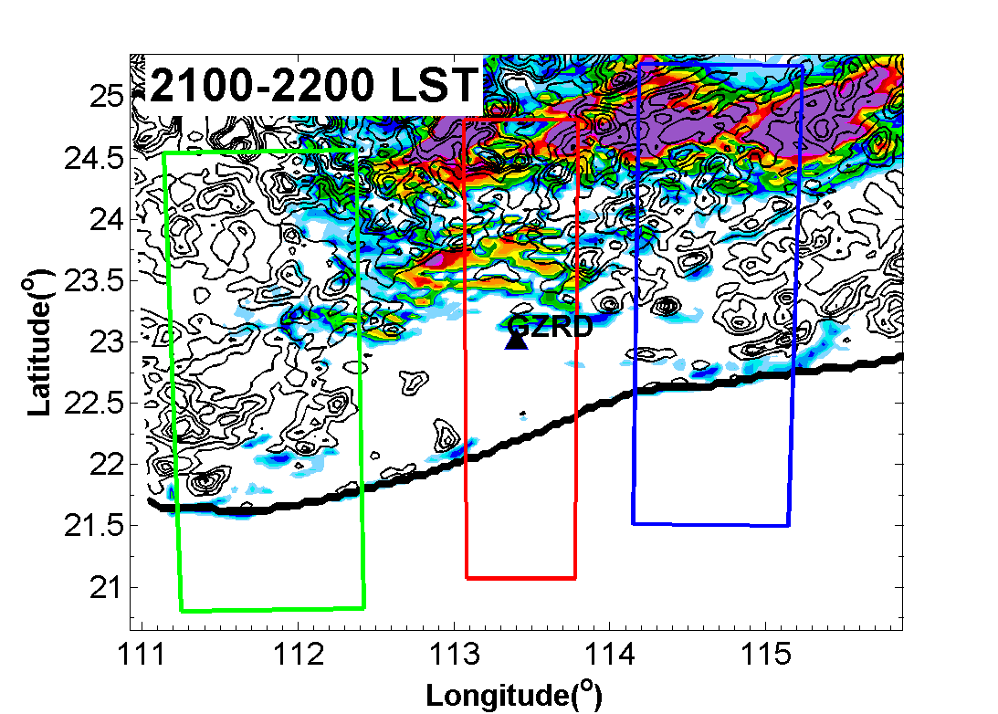
A
B
C

Slide 14
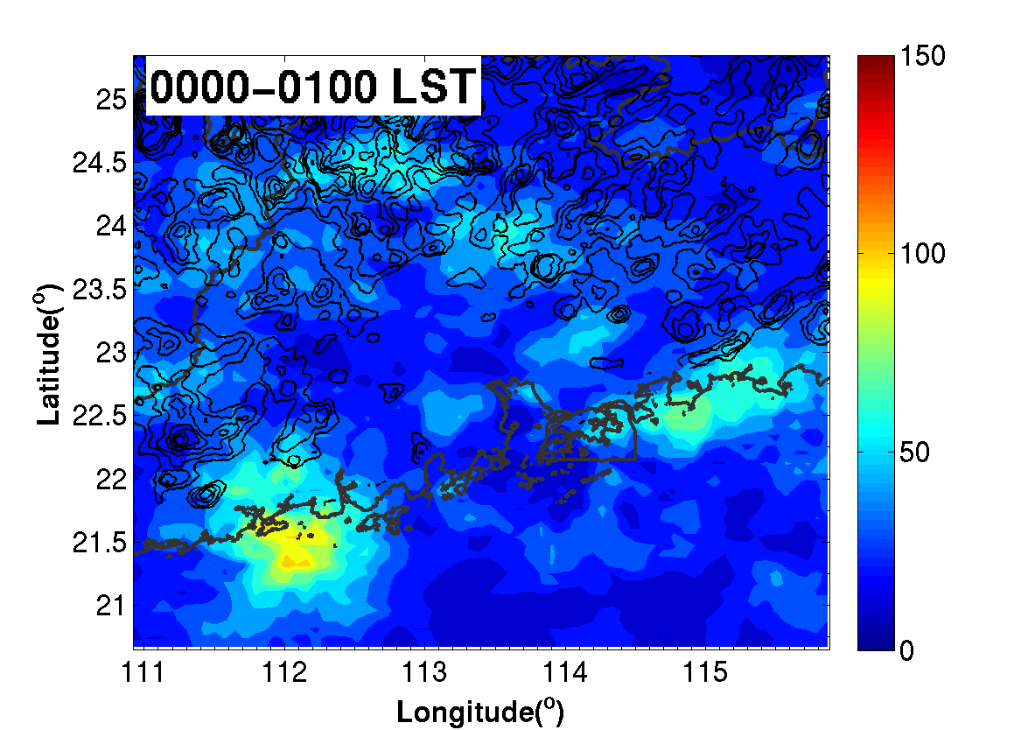
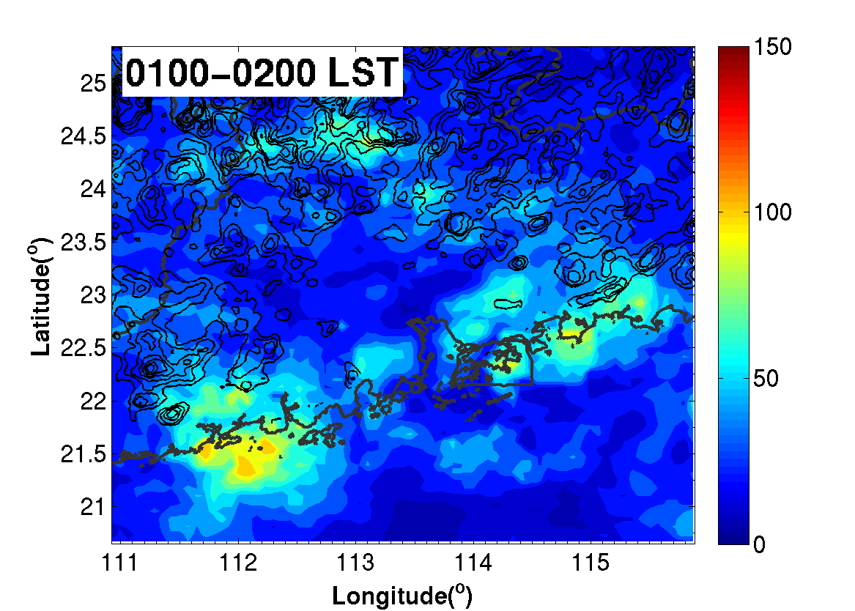
Mechanisms of convection initiation and propagation
CMORPH: Same with simulation, two offshore rainfall maxima along coastline during night

Slide 15
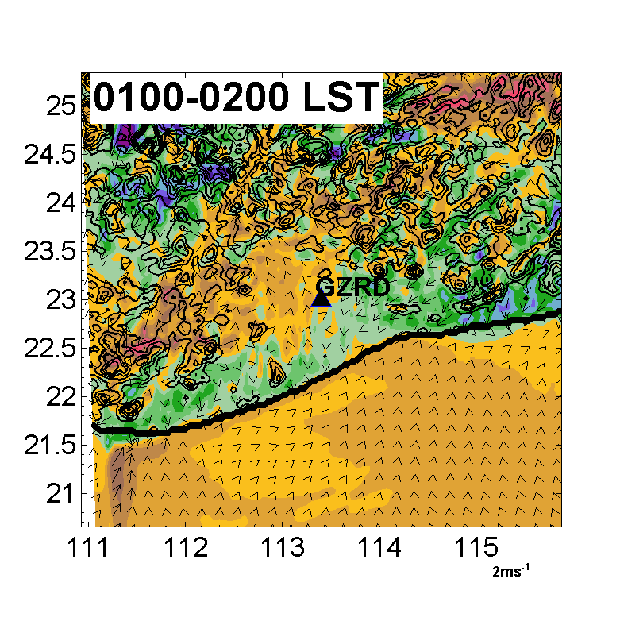
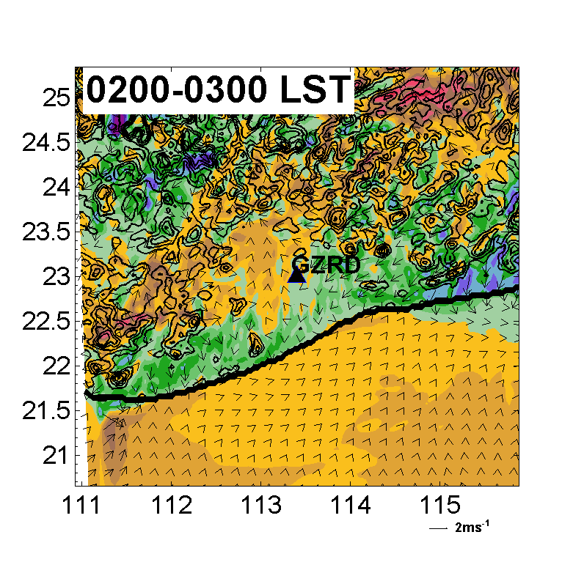
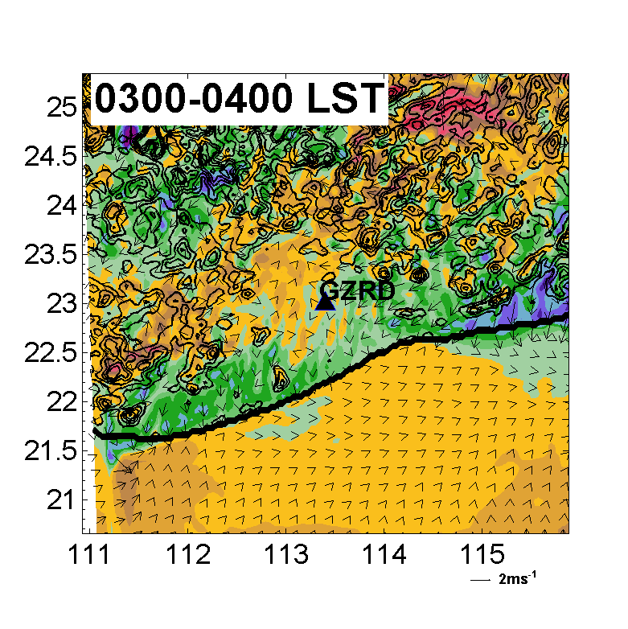
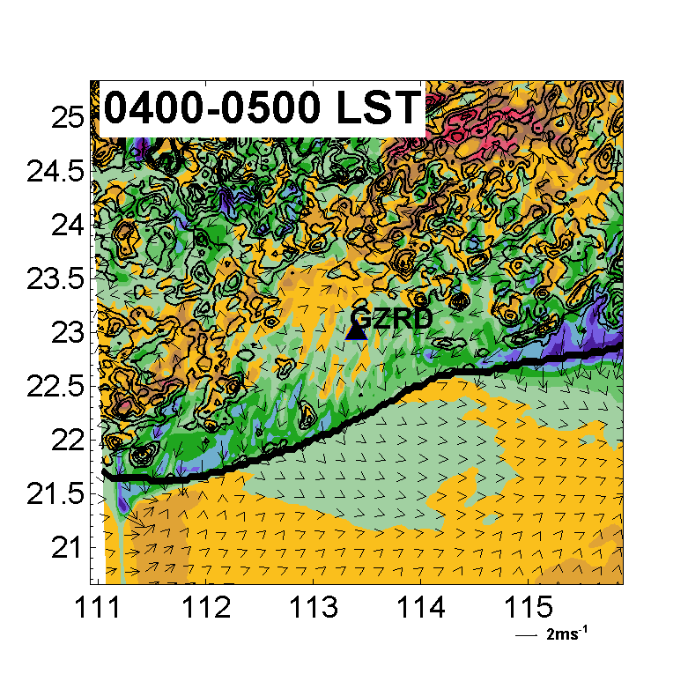
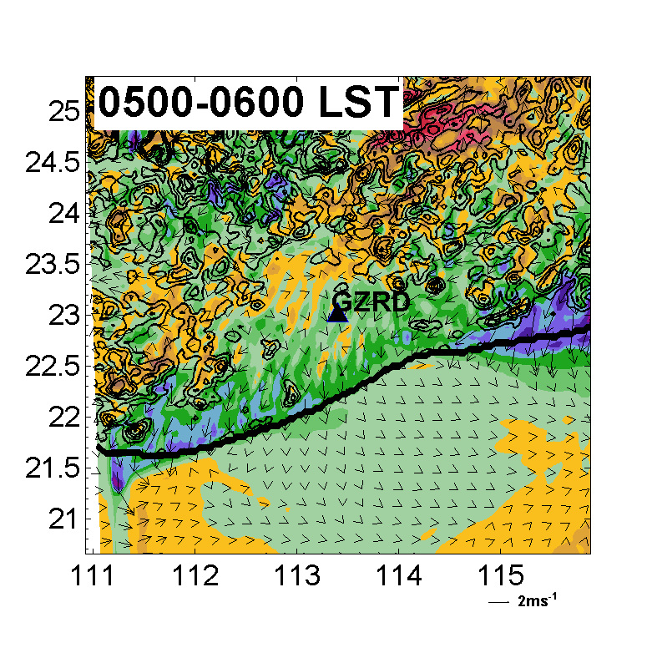
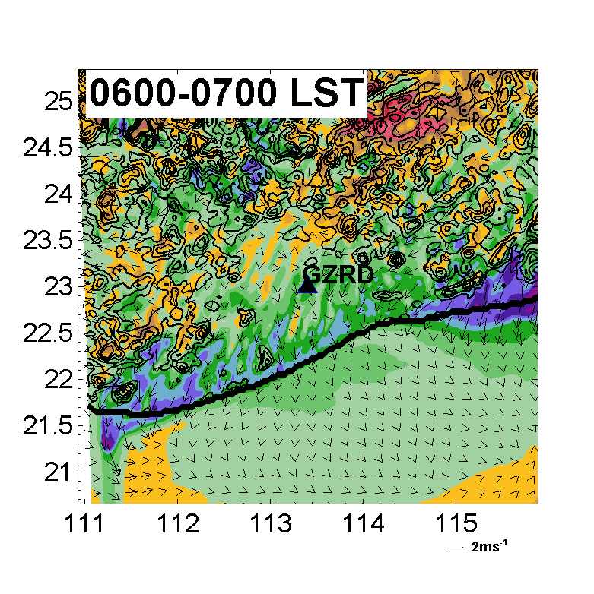
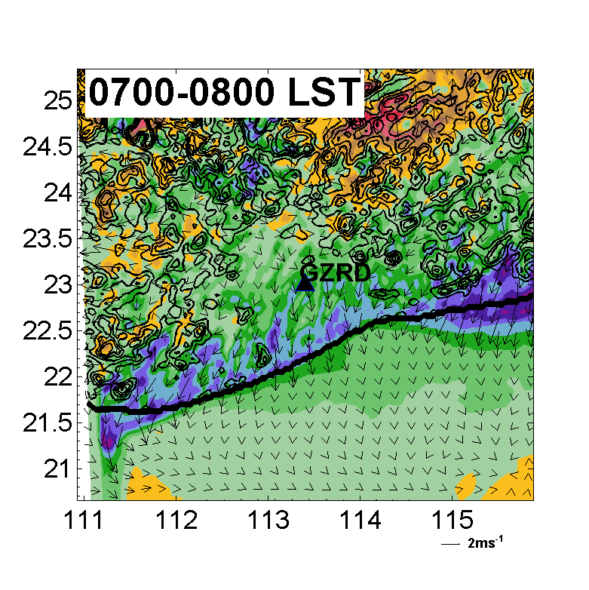
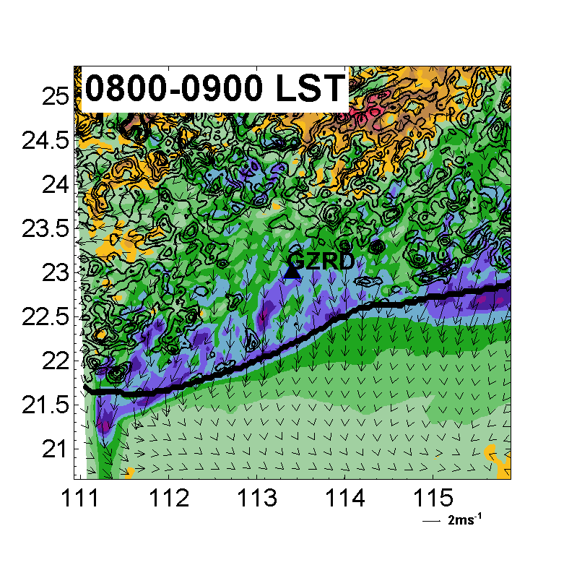
Color field: Perturbation V wind at the second lowest model level (0.994 sigma, about 50m above the surface)
Land Breeze

Slide 16
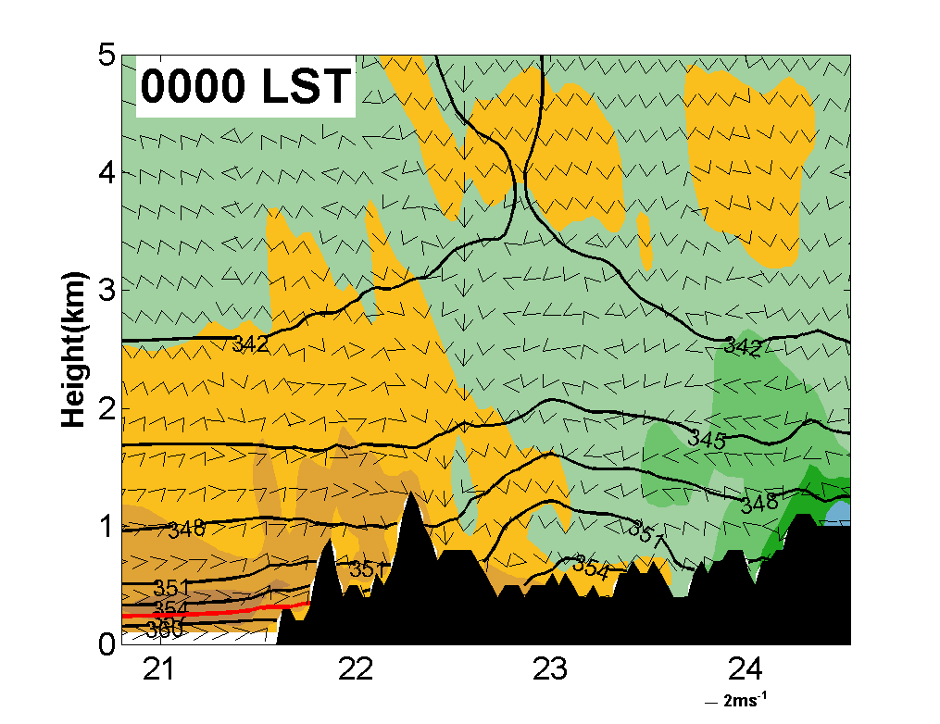
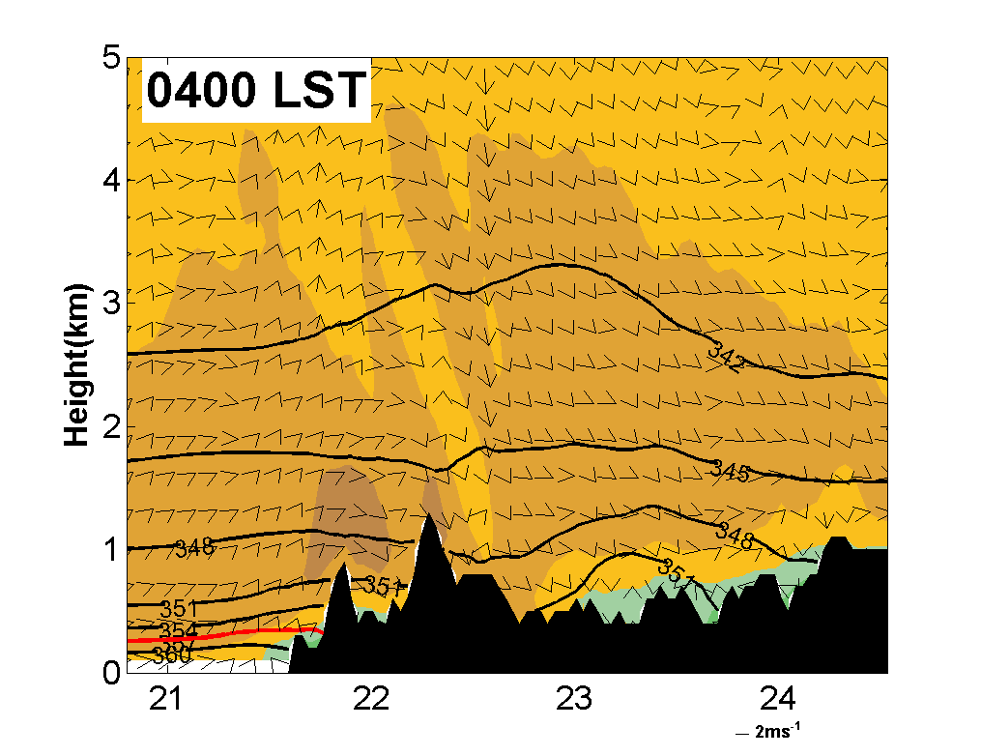
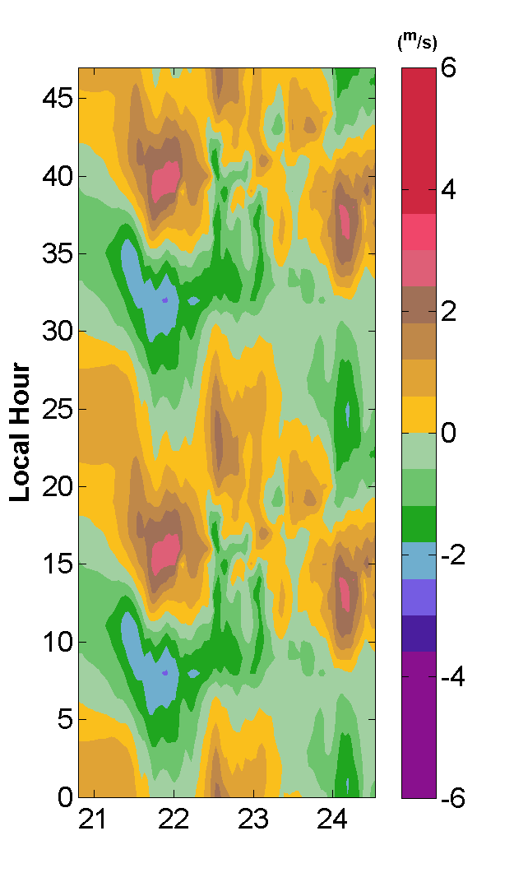
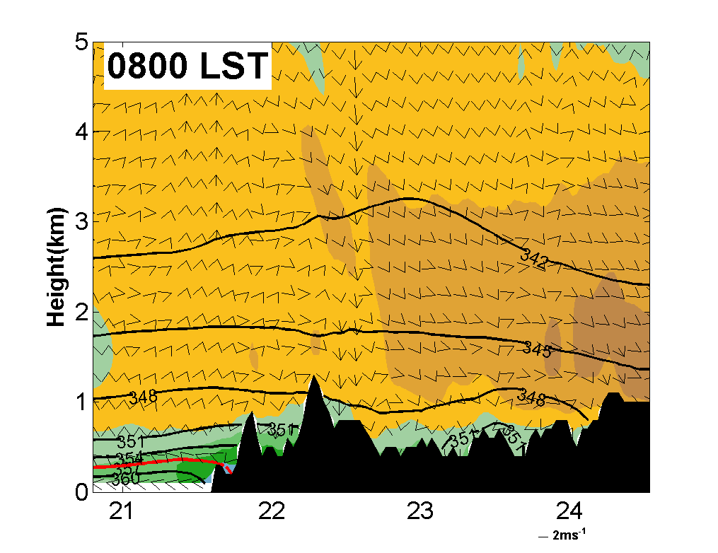
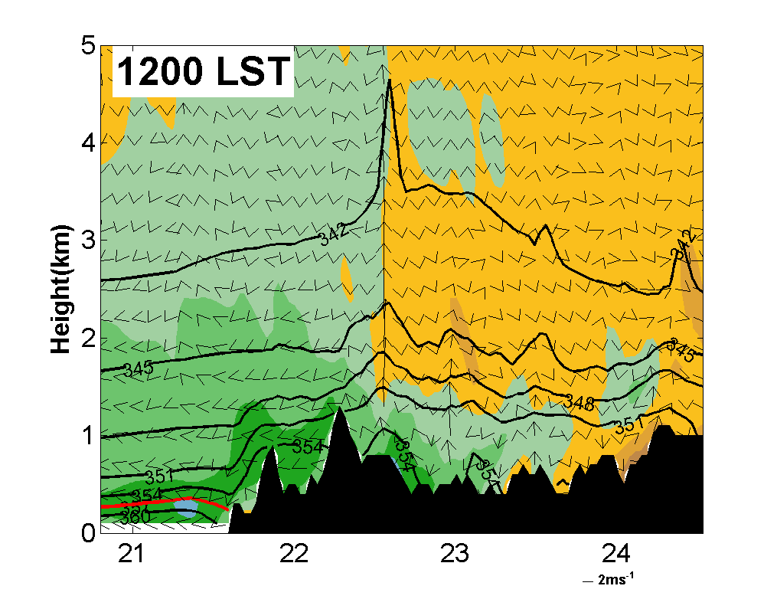
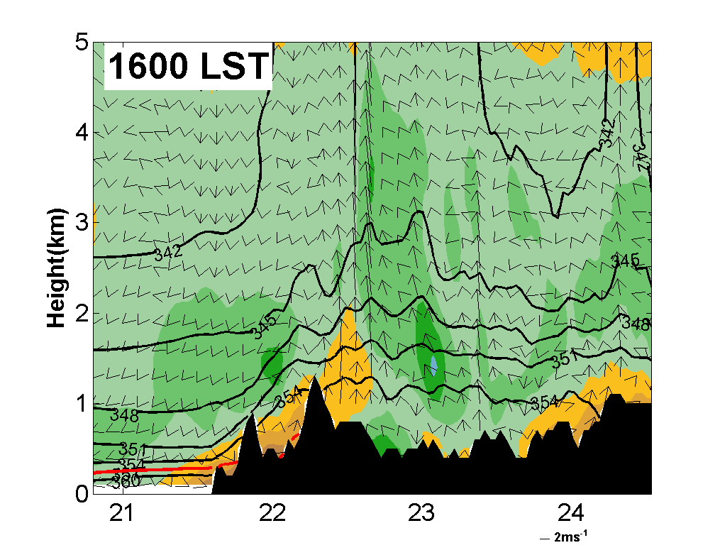

Slide 18
Sensitivity Experiment
Coastline
“IDEAL-half”：
half terrain height
Color field:
V difference between “IDEAL” and “IDEAL-half” (“IDEAL” – “IDEAL-half”)
Slope wind during night can combined with and strengthen the land breeze and induce stronger convergence on the coastline.
Coastline

Slide 19
Color field: Perturbation V wind at the second lowest model level (0.994 sigma, about 50m above the surface)
Sea Breeze
Gust Front

Slide 20
IDEAL EXP
FAKEDRY EXP

Slide 21
Conclusion
the nocturnal offshore rainfall in this region is induced by the convergence line between prevailing low-level wind and land breeze. Obvious inhomogeneity of rainfall intensity can be found along the coastline with heavier rainfall occurs in the region with coastal orography.
Sensitivity experiment of terrain height shows that mountain breeze produced by coastal terrain can combine with land breeze and increasing the intensity of offshore convergence during night.
In the daytime, Rainfall has clearly tends to propagate to inland area both in observations and simulation. This propagation is closely related to the inland penetration of sea breeze and it can be retard by the coastal mountain if this mountain is higher than certain altitude.
Sensitivity experiments show that, cold pool dynamics also play an essential role in the inland penetration of precipitation and sea breeze over PRD during Mei-Yu season.

Slide 22
Thank you for your attention！
Questions？

Slide 23
Hovmöller diagram of precipitation in three regions
A
B
C

Slide 24
Hovmöller diagram of perturbation V wind
A
B
C
Higher mountain (A) along the coastline can retard the inland propagation of sea breeze while lower mountain (B) not. The slope angle, slope length and atmospheric stability may also influence this propagation.

Slide 25
Mechanism of nocturnal convection on windward slope
Boundary Layer Jets
Color shading : Equivalent Potential Temperature
Vector : Diurnal variational wind (minus the mean 24hrs wind)

Slide 26
Mechanisms of convection initiation and propagation
The averaged 0.5º radial velocities from the GZRD that also indicates the nocturnal southwesterly boundary layer jet.

Slide 27
(4) Possible Mechanisms of Coastal Convection
Spatial Distribution Of Convective features
Warm Season
Weak Synoptic
Forcing

Slide 28
(4) Possible Mechanisms of Coastal Convection
Spatial distribution
No-LLJ
Vertical
Profiler
Of
LLJ
Occurrence
frequency
synoptic-system-related
LLJs
LLJ
boundary-layer
LLJs
LLJ： （1） wind speed > 12.5 m/s； （2）vertical wind shear > 1× 10⁻³s⁻¹
（Chen et al , 2014）

Slide 29
Spatial and temporal characteristics of convection
No-LLJ
LLJ
Reanalysis data：
The air at the 850 hPa level is moister on LLJ days than on no-LLJ days on average
The winds are southerly on LLJ days, which bring moister and warmer air to PRD from the ocean, while on no-LLJ days, the mean winds are weaker and are from the southeast.
At the surface, Stronger and deeper updrafts at the coast can be found in the cross section along 114 E on LLJ days than on no-LLJ days.

Slide 30
Spatial and temporal characteristics of convection
Surface data
Surface data：
the velocity convergence along the coastline (the solid black line the dashed black line) in LLJ days is much stronger than the convergence in no-LLJ days.
This stronger velocity convergence on the LLJ days and the resulting stronger coastal upward motion appear to be responsible for the convection occurrence Frequency maximum along the coastline.
NO
LLJ
LLJ

Slide 31
Spatial and temporal characteristics of convection
Radar observation：
Convection occurred under LLJ condition
Wind on low level is onshore direction
There has obvious velocity convergence on the coastline
JGR reviewers：
This paper is one of the best-written manuscript to cross my desk in some time, a noteworthy feat since I presume the authors are not native English speakers! ---Scott Collis
The dataset is valuable and implemented to the long-term satellite statistics. These results are
interesting and significant enough to be published in JGR. ---Reviewer 1

