Slide 1
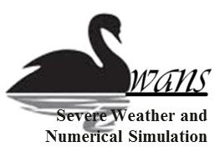
Case Study of a Tornado in China
with Large Eddy Simulation
Dan Yao Zhiyong Meng
Peking University
Summer 2015 Meeting of Fuqing’s Group
Penn State University
17th August 2015, State College, PA

Slide 2
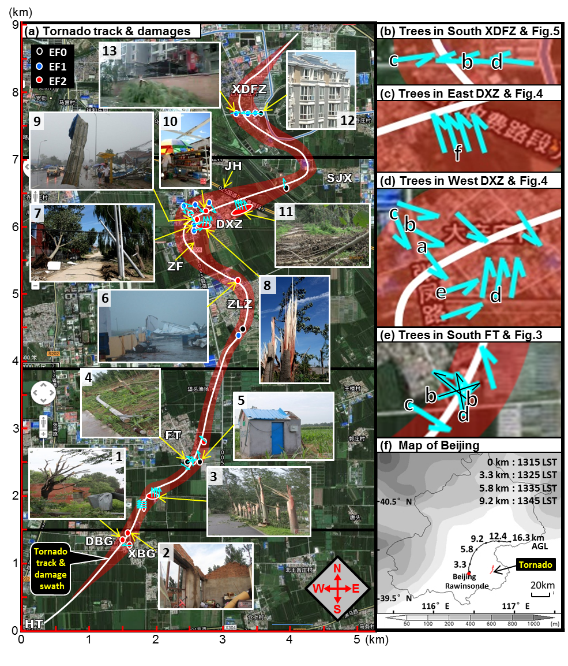
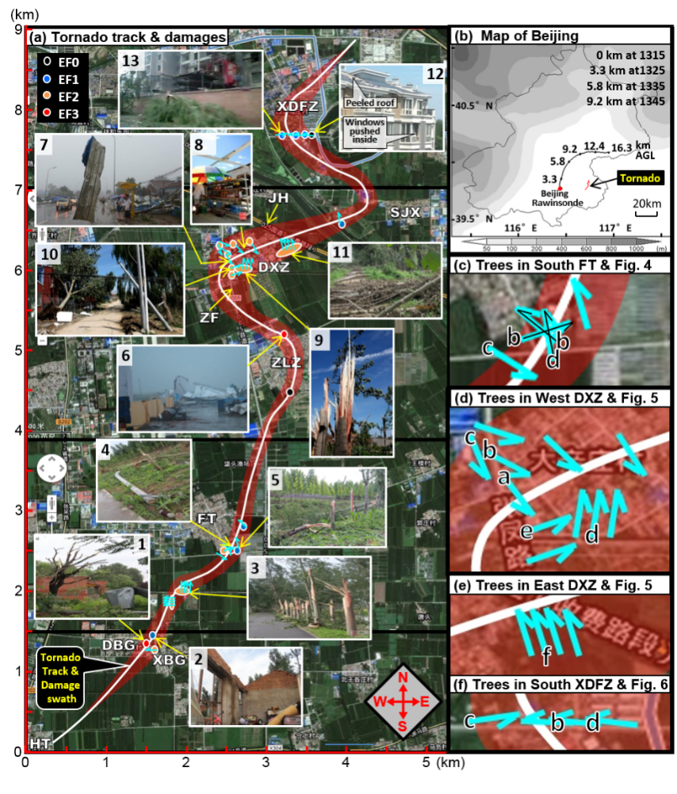
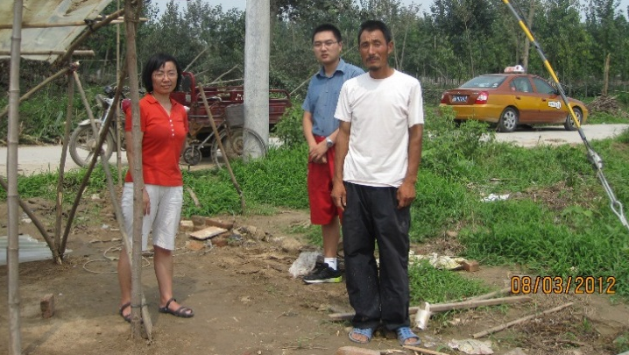
21 July 2012 Beijing Tornado
Beijing
460
Accumulated Precipitation (mm)
Narrow
damage swath
&
Surface convergence
Damage Survey
(Meng and Yao 2014, Weather and Forecasting)

Slide 3
Storm & Tornado by CM1
Tornadogenesis
Re-intensification
t
t+9’
updraft
cold pool
cloud
vorticity
Maturity
Demise
t+15’
t+20’
cloud: 0.1 g/kg cloud water mixing ratio updraft: 15 m s⁻¹ vertical velocity
cold pool: -1 K potential temperature perturbation vorticity: 0.1 & 0.15 s⁻¹

Slide 4
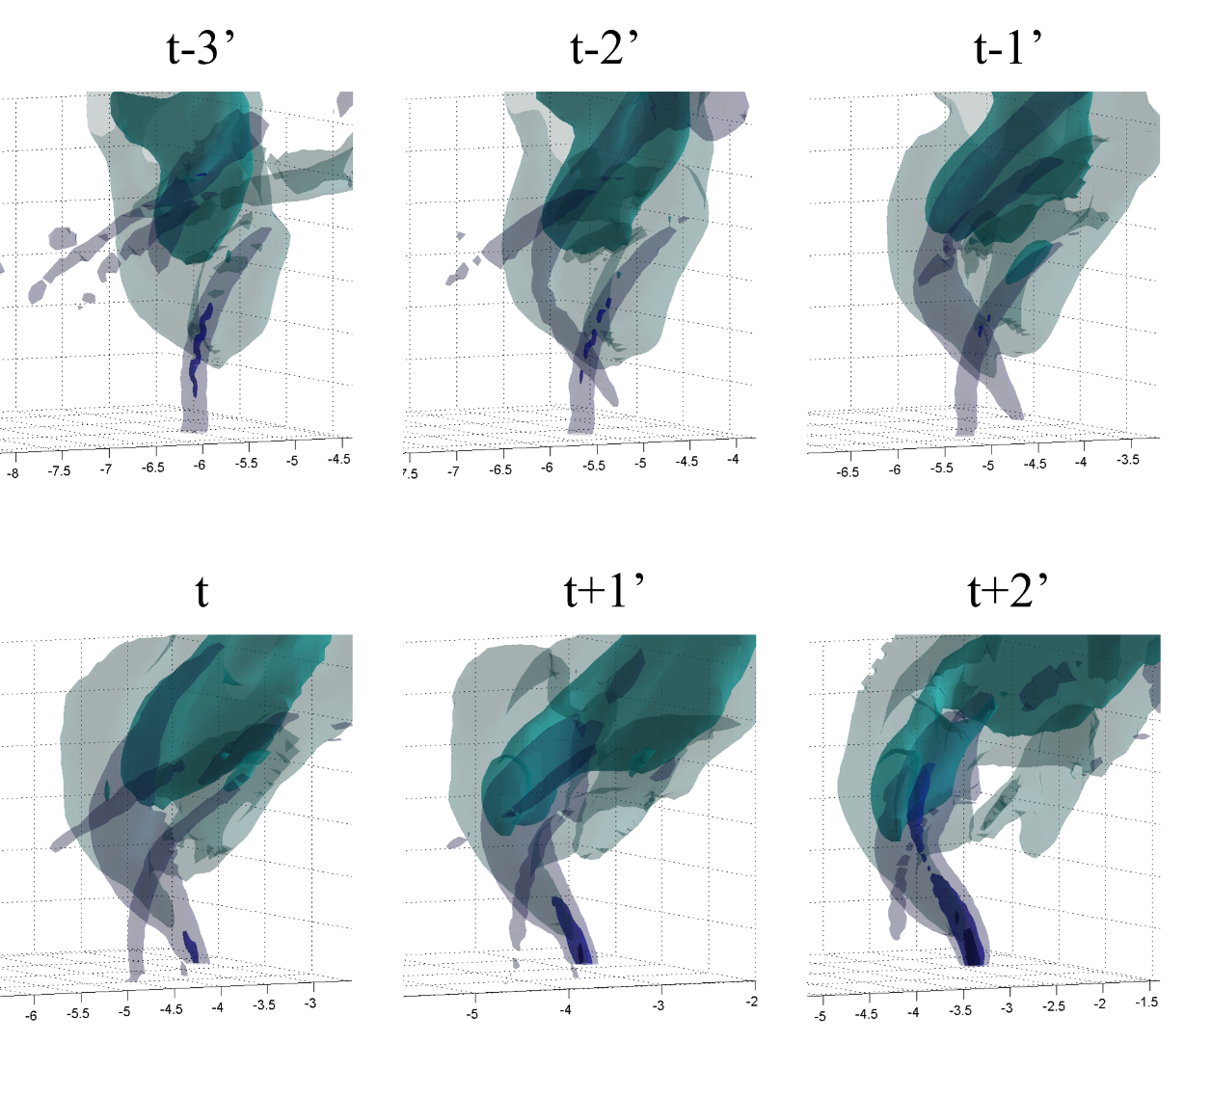
Vorticity Development
Vertical Velocity
15 m s⁻¹
10 m s⁻¹
Vertical Vorticity
top-down
0.1 s⁻¹
0.05 s⁻¹
1. Weaker rotation developed top-down
2. Rotation intensified touching the ground
3. Stronger rotation grew bottom-up
bottom-up
intensified

Slide 5
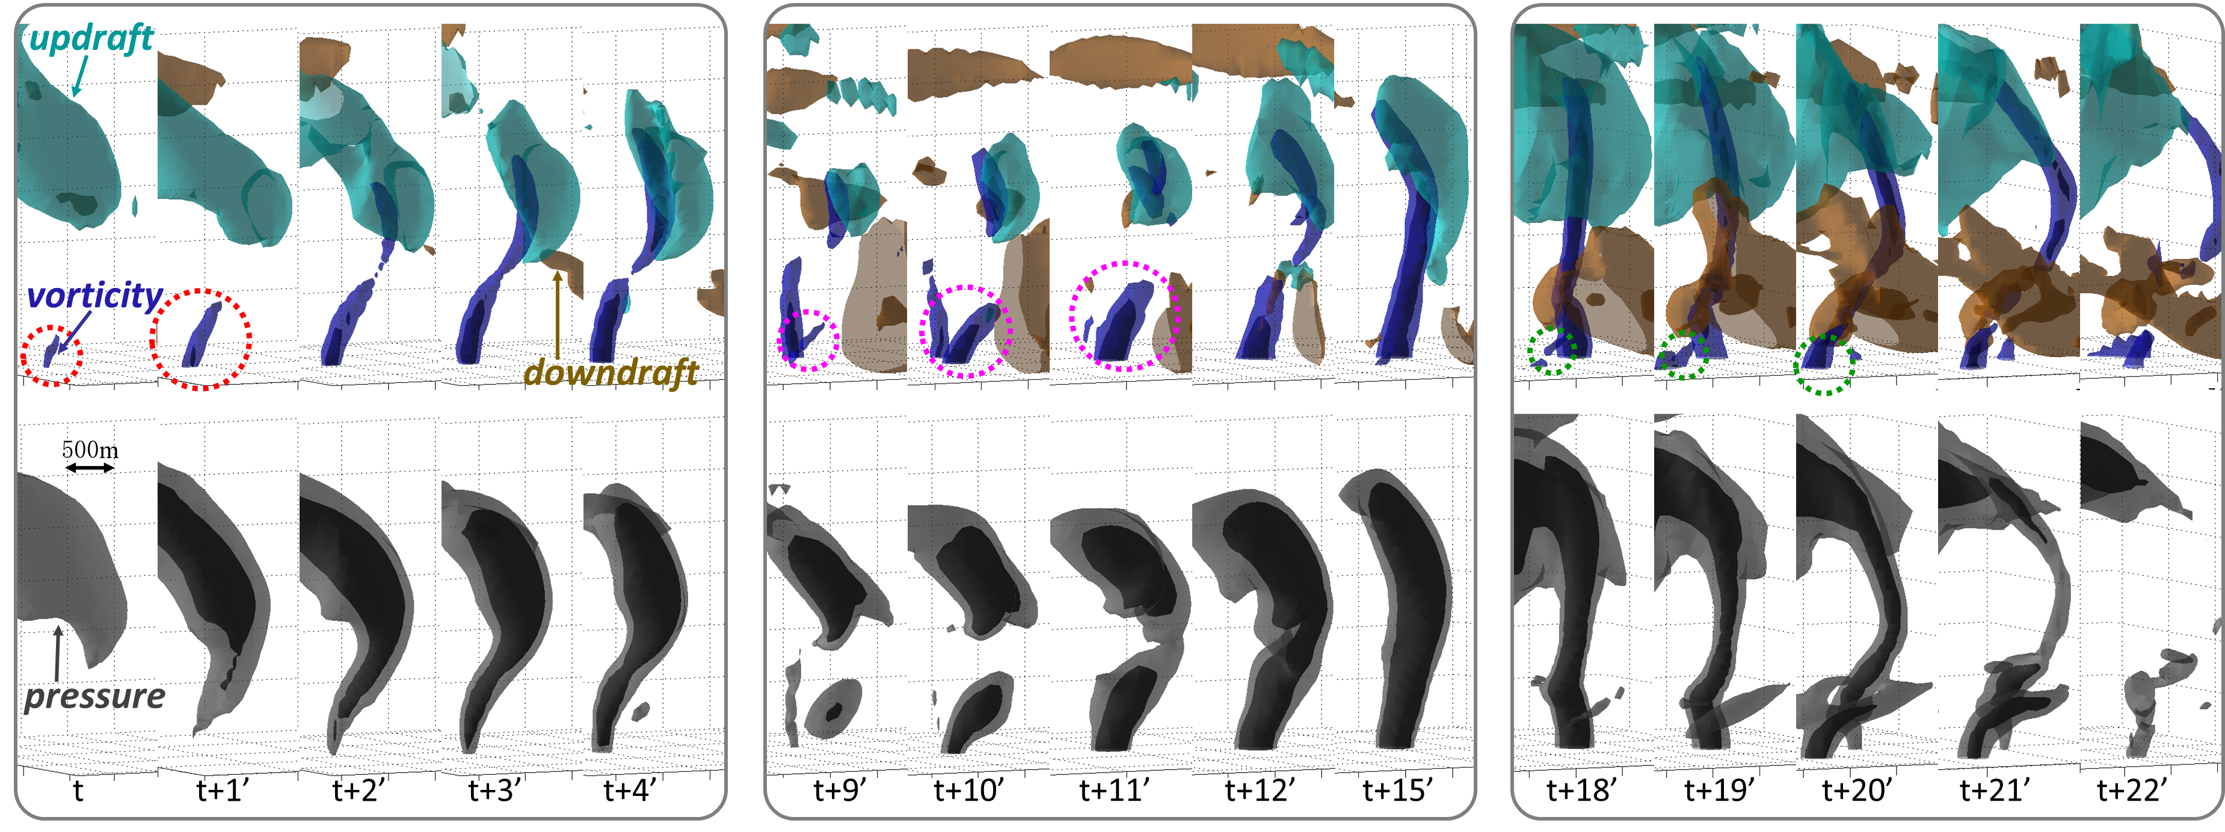
Vorticity Replacement
#1 & Tornadogenesis #2 & Re-intensification #3 & Tornado Demise
Low-level downdraft occluded into the lower part of the tornado,
though the midlevel updraft was intensified, not weakened.
(Yao and Meng 2015, in preparation)

Slide 6
Mechanisms at a Glance
Tornadogenesis
Maintenance
Tornado Demise
Suction
Suction
Suction
Top-down
Occlusion
Downdraft
Bottom-up
#1
#1
#2
#2
#3
Intensified when
touching the ground
Successful
vorticity replacement
Unsuccessful
vorticity replacement

Slide 7
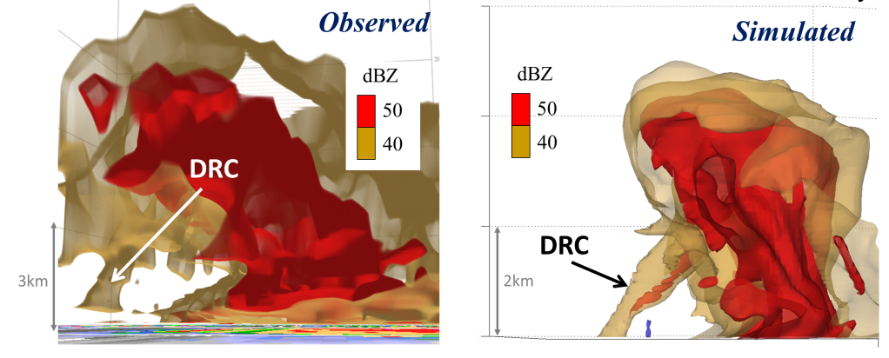
DRC Captured by CM1
3D Isosurfaces of Reflectivity
Observed
Simulated
DRC: descending reflectivity core
Not the funnel cloud. Mechanisms unclear.

Slide 8
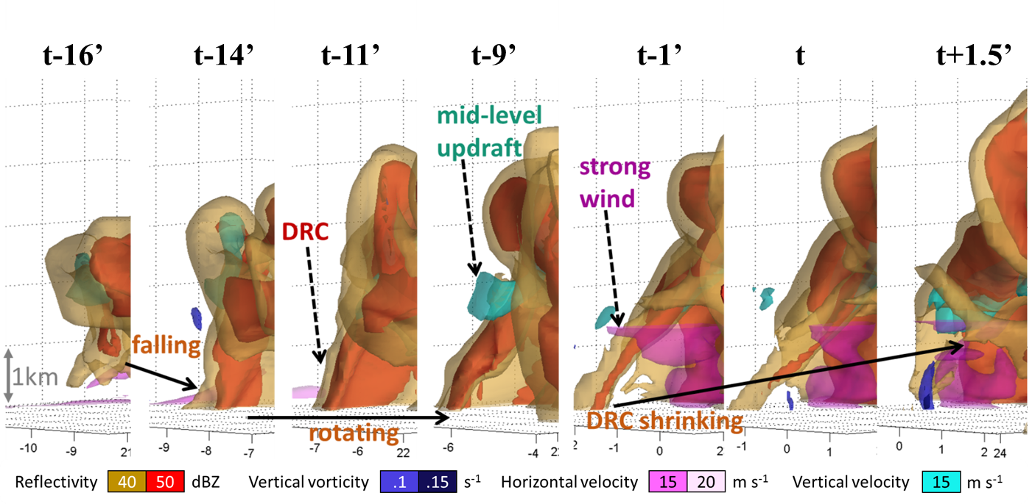
DRC & Tornadogenesis
Next-step interests:
Impact of DRC on the intensification of near-surface rotation.

Slide 9
Skeleton of My PhD Thesis
Part I: Observational Facts (Finished)
Damage survey
Radar analysis
Sounding analysis
Part II: Simulated Features (Finished)
From genesis to maintenance & demise in comparison to observations
Development of vertical vorticity w.r.t. tornadogenesis
Replacement of near-surface vorticity w.r.t. maintenance & demise
Part III: Dynamical Analyses (To be finished here)
Impact of the DRC on the intensification of near-surface rotation
Formation mechanism of the DRC in the Beijing tornado
(Collaborate with Profs. Paul Markowski & Yvette Richardson)

