Slide 1
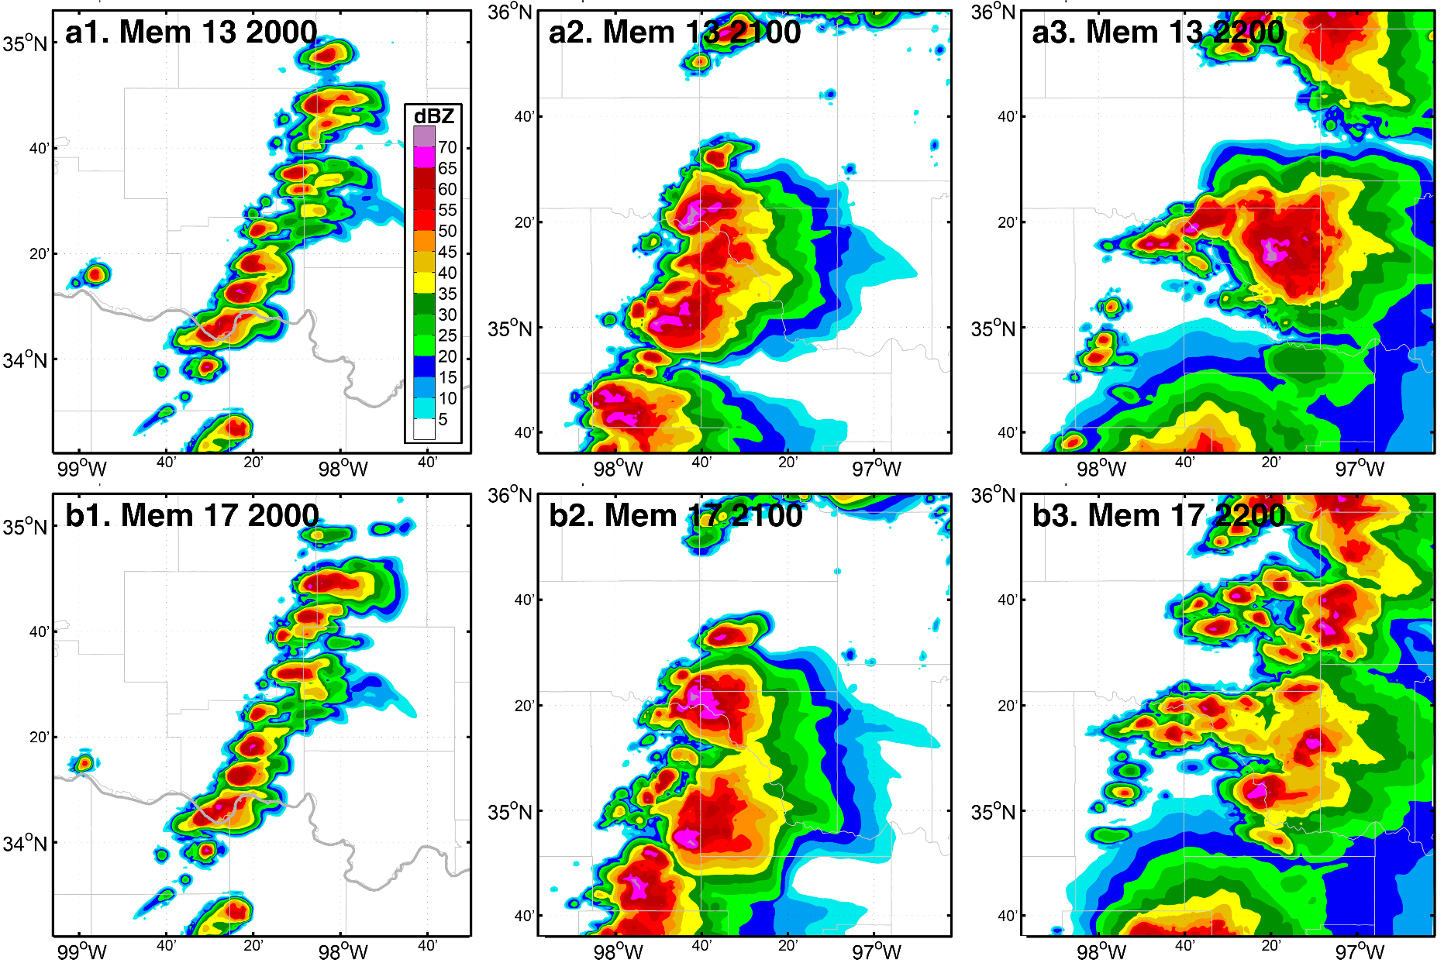
Intrinsic Predictability of Thunderstorms

Slide 2
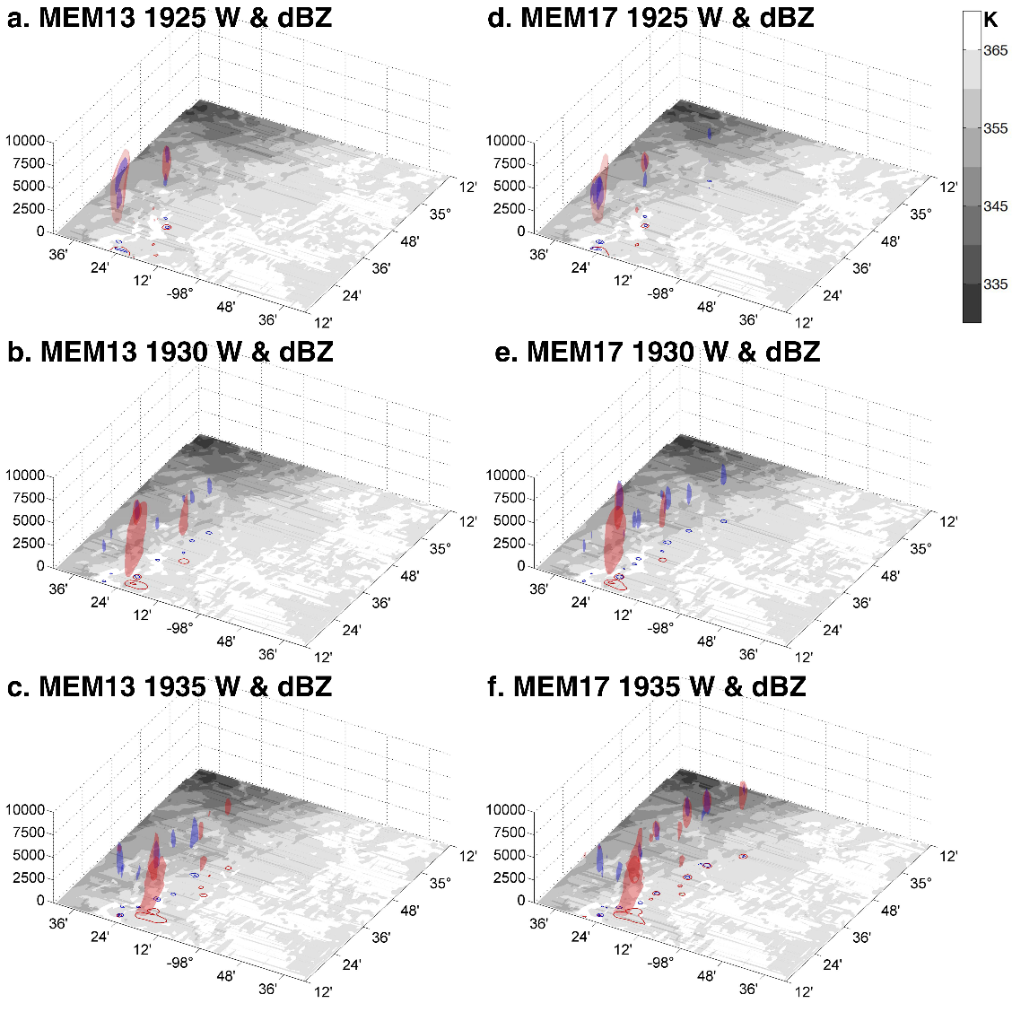
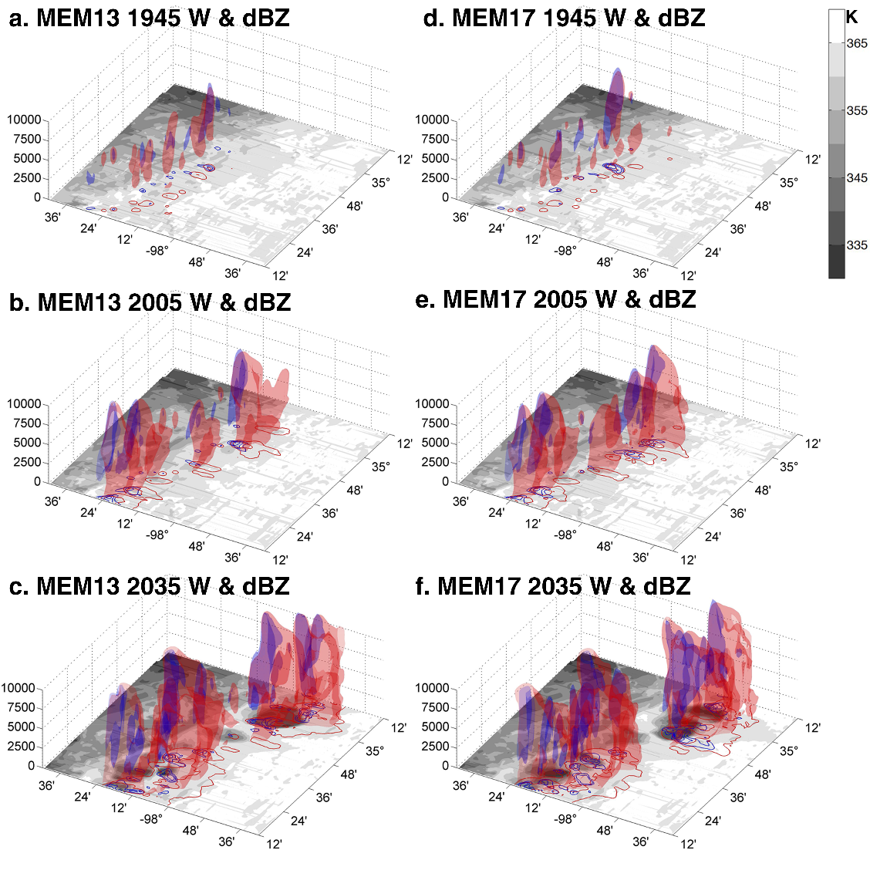
Initiation & Early Development
10 m/s W
40 dBZ

Slide 3
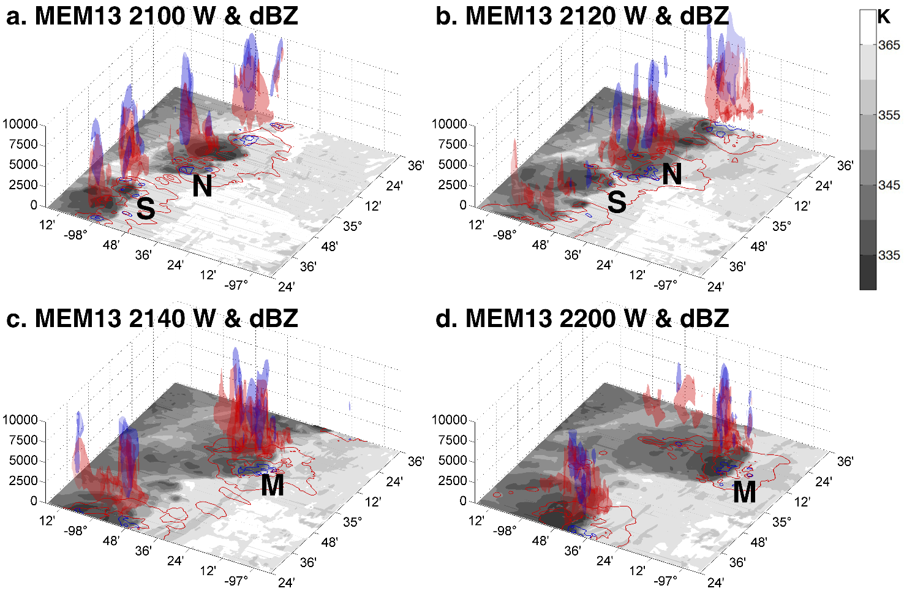
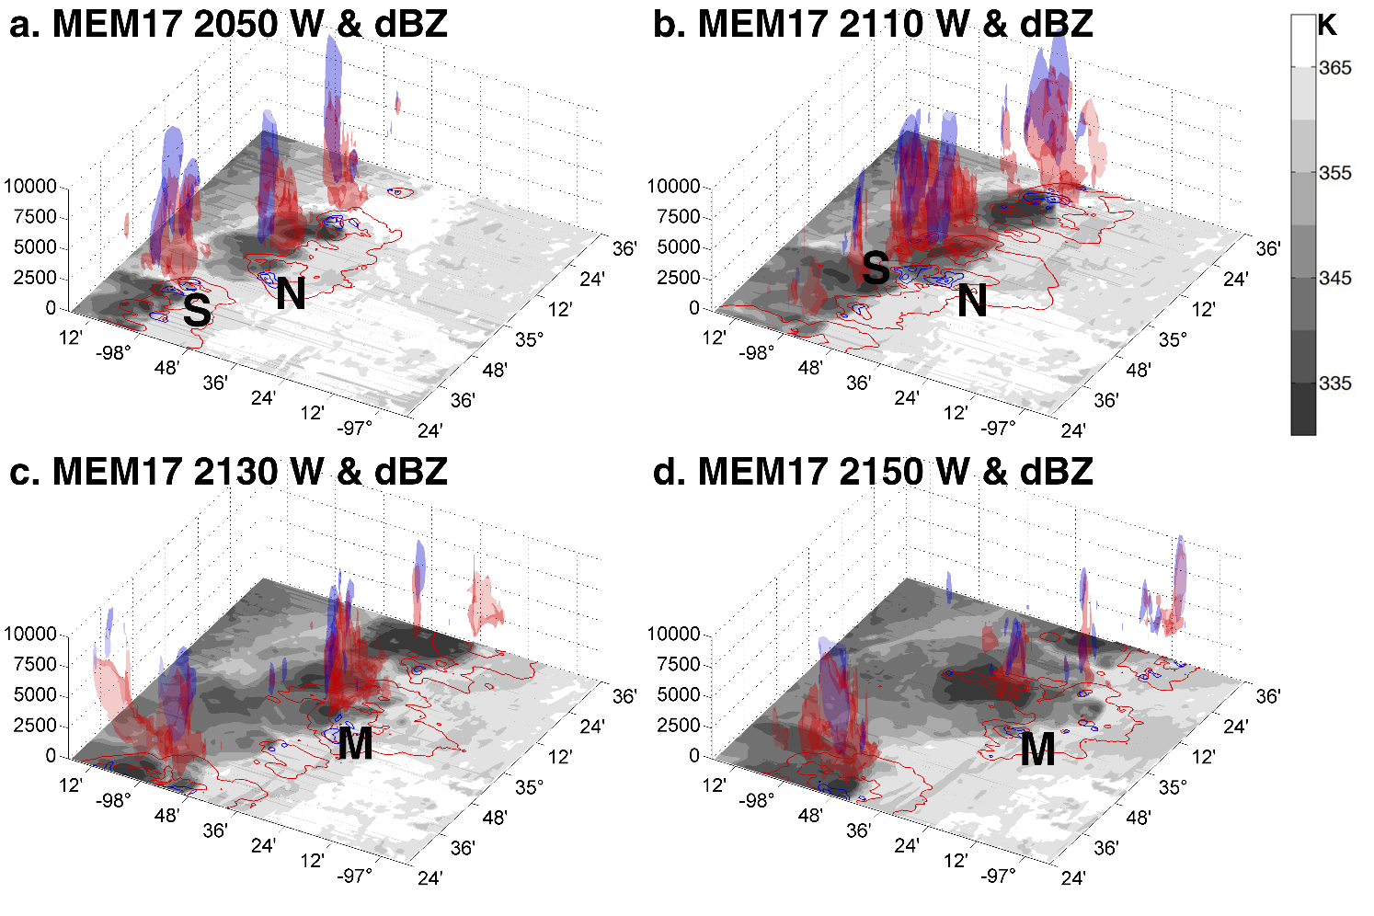
Organization: Merging Processes
20 m/s W
60 dBZ

Slide 4
Cold Bias in Frequent WRF Initializations
TRUTH
INT
TRUTH
INT

Slide 5
Vertical Distribution of Cold Bias

Slide 6
Cold Bias in 2-m T

Slide 7
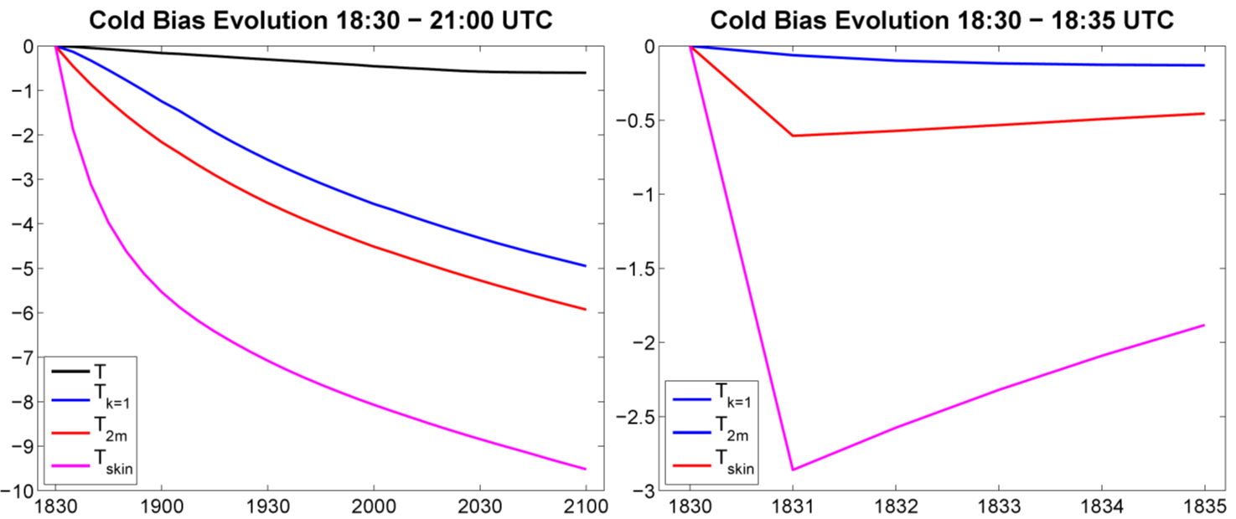
Evolution of Cold Bias in Different Layers

Slide 8
Possible Culprits
TSK is correctly ingested during standard initialization
Modify registry to output all restart variables in standard outputs
60+ variables were incorrectly initialized in LSM model
Input variable of surface-layer scheme:
Minor effect on atmosphere if no PBL scheme
Simple Solution: Using WRF restart in EnKF
  Issue: Storage (5x) and computational cost (2x in ensemble for my case)
AKHS | Surface exchange coefficient for heat | THZ0 | Potential temperature at ZNT
AKMS | Surface exchange coefficient for momentum | UZ0 | U wind component at ZNT
QSFC | Specific humidity at lower boundary | VZ0 | V wind component at ZNT
RMOL | 1/Monin-Obukhov length | ZNT | Time-varying roughness length
QZ0 | Specific humidity at ZNT

