Slide 1

Impact of Assimilating GOES-R Infrared Radiance on the Forecast of
Tropical Cyclones
picture ©Bungotakada city
Group Meeting on 2015.04.31
Masashi MINAMIDE (mum373@psu.edu)

Slide 2
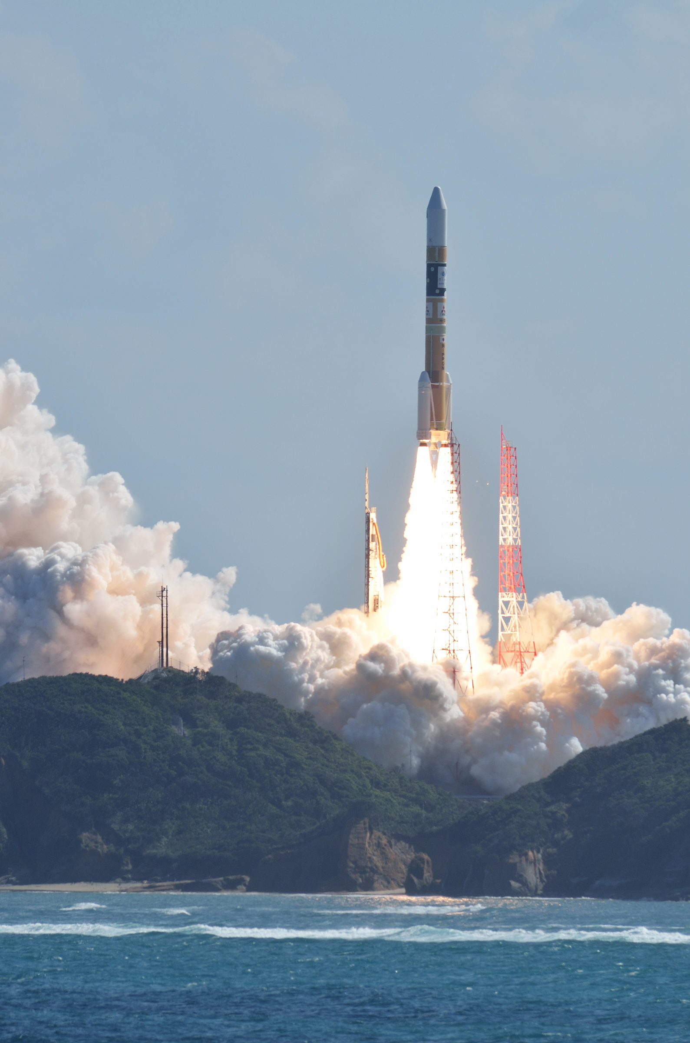
Introduction
“Himawari” (=sunflower in Japanese)
Himawari-8
(my focus satellite!)

Slide 3
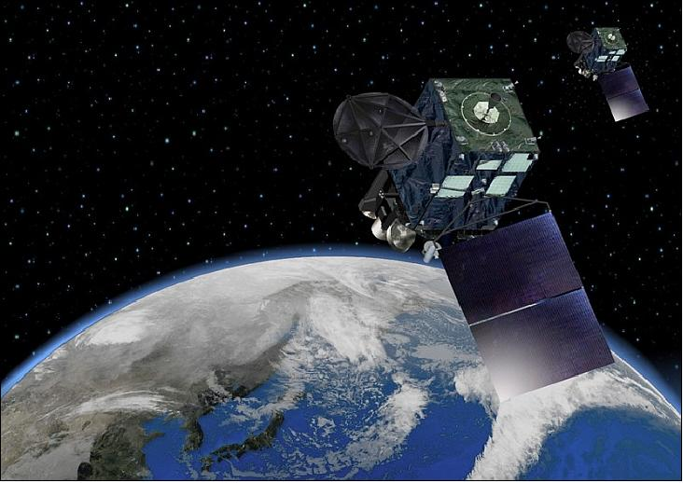
1. Introduction 2. Methodology 3. Results 4. Conclusion
Characteristics of Infrared Satellite Observation
  Radiance depends on Temperature, Moisture and Cloud Microphysical Variables
    Can provide information especially about moisture profile [Singh et al. 2014]
    Impact does not last long because of small sensitivity on wind & pressure fields. [Otkin et al. 2012, Jones et al. 2014]
  2D field observation
    Hemispheric coverage with continuous observation
    Lack of vertical Information

Slide 4
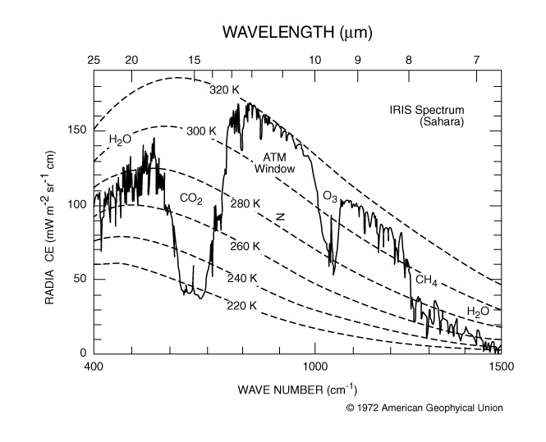
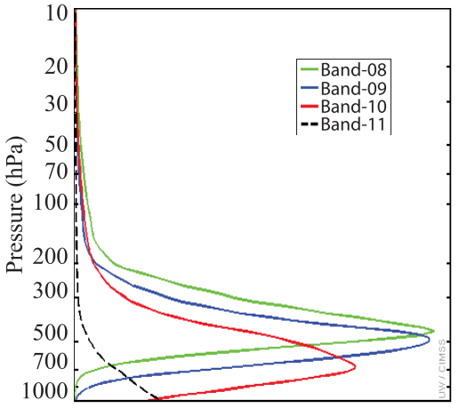
1. Introduction 2. Methodology 3. Results 4. Conclusion
New Satellites! ~Advanced Imagers~
  Advanced “Himawari” Imager (AHI) & Advanced Baseline Imager (GOES-R ABI)
  with high-resolution (~2-4km) at anytime (~every 10-15min)
    High temporal frequency can be the solution to small de-correlation time scale
  3 Water Vapor (WV) channels
    Expected to provide vertical information
Weighting functions on WV channels
[Otkin 2012]
Purpose
To investigate the assimilation strategy of infrared satellite observations

Slide 5
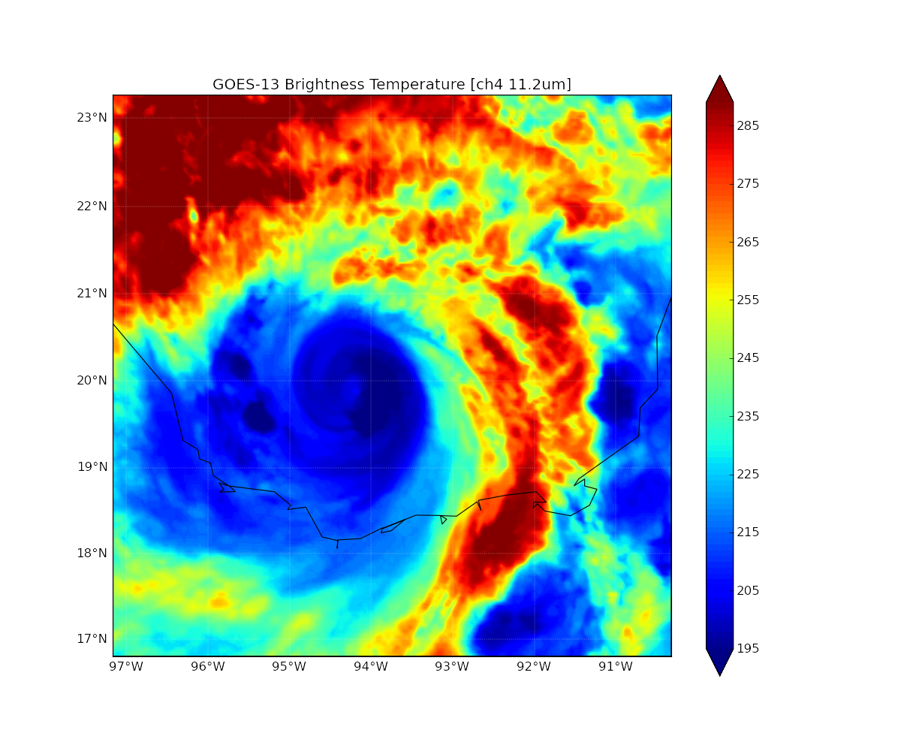
1. Introduction 2. Methodology 3. Results 4. Conclusion
EnKF-CRTM
WRF
EnKF-CRTM
Community Radiative Transfer Model
  Community Radiative Transfer Model (CRTM) is newly coupled to EnKF framework
  This new system can directly assimilate satellite infrared observations.
  Using this system, the assimilation strategy for satellite infrared observation has been investigated.

Slide 6
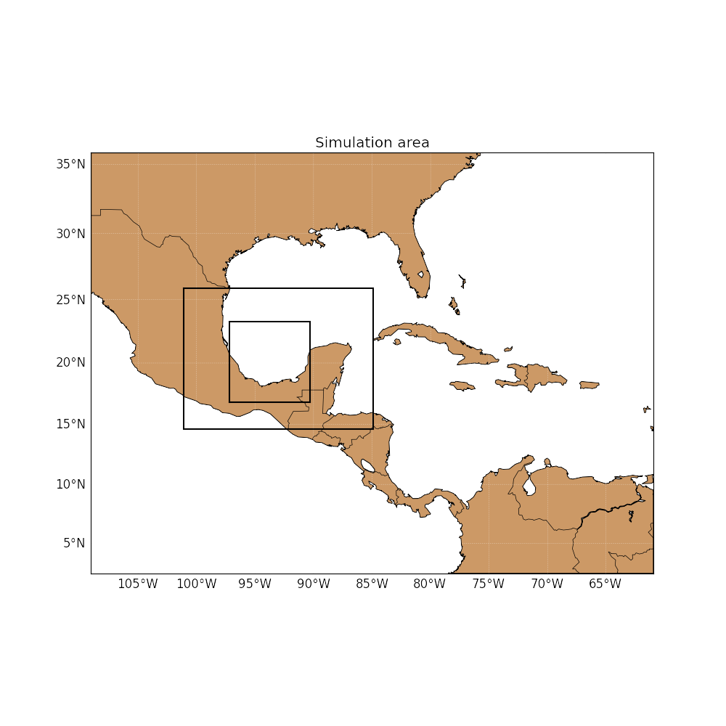
1. Introduction 2. Methodology 3. Results 4. Conclusion
Observation Simulation System Experiments (OSSE)
domain 1
  Since we do not have observations of new satellites yet, OSSE has been conducted.
  Resolution: 27km(d01), 9km(d02) & 3km(d03)
  Time step: 60sec
  “True” simulation has exactly the same domain
  Radiance is assimilated only in domain 3
domain 2
domain 3
12Z/16
19Z/16
20Z/16
21Z/16
Christopher’s simulation with Airborne Radar: ‘’True’
12Z/17
Airborne
  Pick up the 3rd strongest member as the “TRUE” state
  Pick up other members as EnKF initial members
22:00
22:15
22:30
…
end
OSSE
Radiance: 6.95μm

Slide 7
1. Introduction 2. Methodology 3. Results 4. Conclusion
Assimilation Strategy
Results
Main things to be investigated:
Done! (hopefully)
Future featured work
Channel selection
Radius of Influence
Quality Control
Observation error
Data Thinning
Variables Updated
Ensemble Mean
Relaxation
Frequency
Successive Order Localization (SCL)

Slide 8
1. Introduction 2. Methodology 3. Results 4. Conclusion
Assimilation Strategy
Channel selection
Radius of Influence
Quality Control
Observation error
Clear-sky
Band-8 (6.19µm) | upper troposphere
Band-9 (6.95µm) | middle troposphere
Band-10 (7.34µm) | lower troposphere
Band-14 (11.2µm) | surface
Cloudy-sky
Band-8 (6.19µm) | All sensitive to Cloud-top
Band-9 (6.95µm)
Band-10 (7.34µm)
Band-14 (11.2µm)
So, when should we use new 4 channels?

Slide 9
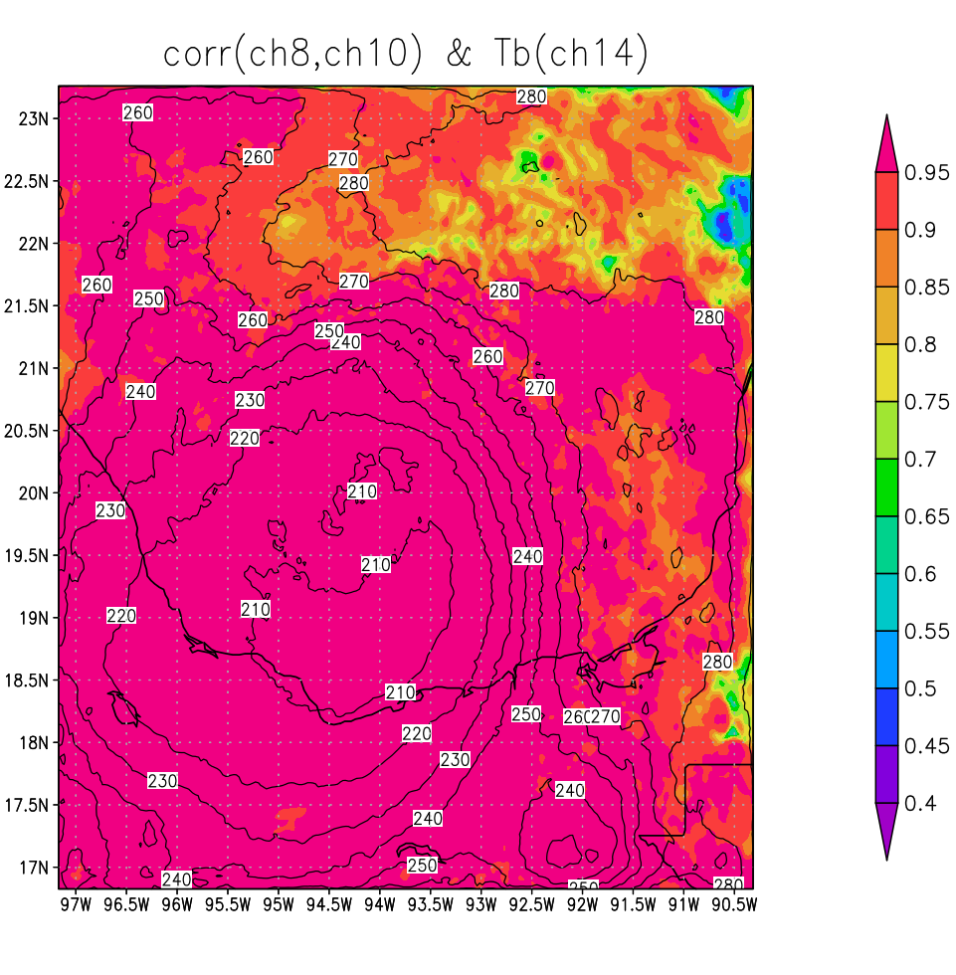
1. Introduction 2. Methodology 3. Results 4. Conclusion
Assimilation Strategy
Channel selection
Radius of Influence
Quality Control
Observation error
Clear-sky
Band-8 (6.19µm) | upper troposphere
Band-9 (6.95µm) | middle troposphere
Band-10 (7.34µm) | lower troposphere
Band-14 (11.2µm) | surface
(shaded)Correlation between band-8 & 10 on each grid, calculated with 60 ensemble members
(contour) band-14 radiance field of ensemble mean
Use 3 (or 4) channels: band8-10(&14) channels in clear-sky (> ~260K),
1 channel: band14 for cloudy sky (< ~260K).

Slide 10
1. Introduction 2. Methodology 3. Results 4. Conclusion
Assimilation Strategy
Channel selection
Radius of Influence
Quality Control
Observation error
How far is the de-correlation radius for infrared satellite observations?
RMSE after first analysis cycle with different ROIs
No-assimilation
Small radius: OK! Because we have hemispheric coverage with 2km²
Small influence on pressure fields: need other observations

Slide 11
1. Introduction 2. Methodology 3. Results 4. Conclusion
Assimilation Strategy
Channel selection
Radius of Influence
Quality Control
Observation error
Pick up one in each 5x5 grids De-correlated length by each radiances
Only allow radiance to update hydrometeors If radiance is assimilated with other observations, radiance only updates moisture, hydrometers & temperature.
The more frequent, the better. Needs more computational costs & smaller time step
Relaxation Coefficient ~ 0.3 is good to suppress spread.
When locations of storms are different between ensembles, we may need to use deterministic forecast as the prior.
TBD
Data Thinning
Variables Updated
Frequency
Relaxation
Ensemble Mean
Successive Order Localization (SCL)

Slide 12
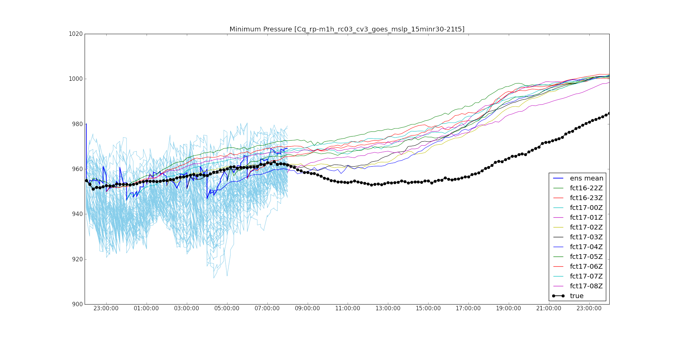
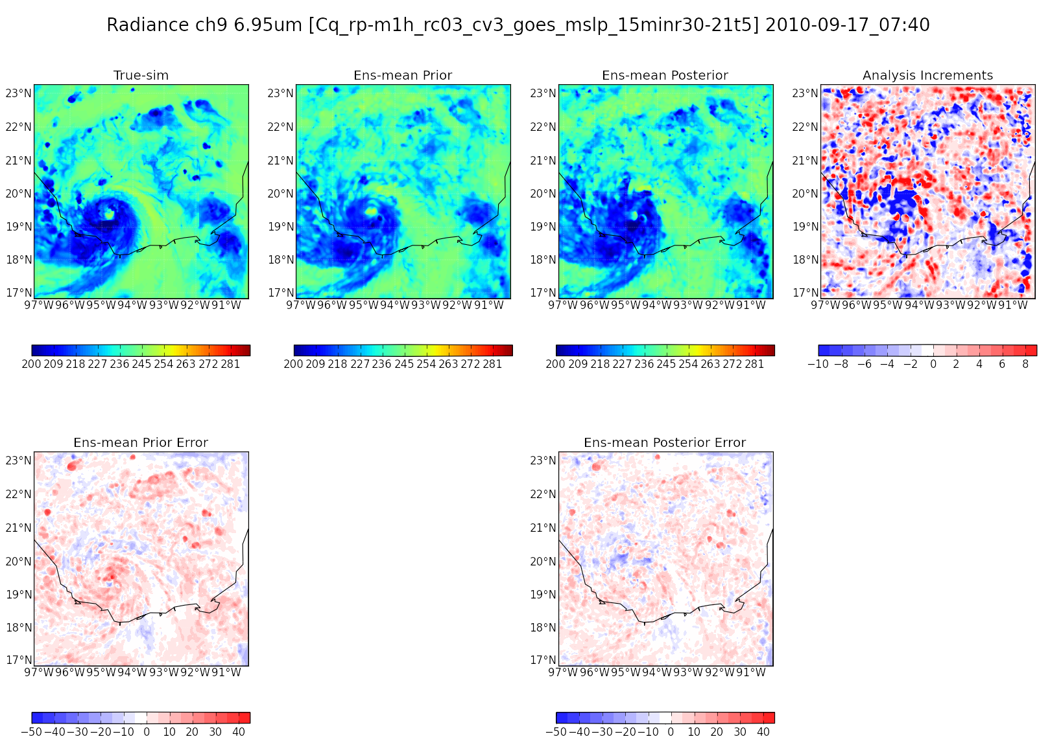
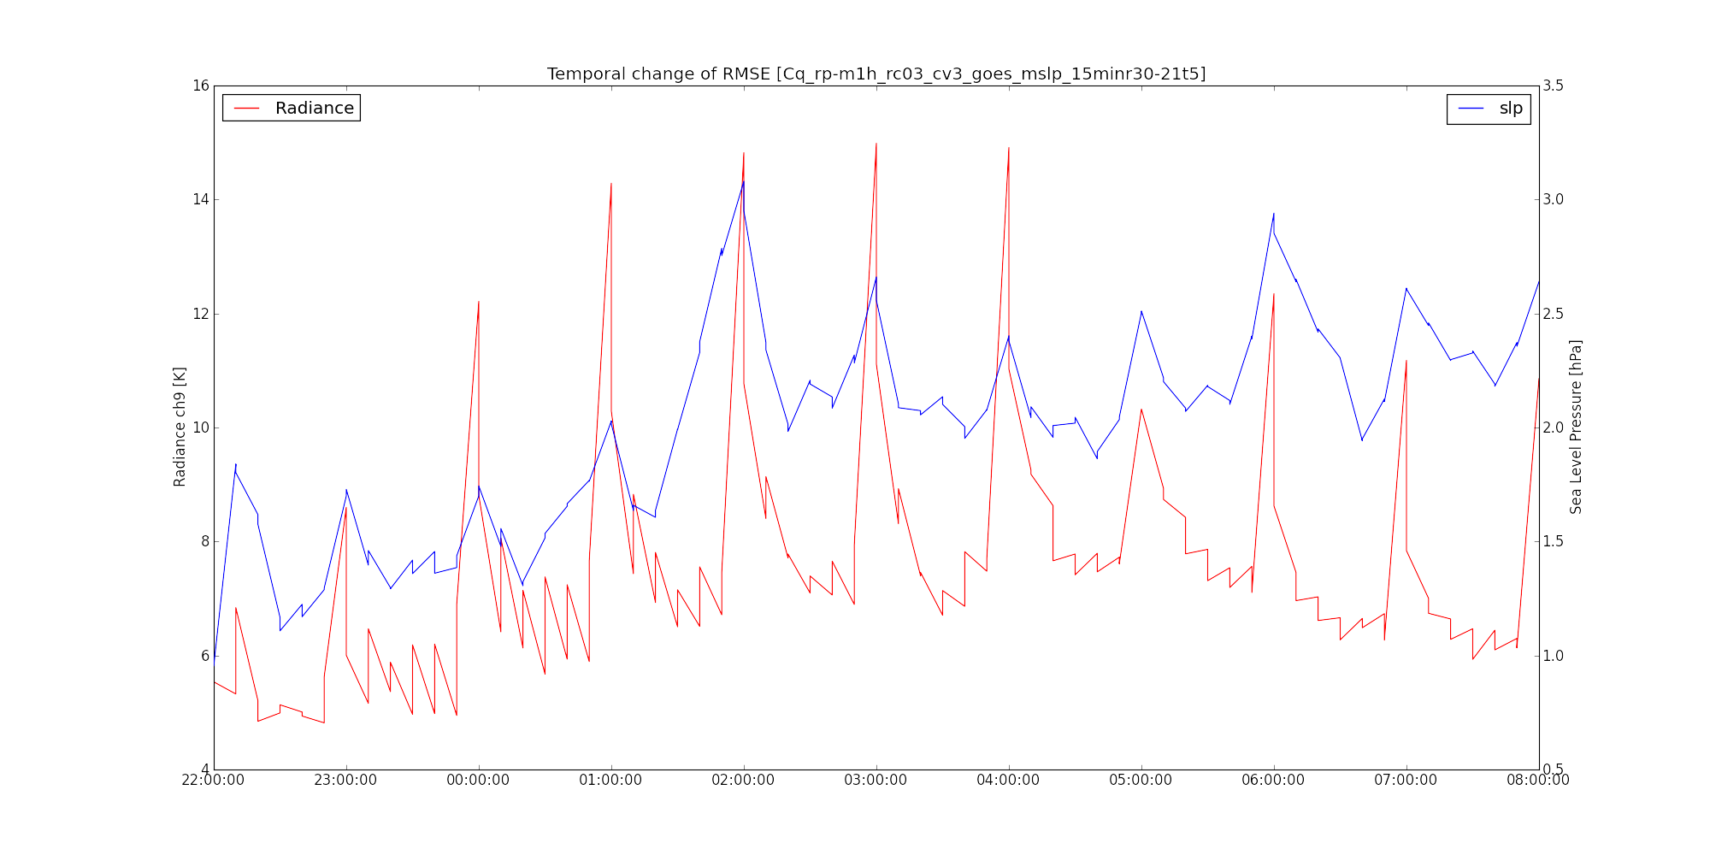
1. Introduction 2. Methodology 3. Results 4. Conclusion
Current Performance
Channel selection
Radius of Influence
Quality Control
Observation error
  OSSE using radiance(10-minutely) & minSLP (hourly)
  Even 10 hours after the initiation, continuous assimilation resulted in good reproduction of cloud fields.
  Cloud not reproduce re-intensification of hurricane.
  RMSE increases after the initiation
  Large perturbation

Slide 13
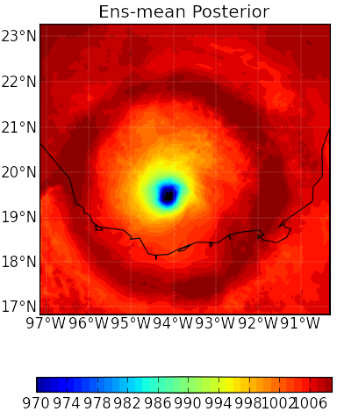
1. Introduction 2. Methodology 3. Results 4. Conclusion
Assimilation Strategy
Channel selection
Radius of Influence
Quality Control
Observation error
Problem: increment sometimes becomes quite huge.
Thought Experiment
  EnSRF
Increment
Distribution of Brightness Temperatures [K] across domain 3
  What if most of the ensembles shows cloudy,
  while observation shows clear-sky?

Slide 14
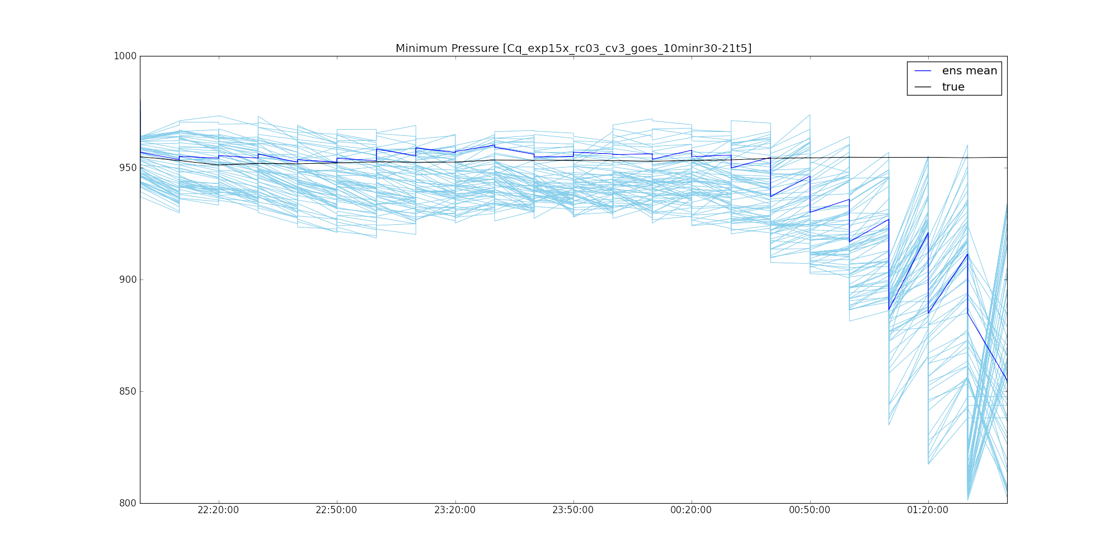
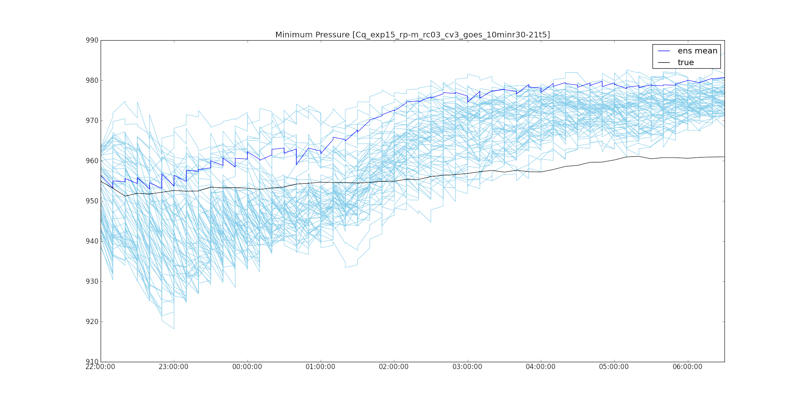
1. Introduction 2. Methodology 3. Results 4. Conclusion
Assimilation Strategy
Channel selection
Radius of Influence
Quality Control
Observation error
Problem: increment sometimes becomes quite huge.
Mitigation Strategy
  EnSRF
Temporal change of minimum SLP with original σ_{yo}
Temporal change of minimum SLP with changing σ_{yo} to Δy
  Too Strong Increment exists
  Increments are too weakened
Currently looking for the intermediate quality controlling strategy.

Slide 15
1. Introduction 2. Methodology 3. Results 4. Conclusion
Summary & Future Plans
Summary
  Strategy for infrared satellite data observation has been investigated.
  Channel selection, radius of influence and some other strategies are well investigated with OSSE experiments.
  There are some remaining strategies to be done such as quality control and observation errors.
  Reproducibility of cloud fields are quite good, but pressure and wind fields are not yet sufficient to reproduce intensity change of tropical cyclones.
Further researches
  Improvement in the impact on the RMSE of radiance, and on the pressure and wind fields.
  I would like to fix the assimilation strategies before the real observation data of Himawari-8 is released!
Thank you for your listening.
minamide@psu.edu

Slide 16
0. Supplementary slides
Advanced Satellite Infrared Imagers
New Sensors!!
Himawari-8/9 Advanced Himawari Imager (AHI)
  Launched on Oct. 7, 2014 (just 2 month ago!)
  To cover East Asia & Western Pacific Region
  16 bands (7 IR-band)
GOES-R Advanced Baseline Imager (ABI)
  To be launched on Oct. 2015
  To cover West Hemisphere
  16 bands (7 IR-band)
(Almost) Same bands!

Slide 17
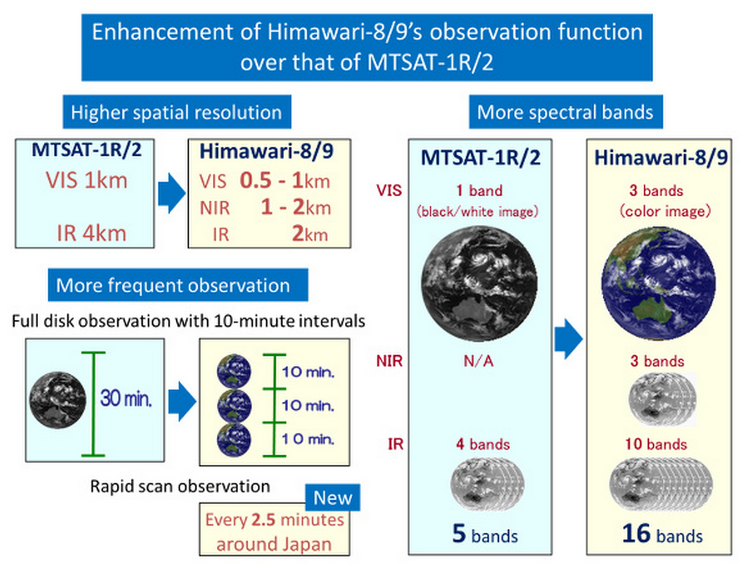
0. Supplementary slides
Advanced Satellite Infrared Imagers
Comparison between current and advanced Imagers
10min (Himawari)
15min
(GOES)
  Otkin (2012) MWR
New Water Vapor channels
  ▶︎Vertical Structure
  of Moisture
(from http://www.data.jma.go.jp/mscweb/en/himawari89/index.html)

Slide 18
0. Supplementary slides
Assimilation Strategy
Channel selection
Radius of Influence
Quality Control
Observation error
  Observation Error of Satellite Observation in Data Assimilation
  must include measurement & representative error, & error correlation [Cohn, 1997]
  have been obtained from sensitivity test [Otkin 2010, 2012], assumption from something…? [Vukicevic et al. 2006] etc.
    Not many studies have statistically estimated.
  For satellite, constant value has been assumed.
    However, clear & cloudy sky may have different observation error.
  Suoperobs also makes it difficult to assume observation error.
  Online estimation technique was proposed by Desroziers et al. [2005].

Slide 19
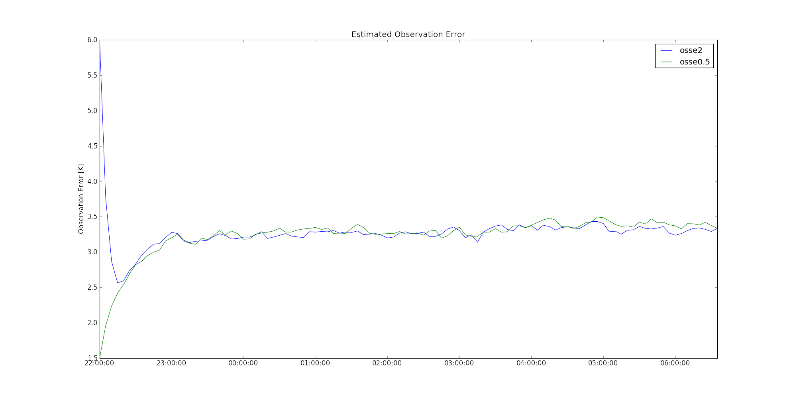
0. Supplementary slides
Assimilation Strategy
Channel selection
Radius of Influence
Quality Control
Observation error
EnKF
Observation Error: R
  Unknown in real
  Online estimation technique
  [Desroziers et al. 2005]
called OMA x OMB method
Estimated Observation error
Experiment | σ_{o(ini)} | R method | σ_{o}
true | - | - | 3.0K
osse2 | 6.0K | OMA x OMB | 3.3142K
osse05 | 1.5K |  | 3.3538K
True
  Desroziers’ Statistical estimation strategy has an ability to steadily estimate the observation error in spite of bad initial value, though it is a little bit overestimation.

Slide 20
0. Supplementary slides
Simultaneous Estimation Strategy
Simultaneous Approach

Slide 21

0. Supplementary slides
Model Domain of Simultaneous Estimation Experiment
  OSSE
  Simulated “True” observation (i.e. error is perfectly controlled) is assimilated
  Every 5 minutes
  Observations are the same grid as simulation
  To check whether simultaneous estimation works with strongly non-linear case: infrared radiance assimilation
  Real observation assimilation
  Channel 3 of GOES-13 (infrared water vapor channel) is assimilated
  Each observation is the average of 7*5 pixels
  Every 15 minutes(Rapid scan)
  To estimate appropriate observation error & inflation factor.
  Grid: 27km*27km (199*149)
  1 domain simulation
21:00/16
22:00
22:15
22:30
…
end
OSSE
Simulated infrared obs.
Obs-pixel
Real
GOES-13 ch.3
Simulation grid

Slide 22
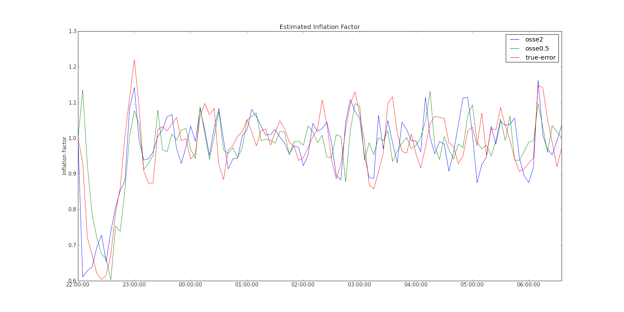
0. Supplementary slides
Simultaneous Estimation of σ_{o} & Δ through OSSE
Estimated Inflation factor
Experiment | σ_{o(ini)} | Δ method | Δ
True-error | 3.0K(const.) | AMB x OMB | 0.9996
osse2 | 6.0K |  | 0.9966
osse05 | 1.5K |  | 0.9966
  Since Δ oscillated around 1.0, inflation are not required with GOES-13 infrared radiance assimilation case.
Estimated Observation error
Experiment | σ_{o(ini)} | R method | σ_{o}
osse2 | 6.0K | OMA x OMB | 3.3142
osse05 | 1.5K |  | 3.3538
  Simultaneous estimation strategy has an ability to well estimate the observation error in spite of bad initial value, though it is a little bit overestimation.
True

Slide 23
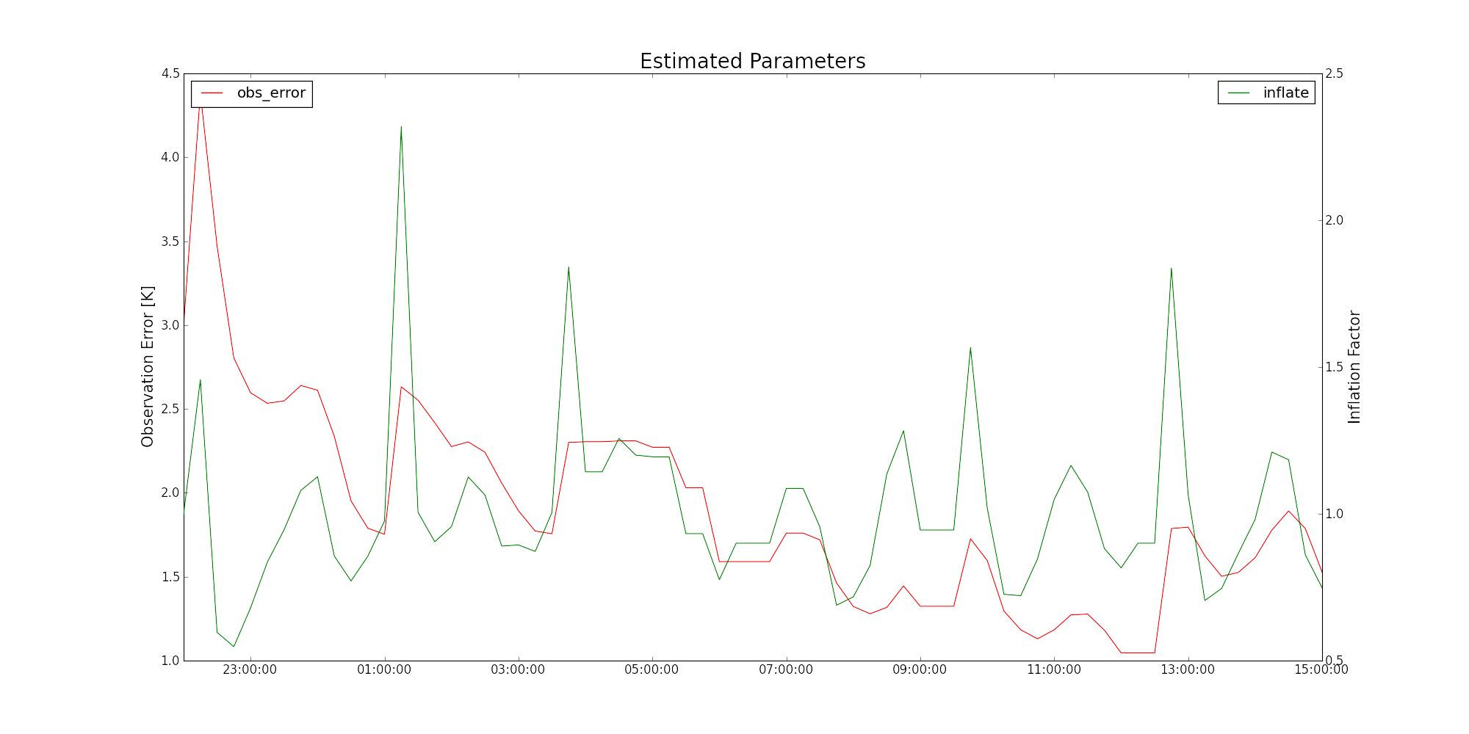
0. Supplementary slides
Simultaneous Estimation of σ_{o} & Δ with Real GOES-13 Data
Experiment | Δ method | R method | σ_{o} | Δ
Real | AMB x OMB | OMA x OMB | 1.4942 | 0.9697
  The results are largely oscillating, but I could not simulate more due to the computational cost.
  However, last several hours seems to have weak tendency.
  Since adaptive Δ is around -3% in average, it might need to give larger weight on observation error than using the inflation factor of 1.0.
  σ_{o} is much smaller than typically used value of ~2.5-3.0K.
    Assimilation strategy can greatly change the value of appropriate observation error.

