Slide 1
All-Sky Microwave Radiative Transfer Modeling: From Scheme-Based Effective Radii to Scheme-Based Cloud Optical Properties
Scott Sieron, Fuqing Zhang,
Eugene Clothiaux, Lu Yinghui
05/01/15

Slide 2
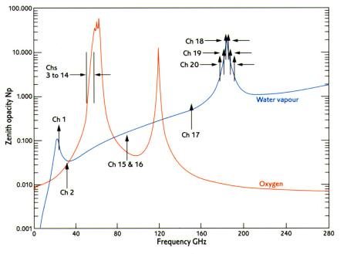
Background
Clear-Air Atmospheric Opacity vs. MW Freq. (AMSU channels demarked)
Primary O₂ Absorption Bands
Primary H₂O Absorption Band
Imaging channels: small clear-air opacity, so signal dominated by the surface and hydrometeors
At higher frequencies (>~50 GHz)
High water surface emissivity (high T_{B} in clear-air)
Hydrometeor impact dominated by snow/graupel/hail scattering
At lower frequencies (<~50 GHz)
Low water surface emissivity (low T_{B} in clear-air)
Hydrometeor impact dominated by rain absorption/emission, augmented by ice scattering
Imaging Channel
Imaging Channels
Temperature Sounding Channels
Moisture Sounding Channels

Slide 3
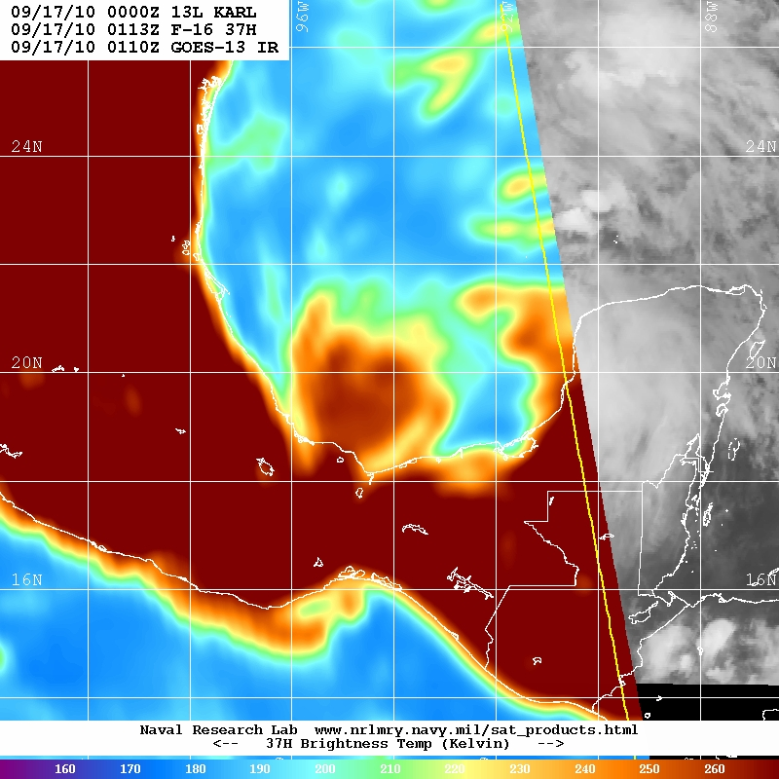
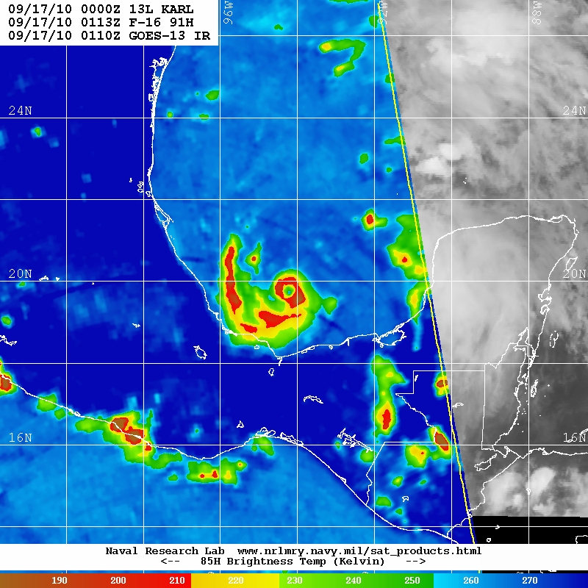
Lower Frequency (37 GHz)
Higher Frequency (91 GHz)
160
180
200
220
240
260
190
210
230
250
270
COLD
WARM
COLD
WARM
Observation at 09/17/10 0113Z
(image courtesy NRL)
Observation at 09/17/10 0113Z
(image courtesy NRL)

Slide 4
Background: Data Assimilation of Microwave Obs
Global DA uses sounding channels: where no precipitation, they collectively are informative of vertical profiles of temperature and moisture
Hurricane DA may find greatest value in using the precipitation information in these imaging channel observations
Can the observation operator (Community Radiative Transfer Model, CRTM) represent the radiance impacts of the hydrometeors with sufficient accuracy for DA?

Slide 5
About Clouds and Precipitation in CRTM
CRTM clouds are specified by
hydrometeor type
Radiative properties are calculated for spheres; snow and graupel are represented as “soft spheres” with densities < 917 kg/m³
amount of hydrometeor
size of hydrometeors
CRTM has lookup tables of per-mass radiation extinction property values for each hydrometeor type
Dimensions of cloud effective radius and (for liquid) temperature

Slide 6
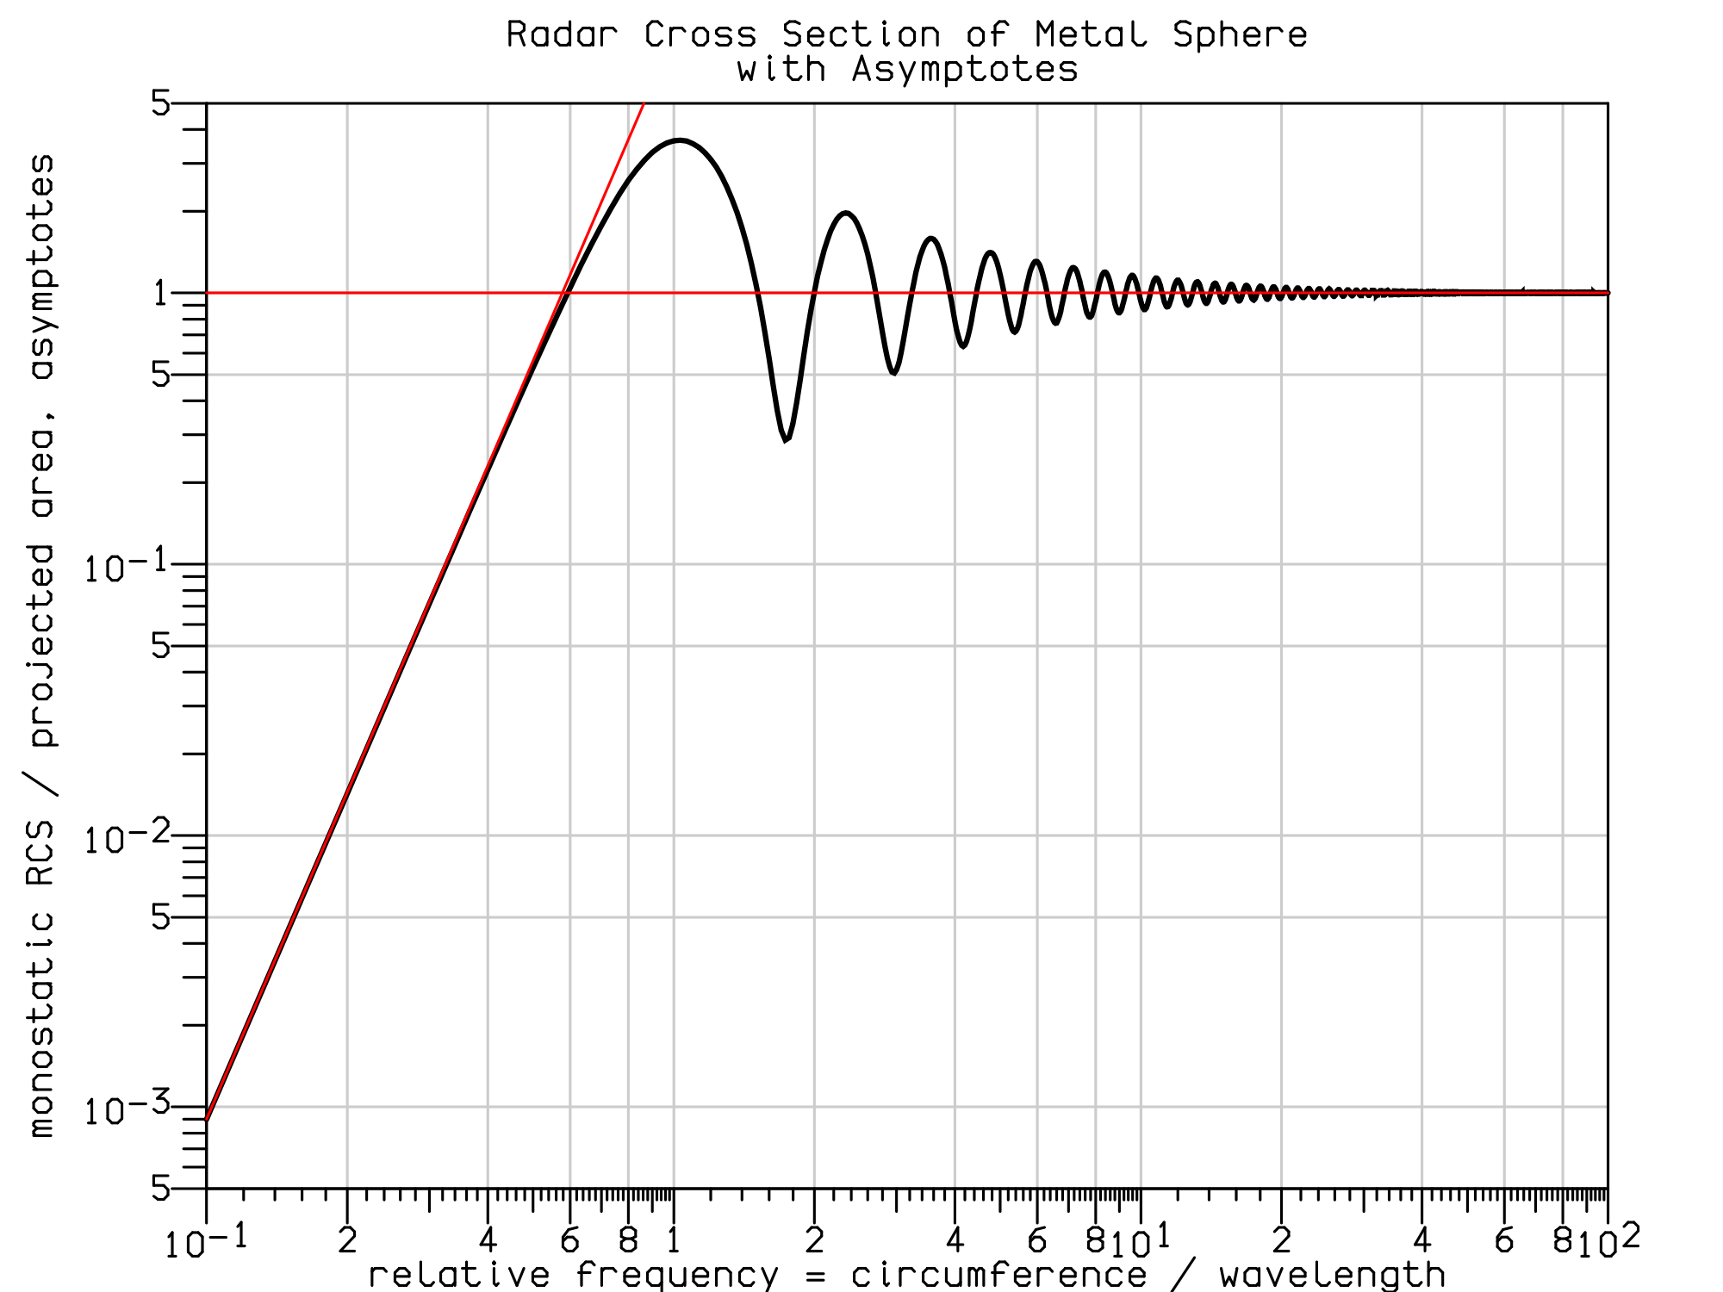
About Clouds and Precipitation in CRTM
Hydrometeor size is very important for microwave:
When (particle diam.) < ~⅓ wavelength, amount of scattering by particle increases by (particle mass)² (Rayleigh scattering)
Considering ever-increasing particle size, scattering per mass growth slows, it oscillates, then declines
These MW wavelengths are ~5 mm; the largest precipitation particles will exceed ~5/3 mm

Slide 7
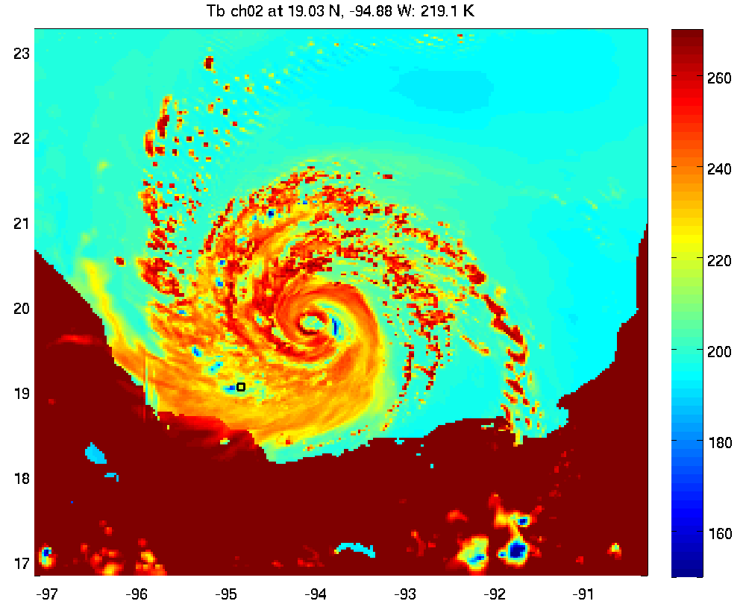
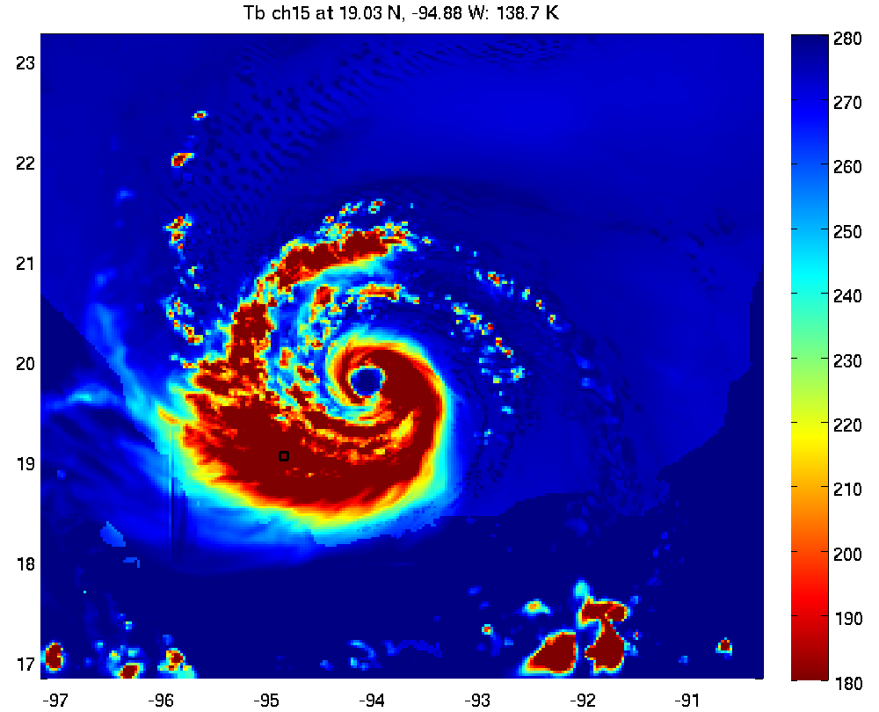
WSM6, Specified and Uniform CRTM Radii
Cloud: 15 μm Rain: 500 μm Ice: 50 μm Snow: 1000 μm Graupel: 1000 μm
37 GHz
89 GHz
160
180
200
220
240
260
190
210
230
250
270

Slide 8
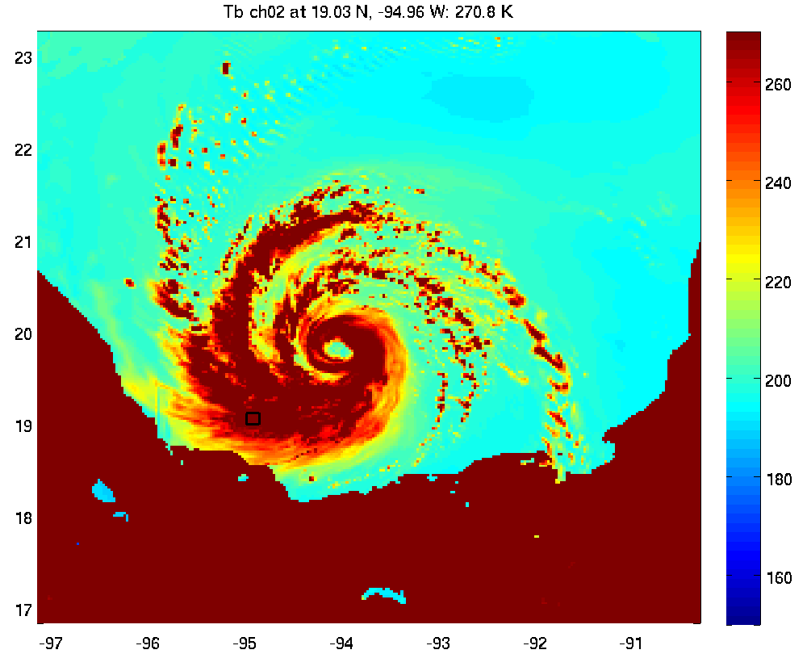
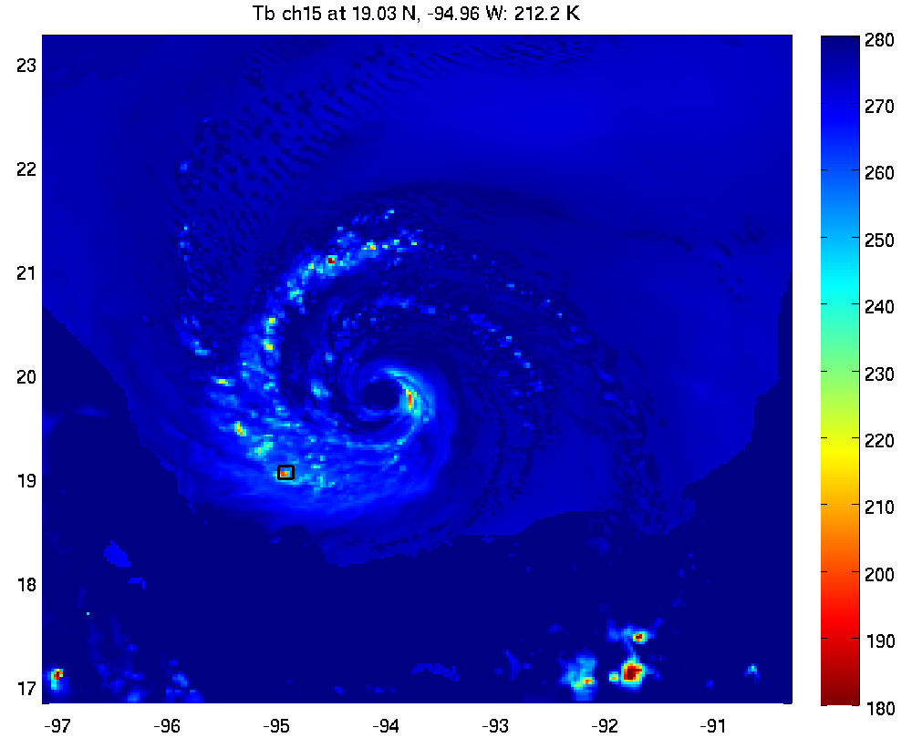
WSM6, Scheme PSD Mean as CRTM Effective Radii
37 GHz
89 GHz
160
180
200
220
240
260
190
210
230
250
270

Slide 9
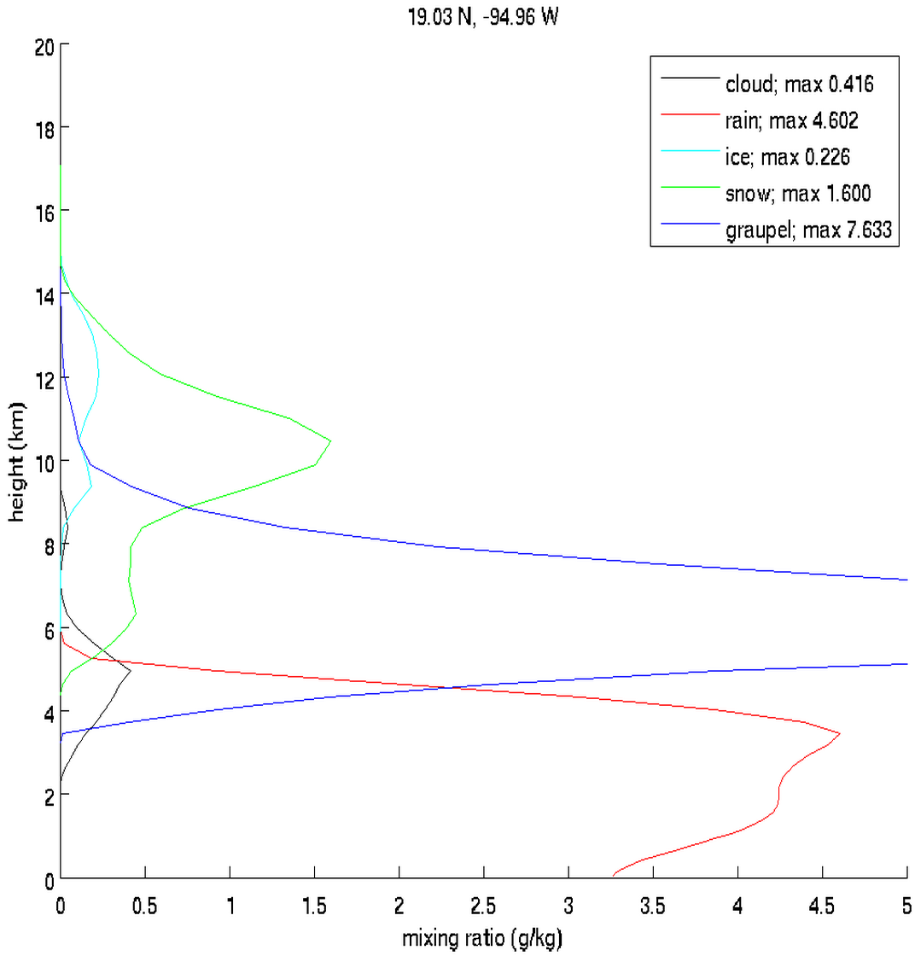
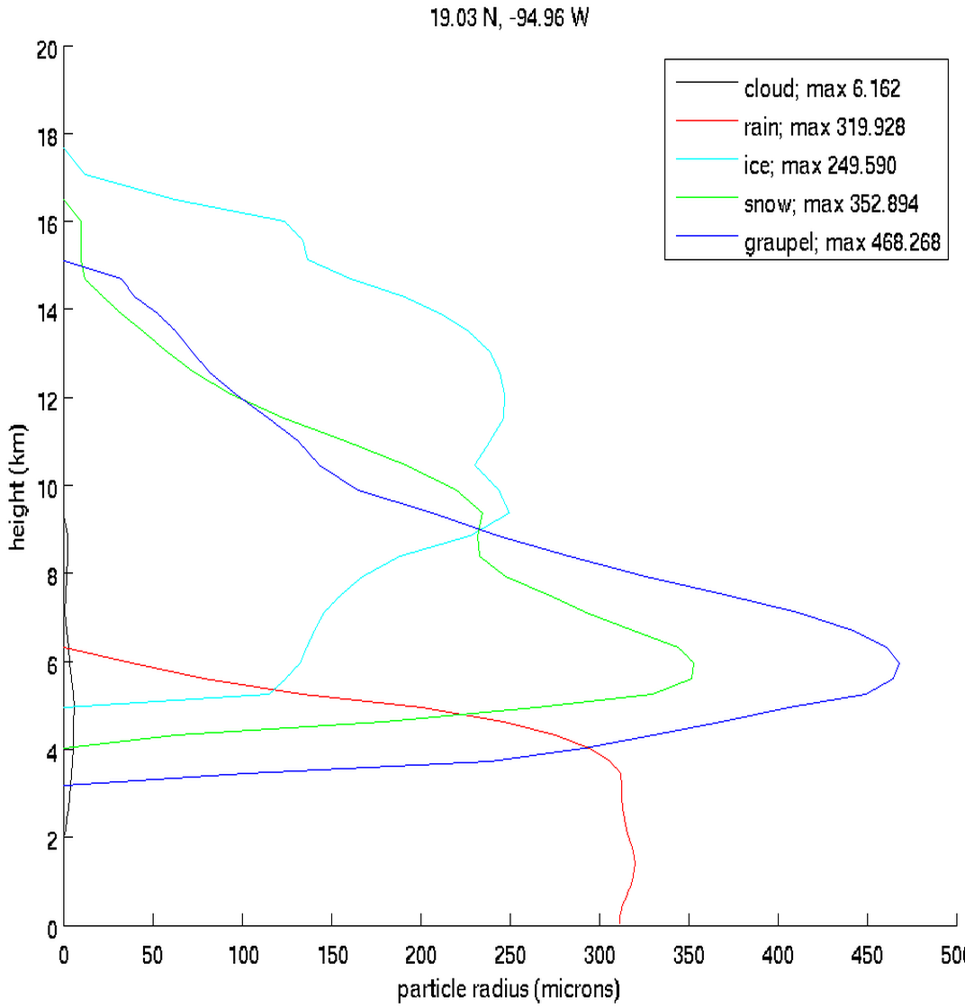
WSM6 Scheme
Compare to previously specified values:
Cloud: 15 μm Rain: 500 μm Ice: 50 μm Snow: 1000 μm Graupel: 1000 μm
Note: CRTM assumes cloud ice is sufficiently small so as to not scatter, which is an invalid assumption for the sizes seen here

Slide 10
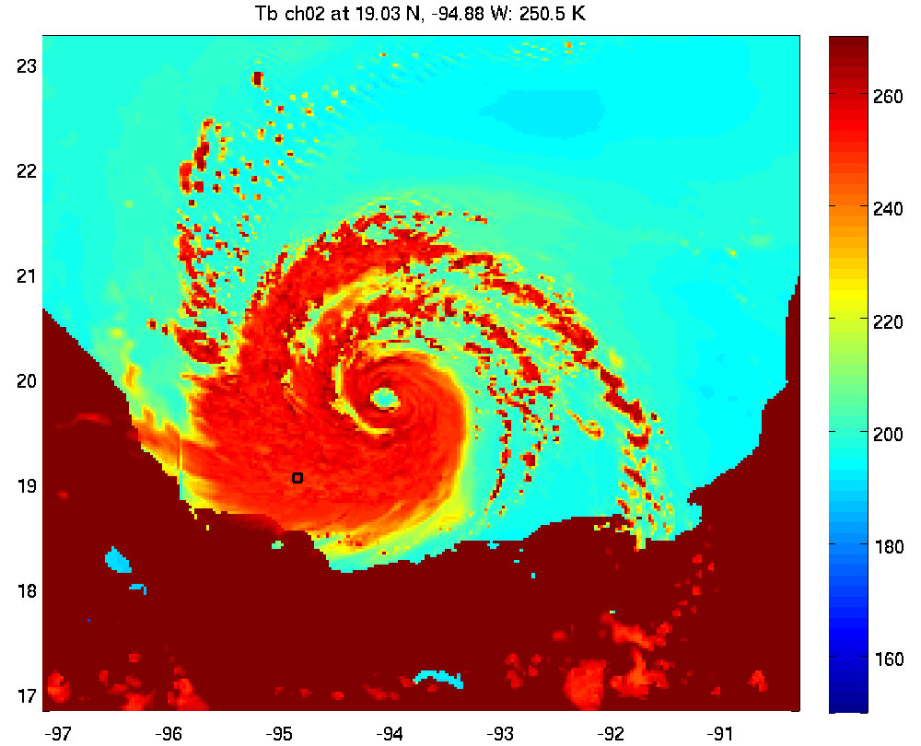
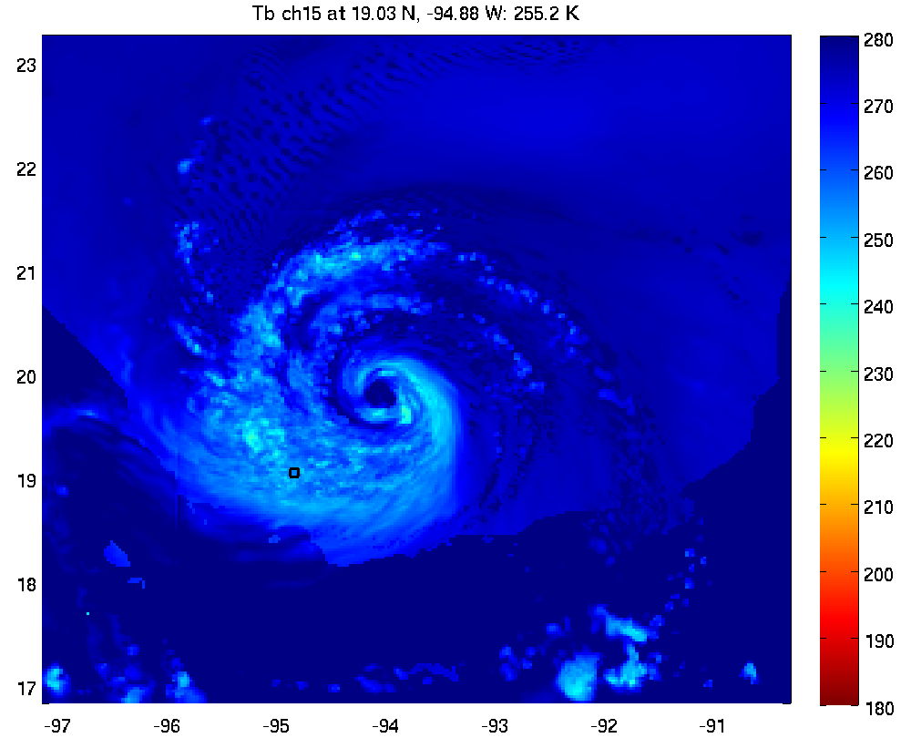
Lin Scheme (#02), Specified and Uniform CRTM Radii
CRTM Effective Radii
Cloud: 15 μm Rain: 500 μm Ice: 50 μm Snow: 1000 μm (No Graupel)
37 GHz
89 GHz
160
180
200
220
240
260
190
210
230
250
270

Slide 11
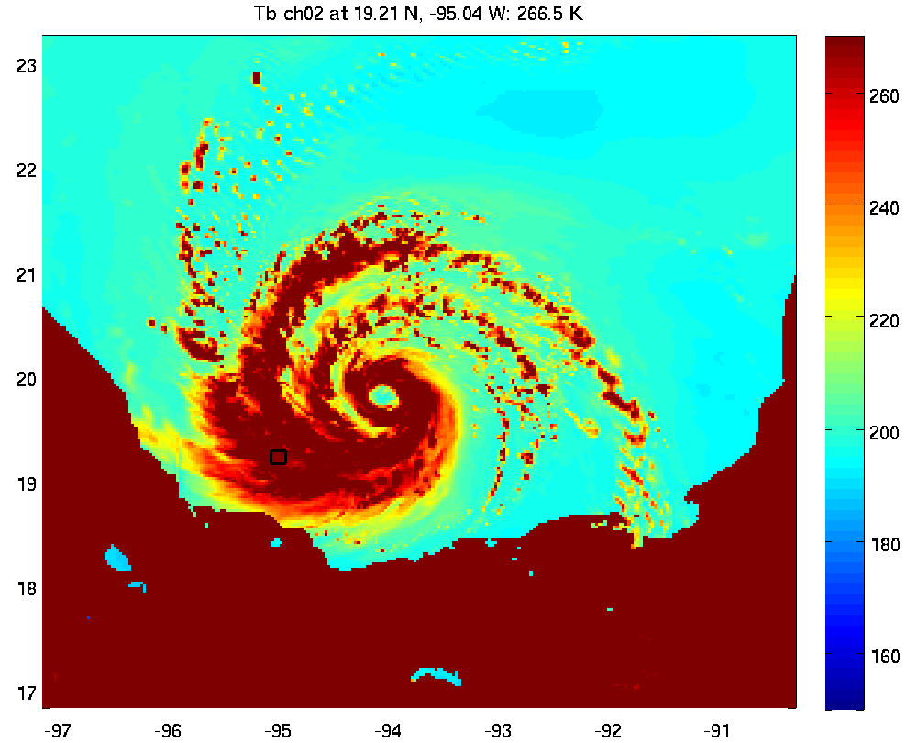
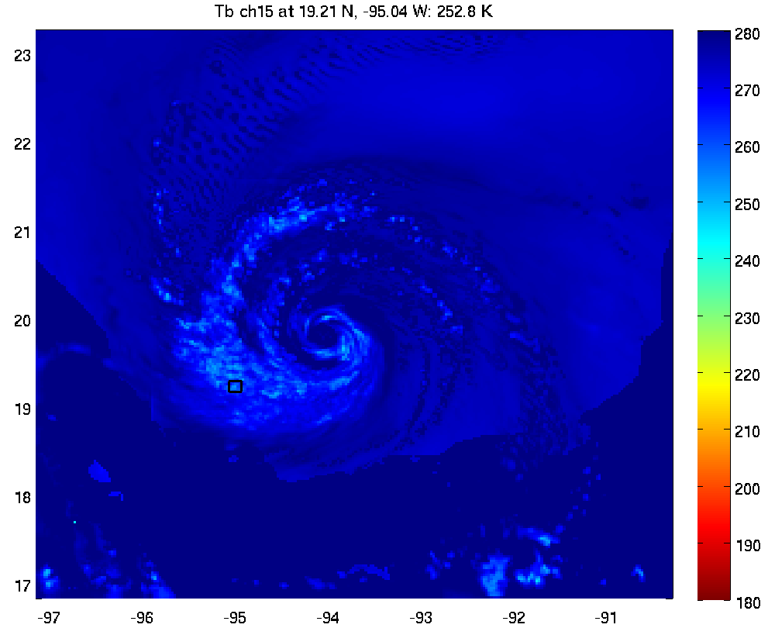
Lin Scheme (#02), Scheme PSD Mean as CRTM Effective Radii
37 GHz
89 GHz
160
180
200
220
240
260
190
210
230
250
270

Slide 12
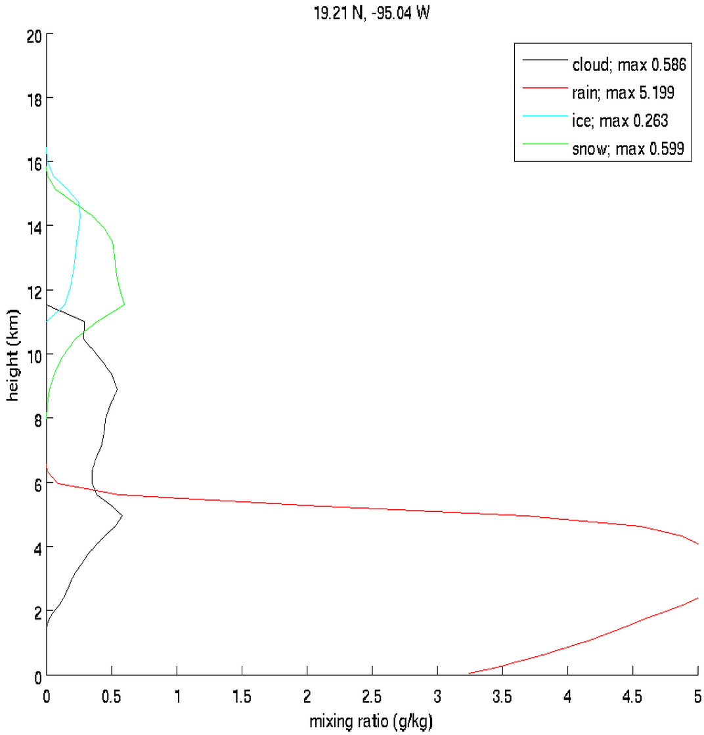
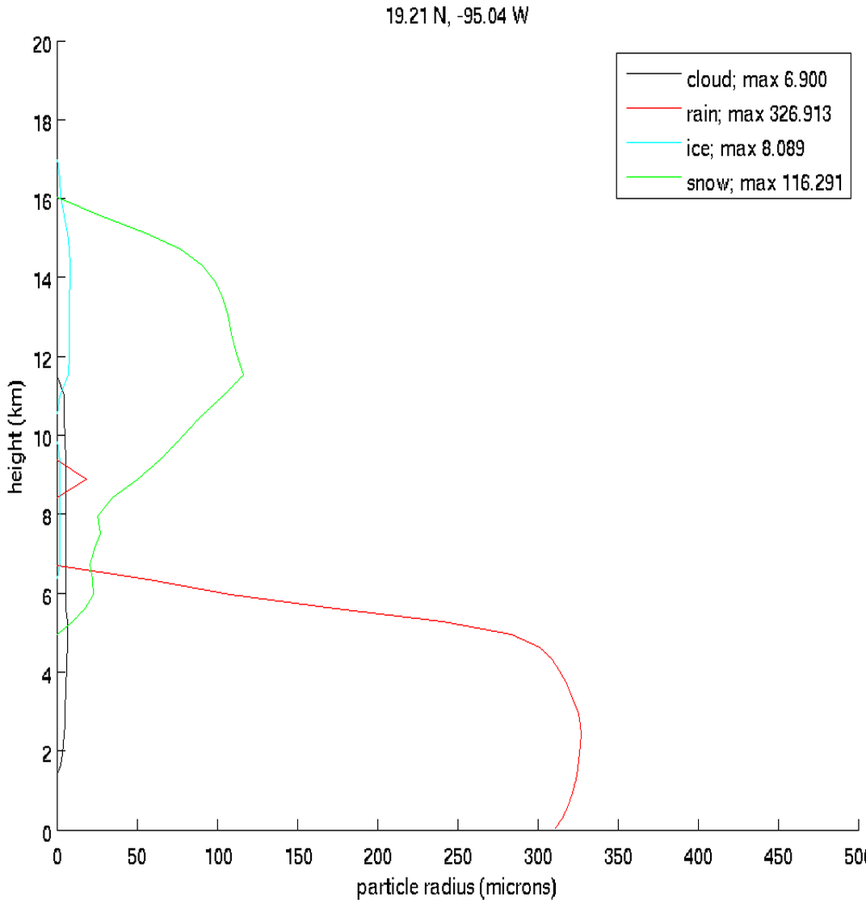
Lin Scheme (#02)
Compare to previously specified values:
Cloud: 15 μm Rain: 500 μm Ice: 50 μm Snow: 1000 μm (No Graupel)

Slide 13
CRTM Results, prescribed and uniform hydrometeor radii
37 GHz
cloud field should be even warmer -> there is too much scattering
too many instances of convective cells producing an anomaly of low temperatures
89 GHz
cloud field should not be that cold -> there is too much scattering
many instances of much too low brightness temperatures (~50 K)

Slide 14
CRTM Results, Effective Radii == Scheme Particle Size Distribution (PSD) mean
37 GHz
cloud field is too warm -> insufficient scattering everywhere
89 GHz
sufficient/excessive scattering in areas of strongest convection
most of cloud field is too warm, insufficient scattering

Slide 15
Why didn’t they work?
Pre-specified radii: too cold, too much scattering
Precipitating ice is generally being represented too large
The high importance of scattering, and the high dependence on particle radius, lends to our understanding that prescribing a particle radius for CRTM (even not vertically uniform) is too gross of an approximation, especially for purposes of DA
Scheme-specified radii: too warm, too little scattering
Mean particle radius of a cloud < “effective” scattering particle radius of a cloud

Slide 16
What else have we tried?
Analytically determining effective particle radii from microphysics (MP) scheme particle size distributions (PSD) for the scattering-dominated frozen hydrometeors
Assume all particles do Rayleigh scattering (problematic)
Result: multiply previous radius estimates by 4.9
This would put most graupel, snow > 1000 μm; CRTM results would have too much scattering

Slide 17
What next?
Create our own cloud property lookup tables for use in CRTM
LUT data calculated using clouds with PSD and particle properties specified by the microphysics scheme
MP scheme will be perfectly and natively interfaced with CRTM

Slide 18
Microphysics Scheme Details, Example
WSM6 Graupel
Exponential PSD: $N_{g}\left(D_{g}\right)=N_{0,g}e^{−λ_{g}D_{g}}$
$N_{0,g}\left[m^{−3}∙m^{−1}\right]=4.0×{10}^{6}$
Based on Houze et al. (1979)
$λ_{g}[m^{−1}]={\left(\frac{πρ_{g}N_{0,g}}{ρ_{a}q_{g}}\right)}^{1/4}, where λ_{g}≤6.0×{10}^{4}$
Shape: soft sphere
Particle density: ρ_{g} = 500 kg m⁻³
Look-up table dimensions and bounds (2): ρ_{a}q_{g}, [frequency]
${10}^{−11}<ρ_{a}q_{g} [{kg m_{air}}^{−3}]< 3.0×{10}^{−2}$

Slide 21
89 GHz extinction coeff from CRTM LUT close to truth when concentration is high (i.e. strong convection)
Value from CRTM LUT much lower than true value at 89 GHz for lower concentration and at all values for 37 GHz

Slide 22
At maximum mass extinction coeff, the largest contributor to total extinction are particles of diameter with maximum extinction
89 GHz extinction coeff from CRTM LUT close to truth when concentration is high (i.e. strong convection)
Value from CRTM LUT much lower than true value at 89 GHz for lower concentration and at all values for 37 GHz

Slide 24
What next?
Differences between CRTM LUT values and our LUT values are entirely consistent with the primary features of prior CRTM simulations
Next steps
Produce other LUT data (e.g. single-scatter albedo)
Modify CRTM scripts
Run CRTM simulations with our LUTs, compare to observation and results from the other CRTM settings
Produce LUT data for other schemes

Slide 25
Scheme-Specified Mean Radii as CRTM Cloud Effective Radii
Specified and Uniform CRTM Cloud Radii
190
210
230
250
270
89 GHz

Slide 26
Scheme-Specified Mean Radii as CRTM Cloud Effective Radii
Specified and Uniform CRTM Cloud Radii
160
180
200
220
240
260
37 GHz

