Slide 1
A Multiple Model Core Examination of Hurricane Sandy (2012)
Christopher Melhauser – Group Meeting – 04.30.2015

Slide 2
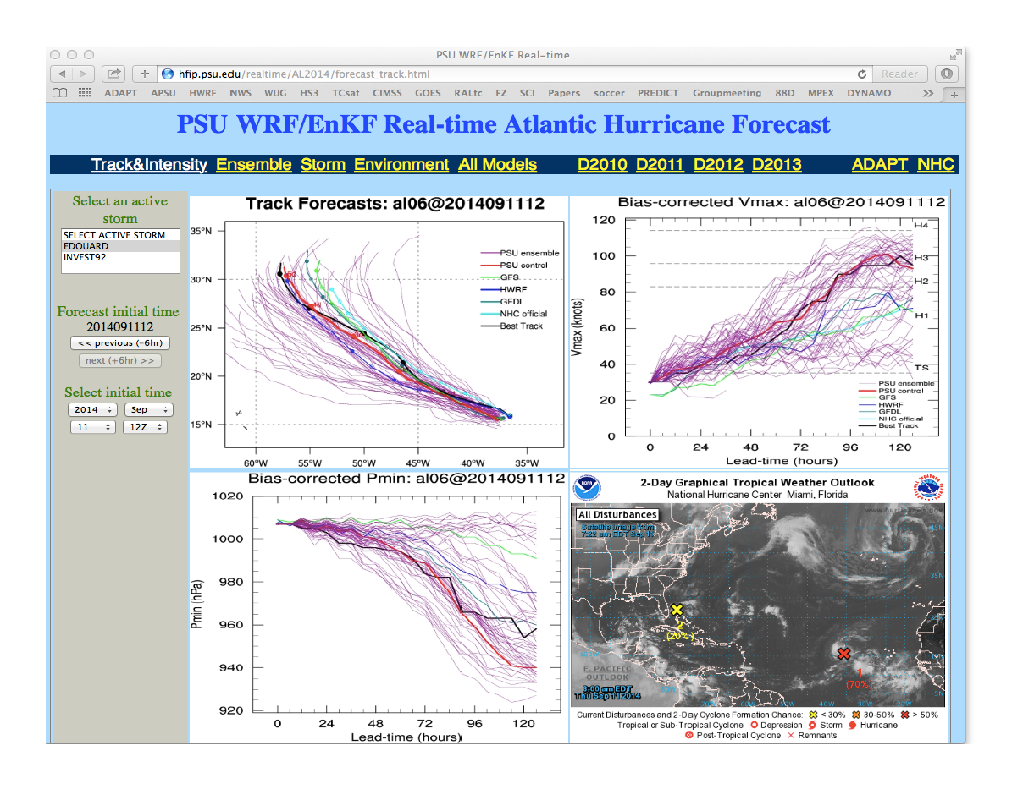
I know it is not sandy Sandy, but Edouard proved to be an ok guy.
APSU real-time system

Slide 3
Motivation…
How do different models (horizontal and vertical grids, numerical methods, dynamical equation formulations, physics, etc.) impact track and intensity forecasts from similar ICs?
Are there systematic biases between different models?
Is there an advantage to using multiple model cores versus single model multi-physics?
  i.e. improved representation of uncertainty?
Notes:
Hurricane track and intensity (among other) metrics are commonly compared between operational hurricane forecast models as a proxy for skill
Comparisons are made between models that have different physics, dynamical cores, and initialization procedures.

Slide 4
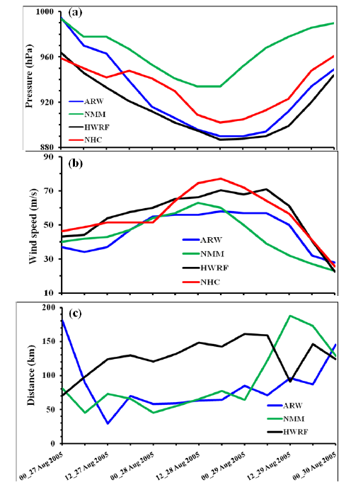
Studies in the literature…
Possibly in the ballpark...?Dodla et al. 2011 (International Journal of Environmental Research and Public Health?)
  Initialized HWRF, WRF-ARW, and WRF-NMM
    Inserted bogus vortex (all three had different procedures)
    Used GFS FNL (1º) for HWRF and GFS forecast (0.5º) for WRF-ARW and WRF-NMM
Many studies on multi-physics ensembles
Dodla et al. (2011) Figure 5
Notes:
27- and 9-km
Started 0000 UTC 27 August 2005 an integrated for 72-h
WRF-ARW and WRF-NMM both used same physics

Slide 5
Tools of the Trade
Pseudo-operational implementation of:
  WRF-ARW v3.6.1 (APSU 2014)
  HWRF v3.5b (same physics as 2014)
  COAMPS-TC v1.1 (Feb. 2015)
Atmospheric component ONLY
  Fixed SST for lower BC
Identical cold start data for IC initialization and BC generation

Slide 6
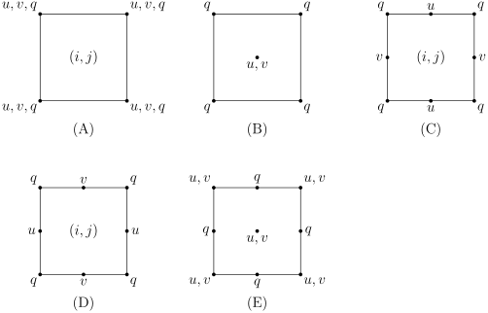
A Few Model Differences
Grid structure:
  Horizontal (determines how numerical differences are computed)
    WRF-ARW and COAMPS-TC (Arakawa-C)
    HWRF (Arakawa-E)
dx
1.41dx
Source: Wikipedia
Notes:
Staggering allows specific differences (pressure or horizontal convergence) to be calculated over a smaller horizontal difference (1deltax) versus (2deltax).
E grid is a rotated B grid. U/V located at location but distance apart is sqrt(2)deltax.
Map Projection (mercator versus rotated Lat, Lon)

Slide 7


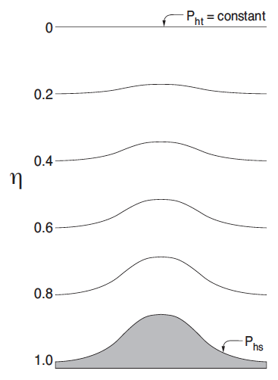
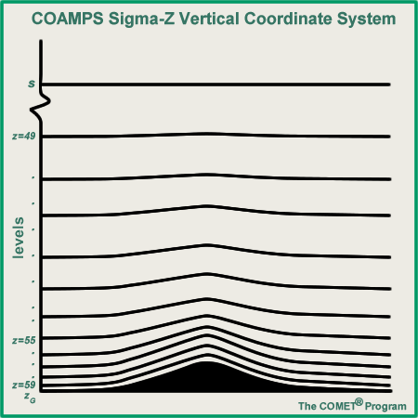
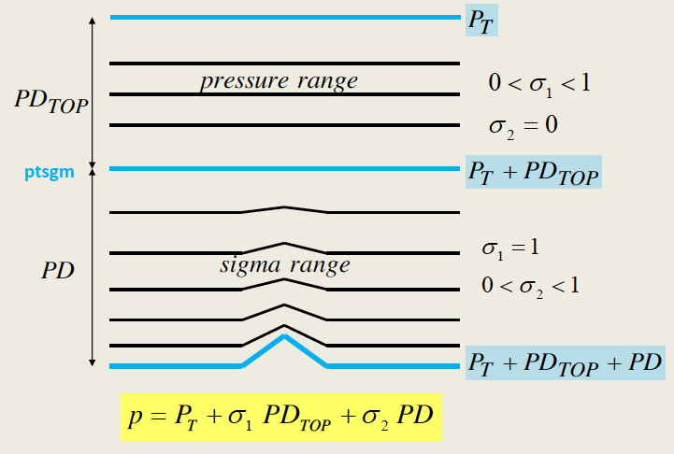
A Few Model Differences
Grid structure:
  Vertical:
    WRF-ARW (Eta)
    HWRF (sigma-pressure hybrid)
    COAMPS-TC (sigma)
WRF-ARW
COAMPS-TC
HWRF
Sources: COMET, ARWv3 Scientific Guide, HWRF Presentation (Young C. Kwon)

Slide 8
A Few Model Differences
Forecast model:
  Prognostic variables:
    WRF-ARW: theta’, phi’, m’, u, v, w, scalars (q_{v}, q_{c}, q_{g}, q_{i}, q_{r}, q_{s,} tracers)
    HWRF: P_{D}, T, Q, CWM, u, v
    COAMPS-TC: pi (Exner), theta, TKE, u, v, scalars (q_{v}, q_{c}, q_{i}, q_{r}, q_{s}, tracers)
  Dynamics:
    Discretization schemes (implicit vs. explicit)
    Map projections
    Moving nest assumptions
  Physics:
    HWRF/COAMPS-TC hurricane ‘tuned’ physics
    WRF-ARW APSU TC surface flux (Green and Zhang, 2013)
Notes:
Q – specific humidity
M’ - perturbation surface pressure of dry air

Slide 9
Cold Starting Models
APSU (WRF-ARW)
  Inner nest setup using TC vitals
  GFS IC and BC
  No vortex initialization
COAMPS-TC
  Center inner nests on TC
  GFS synoptic IC
  Insert* “bogus” Rankine vortex based on TC vitals
    Rankine vortex used in variational system to incorporate vortex
    * large-scale flow field not removed
HWRF
  Center ALL HWRF domains on TC
  HDAS synoptic IC for coarse domain
  Remove global model vortex
    < 30 ms-1 use HDAS vortex
    > 30 ms-1 use synthetic TC vortex
  Modify structure of vortex to match observations (RMW, R34, 10m WS, MSLP, etc.) and rebalance
Notes:
COAMPS-TC
Relaxed geostrophic constraints and correlation length scales when using NAVDAS
Synoptic perturbations
Generated from static WRFVAR(cv3)
Vortex scale perturbations:
Vortex position, max wind, and RMW.
Variances from Torn and Snyder 2012 and Landsea and Franklin 2013
HWRF

Slide 10
A Few Model Differences
Initialization (Global IC Data → Model Grid)
  WRF-ARW (real) and COAMPS-TC (coama): use U10 and V10 diagnostic winds
  HWRF (real_nmm): uses lowest model level and interpolates down
  All three models use different atmospheric profiles for vertical initialization and interpolation

Slide 11
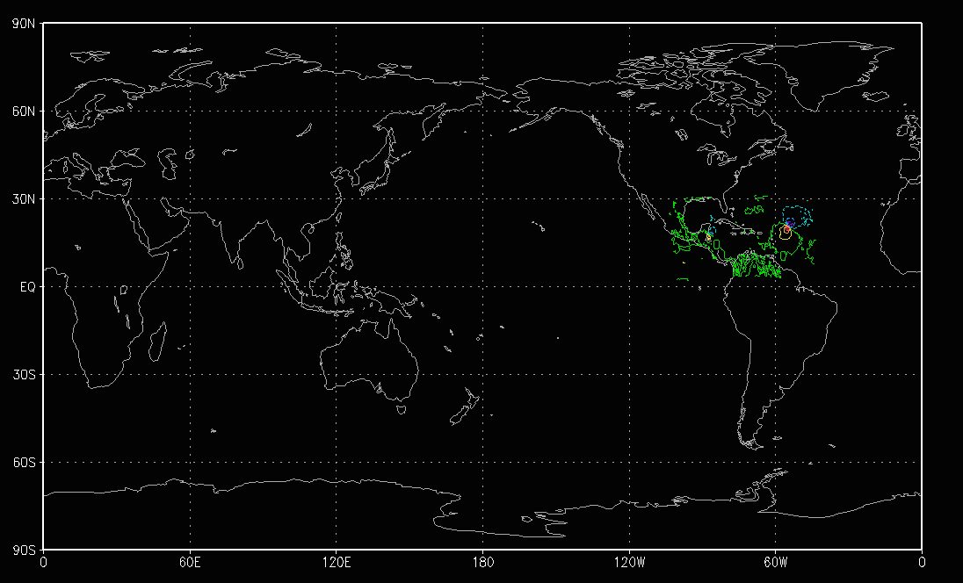
Tools of the Trade
Initial Conditions:
  APSU D2013 retrospective run of Hurricane Sandy (2012)
  GDAS at 0 hr
Boundary Conditions (mean and ensemble runs)
  GFS forecast 0-120hr
All data sources (GFS, APSU) interpolated and merged onto 0.1ºx0.1º grid
GFS 0.5ºx0.5º
APSU 9km
APSU 3km

Slide 12
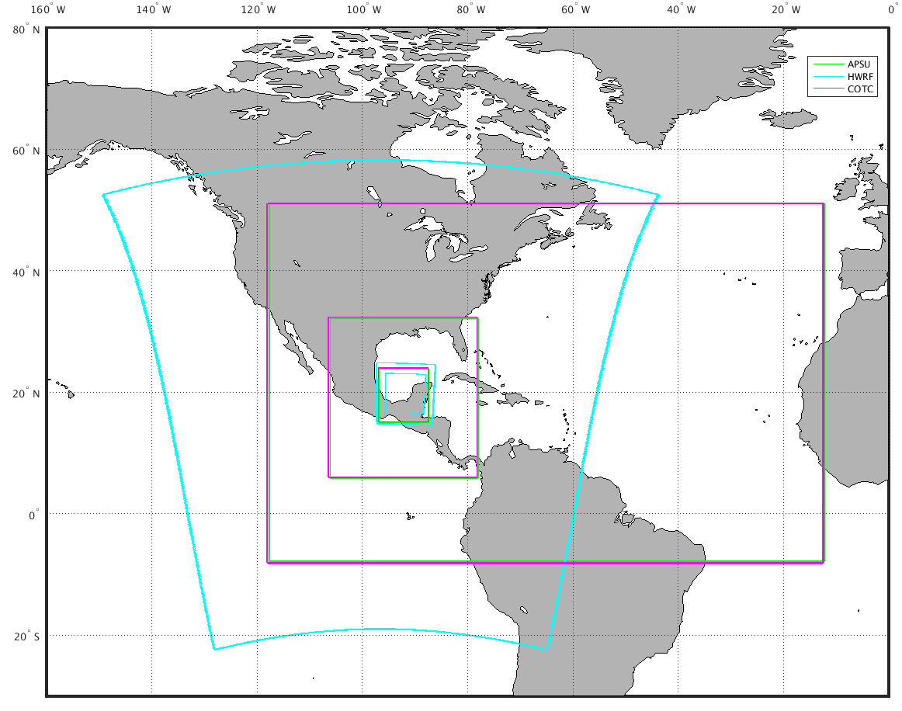
Example Model Domain Setup
Vortex following
Fixed for each initialization time
Permanently fixed

Slide 13
Hurricane Sandy 6-hrly Simulations
Initialized 2012-22-18 through 2012-30-18
5 day forecasts
Max 10 m WS [ms⁻¹]
clear clustering of solutions
MSLP [hPa]

Slide 14
GFDL Tracker Forecast Error Statistics
RMSE
Mean Error
All models MSLP biased low
  APSU consistently lowest
COAMPS-TC/HWRF tend to cluster
**NHC best track used as verification

Slide 15
GFDL Tracker Initial Condition Statistics
RMSE
Mean Error
MODEL – NHC BT
RMSE
Mean Error
MODEL – APSU

Slide 16
min(D03) Single Time Initial Condition RMSE
theta
Horizontal grid and vertical coordinate differences
  - Each model initializes mean background state and vertically interpolates differently
Is this an issue?
Systematic difference between WRF and HWRF and COTC for 2012102218 IC
u-wind
v-wind

Slide 17
Future work…
Use ensemble to calculate lead-time model pair-wise spread, full model specific spread, and combined ensemble spread
Run multi-physics ensemble using WRF-ARW to assess impact of physics on pair-wise spread and full model specific ensemble spread

Slide 18
Supplementary slides

Slide 19
HWRF
geogrid
geo_nmm.d01
GFS
ungrib
FILE*
metgrid
geo_nmm_nest.l*
met_nmm.d01*
DOES NOT USE U10, V10
real
wrfinput_d01
wrfbdy_d01
wrfinput_d01
wrfbdy_d01
HWRF
wrfinput_d*
HWRF
wrfout_d*

Slide 20
WRF-ARW
geogrid
geo_nmm.d0*
GFS
ungrib
FILE*
metgrid
met_em.d0*
real
USES U10, V10
wrfinput_d01
wrfbdy_d01
wrfinput_d0*
wrfbdy_d0*
WRF
wrfout_d*

Slide 21
COAMPS-TC
setup grid
(1) model domains
(2) map factors
(3) grid nesting
(4) Assign surface and terrain fields
GFS
Process input
specify mean state from standard atmosphere
read in and interpolate surface fields
read in global model data on pressure levels and interpolate to COAMPS grids
process boundary conditions from global model data and write out tendencies
write fields
analfld (prl, hzt, msl, sig)
analinc (prl)
bndyfld(sig)
USES U10, V10
COAMPS
fcstfld (prl, hzt, msl, sig)

Slide 22
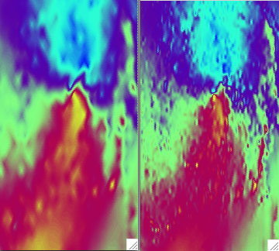
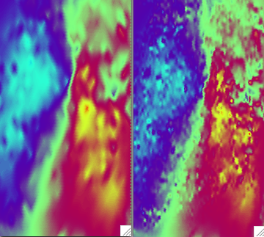
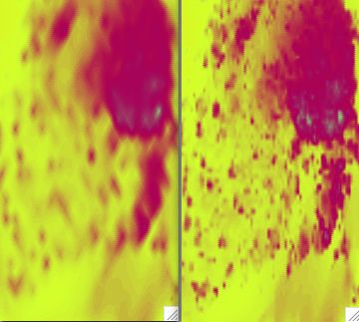
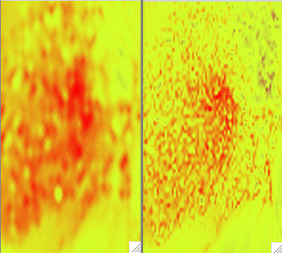
APSU ENKF IC
HWRF 27km -> 3km
3km -> 3km
U
V
T’
Q

Slide 23
COAMPS-TC
WRF-ARW
APSU ENKF IC
- ALL MODELS
0.1 DEG IC
HWRF
[ms⁻¹]
[ms⁻¹]
[ms⁻¹]

Slide 24
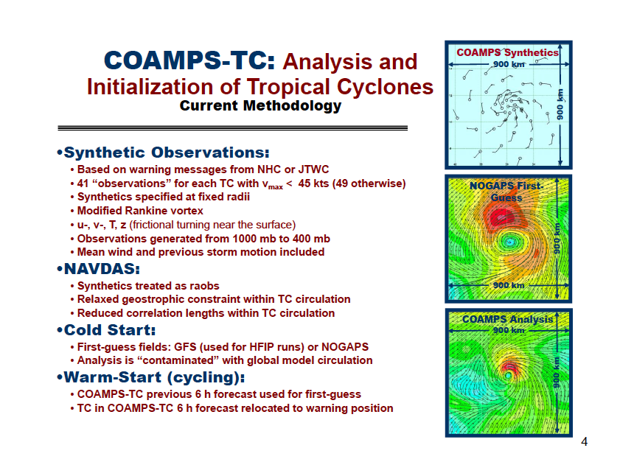

Slide 25
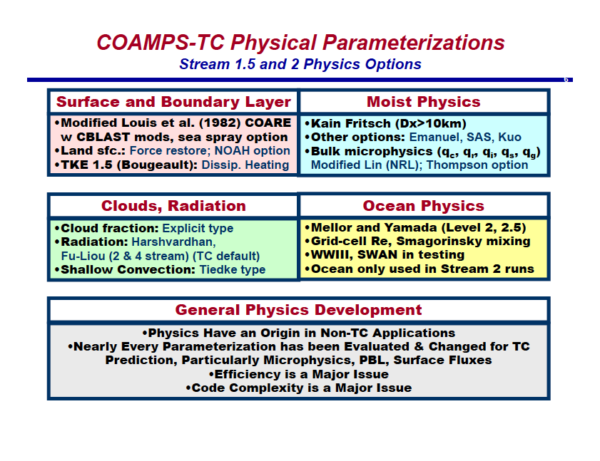

Slide 26
