Slide 1
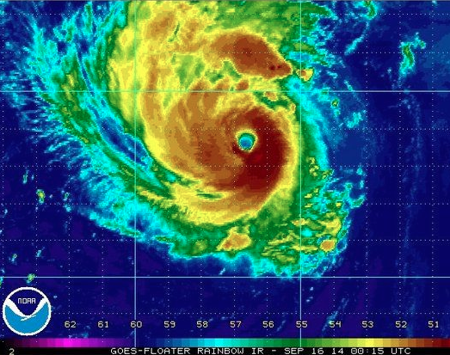

Predictability and dynamics of the rapid intensification of Hurricane Edouard (2014)
Erin Munsell
Spring 2015 Group
Meeting
April 30th, 2015

Slide 2
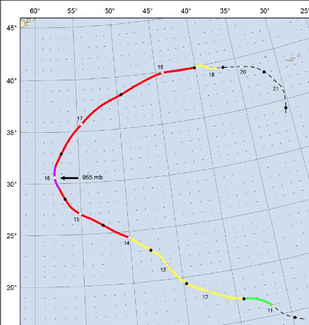
Hurricane Edouard Best Track
PSU WRF-EnKF initialized at 12Z on Sept 11th – TD 6 designation
Simulation ends on 18Z on Sept 16th – just after peak intensity (major hurricane, 1st of HS3!)
2 HS3 flights performed during simulation window – 11-12 Sept and 14-15 Sept (18-27 h and 72-93 h)

Slide 3
Maximum 10-m Wind Speed (kts) classified by performance
Best Track – Black
GOOD – Blue
GOOD_EARLY – Green
GOOD_LATE – Magenta
POOR – Red
Minimum Sea Level Pressure (hPa) classified by performance

Slide 4
Ensemble Tracks classified by performance
SST’s contoured (constant amongst members)

Slide 5
Deep-layer shear (850-hPa – 200-hPa) averaged over a 200-km to 500-km radius for the ensemble members of the composite groups

Slide 6
Mean deep-layer (850-hPa – 200-hPa) shear of composite groups in time in relation to beginning of rapid intensification (RI)

Slide 7
Mean 850-hPa – 500-hPa tilt magnitude (km) for the composite groups of Edouard – using weighted horizontal circulation centers

Slide 8
Mean tilt magnitude (difference between 850-hPa and 500-hPa weighted PV centers) of composite groups in time in relation to beginning of rapid intensification (RI)

Slide 9
T_{RI} – 48 h T_{RI} – 36 h T_{RI} – 24 h
GOOD_LATE GOOD GOOD_EARLY

Slide 10
T_{RI} – 12 h T_{RI} T_{RI} + 12 h
GOOD_LATE GOOD GOOD_EARLY

Slide 11
850-hPa to 500-hPa mean tilt vector evolution for the composite groups of Edouard – using weighted horizontal circulation center

Slide 12
850-hPa to 500-hPa mean tilt vector evolution for the composite groups of Edouard – plotted in a shear-relative sense (where shear direction is always oriented westerly)

Slide 13
Sensitivity Experiments – Set #1
Sensitivity to composited initial conditions

Slide 14
Sensitivity Experiments – Set #2a
Testing the strength of the GOOD_EARLY vortex

Slide 15
Sensitivity Experiments – Set #2b
Testing the strength of the GOOD_EARLY vortex

Slide 16
Sensitivity Experiments – Set #3
Testing the influence of the POOR environment

Slide 17

Summary of Sensitivity Experiments
Environment
 | GOOD_EARLY | GOOD | POOR
GOOD_EARLY
GOOD
POOR
Inner-Core

Slide 18
Sensitivity Experiments – Set #4
Assessing the radii at which the POOR environment becomes detrimental
200 – 300 km
500 – 800 km
1000 – 1200 km

Slide 19
Summary and Conclusions
12 UTC 11 Sept ensemble initialization of Hurricane Edouard provides an excellent framework to assess the predictability of tropical cyclone rapid intensification
Composite groups are created based on the timing of RI
Deep-layer wind shear magnitude is strongest throughout the simulation for POOR and decreases in magnitude for GOOD_LATE, GOOD and GOOD_EARLY
Shear magnitude decreases in all groups approximately 12 h prior to RI onset, while tilt magnitude begins to decrease in all groups approximately 24–48 h prior to RI
Timing of RI onset appears to be related to the impact of wind shear on vortex tilt, location of convection and the subsequent precession process

Slide 20
Summary and Conclusions
Sensitivity experiments reveal that:
  GOOD and GOOD_LATE groups may be indistinguishable
  GOOD_EARLY vortex is initially stronger, leading to smaller tilt magnitudes, a quicker precession process and earlier RI onset
  POOR environment is less favorable for development
    Sensitive region is somewhere between approximately 650-km and 1000-km

