Slide 1
Microwave Assimilation in Tropical Cyclones
Research Group Meeting
December 12, 2014
Scott Sieron, Masashi Minamide and Fuqing Zhang

Slide 2
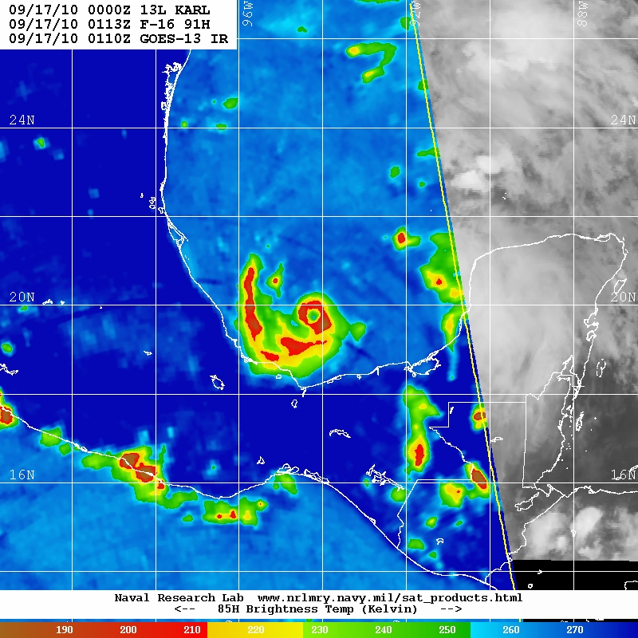
Atmospheric Passive Micrometry
Sensors aboard research aircraft and 24 different low-Earth-orbit satellites
Two scanning methods, conical and cross-track
COLD
WARM
Hurricane Karl (2010), ~90 GHz

Slide 3
Major Dependencies to Observed Microwave (MW) Emissions
Air temperature profile along line-of-sight (LOS)
Surface temperature, composition (land or water), roughness
Water vapor
  LOS-distribution and temperature
Hydrometeors (including clouds)
  LOS-distribution and temperature
  Particle composition (liquid, ice), size, shape
The relative impacts of each depends highly on the frequency and polarization

Slide 4
Major Dependencies to Observed Microwave (MW) Emissions
Air temperature profile along line-of-sight (LOS)
Surface temperature, composition (land or water), roughness
Water vapor
  LOS-distribution and temperature
Hydrometeors (including clouds)
  LOS-distribution and temperature
  Particle composition (liquid, ice), size, shape
The relative impacts of each depends highly on the frequency and polarization
Radiative Transfer Model
(The H Operator)

Slide 5
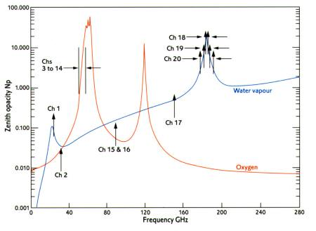
Major Dependencies to Observed Microwave (MW) Emissions
O₂ Absorption Bands
H₂O Absorption Band
Intensification of H₂O “Continuous Absorption”

Slide 6
Major Dependencies to Observed Microwave (MW) Emissions
O₂ Absorption Bands
H₂O Absorption Band
Intensification of H₂O “Continuous Absorption”
Temperature Sounding Channels

Slide 7
Major Dependencies to Observed Microwave (MW) Emissions
O₂ Absorption Bands
H₂O Absorption Band
Intensification of H₂O “Continuous Absorption”
Temperature Sounding Channels
Moisture Sounding Channels

Slide 8
Major Dependencies to Observed Microwave (MW) Emissions
O₂ Absorption Bands
H₂O Absorption Band
Intensification of H₂O “Continuous Absorption”
Imaging Channel
Imaging Channels
Temperature Sounding Channels
Moisture Sounding Channels

Slide 9
Data Assimilation of Microwave Obs
Global DA uses sounding channels
  Especially important observations over oceans
  Informative below cloud-top (unlike IR)
Hurricane DA may find greater value in imaging channels
  Informative primarily of the location and intensity of precipitation
  What correlations exist between hurricane structure/dynamics and MW imaging channel radiances?

Slide 10
Methods
60-member ensemble of WRF simulations of Hurricane Karl (2010)
Run RTM (here the CRTM) on WRF output of each member to get simulated brightness temperature at each model grid point
  1 km grid-spaced storm-centered domain, and the 3 km grid-spaced static domain
Calculate ensemble correlations
Learned that WRFDA built-in CRTM does not use clouds or precipitation; then ran full CRTM

Slide 11
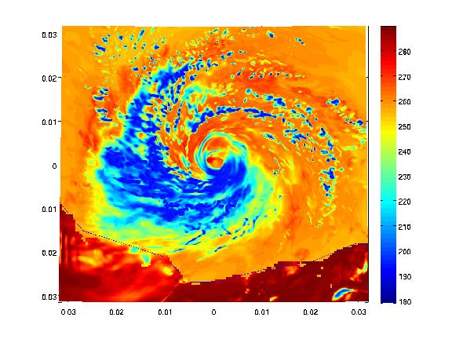
~90 GHz (Ch. 15): Simulated looks fine;
note locations of simulated highest clouds (cold)
WARM
280
260
240
220
200
180
COLD
190
210
230
250
270
COLD
WARM

Slide 12
Simulated low frequencies (Ch. 1 & 2): deepest clouds are too cold
They are as cold as the ocean! This does not seem to happen in reality
Would be problematic for data assimilation
Unrealistic cloud properties the cause?
  Cloud effective radius: 15 μ
  Rain effective radius: 1000 μ
  Ice effective radius: 50 μ
  Snow effective radius: 1500 μ
  Graupel effective radius: 1500 μ

Slide 13
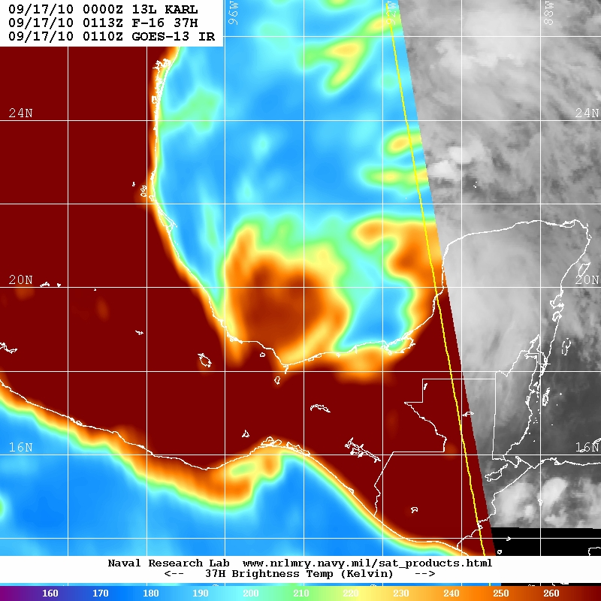
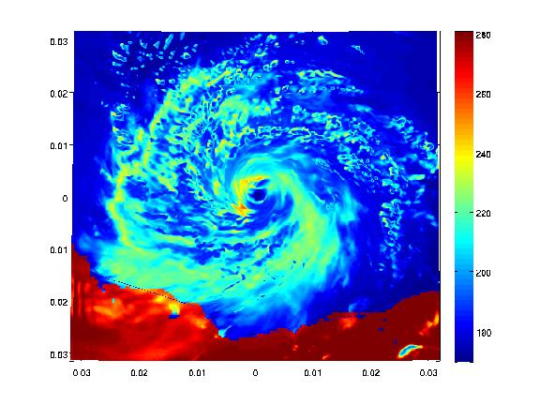
37 GHz: Simulated has some much too cold clouds
WARM
280
260
240
220
200
180
COLD
160
180
200
220
240
260
COLD
WARM

Slide 14
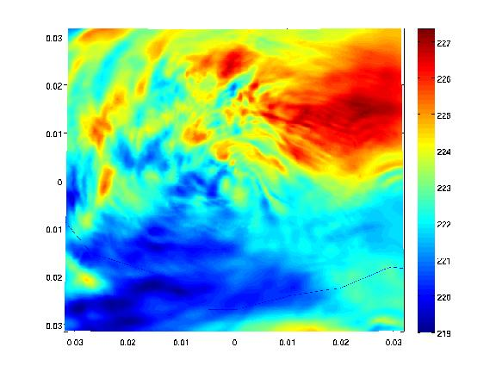

CRTM Results, cont.
Weird results at the peak of O₂ absorption (Channels 10-14, somewhat 9 as well)
  Too low of model top is probable cause
Channel 11
Channel 14
227
260
226
259
225
258
257
224
256
223
255
222
254
221
253
220
252
219

Slide 15
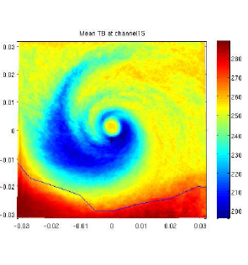
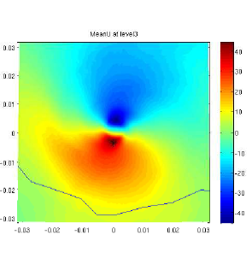
Domain 4 (Vortex-Tracking, 1 km Grid)
Mean Ch. 15 Brightness Temperature
Mean Low-Level U Wind
40
280
260
20
240
*
0
*
220
-20
200
-40

Slide 16
Domain 4 (Vortex-Tracking, 1 km Grid)
Correlation between minimum surface pressure and Tb Ch. 15
0.4
0.2
0
-0.2
-0.4

Slide 17
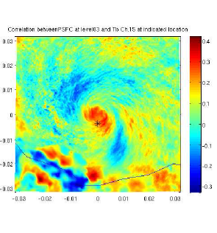
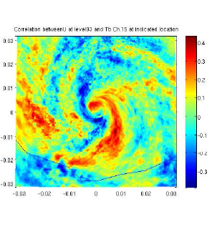
Domain 4 (Vortex-Tracking, 1 km Grid)
Correlation between Tb Ch. 15 at indicated location and surface pressure
Correlation between Tb Ch. 15 at indicated location and low-level U wind
0.4
0.4
0.2
0.2
*
0
*
0
-0.2
-0.2

Slide 18
Domain 3 (Static, 3 km Grid)
Mean Ch. 15 Brightness Temperature
Mean Low-Level U Wind
290
20
270
10
250
0
230
-10
-20
210

Slide 19
Domain 3 (Static, 3 km Grid)
Correlation between minimum surface pressure and Tb Ch. 15
0.4
0.2
0
-0.2
-0.4

Slide 20
Domain 3 (Static, 3 km Grid)
Correlation between Tb Ch. 15 at indicated location and surface pressure
Correlation between Tb Ch. 15 at indicated location and low-level U wind
0.6
0.6
0.4
0.4
0.2
0.2
0
0
-0.2
-0.2
-0.4
-0.4
-0.6
-0.6

Slide 21
Domain 3 (Static, 3 km Grid)
Correlation between Tb Ch. 15 at indicated location and surface pressure
Mean Ch. 15 Brightness Temperature
290
0.3
270
0.2
0.1
250
0
-0.1
230
-0.2
210
-0.3

Slide 22
Domain 3 (Static 3 km Grid)
Correlation between Tb Ch. 15 at indicated location and surface pressure
Mean Ch. 15 Brightness Temperature
290
0.3
270
0.2
0.1
250
0
-0.1
230
-0.2
-0.3
210

Slide 23
Domain 3 (Static, 3 km Grid)
Correlation between Tb Ch. 15 at indicated location and surface pressure
Ch. 15 Brightness Temperature, Member 20
280
0.4
0.3
260
0.2
240
0.1
220
0
-0.1
200
-0.2
180
-0.3
-0.4
160

Slide 24
Domain 3 (Static, 3 km Grid)
Correlation between Tb Ch. 15 at indicated location and surface pressure
Ch. 15 Brightness Temperature, Member 20
280
0.4
260
0.3
0.2
240
0.1
220
0
200
-0.1
180
-0.2
-0.3
160

Slide 25
Final Thoughts
Ensemble correlations are
  Consistent with physical understandings of microwave emissions and tropical cyclone dynamics
  Encouraging signs for future, effective ensemble-based DA
Next: Observing Systems Simulation Experiments (OSSE)
  Designate “truth” ensemble member, take observations from “truth,” assimilate with EnKF and remaining ensemble members
  Refine procedures for the CRTM, processing obs, and the DA
Experiments regarding poor simulated low-frequency brightness temperatures at cloud-tops

