Slide 1
Doppler Radar Data Assimilation for a Local Severe Rainfall Event with
PSU–EnKF System
Xuexing Qiu and Fuqing
Dec. 2014

Slide 2
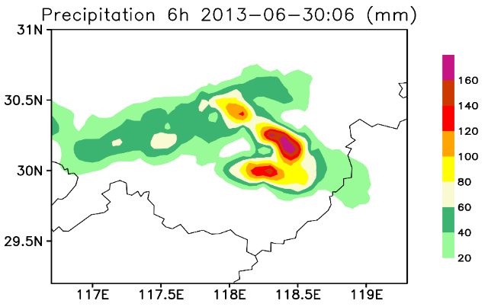
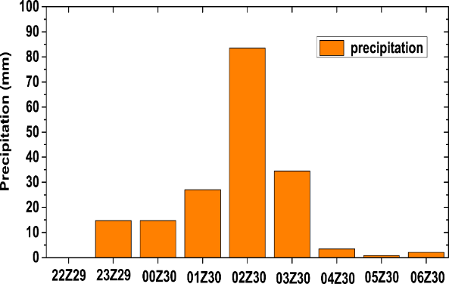
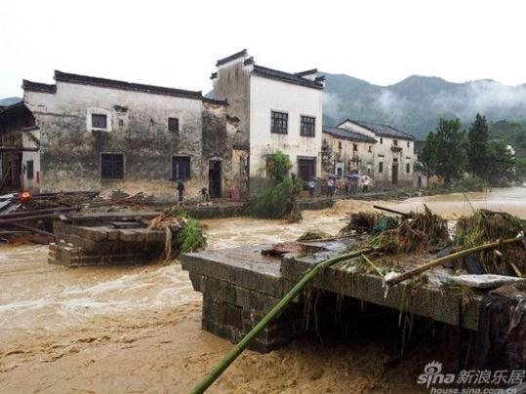
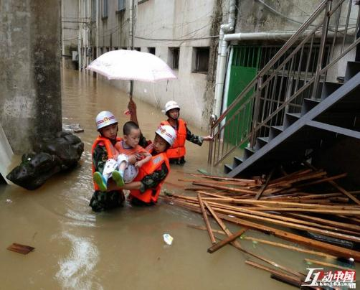
The event（0-6UTC 30th June 2013）
1h precipitation
185mm/6h
12 killed in this event

Slide 3
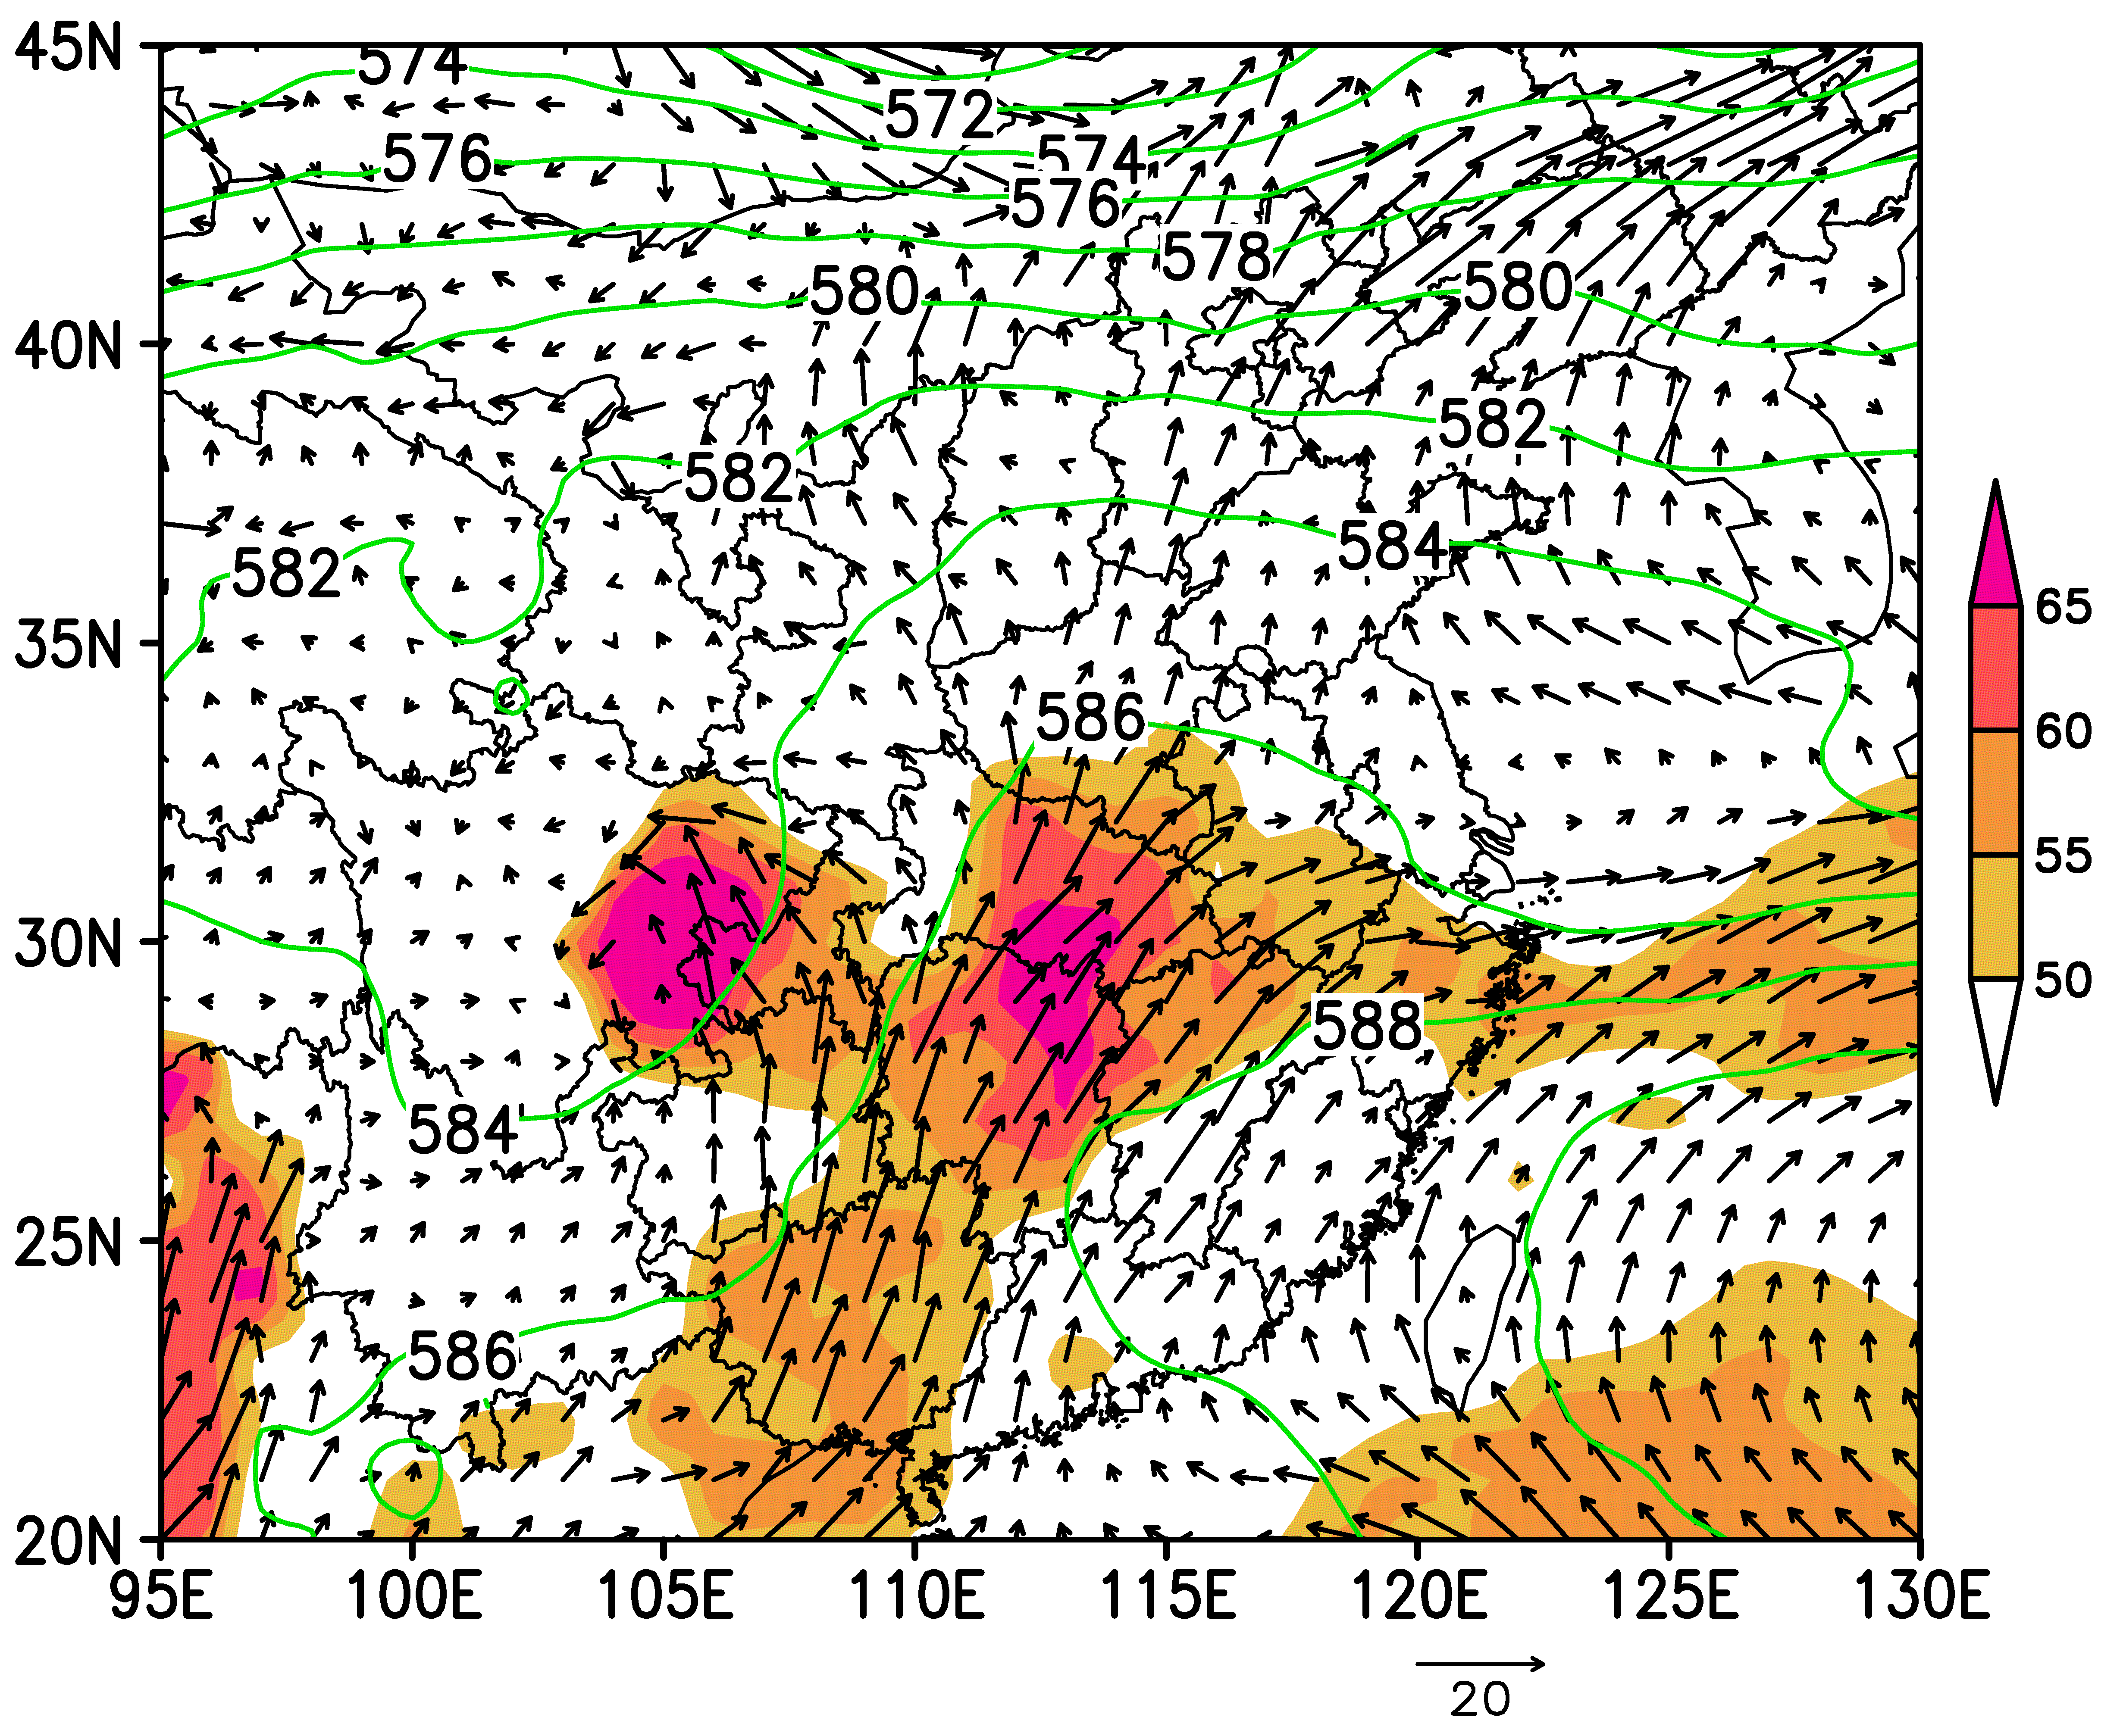
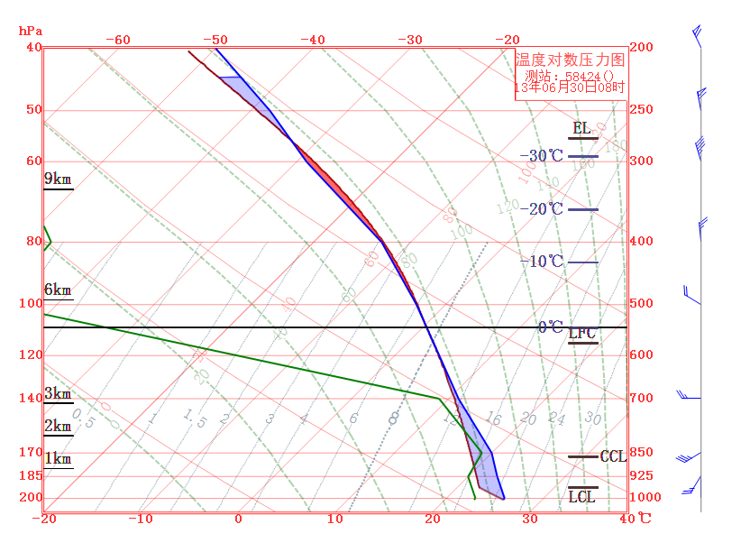
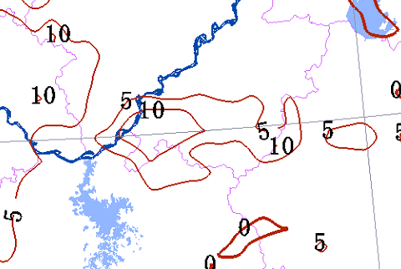
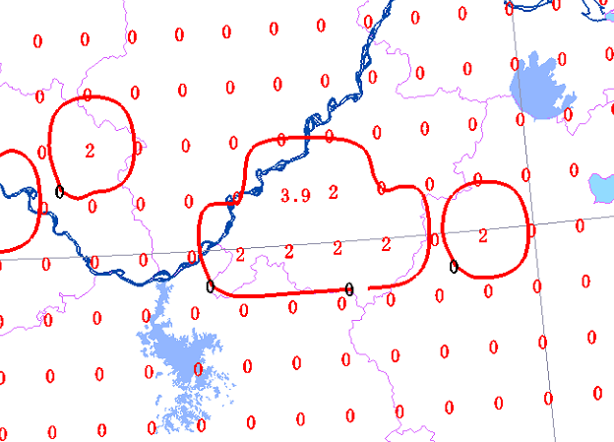
ECMWF deterministic forecast
ECMWF EPS POP > 30mm

Slide 4
Experiment design (36 members)
9km
HSRD
3km
1km
X
12Z/29
21Z/29
00Z/30
06Z/30
perturb_ic
Forecast
NODA
EnKF

Slide 5
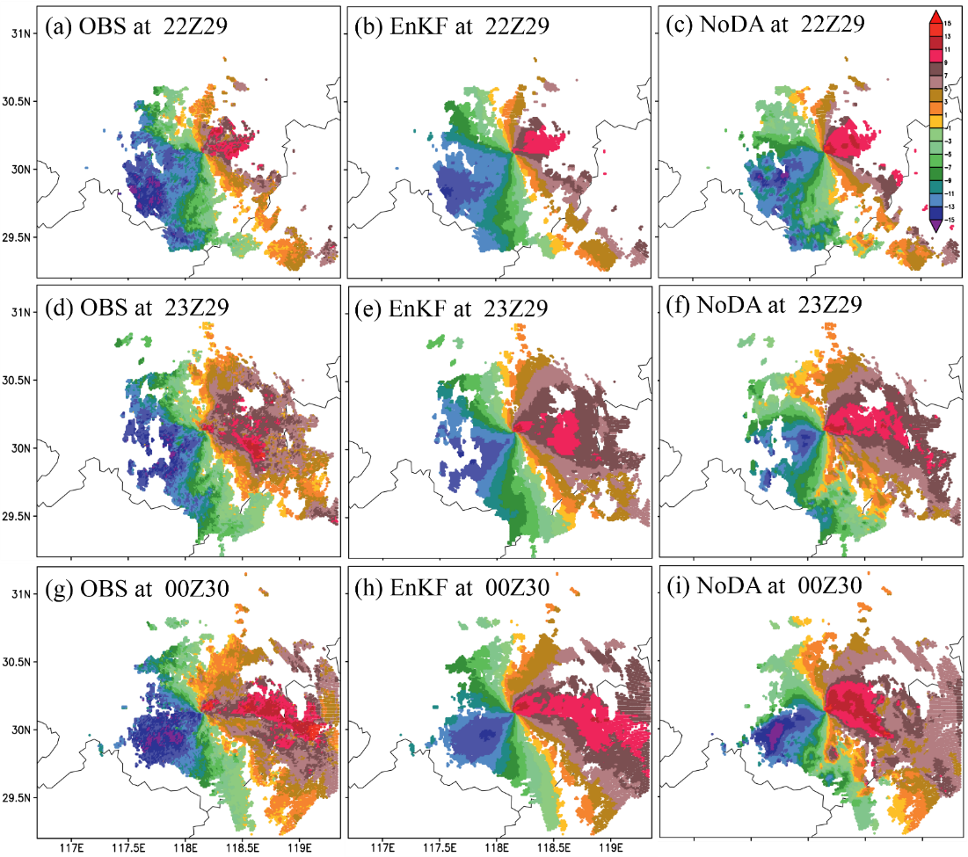
Radial velocity Analysis
EnKF: LLJ height and wind shear was corrected

Slide 6
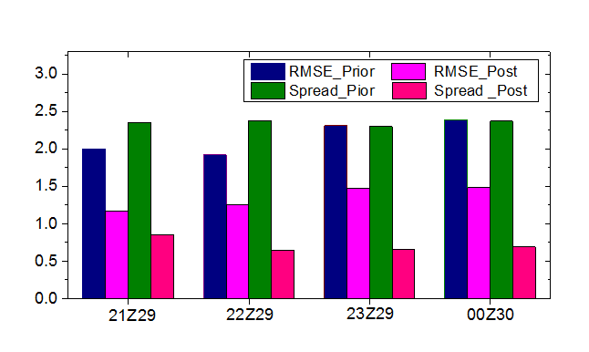
RMSE and Spread of radial velocity
RMSE_prior mean = 2.1m/s
RMSE_post mean = 1.3m/s 38% error reduced
Spread_prior mean = 2.3m/s
Spread_post mean = 0.7m/s

Slide 7
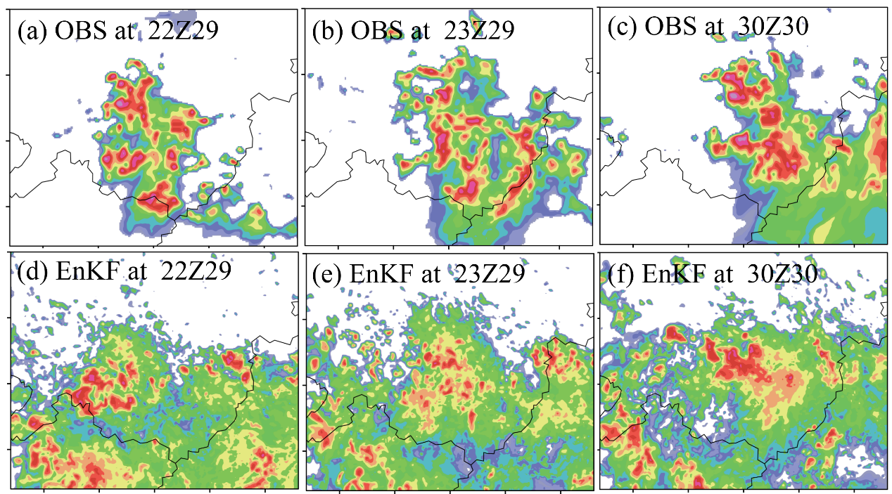
Composite Reflectivity Analysis
With increase times of EnKF, CR was closer to observation

Slide 8
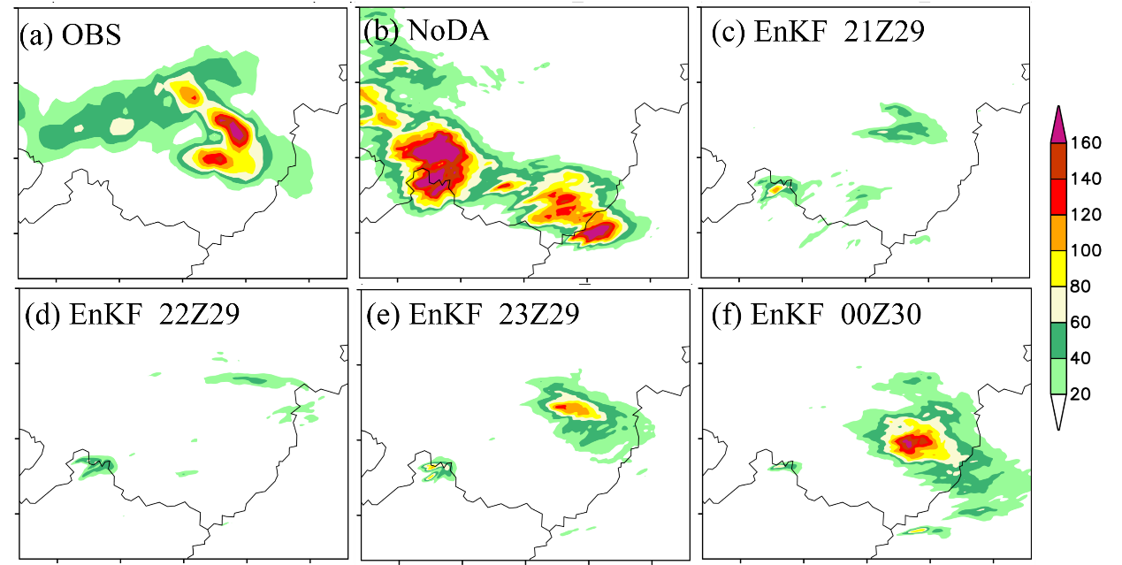
6h rainfall Simulation
00 -- 06Z 30 June
NoDA: southerly position, spurious center
EnKF: the amounts and positions of precipitation getting better

Slide 9
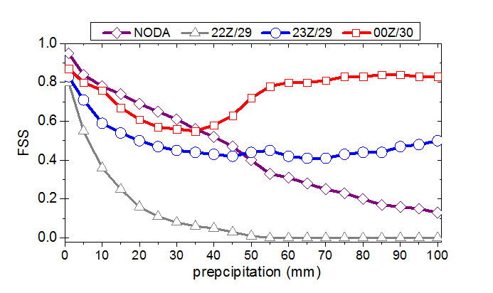
FSS(Fraction Skill Score)
Scale length: N = 80km
For > 50mm/6h: after 3 and 4 times EnKF, FSS of DF greater than NoDA ,EnKF was more skillful

Slide 10
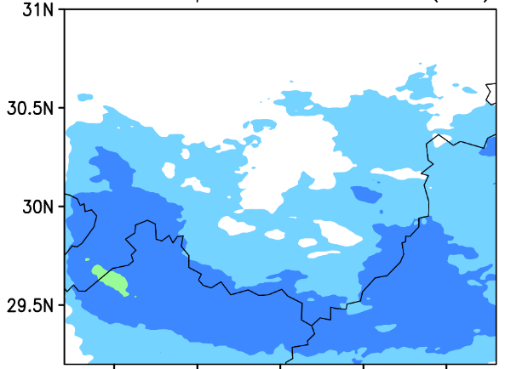
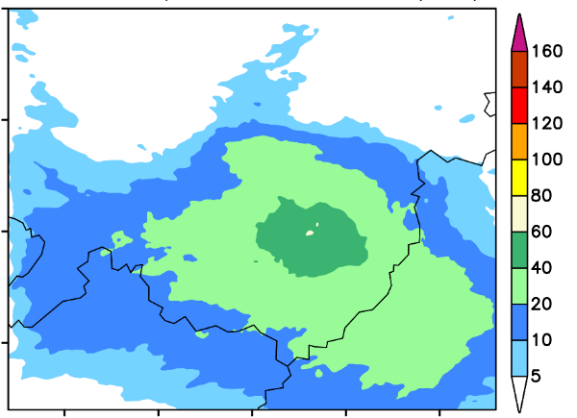
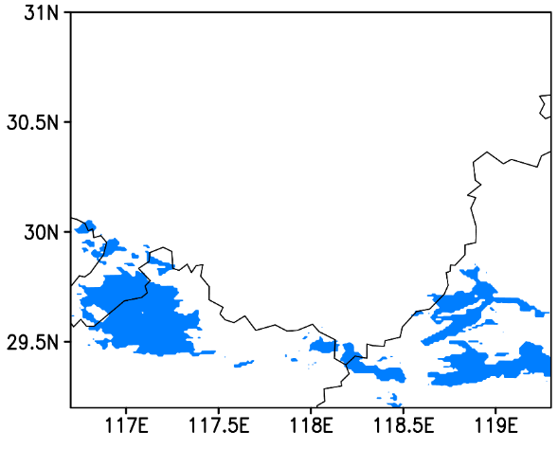
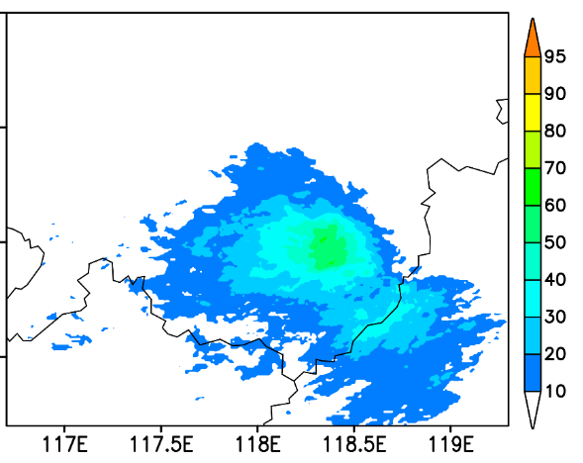
Ensemble forecast results
NODA
EnKF 00Z30
Precipitation Ensemble Mean
Precipitation Ensemble Mean
NODA
EnKF 00Z30
POP > 50mm/6h
POP > 50mm/6h
NoDA: the event was very sensitive to initial condition. EnKF reduced the uncertainty. Mean consistent with DF

Slide 11
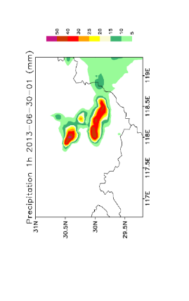
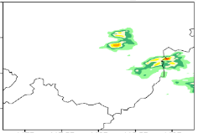
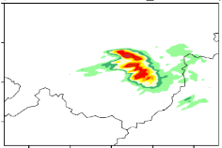
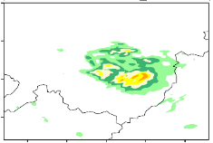
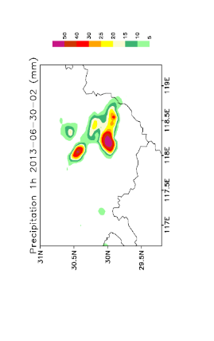
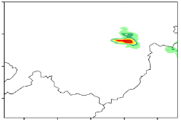
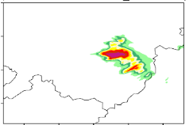
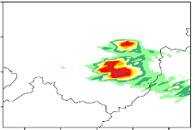
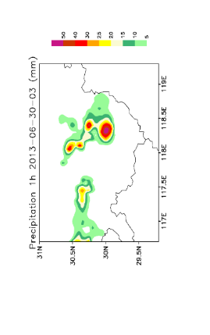
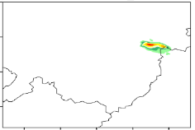
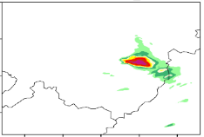
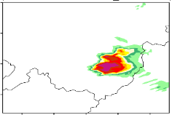
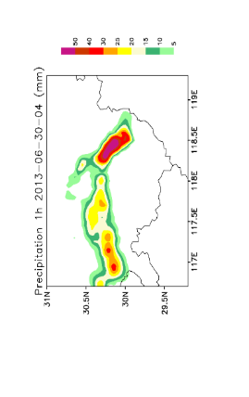
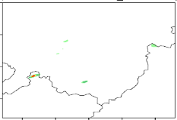
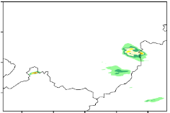
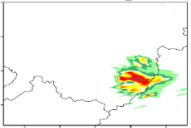
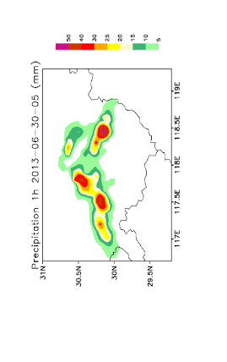
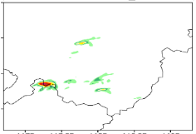
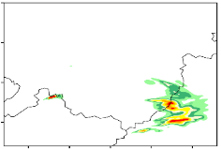
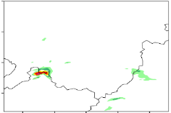
1h Rainfall Simulation
OBS
EnKF 22Z29
EnKF 23Z29
EnKF 00Z30
01Z30
02Z30
03Z30
04Z30
05Z30
OBS
EnKF 22Z29
EnKF 23Z29
EnKF 00Z30
ENKF: improve precipitation forecasting within 4 hours

Slide 12
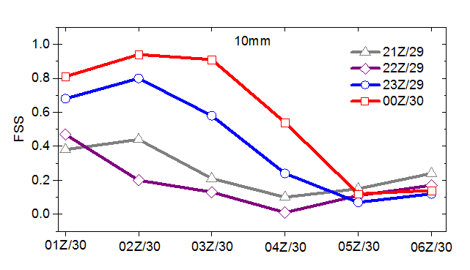
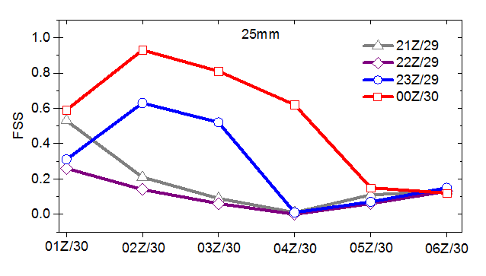
FSS (1h rainfall simulation)
FSS skillful ≈ 0.5
21Z29 22Z29 : no skillful
23Z29 : 1 -- 3h skillful
00Z30: 1-- 4h skillful

Slide 13
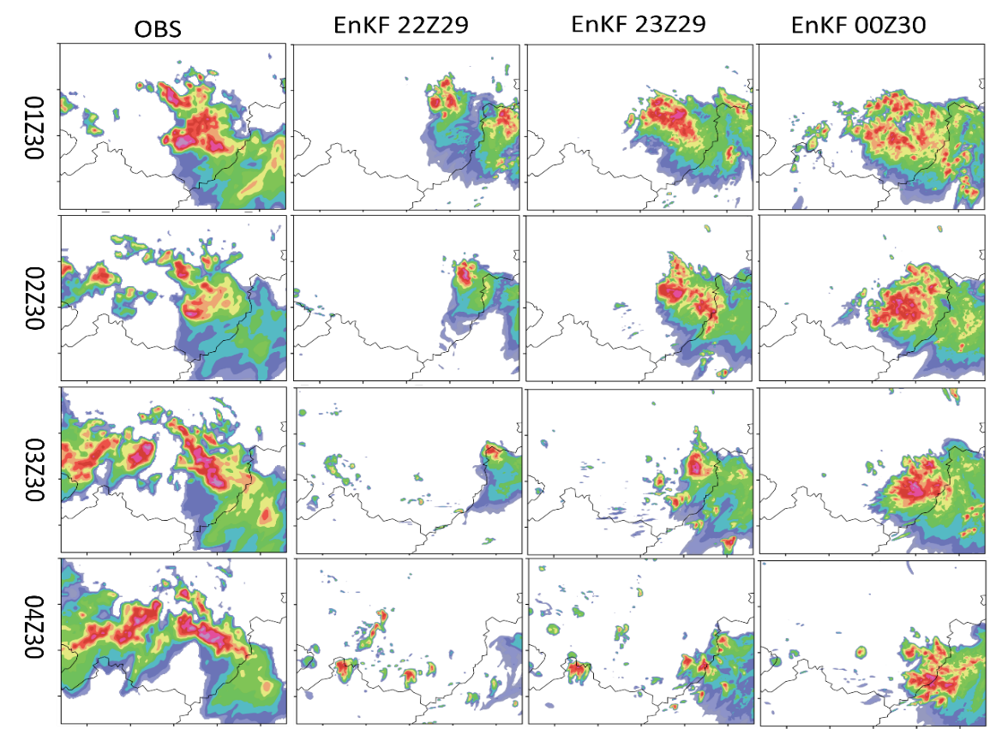
Composite reflectivity Simulation

Slide 14
Sensitive Experiments
Cntrl： 1km EnKF ，1km DF，4cycle
Cntrl_1cycle ：1km EnKF ，1km DF，1cycle(00Z30)
EnKF1_DF3： 1km EnKF ，3km DF, 4cycle
EnKF3_DF3： 3km EnKF ，3km DF，4cycle
EnKF3_DF1 ：3km EnKF ，1km DF，4cycle

Slide 15
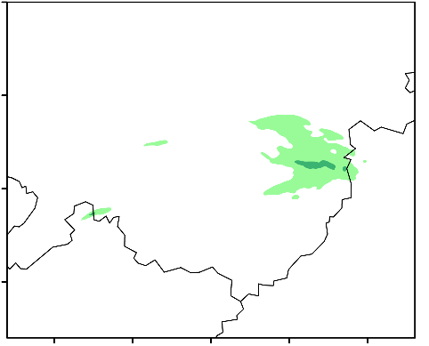
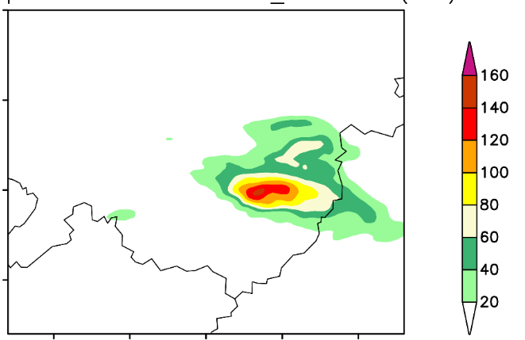
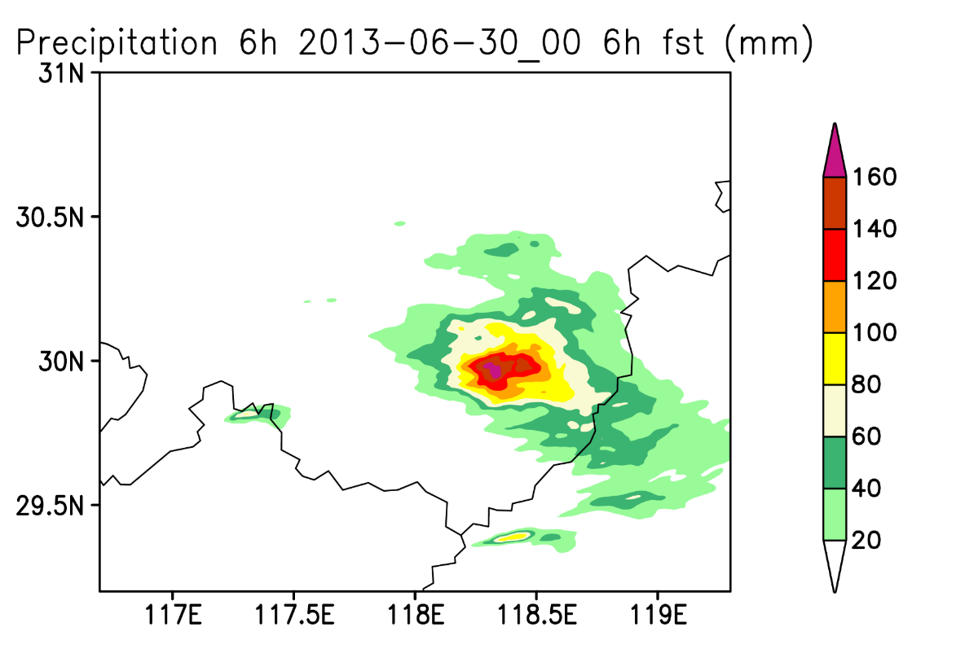
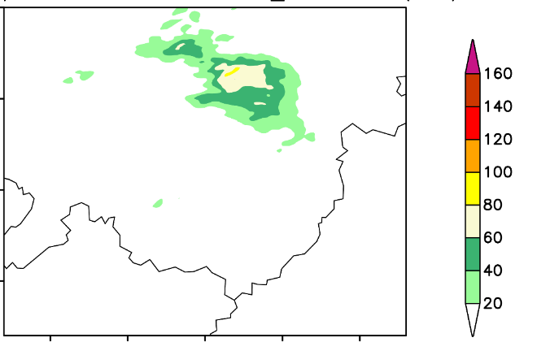
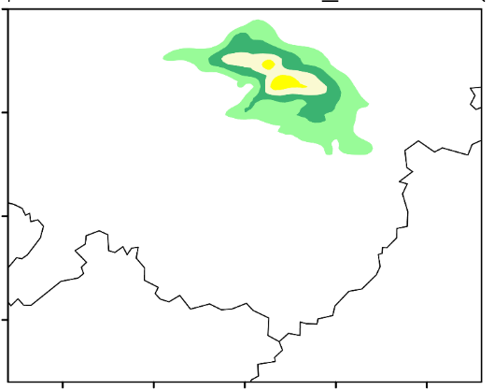
6h Rainfall Simulation
Cntrl_1cycle
Enkf1_DF3
Cntrl
Enkf3_DF3
Enkf3_DF1

Slide 16
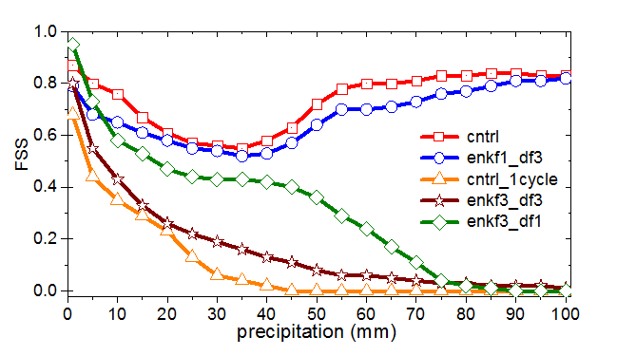
FSS of sensitive experiment
EnKF resolution was the most important factor for simulation results and the followed was the times of EnKF, DF resolution was slight important.

Slide 17
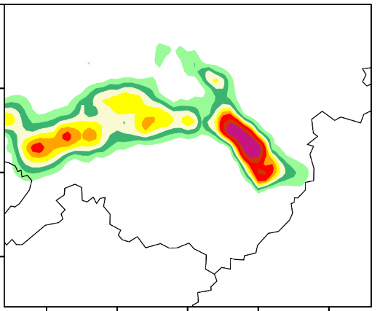
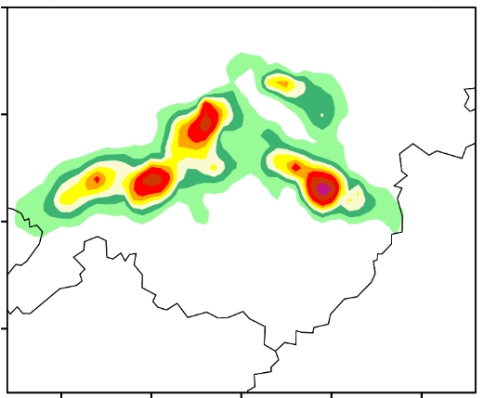
Further EnKF for new cells
OBS 04Z30
OBS 05Z30
12Z/29
21Z/29
00Z/30
03Z/30
06Z/30
DF
perturb_ic
EnKF
Add 3 times EnKF

Slide 18
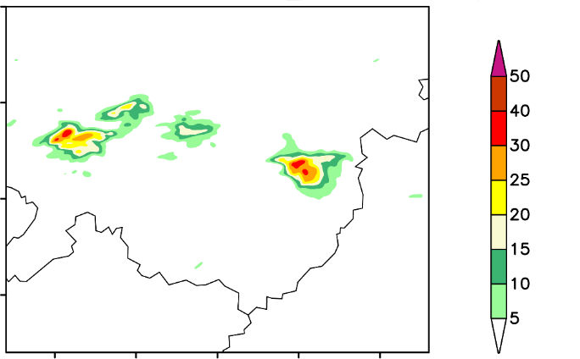
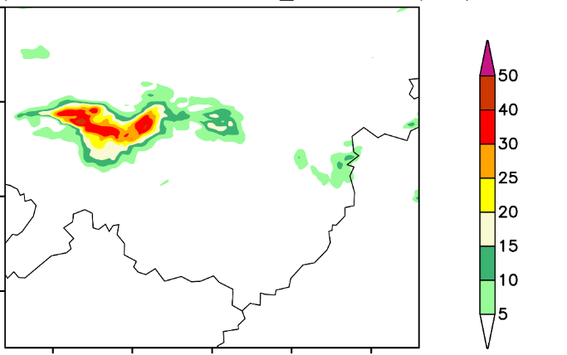
1h Rainfall simulation( from 03Z30)
04Z30
05Z30
Further experiment showed that radar data assimilation by EnKF could forecast local precipitation well

Slide 19
Summary and Conclusion
By assimilating Doppler radar data , PSU-EnKF system can predict this local heavy rainfall event accurately ahead 2-3 hours.
In this event, assimilation of radar data can improve precipitation forecasts within 4 hours
the EnKF resolution was the most important factor for simulated results and the followed was the times of EnKF.

