Slide 1
The Joy of Painting: “Happy Little Trees”
Christopher Melhauser
Fall 2014 Group Meeting

Slide 2

epic “fro”
“happy little trees”
Notes:
http://fivethirtyeight.com/features/a-statistical-analysis-of-the-work-of-bob-ross

Slide 3

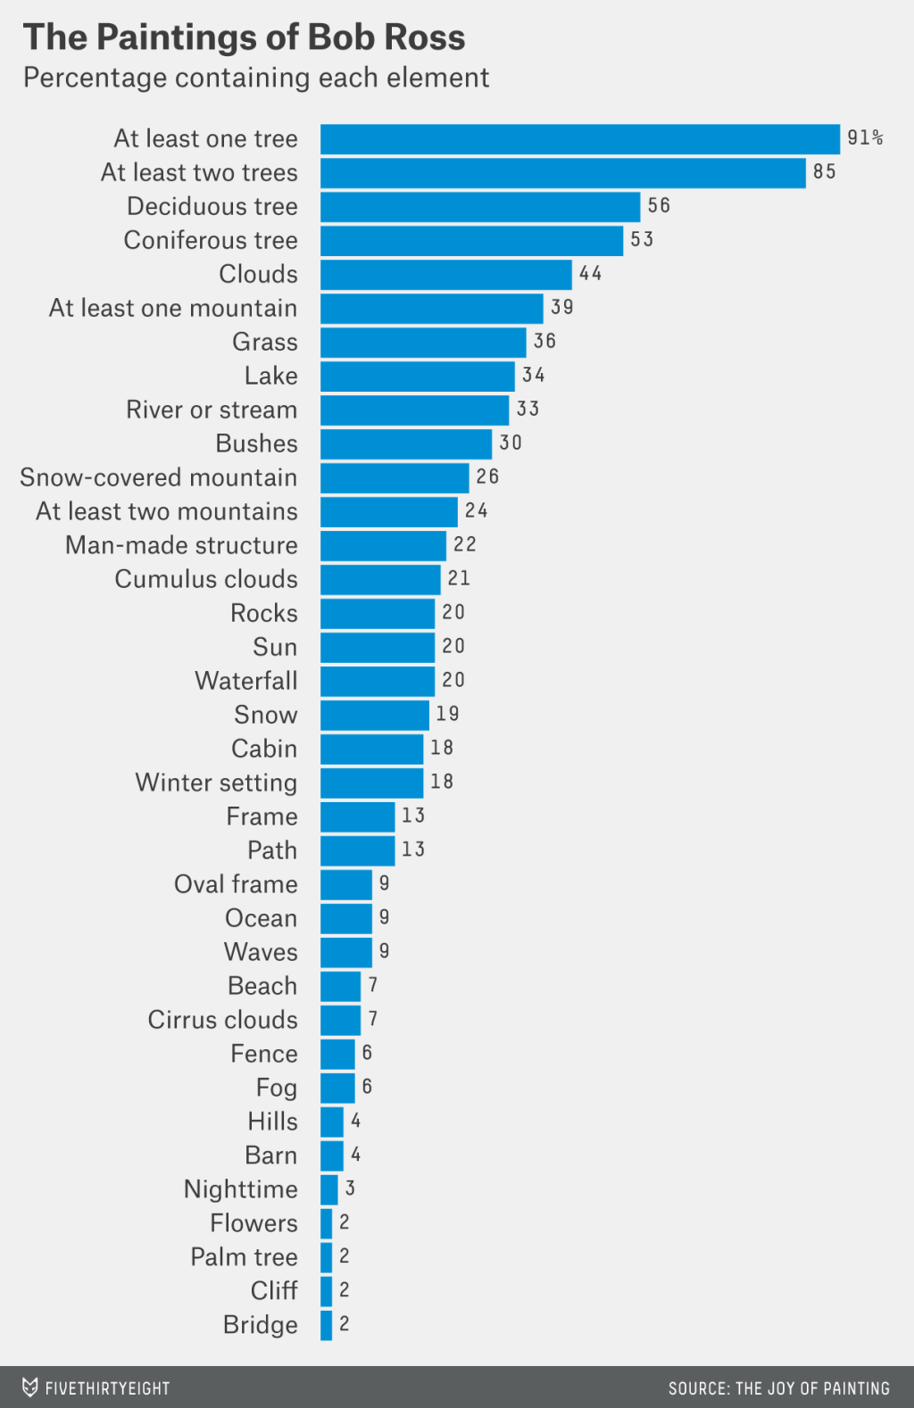

Slide 4
Error Quantification of Super Observation Horizontal Winds from Dual-Beam Airborne Radar Data Using the Coplanar Scanning Technique for Tropical Cyclone Prediction
Christopher Melhauser
Fall 2014 Group Meeting

Slide 5
NOAA P-3 Scanning Strategy
fore
aft
Altitude
flight track
Longitude
Latitude
Fore/Aft Scanning Technique (FAST)
Coplane analysis – exploit geometry

Slide 6
So what?
Radial velocities only provide information of hydrometeor motion along the radial direction of the radar beam. Dual-Doppler analysis (traditional, coplanar, variational, etc.) provide along beam AND cross beam information. More information about the windfield.
but...
There is always a catch. Nothing in life is free.

Slide 7
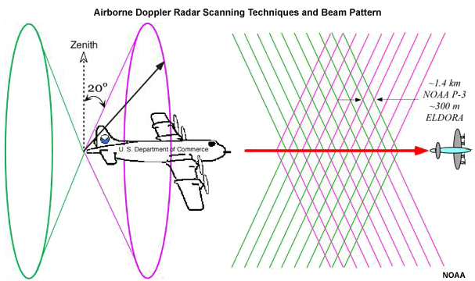
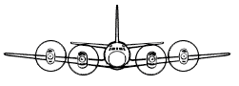
Coplane Geometry
Fore-Aft Scanning Technique (FAST)
Coplane U/V wind Observations
uv
uv
uv
uv
uv
uv
uv
flight track
v_{perp}
Retrieved wind component along flight track independent of vertical motion
Fall speed contamination in retrieved wind component perpendicular to track
w-v_{t}
z
V_{l}
α

Slide 8
Coplane Super Observation (CSO)
Use HRD quality controlled radial velocity data (noise, aliasing, ground reflection, aircraft attitude correction)
Find closest radial bin to intersecting fore/aft scan
Use +/- 3 radial bins along each fore/aft scan and radar beams within +/- 3º alpha (bin width)
Quality control (Weng and Zhang, 2012) :
  Remove fore/aft Vr based on radar specifications (noise, unambiguous range)
  Remove radials based on variance of Vr within fore/aft scans
  Remove CSOs based on variance of all Vr within fore/aft sweep
x
aft
fore
fore/aft radial crossing
radial bin center
SO scan volume
x
x
bin
width
x
ψ
x
α
ψ
flight track
flight track out-of-page
Notes:
CSOs help fill in missing data values
CSOs help smooth data
NOTE: CSOs do not thin data. Coplane methodology thins data.

Slide 9
Real Data Retrieved CSOs
P3 Flight 20100916H Leg #2
HRD
CSOs
wind speed [ms⁻¹]
wind speed [ms⁻¹]
Vr SO
radial velocity [ms⁻¹]

Slide 10
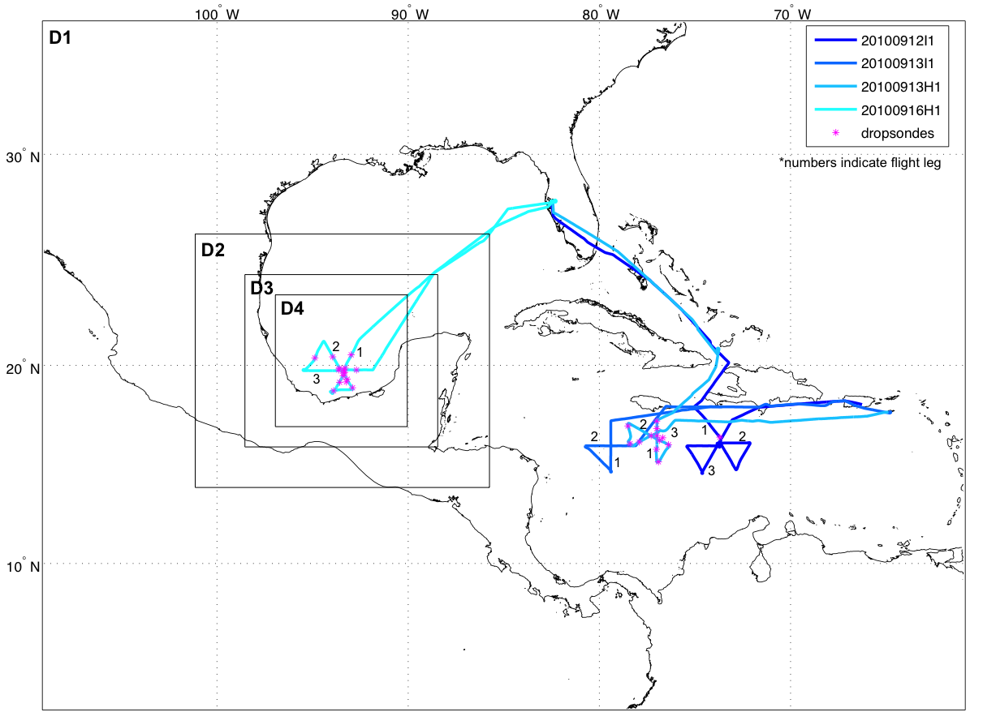
Hurricane Karl (2010) Simulation
Initialized: 1200 UTC 16 Sep
Cycling DA: 19-21 UTC 16 Sep (Airborne Vr SOs)
Retrieved simulated Vr from 00 UTC to 02 UTC 17 Sep
  HiRes Domain: 1km horizontal; 61 vertical Eta-levels

Slide 11
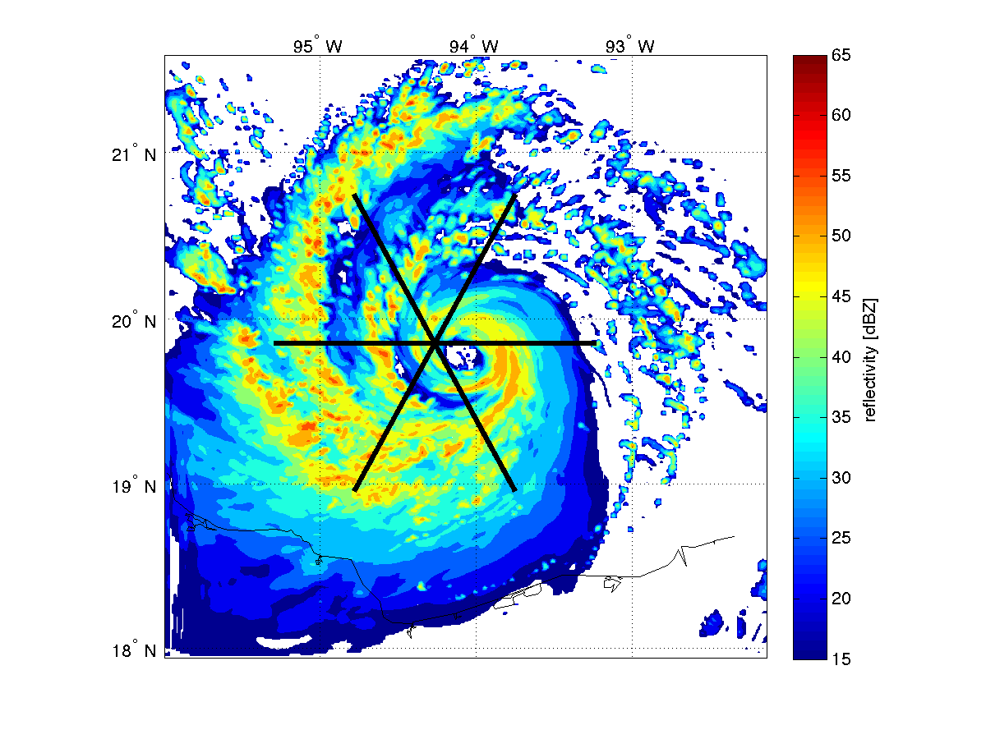
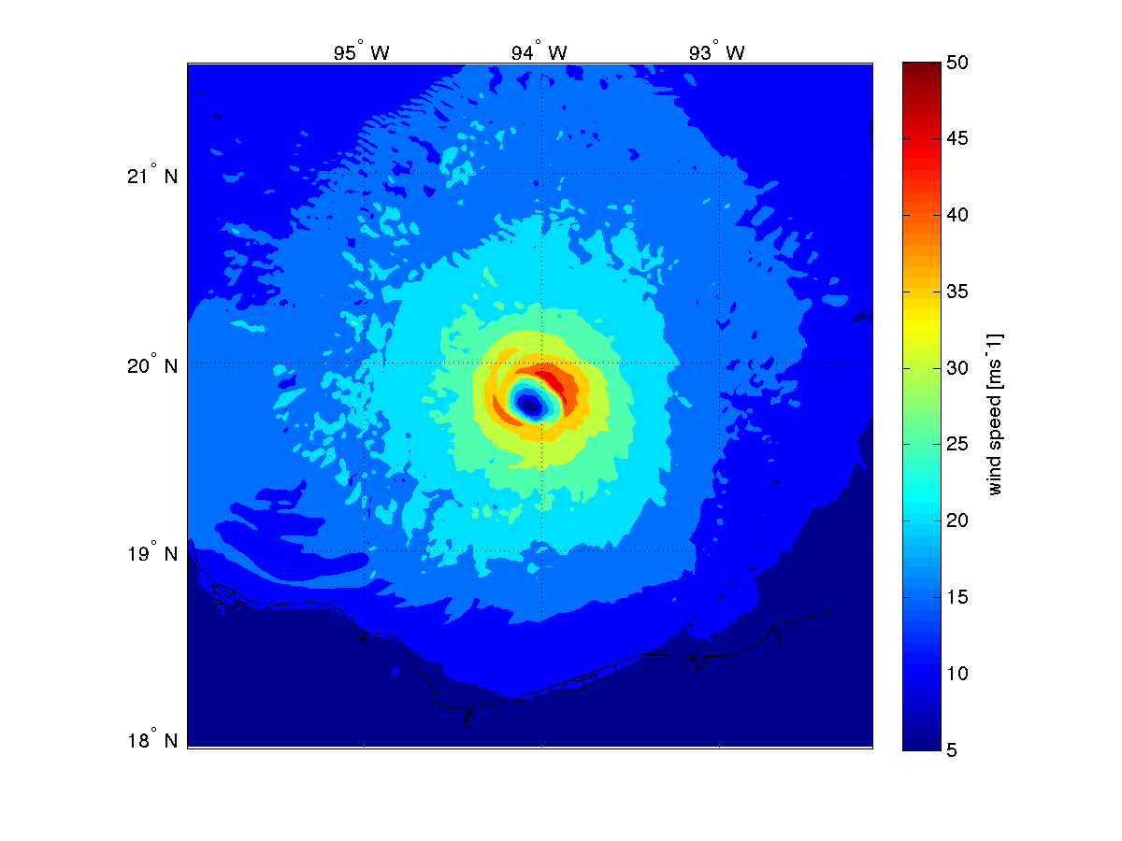
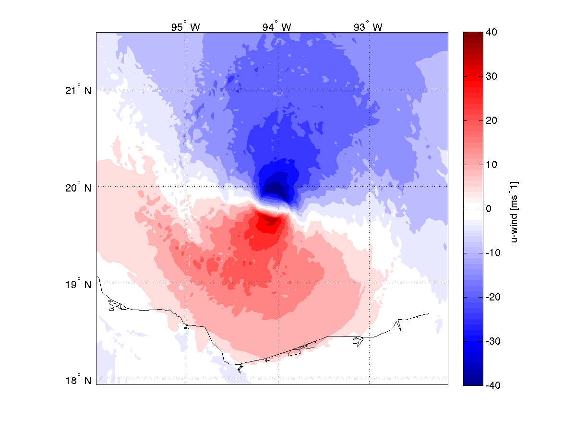
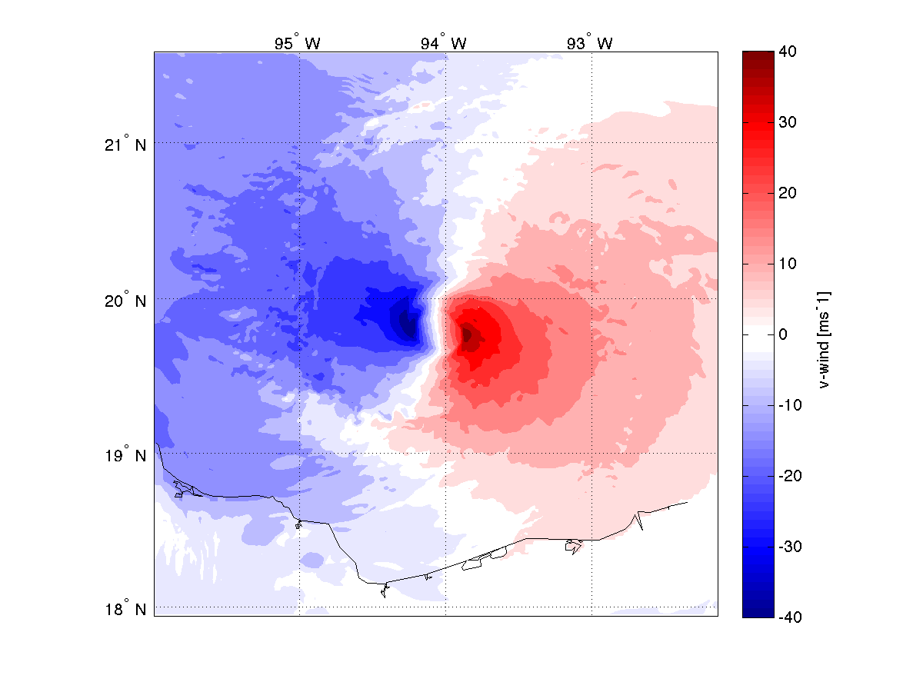
Hurricane Karl (2010)
Simulated Flight Legs
LEG 1
LEG 3
simulated reflectivity [dBZ]
wind speed [ms⁻¹]
LEG 2
u-wind [ms⁻¹]
v-wind [ms⁻¹]

Slide 12
Retrieved CSOs from
Simulated Karl Leg #1
LEG 1
u-wind [ms⁻¹]
v-wind [ms⁻¹]
Simulated reflectivity [dBZ]
u-wind error [ms⁻¹]
v-wind error [ms⁻¹]
fall speed [ms⁻¹]

Slide 13
RMSE Simulated CSO by alpha bin and distance from aircraft track
u-wind
v-wind
RMSE [ms⁻¹]
alpha bin [deg]
alpha bin [deg]
RMSE [ms⁻¹]
U: 2.54
V: 2.54
distance from aircraft [km]
distance from aircraft [km]

Slide 14
Flight Level Comparison
Flight 20100916H Leg #2
alpha 180º
alpha 0º
RMSE [ms⁻¹] CSO U: 1.66 V: 1.49 HRD U: 1.65 V: 1.89

Slide 15
RMSE CSO by alpha bin and distance from aircraft track
Flight Level
Flight Level
Dropsonde
Dropsonde
u-wind
v-wind
alpha bin [deg]
alpha bin [deg]
RMSE [ms⁻¹]
RMSE [ms⁻¹]
CSO U: 2.74
V: 2.55
HRD U: 1.98
V: 2.55
distance from aircraft [km]
distance from aircraft [km]

Slide 16
Key Points
CSOs partially fill in data gaps and smooth radial velocity data
CSOs can provide low error estimates of both along beam and cross beam information under certain constraints
CSO provides low error estimate close to aircraft at small alpha angle deviations
  RMSE: 1-1.5 ms⁻¹
Temporal error assumption becomes an issue > 20 km
Vertical fall speed becomes an issue when alpha > +/- 50º
Data Assimilation Recommendation
  Use CSOs within alpha +/- 50º and < 40 km perpendicular from track
  Use direct Vr SO outside limited perpendicular distance

Slide 17
Selected References
Chong, M., & Testud, J. (1996). Three-dimensional air circulation in a squall line from airborne dual-beam Doppler radar data: A test of coplane methodology software. Journal of Atmospheric and Oceanic Technology, 13(1), 36–53.
Gamache, J. F., Marks, F. D., & Roux, F. (1995). Comparison of three airborne Doppler sampling techniques with airborne in situ wind observations in Hurricane Gustav (1990). Journal of Atmospheric and Oceanic Technology, 12(1), 171–181.
Gamache, J. F., Dodge, P. P., & Griffin, N. F. (1997). Automatic quality control and analysis of airborne Doppler data: Realtime applications, and automatically post-processed analyses for research. Preprints, 28th Conf. on Radar Meteorology.
Lhermitte, R. M., & Miller, L. J. (1970). Doppler radar methodology for the observation of convective storms. In 14th Conference on Radar Meteorology (pp. 133–144).
Zhang, F., Weng, Y., & Sippel, J. A. (2009). Cloud-resolving hurricane initialization and prediction through assimilation of Doppler radar observations with an ensemble Kalman filter. Monthly Weather Review, 137(7), 2105–2125.

Slide 18
Supplementary slides

Slide 19
Retrieved CSOs by various alpha bins
Alpha = 342,198
Alpha = 351,189
Alpha = 000,180
wind speed [ms⁻¹]
Alpha = 009,171
Alpha = 018,162

Slide 20
Aggregated RMSE CSO by alpha bin and distance from aircraft track
EXP_NOW
EXP_PERW
EXP_FALL
EXP_FALLS
RMSE [ms⁻¹]
RMSE [ms⁻¹]
distance from aircraft [km]
alpha bins [deg]

Slide 21
Hurricane Karl (2010) Simulation HRD Fall Speed Correction
Snow
ZZ = radar reflectivity factor
DCOR = density correction factor
VTR = fall speed of rain
VTS = fall speed of snow
VT = fall speed
H = height of observation
HHI = top of melting layer
HLOW = bottom of melting layer
DPB = depth of melting layer
HHI
Melting Layer
DPB
height [km]
HLOW
Rain
ZZ = 10.**(DBZ*0.1)
VTR = -DCOR * (2.6*ZZ**.107)
VTS = -DCOR *(0.817*ZZ**0.063)
VT = VTR*(HHI-H)/DPB +
VTS*(H-HLOW)/DPB
DCOR = EXP(0.45*H*.10437052)
reflectivity factor [dBZ]
Notes:
Radials adjusted for fall speed during radar quality control
Radar reflectivity (Z) – Vertical fall speed velocity (V_{t}) relationship
No attenuation correction
Procedure:
Define melting band center height (HB) and depth (DPW)
Calculate melting band bottom/top (HLOW, HHI)
Use rain below melting band (VTR)
Use snow above melting band (VTS)
Linearly interpolate snow/rain within melting band (VT)
Apply air density correction factor to all V calculations (DCOR)

Slide 22
Coplane Error Function
obsError = alphaError + distError + baseError
Analytical Error Function
Example: alpha 0º,180º
alpha bin [deg]
assigned error [ms⁻¹]
longitude
latitude
distance from aircraft [km]
Notes:
Total Observation Error (obsError): error assigned to each observation
Vertical Component Error (alphaError): error induced by including vertical component in value
Distance from Aircraft Error (distError): error induced by using larger time difference when computing U/V value
Base geometric, navigational, and pointing angle error (baseError): error associated with coplane observation closest to aircraft track

Slide 23
Hurricane Karl (2010) DA Experiment
NHC BT NoDA HRD CSO SO
NoDA
Track Forecast
spin-up
cycling
forecast
09/16 12 UTC
19
UTC
20
UTC
21
UTC
09/18
00 UTC
10-m WS Forecast
MSLP Forecast

Slide 24
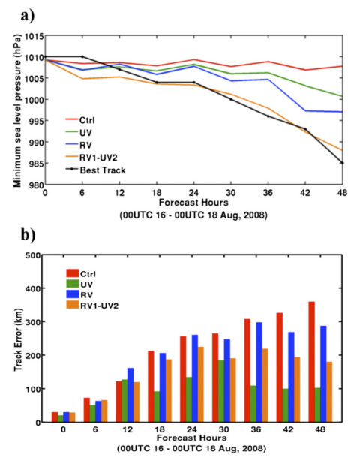
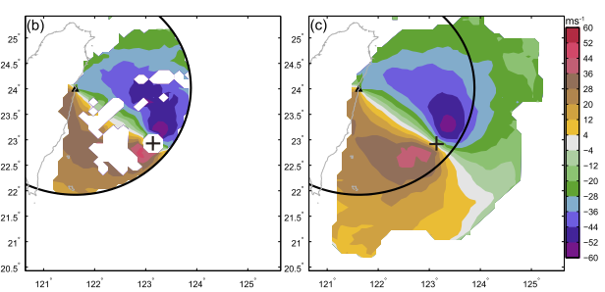
Recent Studies and Next Steps
Li et al. (2014):
  Direct radial velocity assimilation (Improved intensity)
  Analysis derived u-/v-wind assimilation (Improved track)
  Serial assimilation of Vr / derived u-/v-wind best result
Wang et al. (2014), Li et al. (2013)
  Along beam and cross beam components produces better intensity, track, and precipitation forecast versus Vr only
  Build up vortex faster than Vr only
  Better vortex structure in analysis
Li et al. (2014)
Wang et al. (2014)

