Slide 1
China daily Extreme precipitation GEV fitting
Jun Sun
Fuqing Zhang

Slide 2
outline
Data
Method
  GEV-Generalized Extreme Value (GEV) distribution model fitting
Results
  Linear Trend
  Return level and return period
summary

Slide 3
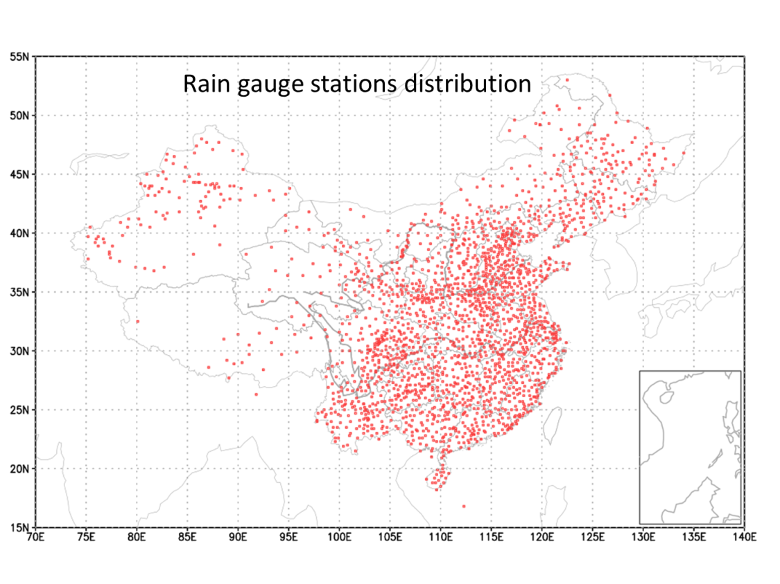
Data
  Rain gauge daily precipitation form 1951-2013;
  Quality controled,and manual checked;
  Missing data days or periods are considered;
  The station’s recorder lengths are equal to or more than 50 years
  2080 stations are selected.

Slide 4
Method
Different approaches related to extreme value theory:
  Block Maxima (BM)
  R-th order statistic
  Peaks over threshold(POT)
  Point processes(PP)

Slide 5

  Block Maxima method
Assumption: daily rain is identically and independently distributed(IID)
considering the distribution of the maximum order statistic
Here,X is daily precipitaion,block size n=365, so M_{n} are annual maxima series
Then the M_{n} meet the GEV distribution

Slide 6

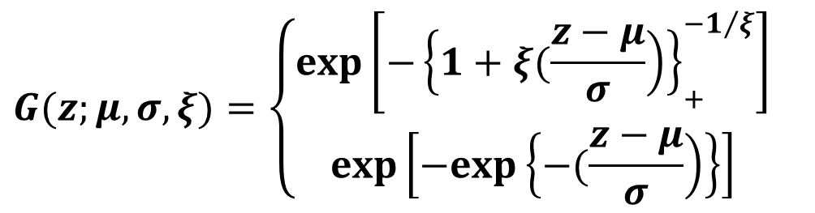

the GEV pdf G(z):
$$G(z;μ,σ,ξ)=\left\{\begin{matrix}exp\left[−{\left\{\left.1+ξ(\frac{z−μ}{σ}\right)\right\}}_{+}^{−1/ξ}\right] \\ exp\left[−exp\left\{\left.−(\frac{z−μ}{σ}\right)\right\}\right]\end{matrix}\right.$$
For $ξ ≠0$
For $ξ→0$
Three types of distributions:
Type I（Gumbel） ξ=0
Type II（Fréchet） ξ>0
Type III（ Weibull）ξ<0

Slide 7
  fitting to the annual series of maxima with the Generalized Extreme Value (GEV) distribution model
  Considering linear trend, using the likelihood ratio test for trend term(μ₁=0?)
  Calculating return level and return period

Slide 8
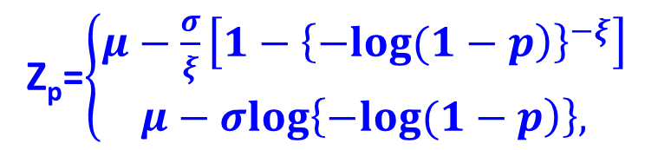
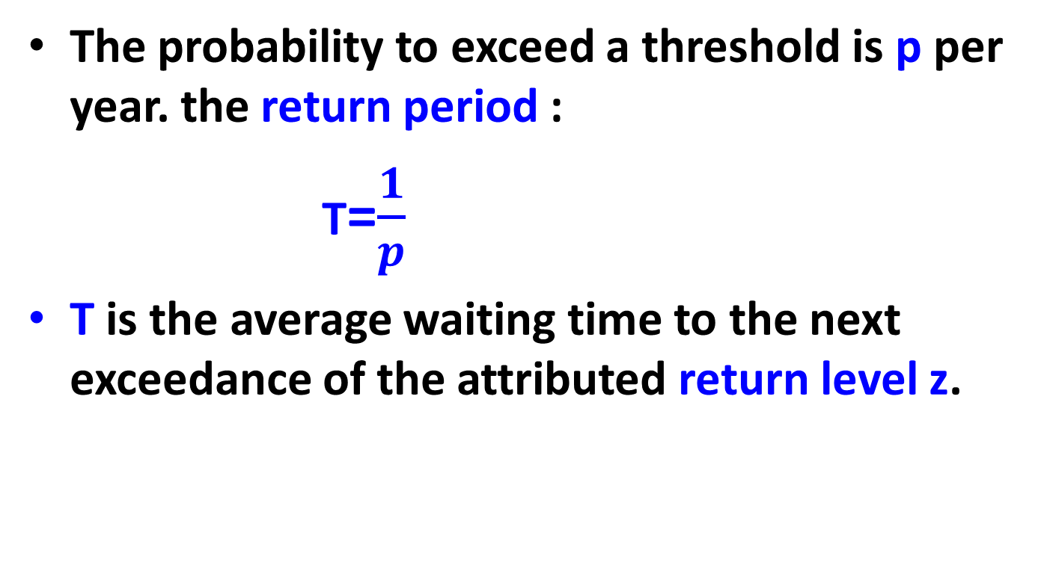


Return level and period
The probability to exceed a threshold is p per year. the return period :
T=$\frac{1}{p}$
T is the average waiting time to the next exceedance of the attributed return level z.
Z_{p}=$\left\{\begin{matrix}μ−\frac{σ}{ξ}\left[1−{\left\{\left.−log(1−p\right)\right\}}^{−ξ}\right] \\ μ−σlog\left\{\left.−log(1−p\right)\right\},\end{matrix}\right.$
For $ξ ≠0$
For $ξ=0$

Slide 9
Considering the non–stationary annual maxima
$$\left.G(z;μ,σ,ξ)=G(z;μ(t),σ,ξ\right)$$

Slide 10

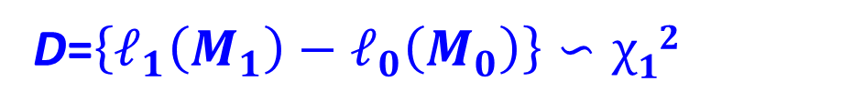
Parameters estimated using the maximum likelihood function:
For $ξ ≠0$
The non–stationary model trend significance test: The deviance statistic
D=$\left\{ℓ_{1}\left(M_{1}\right)−ℓ_{0}\left(M_{0}\right)\right\}∽χ12$
M₁ model including linear time trend term
M₀ model that is μ₁=0

Slide 11
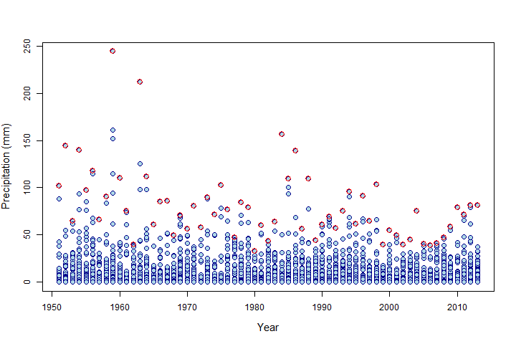
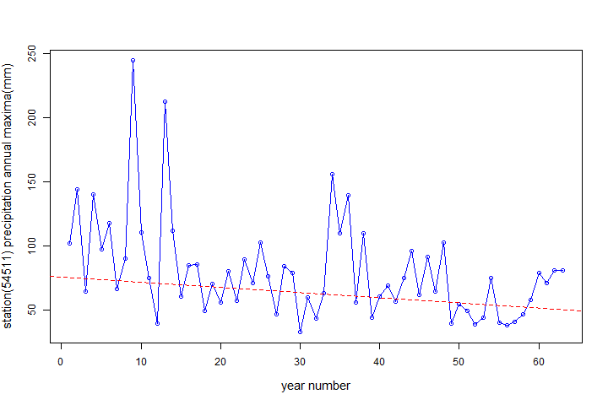
Non-stationary case
Annual maxima series for Beijing(54511)
Daily precipitation series and annul maxima series(red circles)
Annul maxima series and linear trend
Beijing(54511)

Slide 12
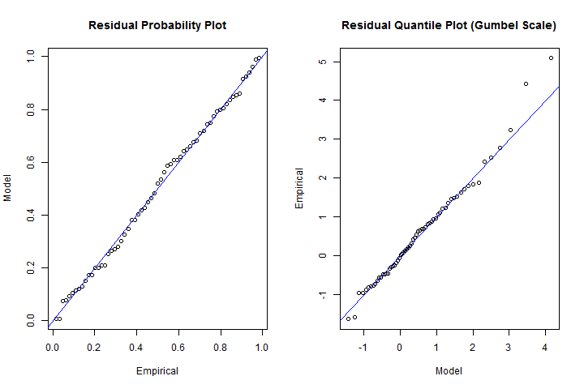
The goodness–of–fit of the GEV model for the annual maximum at beijing, allowing for a linear trend in μ

Slide 13
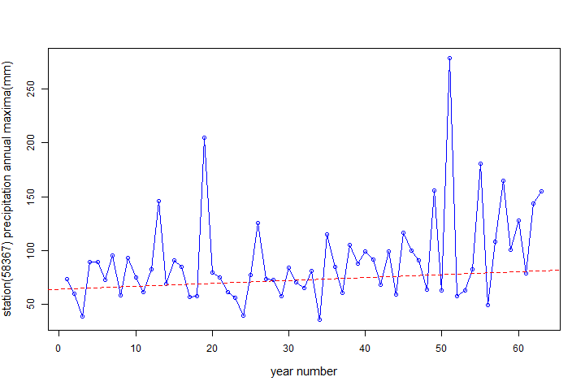
Stationary case
Annual maxima series for Shanghai(58367)
Shanghai(58367),though have some trend, but don’t pass significance test with p-value 0.12 at 0.05 significance level

Slide 14
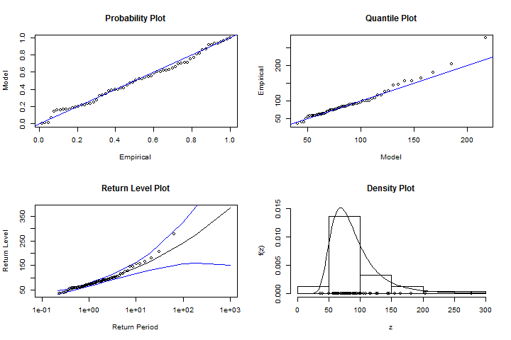
Diagnostic plots indicating the goodness–of–fit of the GEV to the Shanghai precipitation annual maxima

Slide 15
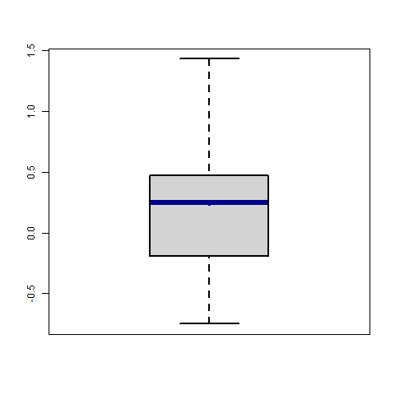
193 stations
Mu1 boxplot
Total stations 2080
Having trend 193(9.3%)
+ trend 142
- trend 51

Slide 16
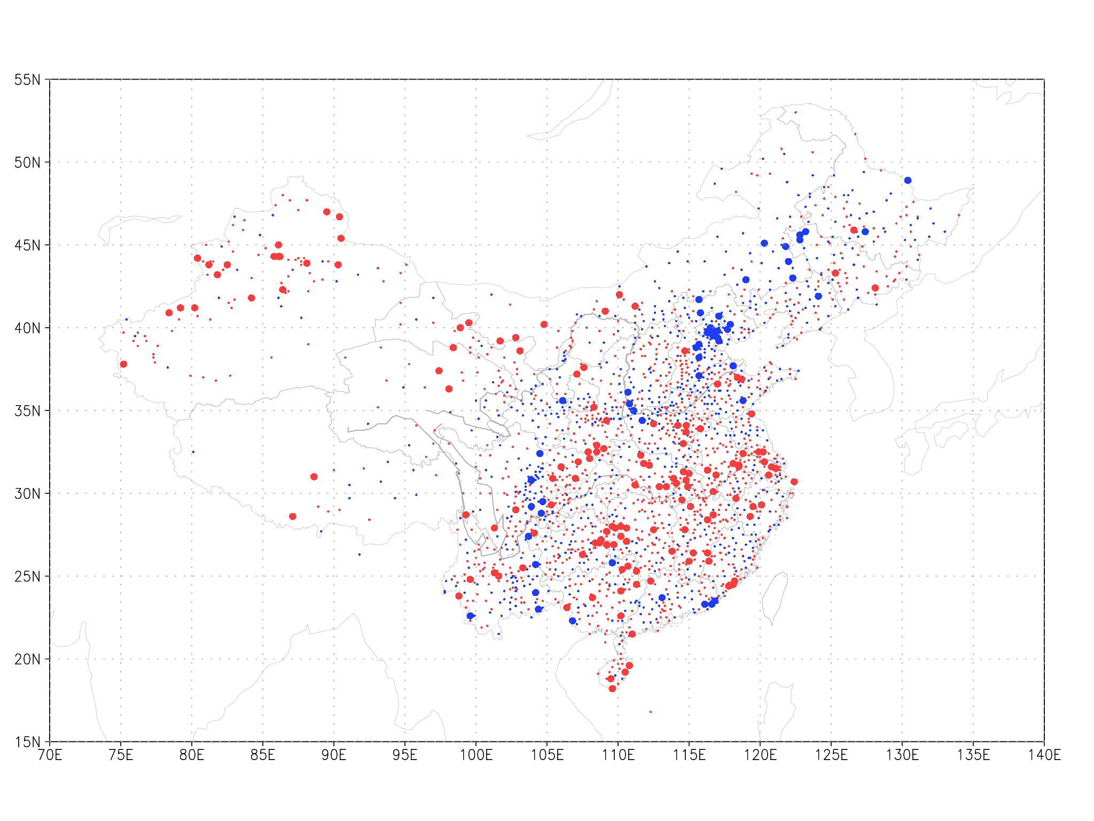
μ₁ regional distributions for 2080 stations,red (blue) dot stand for positive(negetive) trend with larger dot passing the significant test(5% significance level )

Slide 17
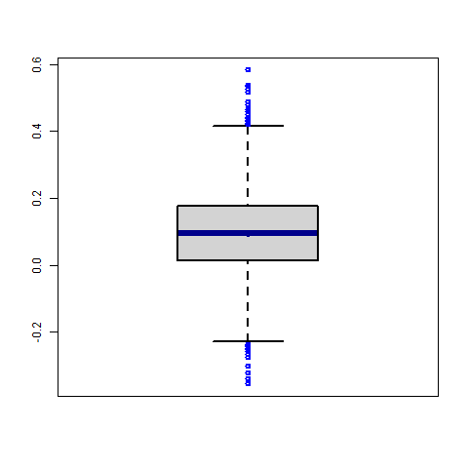
The ξ boxplot
Most distributions are Type II（Fréchet） ξ>0
Or Type I（Gumbel） ξ≈0

Slide 18
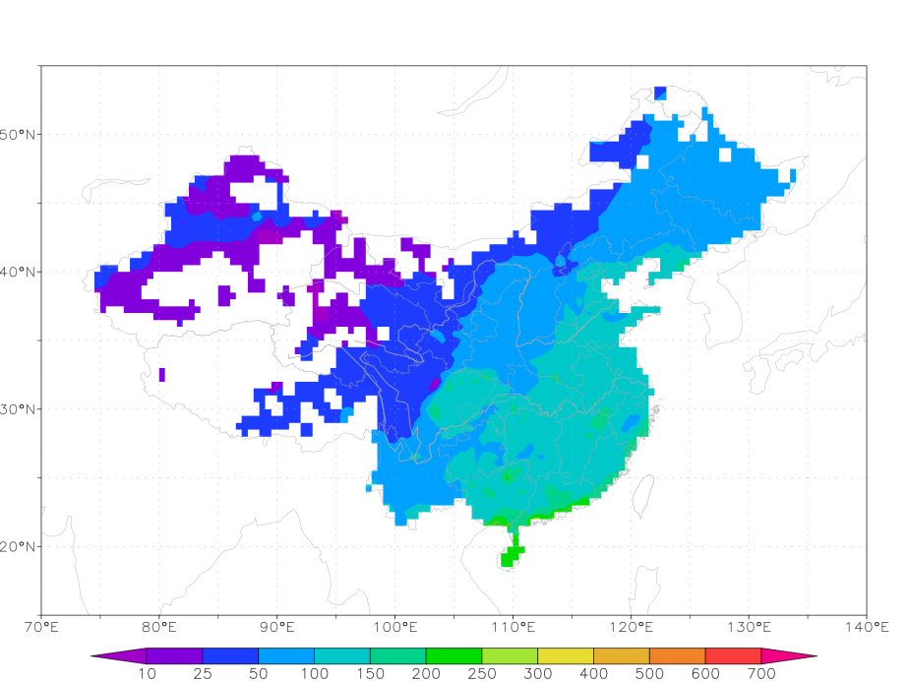
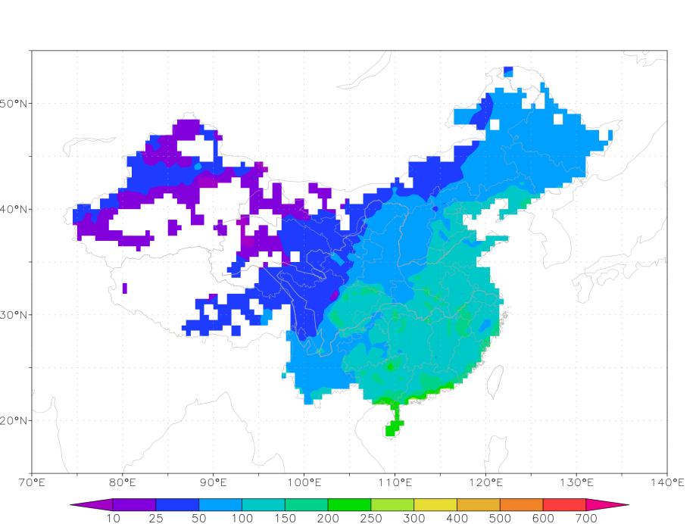
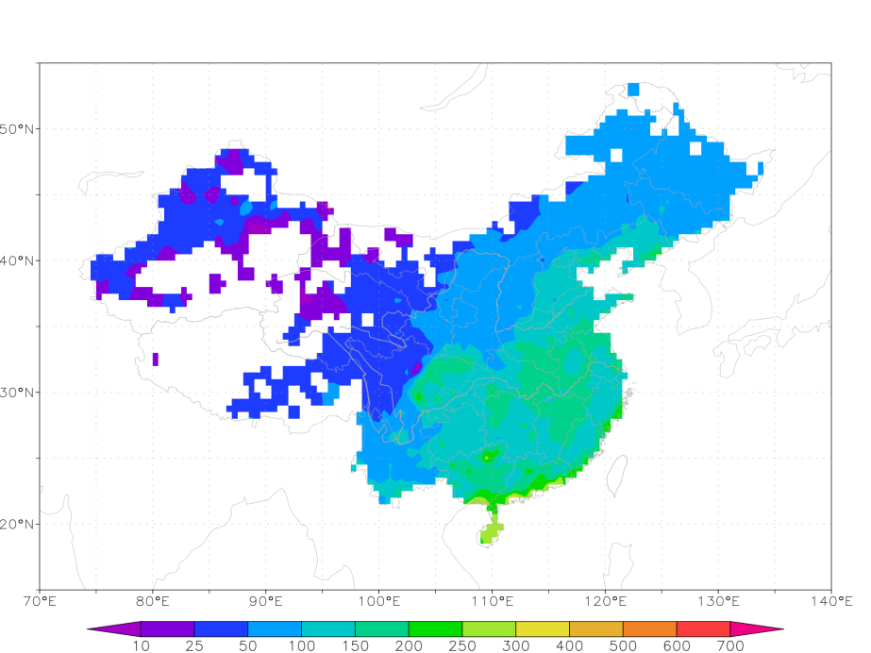

estimated
empirical
5 year
mm
10 year
mm
Return level for 5,10 years

Slide 19
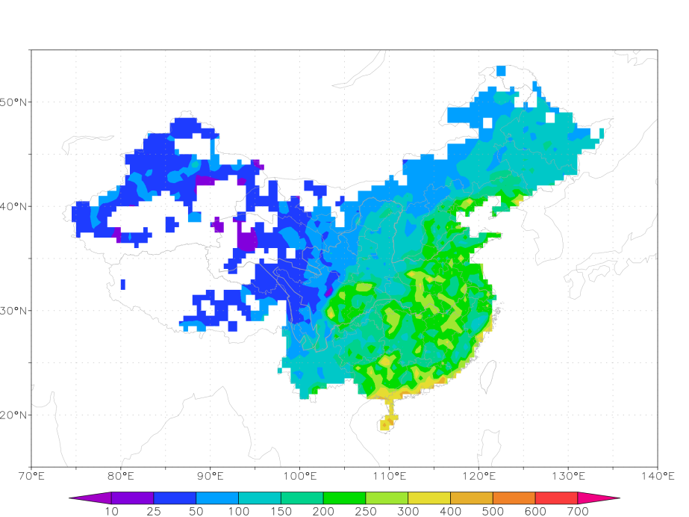

estimated
empirical
mm
mm
Return level for 50 years

Slide 20
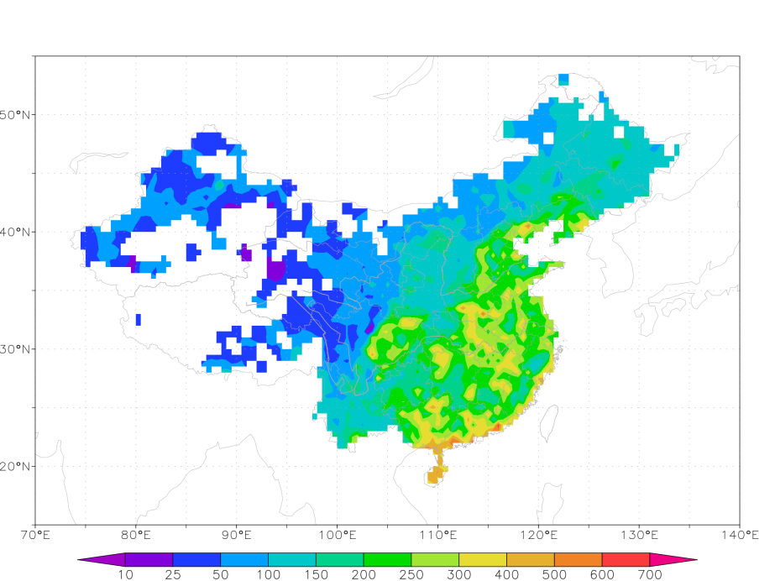
mm
Estimated return level for 100 years

Slide 21
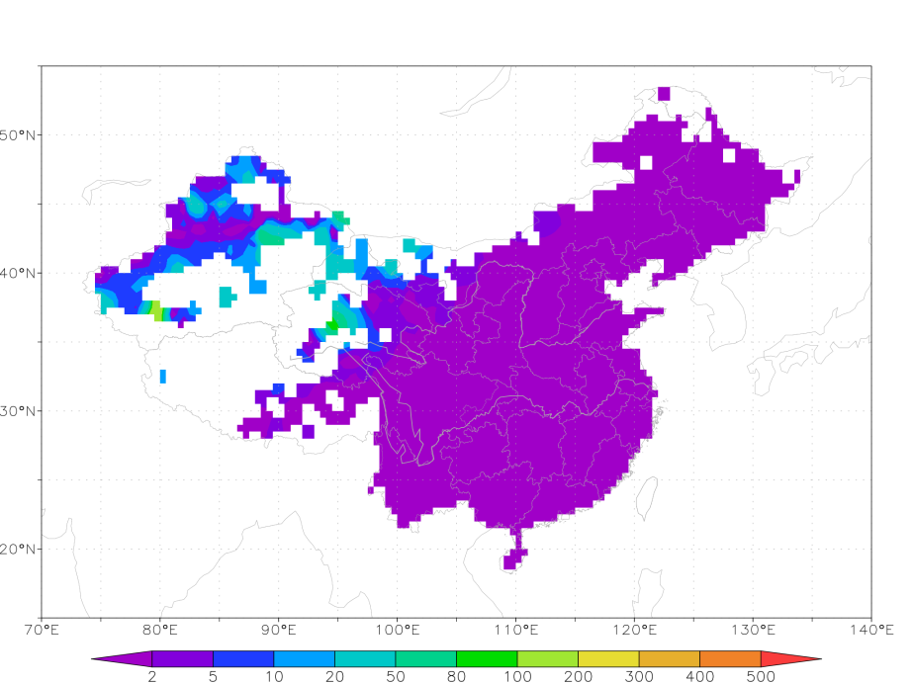
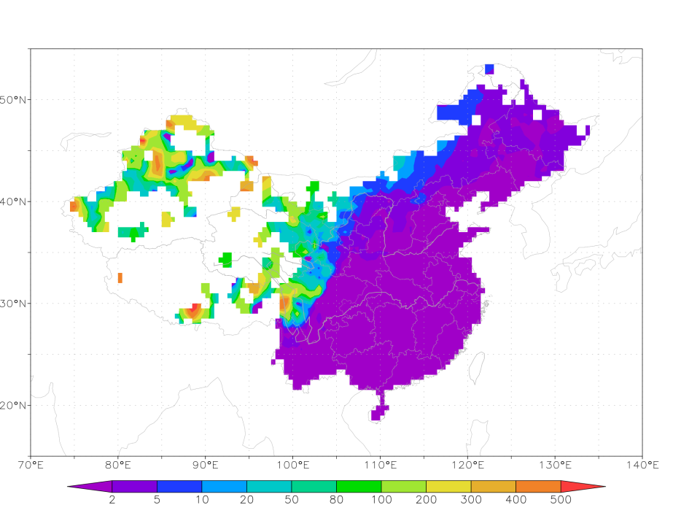
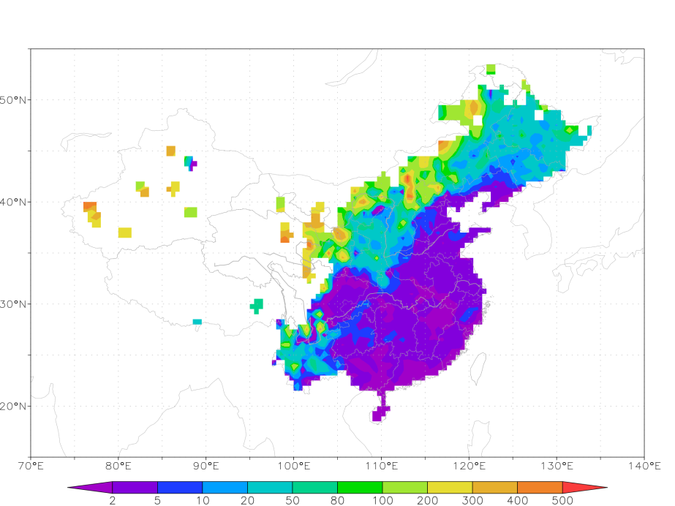
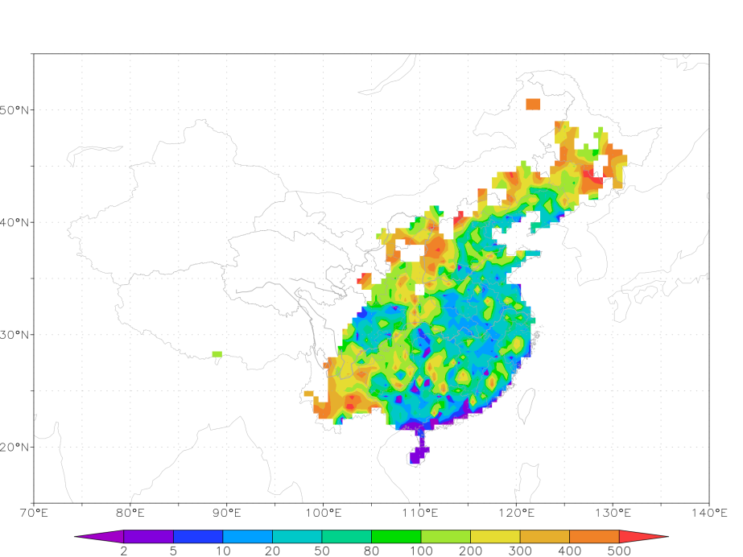
25 mm
50mm
years
100mm
200mm
years
Return period for different precipitation thresholds(>500years are not drawn)

Slide 22
summary
The GEV is reasonable model to fit precipitation annual maxima;
Some rain gauge stations present some trend and pass significance test, that is the North China is tend to negative trend, The Yangtze River, Northwest China are positive trend;
Return level and return period are inferred, and comparable with empirical value.

Slide 23
References:
  Coles, S.G. (2001), An Introduction to Statistical Modeling of Extreme Values. Springer Verlag, New York.
  Feng, S., Nadarajah, S., and Hu, Q., 2007, Modeling annual extreme precipitation in China using the generalized extreme value distribution, Journal of Meteorological Society of Japan, 85, 599–613.
  Gilleland, E. and Katz, R. W. (2011) New software to analyze how extremes change over time. Eos, 92(2), 13--14

Slide 24
THANK YOU
FOR YOUR ATTENTION!

