Slide 1

Mesoscale Predictability:
Energy transfer within moist baroclinic waves
Y. Qiang Sun, Fuqing Zhang
Penn State University

Slide 2
INTRODUCTION
PRACTICAL vs. INTRINSIC PREDICTABILITY
(Lorenz 1996; Melhauser & Zhang 2012 JAS)
PRACTICAL PREDICTABILITY
GOOD REGIME
If truth lies almost entirely in a flow regime
  reducing the initial perturbations will hone in on the truth
  increase the practical predictability of the event
If truth lies near bifurcation
  Reducing initial perturbations will contain both regimes/solutions
  No increase in predictability
  Intrinsic limit
POOR REGIME
OBSERVED
TRUTH
INTRINSIC PREDICTABILITY
ENSEMBLE MEMBERS
ENSEMBLE
MEAN

Slide 3
INTRODUCTION: previous result
OVERVIEW OF THE SIMULATION
Figure vertical vorticity at 500 hpa for the DRY and MOIST cases.
the one shown at upper-left corner shows vertical vorticity at day 4 for both case.
Day 5 at 12 hour is the time when perturbation is added.
DRY
MOIST

Slide 4
INTRODUCTION: previous result
Error (Difference Total Energy) Evolution
NOISE CASE

Slide 5
INTRODUCTION: previous result
Error (Difference Total Energy) Evolution
LARGE CASE

Slide 6
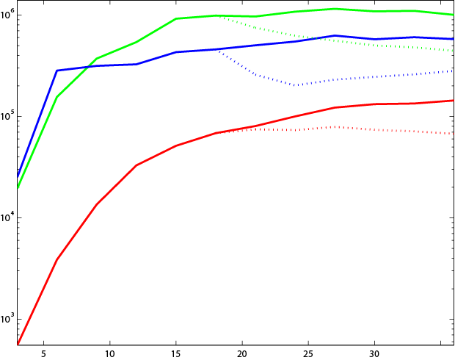



INTRODUCTION: previous result
ZHANG MODEL FOR ERROR GROWTH
Zhang et al. (2007)

Slide 7
Motivation
In this ‘upscale’ picture, How is error transferred from initial small convective scale to the large baroclinic scale?
What’s the role of the moisture in this process?

Slide 8
Energy Equations
Momentum EQNs
Kinetic Energy
Thermo EQN
Available Potential Energy
Pseudoincompresible EQN

Slide 9
Energy Equations
P(k) ~ direct heating + Buoyancy flux + IGW
The only term responsible for energy transfer within different scales is advection term.
Pressure term represents the conversion from potential energy to kinetic energy.

Slide 10
Energy Cycle
LPE
ADV
SPE
pressure
SKE
ADV
LKE
pressure

Slide 11
Total Kinetic Energy Budget
Advection has nearly zero contribution to the Total Kinetic Energy!

Slide 12
Error Energy Cycle
system
LPE
ADV
SPE
pressure
SKE
ADV
LKE
pressure

Slide 13
DKE spectrum
DPE spectrum
36h
24h
12h
6h
3h
NOISE

Slide 14
Summary :
Additional PE added due to convection
Shallower slope is critical for upscale error growth.
Intrinsic predictability ~ 1m/s large scale initial error, this is clearly related to the total precipitation of the system.

