Slide 1

Development and Evaluation of a Multi-functional Data Assimilation Testbed Based on EnKF and WRFVar with Various Hybrid Options
Yonghui Weng, Fuqing Zhang,
Jonathan Poterjoy, Michael Ying,
Christopher Melhauser, Dandan Tao,
Steve Greybush, Xin Zhang and Juanzhen Sun

Slide 2

Methodology & Algorithms
Data assimilation, Parameter estimation, Model error treatment, Ensemble generation, Probabilistic forecasting, Uncertainty quantification
Outreach & Education
Demos & Testbeds
Community sharing
Training & hosting
National partnerships
International collaborations
Dynamical Systems and Disciplinary Sciences
Weather, climate, ocean, air/water/land chemistry and pollution, ecosystem, earth system, oil reserve, storm surge, mudslide, forest fire, earthquake, …
Cyberinfrastructure
Computing
Visualization
Data mining
Data acquisition
Data storage
“BigData”
Introduction to ADAPT
Penn State Center for Advanced Data Assimilation and Predictability Techniques
Notes:
First I’ll introduce you the newly established Penn State Center for Advanced Data Assimilation and Predictability Techniques. The ADAPT center seeks to integrate and enhance the existing strength and expertise in cutting-edge data assimilation and predictability research across Penn State which spans over several academic colleges and research institutes.
The primary objectives of ADAPT include design and develop advanced and efficient DA and predictability algorithms for automatic and accurate estimation of the state and uncertainty of dynamical systems building on both existing ensemble-based and variational methods. And implement these advanced methods with fast efficient numerical solvers and parallel computing capability for numerical weather, water, air quality, climate and ecosystem prediction.

Slide 3
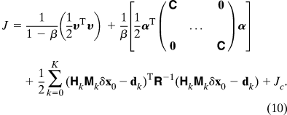
Current ADAPT
Multi-functional Regional DA System
WRF based;
DA functions:
  EnKF ( Ensemble Square-Root Filter)
  Incremental 4DVar (WRFDA)
  δx₀ = x₀ − x₀^{b}
  4dEnVar (with linearized model operations replaced by 4-D ensemble)
  E4DVar (EnKF and 4DVar Hybrid)
(Zhang & Zhang, 2012 MWR; Poterjoy & Zhang, 2014 EnDA Workshop)
Notes:
Currently the ADAPT multi-functional regional DA system is based on WRF model, the DA functions include EnKF, 4DVar, 4d ensemble var and ensemble 4d var. The EnKF we used is the ensemble square-root filter, the 4dvar uses the incremental method, which minimize the cost function of the incremental of the background state vector and the state vector. The ensemble 4DVar uses a 4-D ensemble to replace tangent linear and adjoint model operators in 4DVar. While the EnKF and 4DVar hybrid called E4DVar uses a mixed error covariance with the EnKF ensemble and static background.

Slide 4
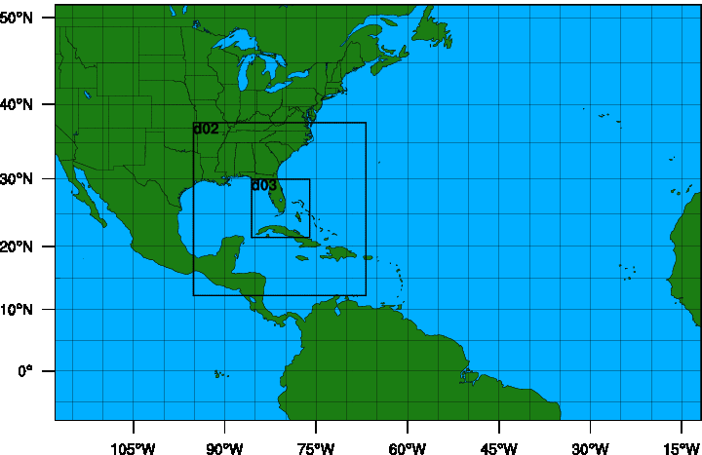
PSU WRF-EnKF Cycling System
D1: 379x244x27kmx44sigma
ARW | V3.5.1
Cumulus | Grell-Devenyi ensemble (27 km domain only)
Microphysics | WSM 6-class graupel
PBL | YSU
Surface Layer | Monin-Obukov
Land Surface | thermal diffusion
Radiation | Rrtm / Dudhia
Air-sea flux | Green and Zhang
Ocean | 1-D
60-member ensemble
Gaspairi & Cohn 99' covariance localization with SCL
IC & BC: GFS using 3DVAR background uncertainty
D2: 304x304x9km
D3: 304x304x3km
Notes:
There are 2 streams for PSU in 2012. Stream 1.5 named ATCF ID APSU is ARW deterministic forecast initialized with TDR data assimilation, while stream 2.0 ANPS is ARW deterministic forecast initialized with operational GFS analysis. Both of them have the same WRF model configuration. They have 3 domains with 27,9,3 km resolution, the out domain is fixed, the 2 inner domains are centered by the TCVital data. For TDR data assimilation, there are 60 members initialized with operational GFS and perturbed by WRFDA.

Slide 5
1st time real-time WRF-EnKF for Ike (2008)
(a)
°C
(b)
m/s
EnKF Analysis vs. aircraft obs. of (a) wind speed and (b) T.
(c)
m/s
(d)
(c) Track and (d) intensity forecasts
(Zhang et al., 2011 GRL)

Slide 6
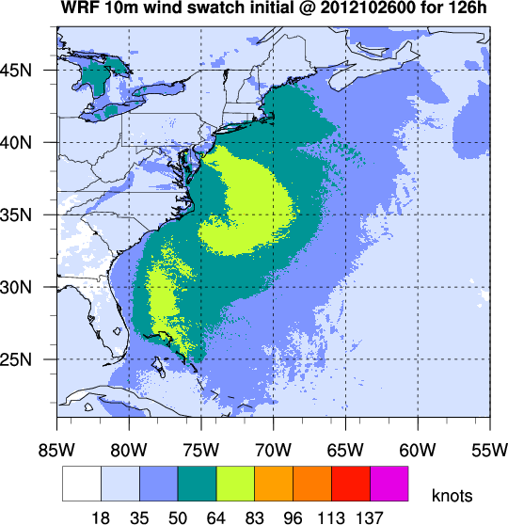
Real-time Cycling WRF-EnKF for Sandy (2012)
120h rain obs.
Sandy (2012) track
Intensity Swatch
Sandy (2012) intensity
120h rain prediction
50kt wind speed probabilities
(Zhang and Weng, 2014 BAMS)

Slide 7
2014 Cycling WRF-EnKF for Edouard (2014)

Slide 8
WRF-EnKF Performance Verification over 2008-2010 61 TDR Cases with the 2010 Real-time System
km
kt
(a)
(b)
h
h
Mean absolute forecast error averaged over 50 samples homogenized by all 61 airborne Doppler missions during 2008–2010 for (a) the track position error (km) and (b) the 10‐m maximum wind speed error (knots) with simple bias correction for all forecasts except for OFCL. (Zhang et al., 2011 GRL)

Slide 9
WRF-EnKF Performance Verification over 2008-2012 all 112 NOAA TDR Cases with the 2012 Real-time System
track forecast error
intensity forecast error
(Zhang and Weng, 2014 BAMS)
Notes:
Figure 1: NHC (a) track error, (b) intensity error.

Slide 10
Multi-incremental 4DVar
Notes:
The WRF 4D-Var system employs the incremental 4D-Var formulation that is commonly used in operational analysis systems. An iterative algorithm is used to solve the quadratic minimization problem. When the solution is found by linearizing the model and observation operators about a basic state, the minimization in 4D-Var is called an inner loop.
To further reduce the computing cost of the 4D-Var algorithm, operational centers typically perform the inner loop minimizations at a lower horizontal resolution than the outer loop and forecast. If there is more than one outer loop, different inner loops may have different horizontal resolutions We call this a multi-incremental 4DVar algorithm. For example, the ECMWF operational 4D-Var now runs outer loops with T1279L91 (16km) and three inner loops with T159/T255/T255 (125km/80km/80km), respectively. Another advantage of introducing the dierent horizontal resolutions step-wise into the minimization is to take nonlinear processes into account with re-initializations in the linearized minimization algorithm (Gustafsson et al. (2012)).

Slide 11
Multi-incremental 4DVar
Multi-incremental 4DVar analysis
Blue: 1:3 outer loop
Red : 1:9 and 1:3 2 outer loops.
Position
Vmax (kt)
ARW forecasts with multi-increment 4DVar analysis
Track
Vmax (kt)
Pmin (mb)
(Zhang et al., 2014 JTECH)
Notes:
To take into account the non-linear processes with the linearized minimization algorithm and further decrease the computational cost of the 4D-Var minimization, a multi-incremental minimization that uses multiple horizontal resolutions for the inner loop has been developed. The method calculates the innovations with a high-resolution grid and minimizes the cost function with a lower resolution grid.

Slide 12
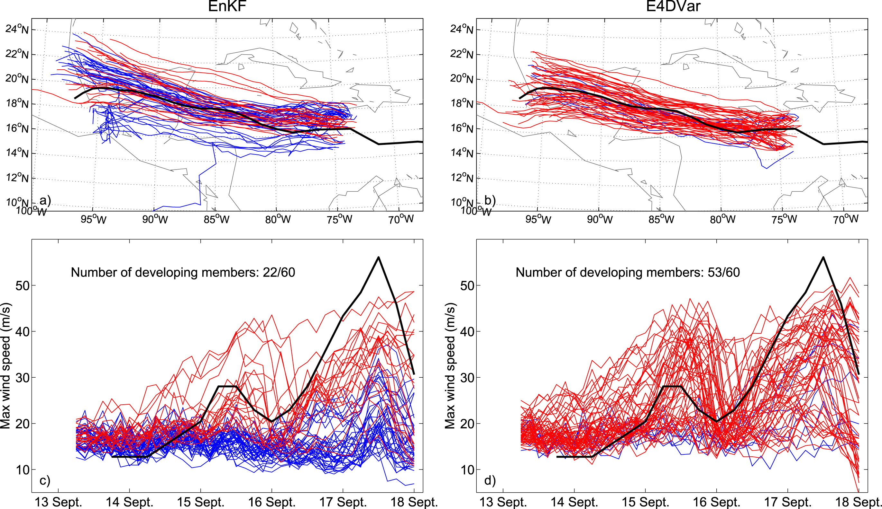
EnKF (left) and E4DVar ensemble forecasts for Atlantic Hurricane Karl (2010).
EnKF and E4DVar: ensemble forecasts
Track
Track
Vmax
Vmax
22/60
53/60
Developing members are red, nondeveloping members are blue, and the best track data are black.
(Poterjoy & Zhang, 2014 MWR)
Notes:
Poterjoy and Zhang (JAS, 2013) also show that the number of ensemble members that capture Karl’s development before landfall increases largely between the 06 and 12 UTC 13 September EnKF cycles. Ensemble forecasts from EnKF and E4DVar analyses on 06 UTC 13 September show that the E4DVar ensemble contains mostly developing members at a time in which only 1/3 of the members develop in the EnKF ensemble.

Slide 13
EnKF, 4DVar and E4DVar: deterministic forecasts
Forecasts are run from each analysis using a 4.5-km nested domain that follows the vortex using preset moves.
Each simulation starts from the respective analysis time and ends on 00 UTC 18 Sept.

Slide 14
Integrate the EnKF, 4DVar and E4DVar into One System:
1 case comparison with the real-time system
Tack (left) and intensity (right) forecasts for hurricane Sandy (2012) initialized at 0000 UTC 21 Oct 2012 from 4DVar (pink), EnKF (blue) and E4DVar (red) assimilations by comparing to the NHC best-track observational analysis (black), GFS forecast (gray) and the PSU 2013 EnKF real-time forecast (green).

Slide 15
Ongoing and Future Works
More tests for the unify system;
Take the system into real-time operation;
Ingest satellite radiance into the system;
Develop the system for tornado, front, regional climate research;
…

