Slide 1
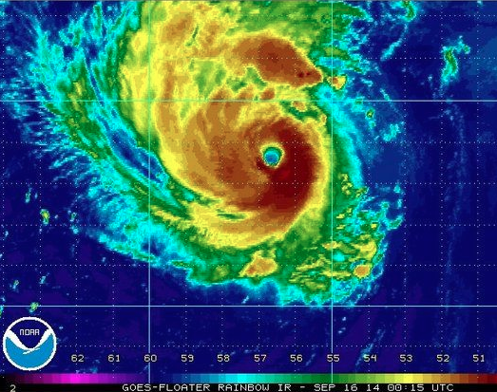

Predictability and dynamics of the rapid intensification of Hurricane Edouard (2014)
Erin Munsell
End of Fall 2014 Group
Meeting
December 11th, 2014

Slide 2
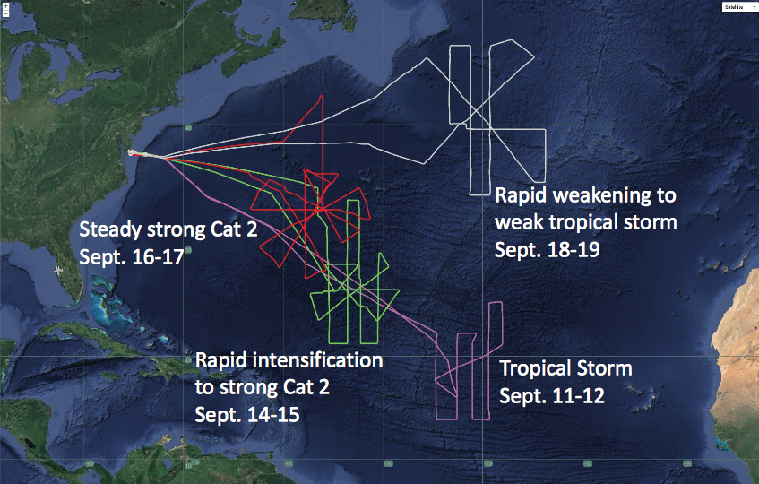
HS3 2014 – Flights over Edouard
Source: Scott Braun, NASA/GSFC

Slide 3
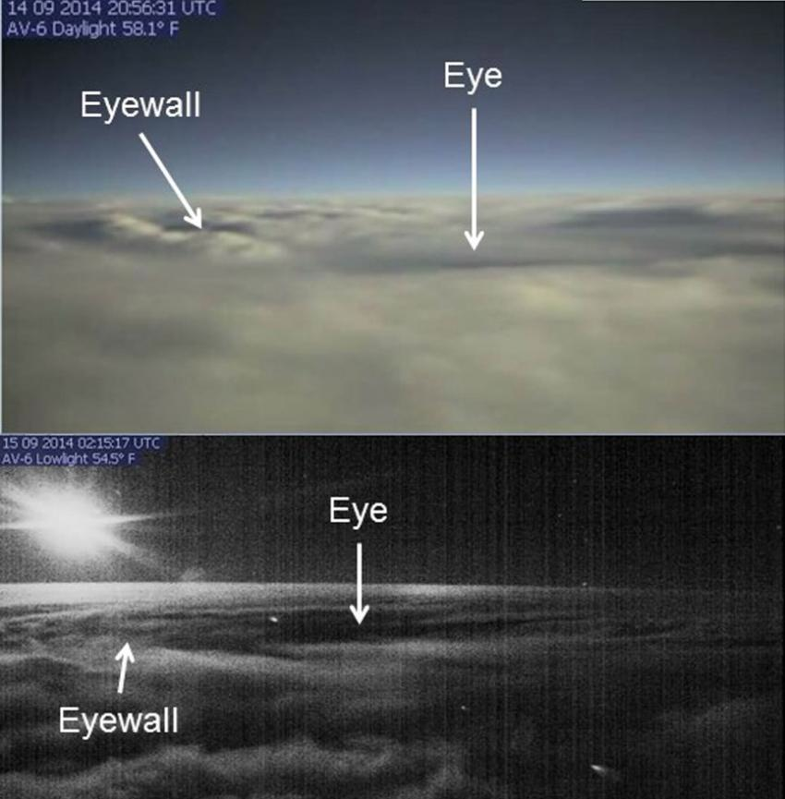
Source: D. Fratello, NASA AFRC

Slide 4
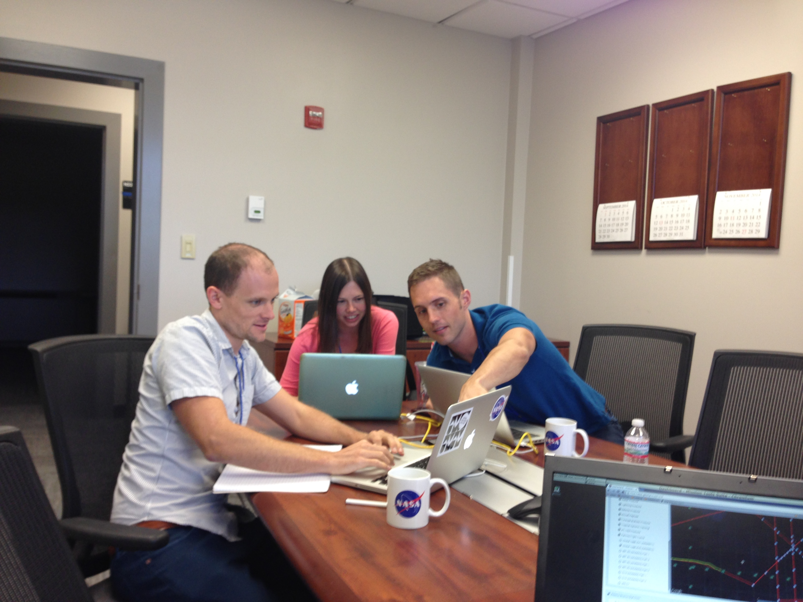

Slide 5
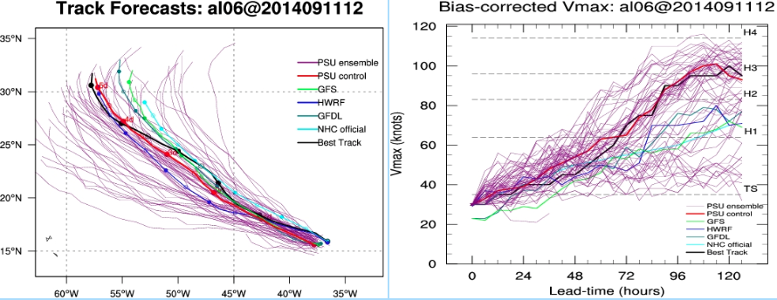
PSU WRF-EnKF ensemble simulation for Hurricane Edouard initialized at 12Z on Sept 11th, 2014
Excellent case for studying the predictability associated with rapid intensification

Slide 6
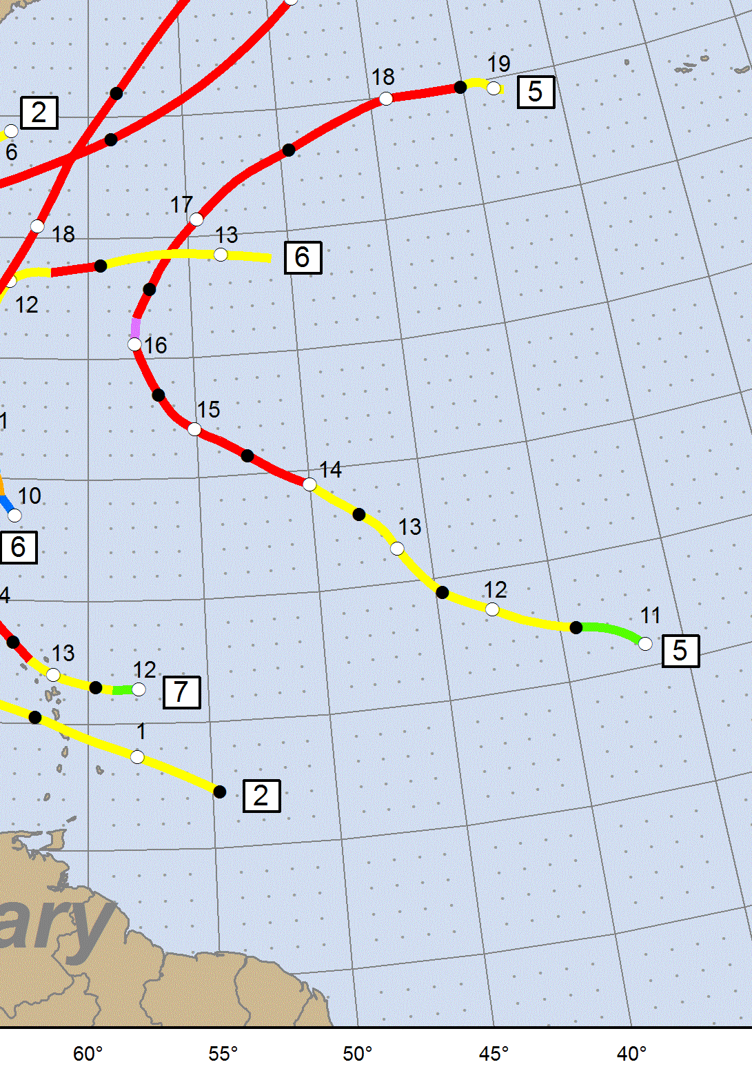
Hurricane Edouard Best Track (Preliminary)
PSU WRF-EnKF initialized at 12Z on Sept 11th – 3 h prior to TD 6 designation
Simulation ends on 18Z on Sept 16th – just after peak intensity (major hurricane, 1st of HS3!)
2 HS3 flights performed during simulation window – 11-12 Sept and 14-15 Sept (18-27 h and 72-90 h)

Slide 7
Maximum 10-m Wind Speed (kts) classified by performance
Best Track – Black
GOOD – Blue
GOOD_EARLY – Green
GOOD_LATE – Magenta
POOR – Red
Minimum Sea Level Pressure (hPa) classified by performance

Slide 8
Ensemble Tracks classified by performance
SST’s contoured (constant amongst members)

Slide 9
Deep-layer shear (850-hPa – 200-hPa) averaged over a 200-km to 500-km radius for the ensemble members of the composite groups

Slide 10
SH7.5-SST29 (GOOD_EARLY)
Idealized Experiments
Ensemble Mean
SH10-SST29 (GOOD or GOOD_LATE)
Standard Deviation
SH12.5-SST29 (POOR)
Source: Dandan Tao ☺

Slide 11
Deep-layer shear (850-hPa – 200-hPa) averaged over a 200-km to 500-km radius for the ensemble members of the composite groups

Slide 12
Mean deep-layer (850-hPa – 200-hPa) shear of composite groups in “Lagrangian” sense – time in relation to beginning of rapid intensification

Slide 13
Mean 850-hPa – 500-hPa tilt magnitude (km) for the composite groups of Edouard

Slide 14
2-km radar reflectivity (dBZ) composites (storm-centered; filled contours), winds (vectors), surface pressure (gray contours) mean shear (red vector) and mean tilt (magenta vector) for the composite groups of the Edouard ensemble
GOOD_EARLY GOOD GOOD_LATE POOR
48 h 24 h 0 h

Slide 15
2-km radar reflectivity (dBZ) composites (storm-centered; filled contours), winds (vectors), surface pressure (gray contours) mean shear (red vector) and mean tilt (magenta vector) for the composite groups of the Edouard ensemble
GOOD_EARLY GOOD GOOD_LATE POOR
120 h 96 h 72 h

Slide 16
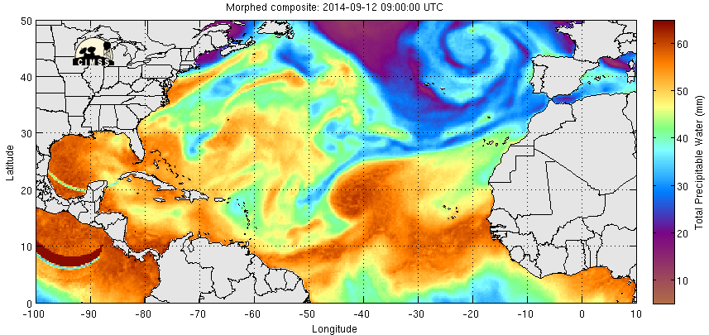
Impacts of environmental dry air in the vicinity of Edouard
Total Precipitable Water Composite
09Z 12 Sept – 08Z 15 Sept
Corresponds to 18-92 h simulation time

Slide 17
Impacts of environmental dry air in the vicinity of Edouard
Dropsondes released during 14 – 15 Sept HS3 flight over Edouard
09/14/14 at 15Z
Colors: 600hPa RH
Wind Barbs

Slide 18
700-hPa relative humidity composites (storm-centered; filled contours), winds (vectors) and surface pressure (gray contours) for the composite groups of the Edouard ensemble
GOOD_EARLY GOOD GOOD_LATE POOR
48 h 24 h 0 h

Slide 19
700-hPa relative humidity composites (storm-centered; filled contours), winds (vectors) and surface pressure (gray contours) for the composite groups of the Edouard ensemble
GOOD_EARLY GOOD GOOD_LATE POOR
120 h 96 h 72 h

Slide 20
Summary and Conclusions
12Z 11 Sept initialization of the PSU WRF-EnKF ensemble of Hurricane Edouard provides an excellent framework to assess the predictability of tropical cyclone rapid intensification
Composite groups are created based on the timing of RI
Deep-layer wind shear magnitude is strongest throughout the simulation for POOR and decreases in magnitude for GOOD_LATE, GOOD and GOOD_EARLY
Shear in “Lagrangian” sense reveals magnitude decreases in all groups approximately 12 h prior to RI onset
Timing of RI onset appears to be related to impact of wind shear on vortex tilt and location of convection – consistent with Dandan’s idealized experiments
Impacts of the presence of dry environmental air in the vicinity of Edouard still being evaluated

