Slide 1
Observation-Based Ensemble Sub-setting Technique for Tropical Cyclone Track Prediction
OBEST
Lin Dong and Fuqing Zhang
Group Meeting 12/12, 2014

Slide 2
Outline
1 Background
Data and Methods
Method Improvement and Experimental Results
4 Summary and Future Work

Slide 3
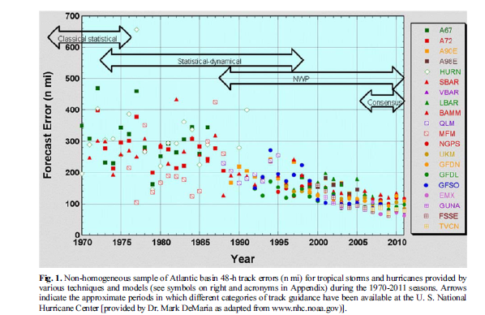
Fig 1
1 Background
The evolution of guidance and models for 48h track forecast errors in Atlantic hurricanes
Consensus
（Elsberry 2014）

Slide 4
Fig 2
1 Background
Consensus Model
Consensus
technique
Consensus component
Subjective Forecast
Statistical models
Statistical-dynamic models
Deterministic Model
EPS
Equal-weight
Unequal-weight
1990s~2000s
1970s~1980s
arithmetic average
multiple regression

Slide 5
1 Background
OBEST comes into being naturally in this background, and is an equal-weight consensus model in which EPS members are used as consensus components.
When CMA forecasters used EPS data, they found that for a special forecast, some members gives small forecast errors, whereas others yields poor forecast tracks. We call the former good members and the latter bad members.
However for different initial time forecasts, good members are not fixed, and it is impossible to tell whether a member is good or not based on the forecaster's subjective judgment only. Therefore an objective method is required for this task.

Slide 6
2 Data and Methods
TIGGE : ECMWF_EPS and NCEP_EPS 120h track forecast
JMA –BEST TRACK
3. A total of 91 TCs from 2010 to 2013

Slide 7
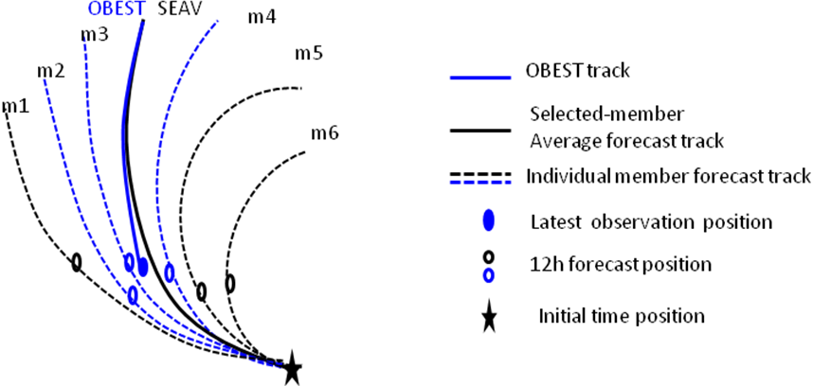
Fig 3
2 Data and Methods
a
b

Slide 8
Number of selected members
Fig 4
2 Data and Methods
2010-2011 EC-EPS Normalized errors
number of selected
members

Slide 9
2 Data and Methods
The algorithm outline of OBEST
Calculate 12h track forecast errors(SLT errors) against observations for all 51 members.
2. Sort the 51 SLT errors in ascending order.
3. Select the first 20 members in sorted order as the good members.
4. Perform a weighted average of forecast position of good members to obtain a mean track(SEAV TRACK).
5. Remove the model initial time position and translate the 12h forecast position to the latest observation. This is the OBEST track.
The inherent premise of this technique is that members with good short-term forecast also give good performance in long-term forecast.

Slide 10
2010-2011 EC Track Errors
Fig 5
2 Data and Methods
sample | 257 | 265 | 241 | 216 | 192 | 169 | 150 | 131 | 112 | 94 | 77
ECM:EC-mean
ECD:EC-deterministic
homogeneous

Slide 11
2012-2013 EC Track Errors
Fig 6
2 Data and Methods
Percent Improvement wrt ECM
6%
4%
4%
8%
sample | 497 | 449 | 397 | 347 | 298 | 251 | 207 | 171 | 138 | 110
1、Consider the time lag
2、calculate error based on CMA operational track

Slide 12
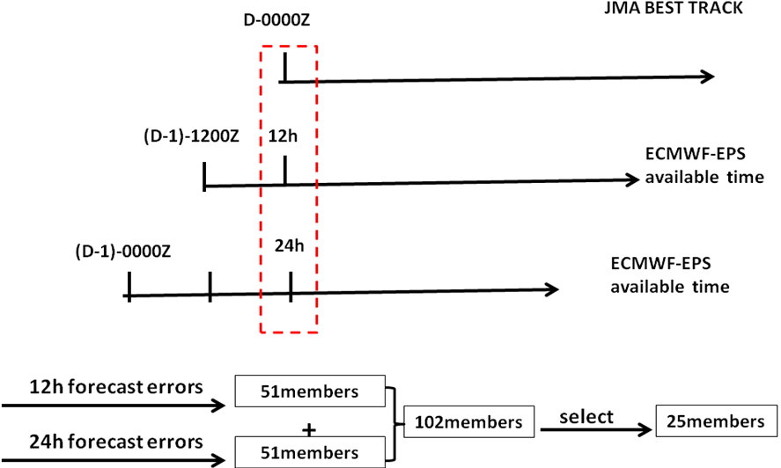
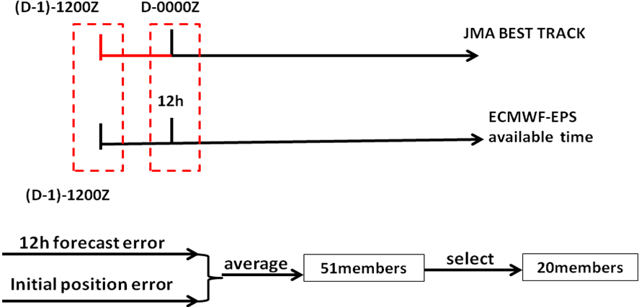
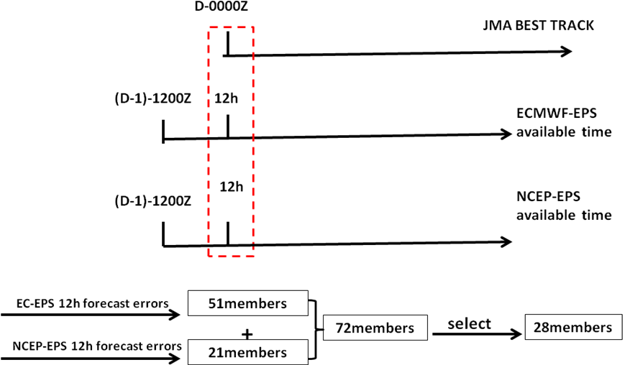
Fig 7
a
3 Method Improvement and Experimental results
EXP-1
LAF
b
EXP-2
(00+12)h Scheme
c
EXP-3
Super-ensemble

Slide 13
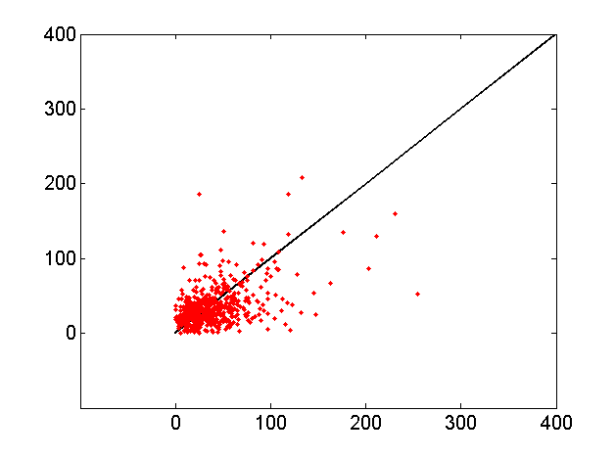
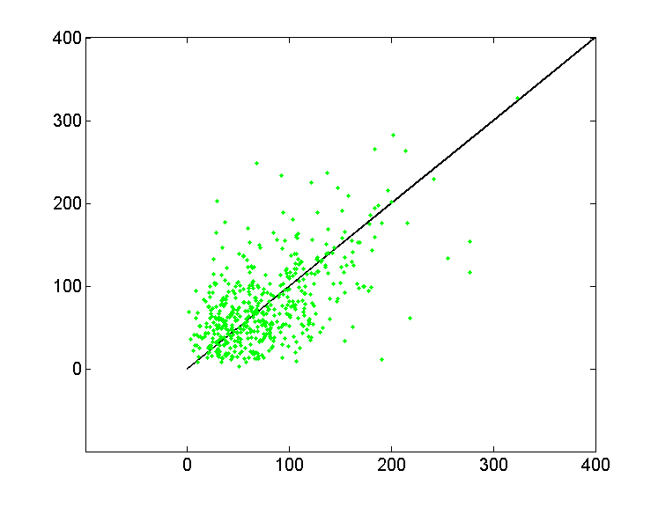
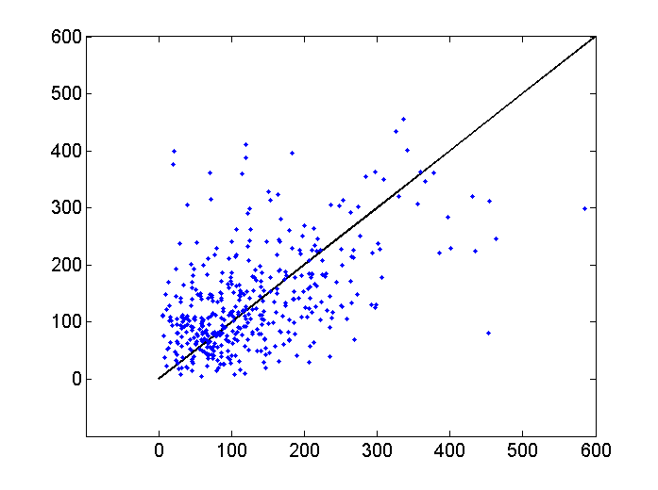
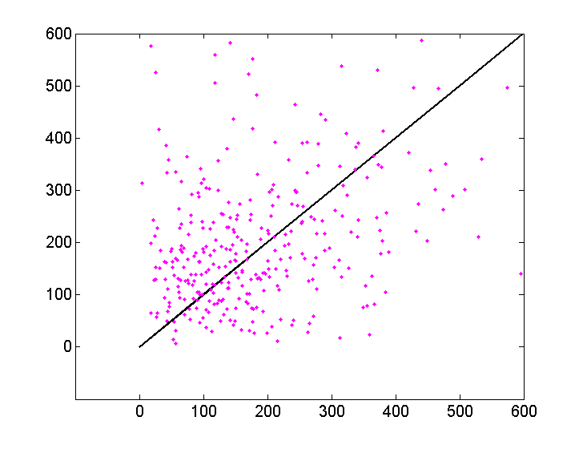
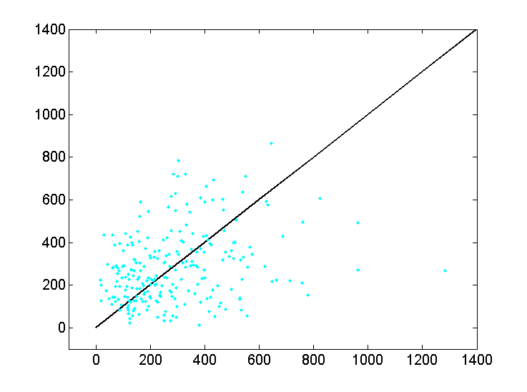
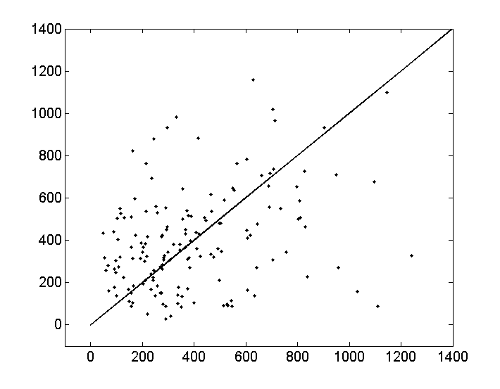
Fig 8
3 Method Improvement and Experimental Results
NCEP>EC 53.2%(00-120h total samples 1924)
2012-2013
00h
NCEP>EC
43.4%(505)
24h
NCEP>EC
50.3%(473)
48h
NCEP>EC
57.1%(372)
NCEP errors(km)
72h
NCEP>EC
59.1%(273)
96h
NCEP>EC
54.9%(182)
120h
NCEP>EC
54.4%(119)
EC errors(km)
Except the initial time, the percentage of the samples in which NCEP error is larger than EC error ranges from 50% to 60%.
Notes:
The percentage of the samples in which NCEP error is larger than EC error ranges from 50% to 60%.

Slide 14
Fig 9
3 Method Improvement and Experimental Results
2012-2013 EC and NCEP Track Errors
Percent Improvement wrt ECM
12%
13%
9%
7%
7%
8%
11%
15%
21%
homogeneous
Notes:
从两个模式的误差对比图来看，EC-EPS在72小时之前的短时效预报较NCEP好，而84-120小时的长时效预报，NCEP则逐渐优于EC。当两个模式组成超级集合之后，即使在没有应用OBEST的方法挑选成员的时候，较任意单个模式，超级集合的误差在所有预报时效（lead time）都处于领先地位。

Slide 15
Fig 10
3 Method Improvement and Experimental Results
a
b
Percent Improvement wrt EC-OBEST20
10%
11%
8%
7%
5%
6%
7%
8%

Slide 16
Fig 11
3 Method Improvement and Experimental Results
Cumulative Density Function (CDF) of SUPER-OBEST errors
a-24h
b-48h
c-72h
d-96h
e-120h
Training method is effective, and training memory can be kept up to 72h.
Excluding outliers helps to reduce the errors in OBEST.
Bin=50KM
Notes:
An analysis of CDF of errors is also carried out. As can be seen from Figure 11,before 72h lead time, the performance of OBEST is the best. For long lead time, OBEST errors are comparable to other models. That means our training method is effective, and training memory can be kept up to 72h. In addition, we found that in most cases, the members with outliers were not selected as good members, especially in long lead time. Excluding outliers helps to reduce the errors in OBEST.

Slide 17
Fig 12
3 Method Improvement and Experimental Results
Track forecast of 1308 TS CIMARON
a
b
a EC-EPS only. b EC-EPS and NCEP-EPS together. (The initial time of models and OBEST track is 201307161200UTC and 2013071700UTC, respectively.
Notes:
An example with and without NCEP-EPS data is given in Fig 12. In the left plot, we can see that OBEST track is better than ECM but still very different from the best track. When we introduce the NCEP-EPS data, SUPERMEAN is better than ECMEAN and OBEST is more accurate than SUPERMEAN. Especially, some members forecast in NCEP are very close to the best-track. So, the application of Super-ensemble not only improves the forecast skill, but communicates more uncertainty information to forecasters and decision makers.

Slide 18
4 Summary and Future Work
Summary
1, OBEST is an equal-weight consensus model in which EPS members are used as consensus components. In OBEST, the forecast errors are calculated based on the latest observation, and a subset of EPS whose forecast errors are minimal are selected. The premise of this technique is that members with good short-term forecast also give good performance in long-term forecast.
2, In order to improve OBEST, we have carried out three experiments, LAF, 00+12H Scheme, and SUPER ensemble. There is no pronounced improvement in the first two experiments but a 5-11% improvement in the last experiment.

Slide 19
4 Summary and Future Work
Summary
.
3, The analysis of cumulative density function(CDF) of the errors indicates that reserving training memory and excluding outliers are two effective ways to improve forecast skill in OBEST. In addition, the application of OBEST to super ensemble not only reducing the forecast errors but communicating more uncertainty information to forecasters and decision makers.

Slide 20
4 Summary and Future Work
Future Work
1 Add CMA-EPS to the super ensemble and
make a comparison analysis of EC, NCEP, and CMA data.
2, Perform uncertainty analysis to forecast errors of
SUPER-OBEST experiment.
Thank you for your time!

