Slide 1
Idealized LES of a TC-like boundary layer… and WRF-LES of Hurricane Katrina (2005)
Benjamin W. Green
Penn State University
Special thanks to: Fuqing Zhang (PSU)
Peter Sullivan, George Bryan, Richard Rotunno (NCAR)

Slide 2
Tropical Cyclone Boundary Layer (TCBL)
Emanuel’s PI theory: TC is like Carnot engine
  Enthalpy input from warm oceans (C_{k})
  Momentum lost to ocean surface (C_{D})
Why is TCBL so important?
  BL communicates information between surface layer and free atmosphere: impacts TC intensity and structure (and thus predictability)
  We live in boundary layer: want to know about mean wind and turbulent gusts
Emanuel (1986; 1995a,b)

Slide 3
Part 1: Idealized Large Eddy Simulation of TCBL
What is the simplest configuration of LES that can represent key features of a TCBL?
According to Nakanishi and Niino (2012):
  Periodic lateral boundary conditions
  Incompressible barotropic flow with extreme winds (35 m s⁻¹) forced by constant horizontal PGF
  Some representation of centrifugal force (v/R)
  No surface heat flux, clouds, or radiation
But is this too simple?

Slide 4

Consequences of NN12 LES configuration
Periodic LBCs + constant horizontal PGF: effectively simulates turbulent statistics at a single vertical column
Simulation of single column w/ periodic LBCs:
  Fixed radius from TC center can represent centrifugal force (V/R) in Cartesian coordinates
  Surface heat flux = 0
  Incompressible: no mean vertical velocity (becomes important close to TC eyewall)
R

Slide 5
Problem with NN12 LES setup
NN12 represent centrifugal force as v/R
  Yields barotropic instability (their Appendix A)
  Their workaround: change v/R to <v>/R
  (<v> = horizontal average v at each vertical level)
To make a 3-month-long story short:
  Unphysical barotropic instability introduced by improper “small angle” approximation in conversion from cylindrical to Cartesian coordinates
  Our solution: Change reference frame to rotate with TC – replace Coriolis parameter f with “effective” Coriolis: f* = f + 2V_{g}/R

Slide 6
LES momentum equations
Coded in Cartesian coordinates (R is constant)
y
V_{g}
V_{g}
V_{g}
V_{g}
x
R

Slide 7
Our idealized LES setup
NCAR LES
Properties unchanged between LES runs:
  Incompressible, periodic LBCs, constant V_{g}
  Grid mesh: Δx = Δy = Δz = 40 m
  Domain size: (L_{x}, L_{y}, L_{z}) = (20 km, 20 km, 4 km) (500x500x100 grid points)
  Time: 40,000 sec (11.11 hr); Δt = 0.1 sec
  Dry, no radiation, no surface heat flux
  Initial θ profile: θ = 300 K at sfc, dθ/dz = 4 K km⁻¹

Slide 8
Configuration of different LES runs
Default (CNTL) LES: R = 60 km, V_{g} = 35 m s⁻¹, C_{D} (via z₀) follows Donelan et al. (2004)
Test sensitivity to…
  f* (via R): R = 30, 60, 120 km [R30, CNTL, R120]
  V_{g}: V_{g} = 17.5, 35, 70 m s⁻¹ [V17.5, CNTL, V70]
  Surface drag (via z₀) at V_{g} = 70 m s⁻¹:
    C_{D} is flat above 33 m s⁻¹ (Donelan et al. 2004) [V70]
    C_{D} increases monotonically w/ wind [Charnock70]
    z₀ = 0.1 m (strong friction over land) [Land70]

Slide 9
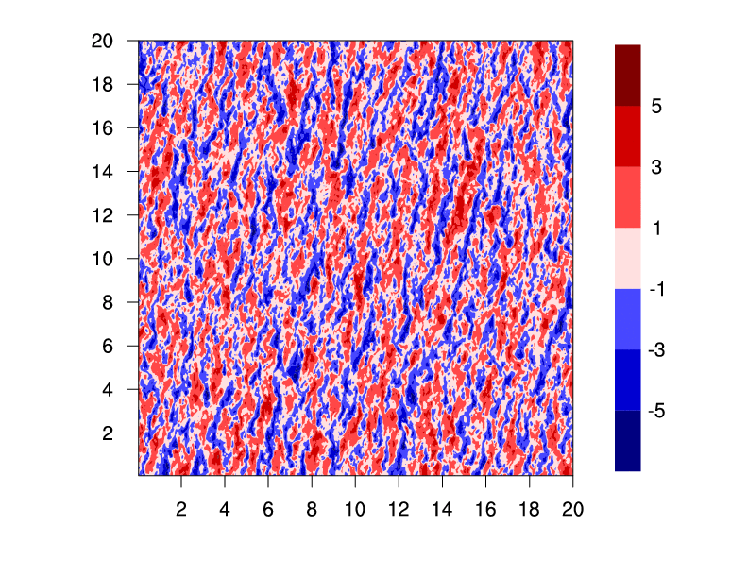

v’ = v - <v> (m s⁻¹) at z = 100 m
Notes:
50 frames of perturbation V (v - <v>) at z = 100 m

Slide 10
Normalized profiles of mean K_{m}
K_{m} = vertical component of eddy viscosity
  Solid: Resolved-scale
  Dashed: Subgrid-scale
All runs (except V17.5) are clearly in LES range
Normalized K_{m} increases with R (decreases with f*)
Normalized K_{m} curves collapse for fixed R and V_{g} ≥ 35 m s⁻¹
a
b
c
Averaged over last 3 h of each run

Slide 11
Normalized profiles of mean v
a
<v>/V_{g} > 1 is characteristic of all rotating (Ekman) flows
Invites comparison with linear theory of Kepert (2001, K01)
  Areas of agreement:
    Increased R (decreased f*) = higher, stronger overshooting jet
    Increased C_{D} = higher, stronger jet
    Weak jet: LES and K01 neglect vertical advection of u (Kepert and Wang 2001)
  Areas of disagreement (due to K_{m}):
    Increased V_{g} = higher, weaker jet
b
c
Averaged over last 3 h of each run

Slide 12
Conclusions (Idealized LES)
Incompressible Cartesian LES w/ periodic LBCs severely constrains modeling TCBL
  Change f to f* (to account for TC’s rotation)
  Neglect mean vertical advection
  Result: Ekman layer with extremely fast rotation, can be compared with linear analytic model of Kepert (2001)
LES agrees with K01 linear model, except when nonlinear effects of K_{m} overwhelm and counteract effects of V_{g}

Slide 13
Part 2: WRF-LES of Hurricane Katrina (2005)
Limitations of Part 1 motivate new approach
Use WRF model to nest down from mesoscale
  Non-periodic LBCs
  Compressibility
  Moist physics and radiation
Problems: High computational/memory requirements
  Short integration time (4-6 hours)
  Infrequent output (every 1 hour)
  Coarser grid mesh (1/3 km, 1/5 km, 1/9 km)

Slide 14
Experimental setup
Run WRF simulations of Hurricane Katrina (Aug. 05)
  Spinup: EnKF assimilation of airborne Doppler velocities
  Deterministic run from 00Z/26 to 12Z/28 with Δx = 3 km
Integrate until 18Z/28 using following 1-way nested, fixed meshes:
  Δx = 1 km (YSU and MYNN PBL schemes)
    Δx = 333 m (YSU PBL scheme and no PBL scheme)
      At 14Z, nest down to Δx = 111 m (no PBL scheme)
    Δx = 200 m (no PBL scheme)

Slide 15
Compare with Rotunno et al. (2009)
Rotunno et al. (2009)
Present work
Two-way nesting
50 vertical levels
Idealized vortex
Sizes of sub-km meshes:
  556 m: 333 km x 333 km
  185 m: 111 km x 111 km
  062 m: 037 km x 037 km
One-way nesting
83 vertical levels
Hurricane Katrina
Sizes of sub-km meshes:
  333 m: 816 km x 816 km
  200 m: 471 km x 471 km
  111 m: 278 km x 278 km

Slide 16
Simulated visible satellite (SWDOWN field), valid 18Z/28 for 111 m simulation
43 km
278 km
Notes:
SWDOWN, 18Z, 111 m

Slide 17
Preliminary results: Katrina LES
Diagnosed SGS fluxes from nonlinear backscatter and anisotropy (NBA) scheme
Finer mesh = weaker, more shallow SGS fluxes (good)
Notes:
SGS FLUX ONLY!!!!

Slide 18
Preliminary results: Katrina LES
Plots of 10-m wind speed at 18Z/28
PBL scheme appears to discourage very strong local wind maxima
Polygonal eyewalls
Compare with Fig. 2 of Rotunno et al. (2009)
3 km YSU
1 km YSU
333 m YSU
333 m
10-m
wind
speed
(m s⁻¹)
200 m
111 m

Slide 19
Preliminary conclusions (Katrina LES)
Δx between 100 m and 1 km give very different results
  Δx = 333 m appears to be in “gray zone” or “terra incognita” for LES
  Δx = 111 m is much more acceptable for TC LES
  May be necessary to nest a LES mesh inside a “gray zone” mesh: don’t use gray zone only!
LES of real TC cases is not quite ready yet for “prime time” – much more testing needed (see next slide)

Slide 20
What needs to be done going forward?
For idealized LES of TCBL
  Look at turbulence structure & higher-order moments
  Add surface heat flux w/ strong capping inversion
  Use compressible, non-periodic LBC LES
  Heterogeneous surface drag: coastline
For LES of TCs: Testing with quasi-idealized vortex
  Various subgrid-scale parameterizations
  1-way vs. 2-way nesting
  Size of < 1 km meshes (absolute, and relative to size of TC vortex)
  Longer integration time: how is practical predictability limited?

Slide 21
References
Bao, J.-W., S. A. Michelson, and J. M. Wilczak, 2002: Sensitivity of numerical simulations to parameterizations of roughness for surface heat fluxes at high winds over the sea. Mon. Wea. Rev., 130, 1926-1932.
Bao, J.-W., S. G. Gopalakrishnan, S. A. Michelson, F. D. Marks, and M. T. Montgomery, 2012: Impact of physics representations in the HWRFX model on simulated hurricane structure and wind-pressure relationships. Mon. Wea. Rev., 140, 3278-3299.
Bell, M. M., M. T. Montgomery, and K. A. Emanuel, 2012: Air-sea enthalpy and momentum exchange at major hurricane wind speeds observed during CBLAST. J. Atmos. Sci., 69, 3197-3222.
Charnock, H., 1955: Wind stress on a water surface. Quart. J. Roy. Meteor. Soc., 81, 639-640.
Donelan, M. A., B. K. Haus, N. Reul, W. J. Plant, M. Stiassnie, H. C. Graber, O. B. Brown, and E. S. Saltzman, 2004: On the limiting aerodynamic roughness of the ocean in very strong winds. Geophys. Res. Lett., 31, L18306, doi:10.1029/2004GL019640.
Garratt, J. R., 1992: The Atmospheric Boundary Layer. Cambridge University Press, 316 pp.
Emanuel, K. A., 1986: An air-sea interaction theory for tropical cyclones. Part I. J. Atmos. Sci., 43, 585-604.
Emanuel, K. A., 1995a: The behavior of a simple hurricane model using a convective scheme based on subcloud-layer entropy equilibrium. J. Atmos. Sci., 52, 3960-3968.
Emanuel, K. A., 1995b: Sensitivity of tropical cyclones to surface exchange coefficients and a revised steady-state model incorporating eye dynamics. J. Atmos. Sci., 52, 3969-3976.
Green, B. W., and F. Zhang, 2013: Impacts of air-sea flux parameterizations on the intensity and structure of tropical cyclones. Mon. Wea. Rev., 141, 2308-2324.
Green, B. W., and F. Zhang, 2014: Sensitivity of tropical cyclone simulations to parametric uncertainties in air-sea fluxes and implications for parameter estimation. Mon. Wea. Rev., in press.
Holthuijsen, L. H., M. D. Powell, and J. D. Pietrzak, 2012: Wind and waves in extreme hurricanes. J. Geophys. Res., 117, C09003, doi:10.1029/2012JC007983.
Jarosz, E., D. A. Mitchell, D. W. Wang, and W. J. Teague, 2007: Bottom-up determination of air-sea momentum exchange under a major tropical cyclone. Science, 315, 1707-1709.
Kara, A. B., P. A. Rochford, and H. E. Hurlburt, 2002: Air-sea flux estimates and the 1997-1998 ENSO event. Bound.-Lay. Meteor., 103, 439-458.
Powell, M. D., P. J. Vickery, and T. A. Reinhold, 2003: Reduced drag coefficient for high wind speeds in tropical cyclones. Nature, 24, 395-419.
Smith, R. K., M. T. Montgomery, and G. L. Thomsen, 2012: Sensitivity of tropical-cyclone models to the surface drag coefficient in different boundary-layer schemes. Quart. J. Roy. Meteor. Soc., doi: 10.1002/qj.2057.
Sraj, I., M. Iskandarani, A. Srinivasan, C. Thacker, J. Winokur, A. Alexanderian, C. Lee, S. Chen, and O. Knio, 2013: Bayesian inference of drag parameters using Fanapi AXBT data. Mon. Wea. Rev., 141, 2347-2367.
Vickery, P. J., D. Wadhera, M. D. Powell, and Y. Chen, 2009: A hurricane boundary layer and wind field model for use in engineering applications. J. Appl. Meteor. Climatol., 48, 381-405.

Slide 22
Extra/Backup slides

Slide 23
Normalized profiles of mean u
a
<u>/V_{g} < 0 is characteristic of all rotating (Ekman) flows
Compare with K01 linear theory
  Areas of agreement:
    Increased R (decreased f*) = deeper inflow layer
    Increased C_{D} = deeper inflow layer
  Areas of disagreement (due to K_{m}):
    Increased V_{g} = deeper inflow layer
b
c
Averaged over last 3 h of each run

Slide 24
Simulated IR (OLR field), valid 18Z/28 for 200 m simulation
50 km
471 km
Notes:
OLR, 18Z, 200 m

Slide 25
Background: Boundary layer modeling
Mesoscale simulations
  Parameterize all BL turbulence
Large Eddy Simulation (LES)
  Explicitly resolve energy-containing eddies
  Parameterize small dissipative eddies
Direct Numerical Simulation (DNS)
  Resolve all turbulence (way too expensive)

Slide 26
Tropical Cyclone Boundary Layer (TCBL)
Emanuel’s potential intensity theory: TCs are like Carnot engines
  Enthalpy input from warm oceans (C_{k})
  Momentum lost to ocean surface (C_{D})
BL communicates information between surface layer and free atmosphere
Emanuel (1986; 1995a,b)

Slide 27
Why is TCBL so important?
Impacts TC intensity/structure (and thus predictability)
We live in the boundary layer… want to know about mean wind and turbulent gusts

Slide 28
Results: Time series of u*
Adjustment oscillation has period very close to 2π/f* (inertial period)
u* increases slightly with f* (decreases slightly with R)
u* impacted much more by V_{g} and surface drag (increased V_{g}, C_{D} = increased u*) – no surprise
a
b
c

Slide 29
Background
Emanuel’s potential intensity theory for TCs
Increase C_{k} and/or decrease C_{D} = stronger TC (faster winds and deeper central pressure)
Problem: uncertainty/error in C_{k} and C_{D} parameterizations = error in TC forecasts
Emanuel (1986; 1995a,b)

Slide 30
C_{D} and C_{k} in an atmosphere-only model
In similarity theory, C_{k} is a function of C_{D} (scalar flux proportional to momentum flux)
This means α, V_{c}, and m also impact C_{k}!

Slide 31
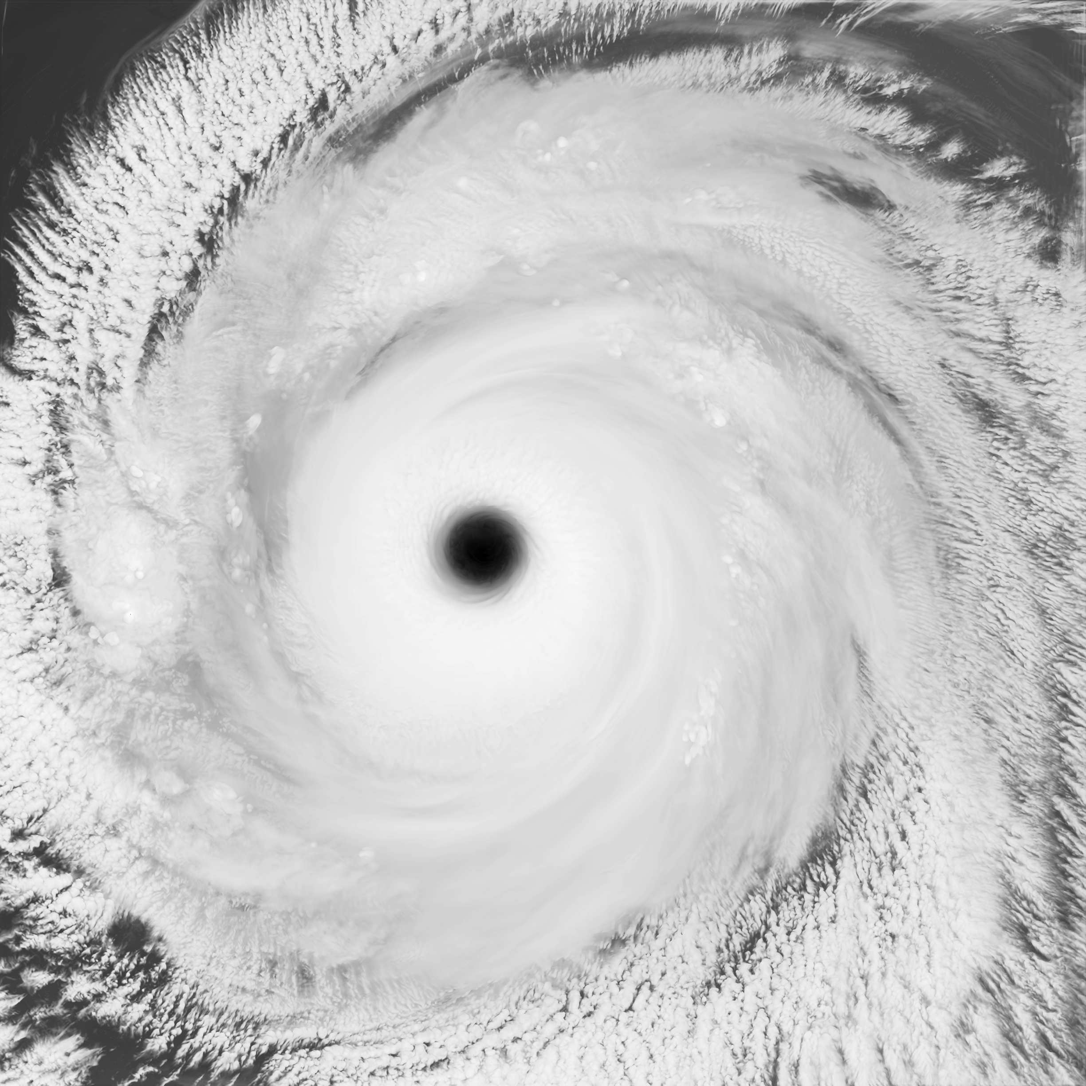
Notes:
Donelan 333 m, valid ??

Slide 32
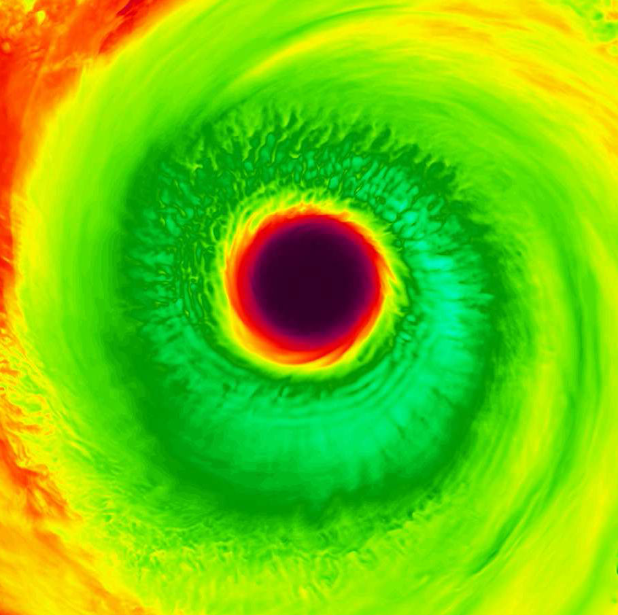
Hot off the supercomputer! LES of Katrina
Max. V₁₀ extremely sensitive to C_{D} formula
  Donelan C_{D}: 98 m s⁻¹
  Charnock C_{D}: 77 m s⁻¹
Horizontal grid:
  Spacing = 333 meters
  Size: 816 km x 816 km
  (2448 x 2448 points)
85 vertical levels
Run for 6 hours

Slide 33
Future work
Move to Very Large Eddy Simulation (VLES)
  The new “gold standard” of TC simulations
  How does turning off PBL scheme impact results?
Test C_{D} independent of C_{k} (Smith et al. 2012)
  Goes against similarity theory and WRF
  But can shed more light on problem
Incorporate parameter estimation into Penn State’s WRF-EnKF system
  Especially for α, the multiplicative parameter in C_{D}
  Requires more near-surface observations

