Slide 1
Quality of the Target Area for Metrics with Different Strengths of Nonlinearity in
a Mesoscale Convective System
Zhiyong Meng, Ling Huang
Peking University, China
2014. 08.13 PSU

Slide 2
What is targeted observation (TO)?
Initial field
Short-range forecast of high-impact weather
Model
Target
area
Error
of a metric
Field Campaigns:
FASTEX (97), NORPEX(98),T-PARC(98), WSR(99-), NA-TReC(03), DOTSTAR(03-)
Forecast skill is improved by 10% on average
70% of cases were improved, some improved by 50%
The benefit is decreasing
background field,
verification method,
Quality of target area,
…
2

Slide 3
Quality of targeted area
Error of the concerned forecast metric is decreased significantly by assimilating additional observations in the target area rather than anywhere else
The targeted area needs to be sufficiently sampled and soundly verified
The targeting strategy needs to be sound
3

Slide 4
Limitations of current TO methods
Singular vectors (Palmer et al., 1998)
Adjoint method (Ancell and Mass 2006; Wu et al. 2009)
Ensemble-sensitivity (Bishop 2001; Hamill and Snyder 2002)
Conditional nonlinear optimal perturbation (CNOP, Mu et al. 2009)
This work:
Totally nonlinear scenario
Wind & temp, precipitation
Linear assumption
Wind & temp
4

Slide 5
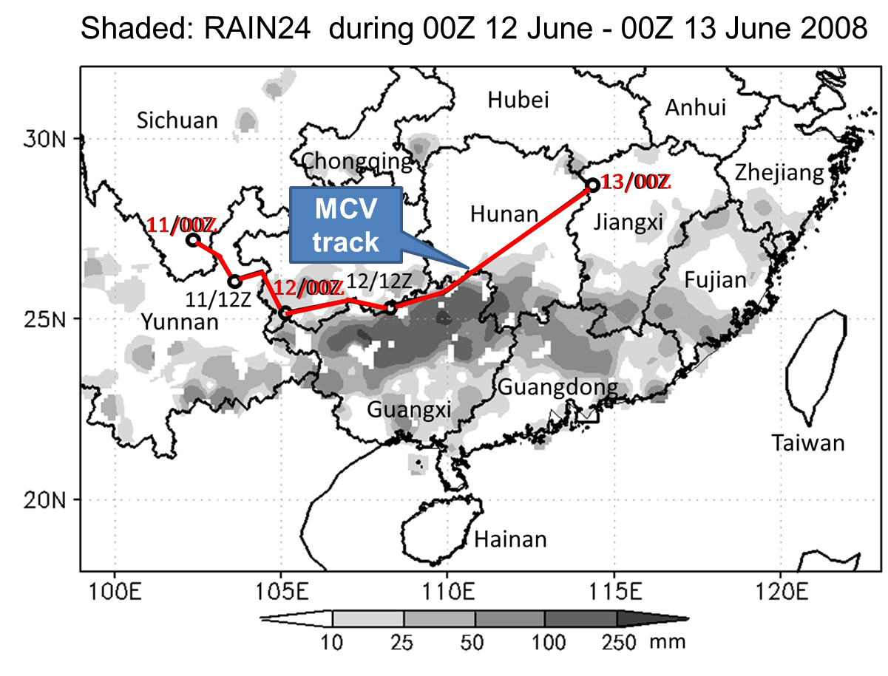
: Mesoscale Convective Vortex (MCV)
Case
5

Slide 6
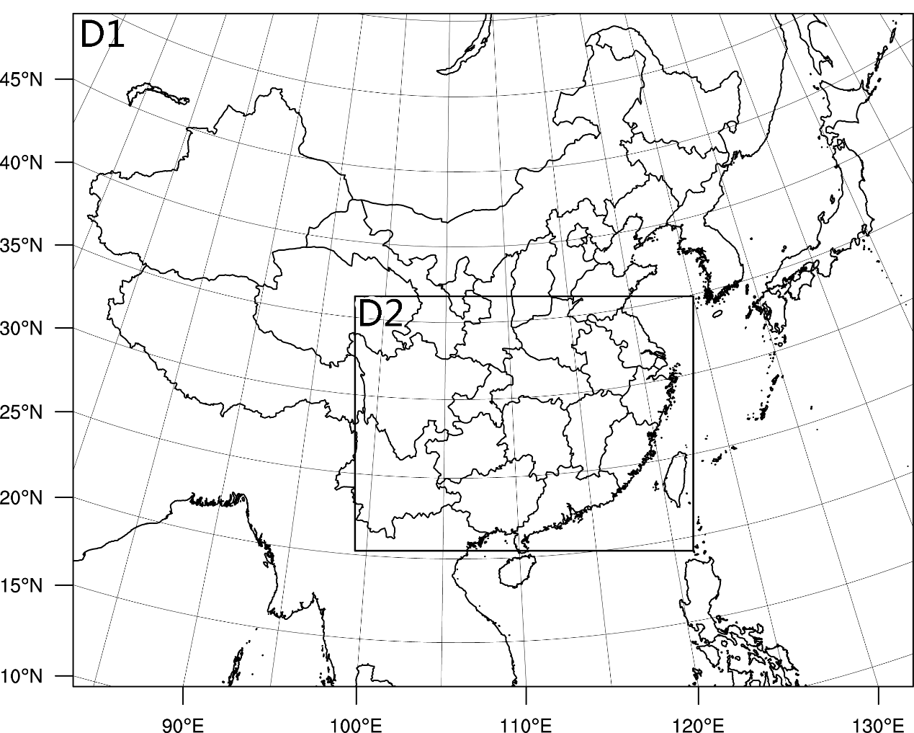
Model: WRF/ARW 3.2
(40.5km)
Microphysics | WRF Double-Moment 6-class scheme
Long wave radiation | RRTMG scheme
PBL | Yonsei University scheme
Cumulus | Grell-Devenyi ensemble scheme
(13.5km)
Initial and boundary: NCEP FNL
6

Slide 7
Methodology: PWDA via OSSE
11/00Z
11/12Z
12/00Z
12/12Z
13/00Z
DA
RAIN24
Total Energy
7

Slide 8
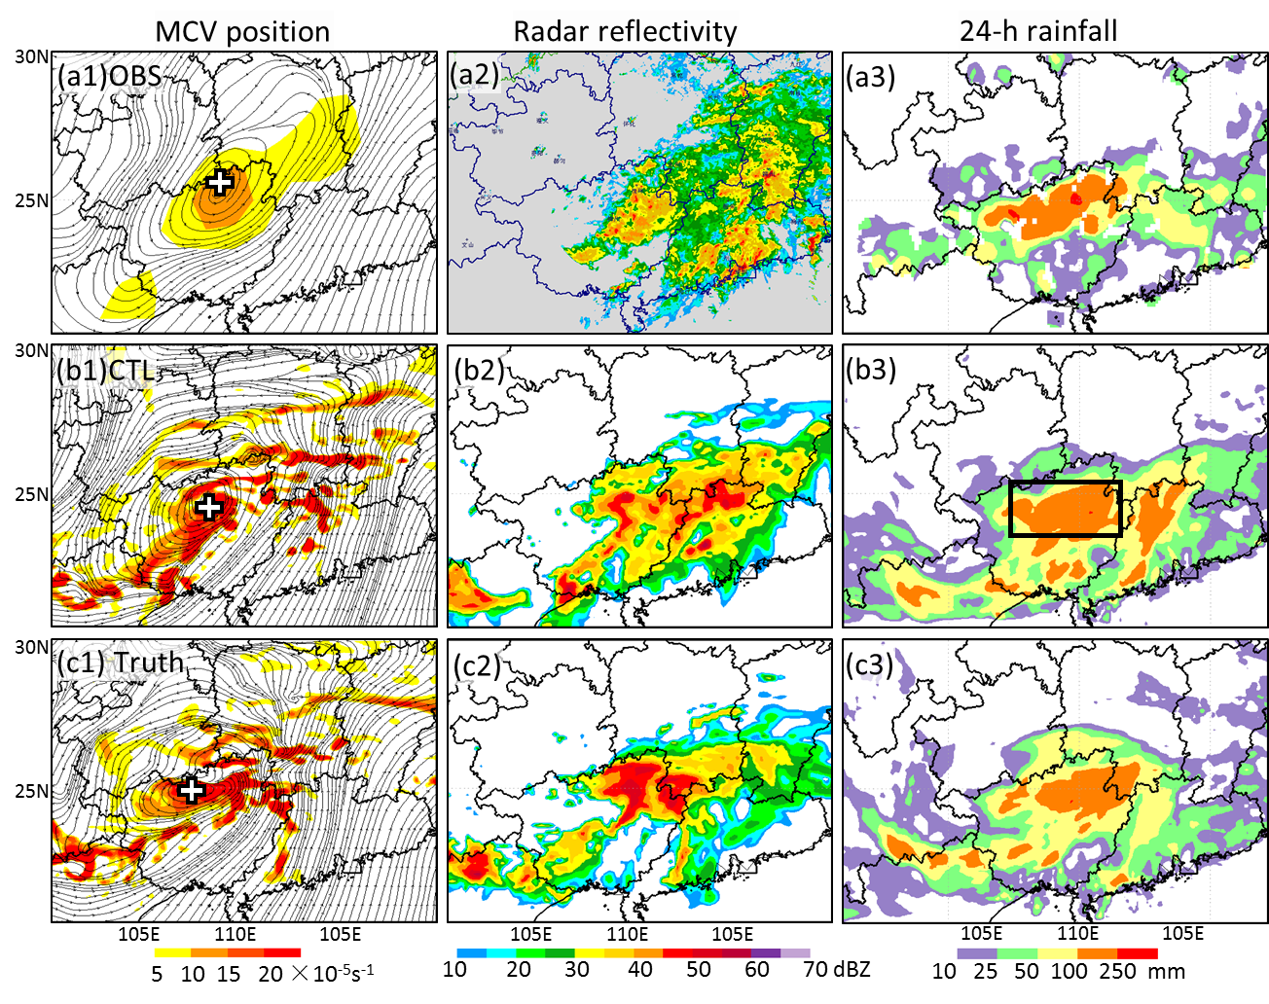
Model verification
12/18Z
Shaded: Vertical Vorticity
8

Slide 9
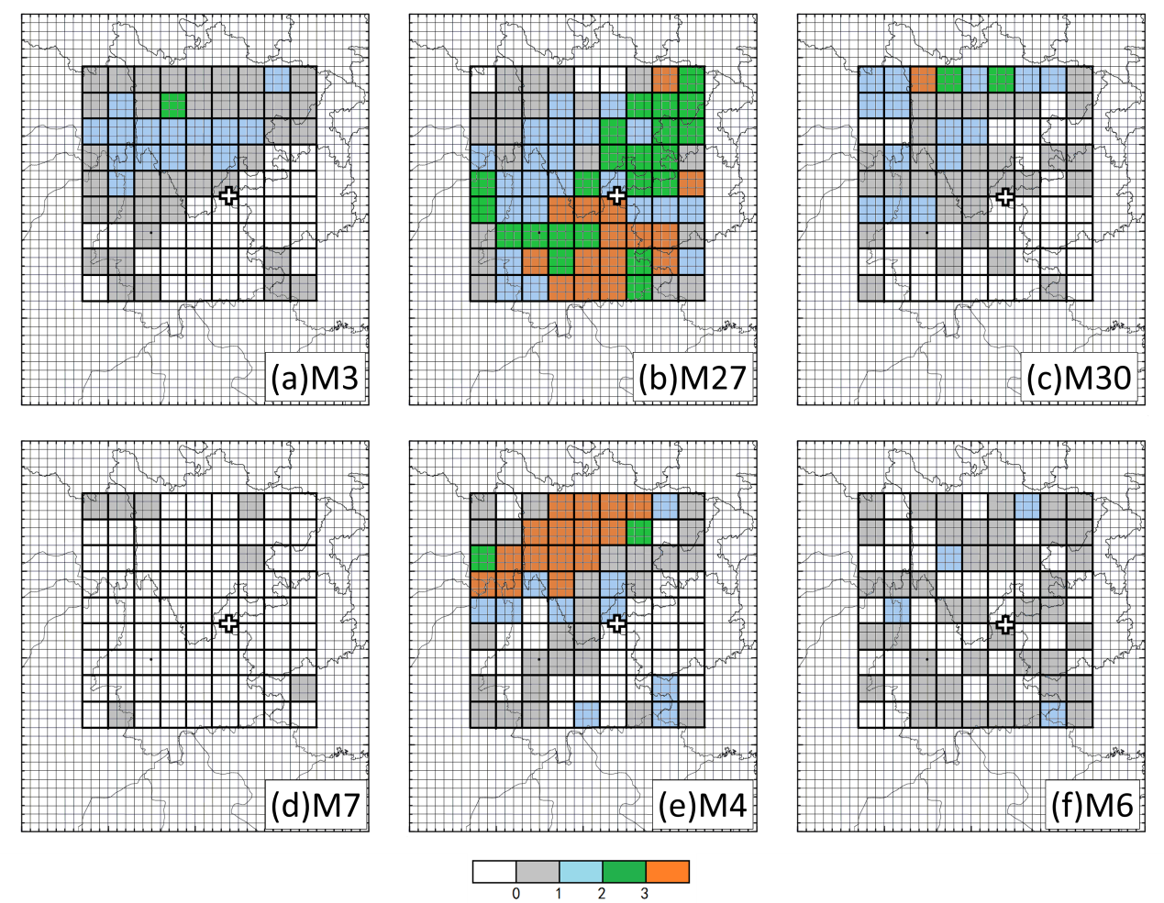
Determination of target area
R-index
The impact index is divided into 4 levels
The area covered by data units of the highest level are defined as a target area if it is localized enough that
  The number of the data units are no larger than 30% of the total 81, which is 24.
  The sum of the number of separated pieces (A) and the smallest number of sides that connect these separated pieces (B) are no larger than 10.
N_{u}(15) ≤ 24
N_{p} (3) + N_{s} (4)=7 ≤ 10
L1
L2
L3 L4
L4
9

Slide 10
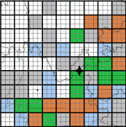
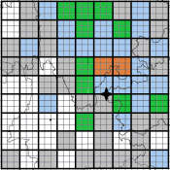
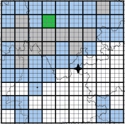
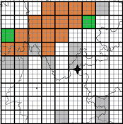
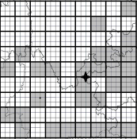
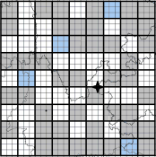
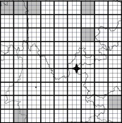
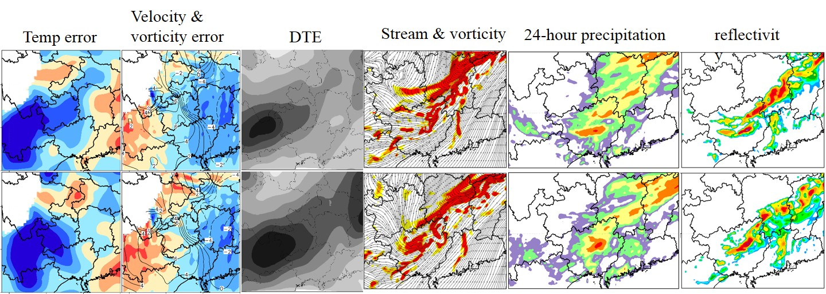
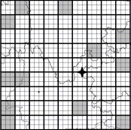
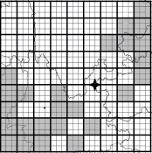
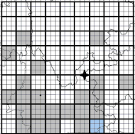
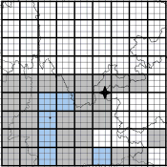
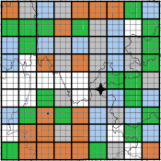
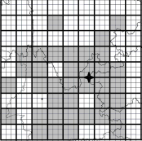
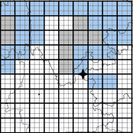
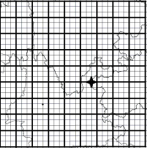
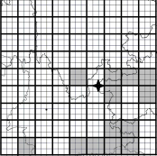
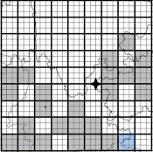
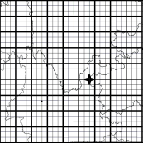
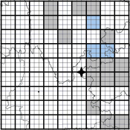
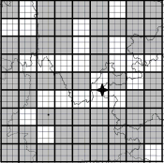
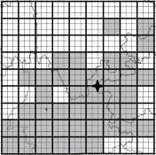
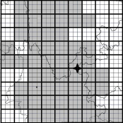
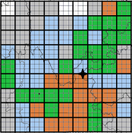
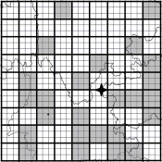
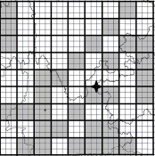
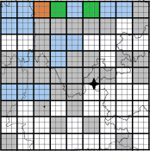
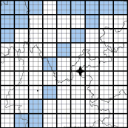
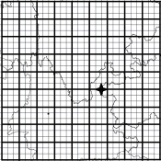
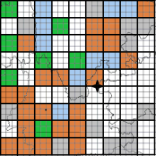
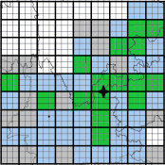
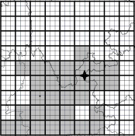
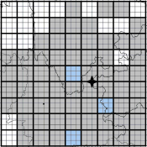
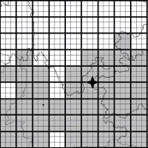
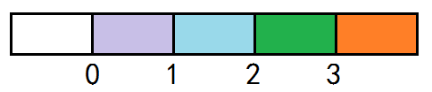
R index (Rain24)
M1
M2
M3
M4
M5
M6
M7
M8
M9
M10
M11
M12
M15
M18
M3
M19
M20
M21
M22
M23
M24
M25
M27
M26
M27
M28
M29
M30
M31
M32
M33
M34
M35
M38
M39
10

Slide 11
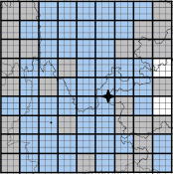
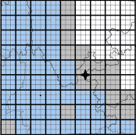
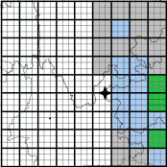
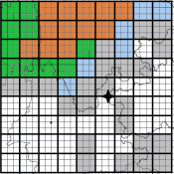
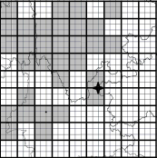
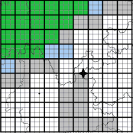
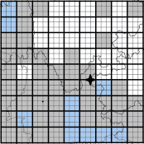
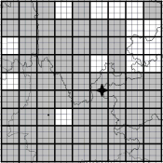
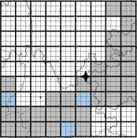
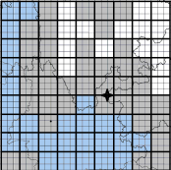
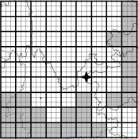























F index (total energy)
M1
M2
M3
M4
M5
M6
M7
M8
M9
M10
M11
M12
M15
M18
M19
M20
M21
M22
M23
M24
M25
M26
M27
M28
M29
M30
M31
M32
M33
M34
M35
M38
M39
11

Slide 12





Verification
Total energy
Forecast error
rain24
Forecast skill
12

Slide 13
Summary
A a piecewise data assimilation targeting observation method
Quality of the Target Area for Metrics with Different Strengths of Nonlinearity in a Mesoscale Convective System
1) Targeting observation should be calculated in a probabilistic perspective
  2) Quality of the target observation for
 | effectiveness | distinctiveness | variability
Total energy | ✓ |  | ✓
Rain24 | ✓ | ✓
Huang, Ling, Zhiyong Meng, 2014: Quality of the Target Area for Metrics with Different Nonlinearities in a Mesoscale Convective System. Mon. Wea. Rev., 142, 2379–2397.
13

Slide 14
I-index ( total energy at the initial time)

