Slide 1
Intrinsic Predictability of the
Tornadic Thunderstorm Event on 20 May 2013 in Oklahoma
Yunji Zhang
Group Meeting 08/14/14

Slide 2
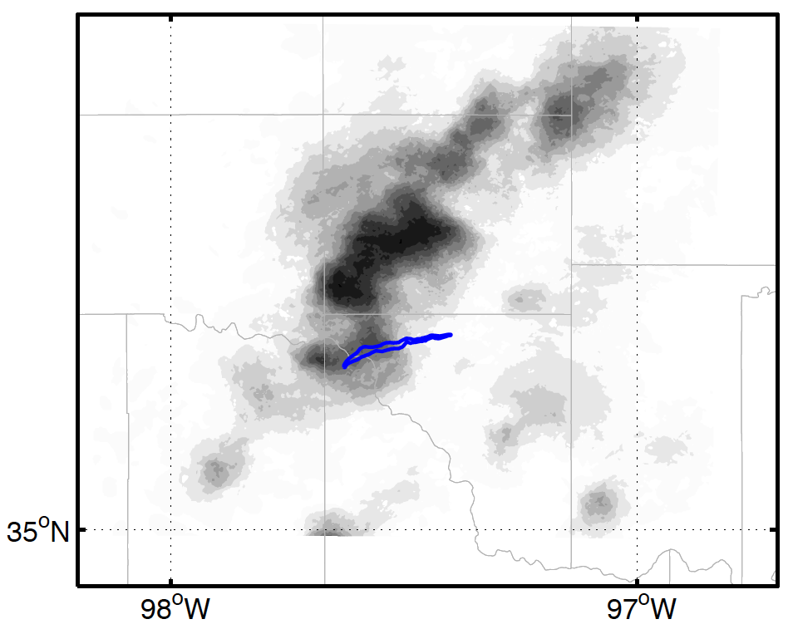
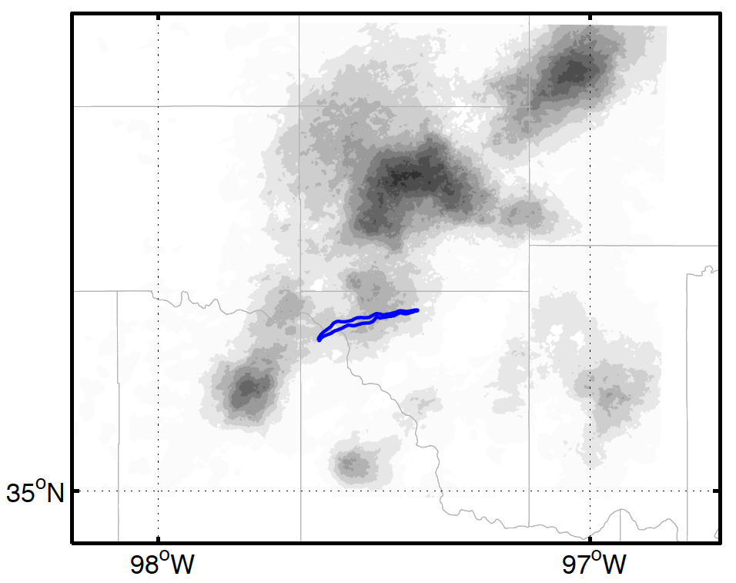
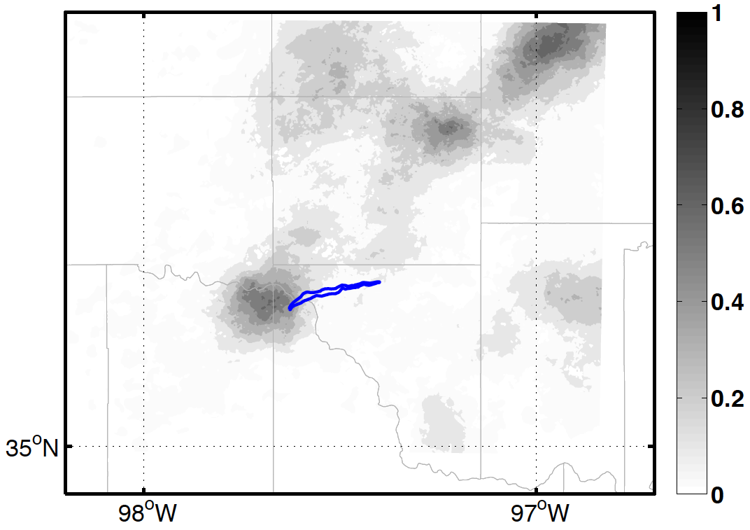
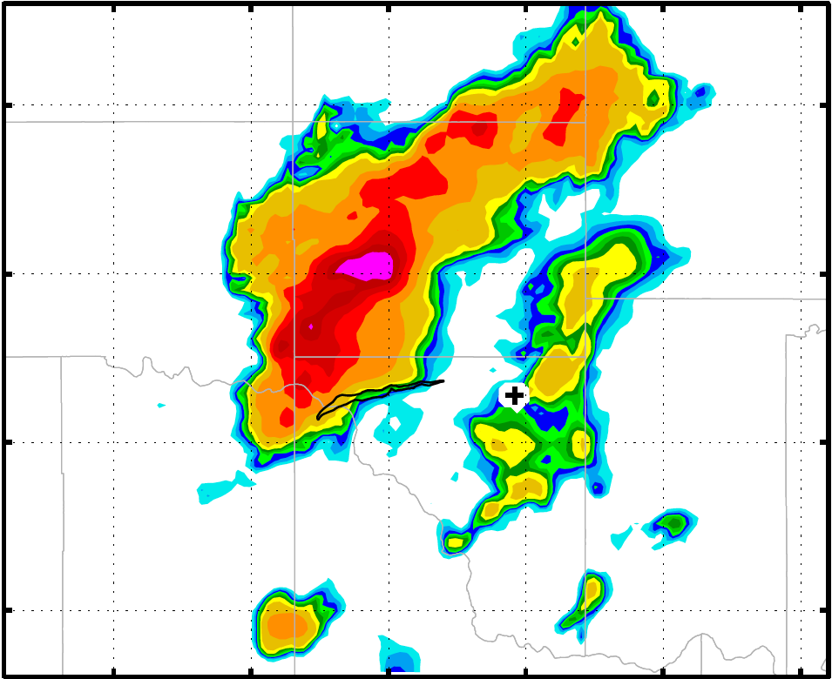
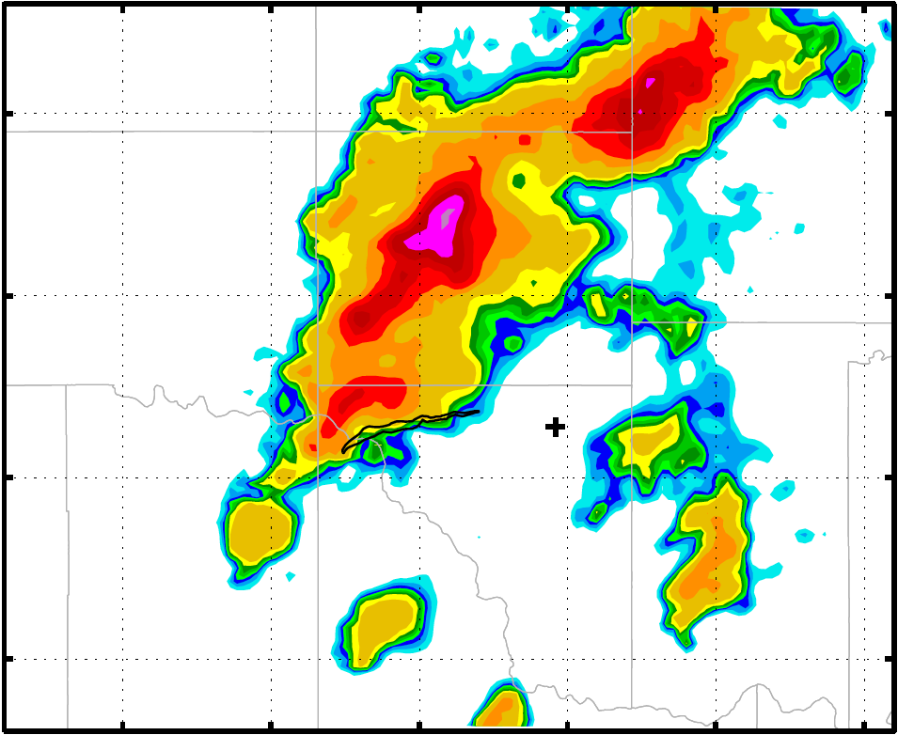
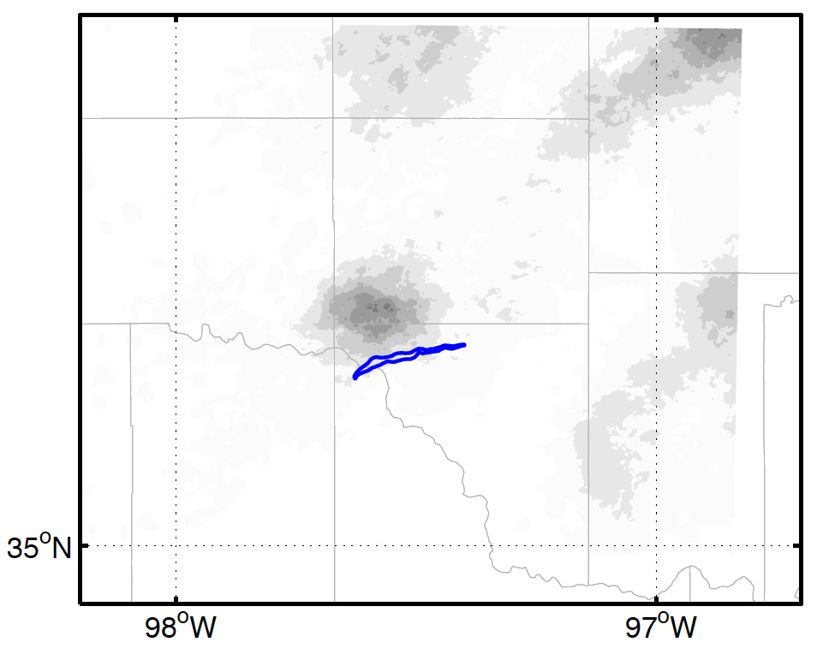
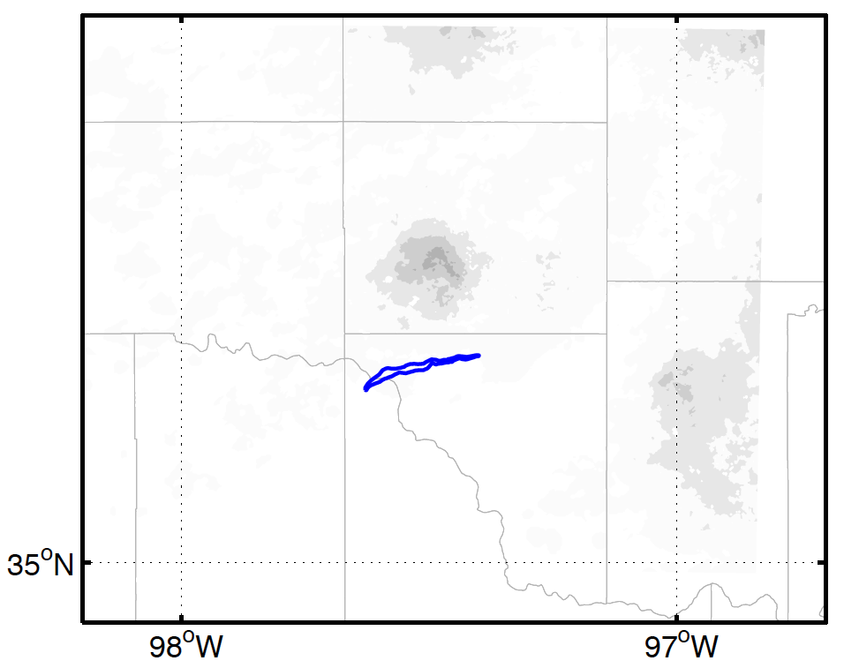
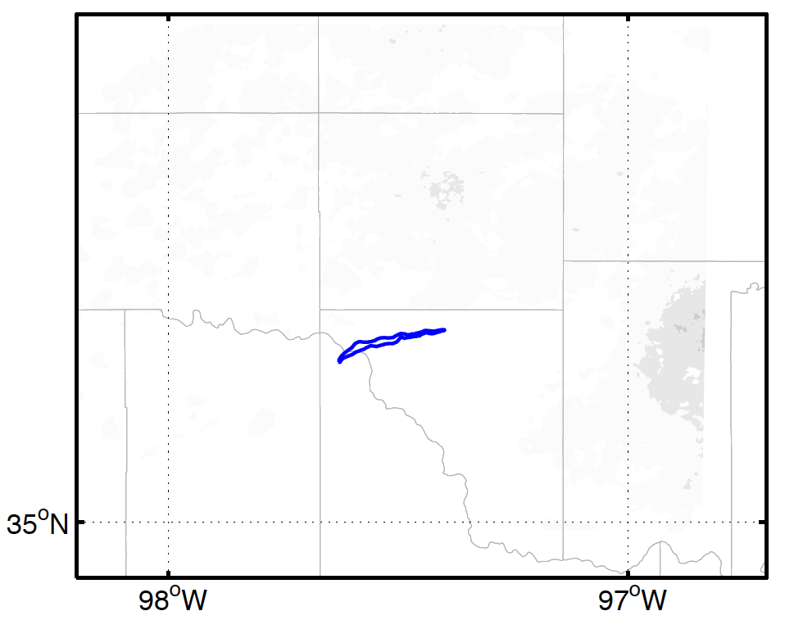
Limited Predictability in EnKF
Probability of 40-dBZ reflectivity (1930 ensemble forecast)
1940
1950
2000
2010
2020
2030

Slide 3
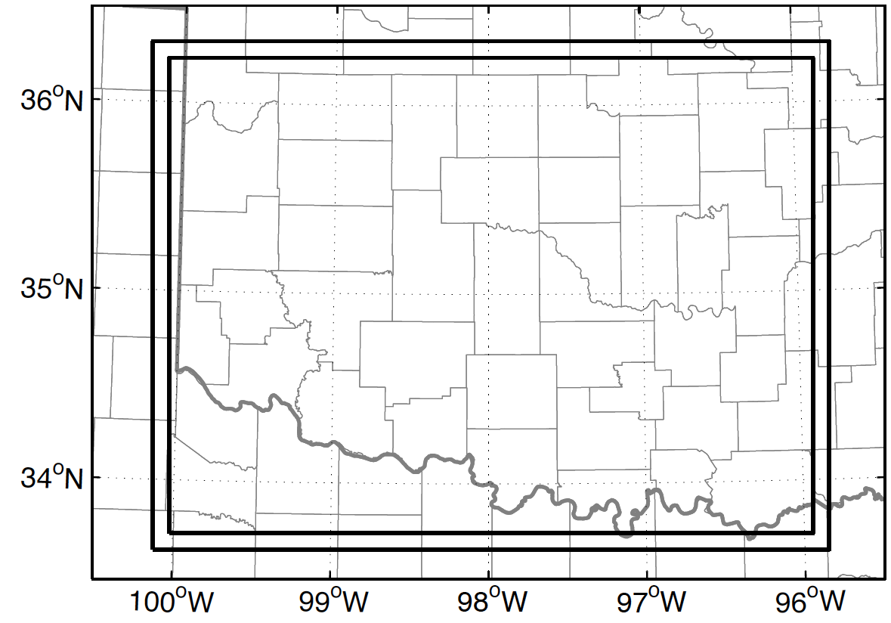
Intrinsic Predictability
Use an extra two-way nested 250-m domain
“Perturbed” U, V, W, θ, Qv
CNTL: 60-member ensemble, 1700~2300
Sensitivity experiments:
  2PERT: Slightly increase initial perturbations
  5PERT: Greatly increase initial perturbations
Perturbation St.D.:
  T: 0.12 K
  Qv: 0.16 g/kg
  U: 0.27 m/s
  V: 0.22 m/s
D04
D05

Slide 4
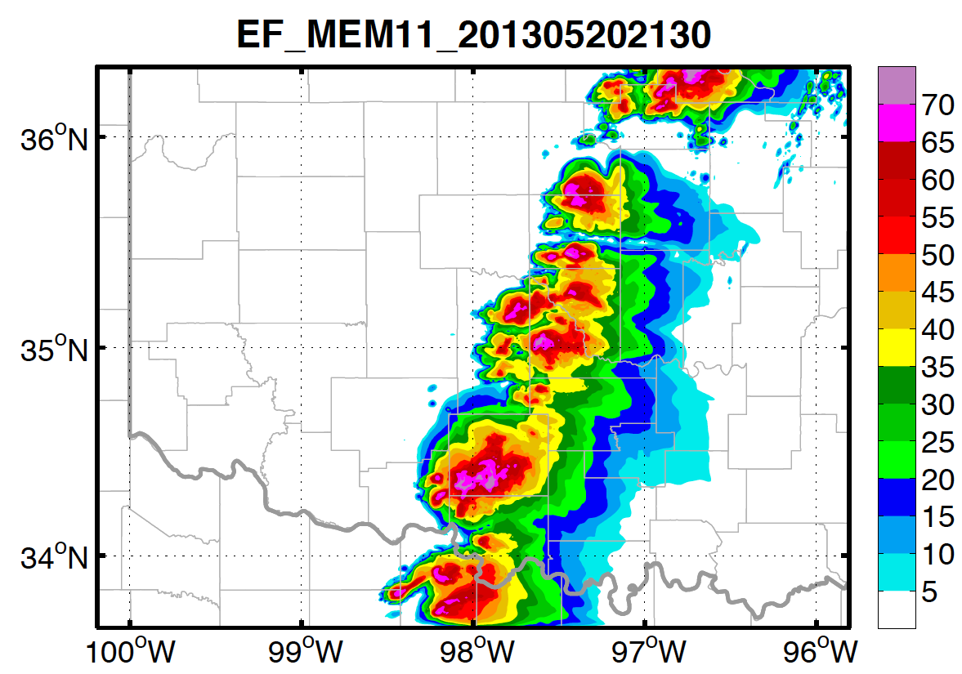
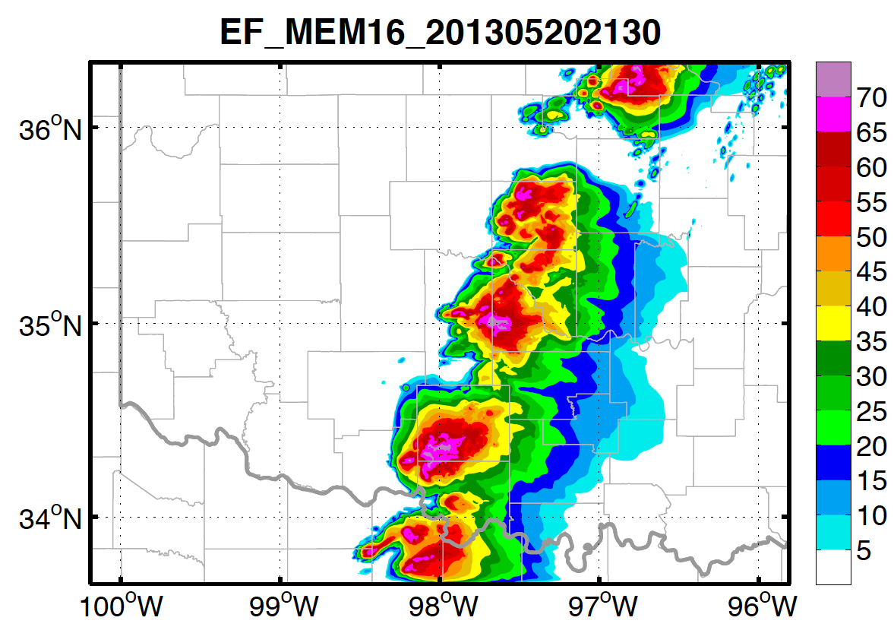
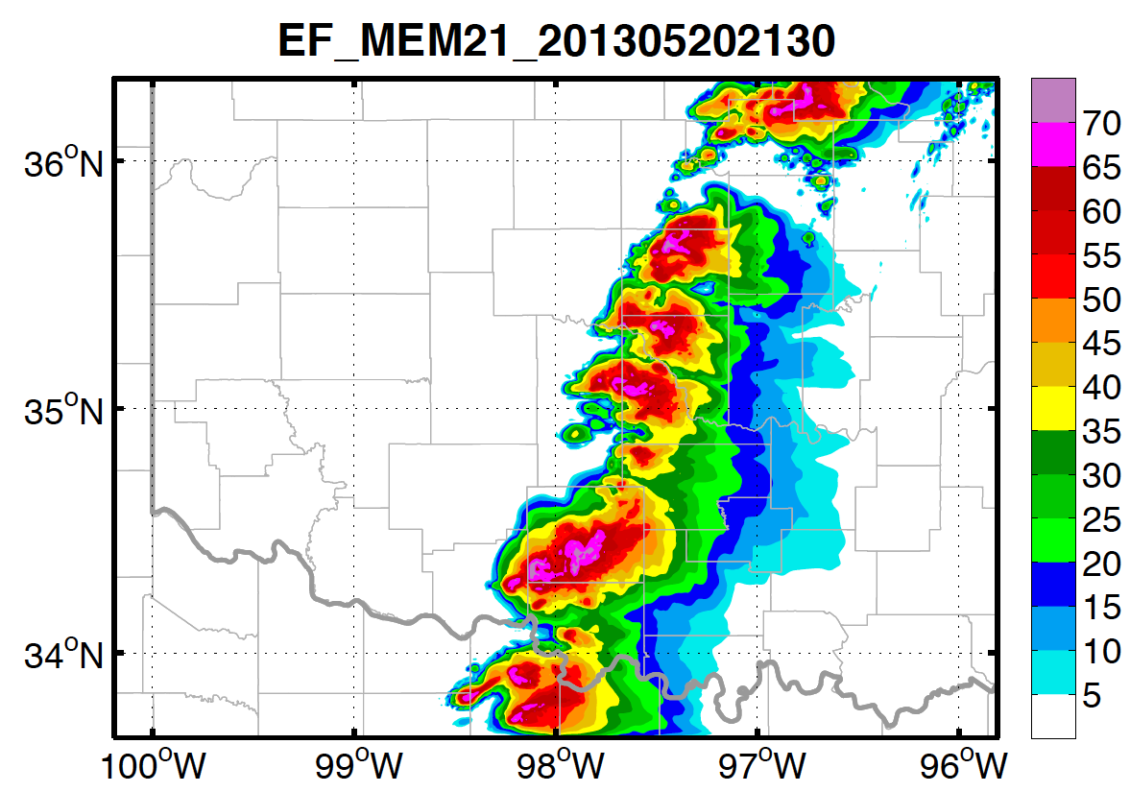
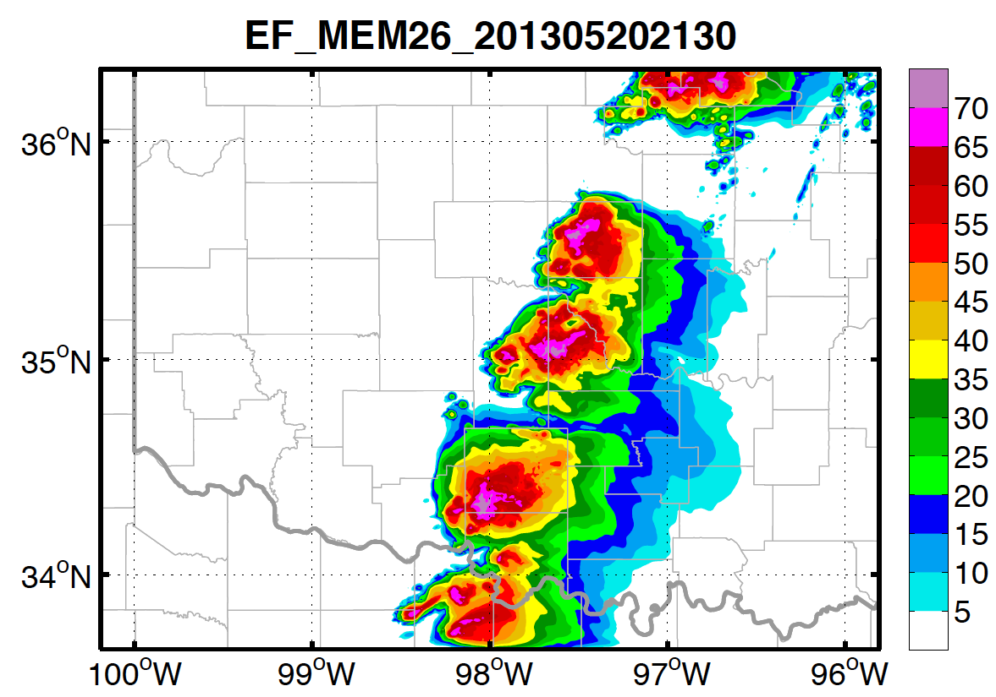
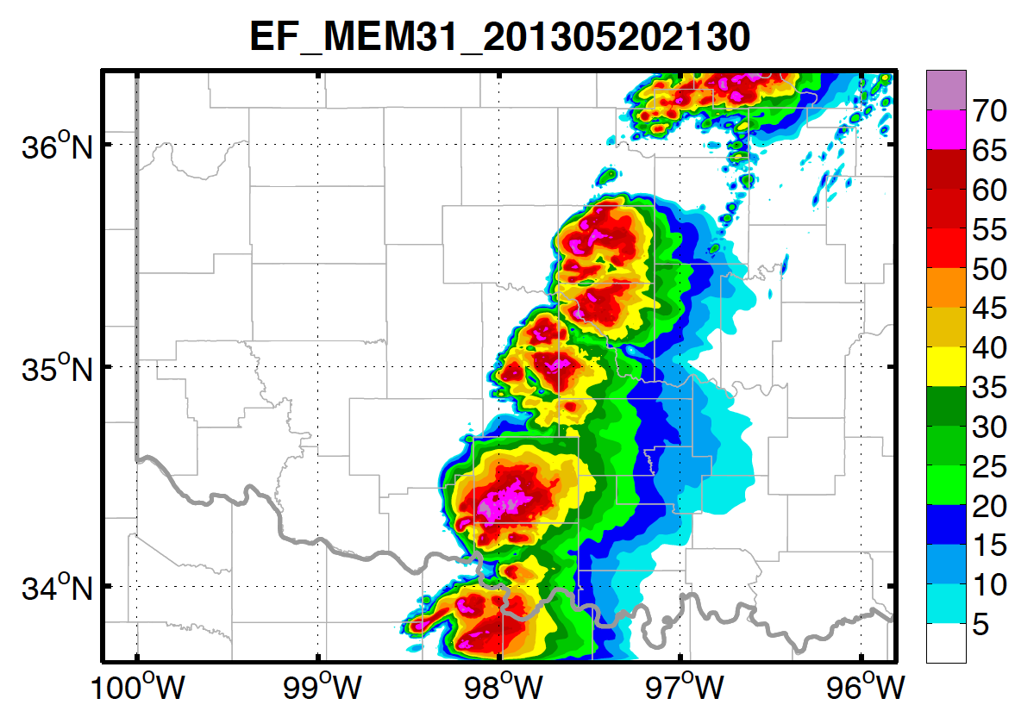
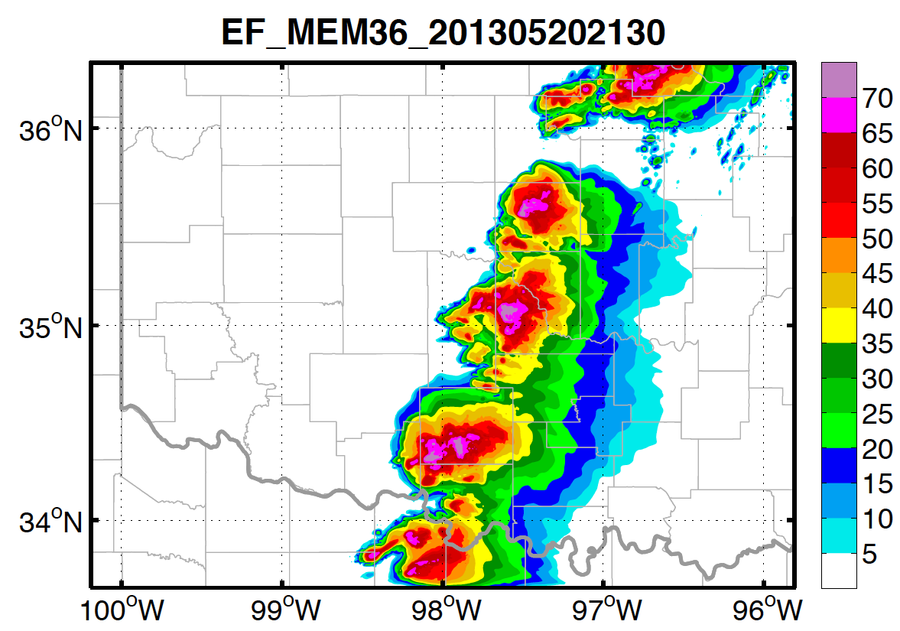
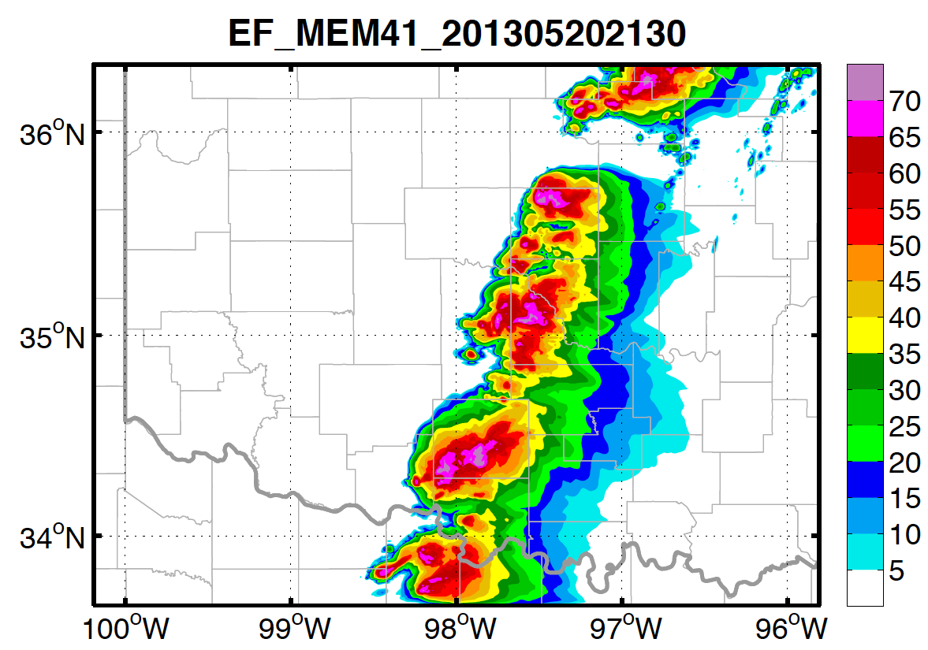
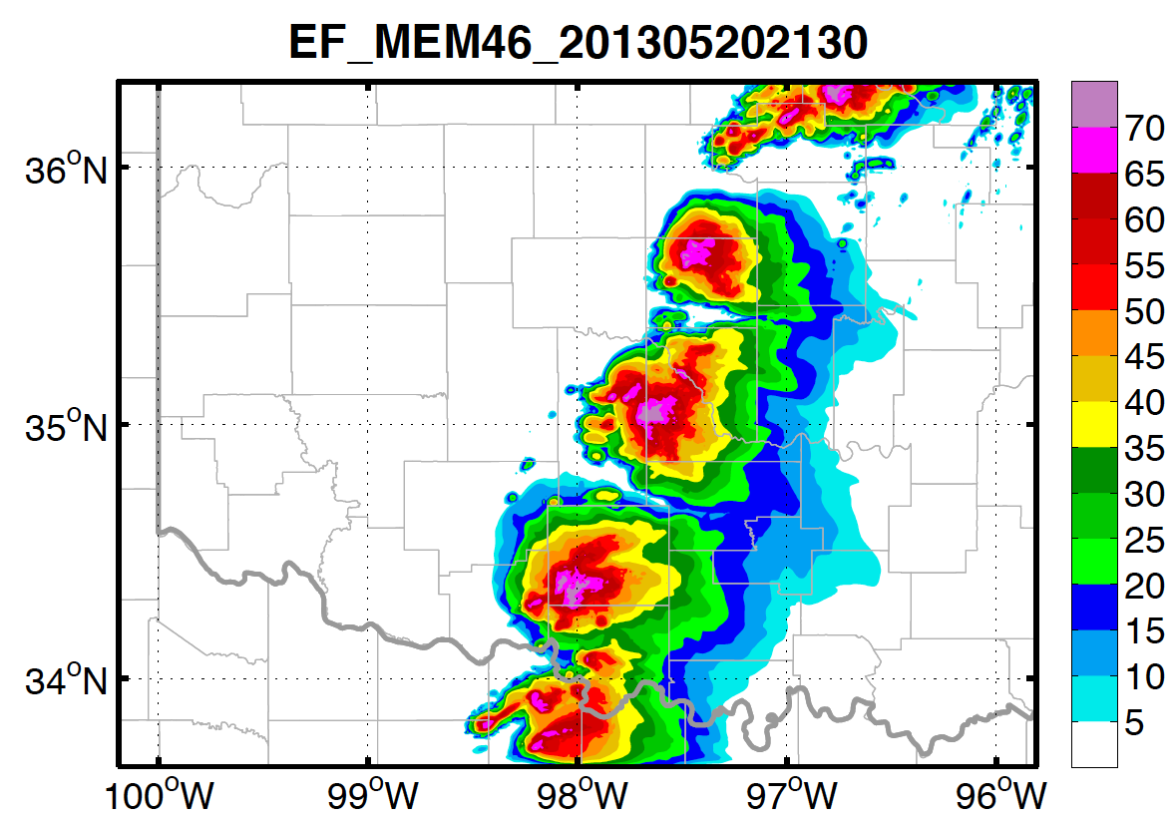
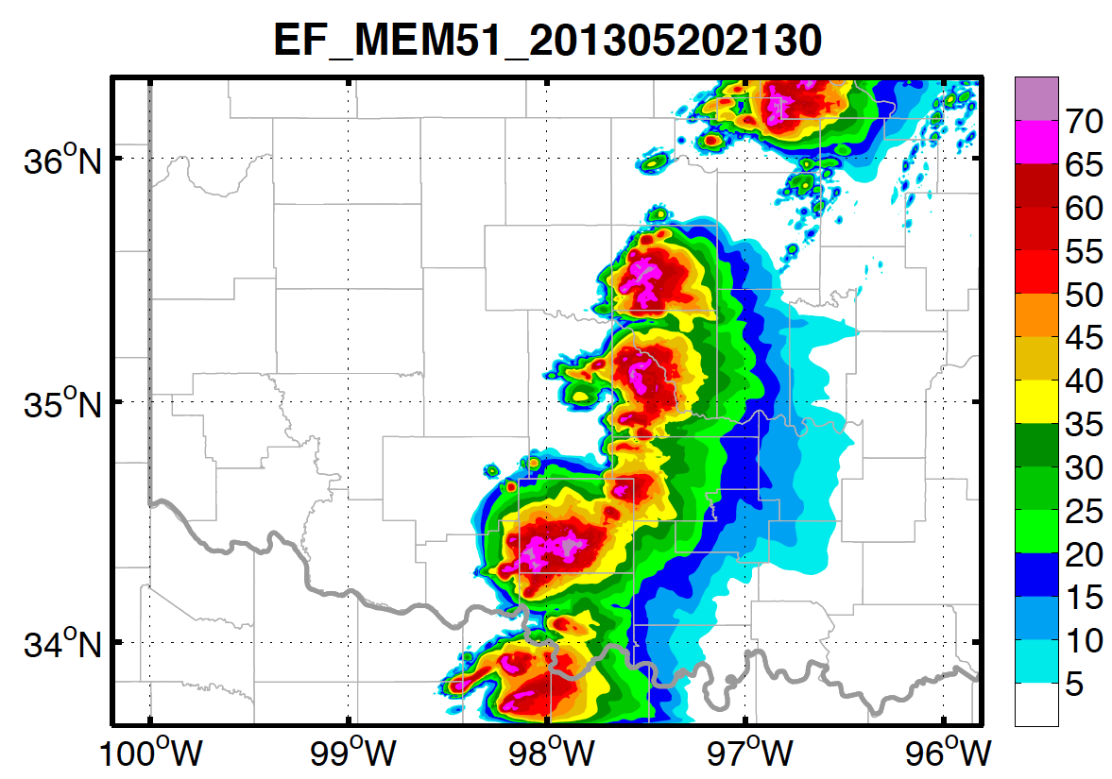
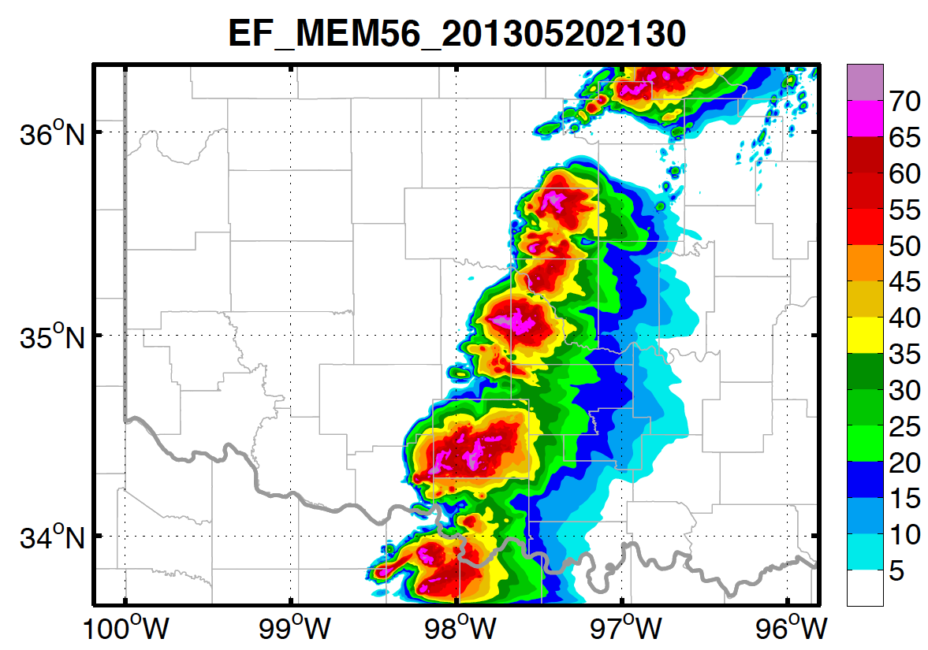
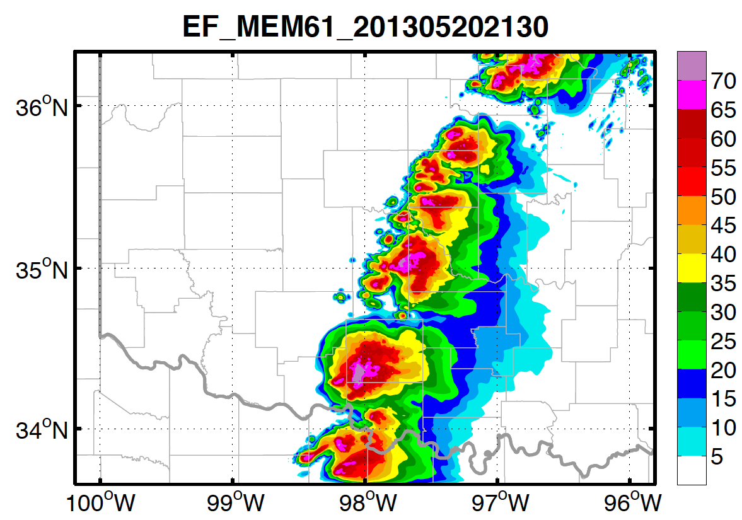
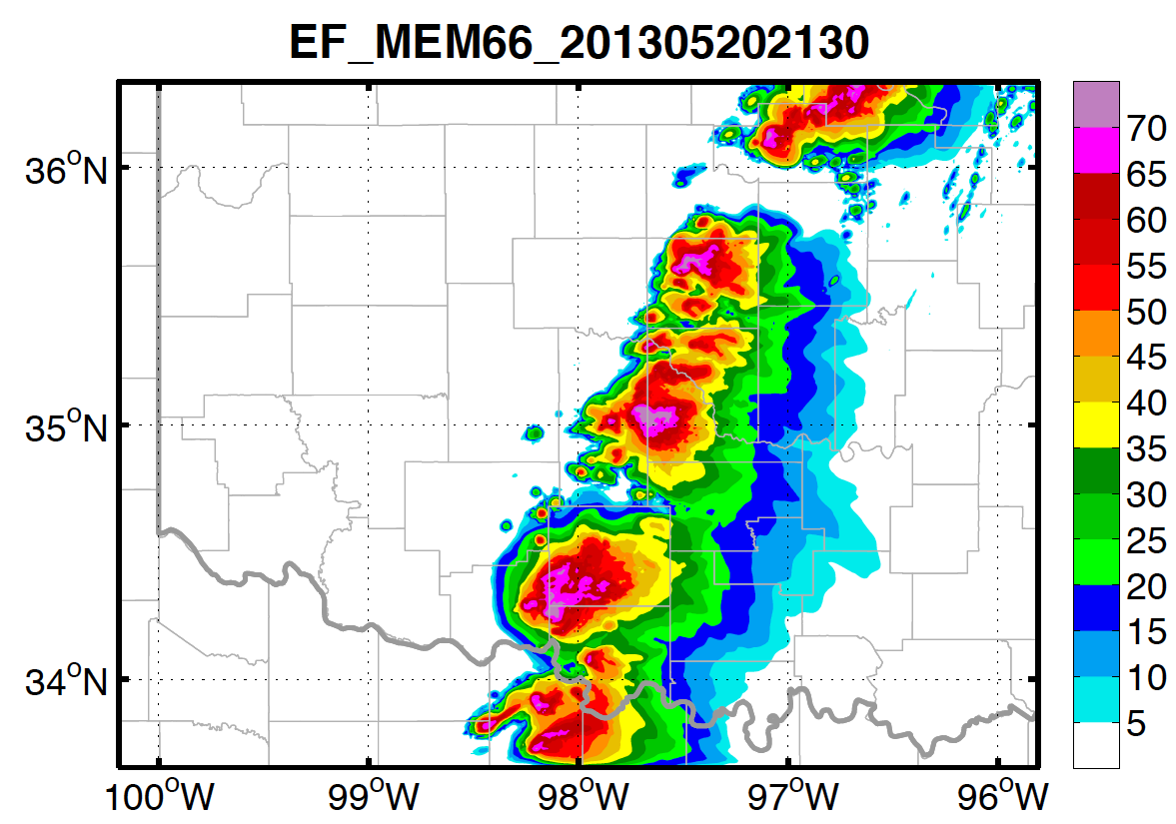
CNTL: Ensemble Appearance
Composite Reflectivity of 12 Members at 2130

Slide 5
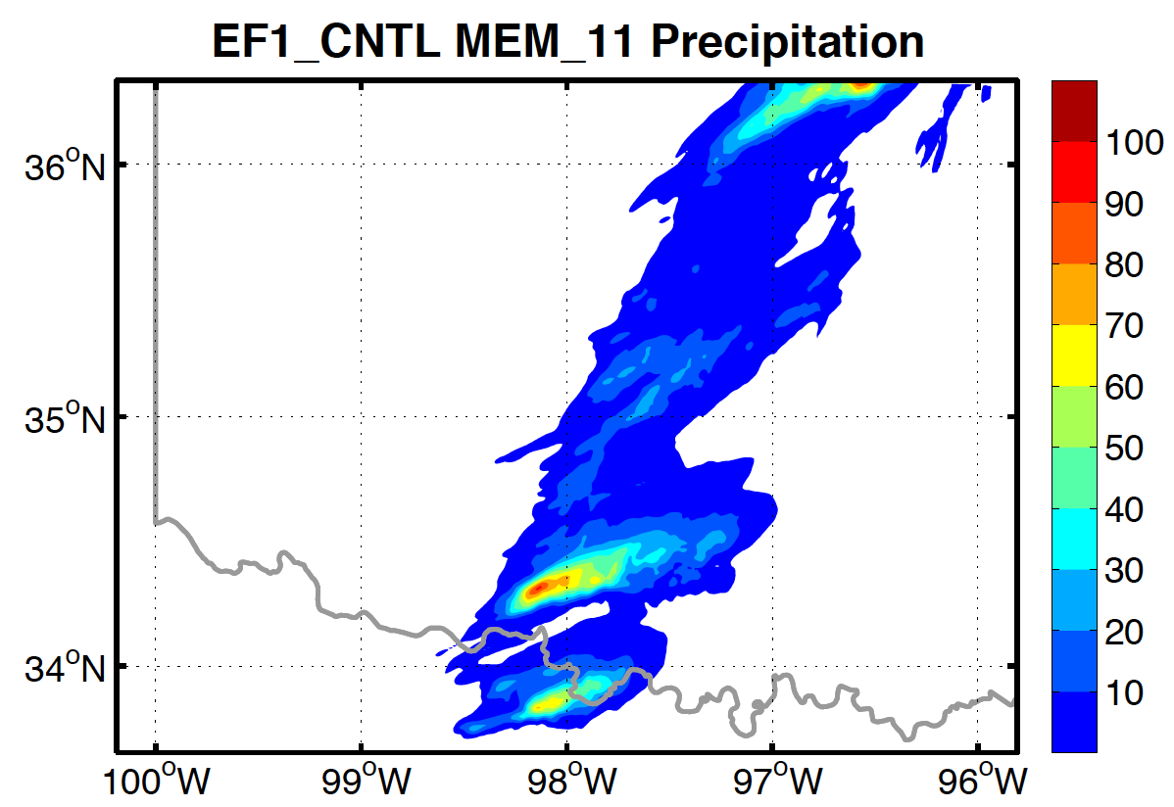
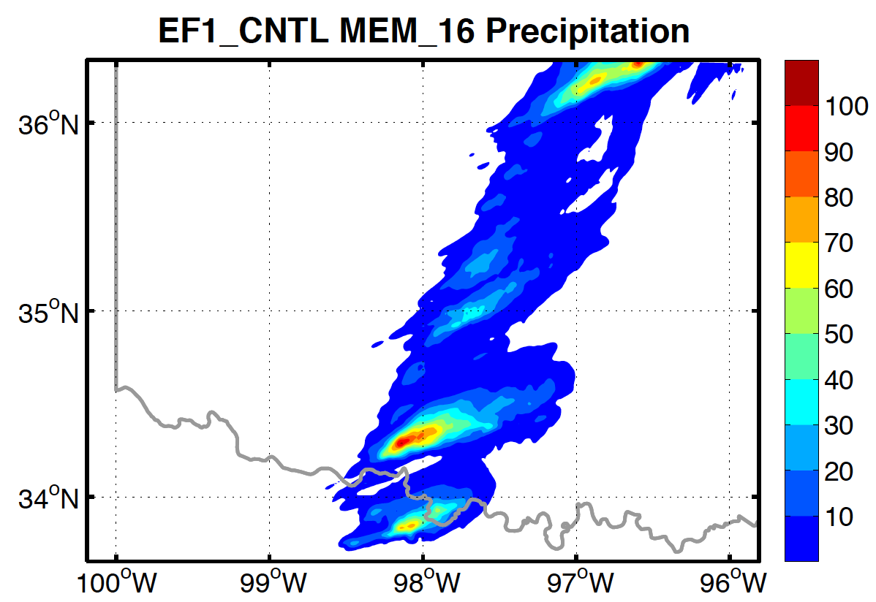
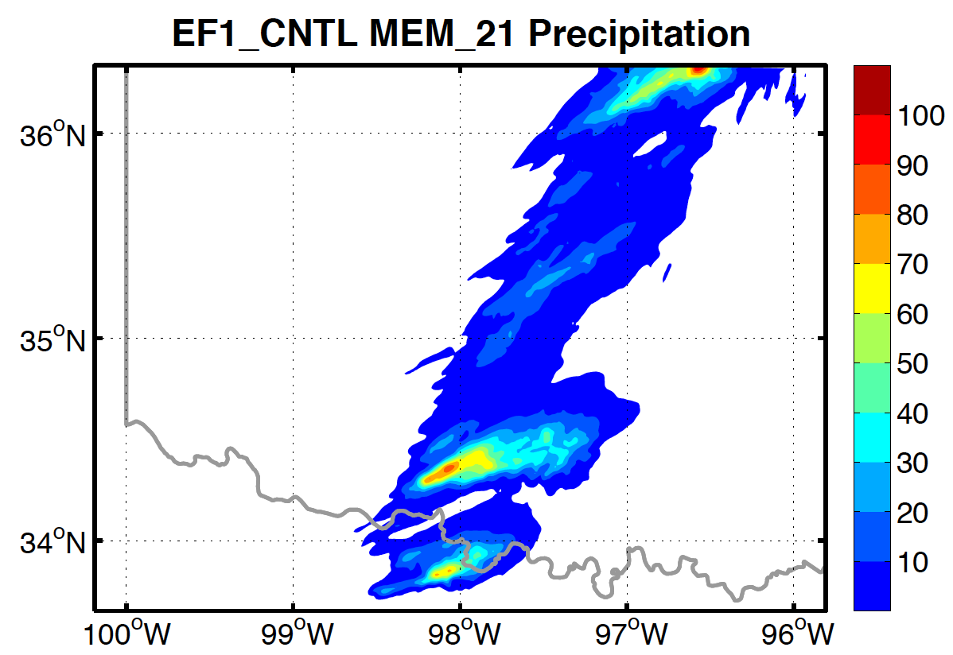
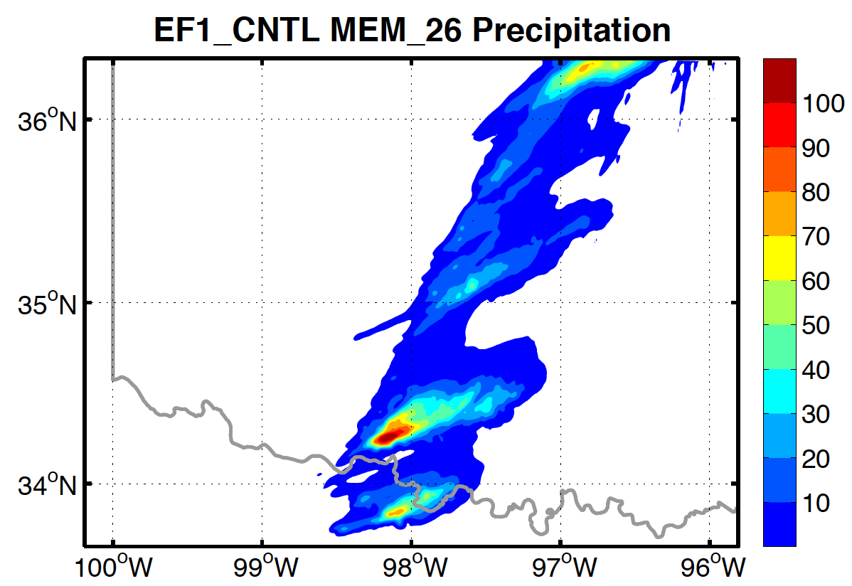
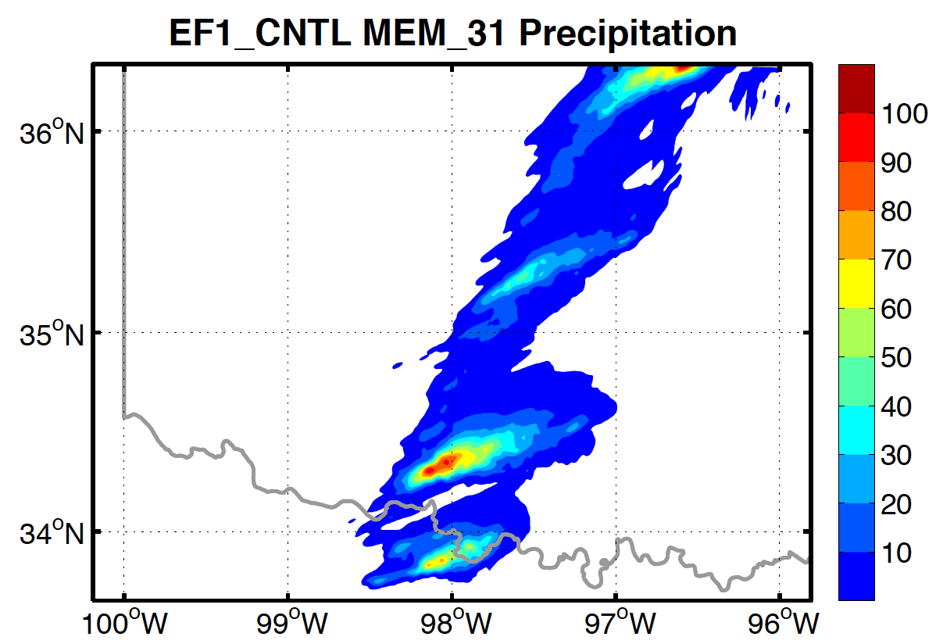
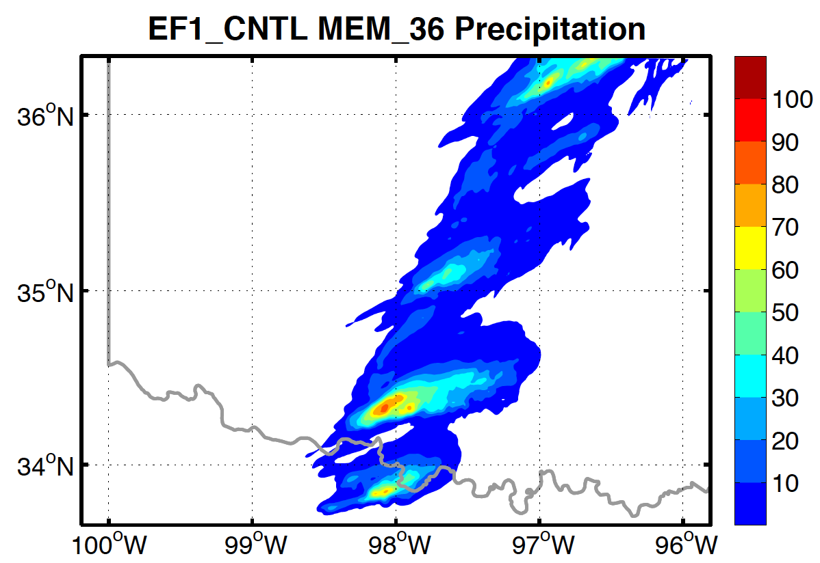
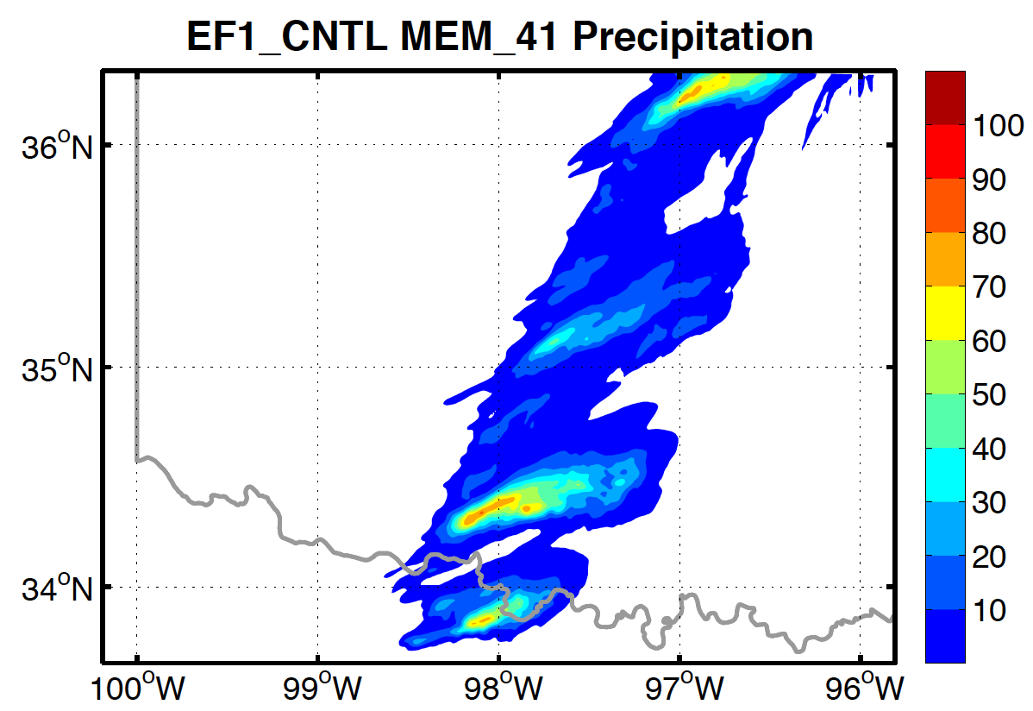
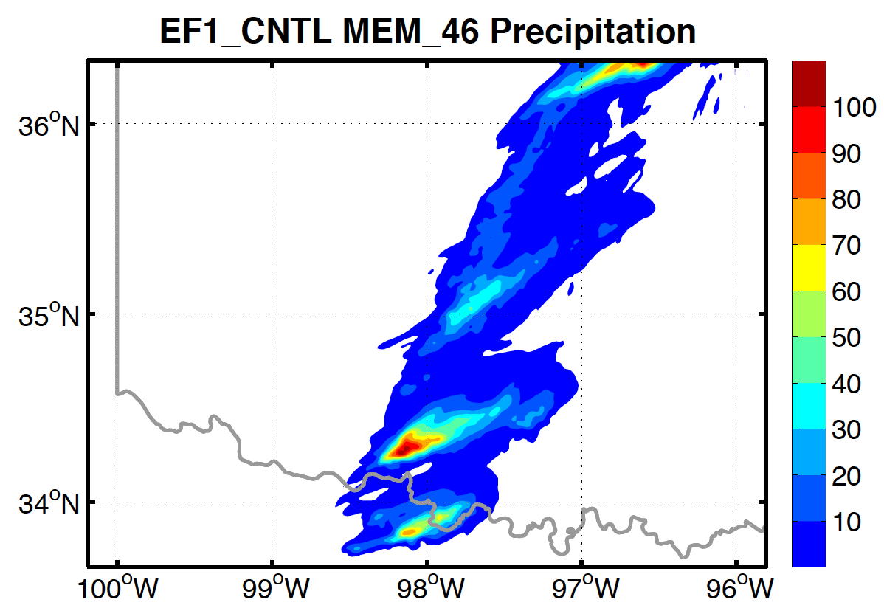
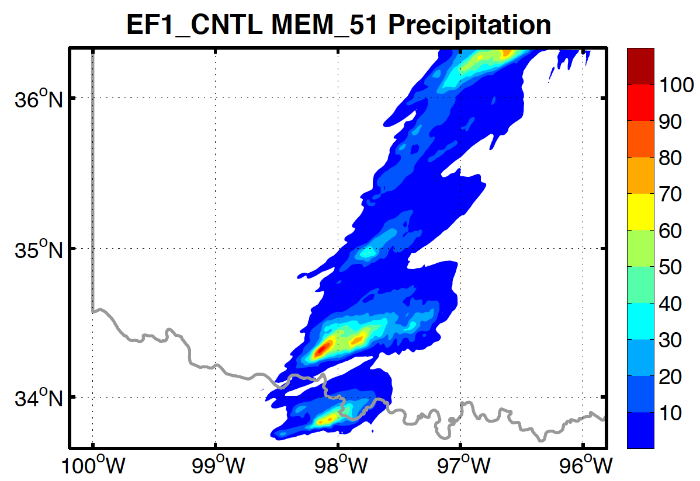
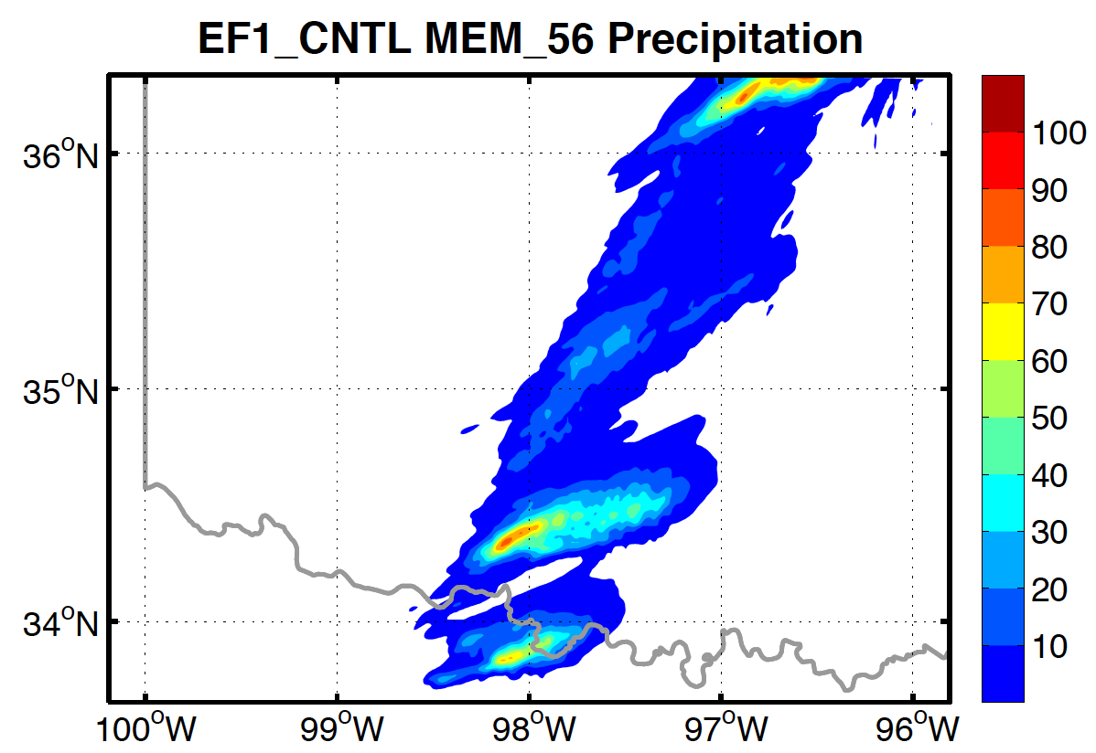
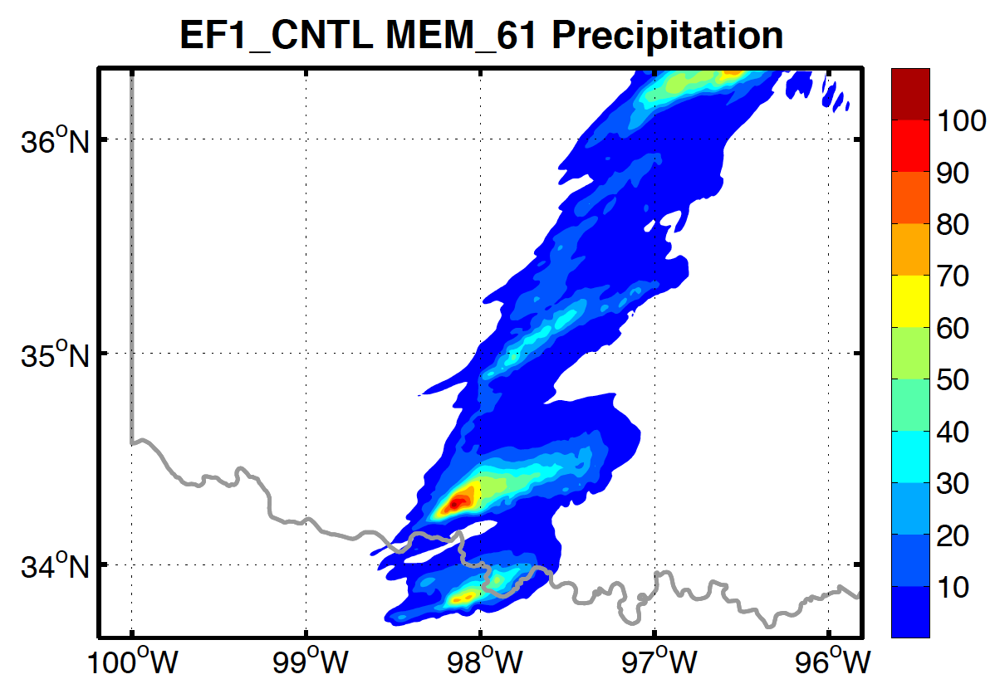
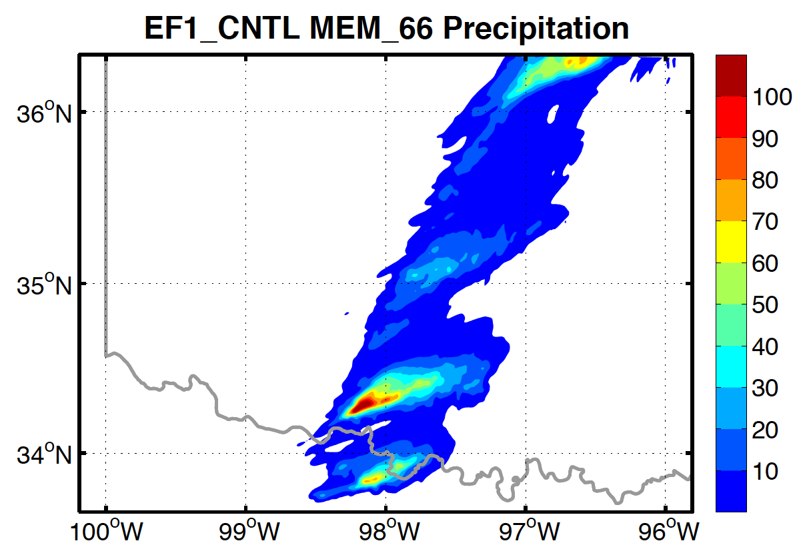
CNTL: Ensemble Appearance
Total Accumulated Precipitation of 12 Members

Slide 6
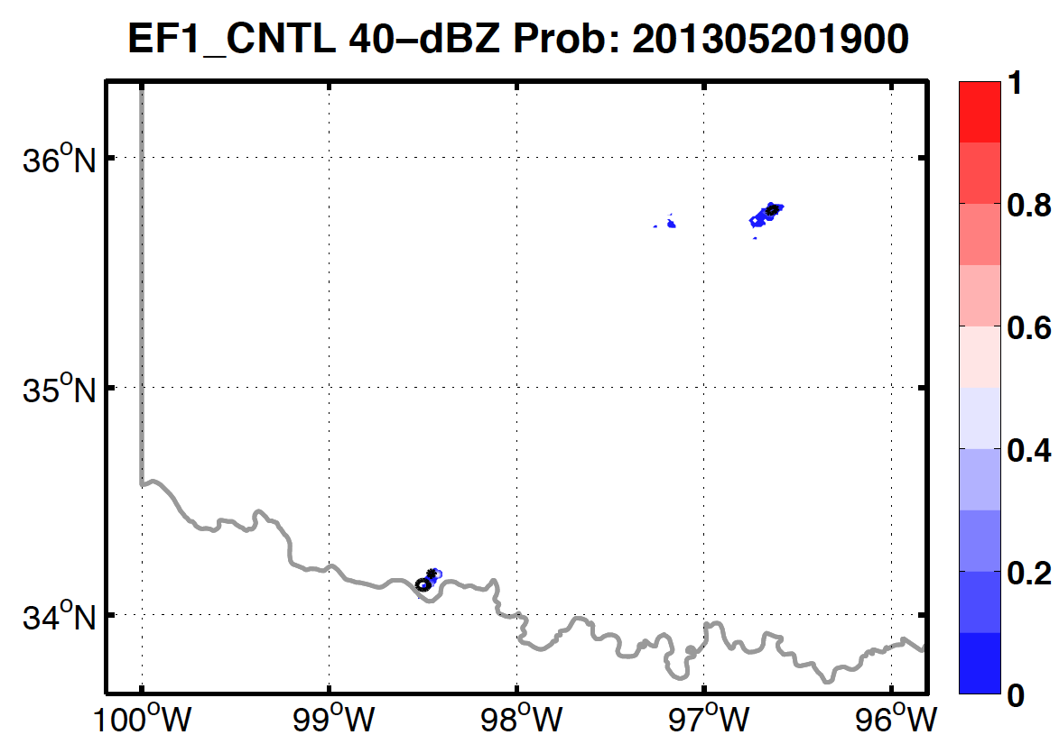
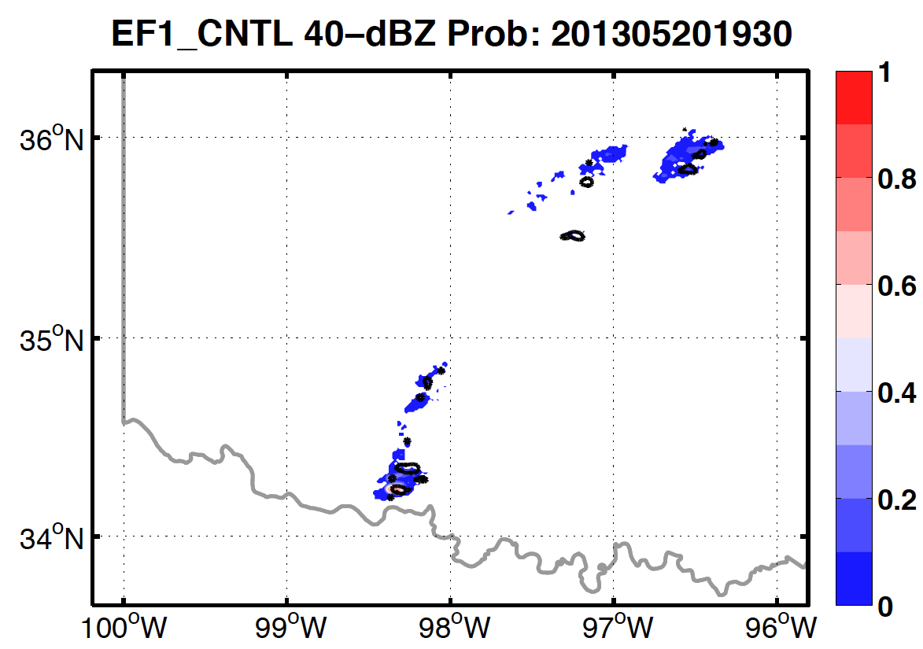
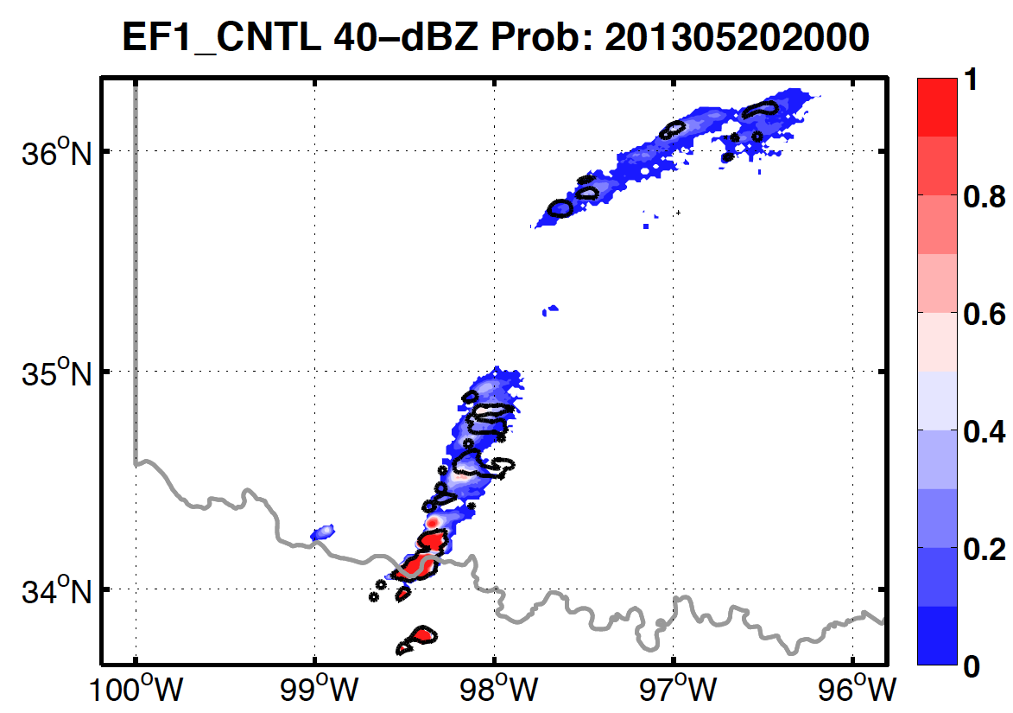
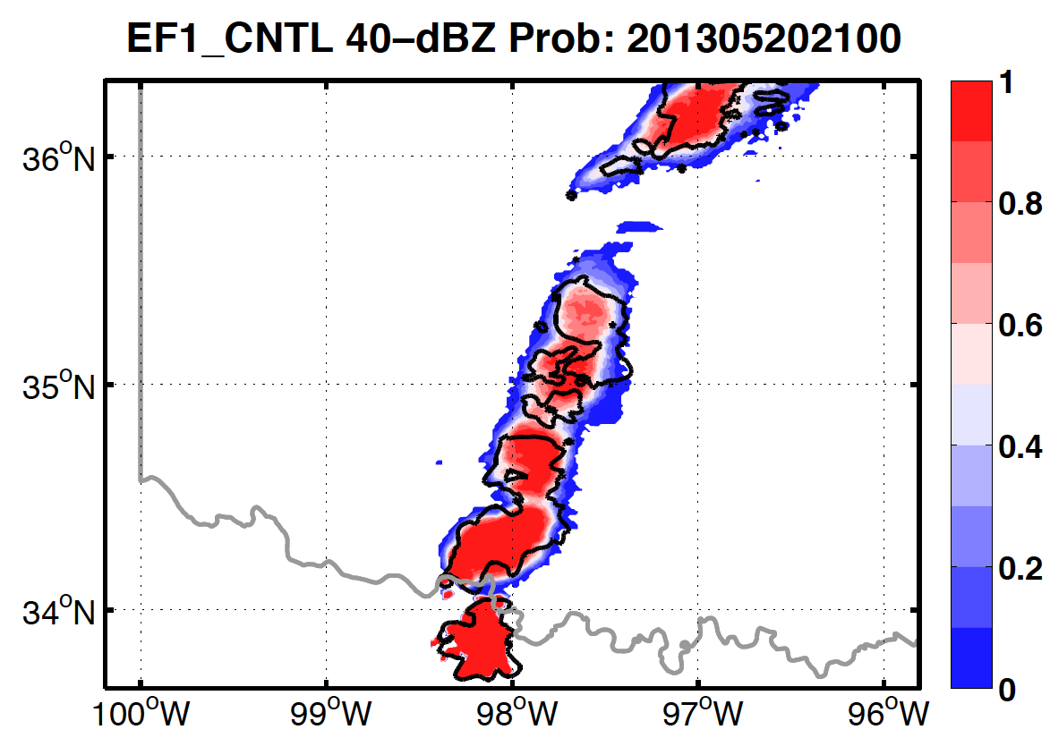
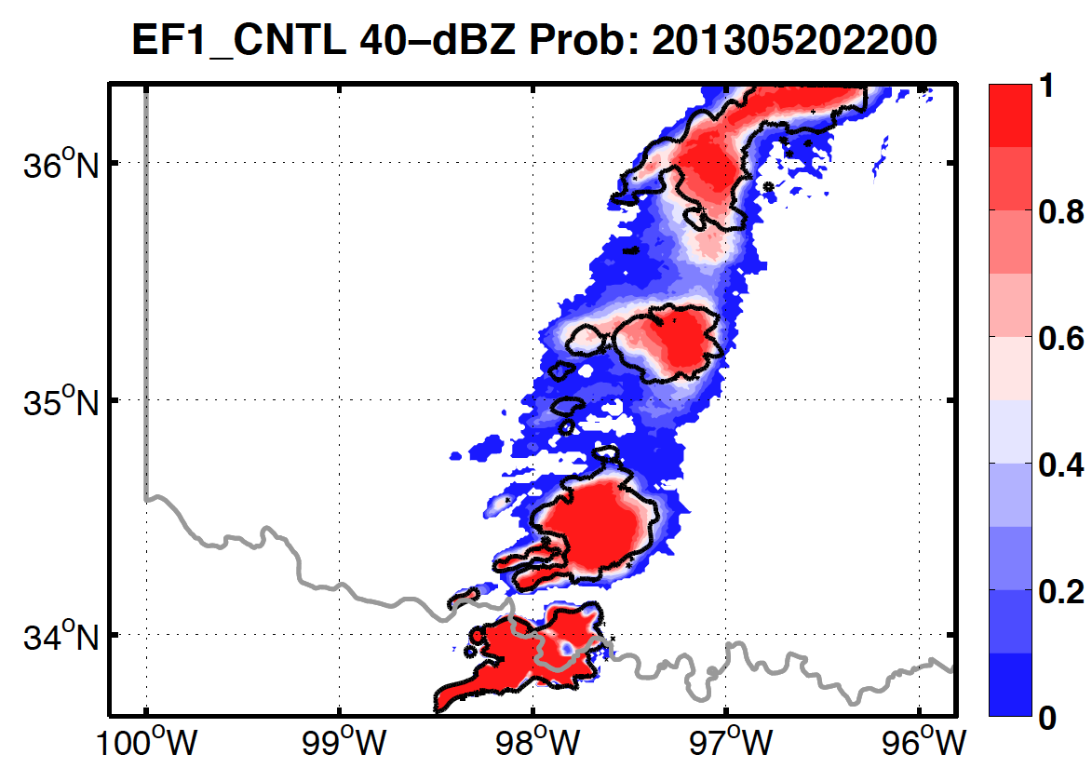
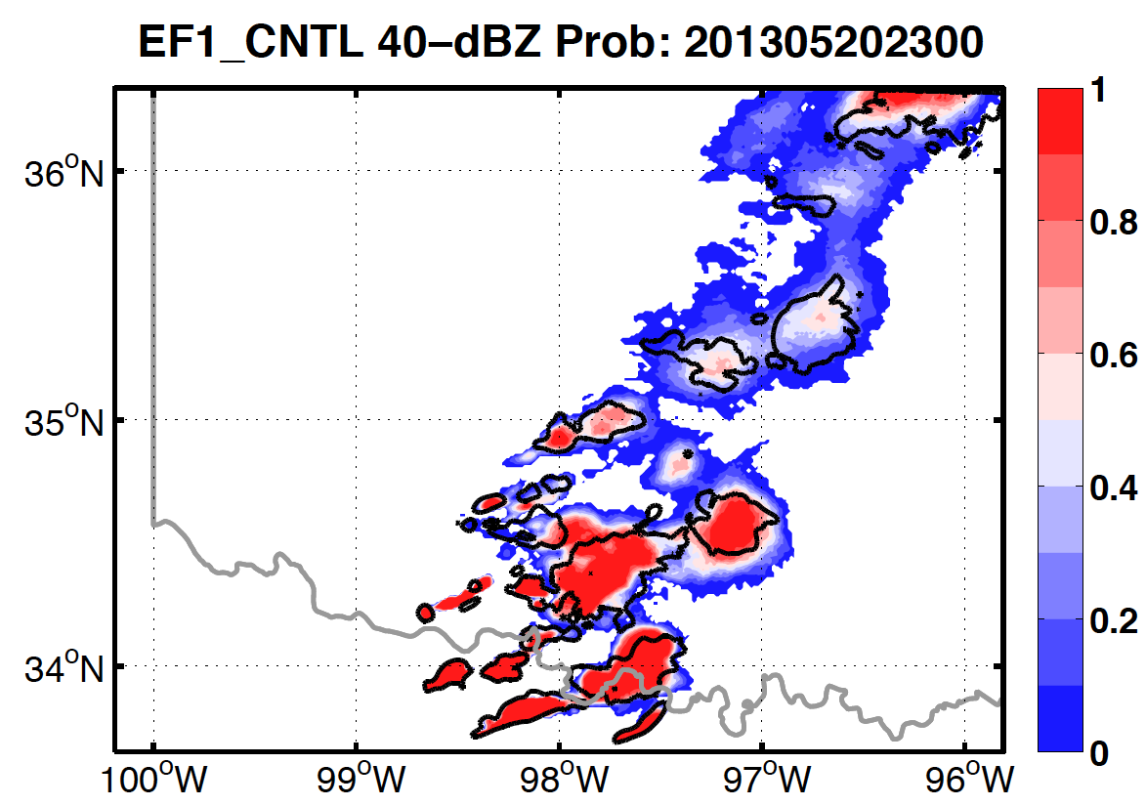
CNTL: Ensemble Probability
Ensemble Probability of 40-dBZ Composite Reflectivity

Slide 7
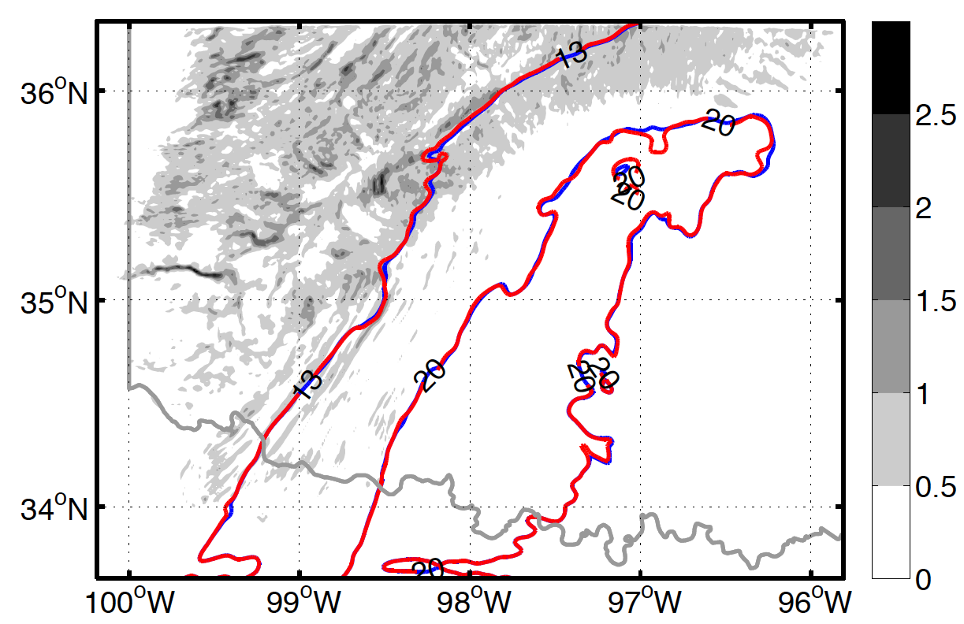
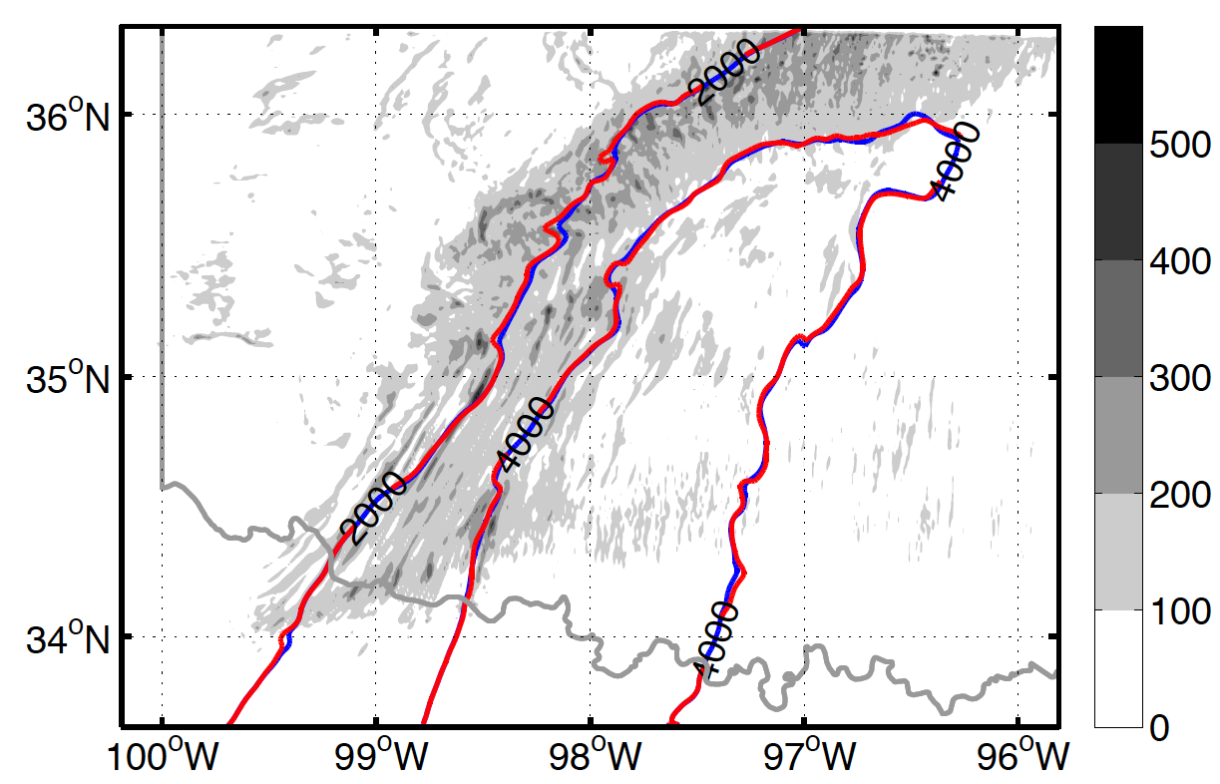
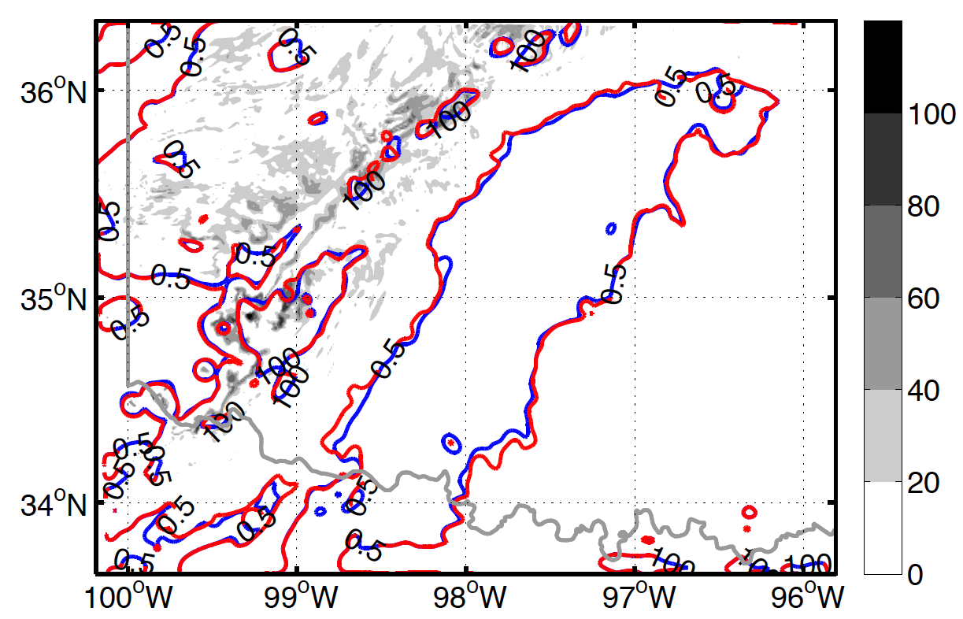
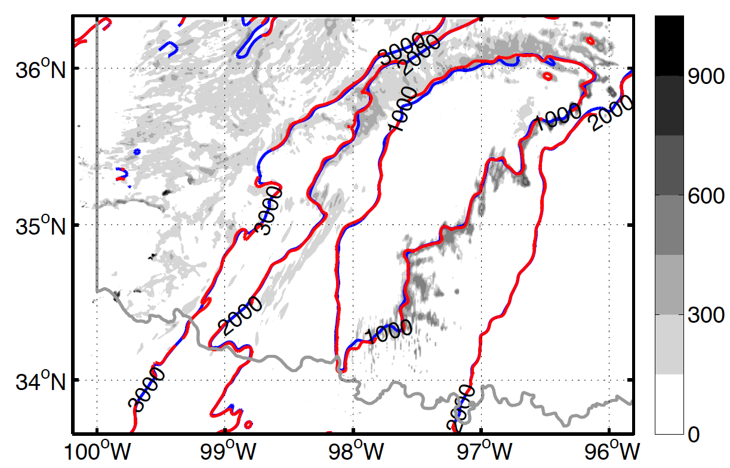
CNTL: Convective Condition
1900 truth & mean
0–1-km Td
MUCAPE
MUCIN
LFC

Slide 8
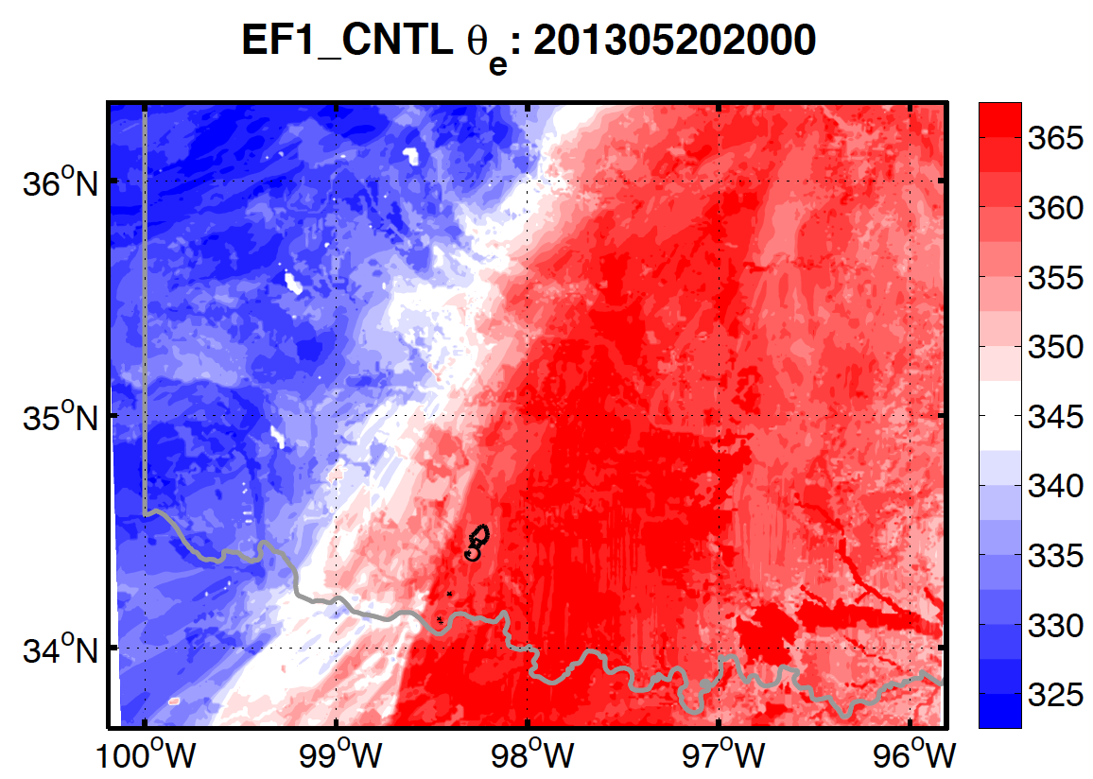
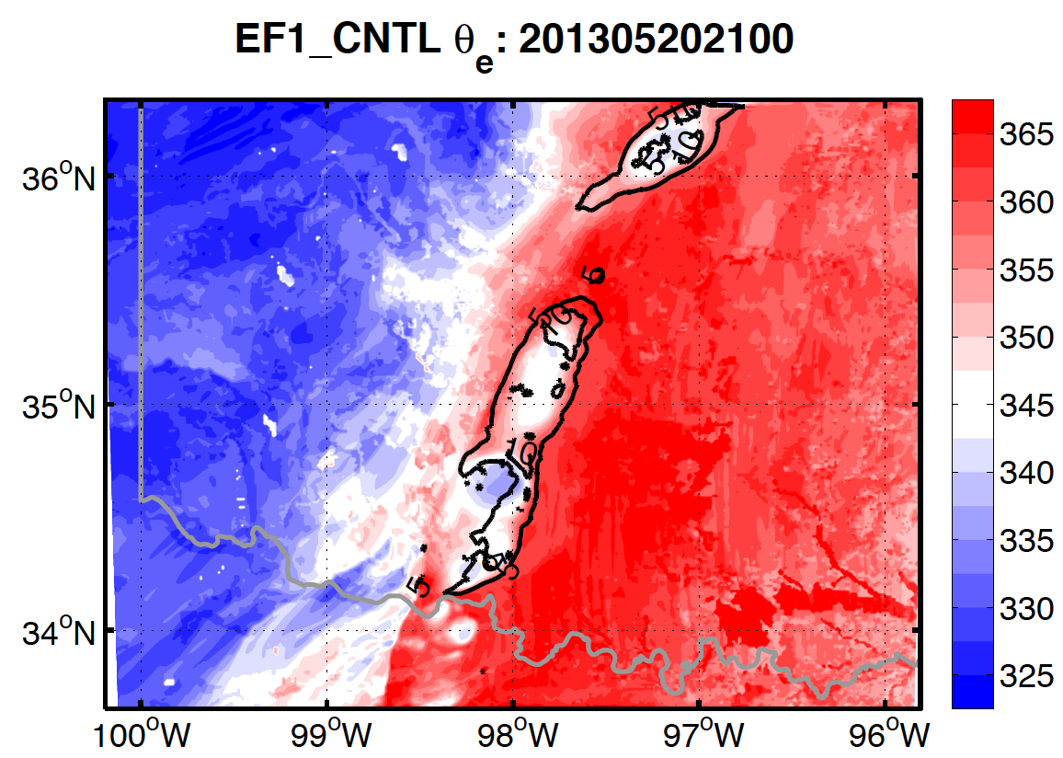
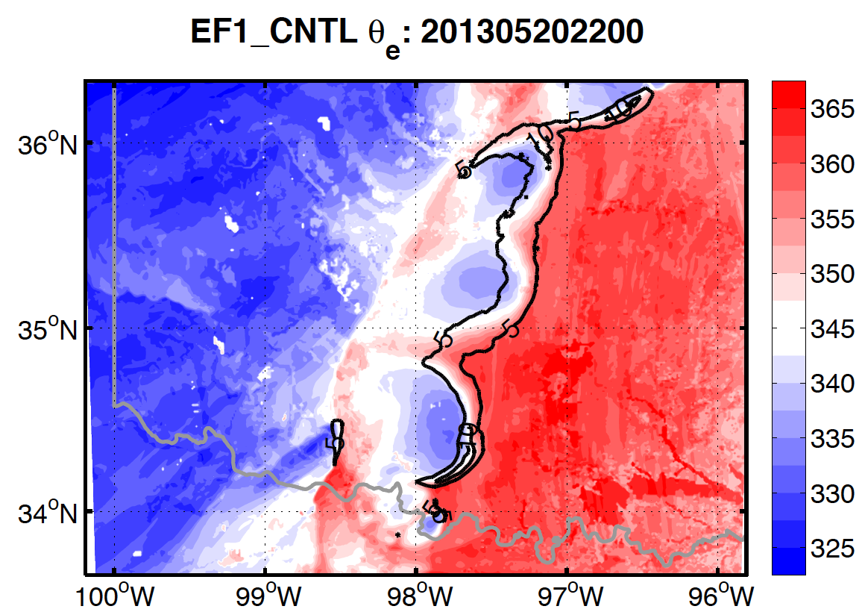
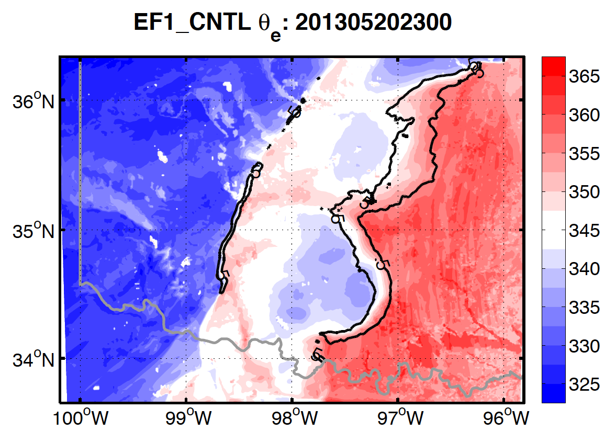
CNTL: Cold Pool (θ_{e})

Slide 9
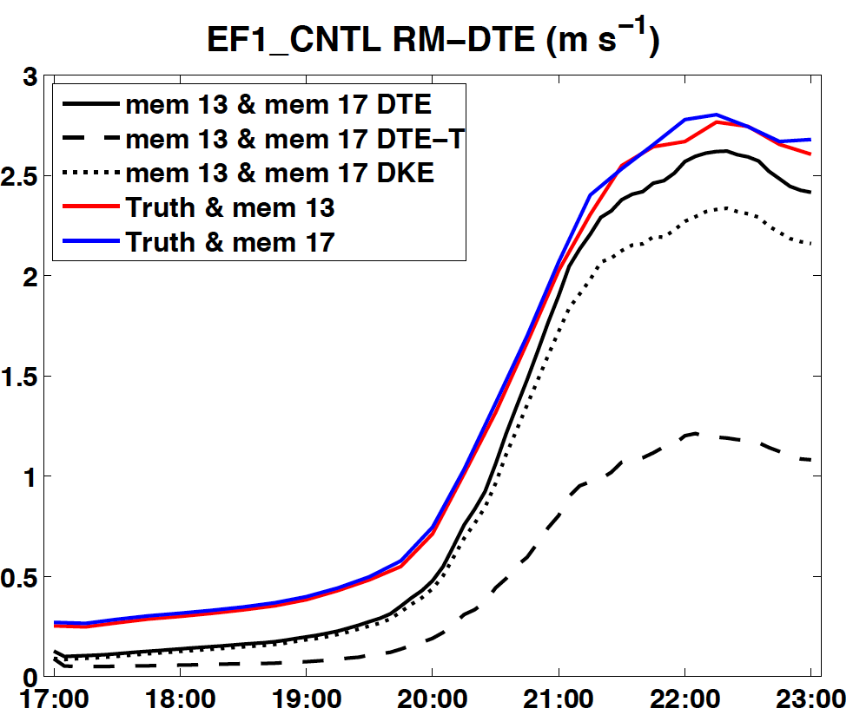
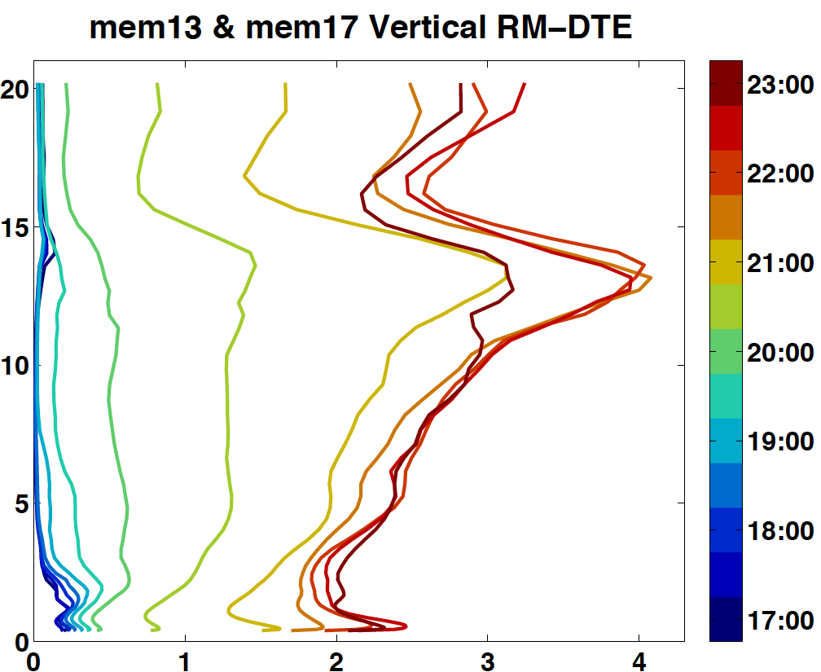
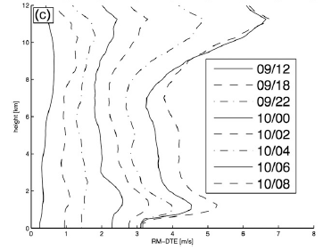
CNTL: Two Members
2.621 m/s
0.101 m/s
 | T (K) | θ (K) | Q (g/kg) | U (m/s) | V (m/s)
Domain RMSD | 0.0018 | 0.044 | 0.090 | 0.10 | 0.11
Max Level RMSD | 0.0026 | 0.096 | 0.23 | 0.23 | 0.20
— Height AGL | ~ 40 | ~ 450 | ~ 450 | ~ 10 | ~ 70
Max Difference | 0.06 | 1.5 | 4.3 | 5.4 | 3.6
(Melhauser & Zhang 2012)

Slide 10






CNTL: Member 13

Slide 11






CNTL: Member 17

Slide 12






Impact of Initial Perturbation
CNTL
2PERT
5PERT
Two different modes instead of continuous shifting

Slide 13




5PERT: Convective Condition
1900 truth & mean
Td
MUCAPE
MUCIN
LFC

Slide 14




Comparison: Initiation

Slide 15






Comparison: Cold Pool

Slide 16


Comparison: RM-DTE
Figure 8. RM-DTE (left) and vertical RM-DTE (right) of EF_CNTL, EF_2PERT and EF_5PERT

Slide 17


DTE Scale Decomposition

Slide 18
Summary
Predictability in storm-scale is intrinsically limited
  Before CI, only errors of wind fields in meso-γ-scale experienced apparent increase
  Convective conditions will not be greatly modified
  Randomness of initial convections and subsequent cold pool dynamics lead to divergence of storm locations
Inflating initial perturbations might lead to different performance of ensemble forecast
  Meso-α and meso-β might be more greatly impacted
  Convective conditions might be modified
  Ensemble mean might be deviated from “truth”
Error saturation and upscale growth are observed in spite of the magnitude of initial perturbations

Slide 19




CNTL-5PERT at 1900 UTC

Slide 20





Slide 21


Translation Speeds

Slide 22



DQE

Slide 23




Comparison: Meso-γ-scale

Slide 24




Comparison: Meso-β-scale

