Slide 1
Ensemble Data Assimilation, Modeling, and Predictability for Lake Effect Snow
Plans and Progress for
Steven J. Greybush
Matthew Kumjian, Fuqing Zhang, George Young,
Daniel Eipper, Christopher Melhouser, Yonghui Weng, OWLeS Team
Data Assimilation Group Meeting
August 15, 2014

Slide 2
Project Goals
Assimilation: Design an advanced WRF-based mesoscale ensemble data assimilation system for winter precipitation.
Evaluate latest techniques: EnKF, 4DEnsVar, E4d-Var
Optimize assimilation of surface, upper air, and radar data.
Assimilate operational observations, validate with field campaign observations.
Predictability: Explore ensemble predictability of lake-effect snow.
Compare the fundamental (dynamics-limited) versus the practical (model/obs limited) predictability.
Characterize the timescales for error growth and saturation.
Understand the relative contributions of initial condition, boundary condition, and model error.

Slide 3
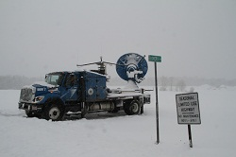
OWLeS: Ontario Winter Lake-effect Systems (LeS)
December 2013-January 2014
Mission Statement from http://www.owles.org/:
The OWLeS project examines the formation mechanisms, cloud microphysics, boundary layer processes and dynamics of lake-effect systems (LeS) at unprecedented detail using X-band and S-band dual-polarization (dual-pol) radars, an aircraft instrumented with particle probes and profiling cloud radar and lidar, a mobile integrated sounding system, a network of radiosondes, and a surface network of snow characterization instruments.
Lake-effect systems form through surface-air interactions as a cold air mass is advected over relatively warm (at least partially) ice-free mesoscale bodies of water. The OWLeS project focuses on Lake Ontario because of its size and orientation, the frequency of LeS events (especially intense single bands), its nearby moderate orography, the impact of Lake Ontario LeS hazards in particular on public safety and commerce, and the proximity of several universities with large atmospheric science programs.

Slide 4
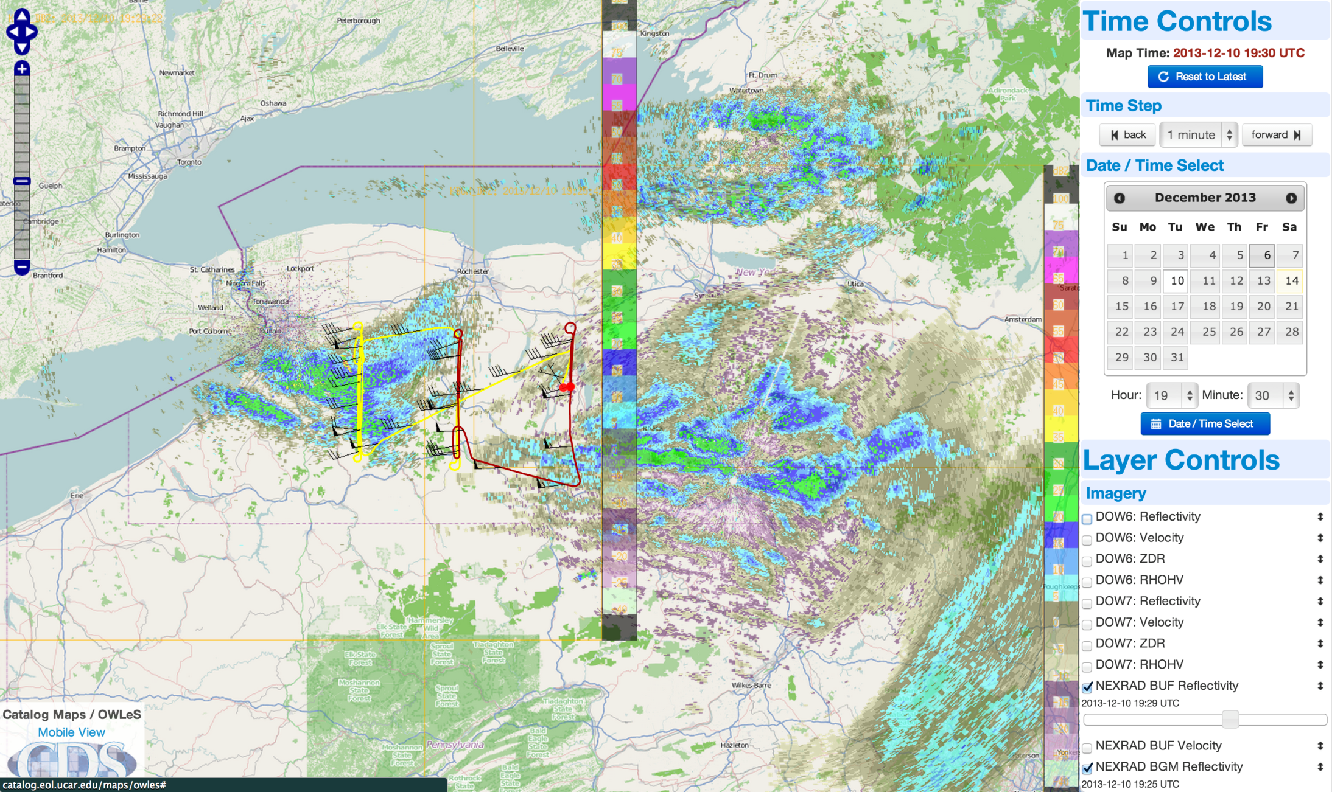
Dec 10 Flight Plan

Slide 5
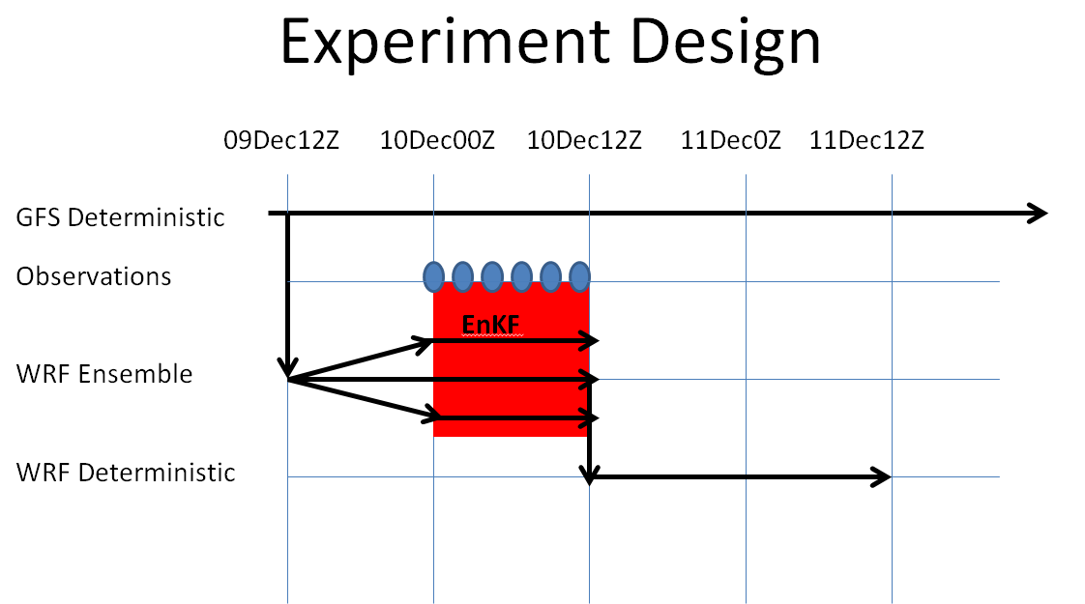
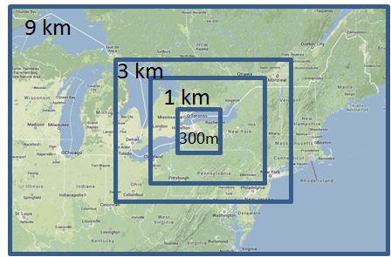
OWLeS as Assimilation Testbed
Why OWLeS?
Wintertime precipitation has not yet been a major focus of DA studies to date.
For lake effect, both the synoptic scale environment and mesoscale details matter.
Involves shallow rather than deep convection, strong surface forcing, and topography.
OWLeS provides unprecedented field obs for verification.
High resolution (3 km, then 1 km) WRF ensemble
Assimilate observations every 30 minutes using PSU-EnKF.
Ensemble mean represents best analysis estimate, ensemble spread characterizes uncertainty.

Slide 6
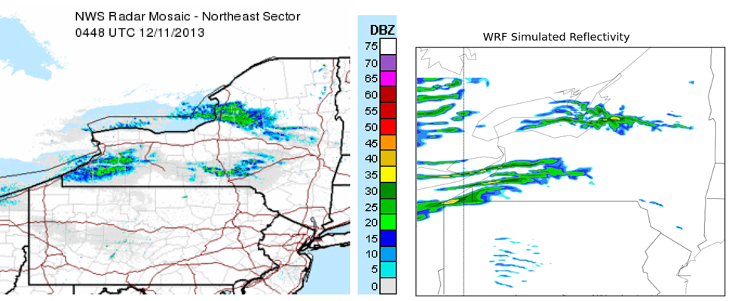
Project Benefits
With the newly-optimized data assimilation system, we will produce an ensemble reanalysis for cases of interest.
(e.g. 3-D winds, temperatures, surface forcing, advection fields)
Product will be available for interested OWLeS investigators.
Sample output of PSU-WRF-EnKF simulated radar compared to NWS composite radar. Forecast initiated from analysis that assimilates conventional observations only.

Slide 7
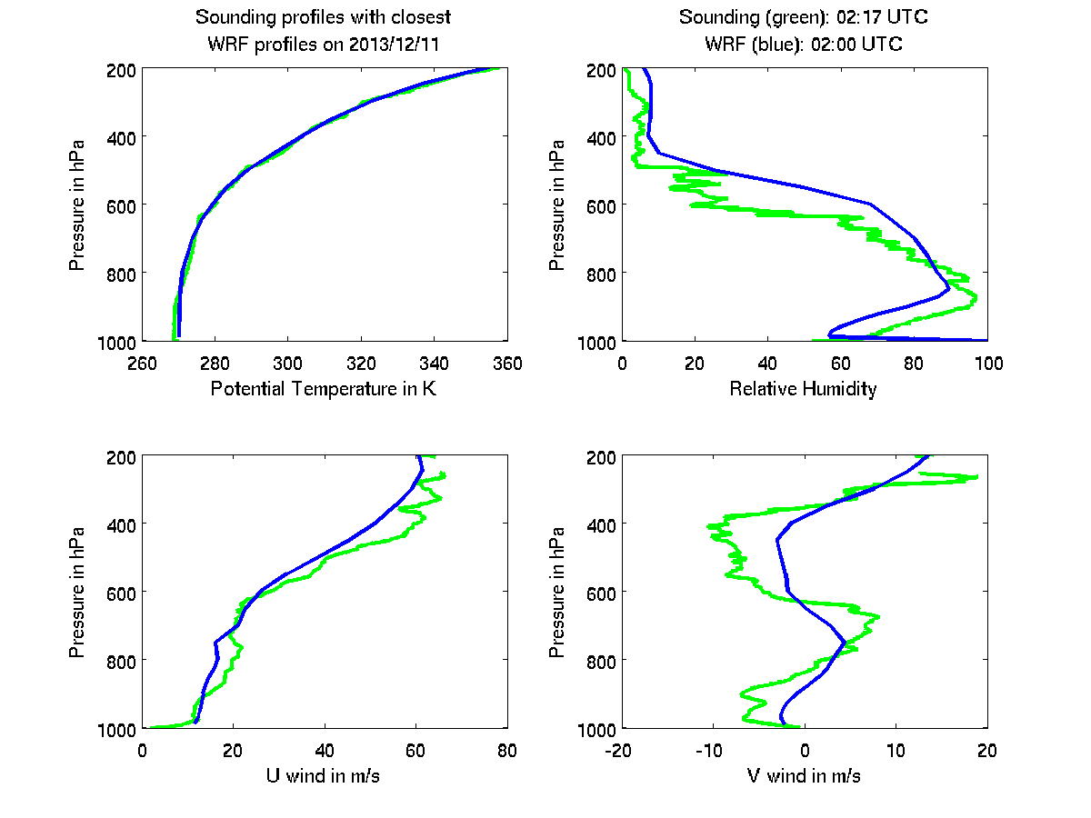
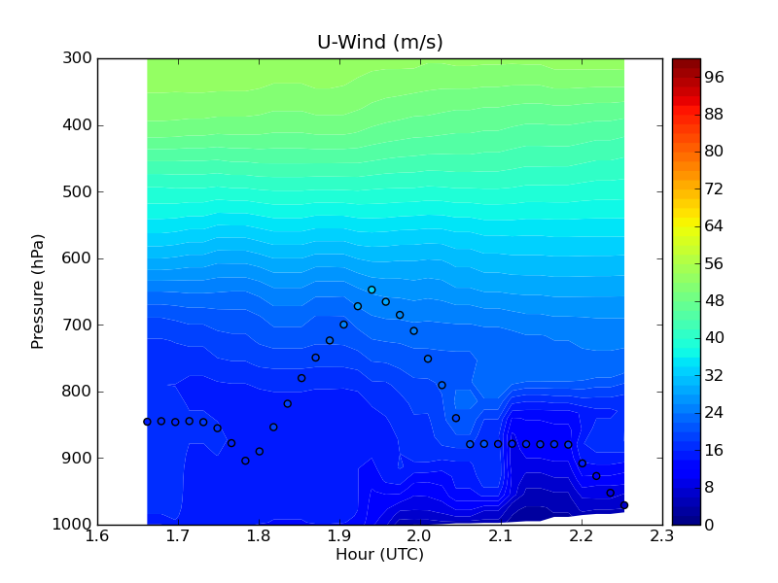
Forecast versus Field Campaign Obs
Special Rawinsondes
Aircraft Data

Slide 8
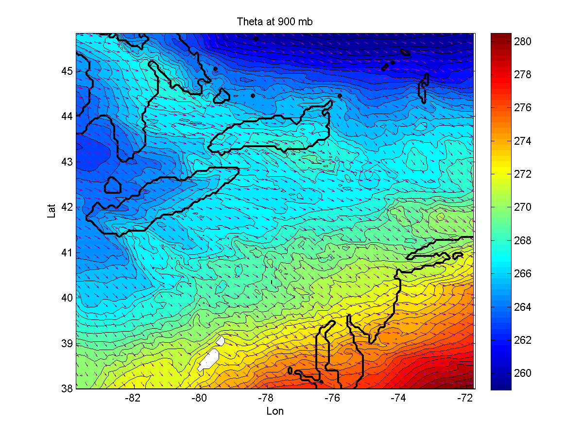
Science Objective: Interaction of Lake-Modified Atmospheric Layers

Slide 9
Approach to Dual-Pol Assimilation
Test in OSSE first, then move to real observations.
x_{a} = x_{b} + K(y_{o} – h(x_{b})), K = BH^{T}(HBH^{T} + R)⁻¹
Observation operator: maps meteorological and microphysical state to dual polarization variables.
Considerations:
Localization
Spin-up
Non-Gaussianity
Superobservations
Spurious Echoes
Quality Control:
Ground Clutter, using Correlation Coefficient
Depolarization Streaks from Lightning

Slide 10
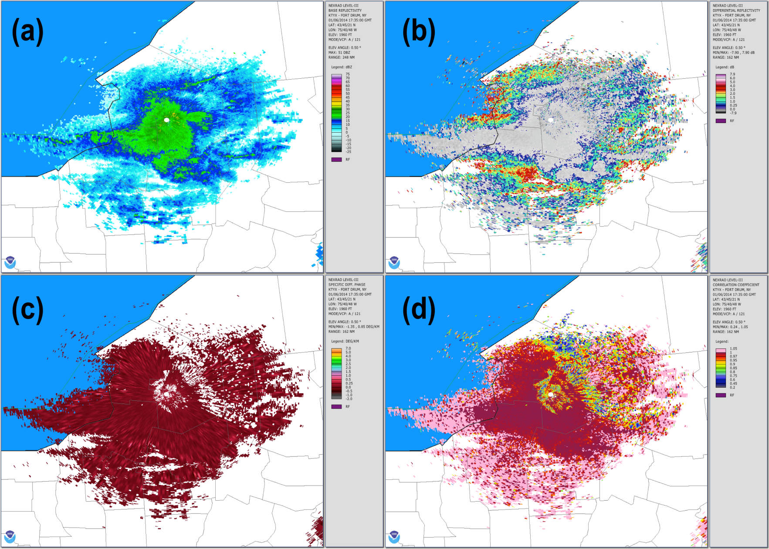
Z_{H}
Z_{DR}
K_{DP}
CC
Example polarimetric WSR-88D radar data from KTYX (Ft. Drum, NY) on 6 January 2014 at 1735 UTC, taken at 0.5°. Fields shown are (a) Z_{H}, (b) Z_{DR}, (c) K_{DP}, and (d) CC.
Fig. 1 shows example WSR-88D radar data from an OWLeS case on 6 January 2014. In the image, a lake-effect snowband is beginning to develop. The distinction between pristine ice and snow aggregates is revealed in the Z_{DR} field (Fig. **b), where large values near the echo peripheries are associated with oblate, pristine ice crystals. K_{DP} is also enhanced in these regions (Fig. **c), but also among some of the higher-Z_{H} echoes where Z_{DR} remains low. This combination of higher Z_{H}, low Z_{DR}, and high K_{DP} reveals a mixture of larger snow aggregates and smaller pristine ice crystals collocated within the snow band. The CC field (Fig. **d) reveals echoes to the north and east of the radar (blues and greens) that are not precipitation, and thus would be flagged for filtering and not included in the data assimilation.

Slide 11
Correlations and Variable Localization
Water Vapor
Raindrops
Z = Reflectivity
ZDR = Differential Reflectivity
KDP = Specific Differential Phase
Snow Aggregates
Pristine Ice Crystals
Graupel and Hail
 | T | U, V | W | Ps | Qv | Qd, Nd | Qs, Ns | Qi, Ni | Qg, Ng
Z | 1 | 0 | 0 | 0 | 0 | 1 | 3 | 2 | 3
ZDR | 1 | 0 | 0 | 0 | 0 | 0 | 2 | 3 | 2
KDP | 0 | 0 | 0 | 0 | 0 | 0 | 2 | 3 | 0
Table 1: This subjective chart illustrates the expected relative magnitude (0=none, 1=low, 2=medium, 3=high) of correlation between observed variables (rows) and model variables (columns), which may be helpful for variable localization.
Two-Moment Microphysics Scheme: Number Concentration and Mass

Slide 12
Conclusions
WRF-EnKF system assimilating conventional obs over E. Great Lakes domain has been built.
Forecast fields are compared to independent observations; appear plausible.
Future work:
Design and evaluate optimal DA system, including radar/dual-pol assimilation.
Understand predictability of lake-effect systems.

Slide 13
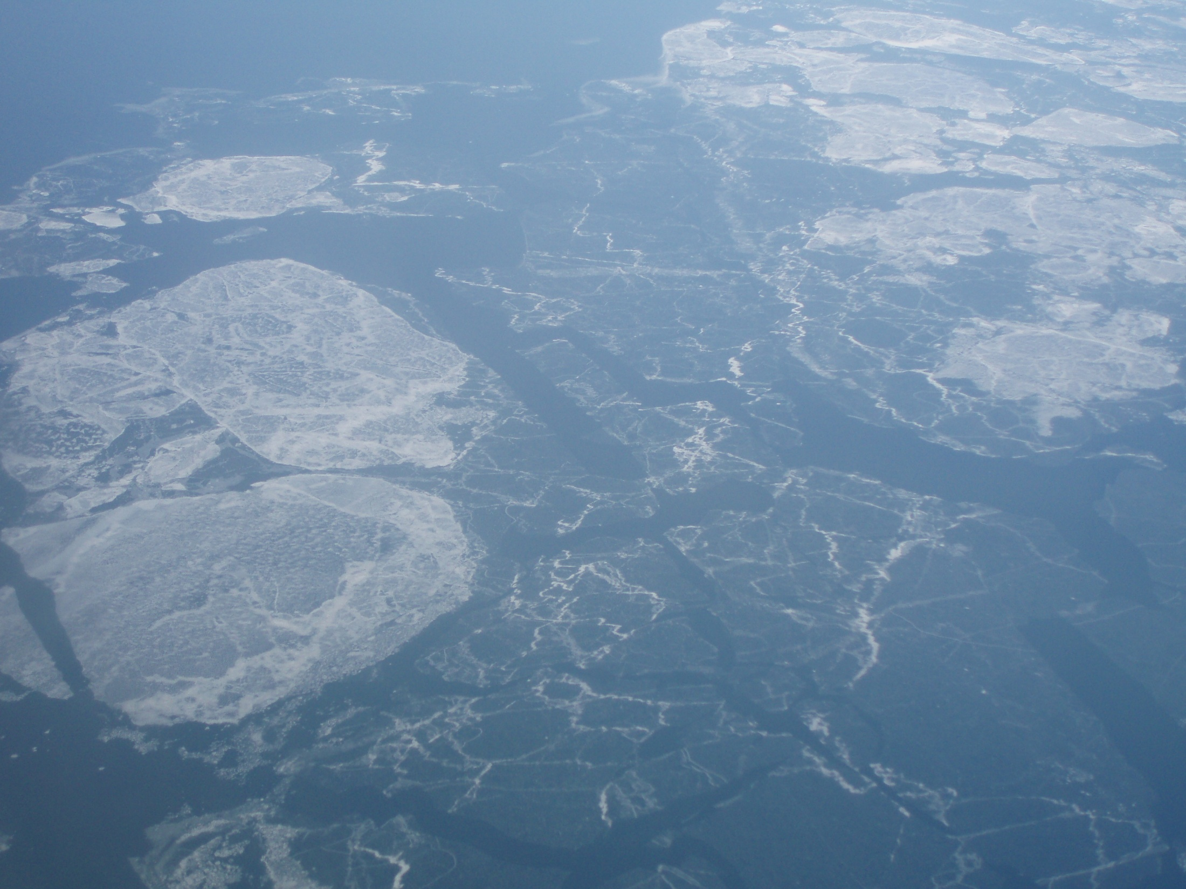
Thank You

