Slide 1
Factors controlling genesis of Super-Typhoon Haiyan (2013) Part II: Numerical Simulations
Shoujuan Shu¹, and Fuqing Zhang*²
[1] Nanjing University, Nanjing, China
[2] The Pennsylvania State University, University Park, Pennsylvania
8/14/2014

Slide 2
Preliminary results from diagnostic analyses
A disturbance from a MRG wave packet provides a precursor for Haiyan.
When the precursor moves into the favorable monsoon trough area, it intersects with the energy propagation from west (related to either MJO or TCED ), forming a significant wave train.
The energy propagation not only strengthens westerlies which then enhances the local vorticity and convergence, but also excites deep convection to the genesis location, leading to rapid development of the incipient vortex.

Slide 3
Objective of the numerical simulation
Test and verify the preliminary results from diagnostic analyses
Complement and confirm the important processes in the genesis of super Typhoon Haiyan
Data and Method
WRF V3.5 released in April 2013
2 domains(27 km, 9 km)
Use ECMWF EPS TIGGE data to initialize the model
No data assimilation

Slide 4
Major numerical experiments
EXP. | Description for IC
Good | The averaged10-good-member fields
Poor | The averaged10-poor-member fields
Good_noUV36 Poor_noUV36 | Same as Good/Poor except no 3-6-day wave train on U,V fields
Good_UV36 Poor_UV36 | Same as Good/Poor except with the 3-6-day wave train only on U,V fields
Good_PoorUV36 | The 3-6-day wave train in Good is replaced by that in Poor
Poor_GoodUV36 | The 3-6-day wave train in Poor is replaced by that in Good

Slide 5
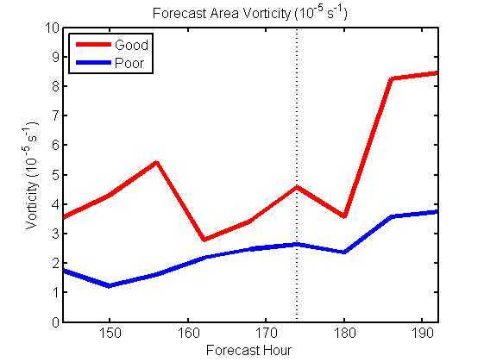
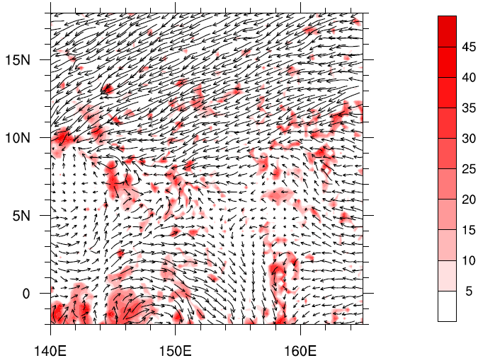
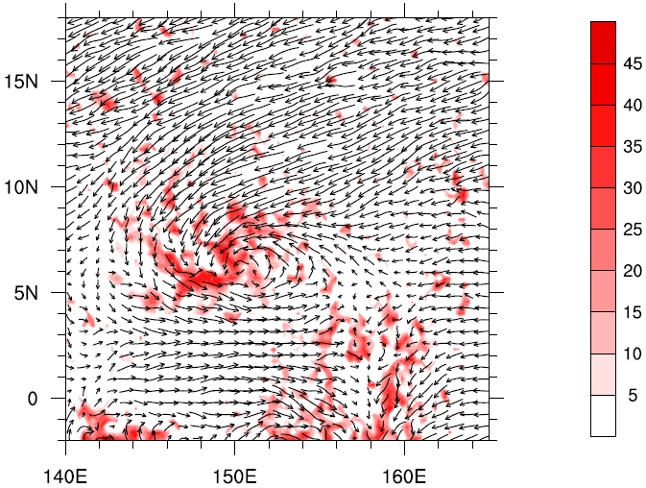
Poor
Good
MDBZ

Slide 6
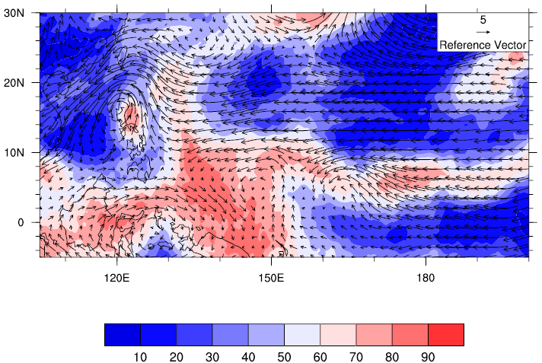
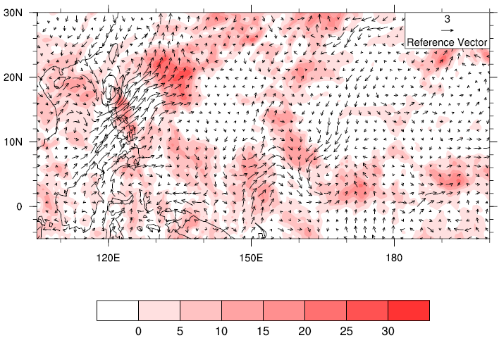
ICs
Vectors: wind850
Shading: rh500
●
Good
Dif = Good-Poor
●
Except for the initial intensity and moisture of the vortex, another significant difference is that the 3-6-day wave train which is more obvious in Good based on previous results.

Slide 7
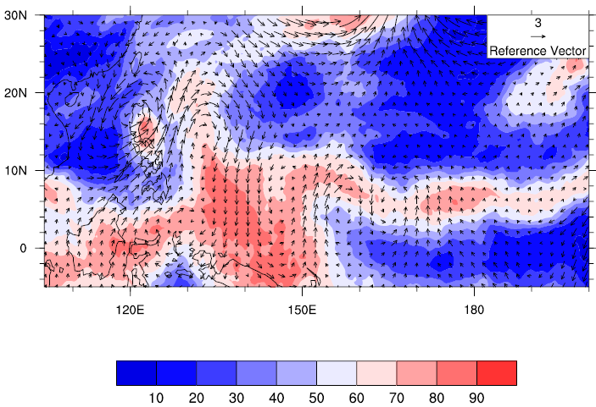
The role of 3-6-day wave train
Krosa
Vectors: wind850
Shading: rh500
●
●
Good_UV36
The wave train formed downstream of a pre-existing TC named Krosa with cyclonic-anticyclonic-cyclonic circulation associated with TCED and a cyclonic vortex moving from eastern MRG wave packet.
In another words, the wave train is a result of the interaction between the TCED and the cyclonic precursor from MRG wave.

Slide 8
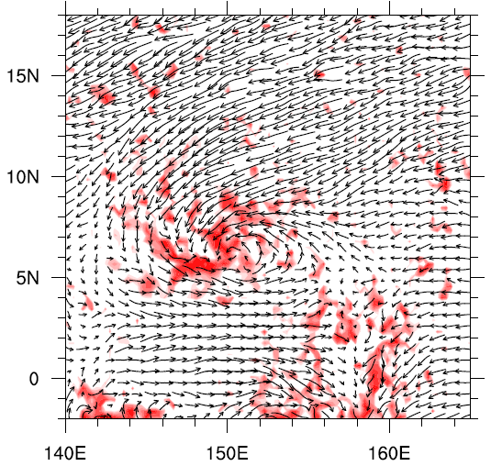
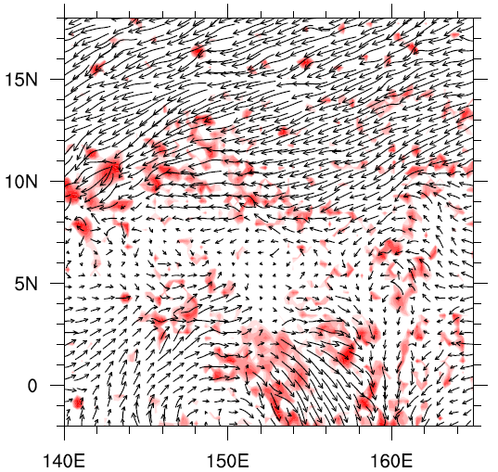
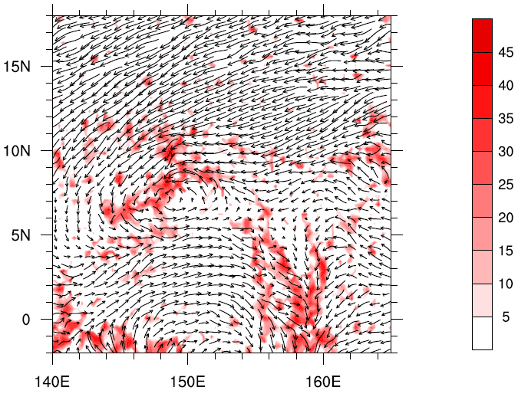
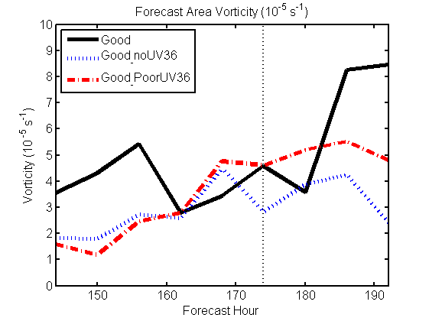
Good
Good_noUV36
Good_noUV36
Good_PoorUV36
If the 3-6-day wave train is excluded from ICs, the TC would not form, suggesting the importance of the wave train and the MRG precursor.

Slide 9
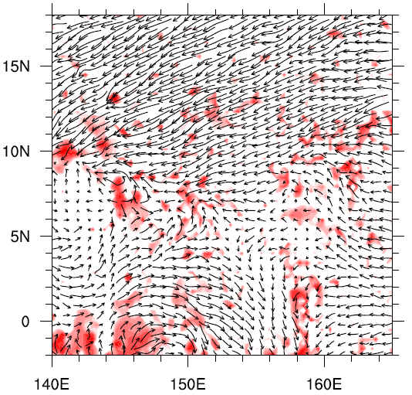
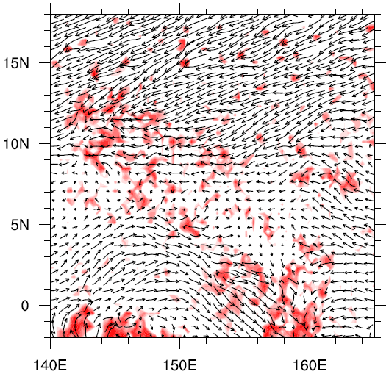
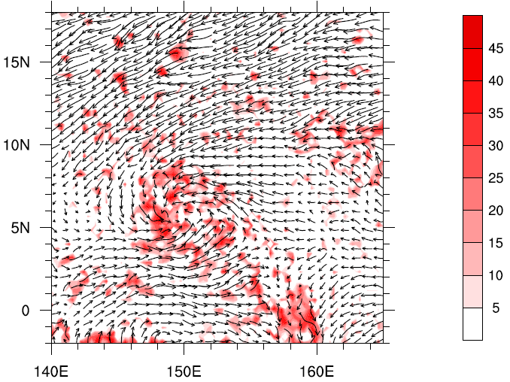
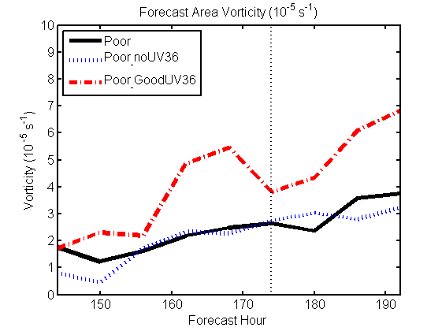
Poor
Poor_noUV36
Poor_GoodUV36

Slide 10
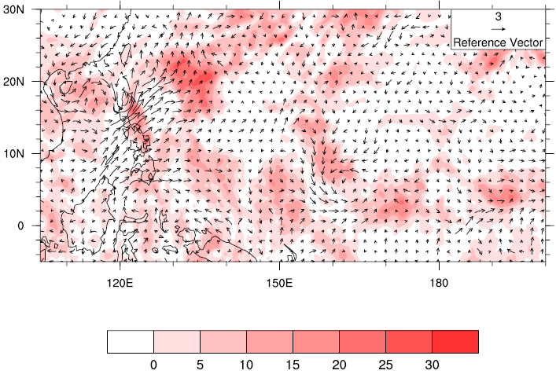
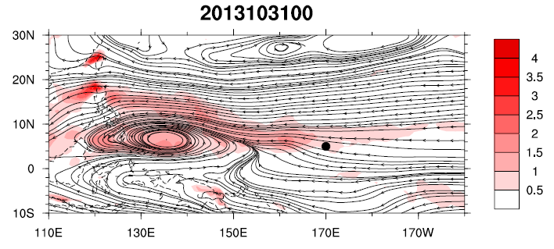
Dif=
Good_noUV36
—Poor_noUV36
●
The Dif between Good_noUV36 and Poor_noUV36 is mainly related to the difference of the large-scale monsoon trough.
Fields without UV36 basically represent the large scale monsoon fields.
Monsoon trough

Slide 11
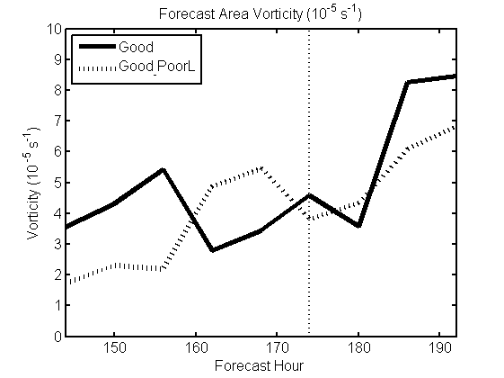
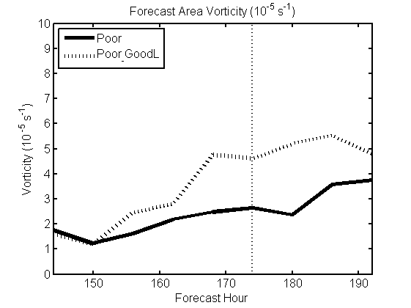
The role of large scale environment
The monsoonal large scale environment impacts the evolution of the incipient vortex greatly.

Slide 12
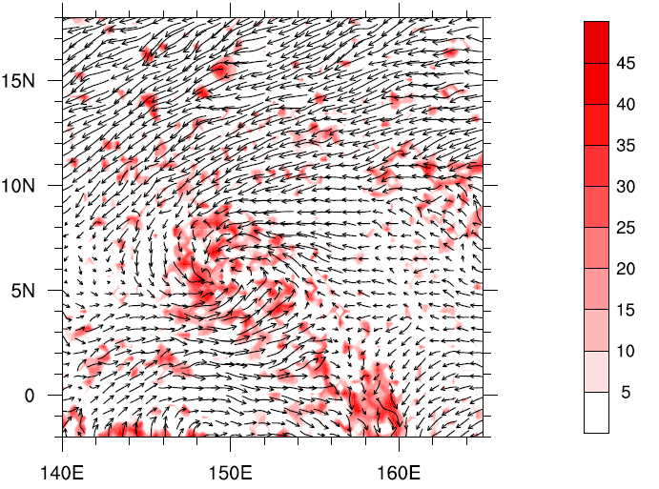
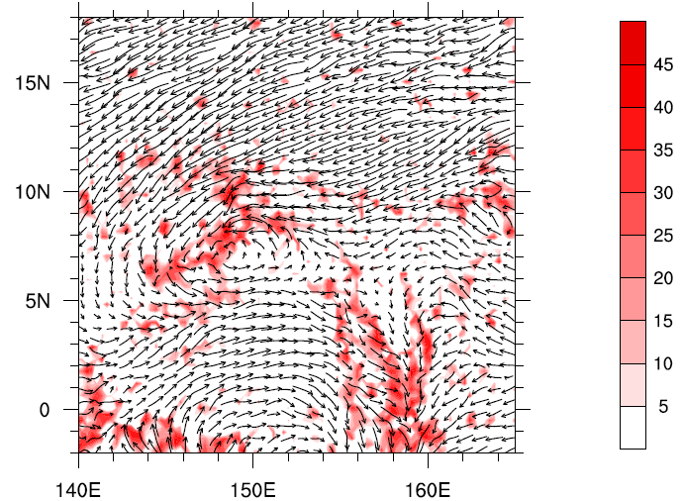
Good
Good_PoorL
Poor
Poor_GoodL

Slide 13
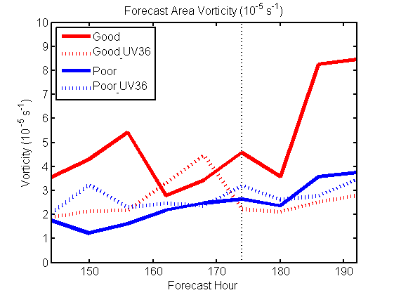
The TC didn’t form with 3-6-day wave train only
Both the large scale environment and the 3-6-day wave train are necessary for the genesis of Haiyan.

Slide 14
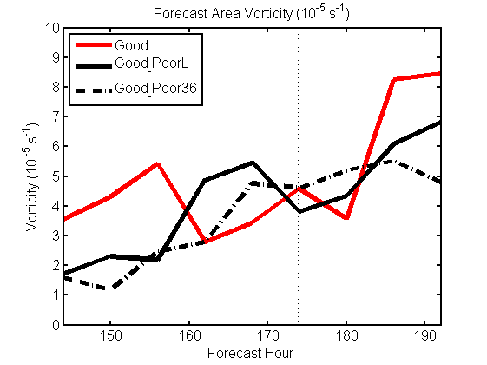
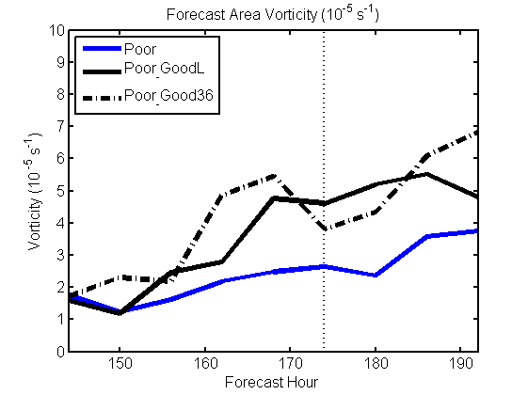
Which one is more important
The 3-6-day wave train plays a little more important role in the genesis of Haiyan.

Slide 15
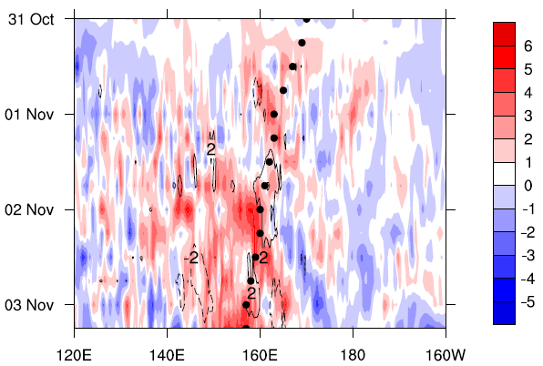
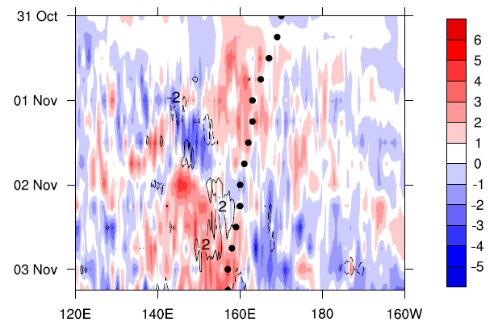
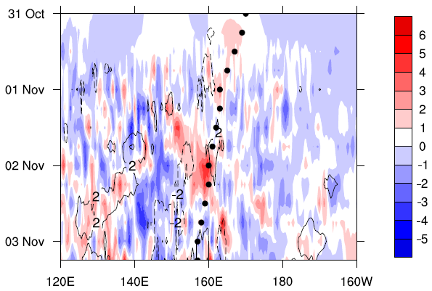
The impact of 3-6-d wave train on U_1000
Good-Poor
U(shading)+V(cont)
Good_L-Poor_L
Good-Good_noUV36
The enhanced westerlies not only increase the local vorticity and convergence, but also help to excite deep convection to the genesis location

Slide 16
Future works
Verify the role of the TCED associated with Krosa.
How does the precursor develop in the wave train?

