Slide 1

Mesoscale Predictability:
Error Growth Dynamics in Moist Baroclinic Waves
Y. Qiang Sun, Fuqing Zhang
Penn State University

Slide 2
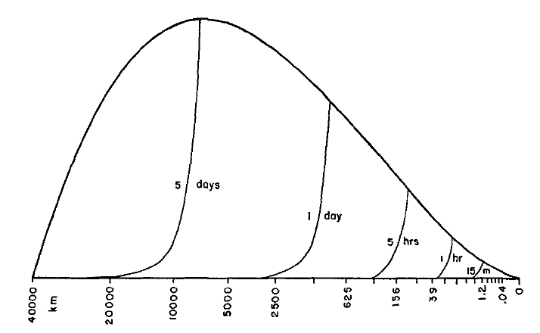
INTRODUCTION
The Predictability of Flows with Many Scales of Motion
Base Energy Spectrum
Error Energy Spectrum
Lorenz (1969)

Slide 3
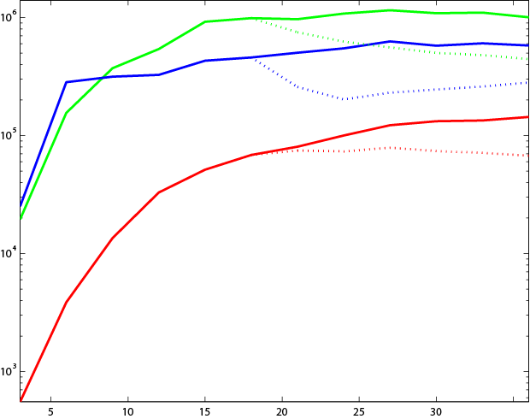



INTRODUCTION
Difference Energy of Band-Pass Filtered Fields
Zhang et al. (2007)

Slide 4
INTRODUCTION
Scientific Questions:
We want to know more about Error growth with respect to initial perturbations of different scale

Slide 5
METHODLOGY
“Identical twin” perturbation Experiments
Using WRF model
CTRL
Add initial perturbation
PETURBED

Slide 6
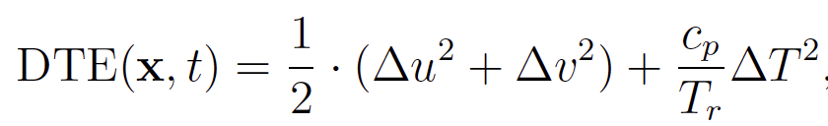


METHODLOGY
Diagnostic Tool:
Difference Total Energy (DTE) :
Difference Kinetic Energy (DKE):
Spectrum Decomposition:

Slide 7
METHODLOGY
MODEL SETUP: CTRL
WRF ARW V3.5.1, idealized b_wave, f-plane,
no pbl, no radiation, no cumulus

Slide 8
CTRL OVERVIEW
Eddy Kinetic Energy
Rain
Time (240 hour)

Slide 9
CTRL OVERVIEW
Day 0
Moisture accelerate Large Scale wave development
Dry
40%Vapor
Moist

Slide 10
PETURBATION
Perturbation:
Type 1: Gaussian Noise
Random Gaussian Noise on Potential Temperature
(mean: 0; Standard deviation: 0.2)
Type 2: Large Scale
Filter out the baroclinic wave(>1000km) at day 0 and multiply it by a tiny coefficient so that the maximum of potential temperature is 0.1 Cº

Slide 11
RESULTS
DTE growth at Different scale
NOISE
LARGE
DRY
NOISE
LARGE
MOIST
0h 36h 72h
0h 36h 72h

Slide 12
RESULTS
Development of perturbation: Noise Case

Slide 13
RESULTS
Development of perturbation: Large Case

Slide 14
RESULTS
Power Spectrum of DTE
DRY_case : close to -3 power law
Moist_case: close to -5/3 power law
LARGE_DRY
Power density
NOISE
LARGE
Power density
1 10 100
wavenumber
1 10 100
wavenumber

Slide 15
RESULTS
Sensitivity to initial perturbation amplitude
LARGE
10XLARGE
10XLARGE_DRY
NOISE
NOISE/10
NOISE_40Vapor

Slide 16
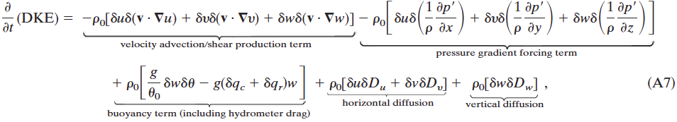
DKE growth within different scale
Zhang et al. 2007
Perform Spectral Decomposition for each term:

Slide 17
DRY Case:
TOTAL
LARGE
MEDIUM
SMALL

Slide 18
NOISE Case:
TOTAL
LARGE
MEDIUM
SMALL

Slide 19
Latent heating directly contribute to relative large scale.

Slide 20
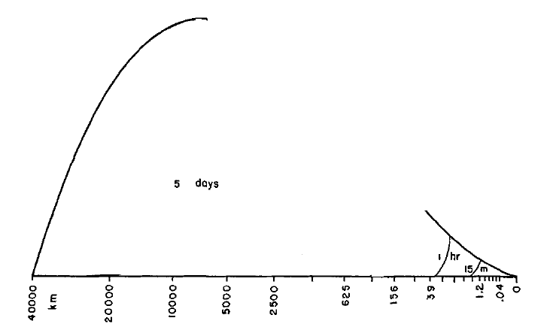
Summary
Dry Case: A really long (even infinite) predictability could be expected.
Moist Case: predictability is limited
L
M
S

