Slide 1
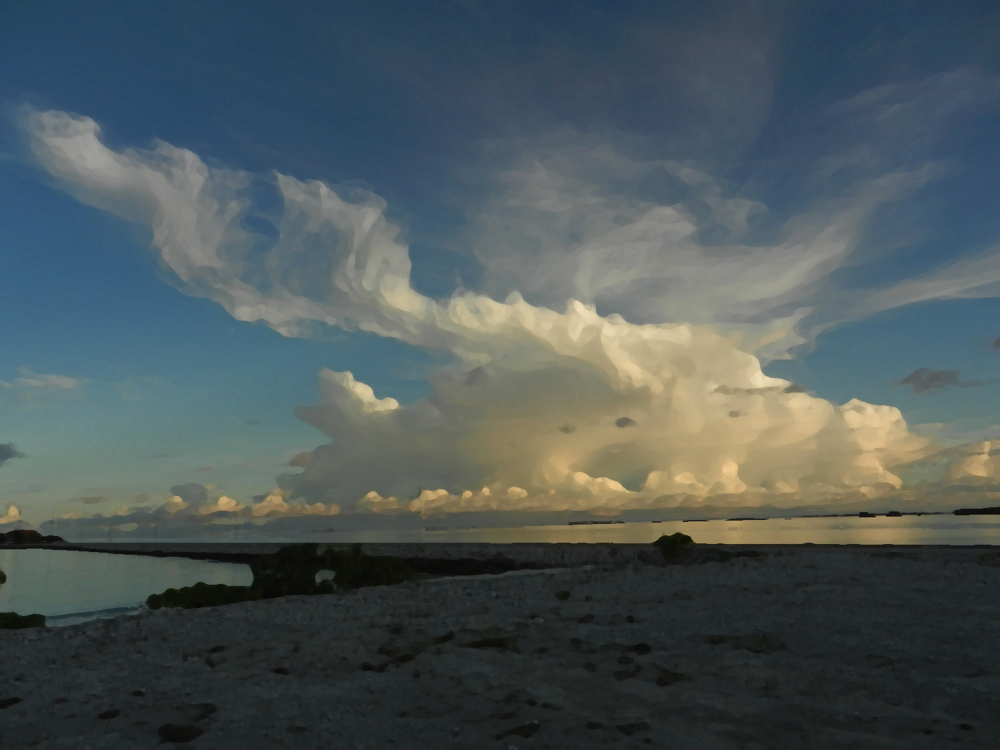
A Conceptual Model for the Hydrometeor Structure of Mesoscale Convective Systems during the MJO Active Stage
Hannah C. Barnes
Robert A. Houze, Jr.
University of Washington
Funded by NSF –Grant AGS 1059611 and DOE Grant DE-SC0008452

Slide 2
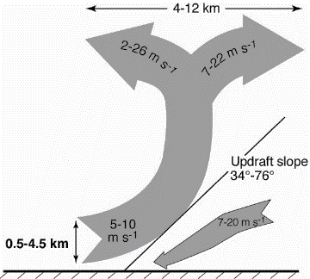
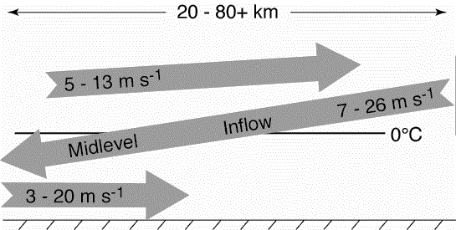
Kinematic Structure of
Mesoscale Convective Systems (MCSs)
Moncrieff (1992): Layer airflow
Kingsmill and Houze (1999a): 3D structure
Convective
Stratiform
Notes:
Brief introduction to MCS structure
Emphasize that TOGA COARE added to that picture by confirming that layered airflow structures described by Moncrieff (1992)
Convective regions characterized by steeply sloping convergent zones with a divergence signature aloft
Stratiform often characterized by mid-level inflow that starts below the anvil and slowly descends into the precipitating stratiform region. The mid-level inflow may or may not reach the surface.
DYNAMO is opportunity to add another layer of knowledge of the structure of MCS through microphysics

Slide 3
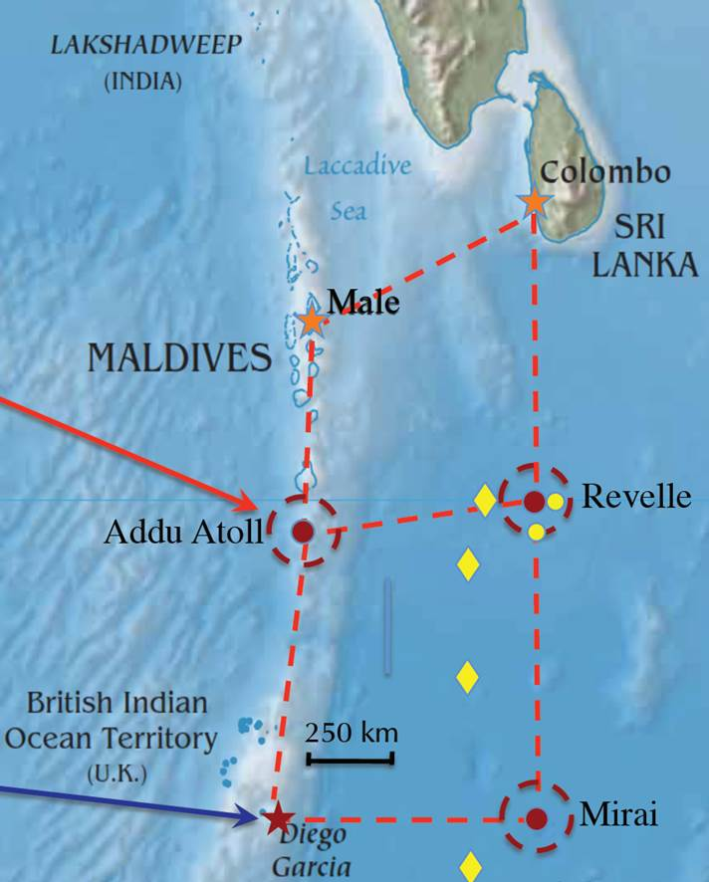
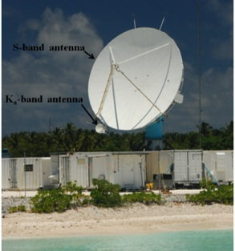
NCAR SPolKa Radar
DYNAMO/AMIE
  (Oct 2011 – Jan 2012)
Addu Atoll, Maldives
S-Band
  Single Doppler
  RHI sector and within 100 km
Dual-polarimetric
  Particle Identification Algorithm (Vivekanandan et al., 1999a)
Notes:
Briefly introduce SPolKa
Doppler capabilities allow us to identify the kinematic structures of Kingsmill and Houze (similar to TOGA COARE)
Dual-polarimetric capabilities new for DYNAMO and allow to identify different types of hydrometeors.
PID algorithm developed by Vivekanadan et al. 1999 was APPLIED to the SPolKa data
In two regions the SPolKa radar did a series of high resolution RHI scans, which enabled us to obtain a detailed vertical picture of the hydrometeor structure within MCSs

Slide 4
Hydrometeor Types
Heavy Rain
Moderate Rain
Light Rain
Graupel/Rimed Aggregates
Wet Aggregates
Dry Aggregates
Small Ice Crystals
Horizontally-Oriented Ice
Rain
Mixed Phase
Frozen

Slide 5
Spatial Compositing

Slide 6
Spatial Compositing: Case Selection
Convective: 24 Oct 2011
dBZ
V_{r} profile
SPolKa data during active phases
Subjectively identify cases
  SPolKa radial velocity
  Layer lifting
  One per storm
25 Convective Cases
37 Stratiform Cases
Stratiform: 23 December 2011
dBZ
V_{r} profile
Notes:
Explain that focusing on the 11 top rain events during DYNAMO, which all occurred during the active phase.
Rain events selected on the 24 hr running mean time series. Consider 24 hours before and after the 11 maxima identified in that timeseries
Explain composite method
Explain basic process of selecting cases (the bottom figure highlights the region where I look for these features)
Subjective
Create map of hydrometeors in each case by hand
Enables to reduce noise and artifacts
Composite.
Done by scaling so that all cases have the same slope, height, and range.
The slope, height, and range used for compositing are the average values of all the events
____________EXTRA INFORMATION ____________
Number of events in each composite
Convective – 27
Mid-Level Inflow – 38
Trailing Stratiform – 7
Non-Trailing Stratiform – 29

Slide 7
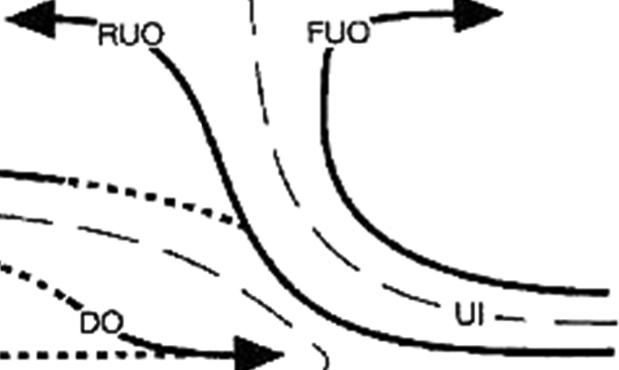
Spatial Compositing: Methodology
1.) Map kinematics and hydrometeors using radial velocity and PID
2.) Composite around layer lifting model
Radar Data
Composite Structure
X Scale Factor
Z Scale Factor

Slide 8
Spatial Compositing: Results
Wet Aggregates
Height
Range
Notes:
WET AGGREGATES ONLY FIRST
Red line is the convergent updraft.
Colors shows how often that type of hydrometeor is located at a given location. The scales in each figure or different in order to show their distribution most clearly.
Top row shows the rain categories, the middle row shows the categories with graupel (there was no hail), and the bottom line shows the snow and ice categories.
Structure is systematic
Few features to emphasize
Heavy rain just downwind of updraft
Moderate rain within updraft core
Graupel just downwind updraft in a narrow vertical column
Dry aggregates extend from the melting level to the base of the divergence signature
Non-oriented ice surround dry aggregates

Slide 9
Convective Updraft Composites
Graupel
Rimed Aggregates
Heavy Rain
Moderate Rain
Light Rain
Wet Aggregates
Dry Aggregates
Small Ice Crystals
Horz. Oriented Ice
Notes:
Red line is the convergent updraft.
Colors shows how often that type of hydrometeor is located at a given location. The scales in each figure or different in order to show their distribution most clearly.
Top row shows the rain categories, the middle row shows the categories with graupel (there was no hail), and the bottom line shows the snow and ice categories.
Structure is systematic
Few features to emphasize
Heavy rain just downwind of updraft
Moderate rain within updraft core
Graupel just downwind updraft in a narrow vertical column
Dry aggregates extend from the melting level to the base of the divergence signature
Non-oriented ice surround dry aggregates

Slide 10
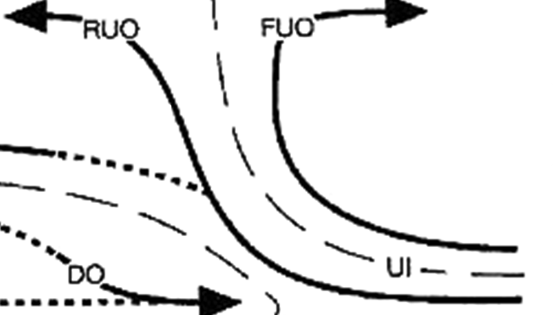
Hydrometeor Organization in Convective Updrafts
Small Ice Crystals
Dry Aggregates
Graupel/Rimed Aggregates
Light Rain
Heavy Rain
Z
Wet Aggregates
Moderate Rain
X
Notes:
Based on those results we have developed this conceptual diagram for the hydrometeor structure of convective updrafts.

Slide 11
Stratiform

Slide 12
Stratiform Composites
Graupel
Rimed Aggregates
Heavy Rain
Moderate Rain
Light Rain
Wet Aggregates
Dry Aggregates
Small Ice Crystals
Horz. Oriented Ice
Notes:
- More cases in this composite so images not as fragmented but the overall hydrometeor structure is the virtually the same.

Slide 13
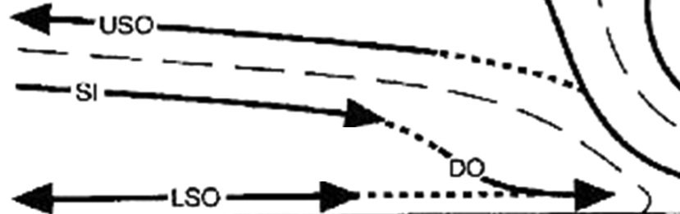
Hydrometeor Organization in Stratiform
Horizontally Oriented Ice
Small Ice Crystals
Dry Aggregates
0˚C
Light Rain
Heavy Rain
Graupel / Rimed Aggregates
Z
Moderate Rain
Wet Aggregates
X
Notes:
Using these results we have created this conceptual diagram of the hydrometeor structure for regions characterized by a mid-level inflow.
Key features
Heavy rain from events when mid-level inflow reached surface, otherwise very rare
Rain intensity decrease with distance from center of storm
Snow and ice crystals are layered
Wet aggregate layer becomes fragmented as move towards anvil

Slide 14
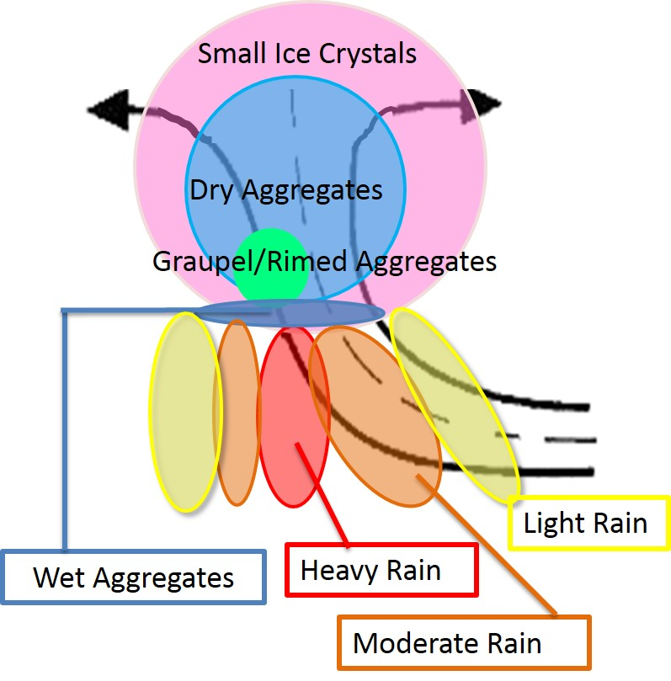
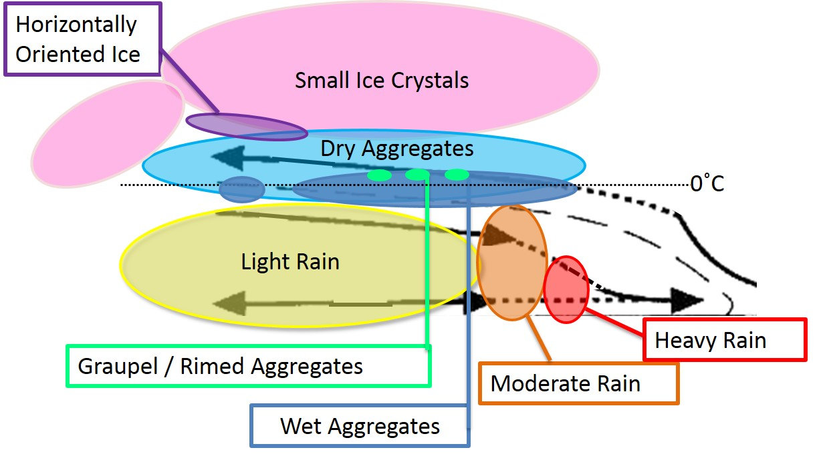
Conclusions
Convective
Stratiform
Hydrometeor organization systematic
Interpretation of microphysical processes
  Comparison of model output and radar observations
Notes:
The two previous conceptual diagrams are combined and summarized
Differences between convective updrafts and mid-level inflow
Graupel: narrow and vertical in convective updraft, but shallow and flat in mid-level inflow
More dry aggregates than non-oriented ice in convective updrafts but more non-oriented ice than dry aggregates in mid-level inflows
Two reasons why results are exciting
These hydrometeor structures are very robust. For example saw very little difference between leading line and embedded convection.
Suggests the structure of MCSs are not different because of differences in their hydrometeor structure
Emphasizes a need to further explore why MCSs take on different structures.
Can use to more directly compare model output with radar observations

Slide 15

The End

