Slide 1

Predictability and dynamics of tropical cyclones
under vertical wind shear
Dandan Tao and Fuqing Zhang
Group Meeting, Aug 14, 2014

Slide 2
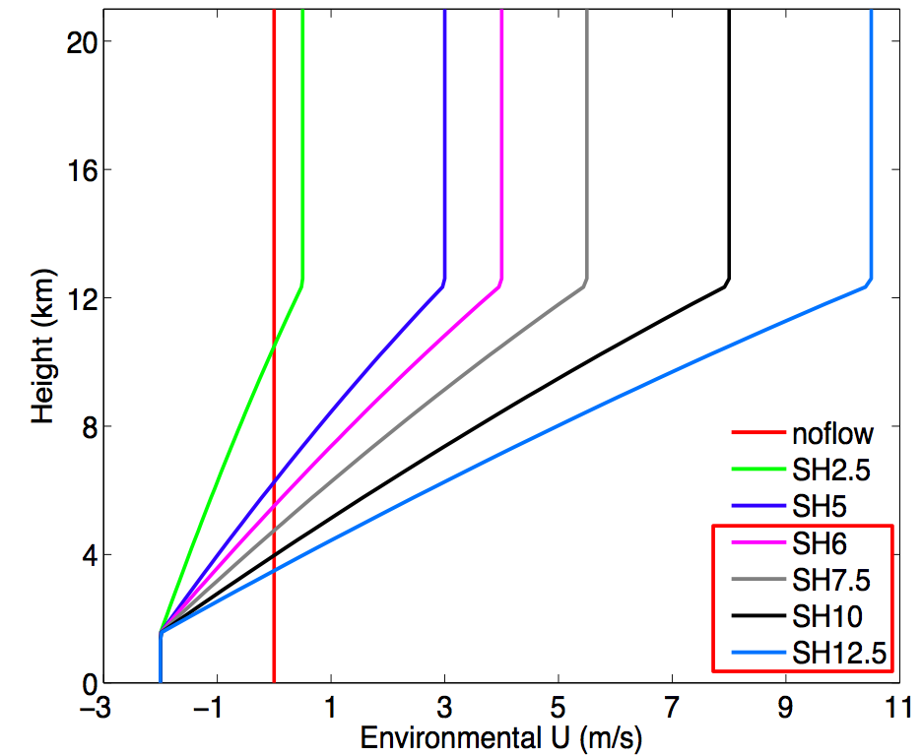
Experimental Design (follow-up of Zhang and Tao (2013))
WRF version 3.1
18km, 6km, 2km
240*240, 240*240, 360*360
41 vertical levels
Physics: YSU, WSM6
No radiation scheme
Rankine Vortex
Vmax = 15 m/s
Rmax = 135 km
20 members in each set
Random moisture perturbation: ± 0.5 g/kg under 950hPa
NEW: 1. Predictability under larger-amplitude shear (6, 7.5, 10 and 12.5 m/s)
2. Predictability under warmer sea-surface temperature (SST=29°C)
3. Predictability under drier environment

Slide 3
Impact of Vertical Wind Shear on TC Predictability: a schematic diagram
Upscale error growth from differences in moist convection first alters the amplitude of the tilt of the incipient storm, which leads to significant differences in the timing of precession
Precession
Precession
shear
shear
Projection of strong convection induced midlevel positive vorticity at surface
Projection of midlevel vortex related positive vorticity at surface
Tilt Vector
Notes:
Figure 19. A diagram of how convection influence the tilt of the TC vortex. Given a tilted vortex, (a) if the convection is closer to the surface center, the tilt will become smaller; (b) if the convection is far from the surface center, the tilt will become larger.

Slide 4
Tropical Cyclone Predictability
Max Surface Wind of Ensembles under SST=27°C
Larger shear -> larger spread of rapid intensification onset
Too large shear -> no development of the storm
Notes:
Time evolution of maximum 10-m wind

Slide 5
Predictability under different SST: 27 vs. 29°C
SST = 27°C
SST = 29°C
Higher SST:
Larger magnitude of critical shear
Smaller spread for RI onset time

Slide 6
Sensitivity under different Environmental Moisture
Original
Reduced Moisture
Reduced Moisture
Larger spread for RI onset time under medium shear condition
Kill the TC vortex under large shear condition
Reduced Moisture:
100%
200km
300km
linear decrease
50%

Slide 7
Tropical Cyclone Predictability Under 5m/s Shear
10m maxWSP from ensemble with minute initial perturbations
_{Early}
_{Late}
_{Medium}
(Zhang and Tao 2013, JAS)
Notes:
We can see that the small initial moisture perturbation under the sheared environment actually alters the onset of tropical cyclone rapid intensification stage.

Slide 8
Tilt Vector Evolution for selected Members
Tilt = X450hPa – X850hPa
X is the circulation center location
Tilt Magnitude
Shear
Tilt Angle
X : Simulation days
Correlation of Tilt Vector & RI onset time
: 6 h interval
Larger tilt magnitude
--> longer onset time
Larger tilt angle,
faster precession
--> earlier onset
First RI onset time

Slide 9
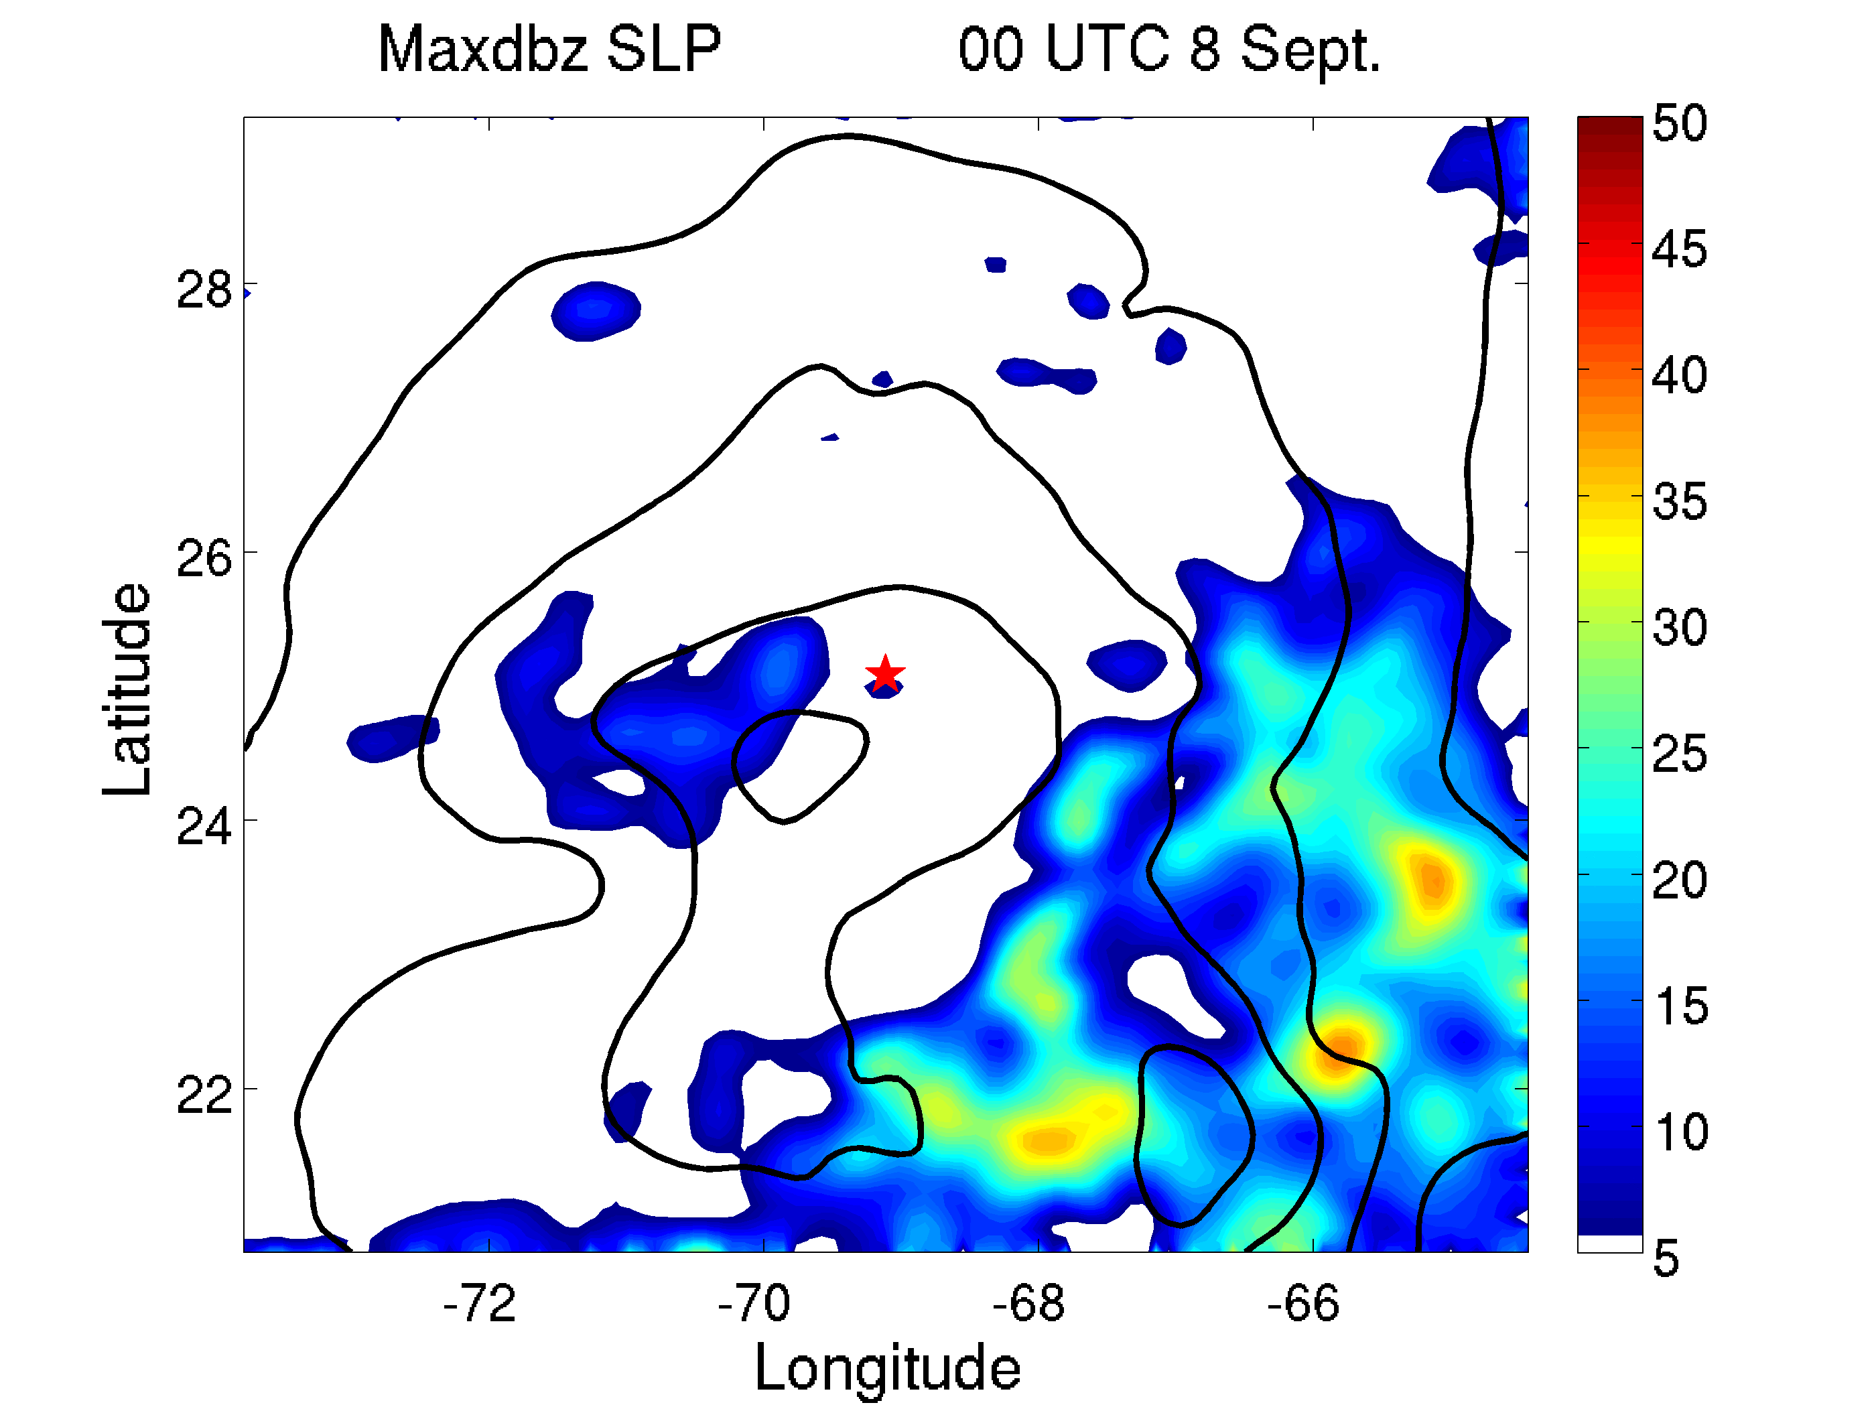
Ongoing Work: Tropical Storm Gabrielle (2013)

Slide 10
Best Track, EnKF Analysis 950hPa center track, APSU forecast 950hPa center track

Slide 11
Best Track, EnKF Analysis, APSU forecast intensity

Slide 12
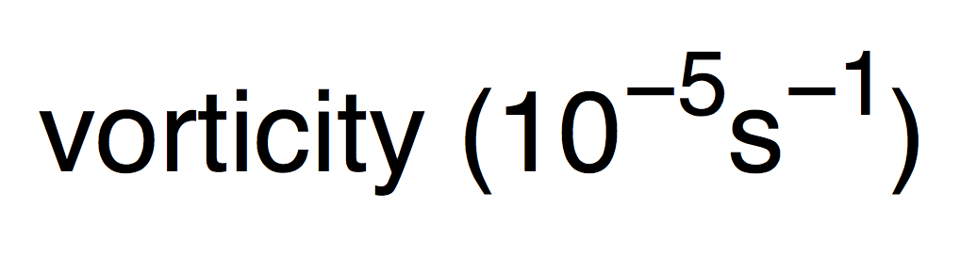

Time Evolution of Tilt, Shear, Vorticity and RH
Tilt and Shear between 950hPa and 500hPa
Clear decrease of tilt from 00UTC 8 Sept.
Low level vortex develops ahead of midlevel.
RH change is consistent with the other changes
Relative vorticity of 950hPa and 500hPa
Column Mean RH between 950hPa and 500hPa

Slide 13
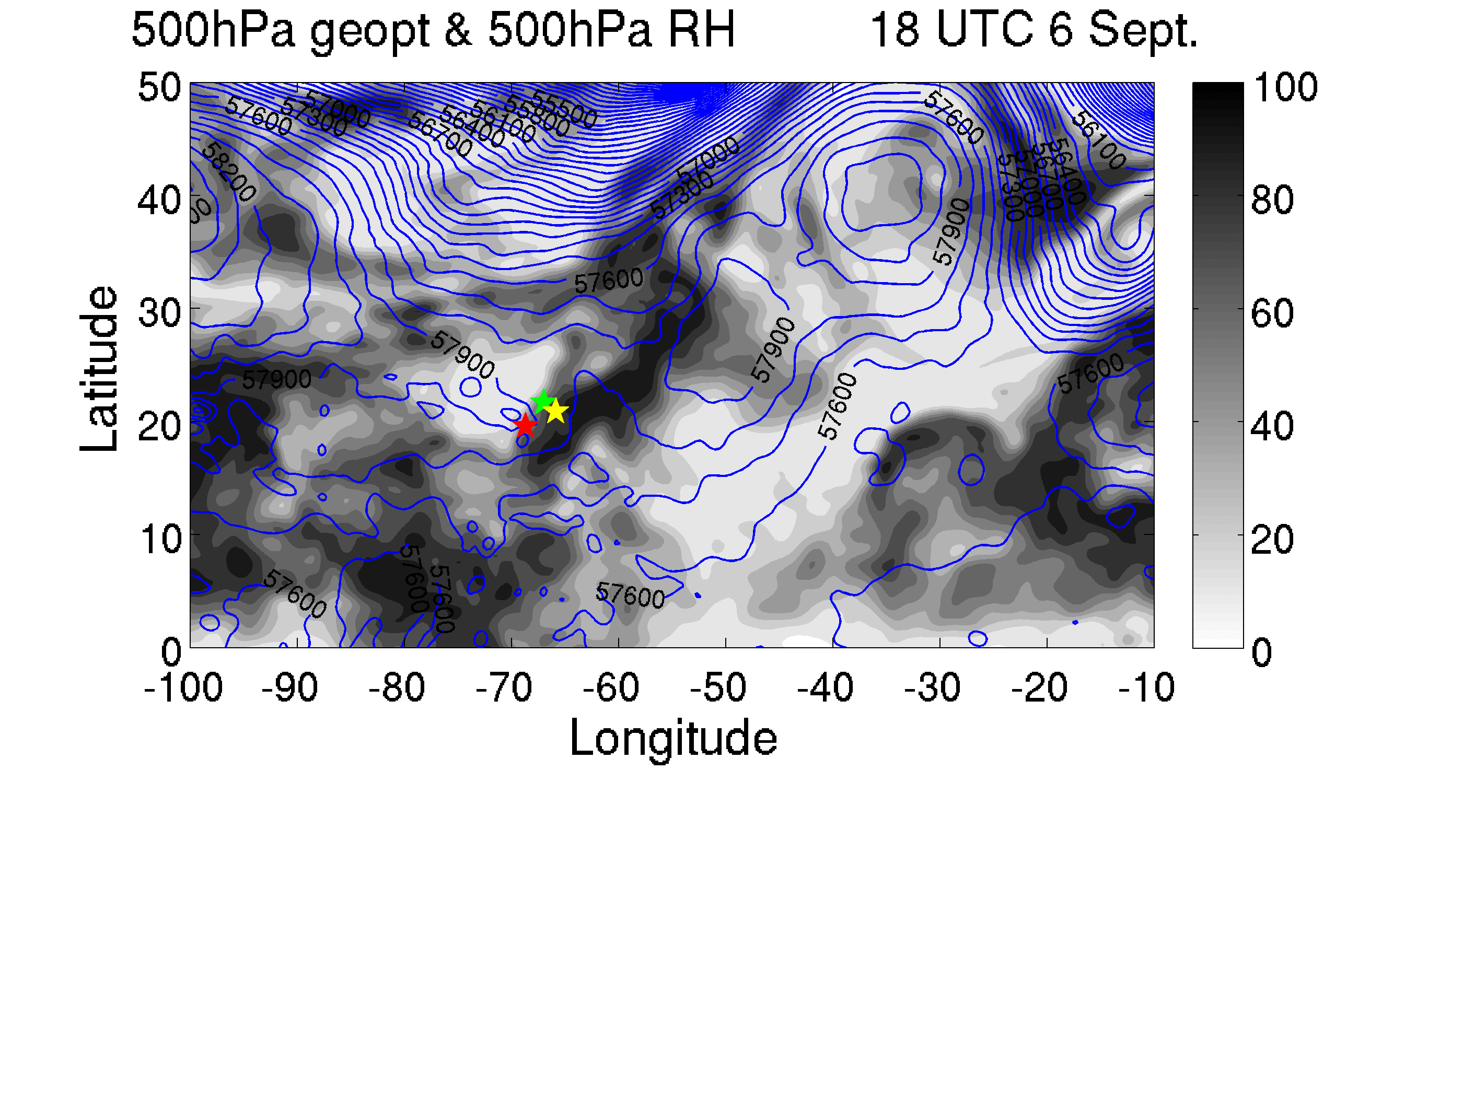
-950hPa center -700hPa center -500hPa center
Dry air on its left side.
Alignment of the vortex.

Slide 14
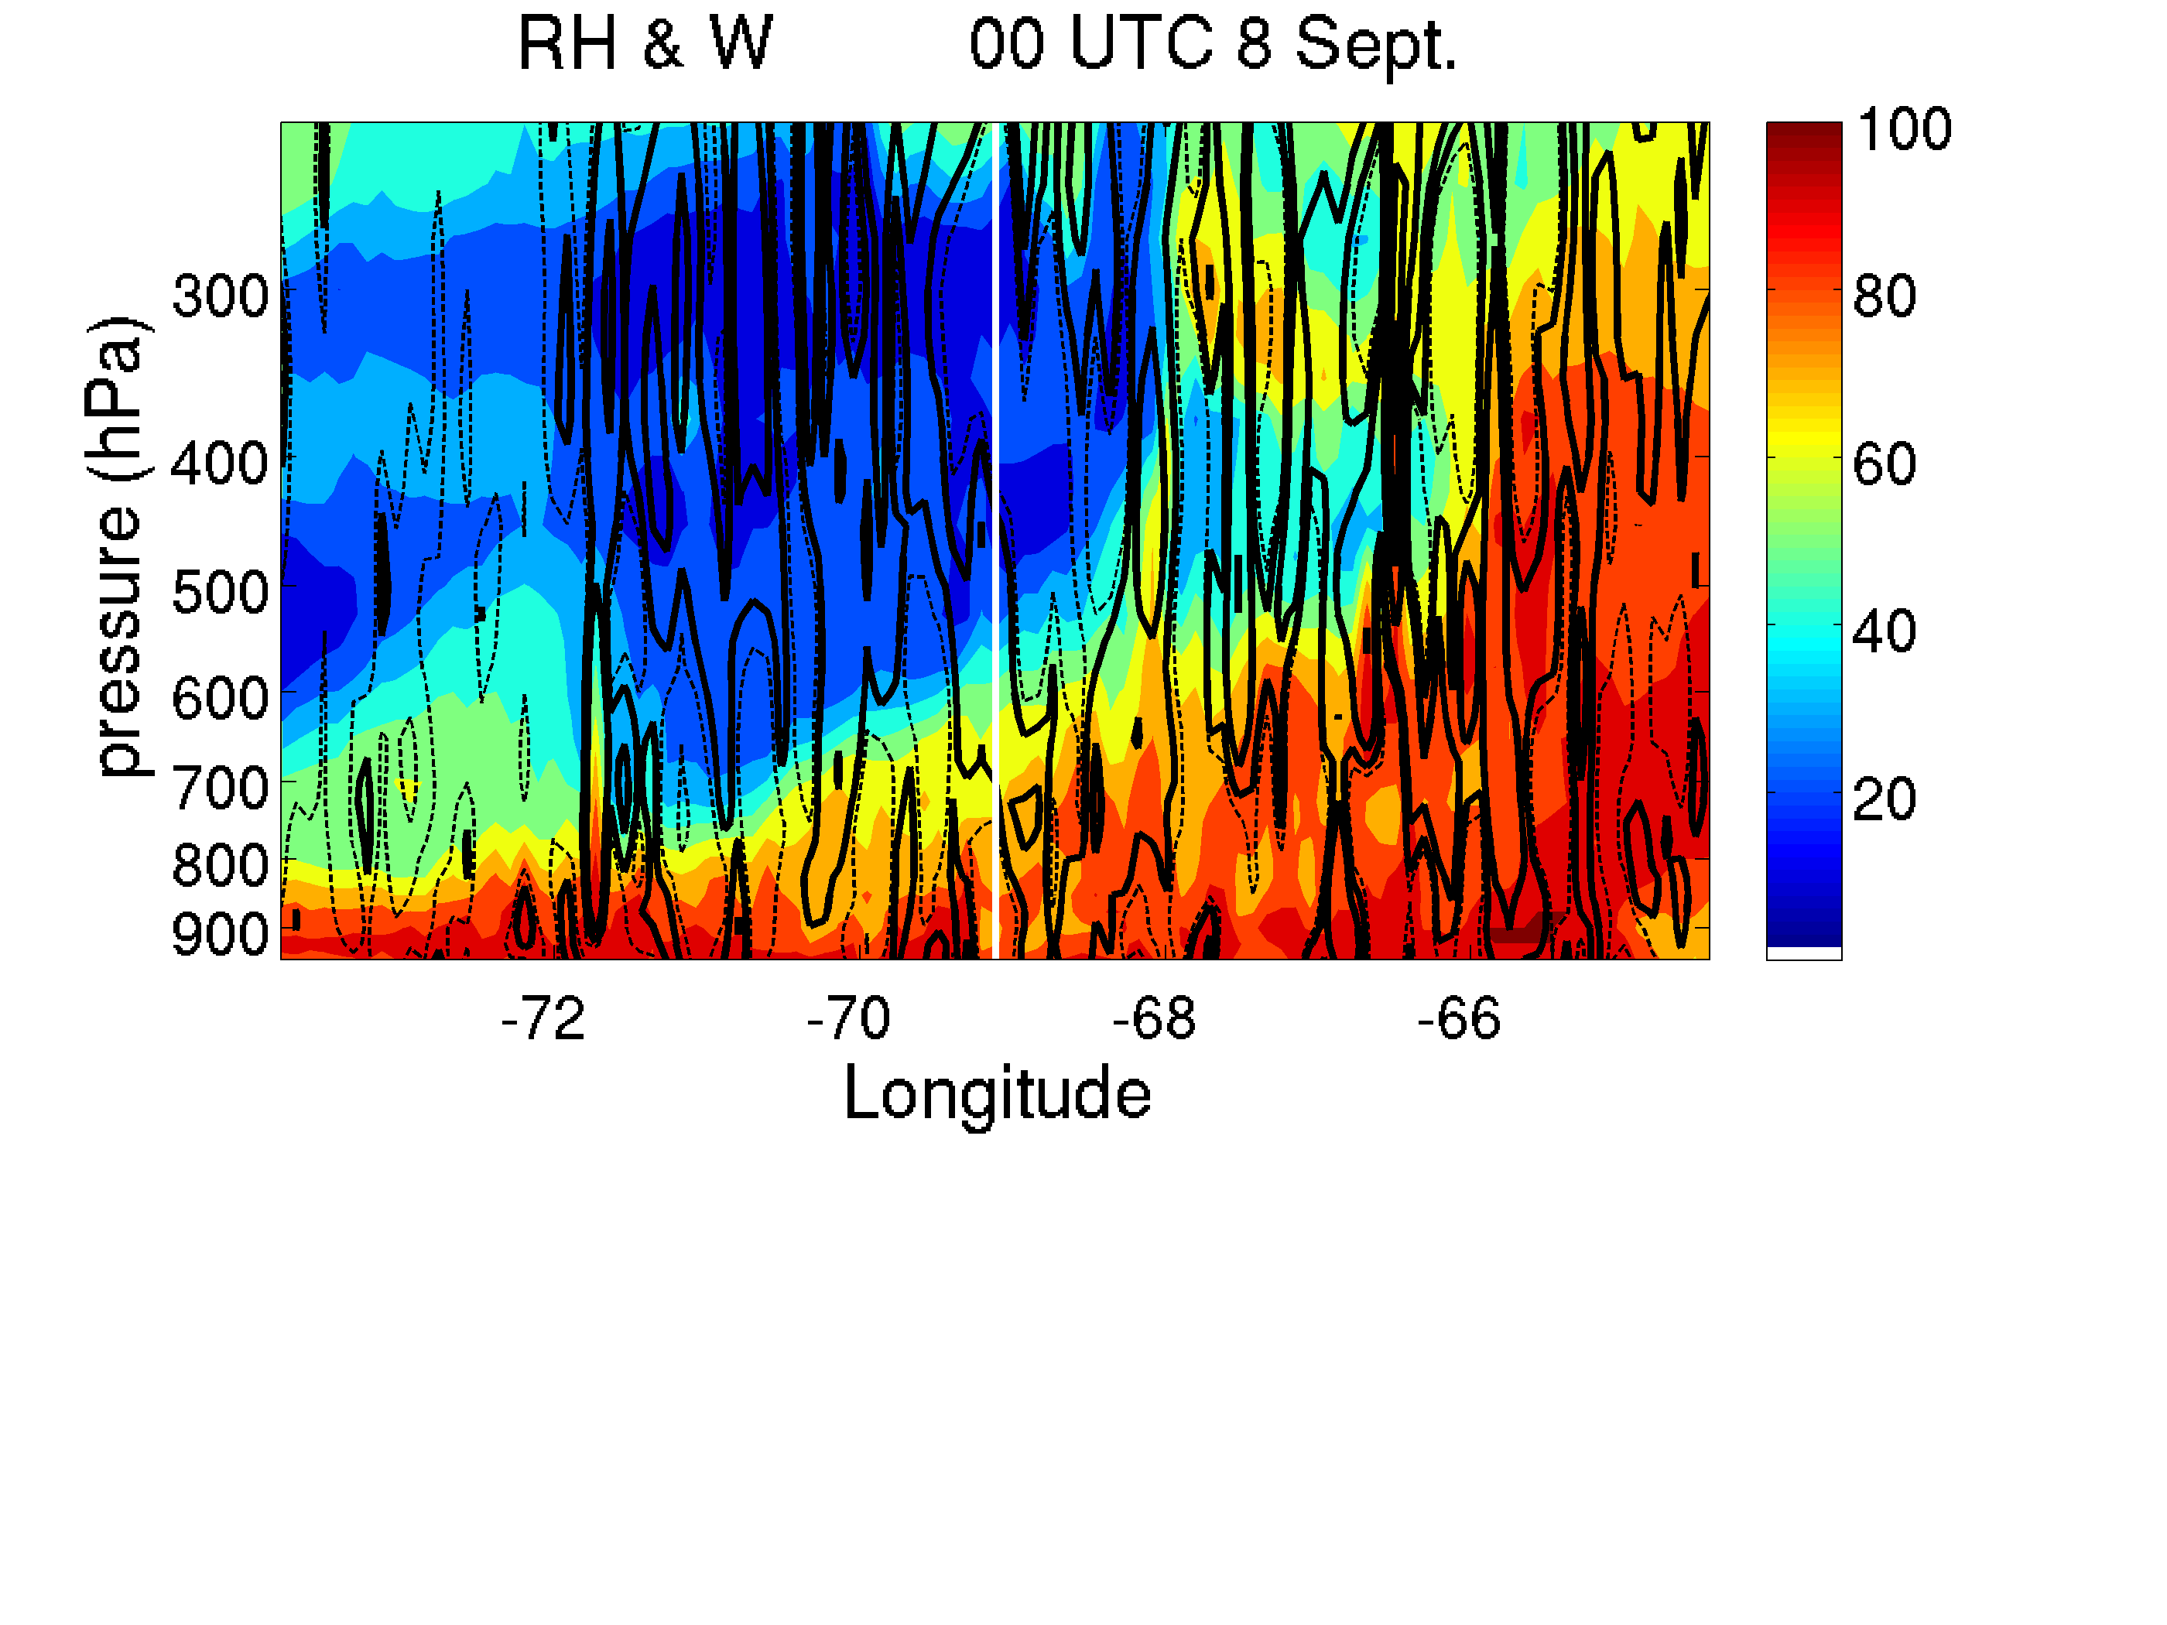
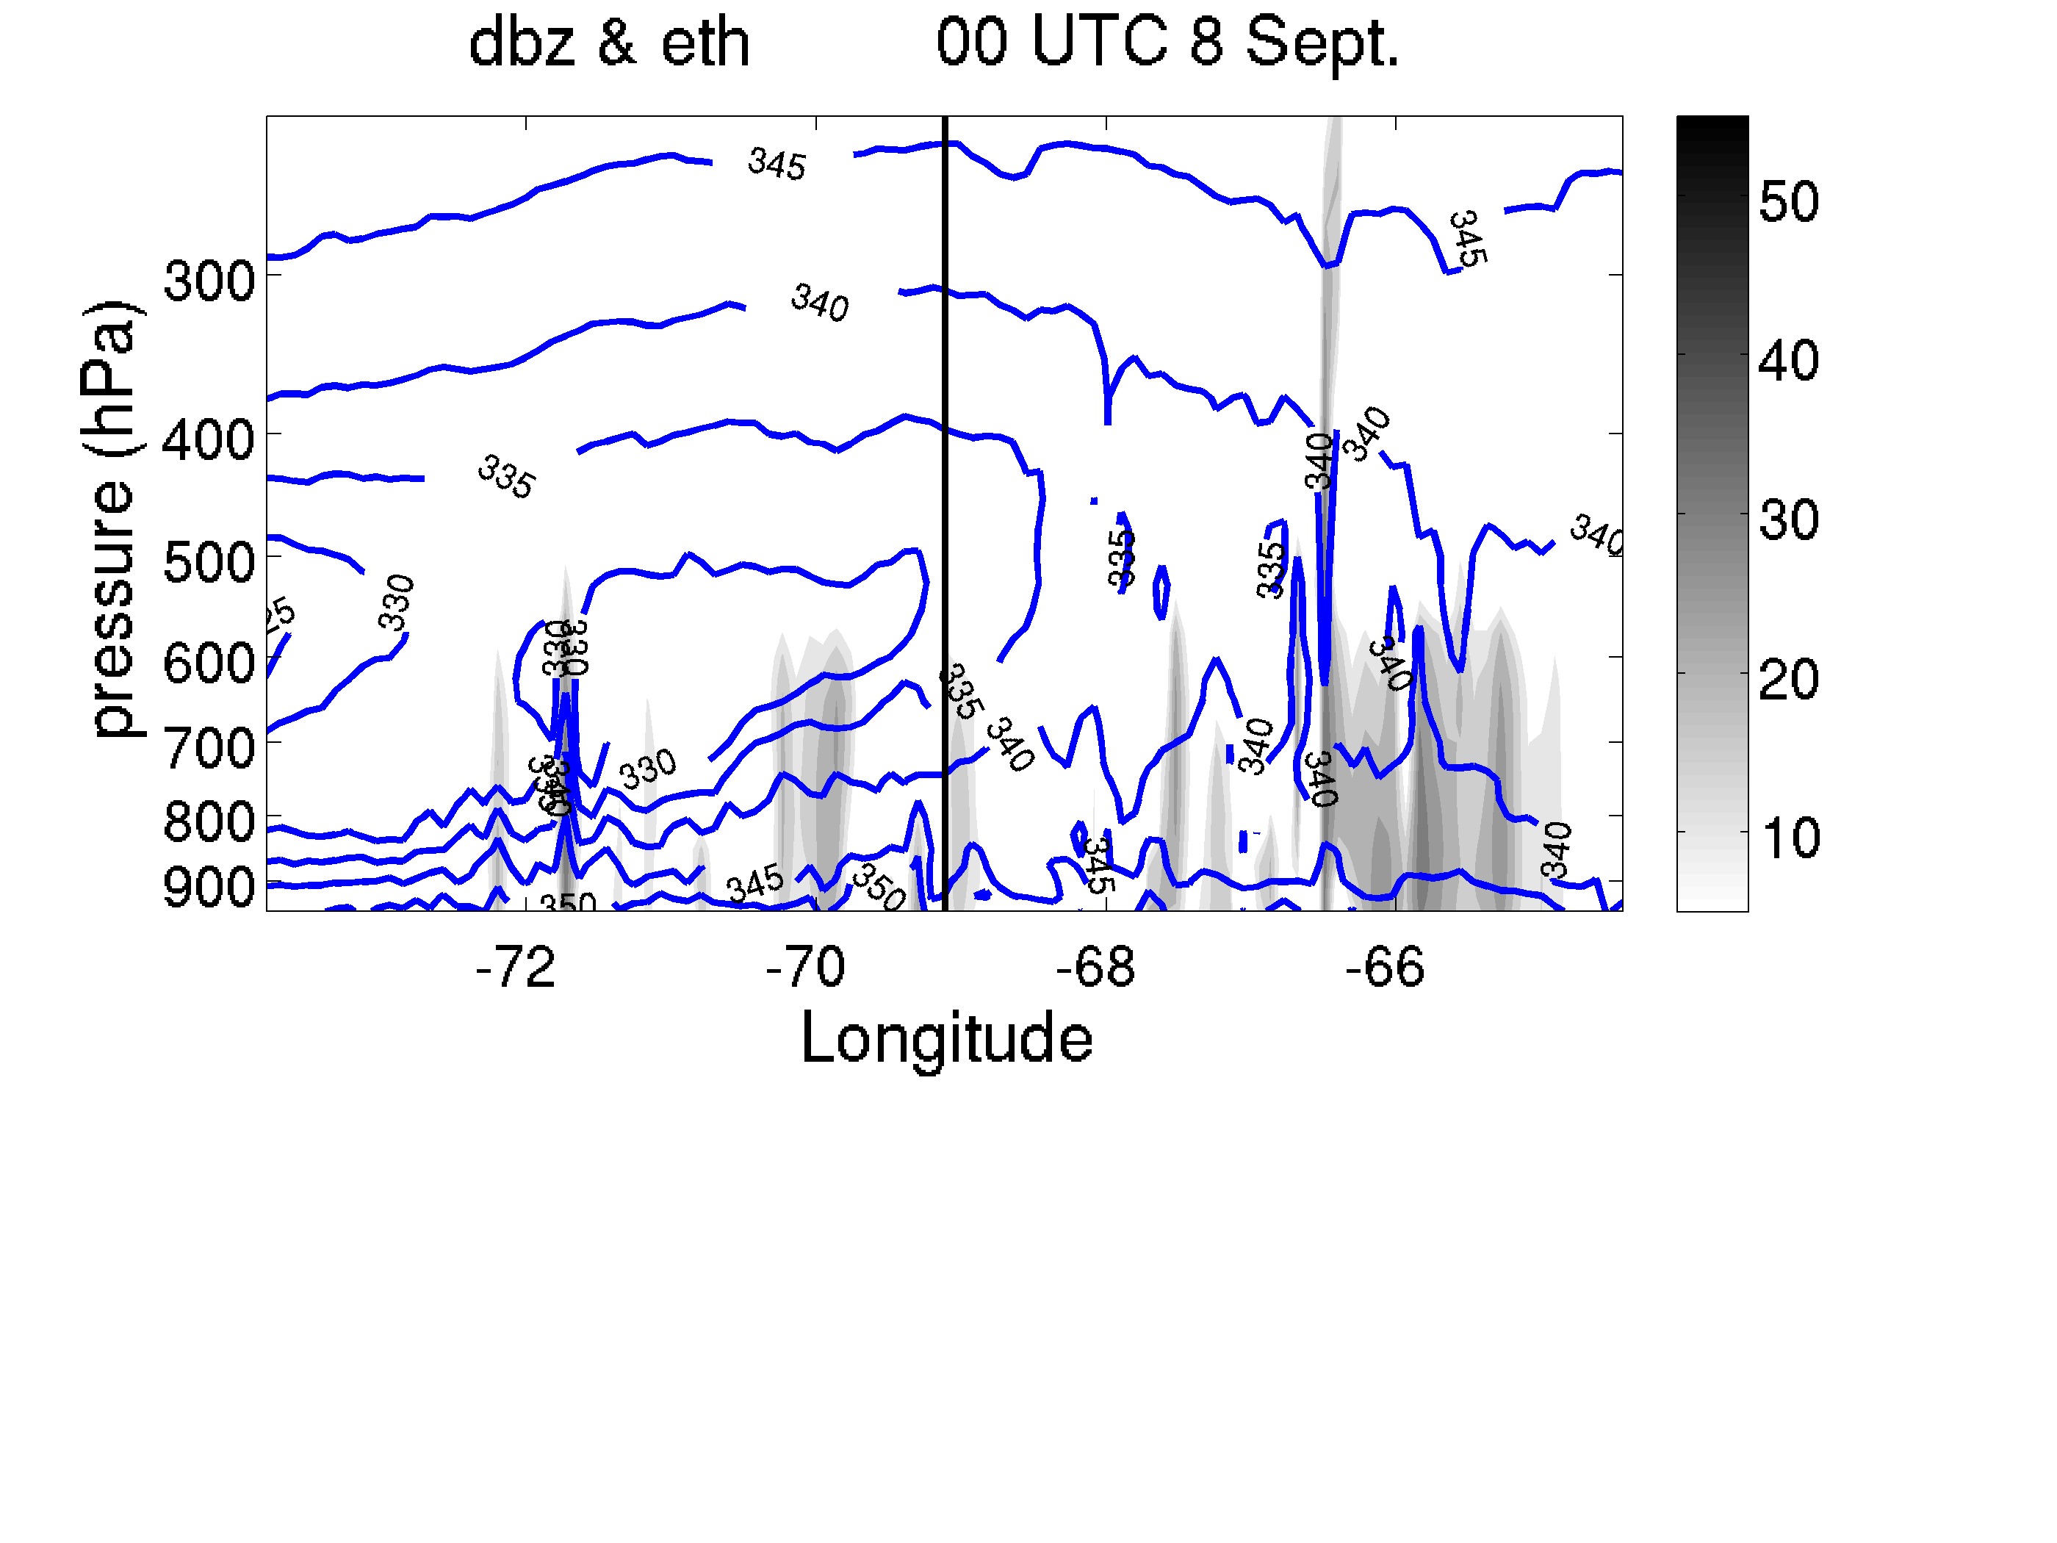
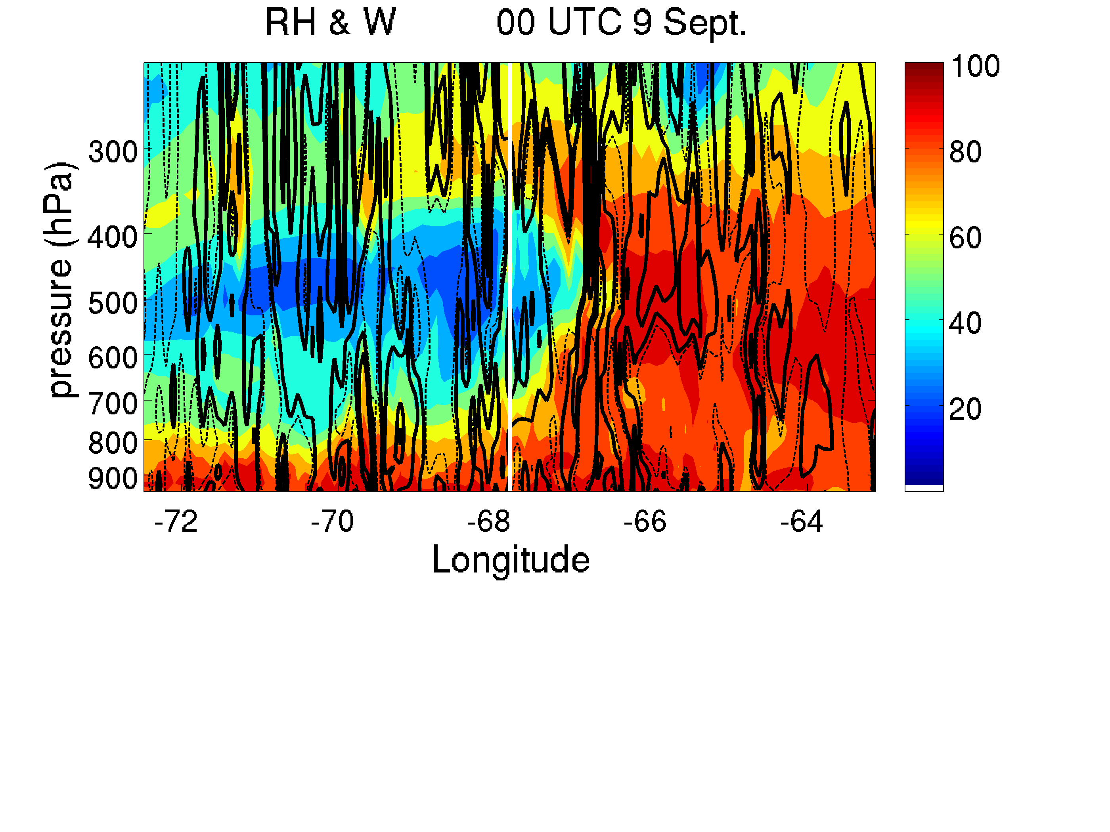
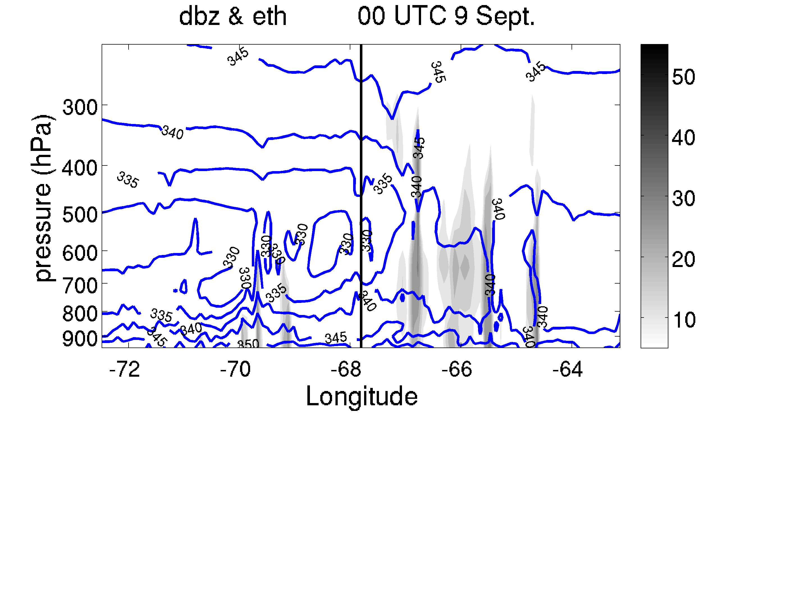
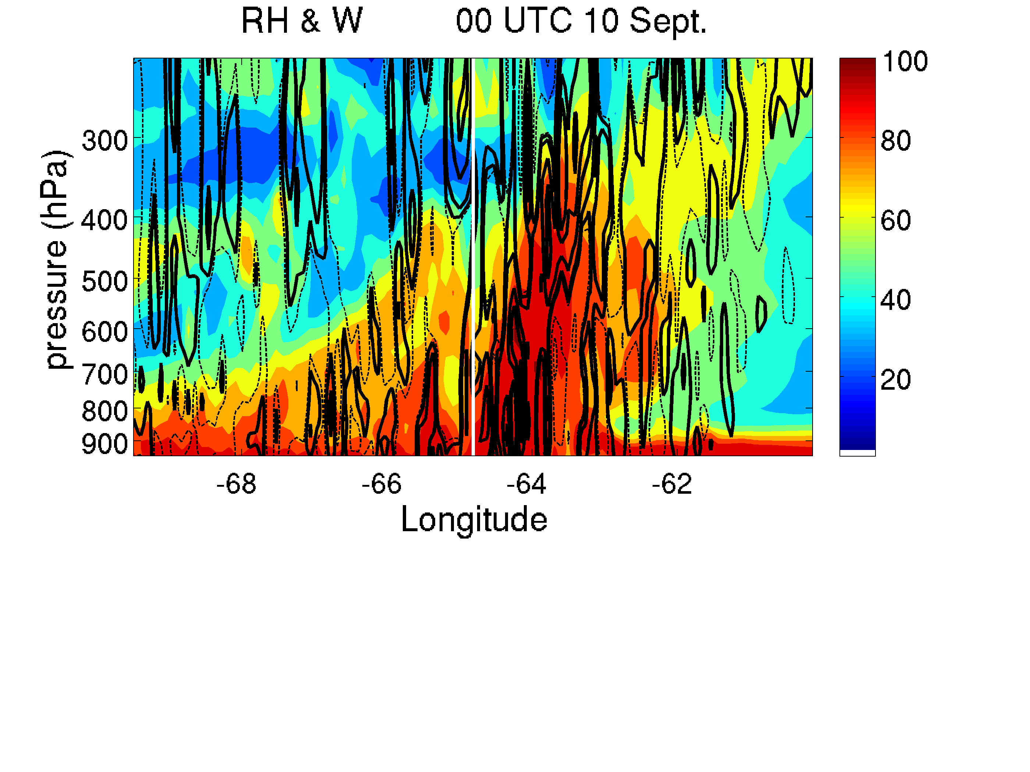
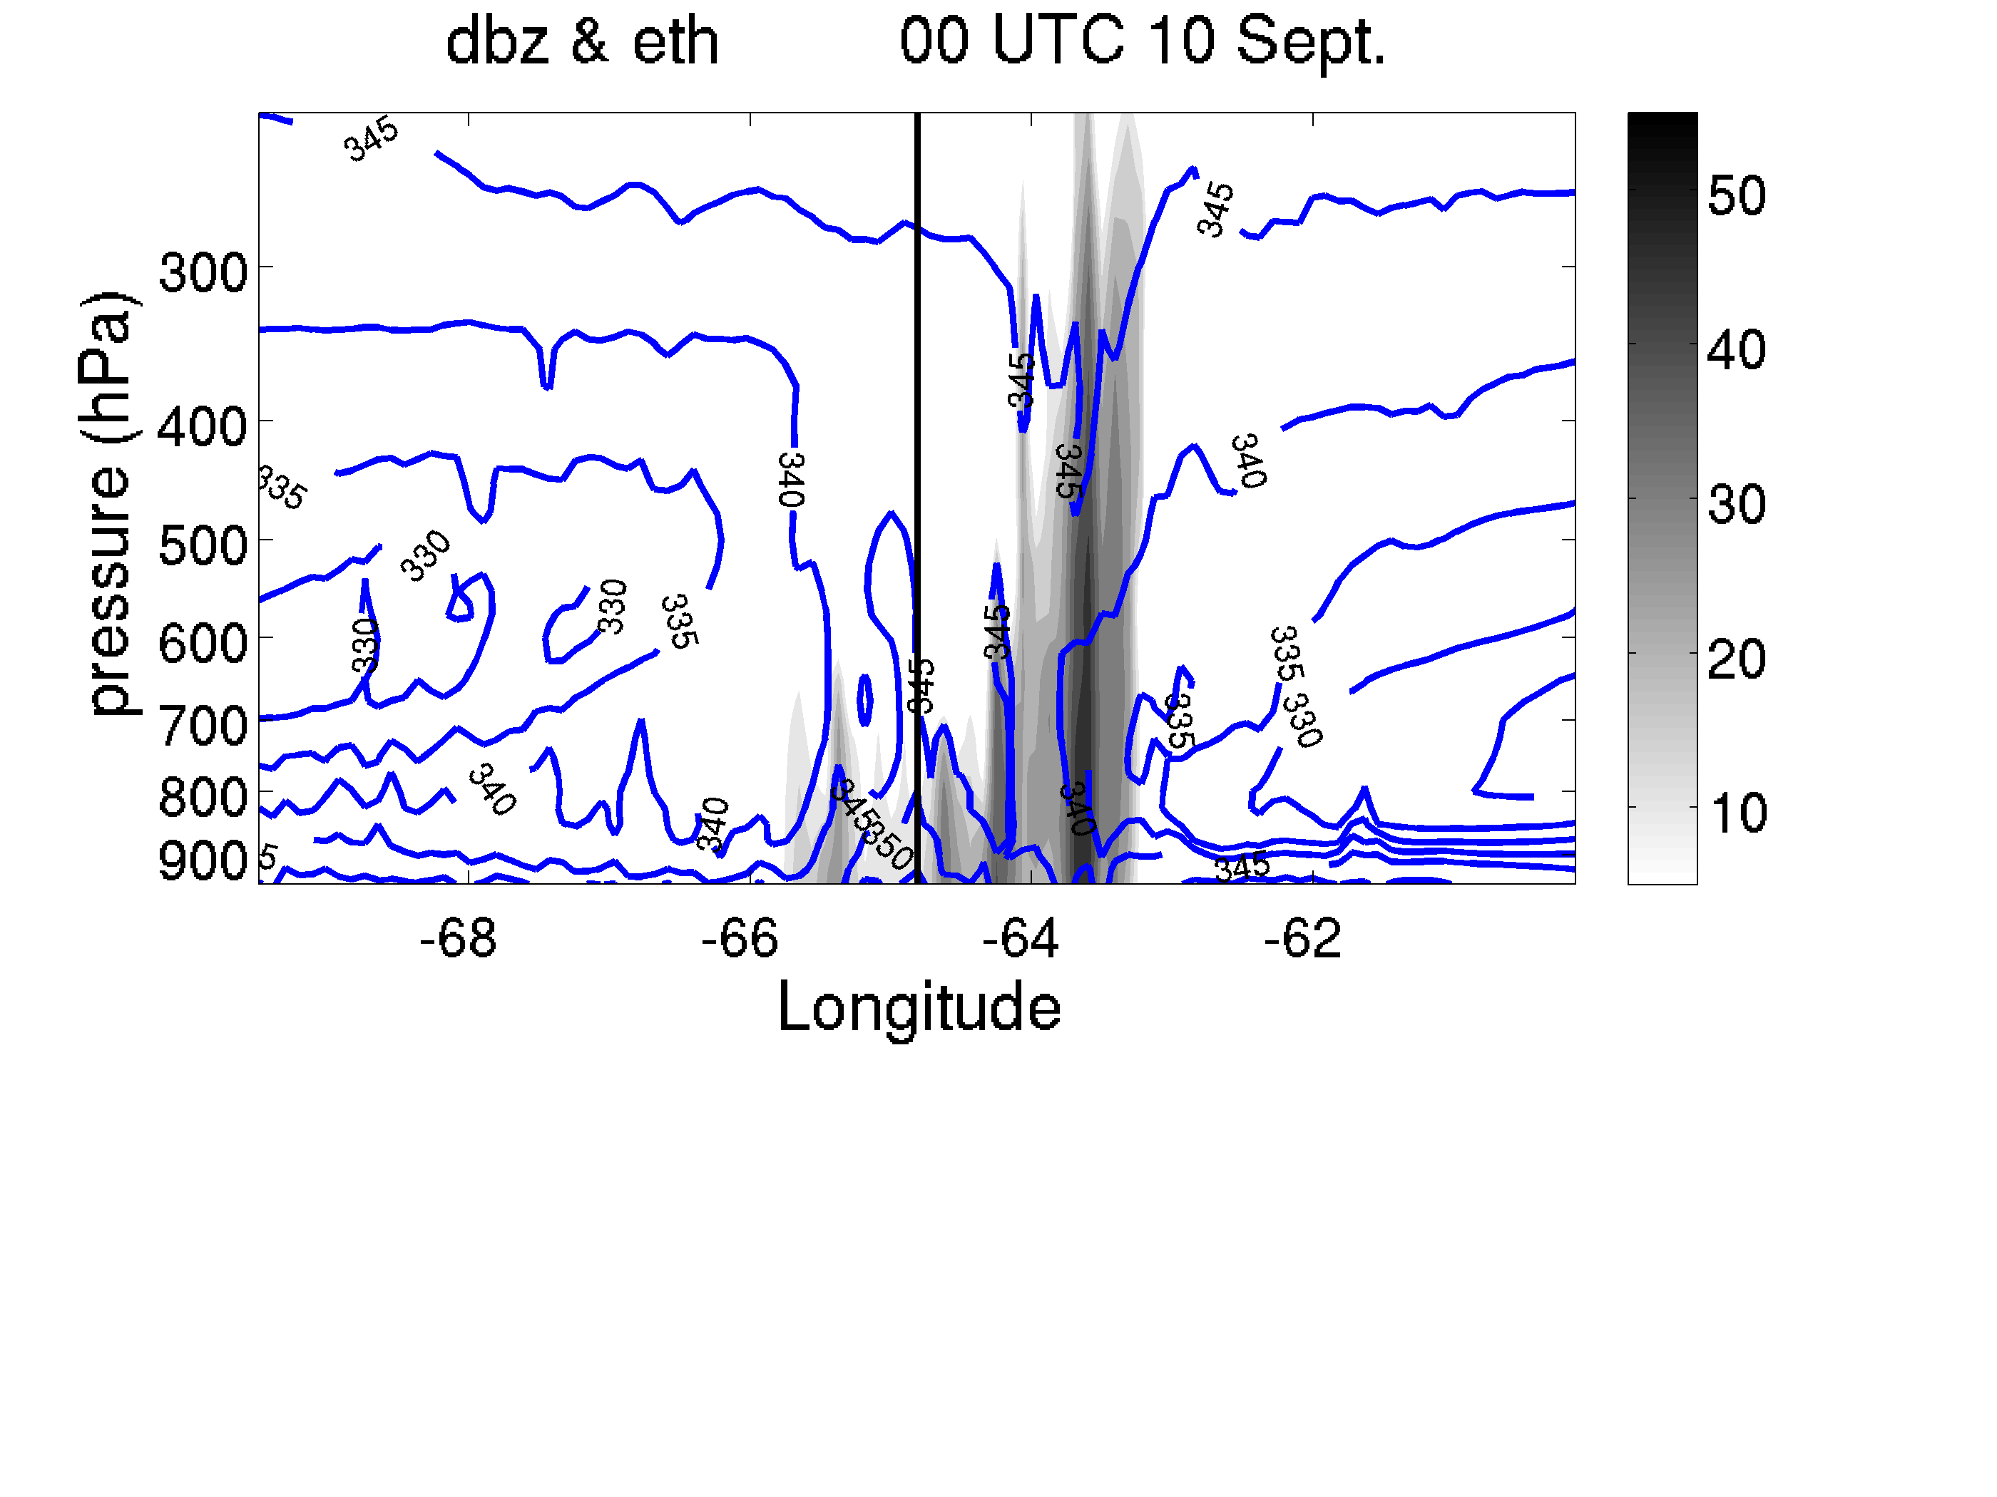
West-East cross section across the 950hPa storm center
RH and Vertical Motion
Θe and dbz
00UTC 8 Sept.
00UTC 9 Sept.
00UTC 10 Sept.

Slide 15
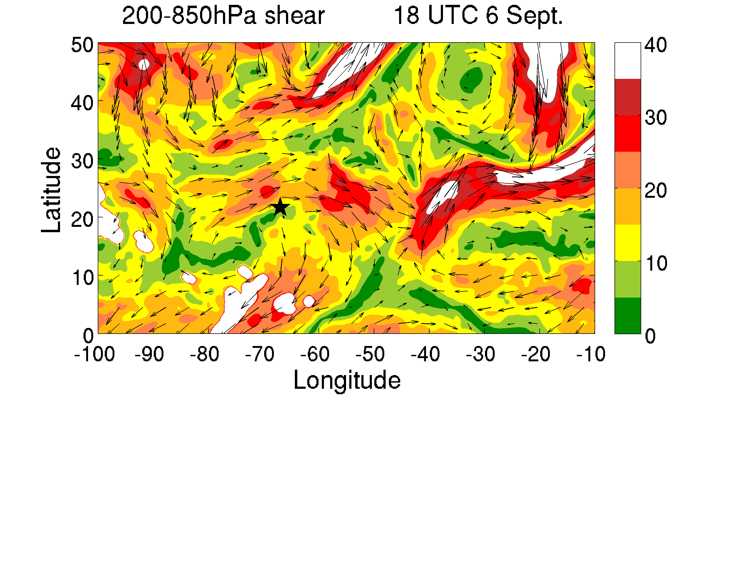
The TC moves into the area with smaller shear magnitudes.

Slide 16
Concluding Remarks:
Gabrielle is embedded in an area with dry surroundings.
The change of intensity is closely related to the change in dry air and environmental shear.
Future Work:
Rerun the ensemble simulations and study the predictability of Gabrielle.

