Slide 1
Observation-Based Ensemble Sub-setting Technique for Tropical Cyclone Track Prediction
OBEST
Lin Dong
Group Meeting 14/8, 2014

Slide 2
Outline
Background
Data and Methods
Method Improvement and Experimental Results
Summary and Future Work

Slide 3
Background
Fig 1
 | 2011 | 2013 | IMPRO
24h | 120 | 85 | 29%
48h | 195 | 134 | 31%
72h | 289 | 201 | 30%
96h | 406 | 309 | 24%
120h | 513 | 530
 | TC numbers | 24h | 48h | 72h | 96h | 120h
sample | 234 | 3832 | 3013 | 2277 | 819 | 384

Slide 4
Motivation
Background
Before 2010
When forecasters made track forecast before 2010, they used deterministic models (both global and regional) from multiple centers, and then applied either a simple arithmetic average or a weighted average to the forecast results of all selected models, the calculation result would be used as the final official forecast.
From 2010 to 2011
Firstly, from the prospect of annual track forecast verification, ensemble mean gives a slightly better results than deterministic results, but the spread is unreasonably large in cases of certain typhoons.
Secondly, for a special initial time model, some members gives small forecast errors, whereas other members yields poor forecast tracks that deviate far away from the real tracks.

Slide 5
Motivation
Background
We call the former good members and the latter bad members.
Now a natural question arises: Can we differentiate good members from bad members, and give more weights to good ones so as to improve forecast results? This idea is the preliminary motivation behind the OBEST developed in CMA. However for different initial time forecasts, good members are not fixed, and it is impossible to tell whether a member is good or not only based on the forecaster's subjective judgment. Therefore an objective method is required for this task.

Slide 6
Data and Methods
Dataset
1. TIGGE : ECMWF_EPS 120h track forecast
http://tigge-portal.ecmwf.int/d/tigge/levtype=sfc/type=cf/
JMA –BEST TRACK
http://www.jma.go.jp/jma/jma-eng/jma-center/rsmc-hp-pub-eg/trackarchives.html

Slide 7
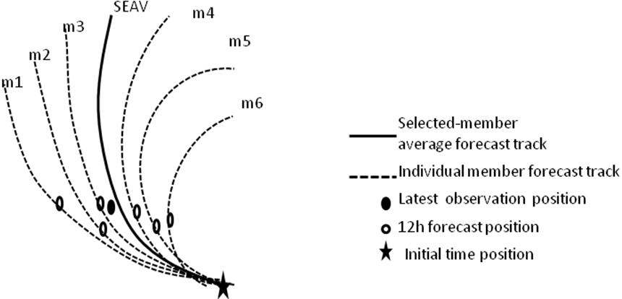
Methodology-1
Data and Methods
Fig2 a
Fig2 b

Slide 8
Number of selected members
Methodology-2
Data and Methods
Fig 3
2010-2011 EC-EPS Normalized errors
number of selected
members

Slide 9
Methodology-3
Data and Methods
The outline of OBEST :
Calculate 12h track forecast errors(SLT errors) against observations for all 51 members.
2. Sort the 51 SLT errors in ascending order.
3. Select the first 20 members in sorted order as the good members.
4. Perform a weighted average of forecast position of good members to obtain a mean track(SEAV TRACK).
5. Remove the model initial time position and translate the 12h forecast position to the latest observation. This is the OBEST track.
The inherent premise of this technique is that members with good short-term forecast also give good performance in long-term forecast.

Slide 10
2010-2011 EC Track Errors
Methodology-4
Data and Methods
Fig 4
sample | 257 | 265 | 241 | 216 | 192 | 169 | 150 | 131 | 112 | 94 | 77
homogeneous

Slide 11
2012-2013 EC Track Errors
Methodology-5
Data and Methods
Fig 5
sample | 497 | 449 | 397 | 347 | 298 | 251 | 207 | 171 | 138 | 110
1、Consider the time lag
2、calculate error based on CMA operational track

Slide 12
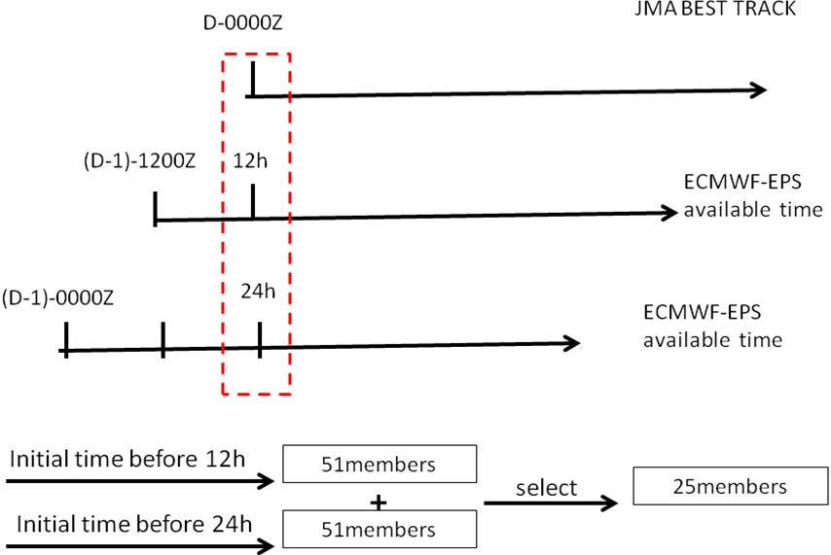
LAF-1
Experiment-1
Method Improvement and Experimental Results
Fig 6

Slide 13
LAF-2
Experiment-1
Method Improvement and Experimental Results
EC-JMA | 0 | 24 | 48 | 72 | 96
LAF20 | 38 | 57 | 118 | 191 | 280
LAF25 | 38 | 57 | 117 | 189 | 277
LAF30 | 39 | 58 | 116 | 188 | 280
LAF35 | 39 | 59 | 117 | 189 | 282
LAF40 | 39 | 60 | 117 | 190 | 283
LAF45 | 39 | 61 | 117 | 190 | 283
LAF50 | 39 | 62 | 118 | 191 | 284
LAF55 | 40 | 64 | 119 | 191 | 285
LAF60 | 40 | 66 | 120 | 193 | 288

Slide 14
2012-2013 EC Track Errors
Experiment-1
LAF-3
Method Improvement and Experimental Results
Fig 7
EC-LAF | 0h | 24h | 48h | 72h | 96h
ECM | 41 | 78 | 130 | 194 | 286
ECD | 42 | 78 | 129 | 201 | 294
OBEST | 40 | 61 | 117 | 185 | 278
LAF25 | 38 | 57 | 117 | 189 | 277

Slide 15
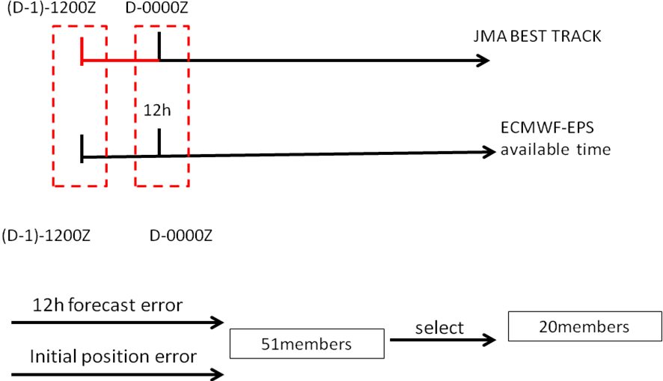
Experiment-2
Method Improvement and Experimental Results
(00h+12h)scheme-1
Fig 8

Slide 16
Experiment-2
Method Improvement and Experimental Results
(00h+12h)scheme-2
Fig 9
EC-0012 | 0 | 24 | 48 | 72 | 96 | 120
ECM | 41 | 78 | 130 | 194 | 286 | 398
ECD | 42 | 78 | 129 | 201 | 294 | 424
OBEST | 40 | 61 | 117 | 185 | 278 | 381
00+12 | 37 | 61 | 116 | 187 | 279 | 382

Slide 17
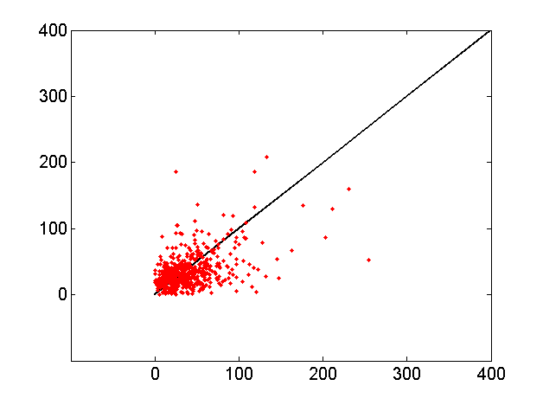
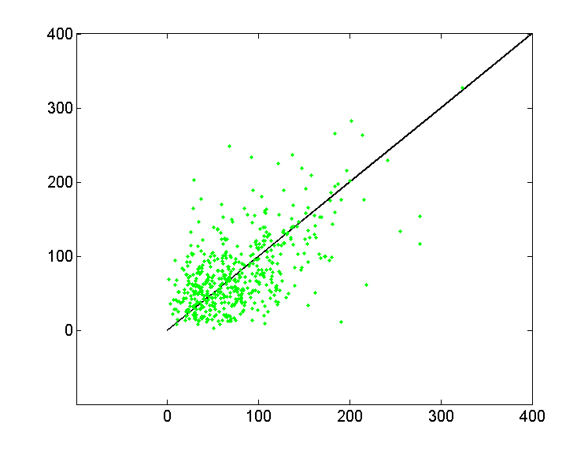
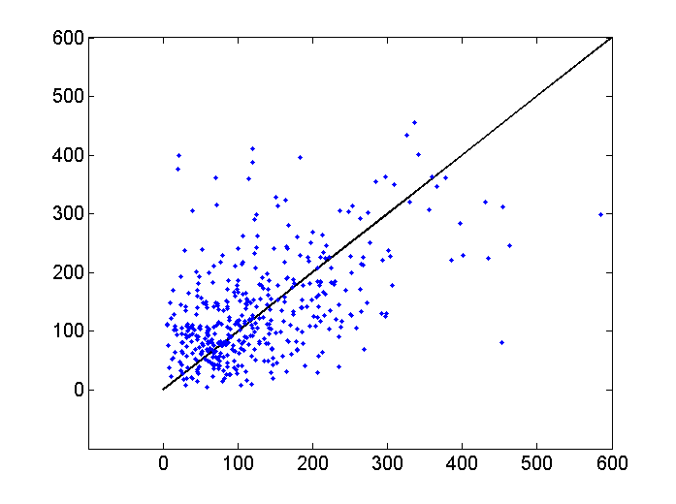
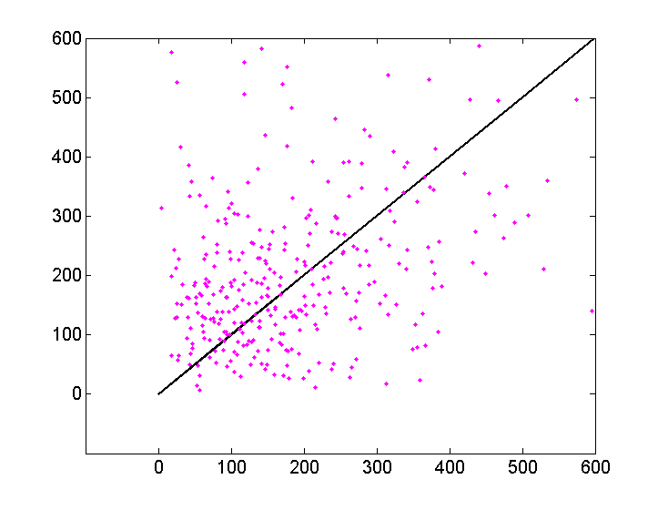
Experiment-3
Method Improvement and Experimental Results
super scheme-1
2012-2013
00h
NCEP>EC
43.4%(534)
NCEP>EC
50.3%(505)
24h
NCEP
Fig 10a
Fig 10b
48h
NCEP>EC
57.1%(425)
NCEP>EC
59.1%(327)
72h
Fig 10c
Fig 10d
EC

Slide 18
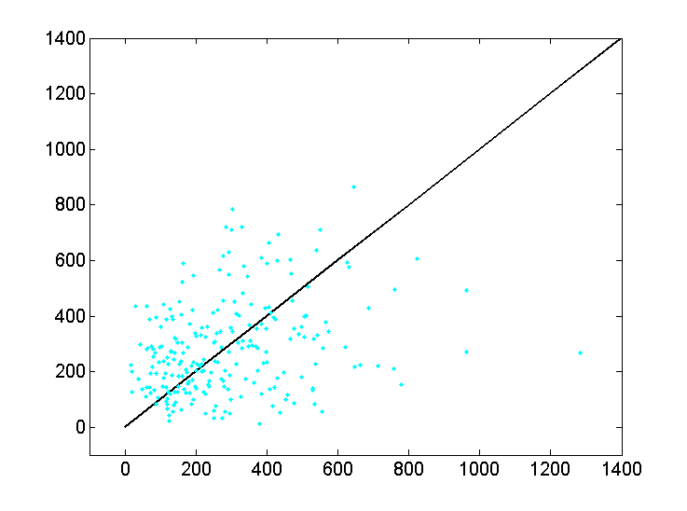
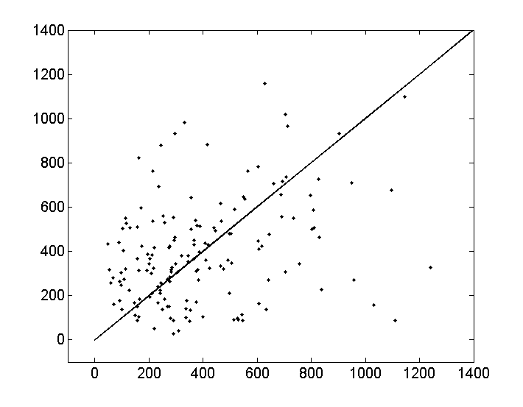
Experiment-3
Method Improvement and Experimental Results
super scheme-2
2012-2013
96h
NCEP>EC
54.9%(237)
NCEP
NCEP>EC
54.4%(160)
Fig 10e
120h
Fig 10f
EC

Slide 19
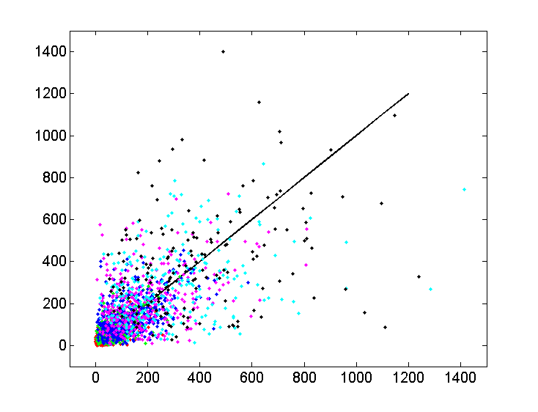
Experiment-3
Method Improvement and Experimental Results
super scheme-3
NCEP
Fig 10g
NCEP>EC
53.2%(2188)
00-120h
EC

Slide 20
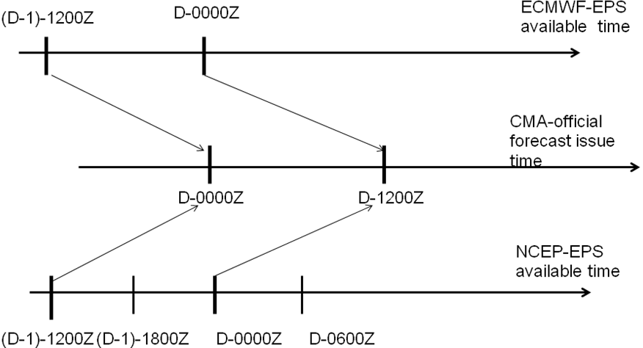
Experiment-3
Method Improvement and Experimental Results
super scheme-4
Fig 11

Slide 21
Experiment-3
Method Improvement and Experimental Results
super scheme-5
2012-2013 EC and NCEP Track Errors
Fig 12
sample | 483 | 519 | 473 | 421 | 372 | 324 | 273 | 225 | 182 | 147 | 119
homogeneous
Notes:
从两个模式的误差对比图来看，EC-EPS在72小时之前的短时效预报较NCEP好，而84-120小时的长时效预报，NCEP则逐渐优于EC。当两个模式组成超级集合之后，即使在没有应用OBEST的方法挑选成员的时候，较任意单个模式，超级集合的误差在所有预报时效（lead time）都处于领先地位。

Slide 22
Number of selected members
Experiment-3
Method Improvement and Experimental Results
super scheme-6
 | 24h | 36h | 48h | 60h | 72h | 84h | 96h | 108h | 120h | AVE
SUPER-OBEST20 | 0.903 | 0.962 | 0.991 | 0.999 | 1.003 | 1.011 | 0.984 | 0.981 | 0.965 | 0.9777
SUPER-OBEST28 | 0.925 | 0.96 | 0.972 | 0.977 | 0.981 | 0.988 | 0.972 | 0.979 | 0.978 | 0.9702
SUPER-OBEST35 | 0.953 | 0.976 | 0.973 | 0.968 | 0.974 | 0.979 | 0.969 | 0.988 | 0.995 | 0.975
SUPER-OBEST42 | 0.983 | 0.989 | 0.979 | 0.969 | 0.977 | 0.976 | 0.972 | 0.988 | 1.004 | 0.9819
SUPER-OBEST48 | 1.008 | 1.001 | 0.983 | 0.972 | 0.977 | 0.971 | 0.964 | 0.982 | 0.993 | 0.9834
SUPER-OBEST60 | 1.068 | 1.027 | 0.996 | 0.979 | 0.98 | 0.967 | 0.97 | 0.989 | 0.996 | 0.9969
SUPER-MEAN | 1 | 1 | 1 | 1 | 1 | 1 | 1 | 1 | 1 | 1

Slide 23
Experiment-3
Method Improvement and Experimental Results
super scheme-7
2012-2013 SUPER-EPS Track Errors
Fig 13
Forecast | 0h | 12h | 24h | 36h | 48h | 60h | 72h | 84h | 96h | 108h | 120h
SUPERM | 33 | 32 | 59 | 82 | 111 | 145 | 182 | 222 | 262 | 301 | 360
OBEST28 | 32 | 25 | 55 | 79 | 108 | 142 | 179 | 219 | 254 | 295 | 352
IMPROVEMENT |  |  | 7% | 4% | 3% | 2% | 2% | 1% | 3% | 2% | 2%
homogeneous

Slide 24
Experiment-3
Method Improvement and Experimental Results
super scheme-8
2012-2013 EC20,NCEP8 and SUPER28 Track Errors
Fig 14
 | 0h | 12h | 24h | 36h | 48h | 60h | 72h | 84h | 96h | 108h | 120h
EC-OBEST20 | 32 | 31 | 60 | 87 | 116 | 150 | 189 | 235 | 277 | 331 | 390
SUPER-OBSET28 | 33 | 25 | 55 | 79 | 108 | 141 | 179 | 219 | 254 | 295 | 352
IMPROVEMENT |  |  | 8% | 9% | 7% | 6% | 5% | 7% | 8% | 11% | 10%
homogeneous
Notes:
图14是将OBEST方法分别应用于EC，NCEP和SUPER 集合，并选取最佳成员数20，8和28的误差对比。从图中可以看出，将OBEST方法应用于超级集合时，较目前CMA仅使用EC-EPS一种集合预报资料而言，从24小时到120小时预报时效，误差减小了5%-11%.

Slide 25
Summary and Future Work
Summary
1, OBEST method is an objective method in which the forecast errors are calculated based on forecast and real positions, and a portion of members whose forecast errors are minimal are selected. The premise of this technique is that members with good short-term forecast also gives good performance in long-term forecast.
2, In order to improve the OBEST method, we have carried out three experiments, LAF, 00+12H, and SUPER ensemble. The experimental results show that there is no pronounced improvement in the first two experiments but a encouraging one in the third experiment. There is a 5%-11% forecast errors reduction in SUPER-OBEST method.
3, When it comes to the number of selected good members, we found the ratio between good members and all members is around 40%, this applies to EC, NCEP and SUPER ensemble data sets.

Slide 26
Summary and Future Work
Future Work
1, Perform uncertainty analysis to forecast errors of SUPER-OBEST.
2, Do significance test to experimental results.
Thank you for your time!

