Slide 1
The influence of atmospheric circulation on the occurrence of hail in China
Qinghong Zhang and Mingxin Li
Department of Atmospheric and Oceanic Sciences, Peking University, Beijing 100871

Slide 2

Trends of hail occurrence
Kunz et al. 2009
Cao 2008
Xie & Zhang
et. al 2008
Changnon & Changnon（2000)
Brooks and Dotzek 2008
Understanding the potential effects of global-scale changes on local-scale hail weather is a persistent challenge for research.
Notes:
It has been found that hail occurrence show different trend in the different area of the world. IN North America, in increasing trend was found in Otarria of Cananda, and decreasing trend in United states. I Ueope, Kunz 2009 showed dereasing hail occurrence trend in south of German. In Asia, my student and I found the trend of hail is dereaseing in north China but flat in South China. In the mean while, It has been found that the number of severe storm or thunder storm did not show significant trend in Unite and German, respectivally. Recently we do found the hail frequency are dereasing in Tibetan Plataeu. How to understand the potential effects of global-scale changes on local scale weather is a persistant challenge for reasarch.

Slide 3



Challenge: the stark mismatch of scale
It requires novel research approaches to connect the questions and processes across both weather and climate scales
Notes:
One of the challenges inherent to understanding hail changes
in the context of global climate change is the stark mismatch
of scale. Climate models simulate large-scale patterns of change.
It requires novel research approaches to connect the questions and processes across both weather and climate scales

Slide 4
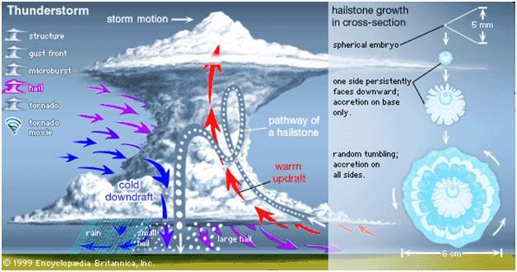
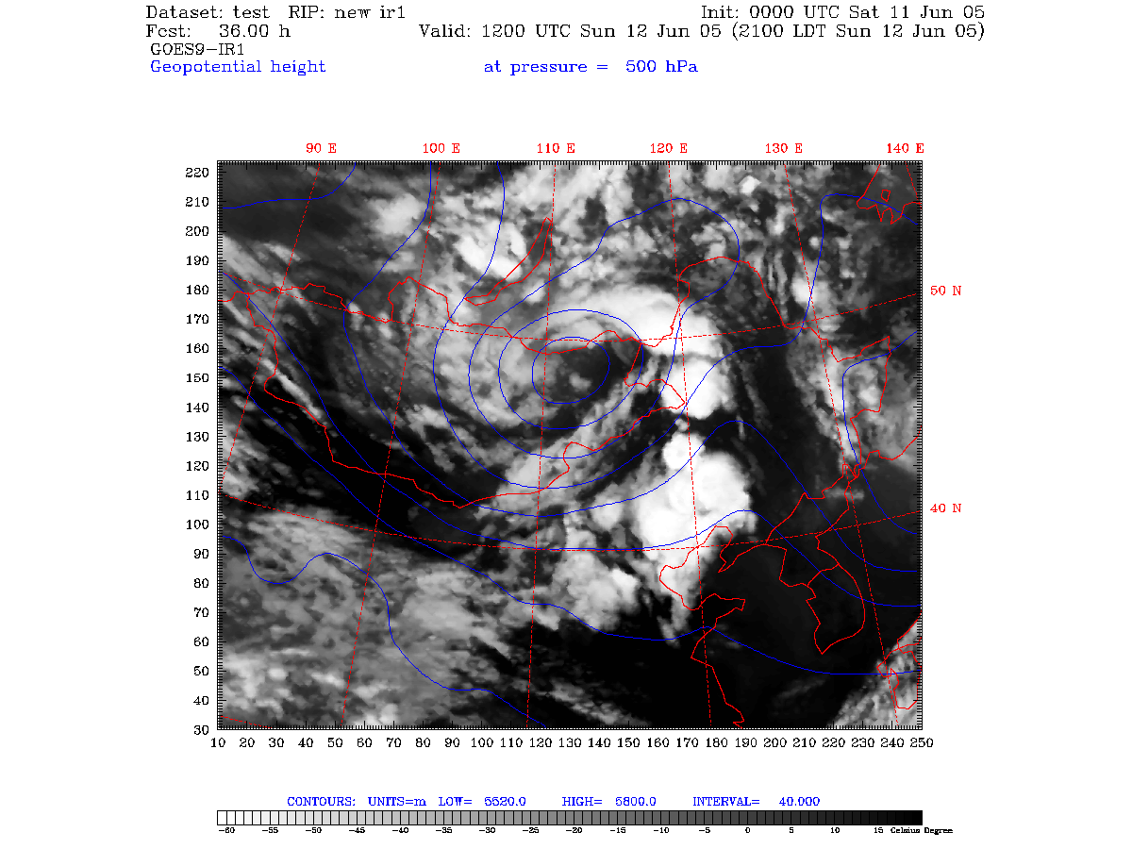
Possible bridges between hail and climate change?
severe convective
storm
Large scale circulation
change
Climate change
６－８月
３－５月
CAPE
Vertical wind shear
Freezing level height
Trigger
６－８月
３－５月
May 26-31 2005
Notes:
Although the exact mechanisms for hail formation within a cumulus cloud
are very complex and not yet fully understood, the prerequisites
for severe convective storms are well known: CAPE, which is the energy content of the prevailing
environment, vertical wind shear is relevant for determining
the kind of convective organization, Freezing level height determine the melting of hail drop from the cloud to the ground, and the fourth for the release of atmospheric instability.
There is another connection is large scale circulation change may be associated with climate change, may change the frequency and intensity of severe convection storms embedded in large scale circulation, like cold vortex

Slide 5
Objective
to investigate the effect of large scale circulation to the occurrence of hail and its long term trend in China

Slide 6
Methodology and Data
Objective classification(PCA: T-mode Principal component analysis)
  Huth (2008) compared the classification methods and proposed that the performance of the T-mode PCA is best in terms of its reproduction of predefined types, its temporal and spatial stability, and its less dependence on pre-set parameters.
Datasets 1960-2012
  NCEP/NCAR reanalysis
  Hail data at 753 surface stations from information center of CMA
(hail starting and ending time)

Slide 7
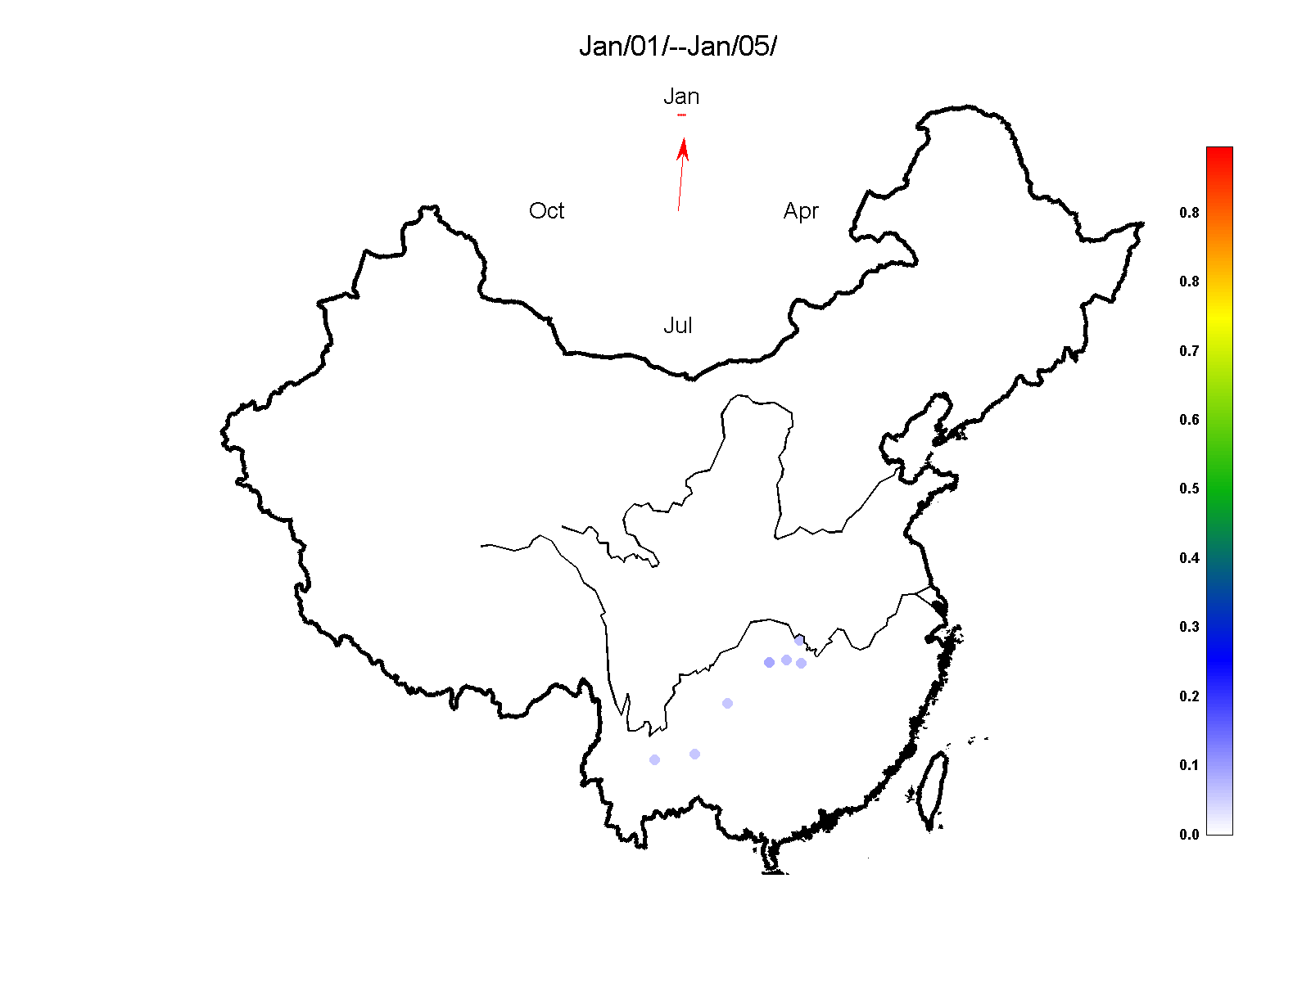
Seasonal variation of 5-day annual mean hail frequency in China 1960-2012
548 Station

Slide 8
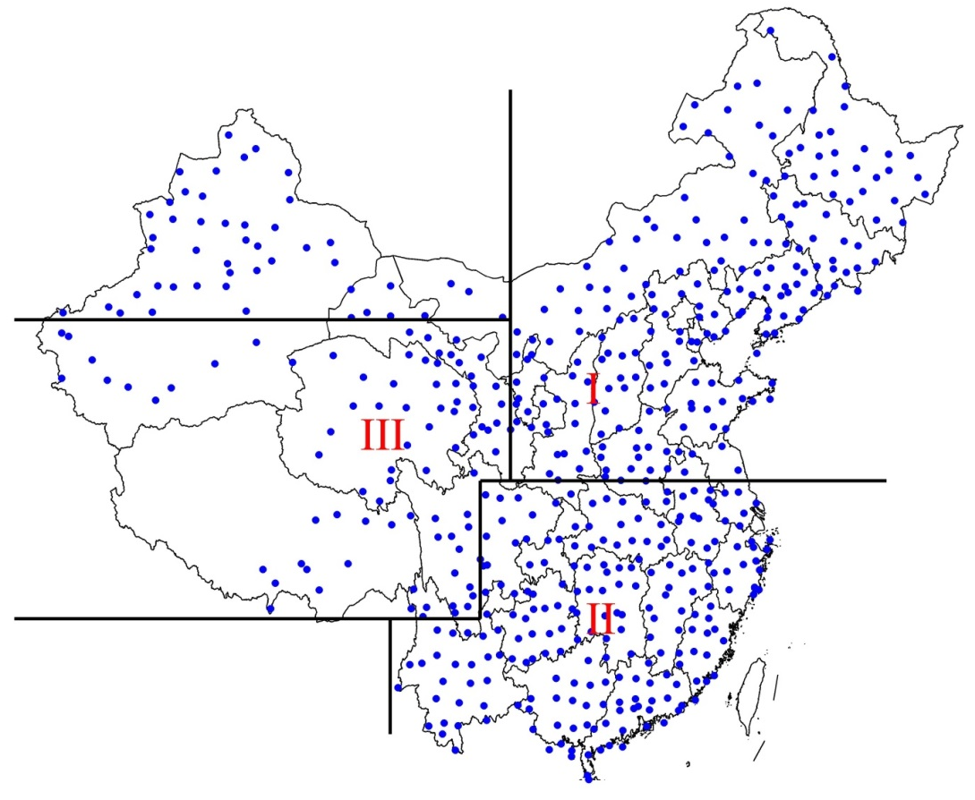
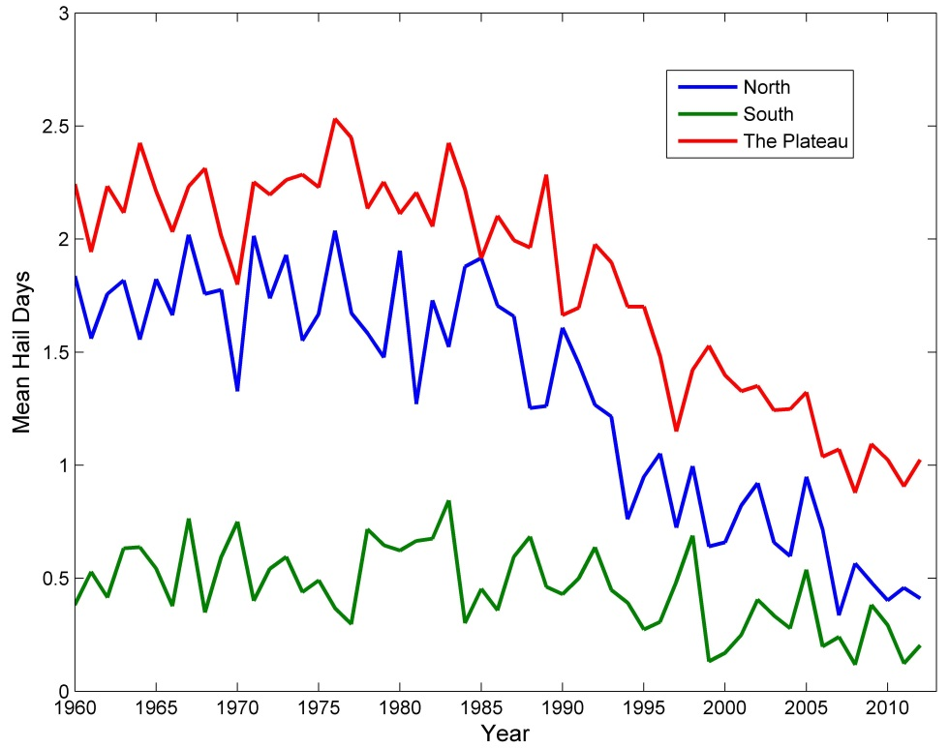
Variation of annual mean hail frequency of different regions 1960 -2012
North China
Tibetan Plateau
South China
1960 1970 1980 1990 2000 2010
Warm season Apr~Oct
Cold season Oct~Apr

Slide 9
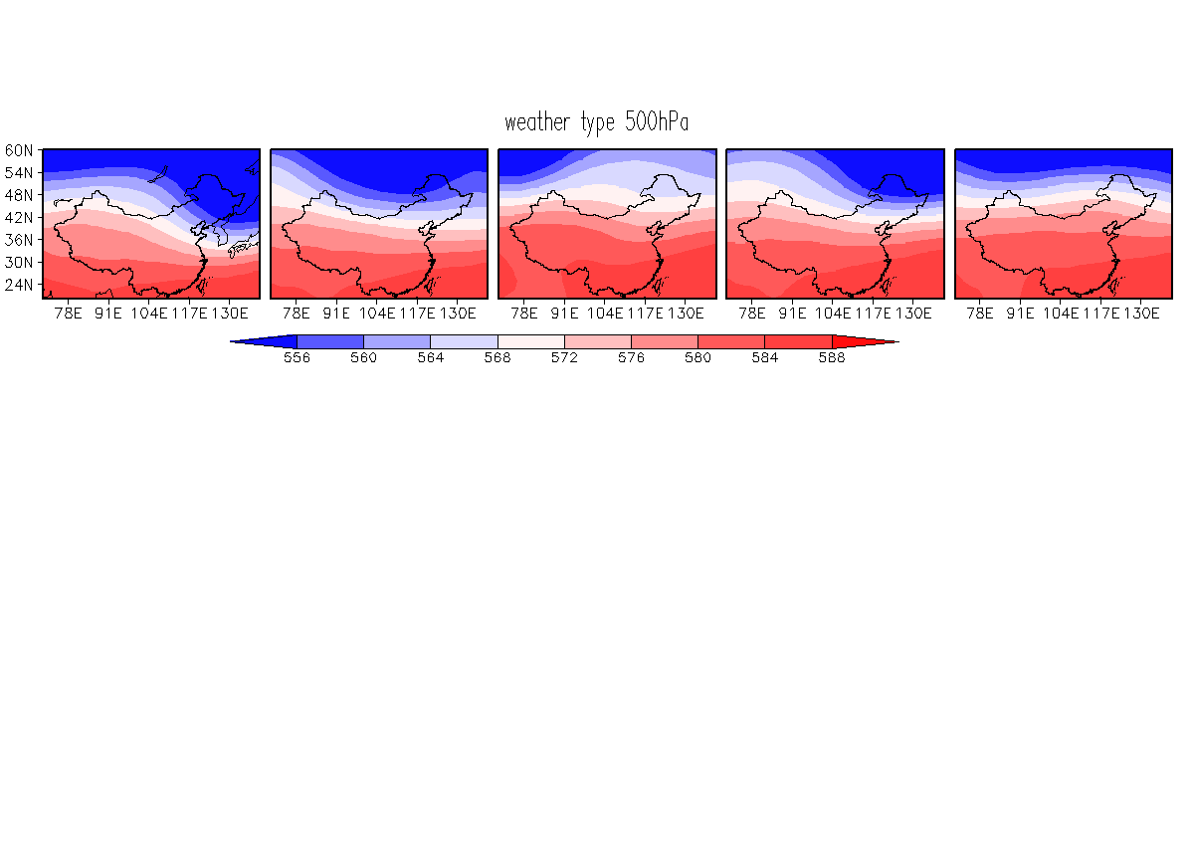
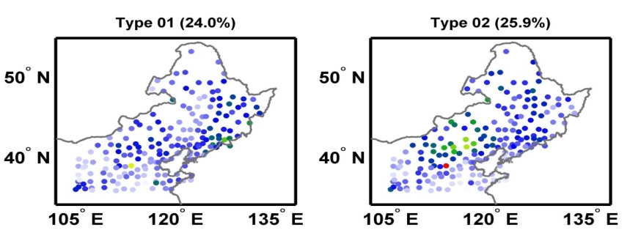

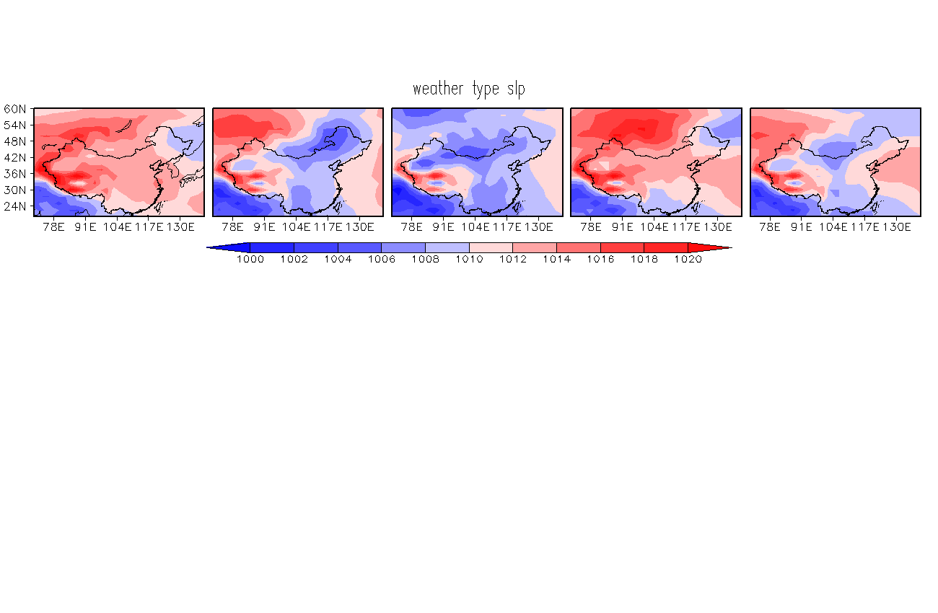
Results of circulation classification in North China(1960-2012)
Type 1
Type 2
Type 3
Type 4
Type 5
GPH 500hPa
Hail
frequency
SLP

Slide 10
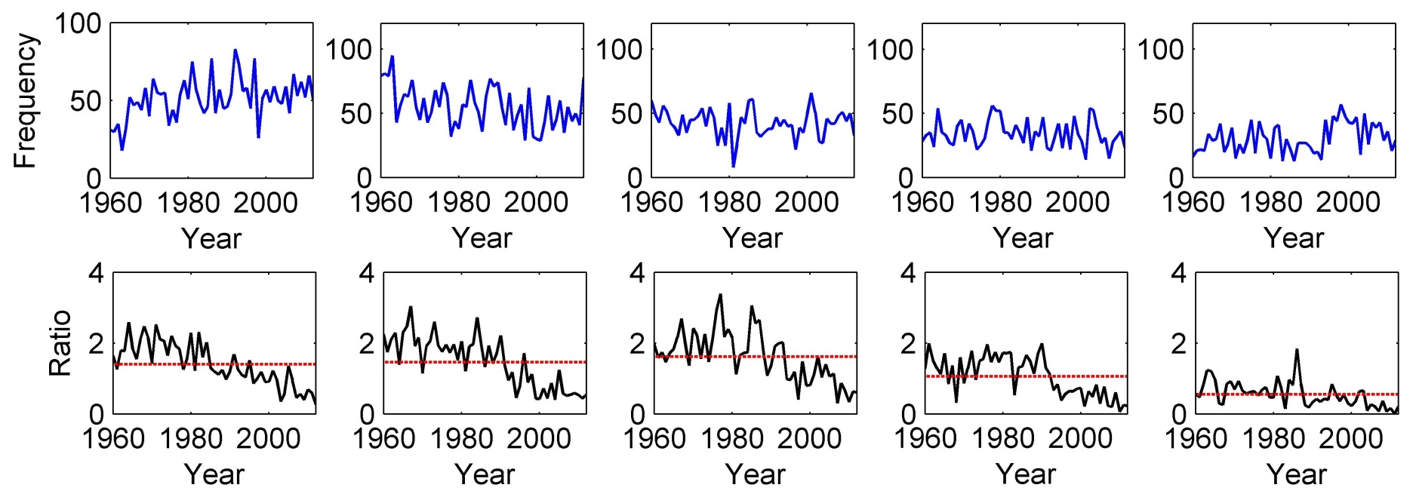
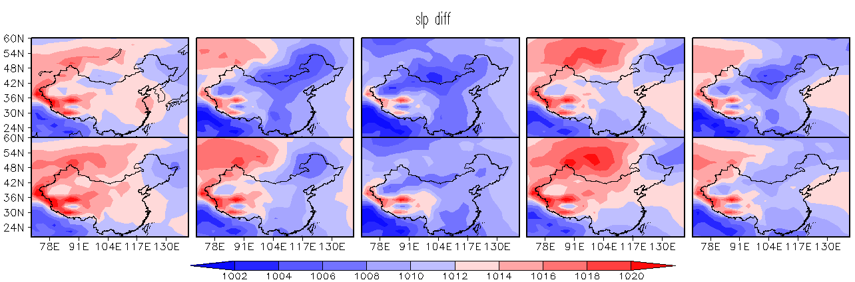
The variance of the frequency of each circulation type in north china
Type 2 and type 3 are more related with hailstorm. The Weakened weather systems from 90s mainly associated with the hail frequency decrease in the north.

Slide 11
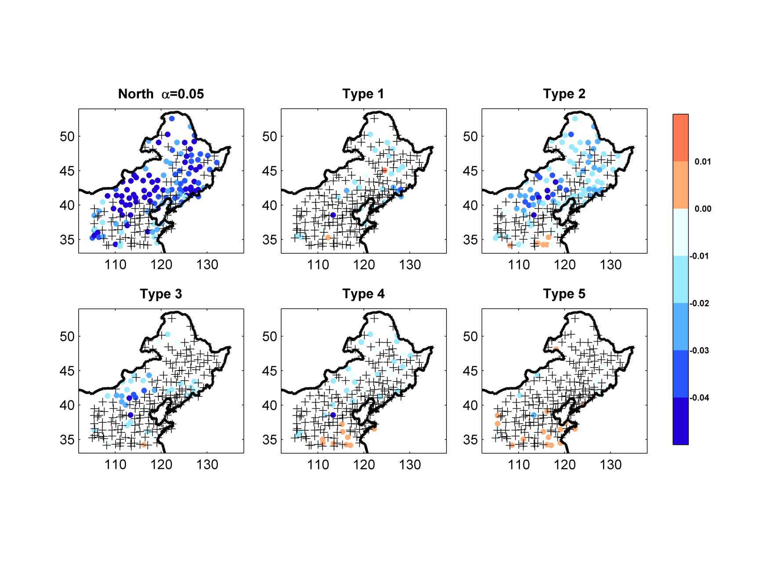
Spatial distribution in hail trends in North China 1960-2012
+ flat

Slide 12
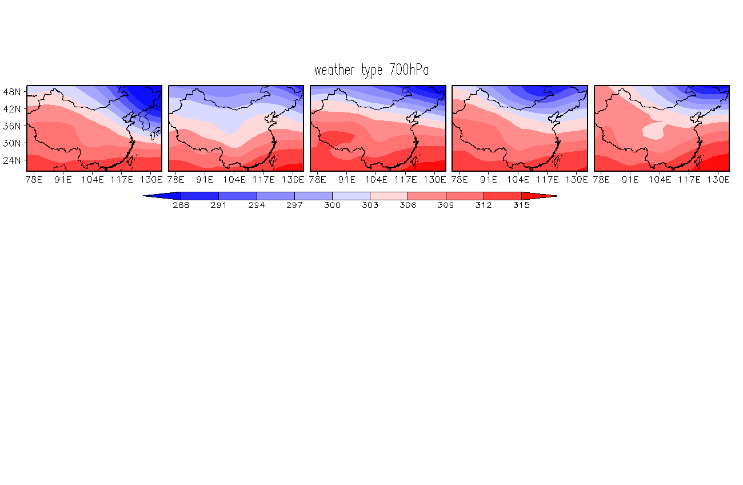
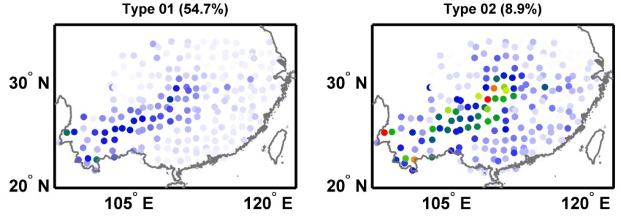

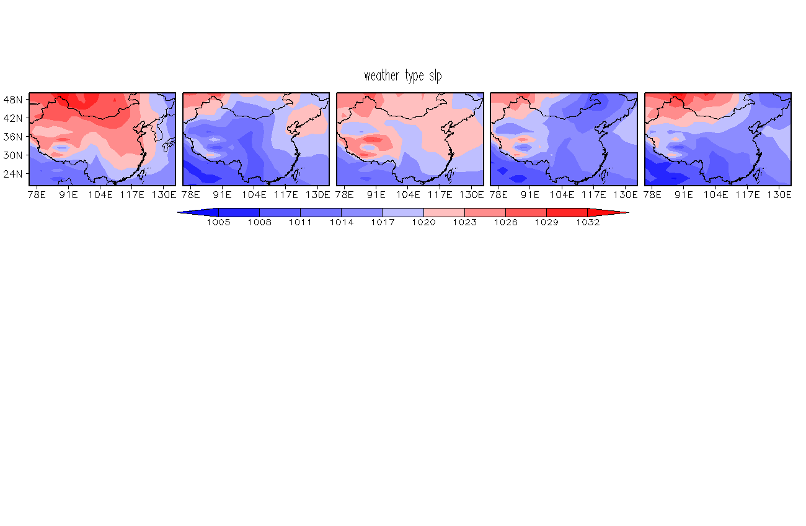
Results of circulation classification in South China (1960-2012) cold season
Type 1
Type 2
Type 3
Type 4
Type 5
GPH 700hPa
Hail
frequency
SLP

Slide 13
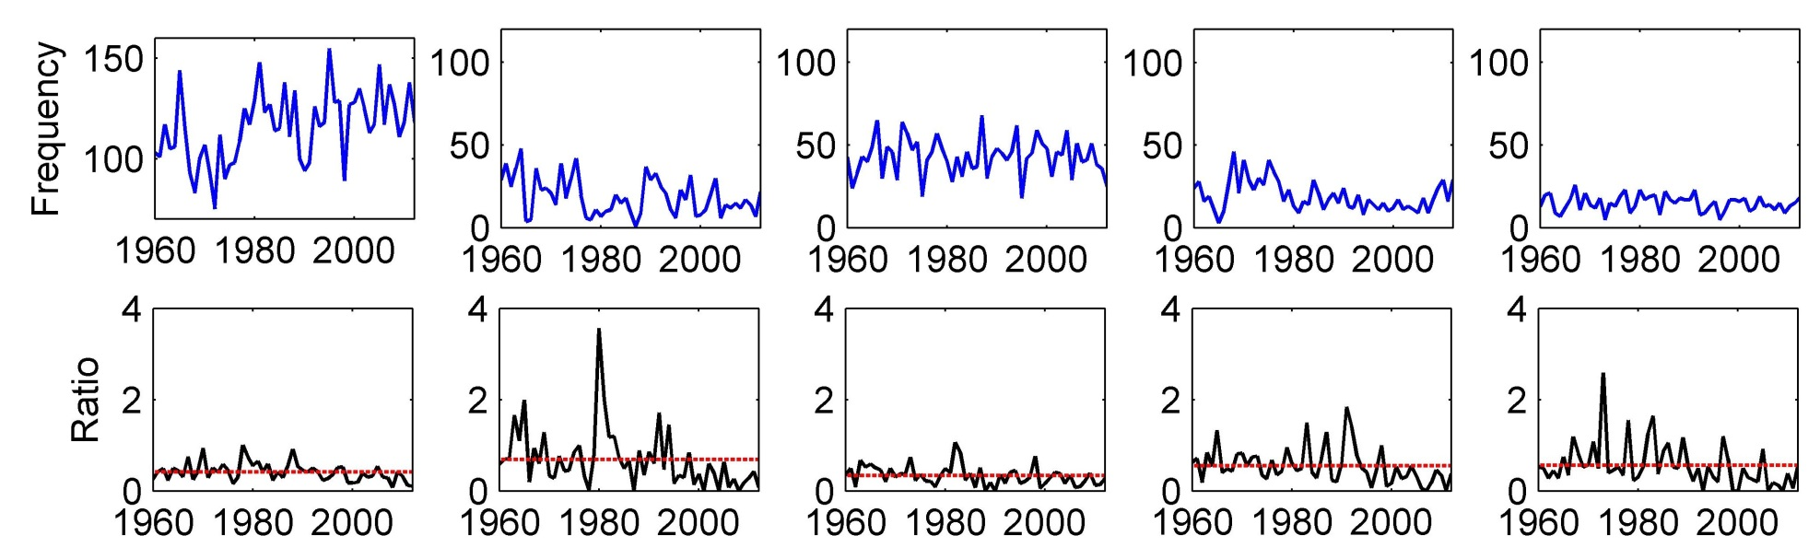
The variance of the frequency of each circulation type in south china 1960-2012
Type 2 is a dominated circulation type with a trorph on 700hPa and meridinol flow near surface.
Circulation frequency show no obvious trend and it’s more of an annual variation

Slide 14
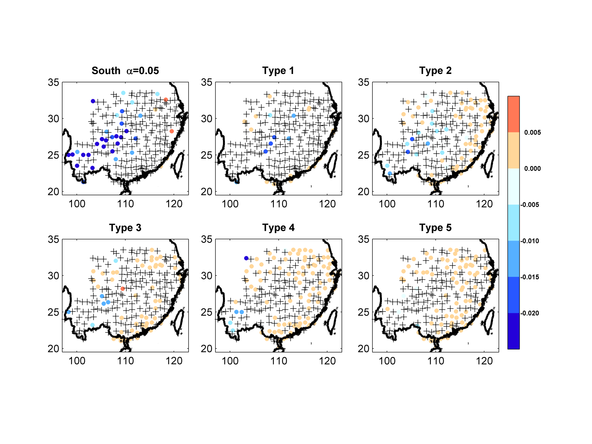
Spatial distribution in hail trends in South China 1960-2012
+ flat

Slide 15
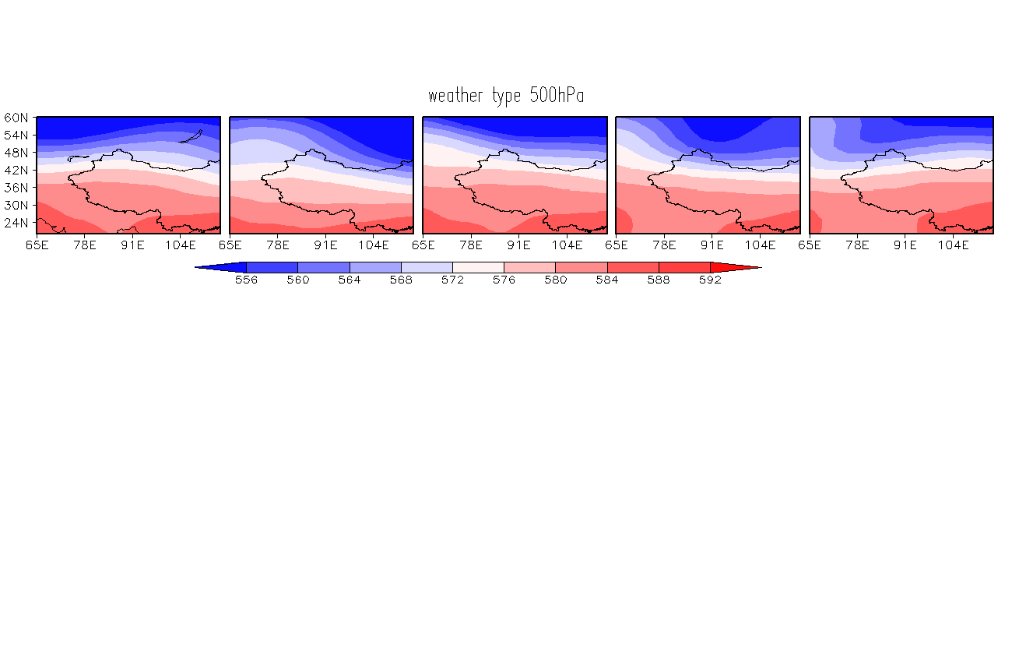
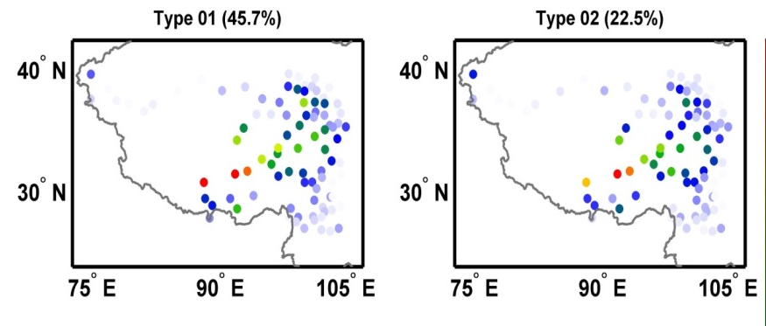

Results of circulation classification and their associated hail frequency in Tibetan plateau (1960-2012)

Slide 16
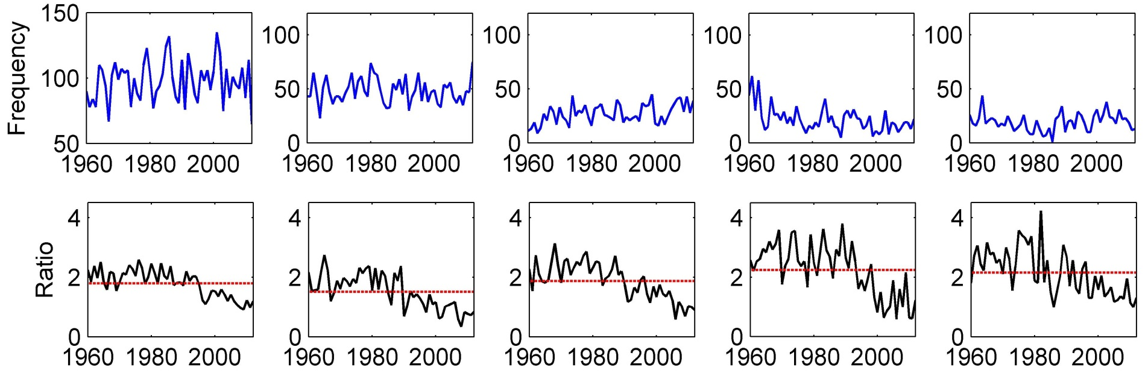
The variance of the frequency of each circulation type in Tibetan Plateau
Hailstorms occur in all the types and all with a high frequency. We believe that hailstorms are mostly isolated system in Tibetan plateau

Slide 17
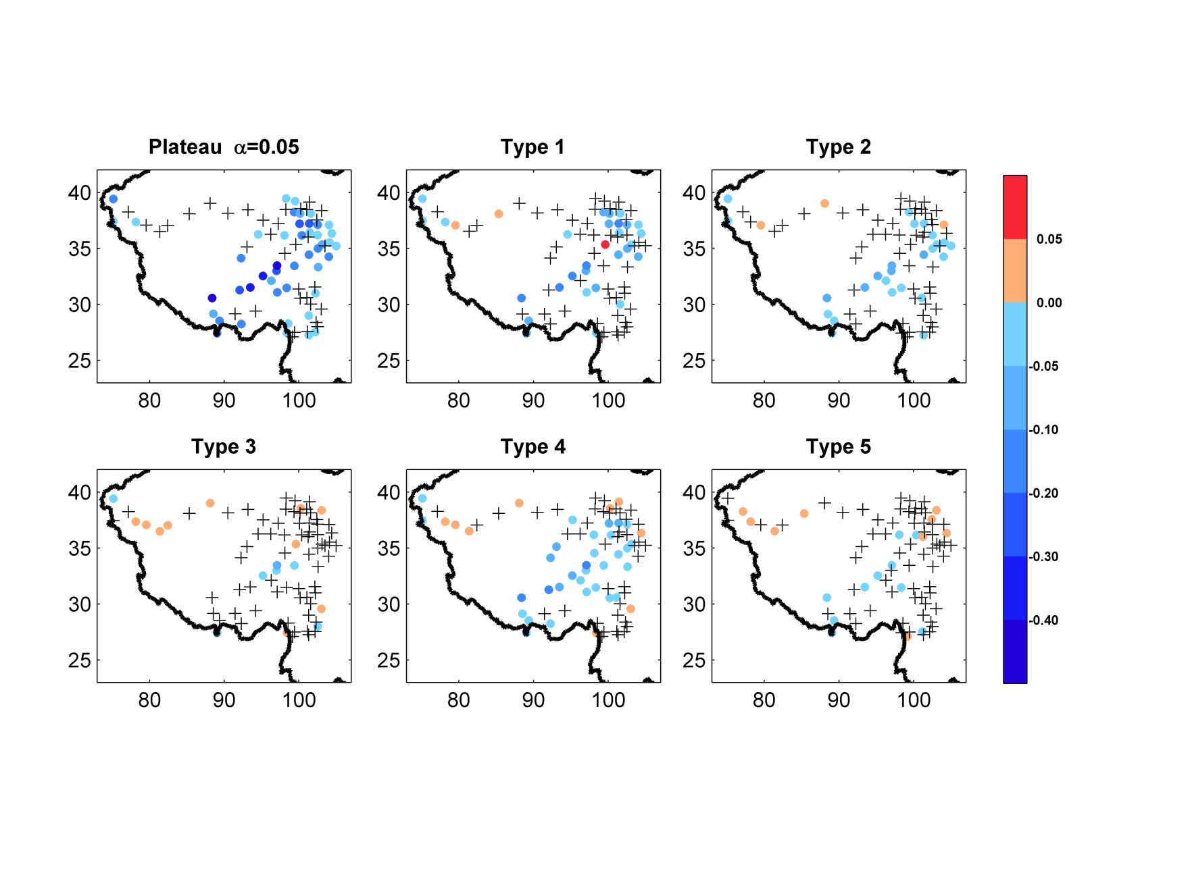
Spatial distribution in hail trends in Tibetan Plateau 1962-2012
+ flat

Slide 18
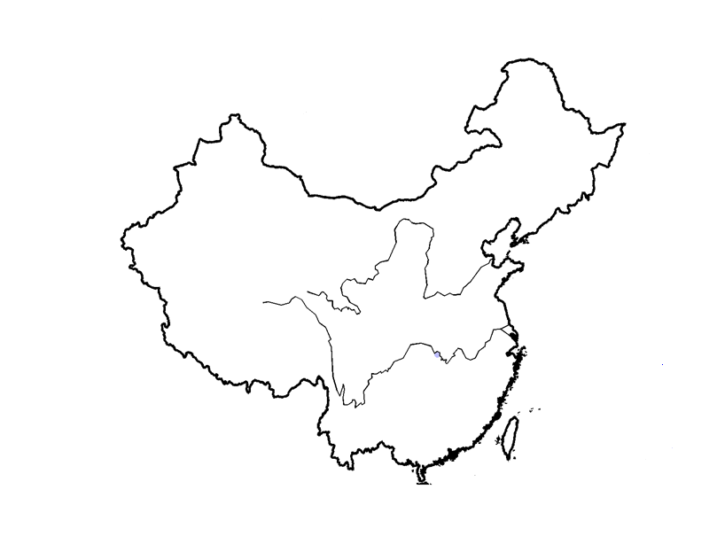
Summary
500hPa
500hPa
Circulation frequency did not changed significantly, but their intensity is weaker after 90’s
SLP
SLP
700hPa
SLP
Dominated by local factor rather than the large-scale circulation
Circulation frequency
show no obvious trend

Slide 19

Further Research
Local weather type
Large scale circulation
Number
thunderstorm
Local climate
CCN
radiation
Aerosol

Slide 20
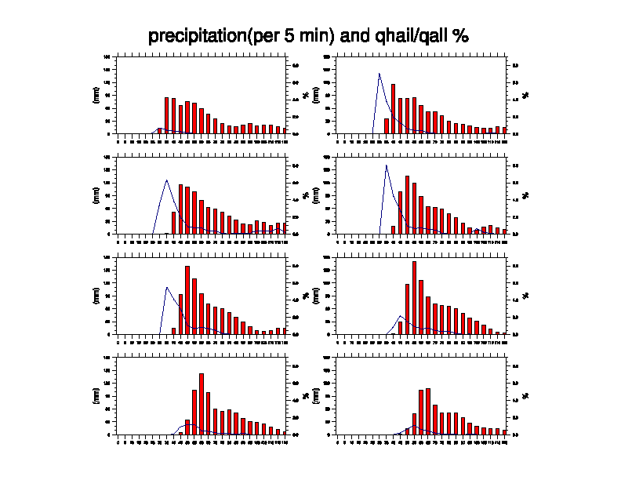
Sensitivity of area precipitation and relative hail contribution to the initial CCN in idealized WRF model
1×10⁸ /Kg
3×10⁸ /Kg
5×10⁸ /Kg
7×10⁸ /Kg
1×10⁹ /Kg
3×10⁹ /Kg
5×10⁹ /Kg
7×10⁹ /Kg

Slide 21
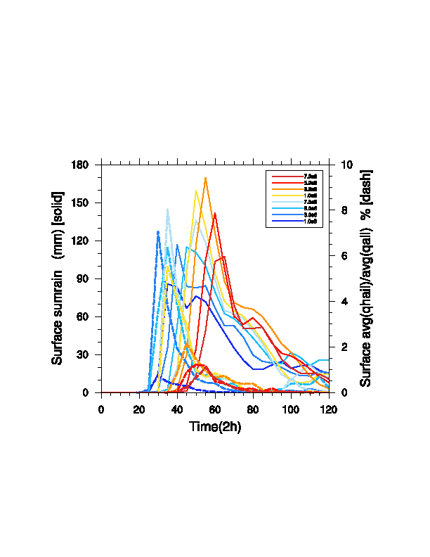

Slide 22
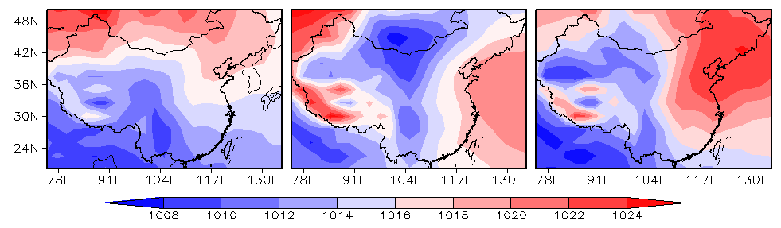
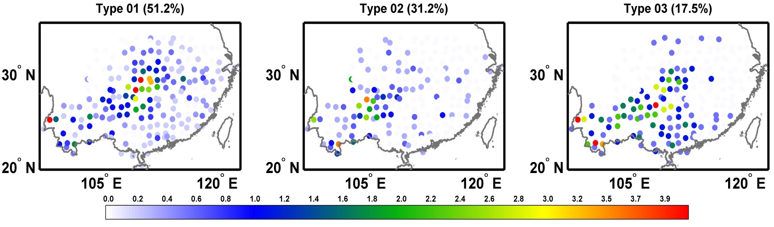
Further classification of type 2 based on SLP

