Slide 1
Toward Radiance Assimilation in an Ensemble Framework for Tropical Cyclone
Summer 2014 Group Meeting August 14, 2014
Scott Sieron

Slide 2
Data Assimilation of Tropical Cyclones
Qualities of observations w.r.t. assimilation:
Correlations with other variables
Quantity and frequency
Quality (accuracy)
Location relative to phenomenon
Success with radar velocity data assimilation with EnKF
Measurements of the inner dynamics of the storm
Strong correlations between wind field and other atmospheric variables

Slide 3
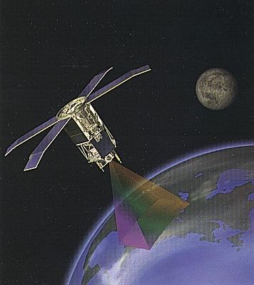
Passive Remote Sensing, Overview
Sensor on satellite measures how much radiation is hitting it through field of view
Amount of emission is directly related to the temperature of the source matter
Can convert this radiance measurement into brightness temperature
inverting the radiative transfer equation
At many frequencies/bands, measured radiance depends on the state of the atmosphere
Image courtesy http://oceancolor.gsfc.nasa.gov/SeaWiFS/SEASTAR

Slide 4
Passive Remote Sensing, Visible
Visible: Satellite sees primarily scattered (reflected) solar radiation
Satellite radiance depends primarily on the density and composition of clouds in the field of view
Cloud-free = satellite sees surface reflection (not much)
Clouds = more reflection
Thick, cumulus clouds reflect more than thin, cirrus clouds

Slide 5
Passive Remote Sensing, Far IR
Far Infrared (IR): Satellite sees primarily emissions from the Earth system
Satellite radiance depends primarily on the density, composition and height of clouds in the field of view
Cloud-free = high transmissivity: all of what satellite sees is all that is emitted by surface
Clouds = low transmissivity: all surface emission is absorbed; satellite sees that emitted by top of highest cloud
Lower, warmer cloud tops emit more than higher, colder cloud top

Slide 6
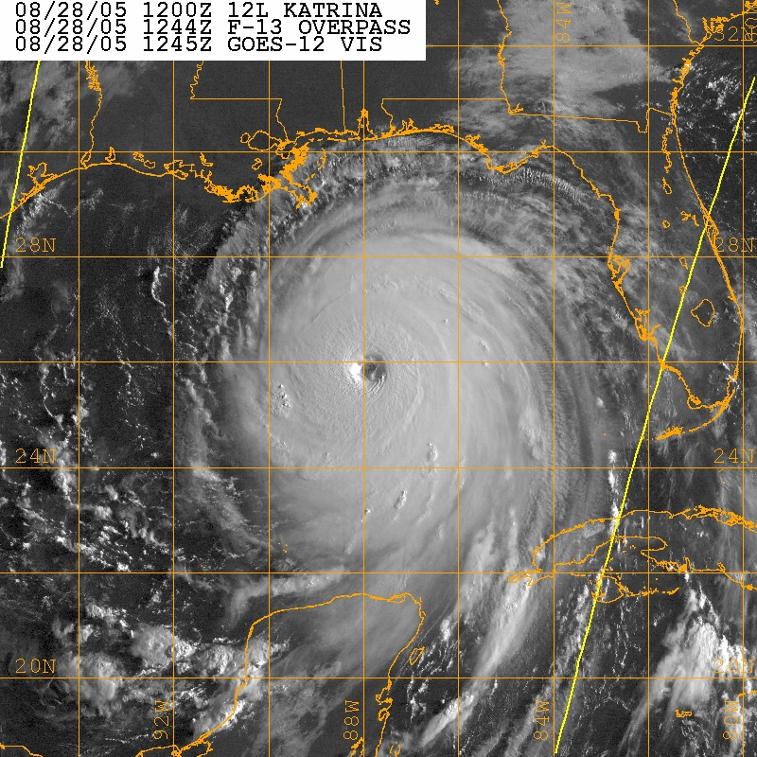
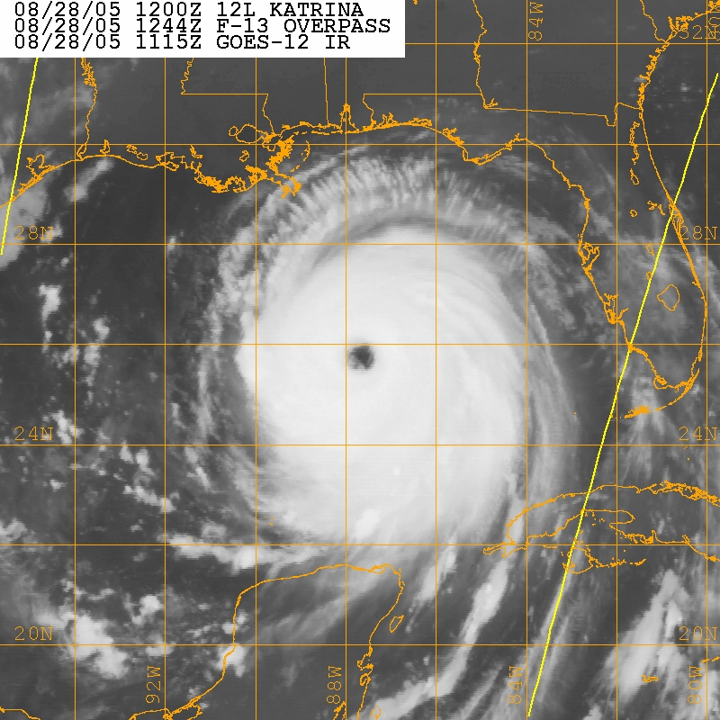
GOES-12 Visible
GOES-12 IR
Hurricane Katrina (2005) at August 28 ~12Z (140 kts)

Slide 7
Passive Remote Sensing, Microwave
Microwave: Satellite sees primarily emissions from the Earth system
Dependency of radiance on state of atmosphere can be more complex

Slide 8
Passive Remote Sensing, Microwave cont.
At some frequencies, emission/absorption depends on concentration of CO₂ or H₂O
Concentration depends on pressure/height and (for H₂O) weather
CO₂ Slicing method constructs vertical temperature profiles
Weaker absorption = satellite sees primarily emission from lower in atmosphere
Stronger absorption = satellite sees primarily emission from higher in atmosphere

Slide 9
Passive Remote Sensing, Microwave cont.
The emission at 89 GHz is weakly dependent on water vapor
Satellite radiance depends primarily on the density and height of precipitation in the field of view
Rain-free = high transmissivity: most of what satellite sees is that emitted by surface
Rainy = lower transmissivity: some surface emission is absorbed; satellite sees some emitted by precipitation
The more dense and the higher-up that there is precipitation, the colder the brightness temperature
Height and density of precipitation correlates to intensity of convection

Slide 10
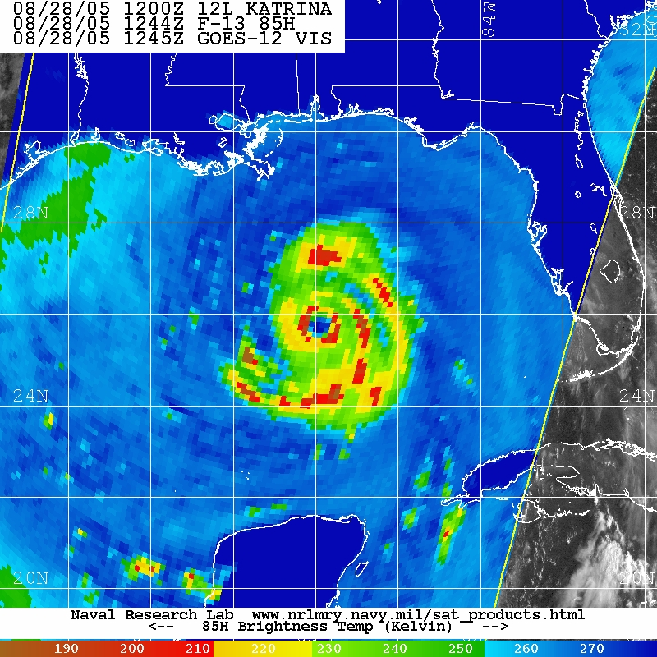
GOES-12 Visible
SSM/I 89GHz Brightness Temperature
Hurricane Katrina (2005) at August 28 ~12Z (140 kts)

Slide 11
GOES-12 IR
SSM/I 89GHz Brightness Temperature
Hurricane Katrina (2005) at August 28 ~12Z (140 kts)

Slide 12
Radiative Transfer Model
Tremendously complex observation operator: a radiative transfer model
What would the radiance at frequency X be given the state of the atmosphere?
Biggest challenge: cloud-impacted radiances
RTM is a function of
Temperatures
Clouds and hydrometeors
Emissivity of surface
…
Using the Community RTM (CRTM)

Slide 13
Research
Analyze ensemble-derived correlations between radiance measurements and other field variables
In-process
Future work
Assimilating clear-sky radiances (microwave, IR)
Assimilating all-sky radiances (+ microwave cloudy and rainy scenes)
Using hybrids

Slide 14
