Slide 1
Error growth of Moist Baroclinic Waves: A Sensitivity Study
Y. Qiang Sun
Groupmeeting
May 8th, 2014

Slide 2
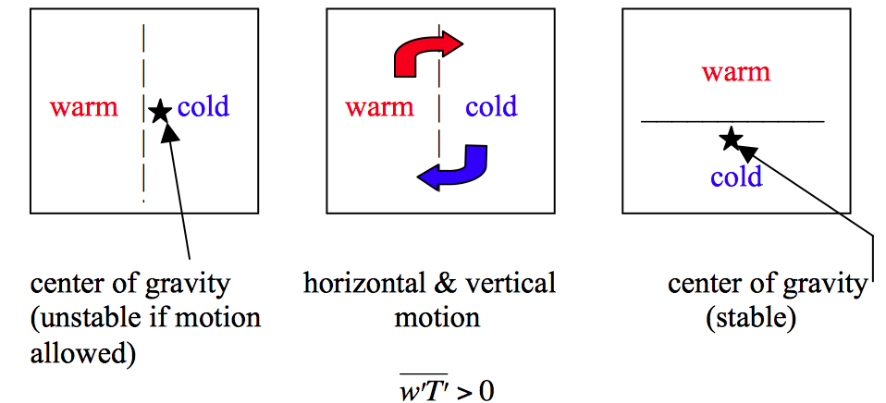
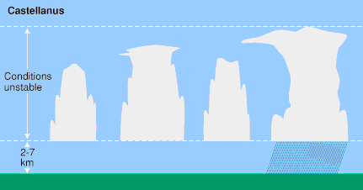
Error grows through instability
Large scale: Baroclinic instability
Small scale: Conditional instability

Slide 3
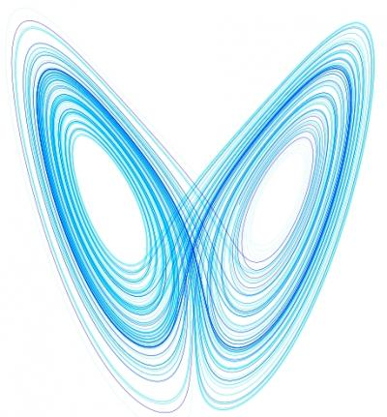
Do these different scales talk to each other?
Sure ! That’s why the so called “butterfly effect” would make sense.
Zhang et al 2007:
Convective stage
1
Transition stage
2
Baroclinic stage
3

Slide 4
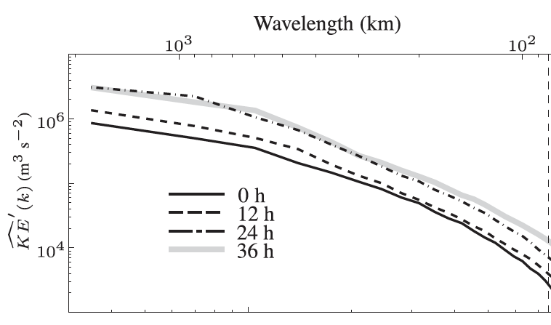
Disagreement with Zhang (2007)’ model
Durran et al 2013
Question:
How to resolve this disagreement?
What’s the sensitivity of error growth to different perturbation?

Slide 5
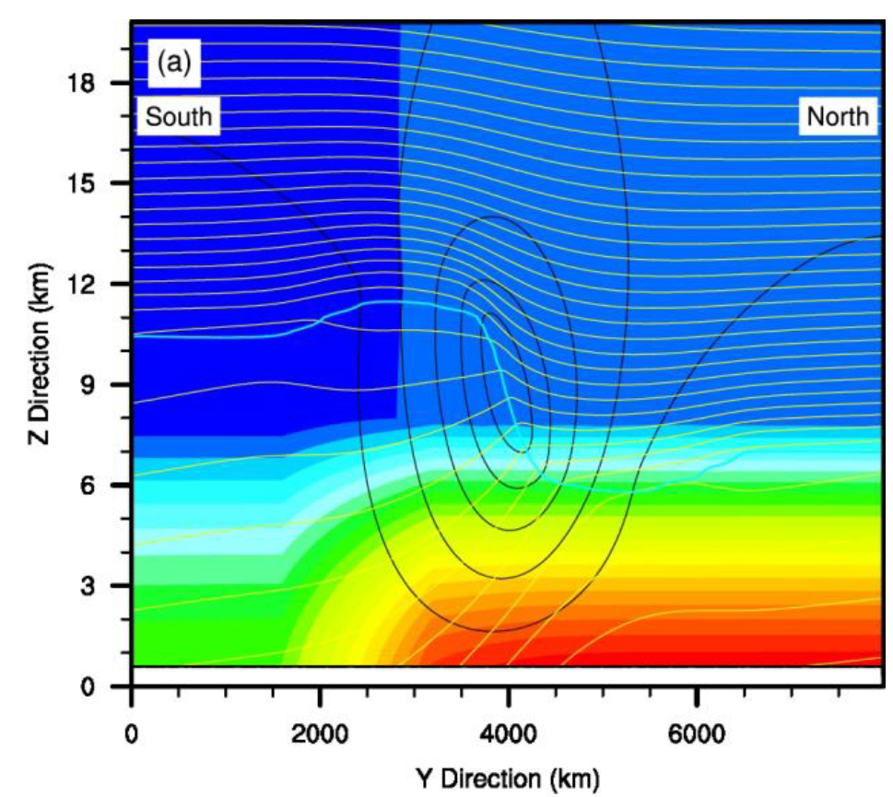
Model setup
Wei and Zhang (2013)
JET
Model: WRF b_wave.
Resolution: 10 km.
No parameterization scheme used.

Slide 6
Ctrl Experiment
Add perturbation

Slide 7
Error growth for Large-scale perturbation

Slide 8
Error growth for Large-scale perturbation

Slide 9
Error growth for Large-scale perturbation

Slide 10
Error growth for Large-scale perturbation

Slide 11
Error growth for Large-scale perturbation

Slide 12
Error growth for Random Small-scale perturbation

Slide 13
Error growth for Random Small-scale perturbation

Slide 14
Error growth for Random Small-scale perturbation

Slide 15
Error growth for Random Small-scale perturbation

Slide 16
Error growth for Random Small-scale perturbation

Slide 17
Wave Spectrum Analysis
RANDOM
LARGE

Slide 18
Sensitivity to magnitude of perturbation
LARGE_1m
LARGE

Slide 19
Sensitivity to magnitude of perturbation
RANDOM
10%RANDOM

Slide 20
This explains the disagreement!
Since Large-scale perturbation growth has a strong sensitivity to the magnitude of the initial large-scale perturbation, If the initial Large-scale error is big, the error growth will be dominated by the Baroclinic growth of the large-scale perturbation, which resolves the inconsistency between Zhang et al and Durran et al.

Slide 21
Sensitivity to CAPE
RANDOM
RANDOM_RH70

Slide 22
Zhang et al 2007:
Convective stage
1
Transition stage
2
Baroclinic stage
3
PV adjustment process,
During which gravity wave is released, can calculate the gravity wave propagation speed
To further confirm this point.

Slide 23
Future Work
Perturbation at a single point,
check the propagation of the error
Add perturbation at different to study the sensitivity to the baroclinic instability.

Slide 24
Future Work
It might be interesting to think how the analysis would change in the tropics region, where this is little baroclinic instability. Large-scale convectively couple wave is an option.

Slide 25
Thank you!

