Slide 1
Simulation of a Tornadic Supercell:
Dealing with Surface Observations
Yunji Zhang
Dec 12, 2013

Slide 2
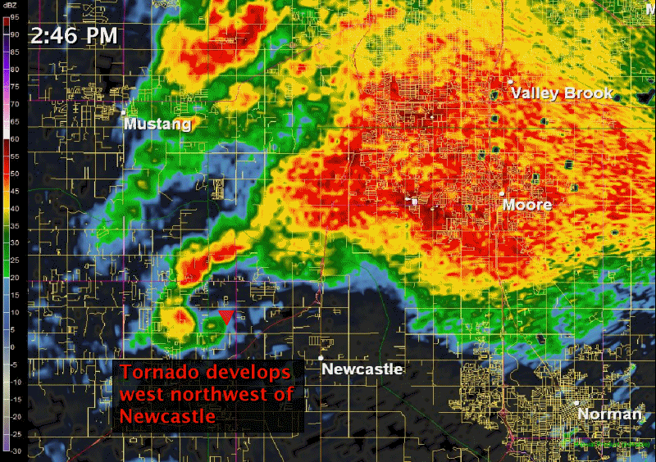
Reminder: the Case

Slide 3
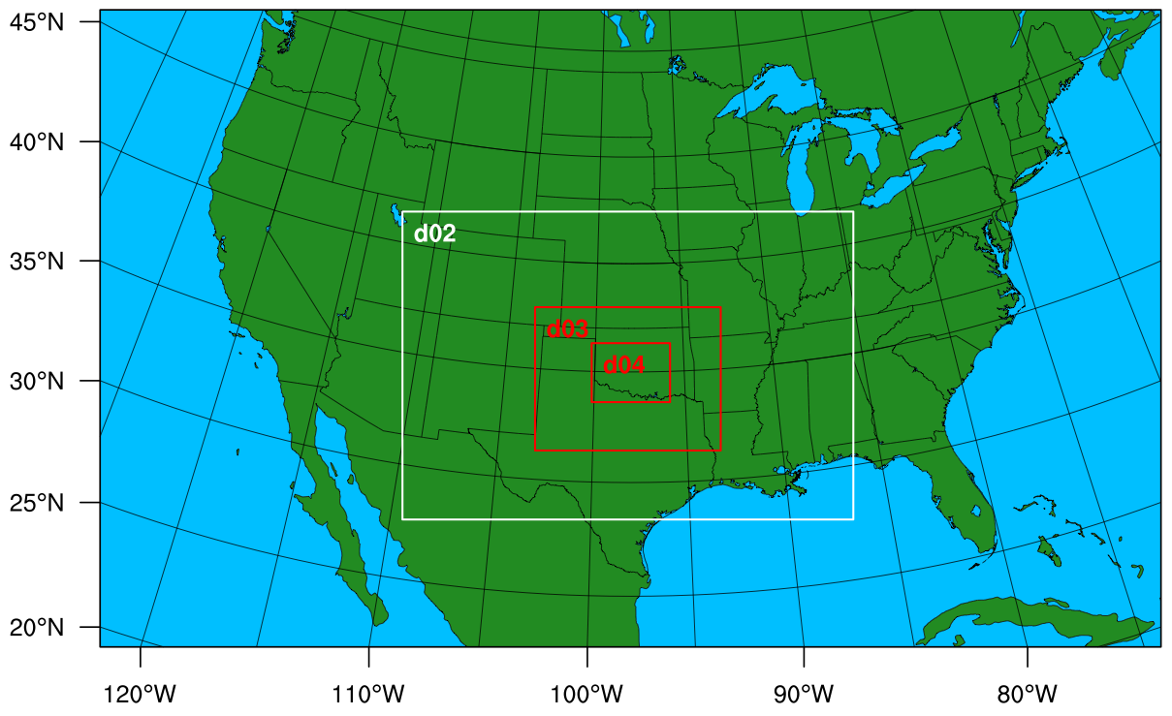
Reminder: the Model
Parameterization schemes:
Thompson MP
Grell-Freitas CU (D01 only)
Monin-Obukhov surface-layer
RUC LSM
MYNN 2.5 PBL
RRTM LW
Goddard SW
(Mainly based on RAP/HRRR)
Spin-up
6-hourly EnKF
ndown.exe
9-km
Spin-up
Hourly EnKF
27-km
Spin-up
Hourly EnKF
3-km
1-km
5-min EnKF
TORNADO
12:00 05/19
18:00 05/19
12:00 05/20
13:00 05/20
18:00 05/20
20:05
3:05 pm
20:35
3:35 pm
21:00 05/20
00:00
05/21

Slide 4
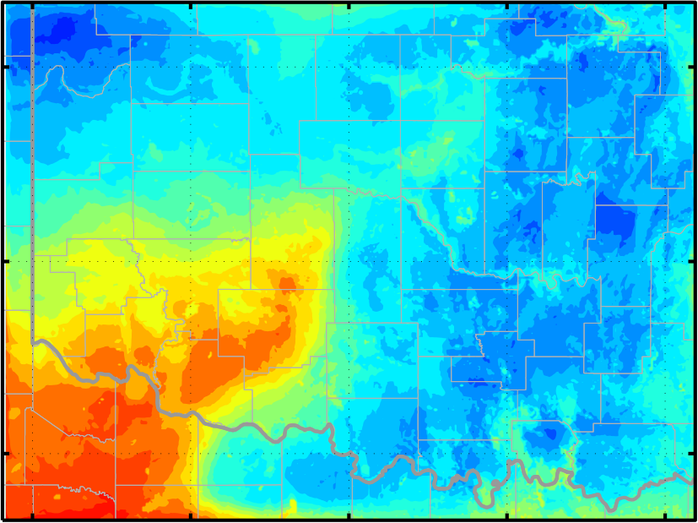
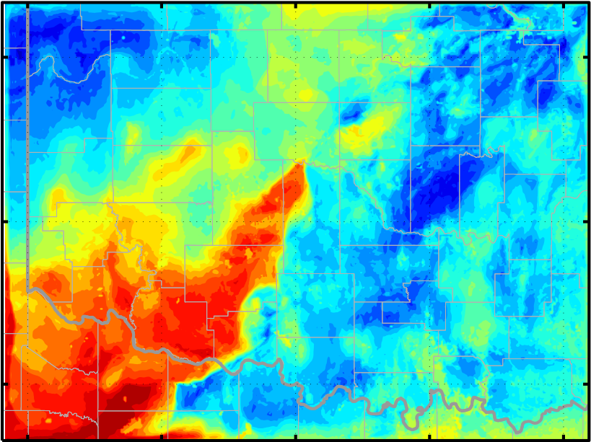
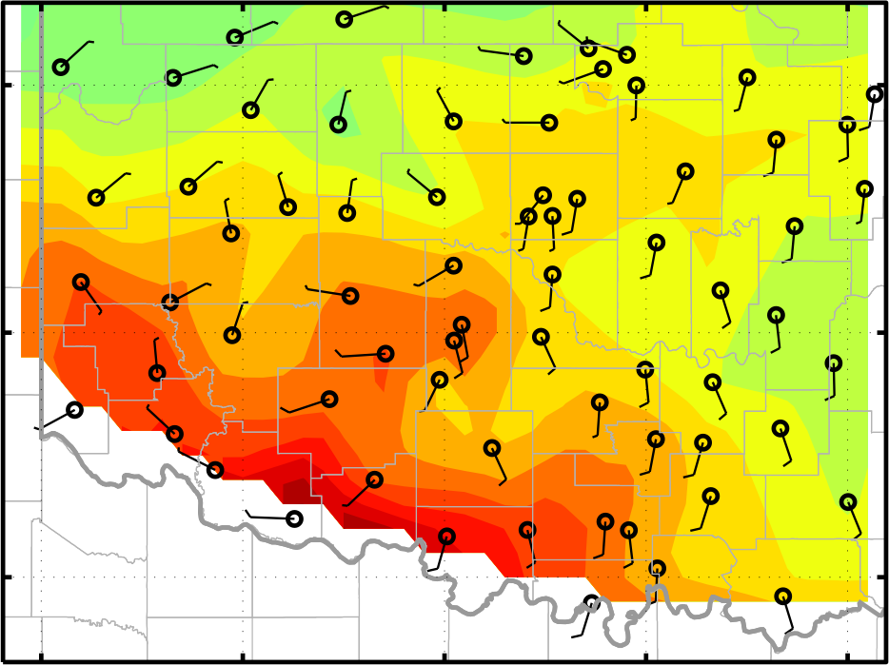
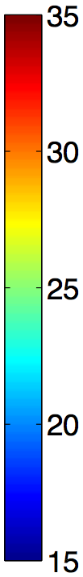
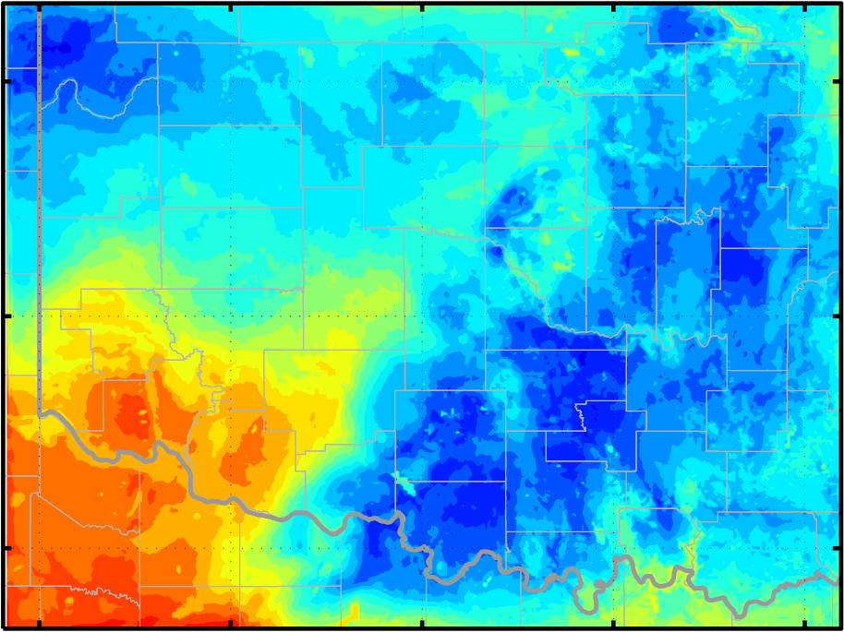
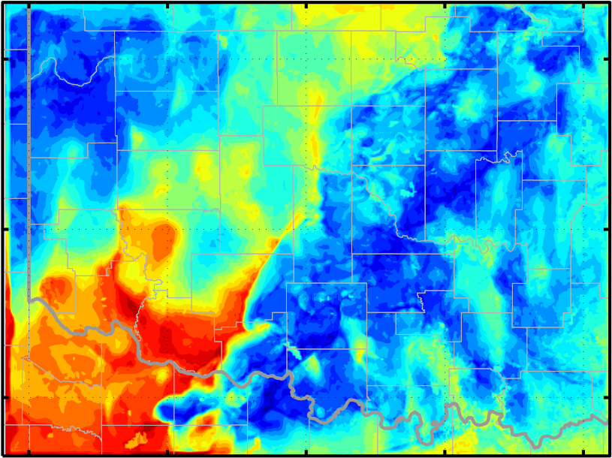
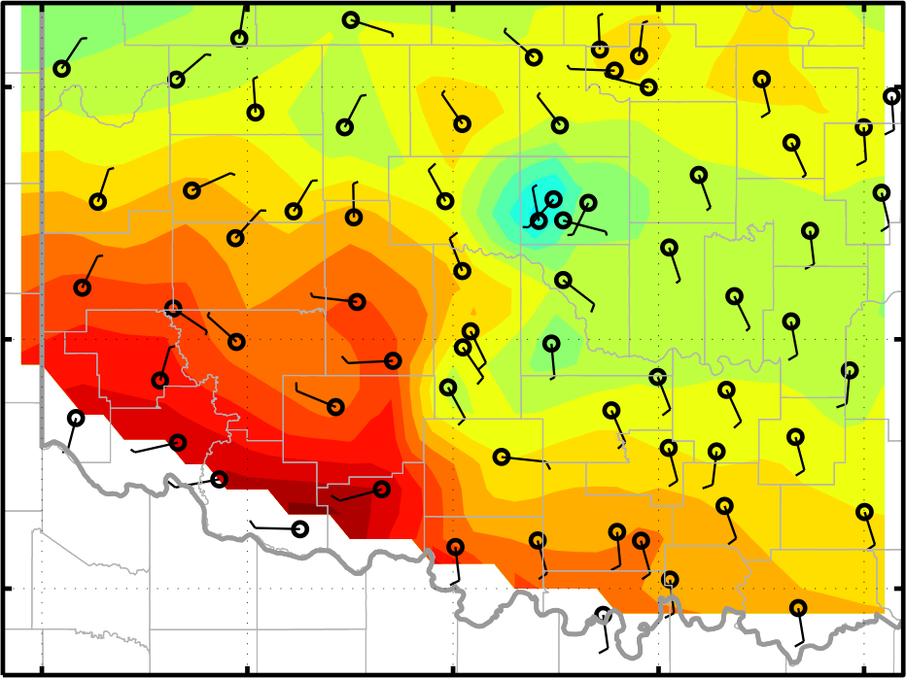
Assimilating using Original EnKF
V18R18
S18V18R18_ENKF
Mesonet
19:00
20:00
Surface 2-m Temperature (°C)

Slide 5
Enhancing Assimilation Strategy
Using θ and T_{d} instead of T and Q_{v} (Fujita et al. 2007)
  Simpler profile near surface thus smaller interpolation errors
  T_{d} is independent from T and varies more smoothly than Q_{v}
Updating soil properties (D. Stensrud)
  Soil temperature & moisture, skin temperature
  Affecting LSM performance

Slide 6
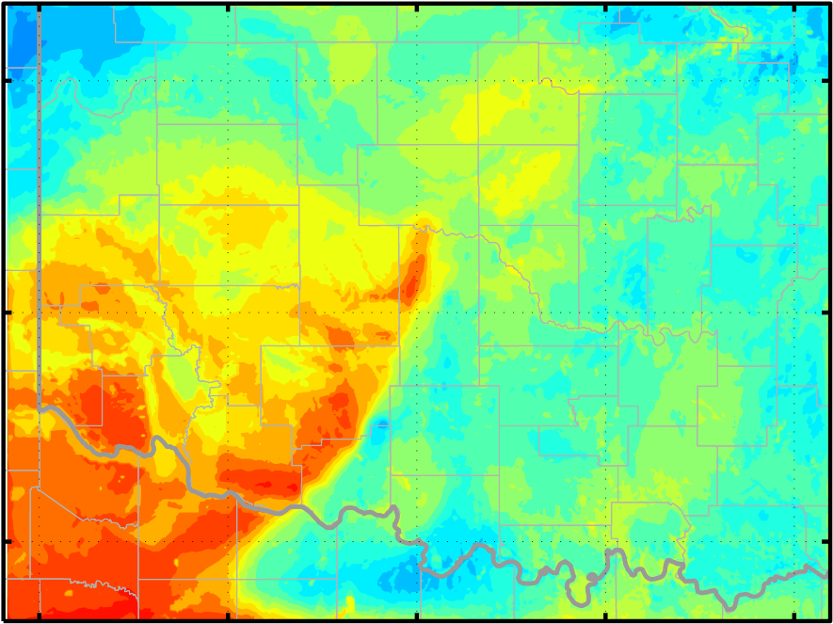
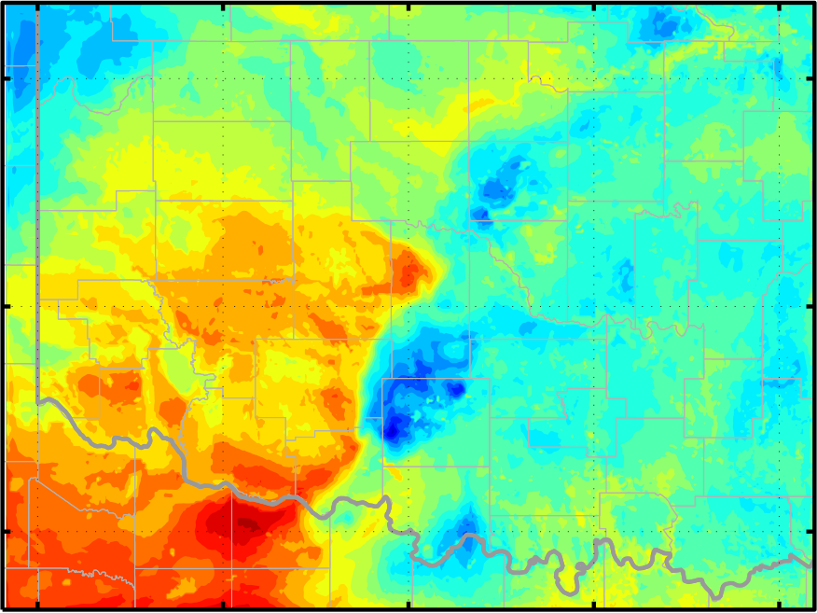
Enhancing Assimilation Strategy
S18V18R18_SFC
S18V18R18_ENKF
Mesonet
19:00
20:00
Surface 2-m Temperature (°C)

Slide 7
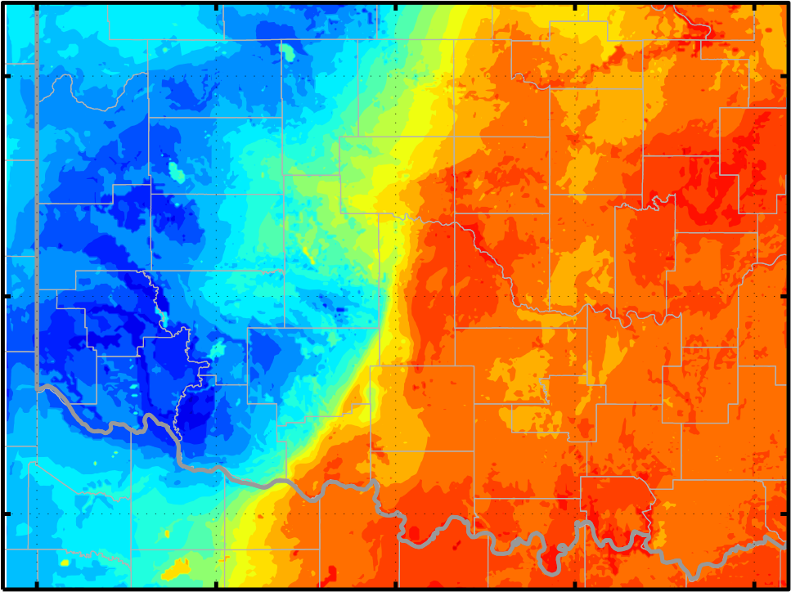
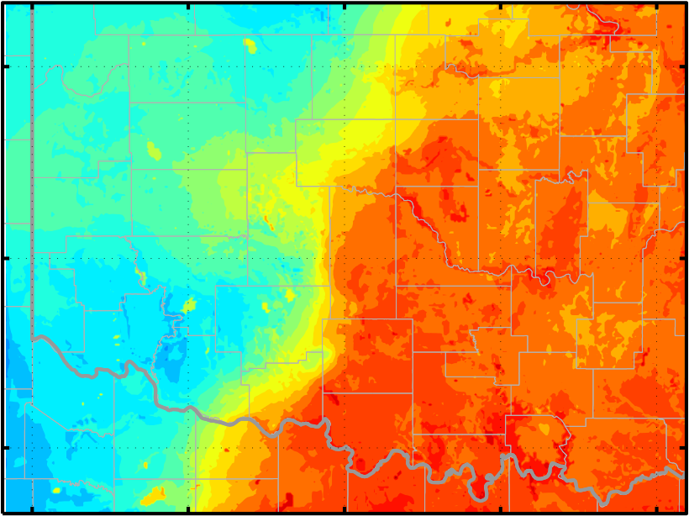
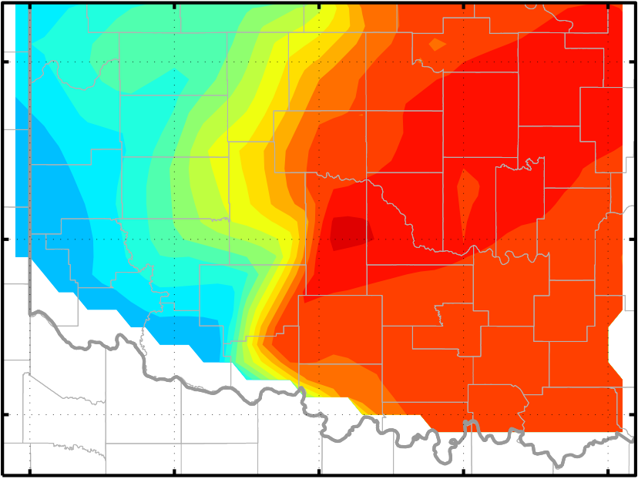
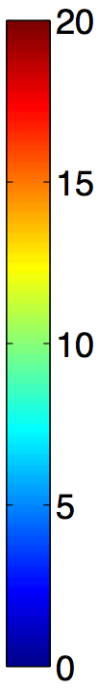
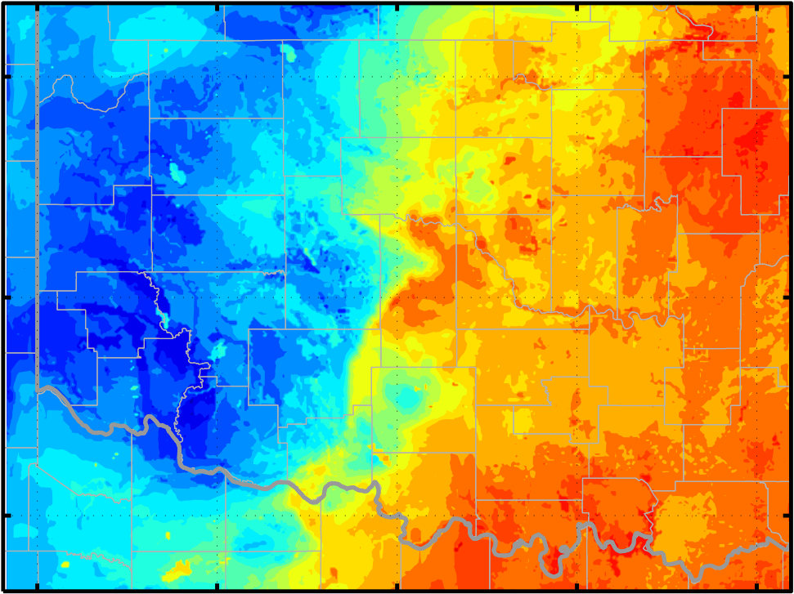
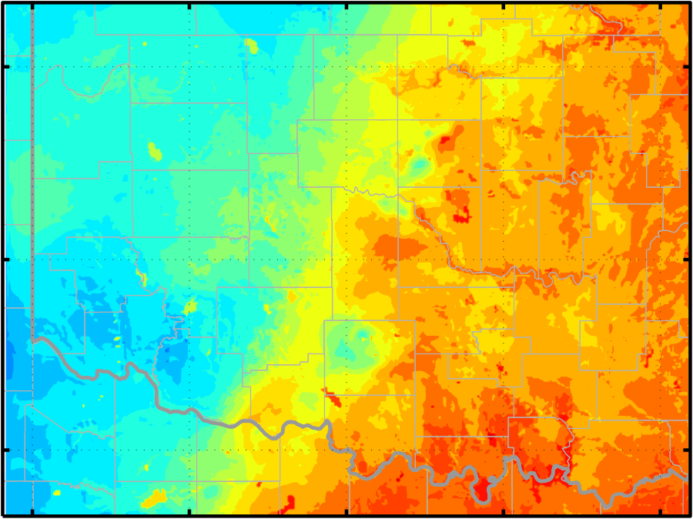
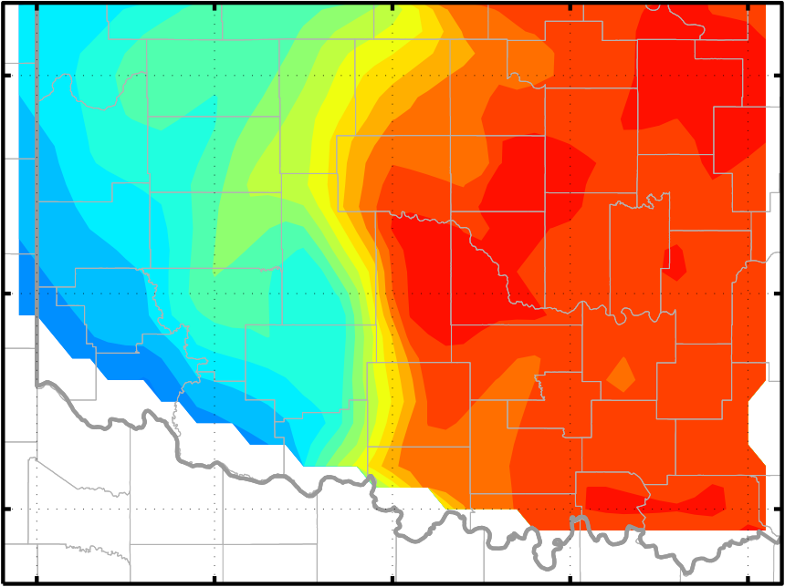
Enhancing Assimilation Strategy
S18V18R18_SFC
V18R18
Mesonet
19:00
20:00
Surface 2-m Water Vapor Mixing Ratio (g/kg)

Slide 8
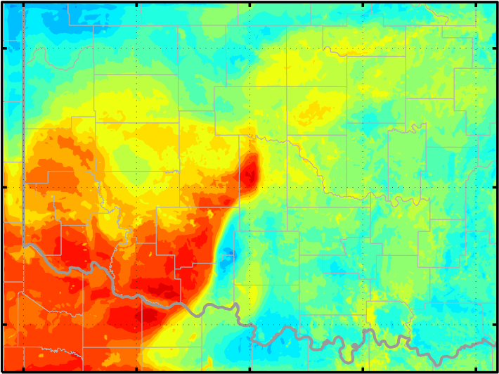
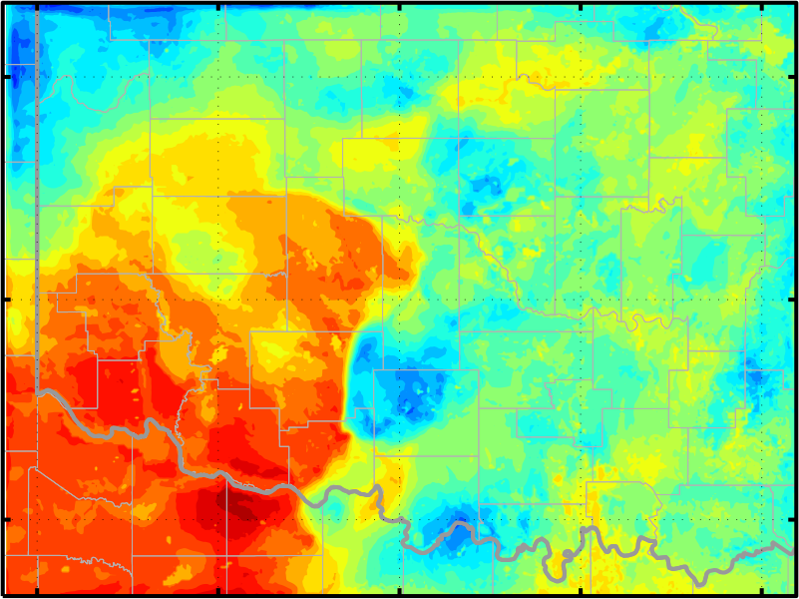
Directly Using WRF-Diagnostics
S18V18R18_SFC
S18V18R18_DIAG
Mesonet
19:00
20:00
Surface 2-m Temperature (°C)

Slide 9
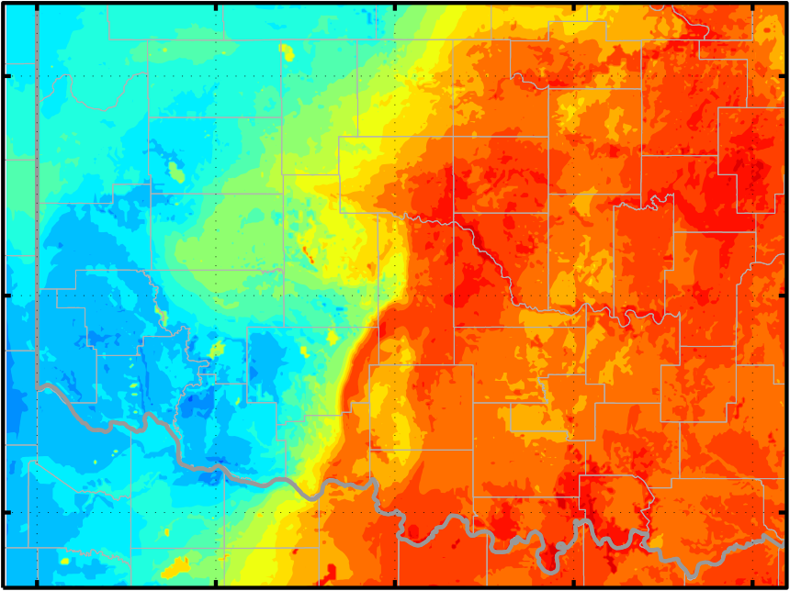
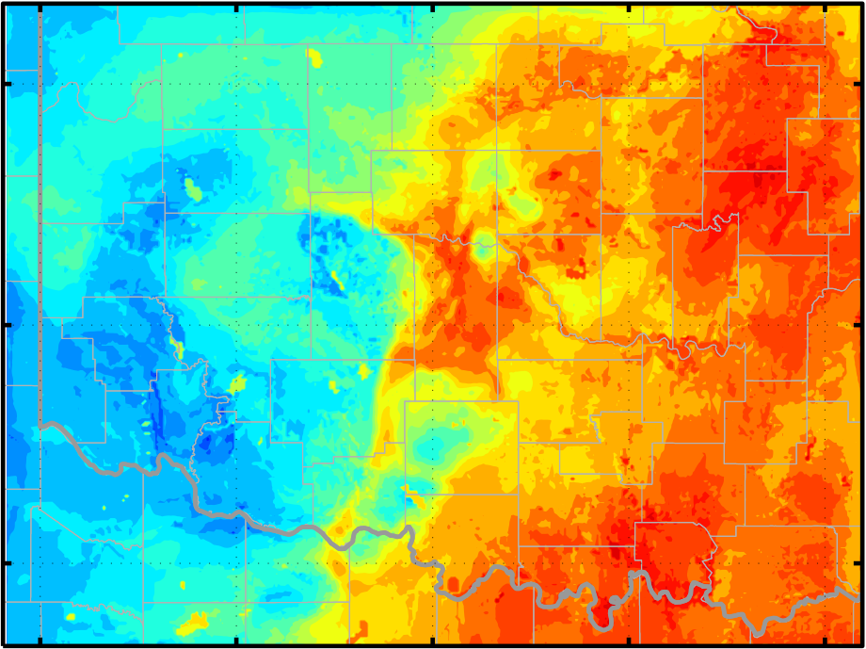
Directly Using WRF-Diagnostics: Q₂
S18V18R18_SFC
S18V18R18_DIAG
Mesonet
19:00
20:00
Surface 2-m Water Vapor Mixing Ratio (g/kg)

Slide 10
RMSE and Bias of Prior Mean
18:00 UTC Statistics of
H(x^{m})_{ENKF} - H(x^{m})_{DIAG}
 | Mean | St. D. | Max | Min
θ | 0.45 | 0.87 | 5.54 | -0.96
T | 0.77 | 1.03 | 5.64 | -0.80
T_{d} | 1.57 | 2.51 | 9.62 | -2.53
U | 0.09 | 0.76 | 2.63 | -1.39
V | -1.39 | 1.86 | 2.43 | -5.29
Thin line: RMSE, St. D. of prior mean error yº-H(x^{m})_{WRF}, H(x^{m}) is diagnosed
Bold line: bias, mean of H(x^{m})_{WRF}-yº

Slide 11
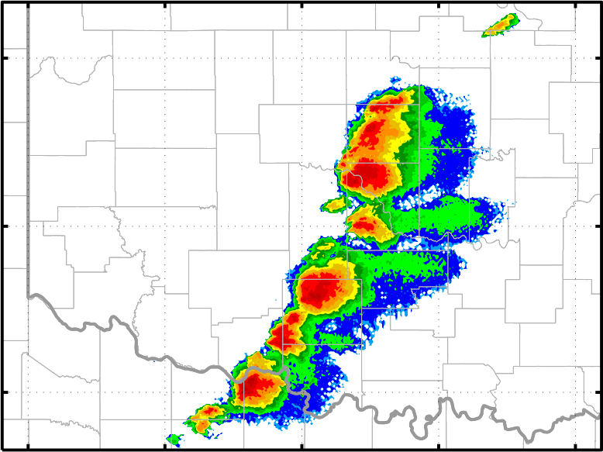
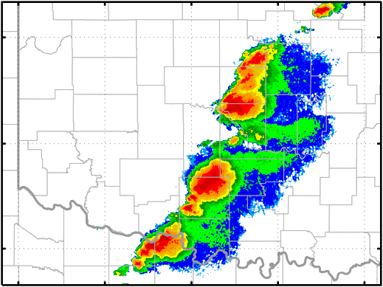
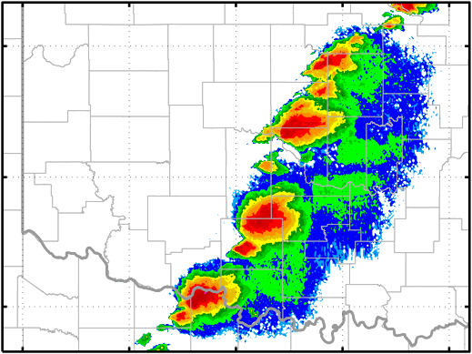
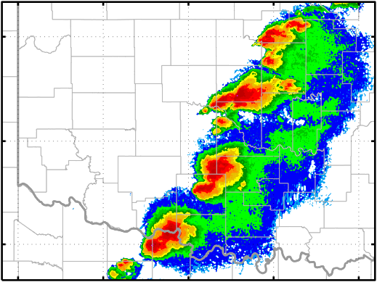
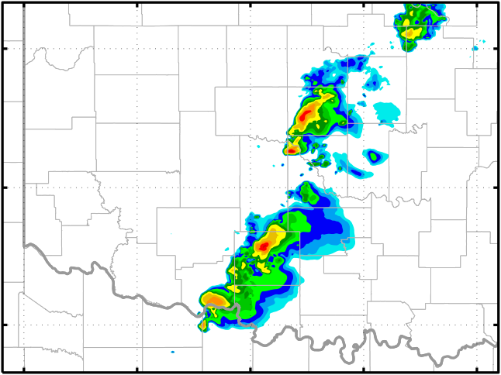
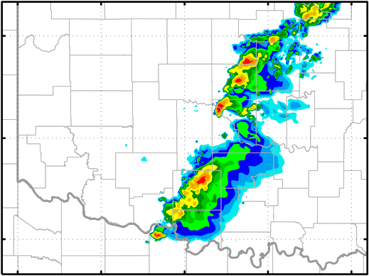
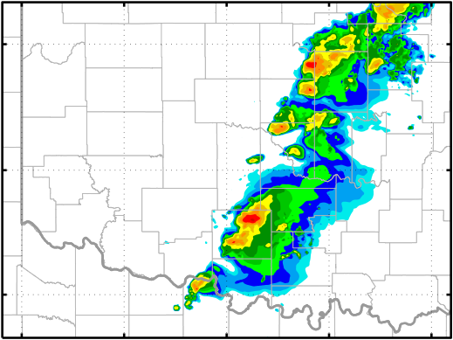
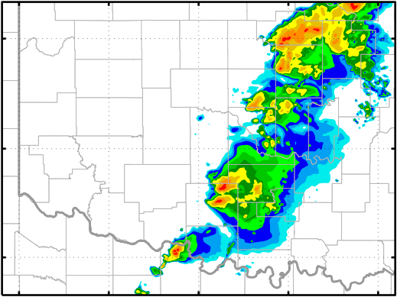
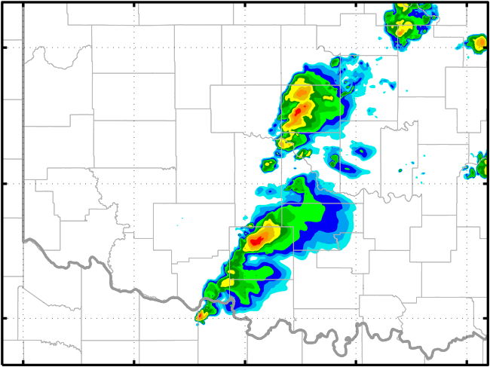
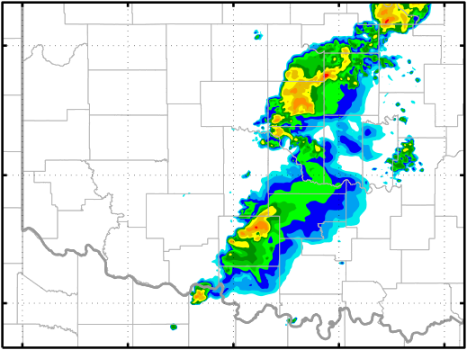
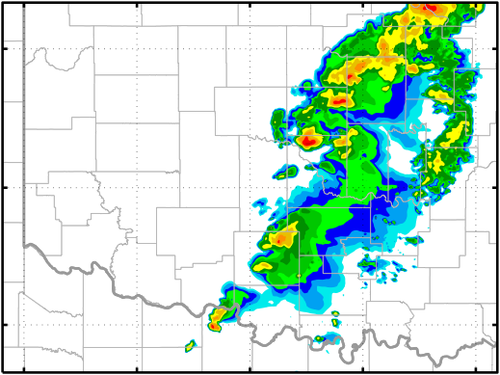
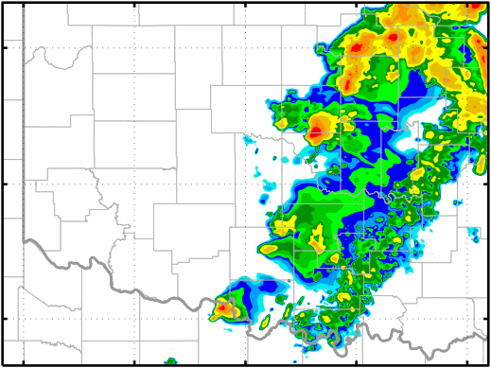
Simulated Composite Reflectivity
19:45
20:00
20:15
20:30
Obs
V18R18
S18V18R18_DIAG

Slide 12

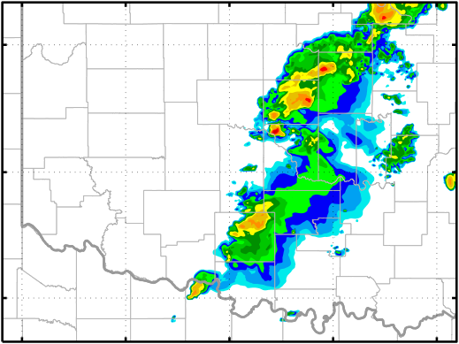
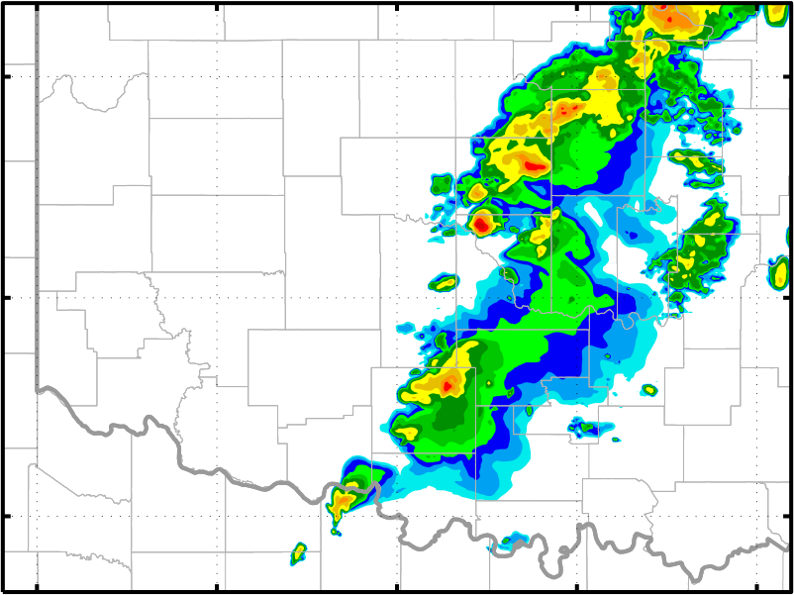
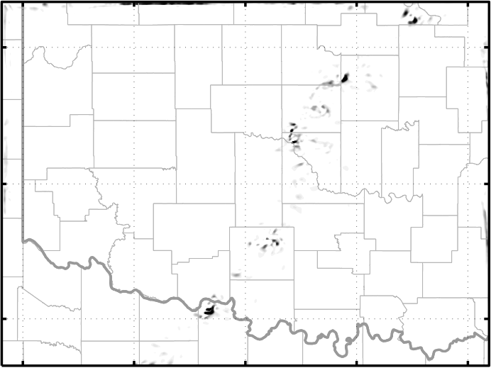
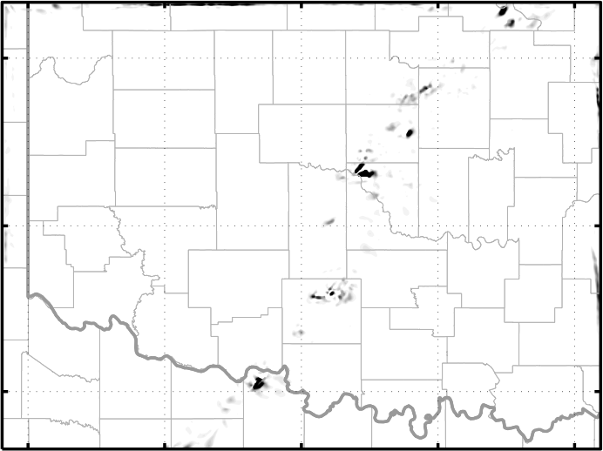
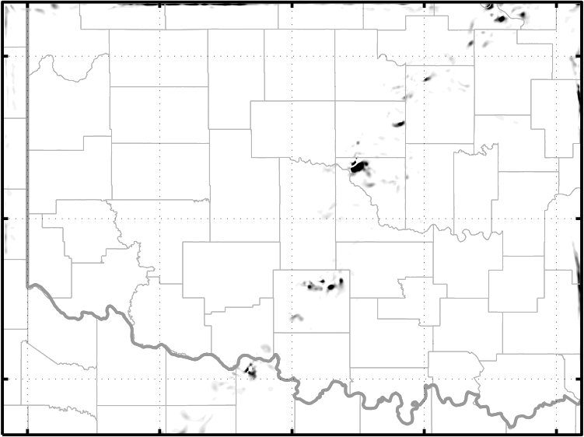
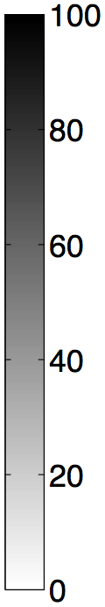
Updraft Helicity in S18V18R18_DIAG
20:00
20:05
20:10
Composite Reflectivity
Updraft Helicity
( , a threshold of 100 m²/s² is used to track mesocyclone in literatures)
(Strong UH appears 20 minutes earlier in V18R18 than S18V18R18_DIAG. Why so?)

Slide 13
Future Works
Begin Mesonet assimilation 3 hours earlier (from 15:00)
Improve convection initialization
Fully double-moment MP, or multi-physics
EnKF in a LES resolution?
Questions & Suggestions?

