Slide 1
Coplane retrieval of airborne radial velocities for Hurricane Katrina (2005)
Christopher Melhauser
Group Meeting
December 11, 2013

Slide 2
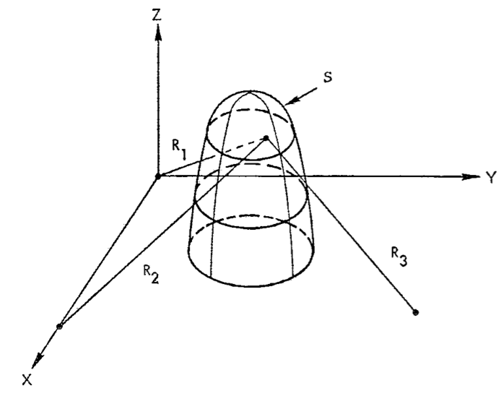
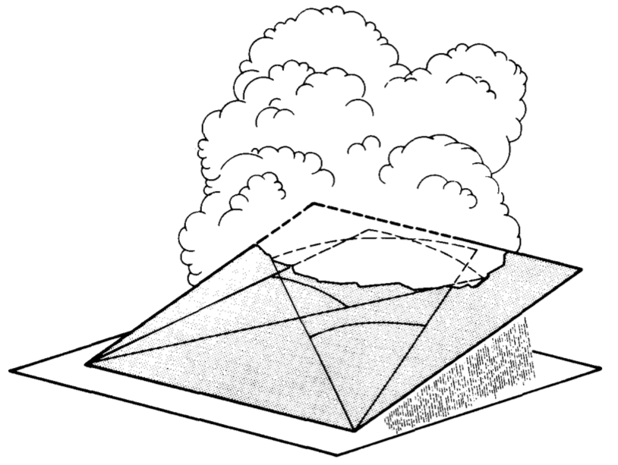
Coordinated Coplanar Scanning
Figure 1: Armijo (1969)
Figure 1: Miller and Strauch (1974)
Armijo (1969):
  Proposed determining u, v, w components of wind
    Two Doppler radars
    mass continuity equation (local variations and advection negligible)
    Assumption: Vertical fall speed of hydrometeors known
Lhermitte and Miler (1970)
  Proposed the COPLAN scanning technique
Miller and Strauch (1974)
  Described technique and algorithm in detail
Chong and Testud (1983)
  Described variational techniques to solve integration errors caused by boundary conditions
Chong and Testud (1996)
  Described airborne coplane technique and error estimates
Notes:
Armijo (1969):
Using an analytical solution to solve for w.
Use cylindrical coordinates to transform the mass continuity into a simpler partial differential equation.
Assume at z=0, w=0 for boundary condition
Lhermitte and Miler (1970):
Proposed at 14th Radar Conference
Miller and Strauch (1971):
Provided case study of snowstorm in Boulder, CO
Chong and Testud (1983):
Boundary conditions extremely important when integrating mass continuity
Large uncertainty in w-component
Doppler radars usually operate at low elevation angle, which implies the contribution of W to the observed radial velocity is poor
Radars actually observe the radial velocity of the hydrometeors
Chong and Testud (1996):
- Use anelastic continuity equation expressed in cylindrical coordinates.

Slide 3
Coplane Geometry - BC
Figure 1: Adapted from Miller and Strauch (1974)
z
Integrate mass continuity to solve mean vertical wind
  Errors amplify exponentially with height
    Biases in surface BC (i.e. orography)
BC assumptions:
  W=0 at Z_{b}
  W=v_{t} at Z_{t}
Proposed solutions:
  Integrate from storm top
  Constrain height integrated divergence (Ziegler, 1978)
  Constraining direct estimates of 3D wind field to satisfy continuity (Ray et al., 1980)
  Use variational technique to adjust error of ground level, i.e. floating BC (Chong and Testud, 1983)
Z_{t}
+y
Radar 1
Baseline
Z_{b}
+x
Radar 2
What can pure geometric retrieval reveal about large-scale hurricane structure?
Can assimilation of these observations improve analyses of TC’s?
Notes:
Chong and Testud (1983)

Slide 4
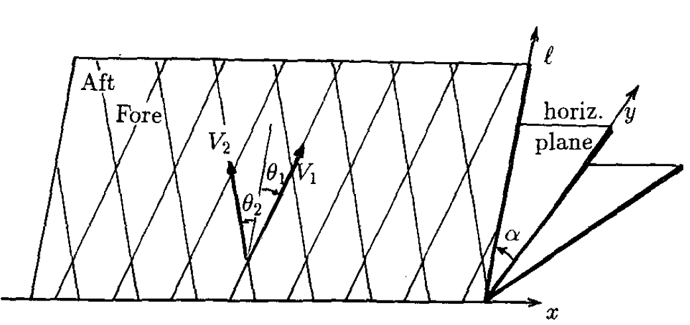
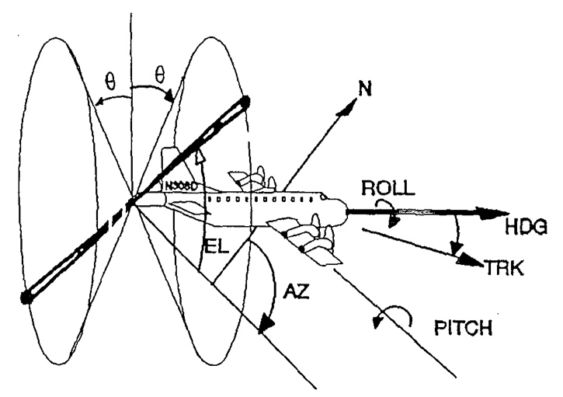
Coplane Geometry - Airborne
Figures 1 & 2: Chong and Testud (1996)
~ 1 km*
760 m**
Performed in cylindrical coordinates
Use fore and aft Doppler radar scans to retrieve mean wind components parallel and perpendicular to flight track on horizontal plane
  Since the aircraft is moving forward, each antenna actually prescribe a helical scan → Assume each fore/aft scan taken at the same time
* Assuming tilt angle of 20º from zenith
** Assuming 10 scans per minute at with plane speed of 130 m s⁻¹
Notes:
Assume 130 m s-1 with 10 scans per minute (i.e. 6 seconds between forward and back scan)
Assume straight line flight track and constant altitude
Pitch, yaw, and roll of aircraft already accounted for in radar data

Slide 5
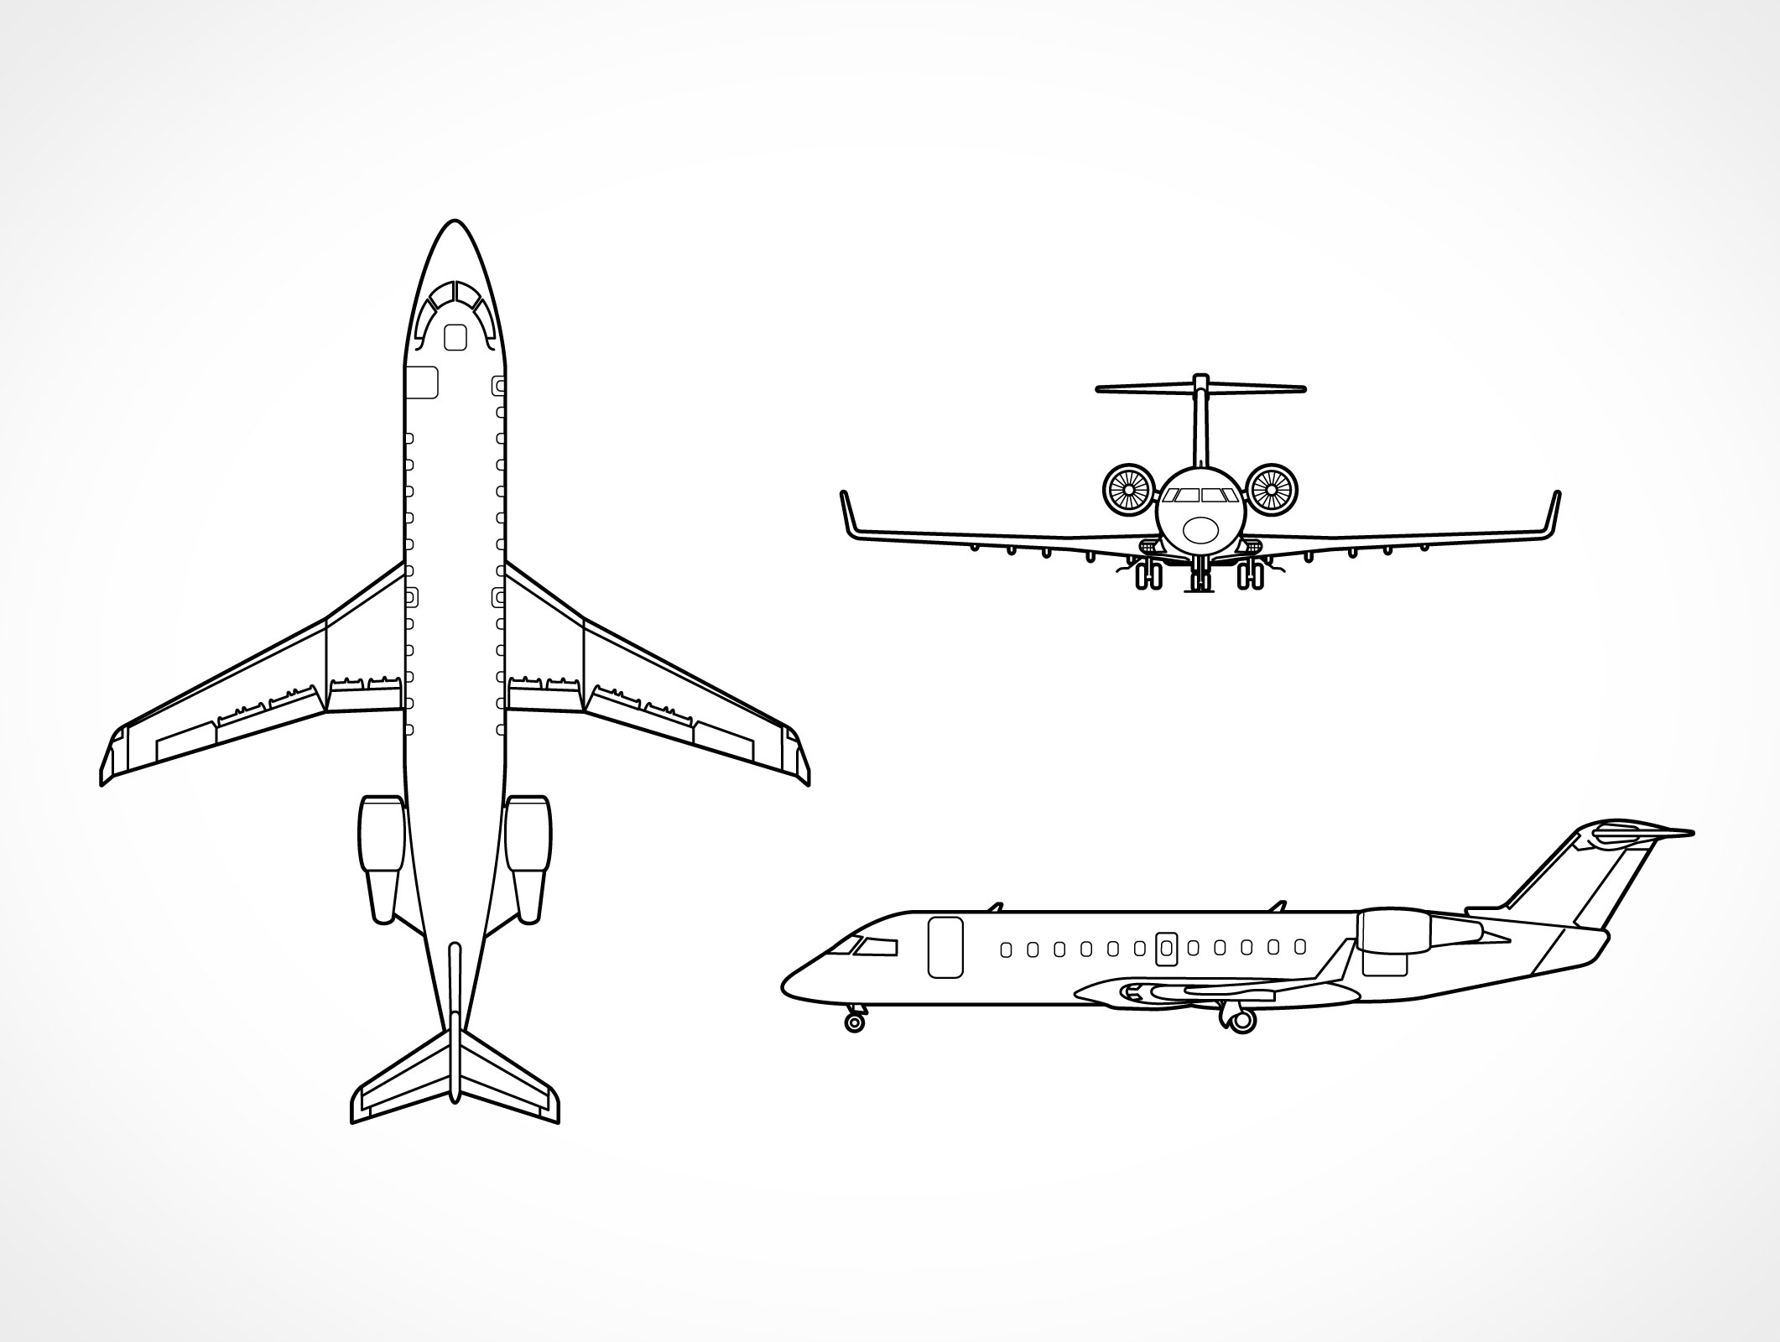
Coplane Geometry - Airborne
s
Beam 1 = fore
Beam 2 = aft
α
r
r
All values of α:
  Unambiguously define mean wind component along flight track:
α = 0º
  Unambiguously define mean horizontal wind component perpendicular to flight track:
α = 90º
  Unambiguously define mean precipitation fall speed

Slide 6
Coplane Geometry
f+2
s
f+1
Assume constant snapshot in time
  10 seconds between fore/aft → use 20 scans (10 fore/10 aft) → 2 minutes
  Advection ignored
Distance from aircraft constrained by geometry and time assumption
  Further distance → requires additional fore/aft scans → reduces confidence in retrieved wind speed
Quality control very important
f
f-1
b+2
f-2
b+1
b
b-1
f = forward scan
b = backward scan
r
b-2
Min: ~1 km
Max: ~41 km

Slide 7
Flight Leg 2018-2058

Slide 8
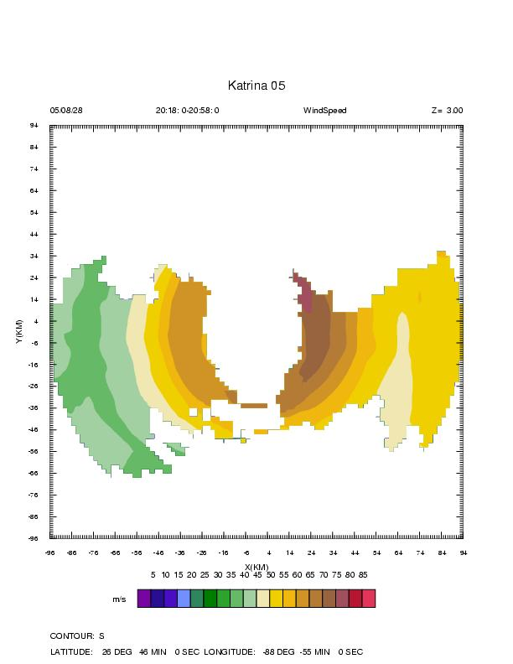
Flight Leg
2018-2058
Flight Level
~1 km coplane retrieved WS
Flight Level WS / ~1 km coplane retrieved WS Departure
RMSE_{starboard} = 4.69 m s⁻¹
RMSE_{port} = 4.44 m s⁻¹
Dual Doppler
(Altitude: 3.0 km)
Coplane Retrieval (Altitude: ~2.8 -3.1 km)
[m s⁻¹]

Slide 9
Katrina Composite
1900-2253
Need to time shift flight legs for comparison
Not apples to apples comparison; altitude changes +/- 700 m along flight leg
[m s⁻¹]

Slide 10
What is next?
Additional QC on retrieved wind velocity, augmented by flight level data
Additional comparison with flight level in-situ observations
Compare coplane retrieval with Dual-Doppler analyses generated at HRD from same radar data
Time shift observations to build composite
Quantify errors in coplane retrieval
  random errors for retrieved v_{r} and v_{s} winds not independent
Assimilate into WRF/COAMPS and compare with SO data

Slide 11
Selected References
Armijo, L., 1969: A Theory for the Determination of Wind and Precipitation Velocities with Doppler Radars. J. Atmos. Sci., 26, 570–573.
Chong, M., J. Testud, 1983: Three-Dimensional Wind Field Analysis from Dual-Doppler Radar Data. Part III: The Boundary Condition: An Optimum Determination Based on a Variational Concept. J. Climate Appl. Meteor., 22, 1227–1241.
Chong, M., and J. Testud, 1996: Three-dimensional air circulation in a squall line from airborne dual-beam Doppler radar : a test of coplan methodology software, J. Atmos. Oceanic Technol. 13, 36-53.
Lhermitte, R. M., and L. J. Miller, 1970: Doppler radar methodology for the observations of convective storms. Preprints 14th Radar Meteorology Conf., Tucson, Amer. Meteor. Soc., 133-138.
Miller, L. J., and R. G. Strauch, 1974: A dual-Doppler radar method for the determination of wind velocities within precipitating weather systems. Remote Sens. Environ., 3, 219-235.
Ray, P. S., C. L. Ziegler, W. Bumgarner and R. J. Serafin, 1980: Single and multiple Doppler radar observations of tornadic storms. Mon. Wea. Rev., 108, 1607-1625
Ziegler, C. L., 1978: A dual-Doppler variational objective analysis as applied to studies of convective storms. Master’s thesis, University of Oklahoma, 115 pp.

Slide 12
Supplementary Slides
Coplane retrieval of airborne
radial velocities for Hurricane Katrina (2005)

Slide 13
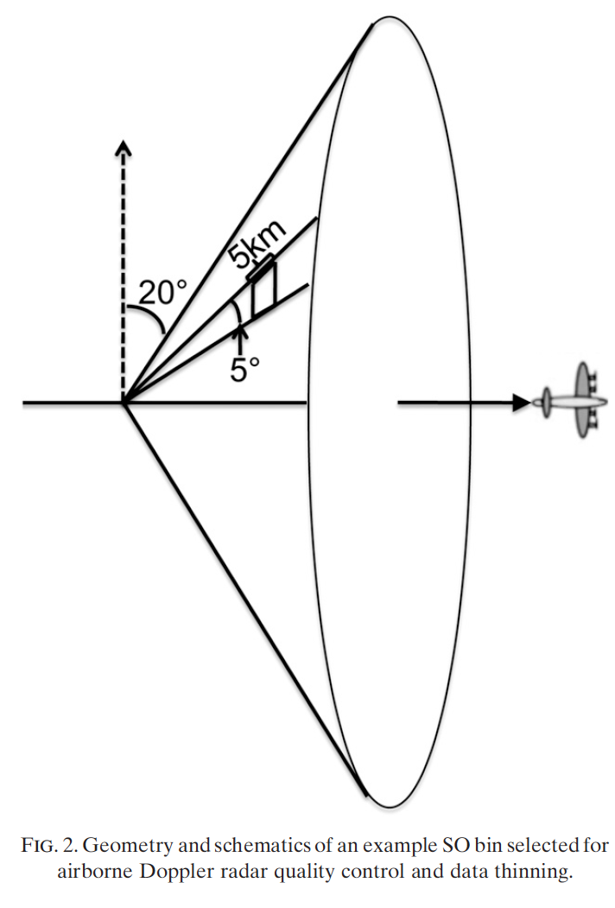
What our group does now…
P-3 Super Observation
Methodology
  Separate forward/backward sweeps
  Generate a volume by combining forward (or backward) scans within 1 minute
  Divide volume into smaller bins
  Observation selection and additional quality control of each observation and bin
  Generate SO value and radar relative location
  Data thinning, random sorting, and innovation thresholds.
One Volume
(Weng and Zhang 2012)
Notes:
Sweep splitting done on each leg. Based on earth relative elevation from horizon. P-3 scanning switches back and forth at top of scanning.
Translation < 5.6 km when scanning; 5 scans in each volume
Each bin has length 5km, azimuth 5º, and thus 5 bins per radial direction.
QC:
Raw observations < 2 m s-1 (inseparable from radar noise) and > 70 m s-1 (larger than maximum unambiguous radial velocity for PRT technique). Remove raw observations within 4 km of radar.
Remove observations if (obs_Vr - bin_mean_Vr) > 2 STDEV bin. Reduce spread of bin.
Remove bin if bin_STDEV > volume_STDEV
Remove bin if < 4 valid raw observations
SO is the median value of bin with observation closest to bin center used for bin location.

Slide 14
Flight Leg 1900-1946

Slide 15
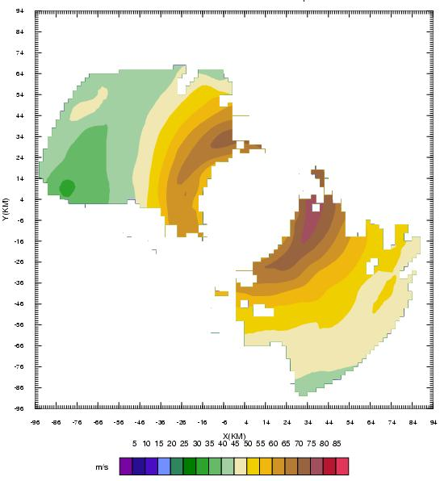
Flight Leg
1900-1946
RMSE_{starboard} = 10.26 m s⁻¹
RMSE_{port} = 11.61 m s⁻¹
[m s⁻¹]
Dual Doppler
Coplane Retrieval

Slide 16
Flight Leg 2209-2253

Slide 17
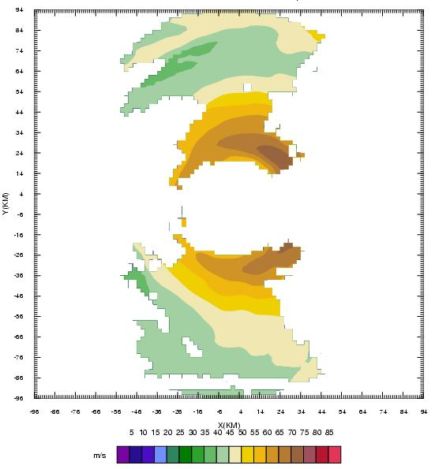
Flight Leg
2209-2253
RMSE_{starboard} = 4.47 m s⁻¹
RMSE_{port} = 5.50 m s⁻¹
[m s⁻¹]
Dual Doppler
Coplane Retrieval

