Slide 1
TRACKING GRAVITY WAVES IN MOIST BAROCLINIC WAVES
Junhong Wei
Fuqing Zhang
Penn State University
Dec. 2013, End-of-semester group meeting

Slide 2
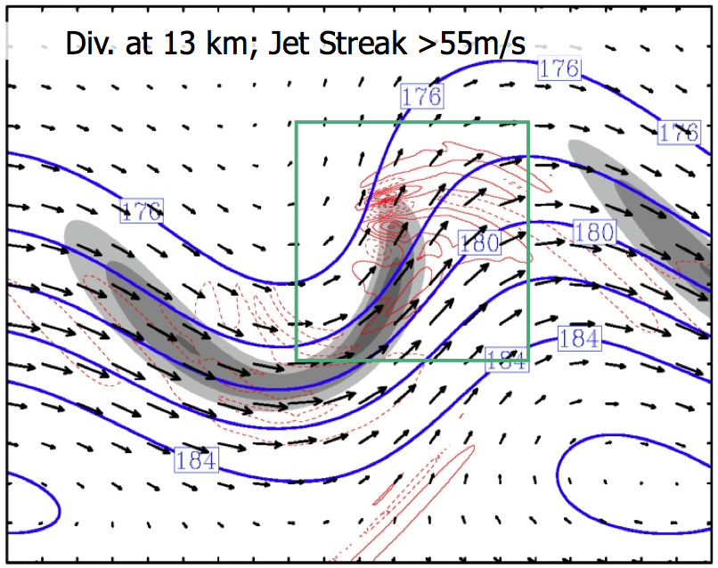
Literature Review ---
Simulation of Dry Baroclinic Waves in MM5
Zhang 2004, JAS; Lin and Zhang 2008, JAS
Zhang (2004): Long-lived vertically propagating mesoscale gravity waves in the jet exit region are simulated.
WP1
WP2
???
???
WP3
WP4
Mesoscale Numerical Simulations Based on MM5

Slide 3
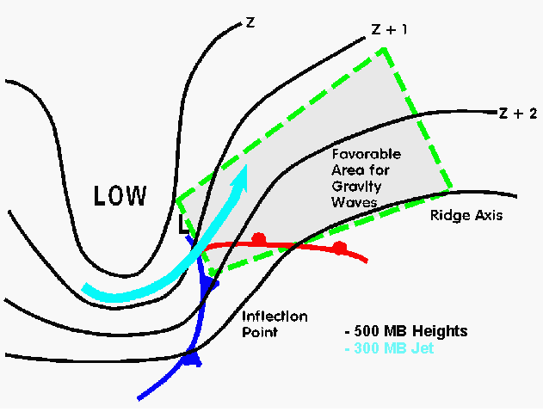
Literature Review ---
Simulation of Dry Baroclinic Waves in MM5
Zhang 2004, JAS; Lin and Zhang 2008, JAS
Uccellini and Koch, 1987, MWR
WP1
WP2
???
???
WP3
UK87 Conceptual Model on Preferred Area for Mesoscale Gravity Wave in Baroclinic Jet-Front System
WP4
Mesoscale Numerical Simulations Based on MM5

Slide 4
Literature Review ---
Simulation of Dry Baroclinic Waves in MM5
Zhang 2004, JAS; Lin and Zhang 2008, JAS
Zhang (2004): Long-lived vertically propagating mesoscale gravity waves in the jet exit region are simulated.
Zhang (2004): It is hypothesized that the continuous generation of ﬂow imbalance from the developing baroclinic wave will lead to the continuous radiation of gravity waves.
WP1
WP2
???
???
WP3
WP4
Mesoscale Numerical Simulations Based on MM5

Slide 5
Literature Review ---
Simulation of Dry Baroclinic Waves in MM5
Zhang 2004, JAS; Lin and Zhang 2008, JAS
Zhang (2004): Long-lived vertically propagating mesoscale gravity waves in the jet exit region are simulated.
Zhang (2004): It is hypothesized that the continuous generation of ﬂow imbalance from the developing baroclinic wave will lead to the continuous radiation of gravity waves.
Lin and Zhang (2008): Using a four-dimensional ray-tracing technique, the propagating characteristics and source mechanisms of mesoscale gravity waves simulated in idealized baroclinic jet-front systems are investigated.
WP1
WP2
???
???
WP3
WP4
Mesoscale Numerical Simulations Based on MM5

Slide 6
Literature Review ---
Simulation of Dry Baroclinic Waves in MM5
Zhang 2004, JAS; Lin and Zhang 2008, JAS
Zhang (2004): Long-lived vertically propagating mesoscale gravity waves in the jet exit region are simulated.
Zhang (2004): It is hypothesized that the continuous generation of ﬂow imbalance from the developing baroclinic wave will lead to the continuous radiation of gravity waves.
Lin and Zhang (2008): Using a four-dimensional ray-tracing technique, the propagating characteristics and source mechanisms of mesoscale gravity waves simulated in idealized baroclinic jet-front systems are investigated.
Lin and Zhang (2008): WP1 and WP2 may originate from the upper-tropospheric jet-front system where there is maximum imbalance, though contributions from the surface fronts cannot be completely ruled out.
WP1
WP2
???
???
WP3
WP4
Mesoscale Numerical Simulations Based on MM5

Slide 7
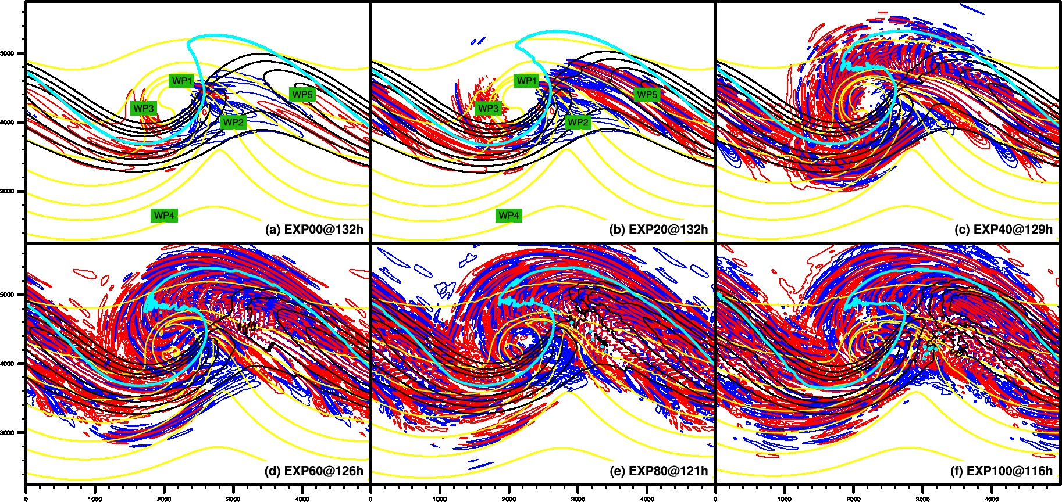
Literature Review ---
Simulation of Moist Baroclinic Waves in WRF
Wei and Zhang 2013, JAS, accepted
Simulated 1-km temperature (yellow lines), 8-km horizontal wind (black lines), 12-km horizontal divergence (blue/red lines, positive/negative)

Slide 8
Literature Review ---
Simulation of Moist Baroclinic Waves in WRF
Wei and Zhang 2013, JAS, accepted
EXP00
Dry Localized Identifiable Gravity Wave Modes Generated By Dry Source
EXP20
Dry Gravity Wave Modes Continue to Dominate
Similar Wave Characteristics With Those in EXP00
The Amplitude of WP5 Is Enhanced By ~2 Times
Modification in WP3
EXP40
Both Shorter-Scale Waves and Intermediate-Scale Waves Are Essential

Slide 9
Literature Review ---
Simulation of Moist Baroclinic Waves in WRF
Wei and Zhang 2013, JAS, accepted
EXP60
More Variances of Shorter-Scale Gravity Waves In the Jet Exit Region
EXP80
Shorter-Scale Wave Signatures Filling the Jet
Imprint of Intermediate-Scale Wave Signatures South of the Upper-Level Northwesterly Jet
EXP100
Particularly Hard to Determine the Dominant Orientation of Wave Front South of the Upper-Level Northwesterly Jet

Slide 10
Literature Review ---
Simulation of Moist Baroclinic Waves in WRF
Wei and Zhang 2013, JAS, accepted
EXP00
Dry Localized Identifiable Gravity Wave Modes Generated By Dry Source
EXP20
Dry Gravity Wave Modes Continue to Dominate
Similar Wave Characteristics With Those in EXP00
The Amplitude of WP5 Is Enhanced By ~2 Times
Modification in WP3

Slide 11
Ray Tracing Analysis
WP3-EXP00, WP3a-EXP20, WP3b-EXP20
Horizontal Propagation of WP3-EXP00, WP3a-EXP20, WP3b-EXP20 Based on a Ray Tracing Model
WP3-EXP20
Tracjectories along the 1-km isothermal, as well as the 12-km phase line.
Fast vertical propagation
Potential Source: Surface Front
WP3b-EXP20
Rays traced back to the northeast
Slow vertical propagation below 8 km
Potential Source: Front, Convection

Slide 12
Ray Tracing Analysis
WP3-EXP00, WP3a-EXP20
Comparison
Lower jet core level along the trajectory of WP3a-EXP20
Lower tropopause along the trajectory of WP3a-EXP20
Accordingly, the maximum/minimum of vertical wavelength in WP3a-EXP20 is slightly lower than those in WP3-EXP00.
However, their potential source may both be surface front.
Wave Characteristics Along the Ray

Slide 13
Ray Tracing Analysis
WP3-EXP00, WP3a-EXP20, WP3b-EXP20
Horizontal Propagation of WP3-EXP00, WP3a-EXP20, WP3b-EXP20 Based on a Ray Tracing Model
WP3-EXP20
Tracjectories along the 1-km isothermal, as well as the 12-km phase line.
Fast vertical propagation
Potential Source: Surface Front
WP3b-EXP20
Rays traced back to the northeast
Slow vertical propagation below 8 km
Potential Source: Front, Convection

Slide 14
Ray Tracing Analysis
WP3b-EXP20
Comparison
All the rays can be traced back to below 3-5 km.
Within 8-12 km, no significant change in horizontal wavelength, vertical wavelength, and intrinsic frequency.
Below 8 km, the lower the ray is, the smaller the vertical wavelength is, the larger the horizontal wavelength, therefore, the smaller intrinsic frequency is.
All the rays are stopped because of small vertical group velocity.
Wave Characteristics Along the Ray

Slide 15
Ray Tracing Analysis
WP5s-EXP00, WP5n-EXP00, WP5s-EXP20, WP5n-EXP20
Comparison Between WP5s-EXP00 and WP5s-EXP20
Similar trajectory for the south ray
Slightly different trajectory for the center and north ray

Slide 16
Ray Tracing Analysis
WP5s-EXP00, WP5n-EXP00, WP5s-EXP20, WP5n-EXP20
Schematic Explanation For Initial Vertical Group Velocity Between WP5s-EXP00 and WP5s-EXP20
Smallest Vertical Group Velocity
Biggest Vertical Group Velocity
Biggest Vertical Group Velocity

Slide 17
Ray Tracing Analysis
WP5s-EXP00, WP5s-EXP20
Comparison
Different behavior for the south, center, north rays
As the rays propagates upward within 10-12 km, horizontal wavelength decreases, vertical wavelength decreases, intrinsic frequency decreases.
Wave Characteristics Along the Ray

Slide 18
Ray Tracing Analysis
Wave Capture
Asymptotically, the wave vector will tend to
Define the strengching rate as:
Wave Capture Limit For Intrinsic Frequency
If wave packet remains in a region where D > 0, then horizontal wave number experiences exponential growth.
Propagation effect will favor certain orientation and intrinsic frequency.

Slide 19
Ray Tracing Analysis
WP5s-EXP00, WP5n-EXP00, WP5s-EXP20, WP5n-EXP20
Hypothesis for the comparison between WP5s-EXP00 and WP5s-EXP20
Most sensitive to the moisture
More possibility to escape from being captured by the background flow
Easy to be captured, or easy to be stopped by background effect
Lest sensitive to the moisture
Less possibility to escape from being captured by the background flow
Hard to be captured, or easy to escape from the background flow

Slide 20
Ray Tracing Analysis
WP5s-EXP00, WP5n-EXP00, WP5s-EXP20, WP5n-EXP20
EXP00
EXP20
Dry Source
Dry Source
Moist Source/Dynamic
WP5n-EXP00
WP5n-EXP20
The tracing is more to the north.
The tracing is more to the west.

Slide 21
Ray Tracing Analysis
WP6-EXP00, WP6-EXP20
Directly above the latent heating release associated with convection
Their trajectories are almost parallel to their phase line
Potential Source: Convection

Slide 22
Ray Tracing Analysis
WP6-EXP20, WP6-EXP100
Comparison
Fast propagation to slow propagation
Angle different tend to be 90 degree within 6-12 km.
Wave Characteristics Along the Ray

Slide 23
Literature Review --- Ray Tracing Equation
This term may be small for WP6.

Slide 24
Summary
A series of ray-tracing experiments are performed to study the propagating wave characteristics and source mechanisms of the mesoscale gravity waves in EXP00 and EXP20.
On one hand, the resemblances between EXP00 and EXP20 in ray-tracing analysis demonstrate the limitation of moisture in modifying certain dry waves.
On the other hand, ray-tracing analysis also partly reflect the role of moist convection.
Ray-tracing analysis confirms that the wave structures for the southern part of the wave packets from the jet exit region in the ridge down to the jet entrance region in the trough may be largely constrained by the environmental wind shear through the wave capture mechanism. In particular, the sensitivity experiment to spatial variability suggests that there may be more chances of escaping waves from being captured by propagation effect over the center part and north part of those waves in EXP20.

Slide 25
Ray Tracing Analysis
WP5s-EXP00, WP5n-EXP00, WP5s-EXP20, WP5n-EXP20
Future Study
Wave Capture
Momentum flux/drag comparison between tracing model and mesoscale simulation

