Slide 1
A Story of the PSU Hurricane System
Group-meeting @ 20131212

Slide 2
The track of PSU EnKF system
  2003, Snyder & Zhang, 1st time EnKF + radar (OSSE); 294 cites;
2004, Zhang et al., relaxing method in EnKF. 216 cites;
2004, Dowell & Zhang et al., 1st time real radar data EnKF assimilation; 166 cites;
2006, Zhang, Meng and Aksoy, MM5-EnKF; 73 cites;
2007, Meng & Zhang, multi-physics EnKF; 80 cites;
2008, Meng & Zhang, WRF-EnKF; 65 cites;
2008, Meng & Zhang, month-long experiment; 38 cites;
2009, Zhang et al., WRF+parallel-EnKF; real ground-based radar; cloud-resolving hurricane; Super-Observing (SO) method; SCL; 96 cites;
2012, Weng & Zhang, Airborne radar EnKF; airborne radar SO method; 18 cites;
2011, Zhang et al., real-time performance with large cases for airborne radar; 25 cites;
2014, cycling WRF-EnKF with all recon observations;

Slide 3
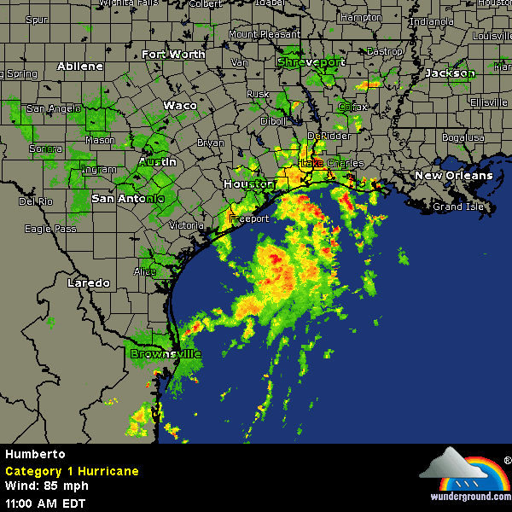
Ground-base Radar for Hurricane Humberto (2007): radars
Reflectivity Mosaic

Slide 4
Ground-base Radar for Hurricane Humberto (2007) : intensity forecasts
NoDA
Operational Forecasts
WRF-EnKF with Vr
Zhang et al., 2009

Slide 5
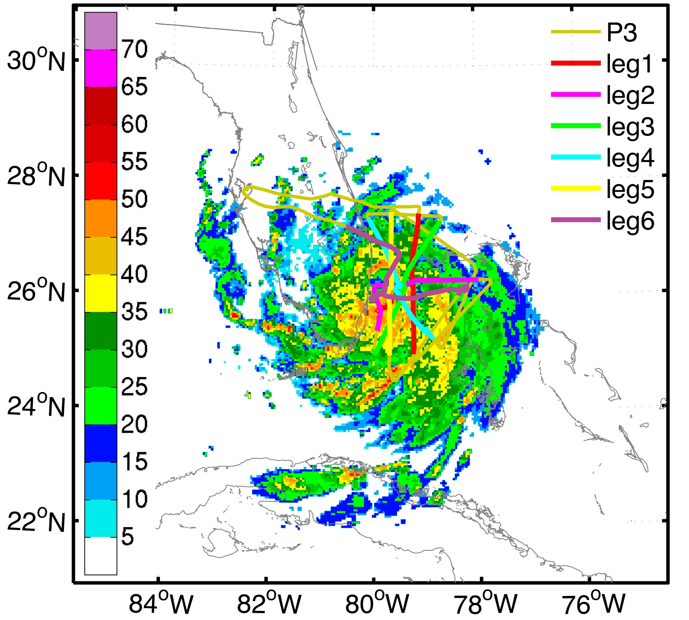
Airborne Radar for Katrina
The NOAA P3 flight track of the 050825I1 mission during August 25 2005 and KAMX composite reflectivity at 2000 UTC 25 Aug 2005, the middle point of time of the last leg over the 4.5 km horizontal resolution model domain. The colored lines with label are the tracks of flight leg – a line across the storm center.
P3 LF composite reflectivity of the 1st leg at Aug 25, 2005.

Slide 6
Airborne Radar for Katrina
Hurricane track (a), minimum sea level pressure (b) and maximum 10m wind speed (c) forecasts. (Weng&Zhang, 2012)

Slide 7
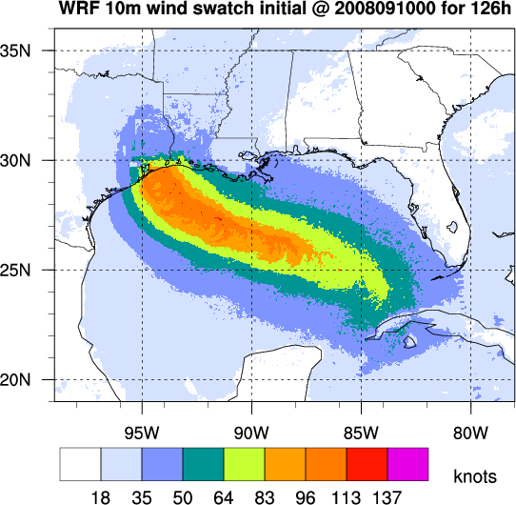
1st time real-time forecast for hurricane Ike (2008)
120h rain obs.
Tracks
Intensity Swatch
孟子曰："天时不如地利，地利不如人和..."
Mencius said, Opportunities of time vouchsafed by Heaven are not equal to advantages of situation afforded by the Earth, and advantages of situation afforded by the Earth are not equal to the union arising from the accord of Men.
Vmax
120h rain prediction

Slide 8
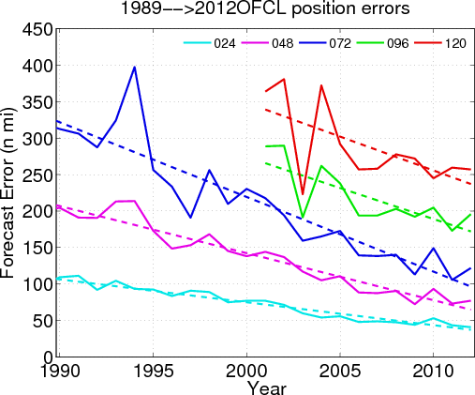
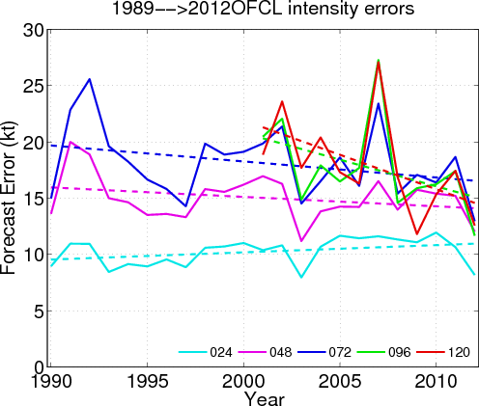
Performance over 5-year cases
NHC yearly intensity forecast error
NHC yearly track forecast error
PSU 5-year track forecast error
PSU 5-year intensity forecast error
Zhang&Weng, 2014
Notes:
Figure 1: NHC (a) track error, (b) intensity error.

Slide 9
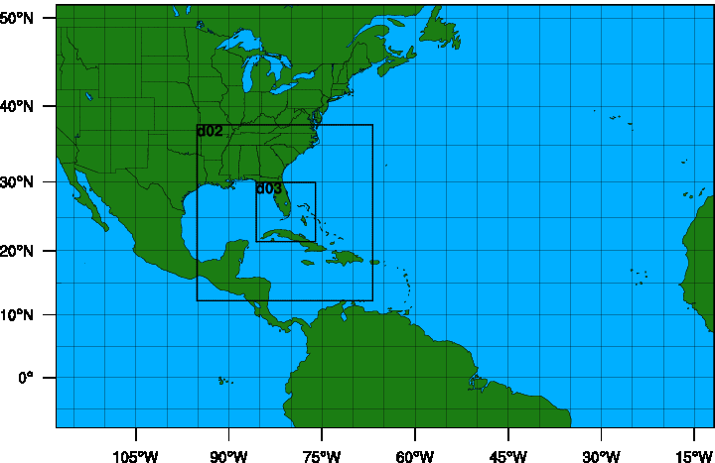
PSU WRF-EnKF Cycling System
ARW | V3.4.1
Cumulus | Grell-Devenyi ensemble (27 km domain only)
Microphysics | WSM 6-class graupel
PBL | YSU
Surface Layer | Monin-Obukov
Land Surface | thermal diffusion
Radiation | Rrtm / Dudhia
Air-sea flux | Green and Zhang
Ocean | 1-D
60-member ensemble
Gaspairi & Cohn 99' covariance localization with varying RoI
IC & BC: GFS using 3DVAR background uncertainty
Hourly assimilation with TDR over all 3 domains
D1: 379x244x27kmx44sigma
D2: 304x304x9km
D3: 304x304x3km
ATCF IDs:
APSU: stream 1.5, ARW 3-km deterministic forecast;
PS01-10: stream 2.0, ARW 3-km ensemble forecasts.
Notes:
There are 2 streams for PSU in 2012. Stream 1.5 named ATCF ID APSU is ARW deterministic forecast initialized with TDR data assimilation, while stream 2.0 ANPS is ARW deterministic forecast initialized with operational GFS analysis. Both of them have the same WRF model configuration. They have 3 domains with 27,9,3 km resolution, the out domain is fixed, the 2 inner domains are centered by the TCVital data. For TDR data assimilation, there are 60 members initialized with operational GFS and perturbed by WRFDA.

Slide 10
PSU Cycling System Workflow
WPS & real.exe
1(job)* 32(cores)*4 minnutes
WRFDA perturb
16J*16* 14m
(256 coers)
BC perturb
3J *8c *2m
3-h WRF
61J*32* 20m
2928c
Replace environment
3J *16c *8m
EnKF
3J *128c *8~65m
3-h WRF
61J*32* 20m
2928c
EnKF
3J *128c *8~65m
(depend on the number of obs)
4 epochs: 00,06,12,18Z @+3:45h
WRF Init
6J * 32 *8m
192c
Replace mean
3J *16c *7m
Replace environment
3J *16c *8m
14:36
14:28
Low Priority (submit after APSU and AP?? running)
15:46
16:04
e.g. for 06Z,
Starts @ 09:45
09:49
10:03
10:11
10:18
10:26
11:31
APSU: 1J *512c *130m
13:41
AP01~10: 10J *240c *180m
14:31
WPP & GFDL Tracker:
11J *16c *24m
NCL plotting:
11J * 16c * 30m
WPS & real.exe
1J *32c *24m
BC perturb
10J *8c *2m
Initial: arwenkf_step1_icbcs.sh
10:55
Assimilation: arwenkf_step2_anacycle.sh
11:20
11:22
Forecast: arwenkf_step3_forecast.sh
WPS & real.exe
1(job)* 32(cores)*4 minnutes
WRFDA perturb
16J*16* 14m
(256 coers)
BC perturb
3J *8c *2m
EnKF
3J *128c *8~65m
(depend on the number of obs)
12Z,
Starts @ 15:45
/lfs2/projects/hfip-psu/yweng/D2013/APSU_Shell/run_APSU.sh
WRF Init
6J * 32 *8m
192c
Replace mean
3J *16c *7m
Replace environment
3J *16c *8m
15:49
16:03
16:11
16:18
16:26

Slide 11
PSU Cycling System: retrospective cases over 2008-2012
Track errors
Intensity errors
PSU NoDA vs. NHC
PSU NoDA vs. PSU Cycling with conventional obs.
PSU Cycling with con. obs. Vs. con.+recon obs.

Slide 12
PSU 2013 real-time performance
track (km)
Vmax (kt)
Bias-corrected Vmax (kt)
Vmax (kt) without homo
Mean absolute forecast errors homogeneously averaged for 2013 stream 1.5 APSU (red), operational OFCL (cyan), GFS (purple), HWRF (blue) and GFDL (green).
Only include the cases in ATCF a-deck files.

Slide 13
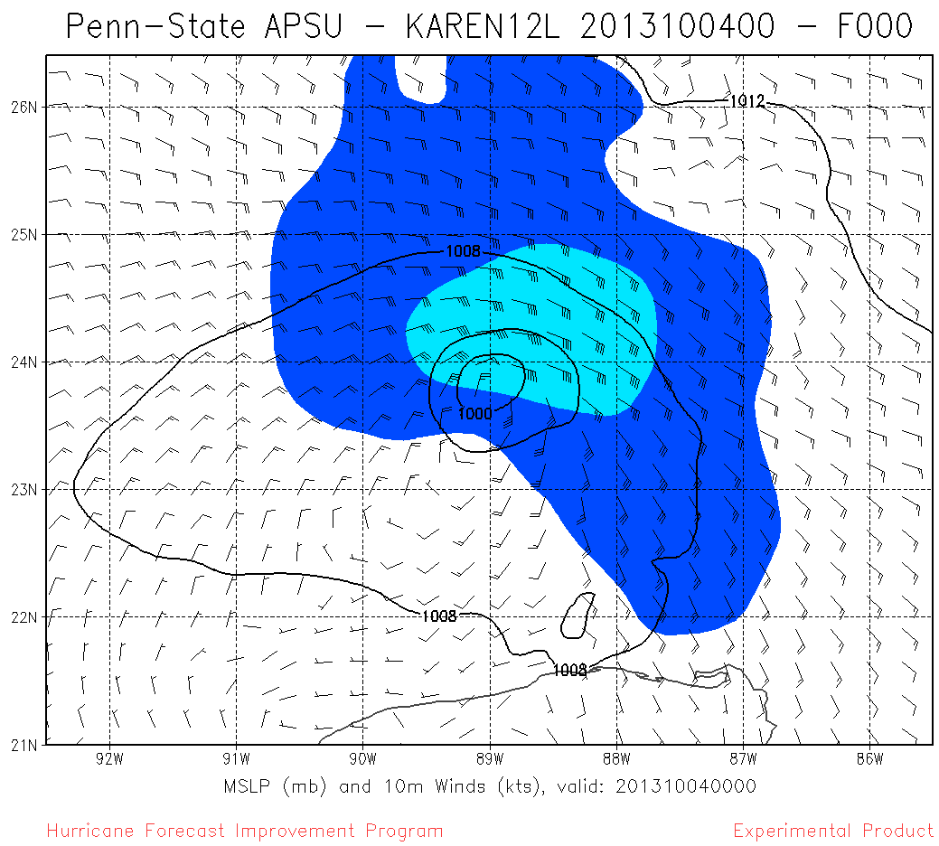
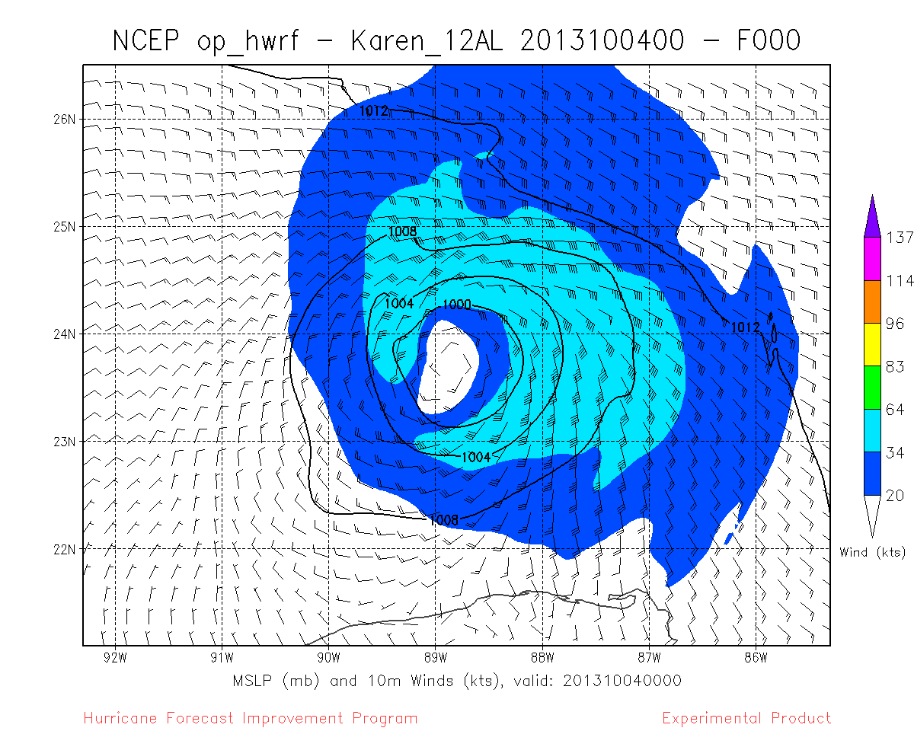
Benefited from Recon inner-core obs.
00Z 4 Oct
PSU IC
HWRF IC
NOAA dropsondes for tropical storm Karen.
06Z 4 Oct
MSLP (mb, contour), 10m winds (bar) and its wind speed (shaded) derived from the initial fields of APSU (left column) and HWRF (right column) at 00Z (top row) and 06Z (bottom row), respectively. These figures are produced by David Zelinsky.

Slide 14
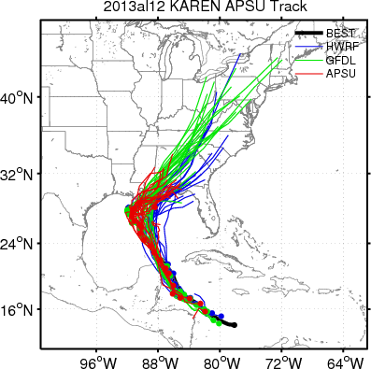
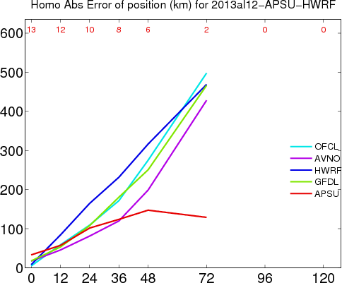
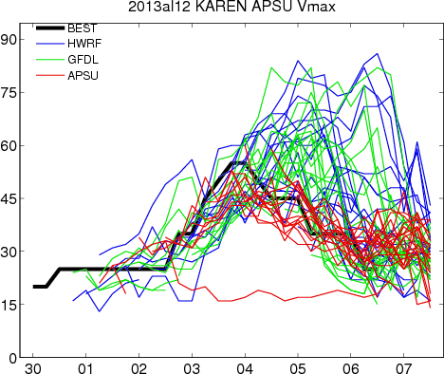
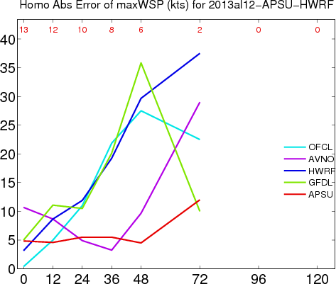
Benefited from Recon inner-core obs.
Track
Track errors
Intensity errors
Intensity
Track (top-left) and intensity (top-right) forecasts and their mean absolute forecast errors of track (bottom-left, unit: km) and intensity in the term of maximum surface wind speed (bottom-right, unit: knots) homogeneously averaged for 2013 stream 1.5 APSU (red), operational OFCL (cyan), GFS (pink), HWRF (blue) and GFDL (green) for tropical storm Karen.

Slide 15
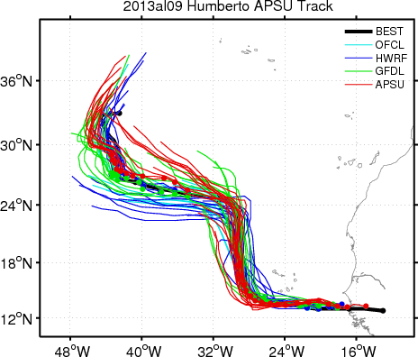
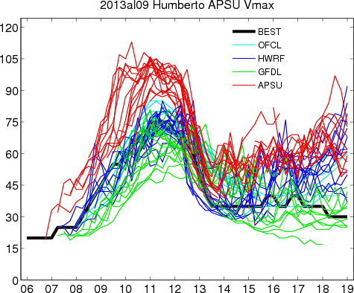
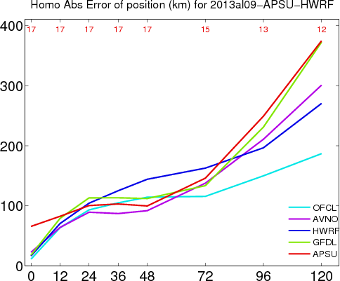
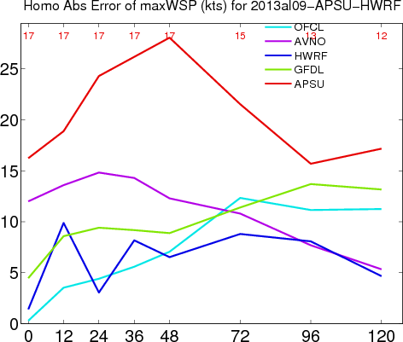
Worse forecasts without inner-core obs.
Track
Intensity
Track errors
Intensity errors
Operational forecast for Humberto

Slide 16
Summary
EnKF had being developed over 13 years in our group.
Real-time performance is a key step for EnKF.
Where will we go?
  Real operation
  E4DVar
  Satellite
  Other convective systems

