Slide 1
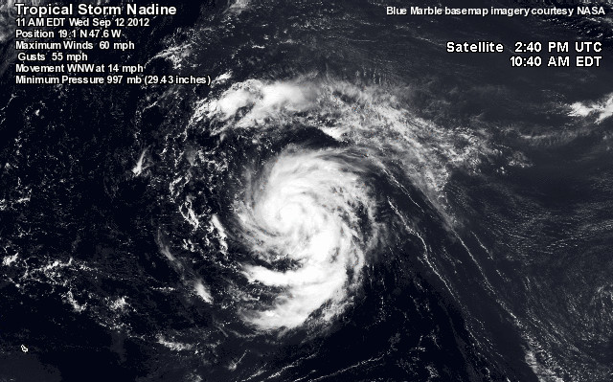
Predictability and forecast evaluation of ensemble simulations of long-lived Hurricane Nadine (2012)
http://www.wunderground.com/blog/JeffMasters/tropical-storm-nadine-forms-newfoundland-cleans-up-after-leslie
Erin Munsell
Group Meeting Presentation
December 11th, 2013

Slide 2
Quick wrap-up of Hurricane Sandy (2012) Project
Ensemble track divergence results from differences in the location of the center of Sandy that develops over the first 48 hours; no differences exist in the location of the mid-latitude trough
Differences in location arise from variations in environmental steering flow that Sandy is embedded in
Track divergence influences precipitation forecasts
  Differences in the timing of landfall leads to a similar difference in the timing of the Sandy-trough interaction
  Impacts the rainfall forecasts, particularly over land

Slide 4
Sensitivity Experiment: Tropical vs. Mid-Latitude Initial Conditions
TCPoor_MLGood
TCGood_MLFair
TCGood_MLPoor
Correlation between 500-hPa zonal wind and performance of member

Slide 5
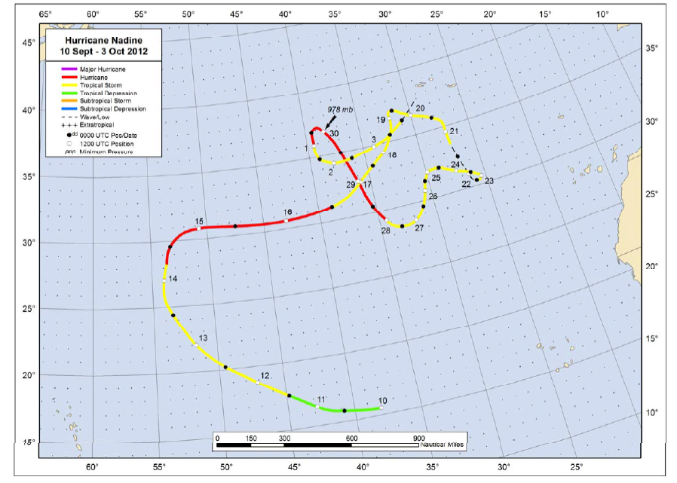
Source: Nadine TC Report

Slide 6
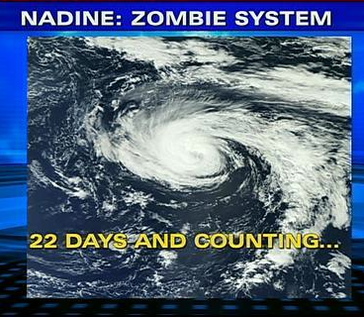
Attained hurricane strength on two occasions; a record 13 days apart
20.75 days as a tropical storm or hurricane; third-longest-lived named storm in the Atlantic
22.25 days (non-consecutive) as a tropical cyclone; fourth-longest-lived Atlantic tropical cyclone

Slide 7
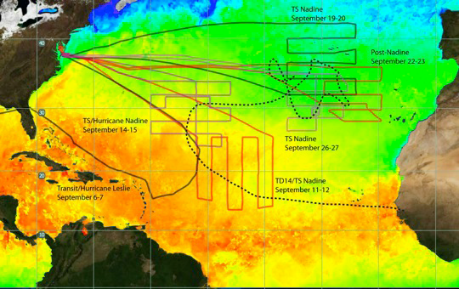
Hurricane and Severe Storm Sentinel (HS3)
Flight tracks of Nadine:
Adverse Conditions
Redevelopment
Reintensification
Saharan air layer interaction

Slide 8
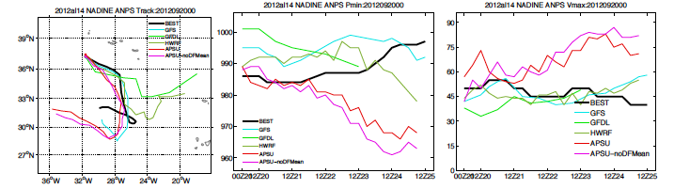
5 day forecasts initialized on September 20th, 2012 at 00Z
ECMWF
GFS

Slide 9
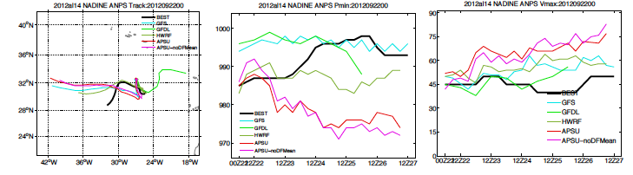
5 day forecasts initialized on September 22nd, 2012 at 00Z
ECMWF
GFS

Slide 10
Summary of Plan to start Nadine project:
Dynamics Issues to Investigate:
  How was Nadine able to survive and subsequently redevelop under such adverse conditions?
    High vertical wind shear, SST’s between 22°C and 24°C, dry air in the vicinity
Predictability Issues to Investigate:
  Divergent track forecasts at 9/20/12 – 00Z and 9/22/12 – 00Z
  Approaching mid-latitude trough; forecasts either absorb Nadine and continue eastward or Nadine turns southwestward ahead of the approaching trough

