Slide 1

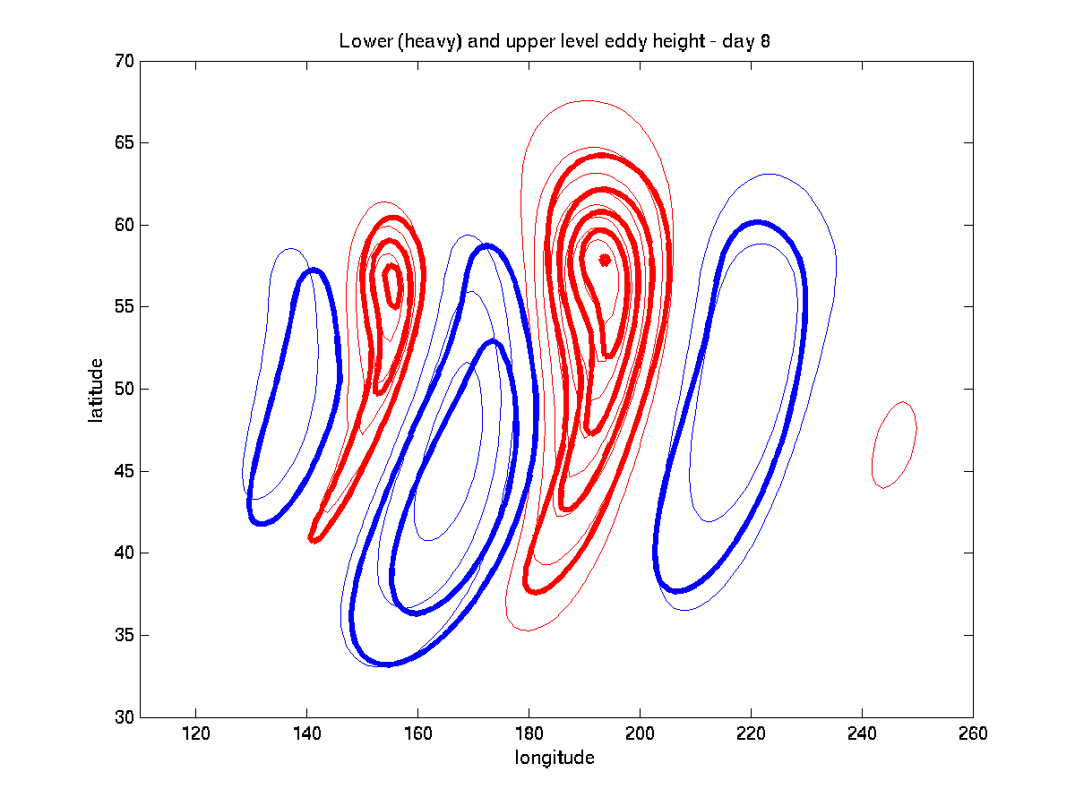
Mesoscale predictability of moist baroclinic waves:
Preliminary work
Y. Qiang Sun & Fuqing Zhang
Penn State University
Group meeting 12/11, 2013

Slide 2
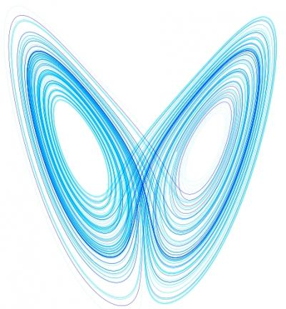
Why do we Care ?
Although the synoptic-scale evolution of the typical midlatitude weather system is relatively well forecasted, numerical weather prediction models still have difficulties in forecasting the “mesoscale details”.
And, these “details” matters!

Slide 3
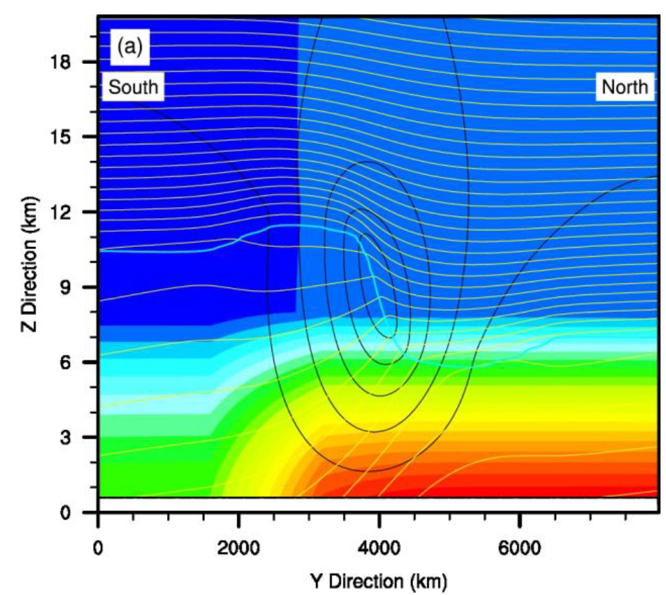
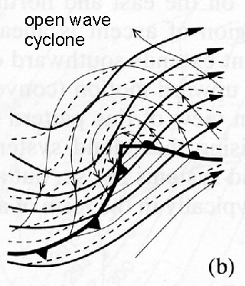
How do we do it?
Wei and Zhang (2013)
First, run the model to get ctrl experiment.
EXP:
After the baroclinic wave develops, add small amplitude perturbations, then investigate how it’s different with the ctrl one.
JET
Model: WRF b_wave.
Resolution: 10 km.

Slide 4
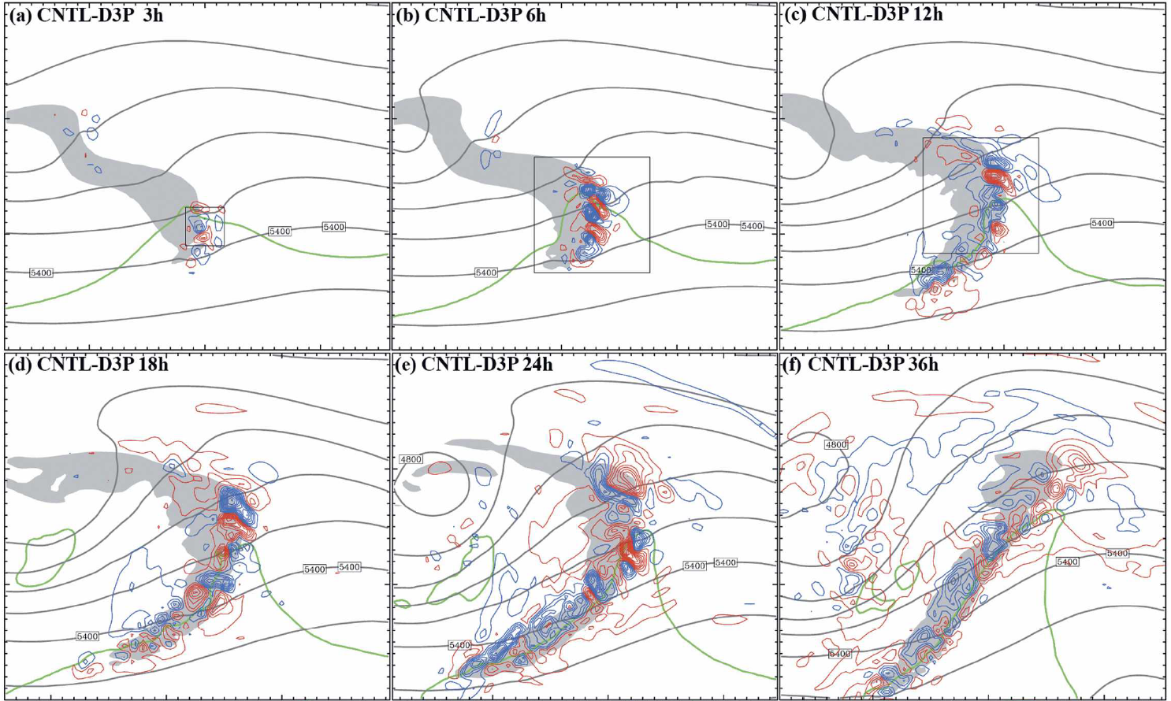
Previous Study
Zhang et al (2007)

Slide 5
Questions
What’s the specific role of gravity wave in the second stage?
What’s the propagation effect of error growth?
Is error growth always an upscale process? What’s the energy cascade like here?

Slide 6
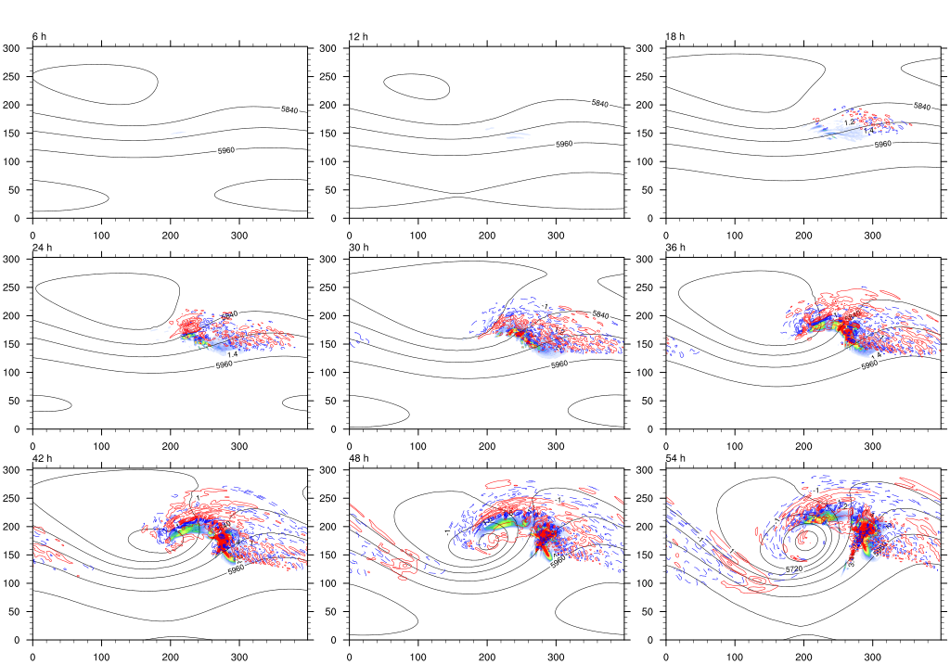
Results1: Dry .vs. Moist
Moist

Slide 7
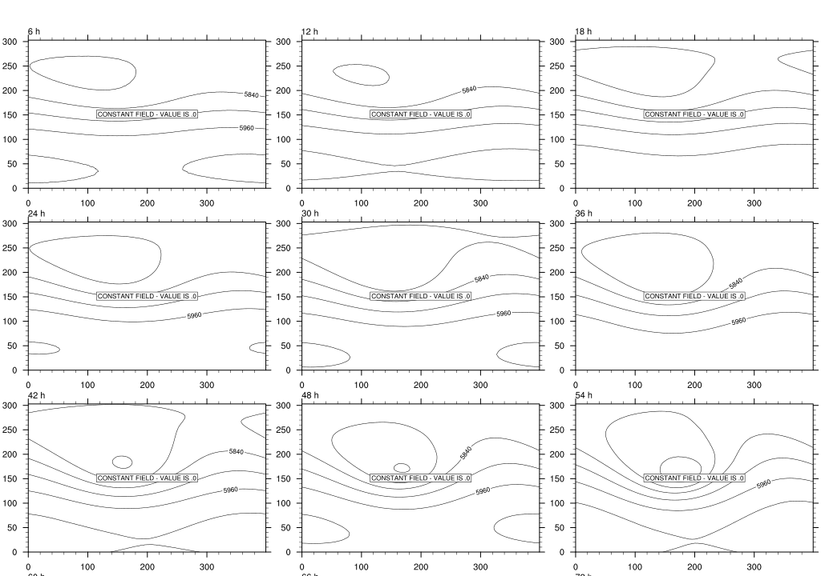
Results1: Dry .vs. Moist
DRY

Slide 8
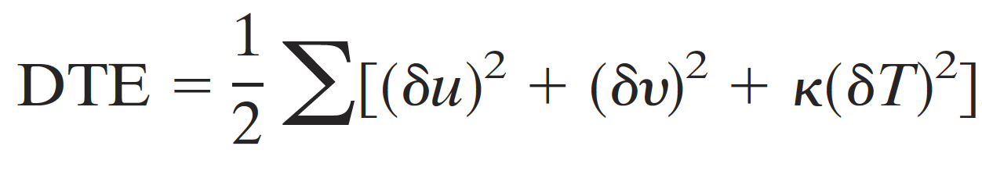
Results1: Dry .vs. Moist
Difference Total Energy:
moist
dry

Slide 9
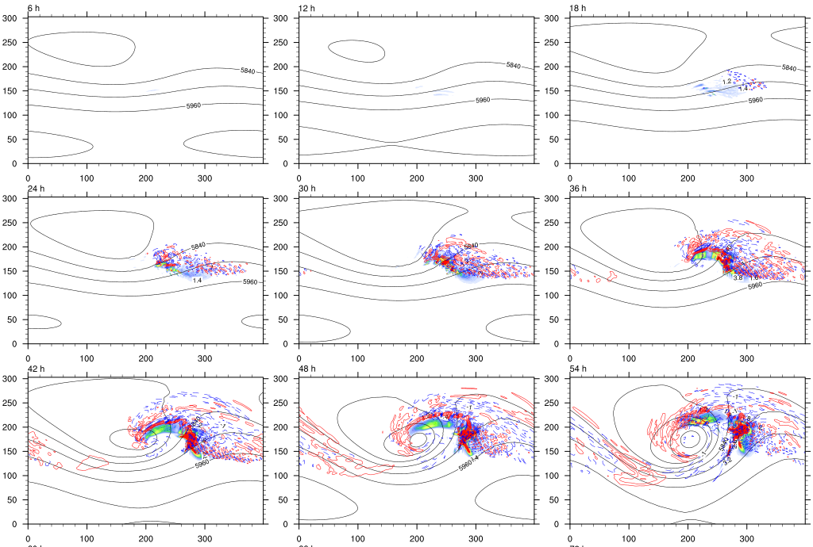
Results2: Different initial error

Slide 10
Results2: Different initial error
Difference Total Energy:
Random
Large

Slide 11
Summary
Consistent with Zhang et al. (2007), moist convection is crucial for small amplitude error to grow.
The saturated error spectrum resembles a -5/3 power law.

Slide 12
Future work
Reading more paper ☑
Discuss with Dr. fuqing ☑
Analysis the rotational KE and divergent KE☐?
Diagnosis gravity wave ☐?

Slide 13
Questions and Comments?
All questions and comments are welcome.
Thanks

