Slide 1
Diagnosing the Intensity of Super Typhoon Haiyan
Winter 2013 Group Meeting December 11, 2013
Scott Sieron

Slide 2
About Super Typhoon Haiyan
(One of the) strongest tropical cyclones ever:
JMA (10-minute): 235 km/hr (146 mph)
Hong Kong (10-minute): 260 km/hr (162 mph)
CMA (10-minute): 270 km/hr (168 mph)
JTWC (1-minute): 315 km/hr (196 mph)
Landfall in Guiuan, Eastern Samar, Philippines at 2040Z 7 Nov.
At peak intensity, by most estimates

Slide 3
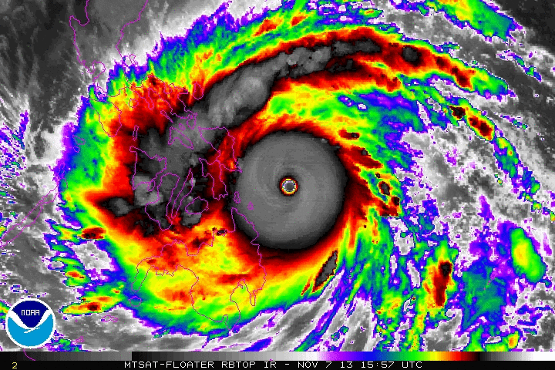
Super Typhoon Haiyan IR Loop

Slide 4
This Work
As per norm in WPAC, there were no reconnaissance flight measurements of the storm
intensity estimation of strong typhoons relies heavily on the Dvorak technique
I use the Wong and Emanuel [2007] theory, and techniques developed in my thesis and subsequent work (Sieron et al. [2013]), to diagnose a maximum sustained surface wind
Observing Systems Simulation Experiment (OSSE)
Two cases of MODIS measurements

Slide 5
Theory of Wong and Emanuel [2007]
Saturation Entropy:
s*_{eyewall}, V_{m}
Maximum Gradient Wind:
[Wong and Emanuel 2007]
storm radius
Maximum Sustained Surface Wind:
s*_{environment}
[Powell 1980; as in Luo et al. 2008]

Slide 6
Theory of Wong and Emanuel (2007) (cont.)
Saturation Entropy:
s*_{eyewall}, V_{m}
Maximum Gradient Wind:
Challenge: How to accurately estimate these quantities from satellite measurements
Old answer: estimate eyewall and environment at cloud top with CloudSat cloud profiling radar
]Wong and Emanuel 2007]
storm radius
Maximum Sustained Surface Wind:
s*_{environment}
[Powell 1980; as in Luo et al. 2008]

Slide 7
Old Technique: use CloudSat to estimate eyewall and environment at cloud-top
Outer-Region Deep Moist Convection (DMC) Top
z_{outerDMC}, T_{outerDMC}
z
Eyewall Top
z_{eyewall}, T_{eyewall}
Δz = z_{eyewall} – z_{outerDMC}
~10 km
ΔT = T_{eyewall} – T_{outerDMC}
Δq* = q*_{eyewall} – q*_{outerDMC}
=
q*(T_{eyewall}) - q*(T_{outerDMC})
z_{BL}
cross section path, radial distance
0 km
~100 km to ~400 km
[Wong and Emanuel 2007]

Slide 8
Theory of Wong and Emanuel (2007) (cont.)
Saturation Entropy:
s*_{eyewall}, V_{m}
Maximum Gradient Wind:
Challenge: How to accurately estimate these quantities from satellite measurements
New Answer: use MODIS cloud-top measurements for eyewall, use weather analysis for environment
[Wong and Emanuel 2007]
storm radius
Maximum Sustained Surface Wind:
s*_{environment}
[Powell 1980; as in Luo et al. 2008]

Slide 9
Moderate-resolution Imaging Spectroradiometer
Cloud-top data (pressure and temperature) has along-swath spacing of 5 km, similar magnitude across-swath
MODIS swath
s*_{eyewall}, V_{m}
storm radius
~2330 km
s*_{environment}

Slide 10
New Methods
Eyewall: search all radii up to 100 km for maximum azimuthally-averaged cloud-top entropy
At a given radii, average the largest 50% of entropy values
Environment: azimuthally-average saturation entropy in the free troposphere (between 850 and 300 hPa) at 500 km radius

Slide 11
Analyses
Use output of Yonghui’s WRF simulations to conduct Observing Systems Simulation Experiment (OSSE)
(Simulating use of real MODIS data)
Very similar methods to Sieron et al. [2013]
Inner-most 1-km domain used for eyewall (and SST); coarser 9-km domain used for environment
Compare diagnosed wind to maximum surface wind of points within 100 km radius (1-km domain)

Slide 12
Analyses (cont.)
Use the two MODIS overpasses that provide good sampling of Haiyan’s core
Same methods as with WRF
Entropy of environment and SST derived from WRF simulation (9-km domain)
Could just as robustly use global/regional weather analysis, etc.

Slide 13
Results, OSSE
11/06/13
11/07/13
11/08/13

Slide 14
Results, OSSE (cont.)
Average absolute error: 6.7 m/s
Starting at 12Z 6 Nov: 4.9 m/s
Average bias: +1.8 m/s (overestimation)
Starting at 12Z 6 Nov: -1.3 m/s (underestimation)
Average eyewall radius ~< 30 km (maximum is 39 km)
Shrinks to ~< 20 km when intensification is diagnosed post-landfall
(Eyewall radius is not a factor in diagnosis)

Slide 15
Results, OSSE (cont.)
11/06/13
11/07/13
11/08/13

Slide 16
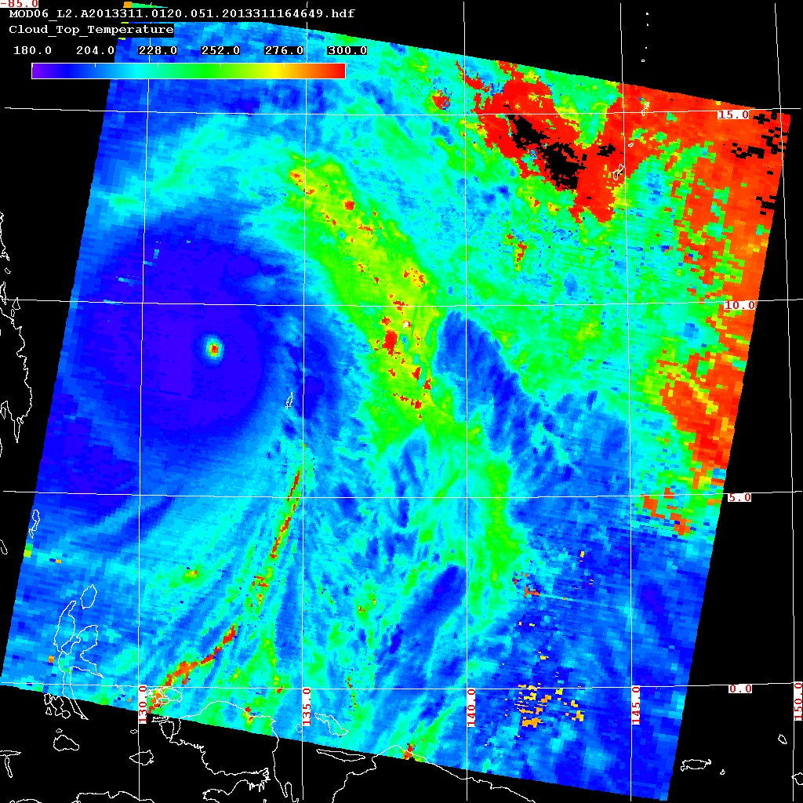
Results, MODIS: 0120Z Nov. 7
s_{eyewall} = 2618.8 J/kg∙K
s*_{environment} = 2565.3 J/kg∙K
∆s = 53.5 J/kg∙K
T_{eyewall} = 190.4 K
SST = 302.4
∆T = 112
Diagnosed Wind: 61.9 m/s (135 mph)
Eyewall radius: 55 km
Larger than all WRF
Terra MODIS Cloud-Top Temperature, Valid 0120Z 7 Nov. 2013

Slide 17
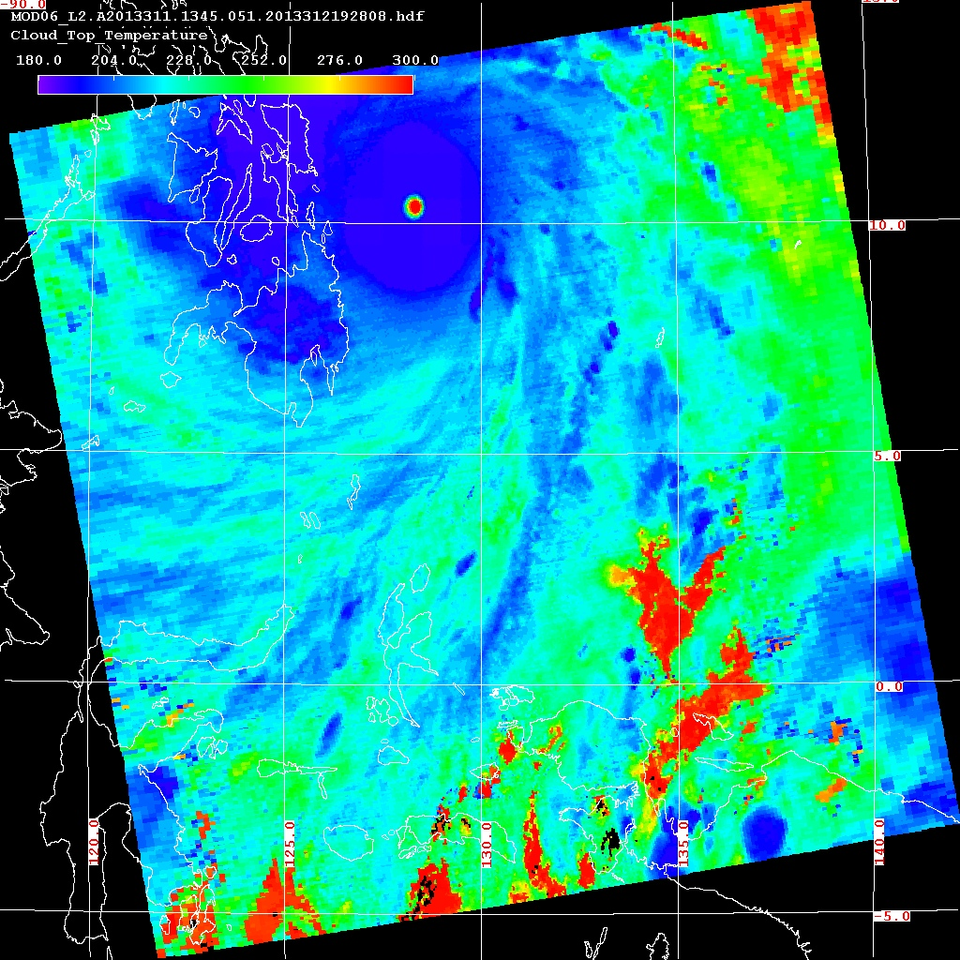
Results, MODIS: 1345Z Nov. 7
s_{eyewall} = 2634.1 J/kg∙K
s*_{environment} = 2565.3 J/kg∙K
∆s = 68.8 J/kg∙K
T_{eyewall} = 189.6 K
SST = 302.4
∆T = 112.8
Diagnosed Wind: 70.5 m/s (158 mph)
Eyewall radius: 80 km
~>2X that in WRF
Terra MODIS Cloud-Top Temperature, Valid 1345Z 7 Nov. 2013

Slide 18
Conclusions
Considering to join debate of Haiyan’s intensity with this analysis and derived intensity
135 mph at 00Z Nov. 7 & 158 mph at 12Z 7 Nov. are both below average advisory intensities (which are based on Dvorak technique)
This technique performs well with OSSE
Overestimates intensity when weak / during intensification
Slightly underestimates intensity when at steady-state

