Slide 1
Regional Scale Dependent Predictability by IPCC Models

Slide 2
Motivation: Inconsistency in the Precipitation simulation by CMIP5 models

Slide 3
Datasets
Model data: Precipitation from CMIP5 historical runs during 1979-2004;
Observation: Global Precipitation Climatology Centre (GPCC) during 1979-2004 with 2.5°x2.5° resolution;
All data are interpolated to T85 (~1.4°x1.4°) resolution.

Slide 4
Model | Sponsor | Atmosphere Resolution
bcc-csm1-1 | Beijing Climate Center, China | 2.8°x2.8°
bcc-csm1-1-m | Beijing Climate Center, China | 2.8°x2.8°
CCSM4 | NCAR, USA | 0.9°x1.25°
CESM1-BGC | NCAR, USA | 0.9°x1.25°
CESM-CAM5 | NCAR, USA | 0.9°x1.25°
CESM1-FASTCHEM | NCAR, USA | 0.9°x1.25°
CESM1-WACCM | NCAR, USA | 1.875°x2.5°
EC-EARTH | 19 institutes in Europe | 1.125°x1.125°
GFDL-CM3 | GFDL, USA | 2°x2.5°
GFDL-ESM2G | GFDL, USA | 2°x2.5°
GFDL-ESM2M | GFDL, USA | 2°x2.5°
GISS-E2-H-CC | NASA/GISS, USA | 2°x2.5°
GISS-E2-H | NASA/GISS, USA | 2°x2.5°
GISS-E2-R | NASA/GISS, USA | 2°x2.5°
HadCM3 | Met Office Hadley Center, UK | 2.5°x3.75°
HadGEM2-AO | Met Office Hadley Center, UK | 1.25°x1.9°
HadGEM2-CC | Met Office Hadley Center, UK | 1.25°x1.9°
HadGEM2-ES | Met Office Hadley Center, UK | 1.25°x1.9°
inmcm4 | Institute for Numerical Mathematics, Russia | 1.5°x2°
NorESM1-M | Norwegian Climate Centre | 1.875°x2.5°
CMIP5 models

Slide 5
Method
Definitions
Ensemble mean:
Ensemble spread:
i and j refer to a pair of models among 22 CMIP5 model set.
(Zhang et al. 2006, Meng and Zhang 2007)
Signal to noise ratio: SNR=P/ΔP
Predictability: (P-ΔP)/P
Power spectrum using FFT is applied on the zonal precipitation for the above quantities.

Slide 6
Power spectrum of JJA precip. over different latitude bands
Global
Midlatitude: AVE(35N-45N), 0-360E
Tropics: AVE(5S-5N), 0-360E
For mid-latitude, models show predictability for wavenumbers 1-3;
In tropics, models show less predictability than mid-latitude.

Slide 7
Power spectrum of JJA precip. over different latitude bands
Regional
AVE(35N-40N), 75W-135W
AVE(25N-35N), 75W-135W
Models show predictability for wavenumbers 1 for mid-latitude.
Predictability of mid-latitude is greater than extra-tropics.

Slide 8
Wavenumber-latitude across-section
CMIP5 (1979-2004) Global
OBS
Ensemble mean
Ensemble mean - OBS
Ensemble spread
Ensemble mean/spread
Predictability

Slide 9
CMIP5 (1979-2004) US
OBS
Ensemble mean
Ensemble mean - OBS
Ensemble spread
Ensemble mean/spread
Predictability

Slide 10
Model | Sponsor | Atmosphere Resolution
BCCR-BCM2 | Bjerknes Centre for Climate Research, Norway | 2.8°x2.8°
CCCMA_CGCM3 | Canadian Centre for Climate Modelling and Analysis | 3.75°x3.75°
CNRM_CM3 | Centre National de Recherches Meteorologiques, France | 2.8°x2.8°
CSIRO_MK3.0 | CSIRO Atmospheric Research, Melbourne, Australia | 1.875°x1.875°
CSIRO_MK3.5 | CSIRO Atmospheric Research, Melbourne, Australia | 1.875°x1.875°
GFDL_CM2.0 | NOAA GFDL, USA | 2°x2.5°
GFDL_CM2.1 | NOAA GFDL, USA | 2°x2.5°
GISS | NASA/GISS, USA | 4°x5°
INGV_ECHAM4.1 | National Institute of Geophysics and Volcanology, Italy | 1.125°x1.125°
INMCM3.0 | Iistitute for Numerical Mathematics, Russia | 4°x5°
IPSL | Institut Pierre Simon Laplace, France | 2.5°x3.75°
MIROC3.2_medres | CCSR/NIES/FRCGC, Japan | 2.8°x2.8°
MPI_ECHAM5.4 | Max Planck Institute for Meteorology, Germany | 1.875°x1.875°
MPI_CGCM2.3 | Max Planck Institute for Meteorology, Germany | 1.875°x1.875°
NCAR CCSM3.0 | NCAR, USA | 1.4°x1.4°
NCAR PCM1 | NCAR, USA | 2.8°x2.8°
UKMO_HADCM3 | Met Office Hadley Center, UK | 2.5°x3.75°
UKMO_HadGEM1 | Met Office Hadley Center, UK | 1.25°x1.9°
CMIP3 models

Slide 11
CMIP3 (1979-2012) Global
OBS
Ensemble mean
Ensemble mean - OBS
Ensemble spread
Ensemble mean/spread
Predictability

Slide 12
CMIP3 (2020-2099) Global
OBS
Ensemble mean
Ensemble mean - OBS
Ensemble spread
Ensemble mean/spread
Predictability

Slide 13
CMIP3 (1979-2012) US
OBS
Ensemble mean
Ensemble mean - OBS
Ensemble spread
Ensemble mean/spread
Predictability

Slide 14
CMIP3 (2020-2099) US
OBS
Ensemble mean
Ensemble mean - OBS
Ensemble spread
Ensemble mean/spread
Predictability

Slide 15
Conclusions
IPCC models show predictability for wavenumber 1-3 for global scale and ~wavenumber 1 for the US;
Larger predictability for mid-latitude than tropics;
No big change of the predictability for climate projection output.

Slide 16
How possible to increase the predictability of small scale through the model improvement?
Any other solutions?

Slide 18
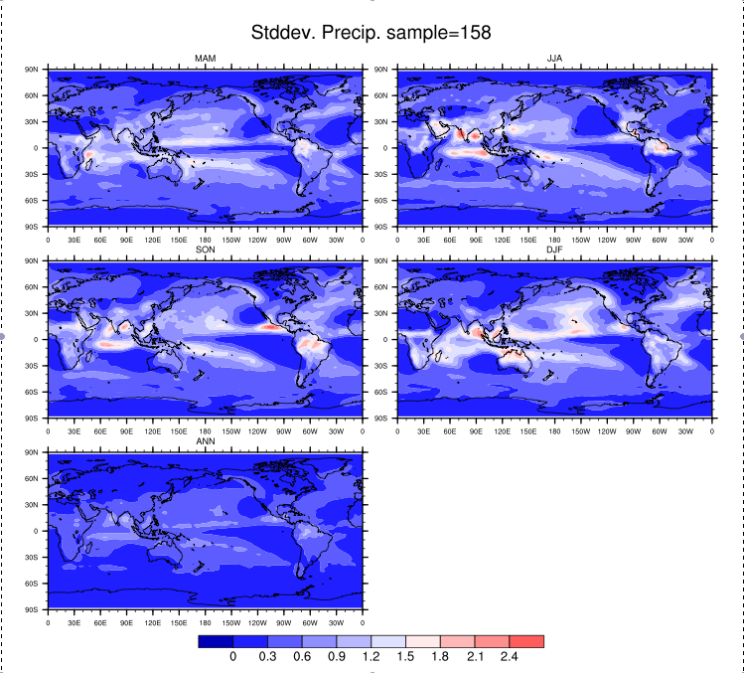

Slide 19
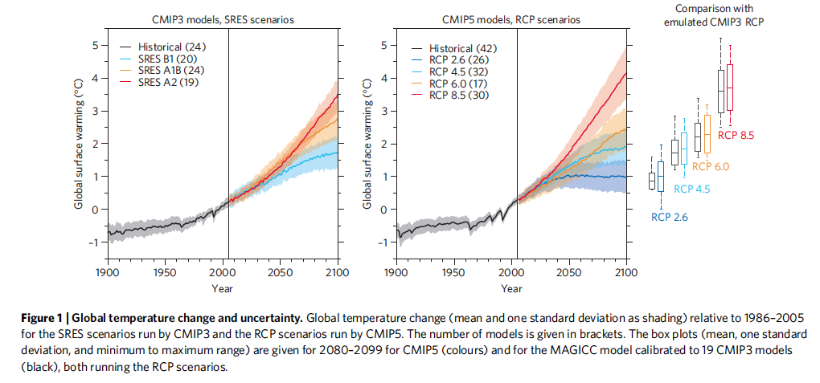
CMIP5 forcing data: http://cmip-pcmdi.llnl.gov/cmip5/forcing.html
Knutti and Sedlacek (2012)

