Slide 1
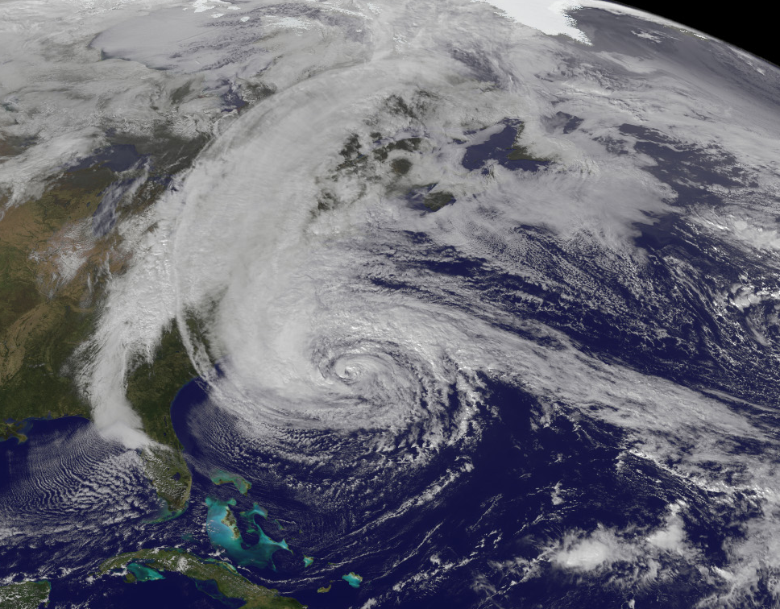
Dynamical Analysis of the PSU WRF/EnKF Real-Time Ensemble Simulation of Hurricane Sandy
Erin Munsell
Group Meeting
September 13th, 2013
http://earthobservatory.nasa.gov/NaturalHazards/view.php?id=79553

Slide 2
Summary of Results from Last Time
Spread of the members is very dependent on the forward motion of Sandy; Landfall location is sensitive to the timing of the mid-latitude front and tropical cyclone interaction
Operational forecast tracks consistent with PSU ensemble (ECMWF and Good/Fair members, NCEP and Bad members); Divergence also due to steering flow differences
Rainfall forecasts compare very favorably with observations; Differences that arise can be contributed to differences in track
Things to Consider this Time
Ensemble performance (PSU, ECMWF, and GFS) for various initialization times; Results and implications of sensitivity run
Impacts of difference in timing of mid-latitude and Sandy interaction, specifically concerning the rainfall distribution

Slide 4
PSU Ensemble Tracks and Intensities (10/26/12 – 00Z)

Slide 5
Track and Intensity of Sensitivity Run (Composited Initial Conditions)

Slide 6
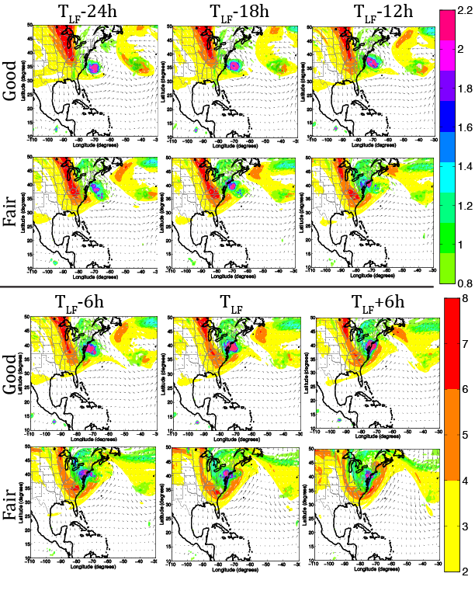
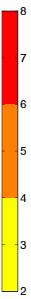
Mid-Latitude Trough and Hurricane Sandy Interaction

Slide 7
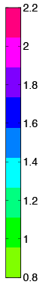
Mid-Latitude Trough and Hurricane Sandy Interaction

Slide 8
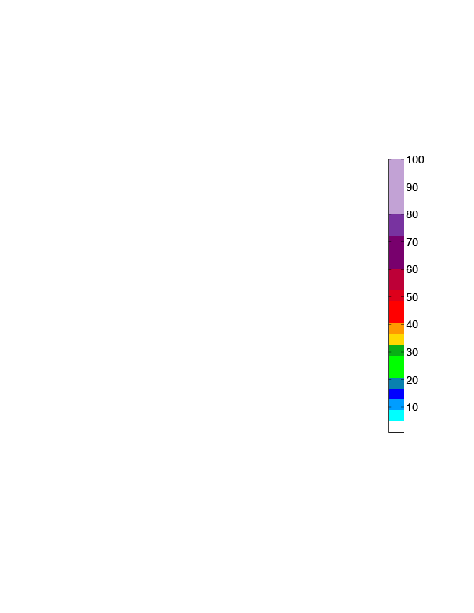
6-hourly Composite Rainfall Prior to Landfall

Slide 9
6-hourly Composite Rainfall During Landfall

