Slide 1
Data Assimilation of an MJO Event: Diagnostics
Michael Ying

Slide 2
Outline
Purpose: to explore the dynamics and predictability of MJO from convective to intraseasonal scales using DA methods
Start with coarse resolution runs
Statistics: evaluate the results
Take a further step into higher resolution

Slide 3
Experimental Design
WRF, 81km horizontal grid spacing, 35 vertical levels
Initialized with NCEP fnl analysis
Cycling period=6h
Assimilating GTS observation
Run time = 1 month
Num_ensemble=40
mixing (relaxation)=0.5
HROI_upperair=30
HROI_sfc=10
VROI=35

Slide 4
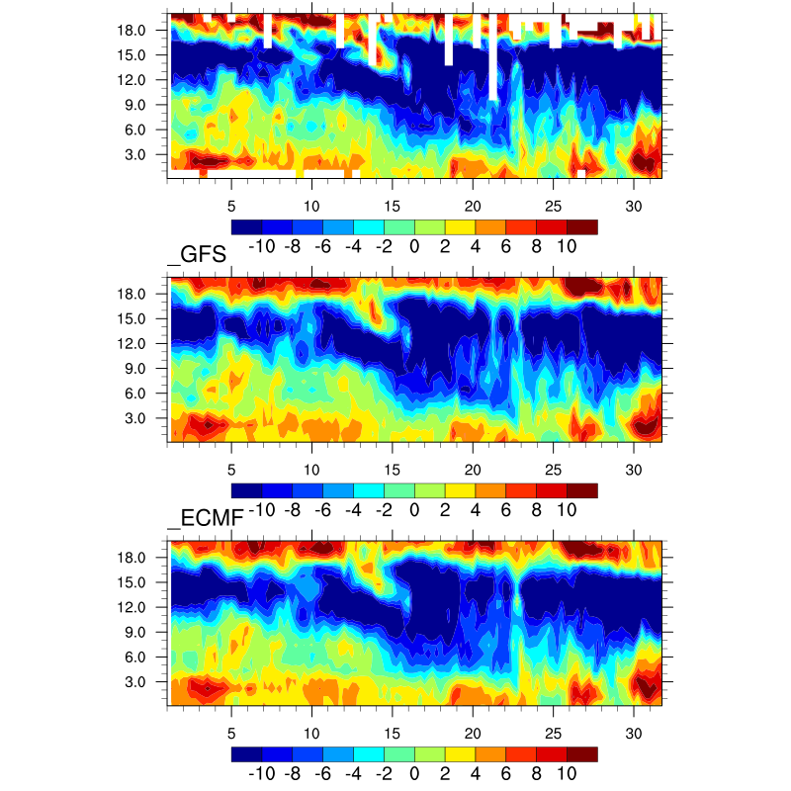
Male
U-component wind

Slide 5
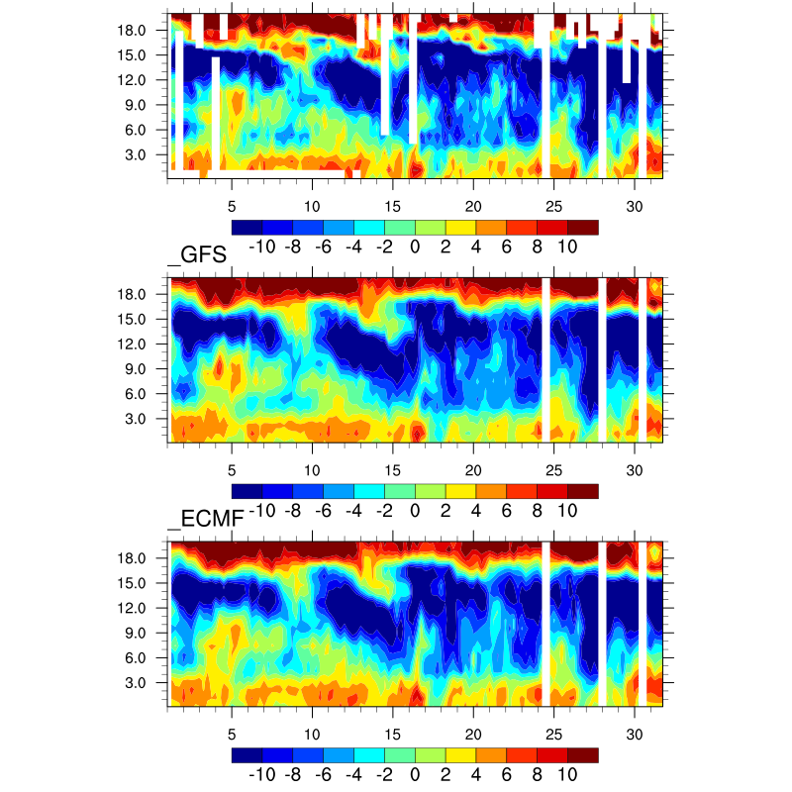
Gan
U-component wind

Slide 6
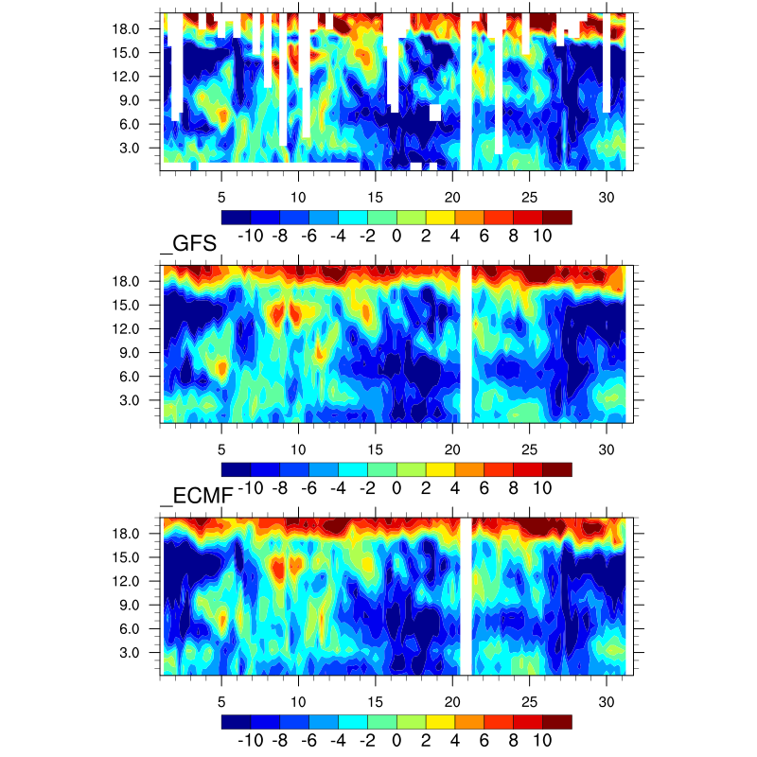
Diego
U-component wind

Slide 7
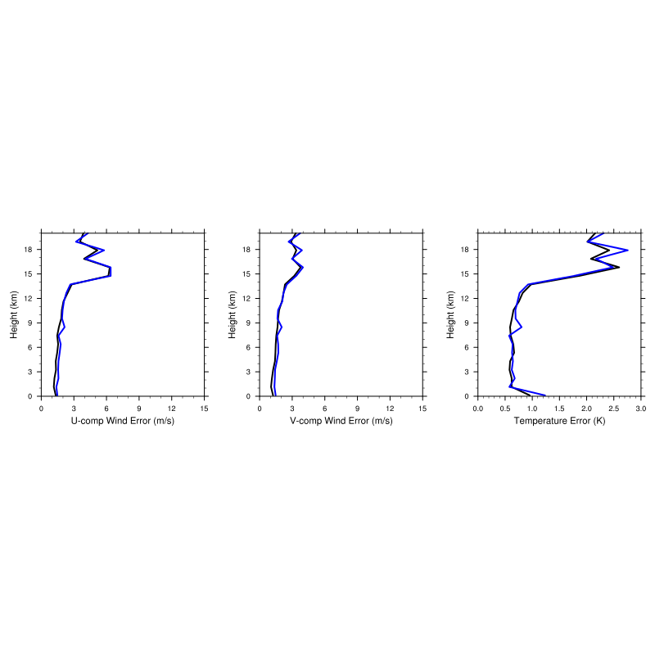
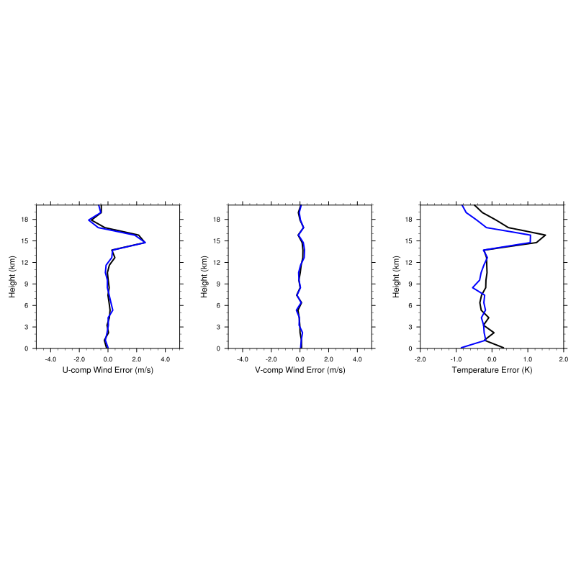
RMSE against 6 sounding stations:
U V T
GFS
ECMF
Bias
U V T

Slide 8
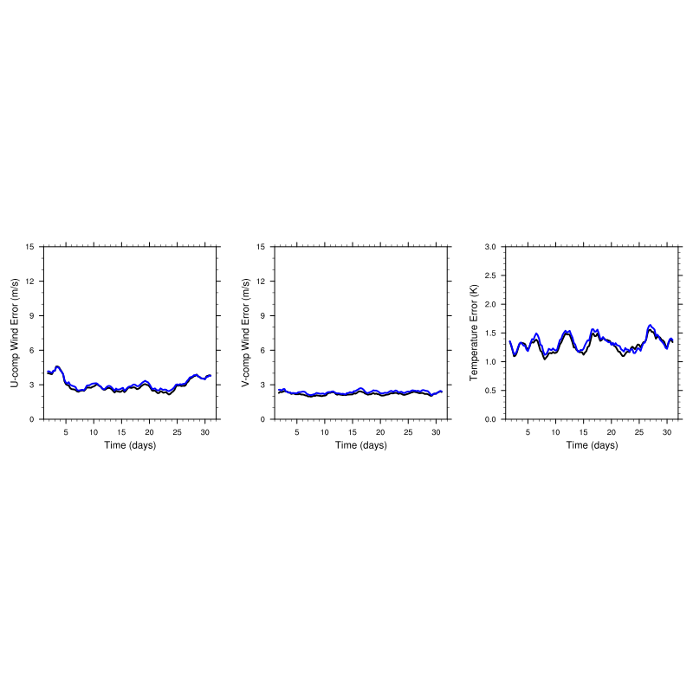
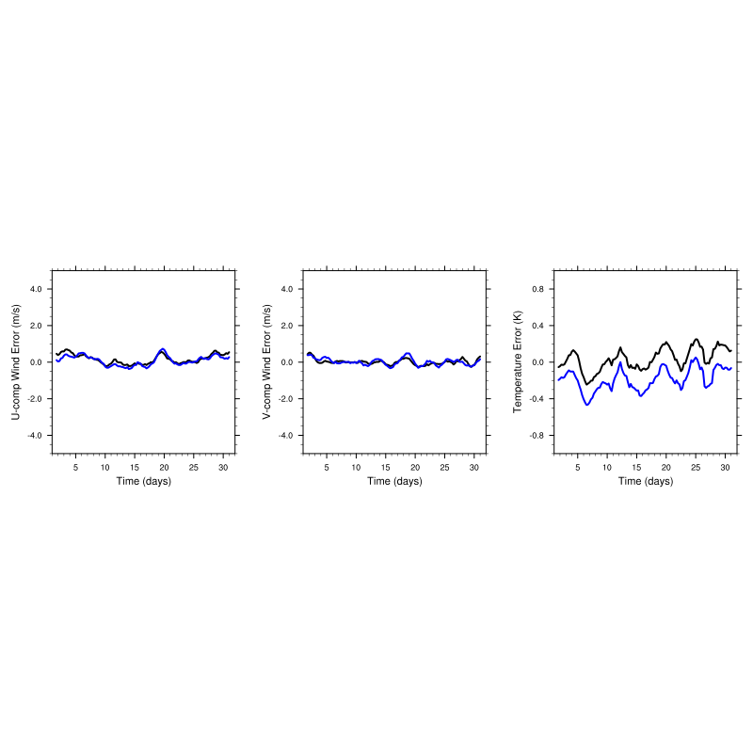
RMSE against 6 sounding stations:
U V T
GFS
ECMF
Bias
U V T

Slide 9
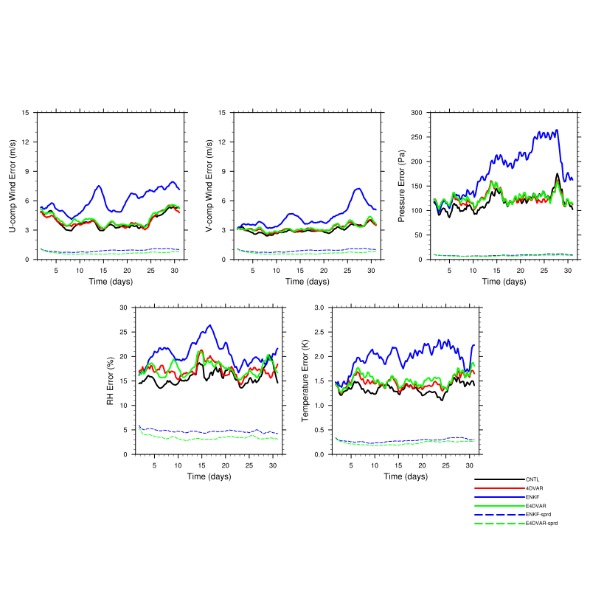
Error evolution for the priors
U V P
RH T
CNTL
4DVAR
ENKF
E4DVAR

Slide 10
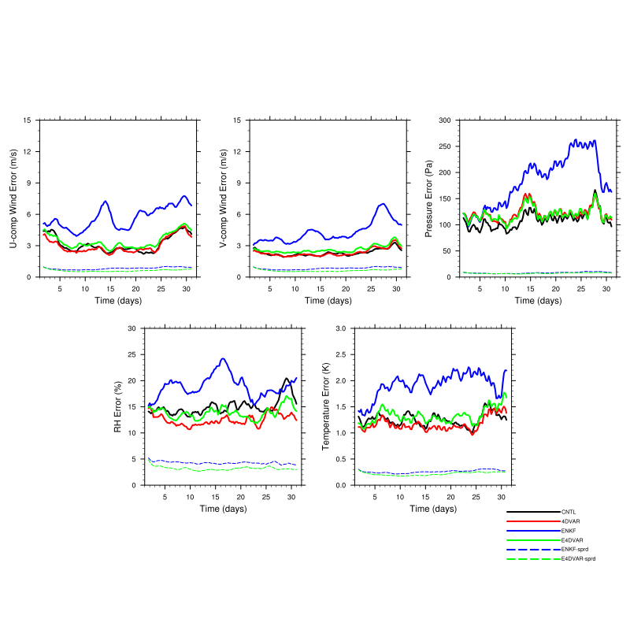
Error evolution for the posteriors
U V P
RH T
CNTL
4DVAR
ENKF
E4DVAR

Slide 11
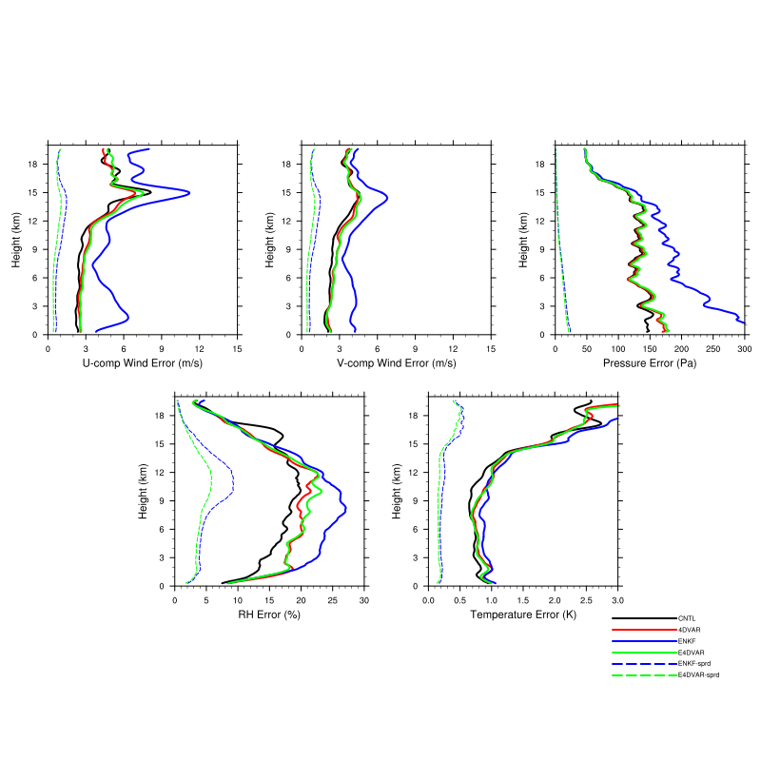
Error profile for the priors
U V P
RH T
CNTL
4DVAR
ENKF
E4DVAR

Slide 12
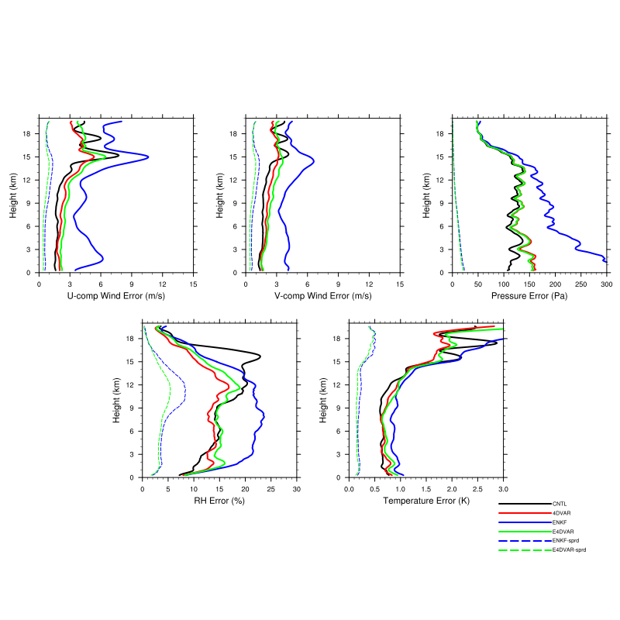
Error profile for the posteriors
U V P
RH T
CNTL
4DVAR
ENKF
E4DVAR

Slide 13
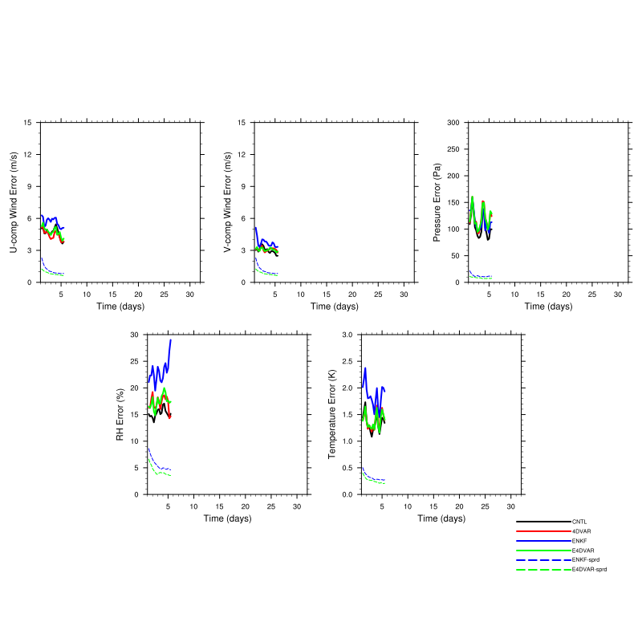
New run with inflated initial ensemble variance
Relaxation=0.5
U V P
RH T
CNTL
4DVAR
ENKF
E4DVAR

Slide 14
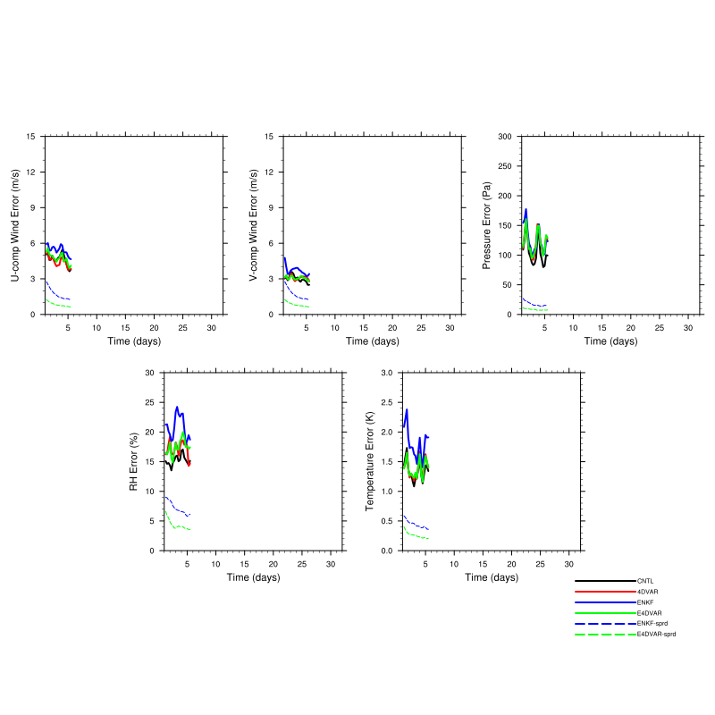
New run with inflated initial ensemble variance
Relaxation=0.8
U V P
RH T
CNTL
4DVAR
ENKF
E4DVAR

Slide 15
Conclusion
~3 m/s error in GFS/ECMWF wind analysis
Large error/bias at higher model levels
Ensemble methods didn’t perform well due to filter divergence
Next step: go for higher resolution (30km) domain over the sounding array (d02).

