Slide 1
Super-obbing and assimilation of Doppler radar observations for tropical cyclone prediction
Christopher Melhauser, Fuqing Zhang,
Yonghui Weng, Jason Sippel
The Pennsylvania State University
36th Conference on Radar Meteorology
Notes:
Superobbing reduces the redundant dense operations produced by Doppler radar observations. Less burden on assimilation system. Helps reduce noise in data along with some random observation errors.

Slide 2
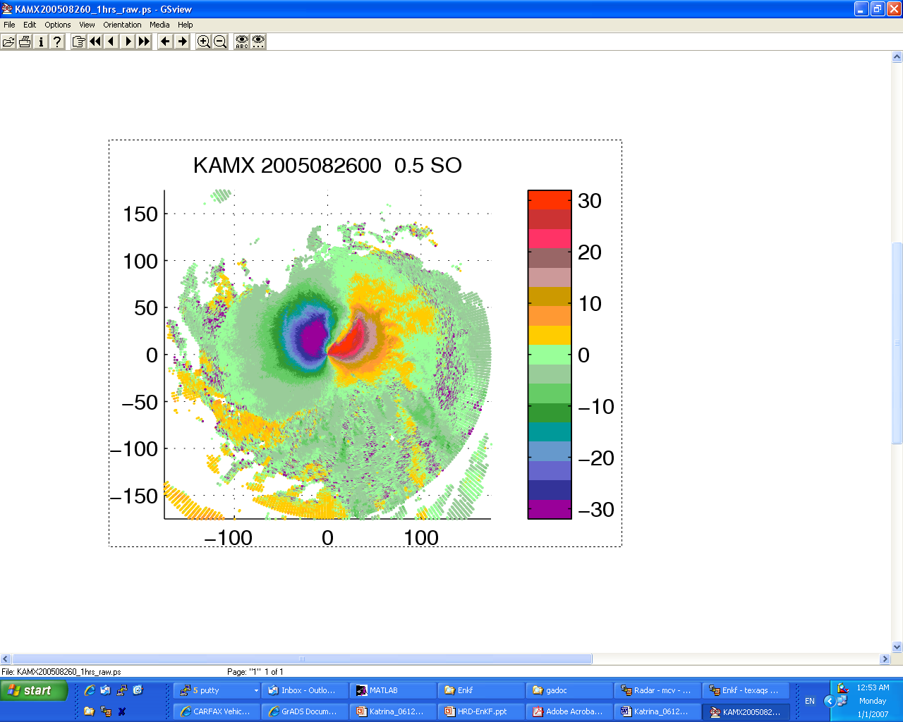
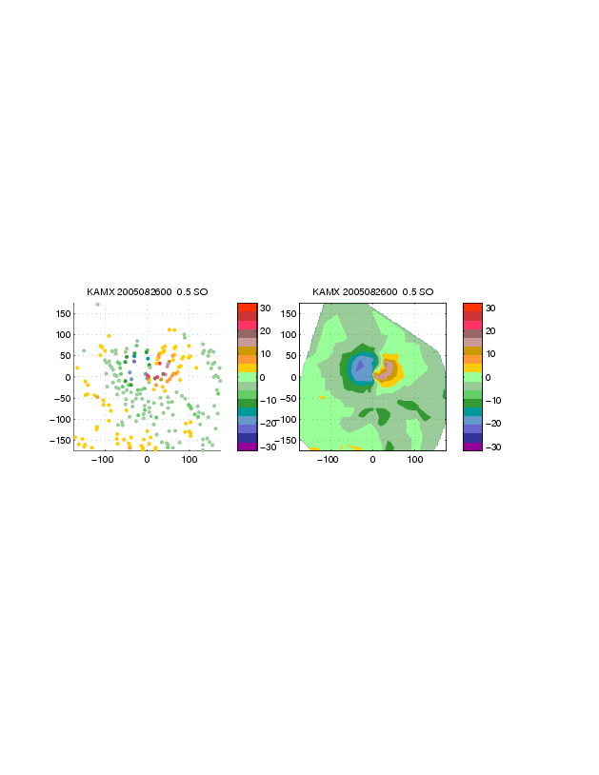
Super-obbing: QC and thinning of WSR-88D Vr Observations
0.5 deg RAW Vr data
[ms⁻¹]
0.5 deg RAW Vr data
[ms⁻¹]
Systematic SO position depends on the radial distance from radar
Define an averaging bin with 5km max radial range and 5° max azimuthally resolution
Calculate SO as average 10 nearest data points to SO position
Perform standard deviation checking of the raw and binned Vr
(Zhang et al. 2009 MWR)
Notes:
Since original radial velocity is too dense, super observations are generated by firstly determining a roughly evenly scattered positions. Then around each position, a bin is defined within which the nearest 10 data to the position are averaged to form the super observation. The bin has a radial range of no larger than 5 kilometers and azimuthal range of no larger than 5 degrees. Missing data is assigned to a position if within the bin of which there are less than 4 original observations or the standard deviation of chosen data are more than twice the standard deviation over all data in the bin. What you see here in right panel is an example of so-created super obs based on its original data in left panel. We can see that the original wind pattern is well kept. Further thinning is performed on the super observation so that only 10% data are actually assimilated.

Slide 3
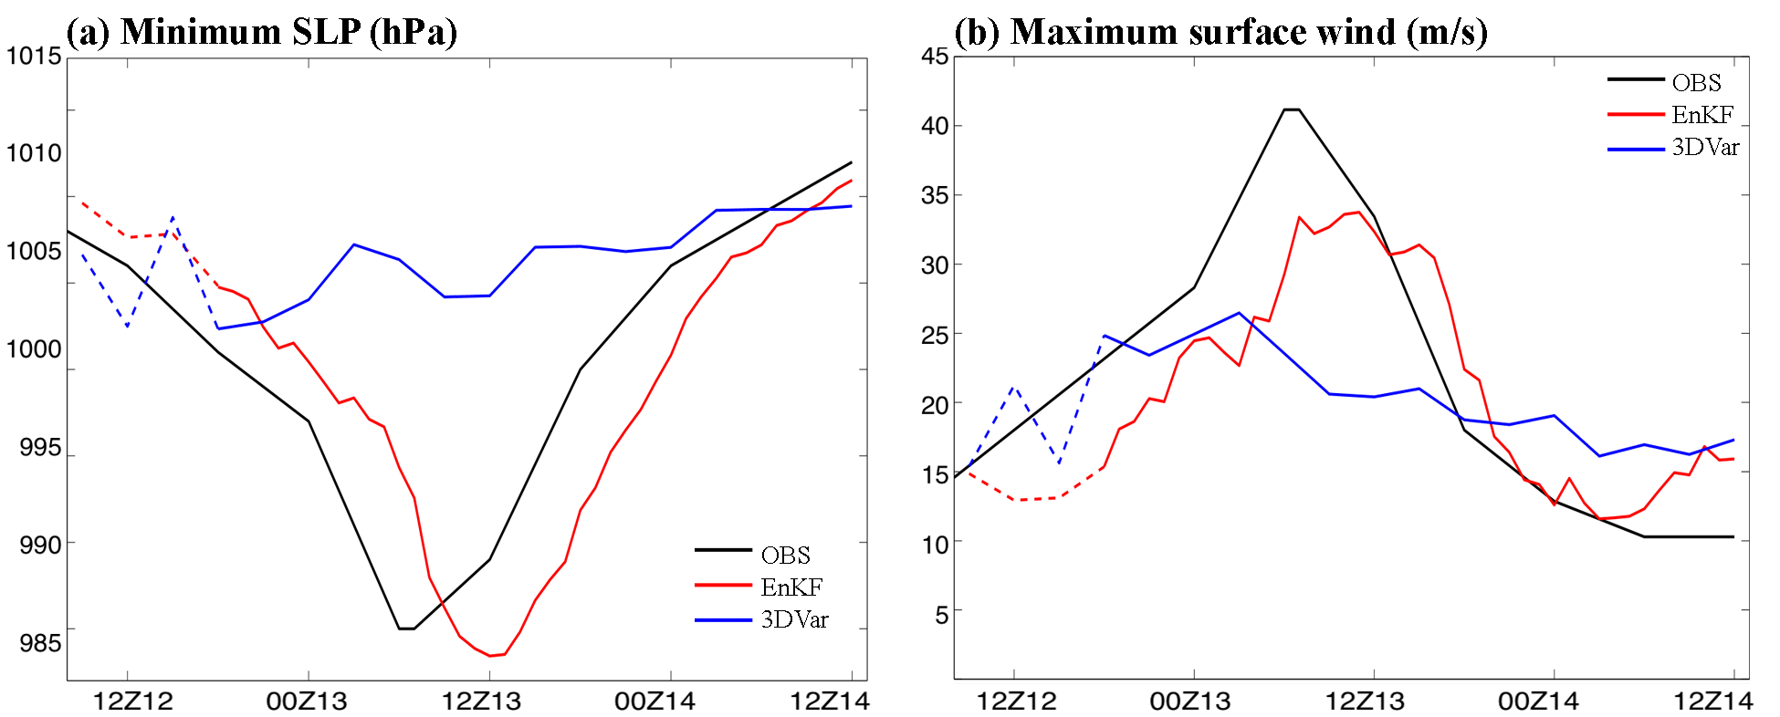
Assimilate WSR-88D Doppler Vr
for Humberto 2007
WRF-EnKF Forecast vs. Observations vs. 3DVAR
Analysis
Forecast
Analysis
Forecast
Use WRF-3DVar used as surrogate of operational algorithms
  Assimilates the same radar data, but without flow-dependent background error covariance
  Forecast failed to develop storm, despite better initial fit to best track observation
(Zhang et al. 2009 MWR)

Slide 4
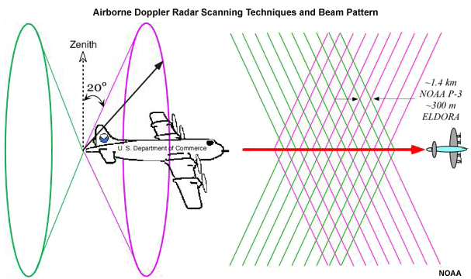
NOAA P-3 Airborne Doppler
Radial Velocity Observations
Use P-3 Vr data in Real-time
  Generate the super observations on aircraft
Pre-super observation quality control
  Hurricane Research Division real-time algorithms (Gamache 2005)
Image: courtesy Dr. David Jorgensen
P-3 samples TC structure further from land
Never used in operation
  lack of assimilation mode resolution and/or
  lack of efficient data assimilation method
Notes:
Overcome reduced bandwidth
HRD QC: noisy data, airplane velocity correction, and unfolding.

Slide 5
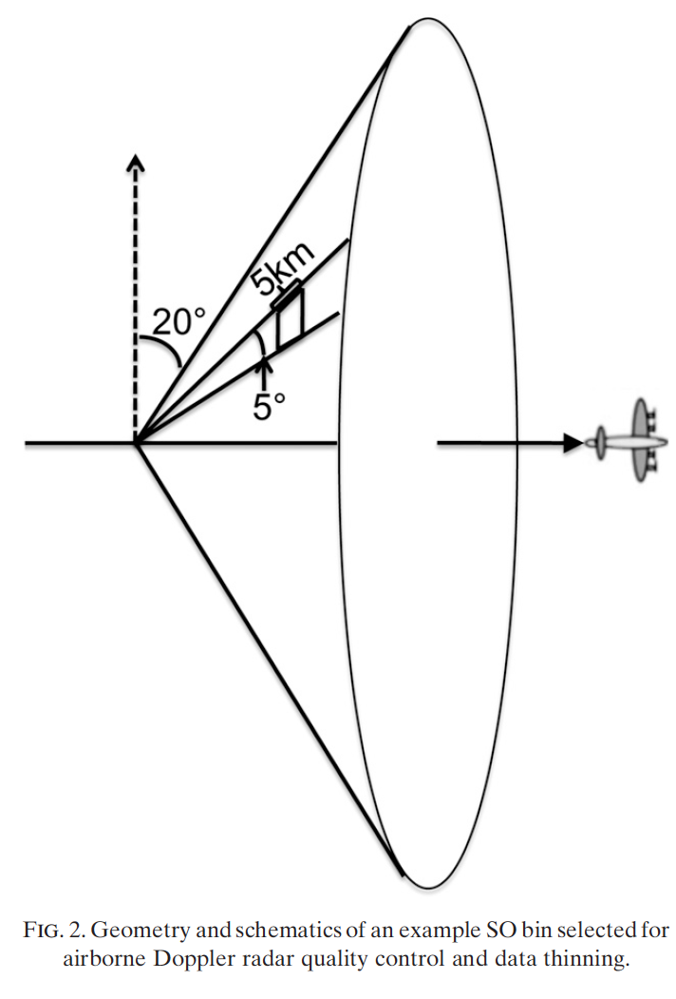
P-3 Super Observation Generation
Methodology
  Separate forward/backward sweeps
  Generate a volume by combining forward (or backward) scans within 1 minute
  Divide volume into smaller bins
  Observation selection and additional quality control of each observation and bin
  Data thinning and random sorting.
(Weng and Zhang 2012)
Notes:
Sweep splitting done on each leg. Based on earth relative elevation from horizon. P-3 scanning switches back and forth at top of scanning.
Translation < 5.6 km when scanning; 5 scans in each volume
Each bin has length 5km, azimuth 5º, and thus 5 bins per radial direction.
QC:
Raw observations < 2 m s-1 (inseparable from radar noise) and > 70 m s-1 (larger than maximum unambiguous radial velocity for PRT technique). Remove raw observations within 4 km of radar.
Remove observations if (obs_Vr - bin_mean_Vr) > 2 STDEV bin. Reduce spread of bin.
Remove bin if bin_STDEV > volume_STDEV
Remove bin if < 4 valid raw observations
SO is the median value of bin with observation closest to bin center used for bin location.

Slide 6
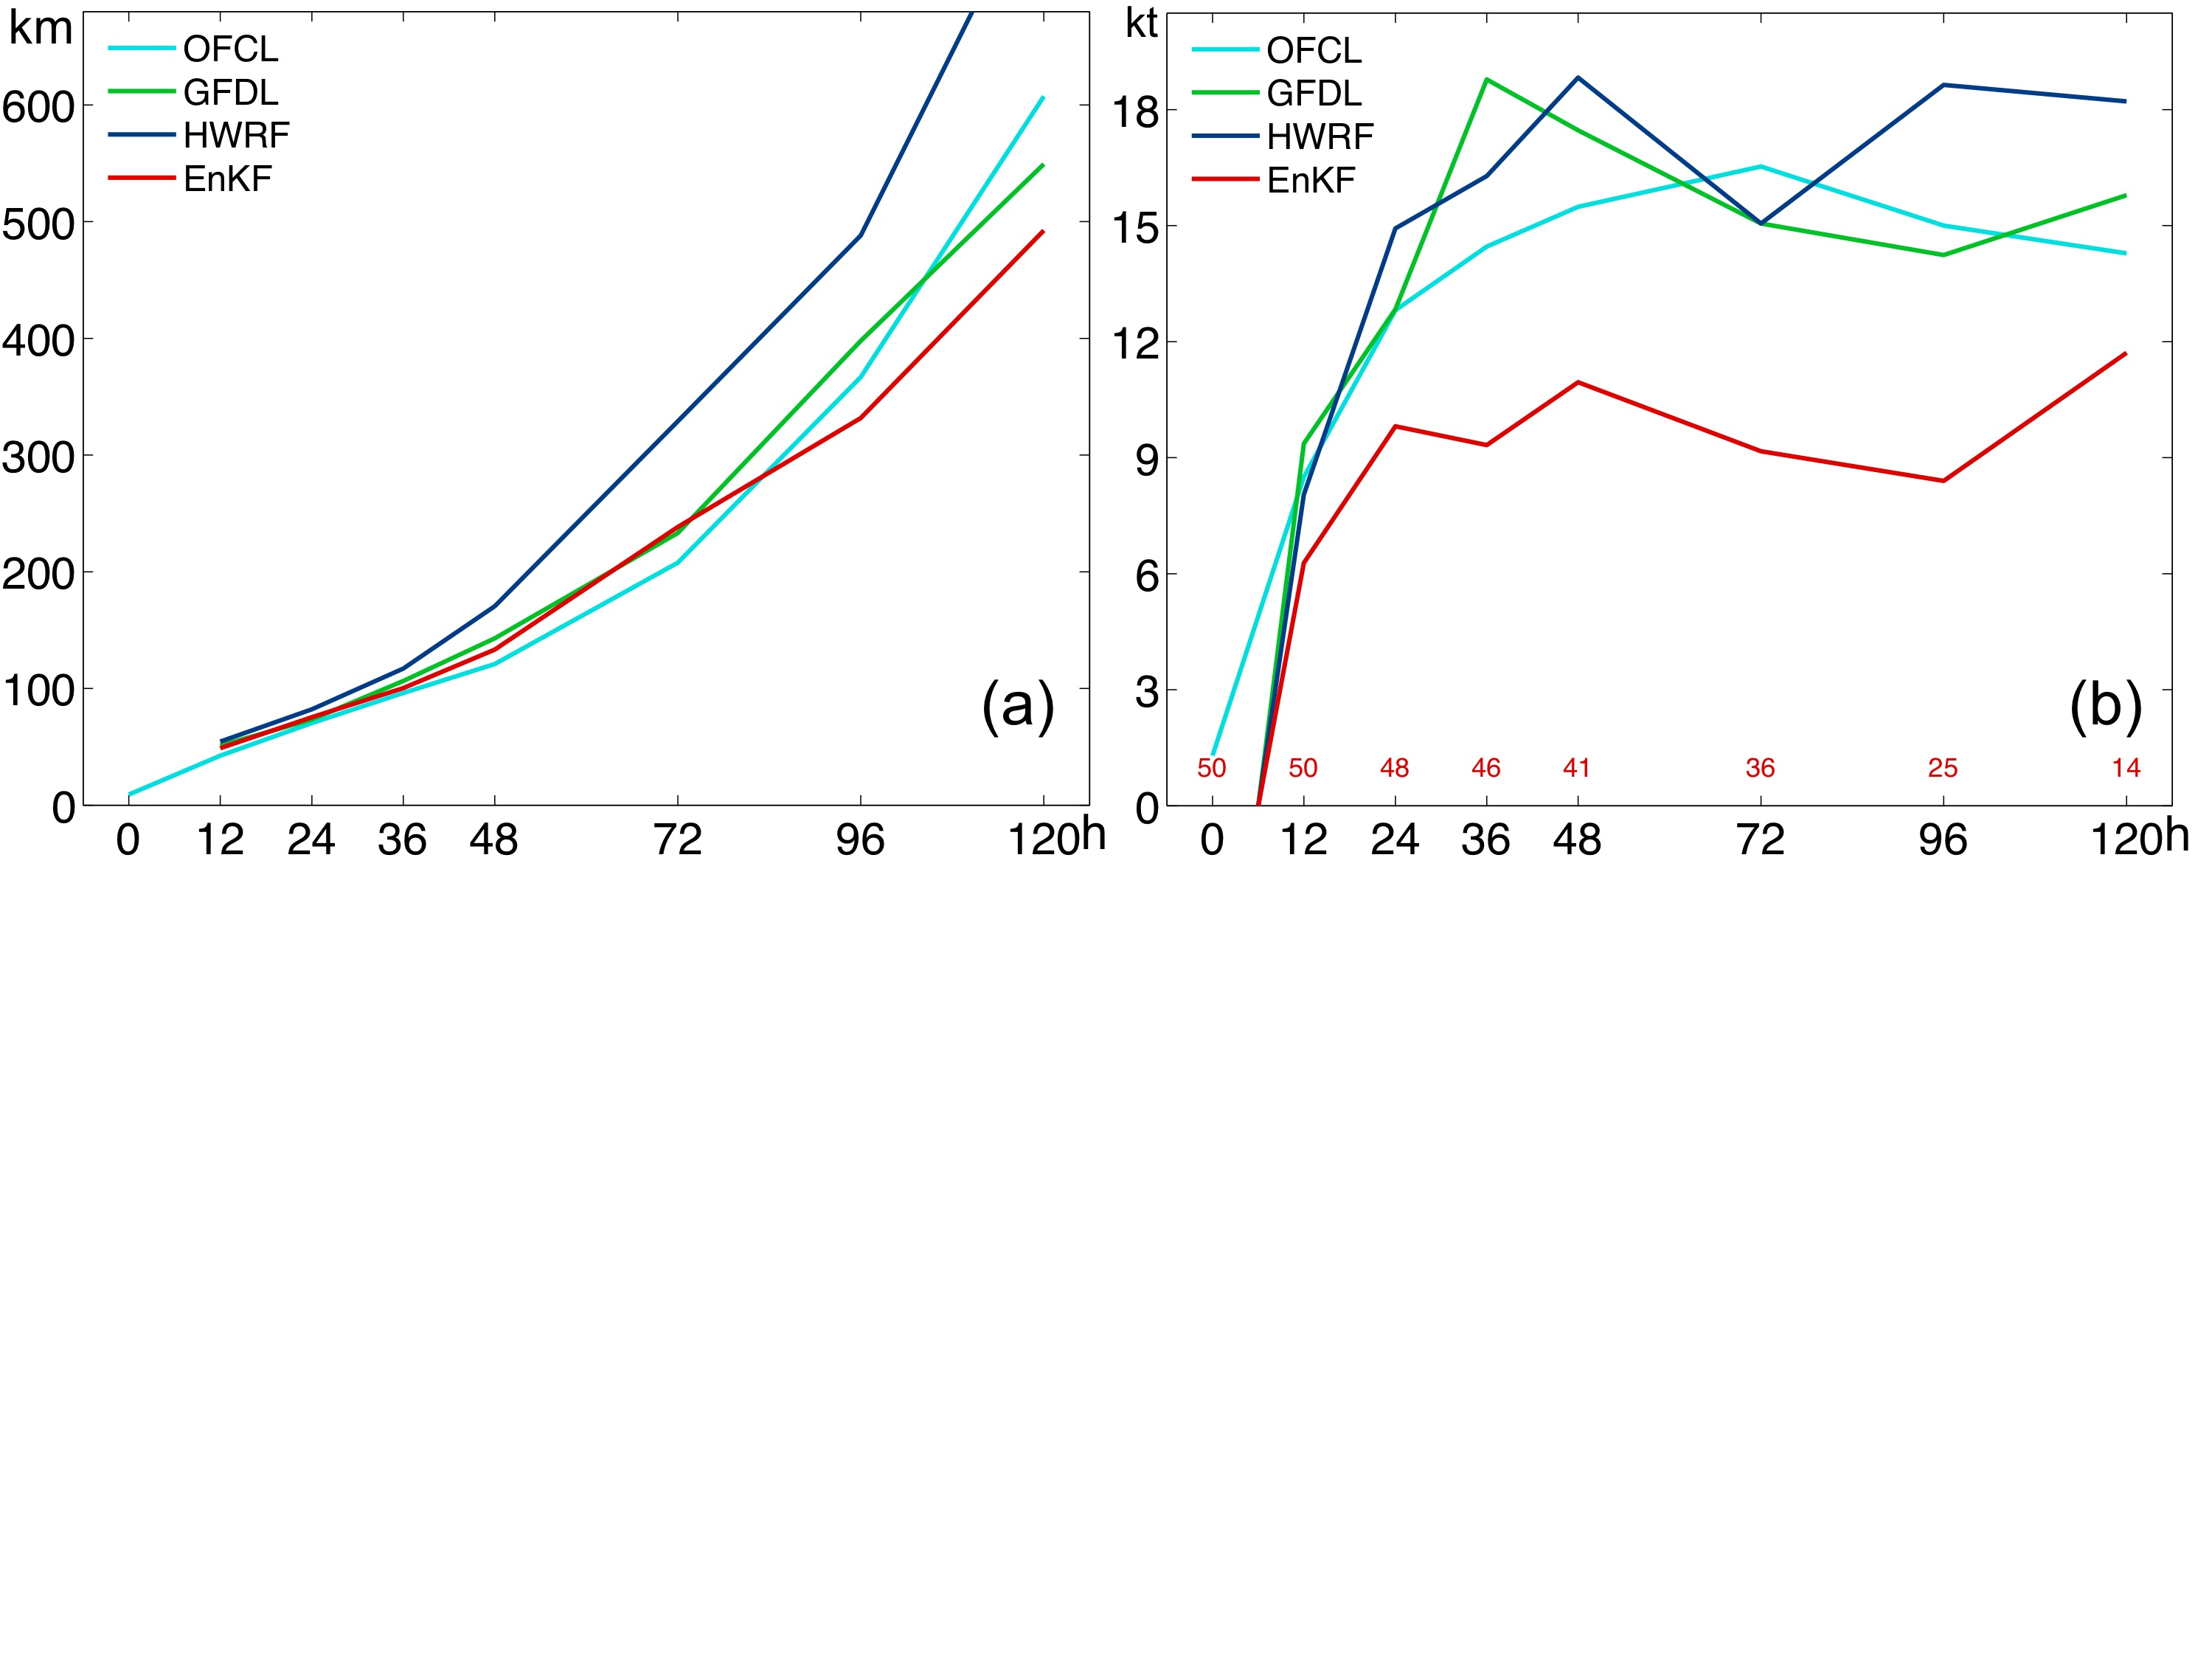
WRF-EnKF Performance Assimilating Airborne Vr
(2008-2010 P3 missions; 61 Applicable cases)
Mean absolute track error (km)
Mean absolute intensity (kts) error
(Zhang et al. 2011 GRL)
Notes:
Applicable cases are “flights” (61 flights sampling 14 storms)
Homogenous comparison → errors are averages over the same number of forecasts for each model at each forecast time.
“Variable Interpolator” termed at NHC for late cycle models → remove bias in maximum wind speed
NODA performed better than HWRF/GFDL, but not as well as assimilating Airborne observations.
Initialized from the GFS 9-12 h prior to assimilation. GFS forecast closest to assimilation window used as BC.
Hurricane Ike was first realtime forecast using airborne Vr in 2008.
Bogusing schemes have been developed to generate a balanced synthetic vortex that is representative of an observed storm's size, intensities, and even shape, for merging with the model initial field.
It is necessary to use an advanced data assimilation scheme to assimilate high-resolution observations in order to represent the realistic mesoscale structures.

Slide 7
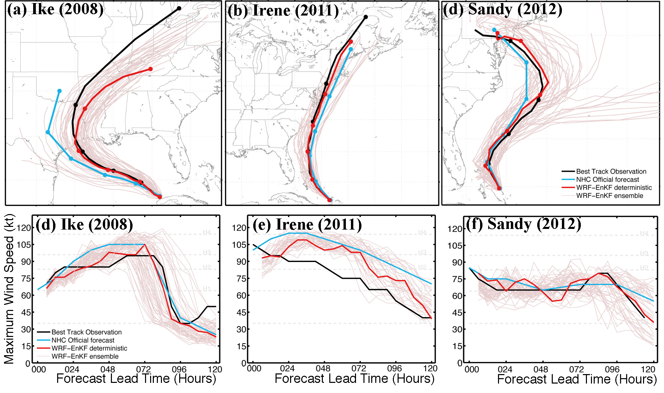
Realtime EnKF assimilation of airborne Doppler winds for Hurricane Forecasts
(Zhang and Weng 2013)

Slide 8
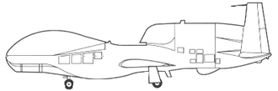
Global Hawk Radar Geometry
Dual band allows for dynamic range of sampled conditions
Issue: conically scanning radar
  Large vertical component inherent in retrieved Vr
  Vertical velocity generally noisy, small scale, and weakly correlated with other state variables (Poterjoy and Zhang 2011)
  Particle fall speed contamination
40º
30º
Ka and Ku
Bands
HIWRAP
High Altitude Wind and Rain Profiling Radar
Notes:
Solid-state transmitter-based system.
Dual band (Ka and Ku): extend the dynamic range of conditions being sampled, precipitation drop size measurements.
Ka band: image winds though volume backscattering from clouds and precipitation (tropospheric winds at high altitudes above heavy rain)
Ku band: full atmospheric boundary layer winds from Doppler-precipitation volume backscatter measurements, dropsize distribution, determine ocean surface wind field using ocean wind scatterometry techniques.
Any given volume cell within inner-beam: view from two different incidence angles and four different azimuthal angles → 3 components of the wind will be derived.
HIWRAP Specifications:
About 2.2 Deg for azimuth resolution;
About 3.8 seconds for each scan (360 degree);
Aircraft speed is about 165m/s, about 625m for a scan;
150m for ranger resolution;
Aircraft altitude: 18.1~18.4km;
aircraft roll angle: -16.8631 ~ 16.9072;
aircraft pitch angle: 0.6037~ 3.6393;

Slide 9
GH Super Observation Generation
Methodology
  Raw observation quality control
  Split inner/outer beam into separate 360º scans
  Combine 5 scans into single volume and define bins
  Correct for vertical fall speed (Marks and Houze 1987)
  Observation selection and additional quality control of each observation and bin (Weng and Zhang 2009)
  Data thinning and random sorting.
30º (Inner) or 40º (Outer) Beam
3º
1 km
Notes:
Data processing from GRIP. Already unfolded and corrected for aircraft motion.
Vertical Fall Speed Correction (account for hydrometeors by subtracting out mean velocity of liquid and ice hydrometeors based as a function of DBZ).
- Assume liquid precip below 5 km, ice above 6.5 km, throw out between 5 and 6 km.
(1) Remove raw observations lower than 100m or higher than 19 km
Remove the raw velocity observations when the reflectivity value is smaller than 15 dbZ or larger than 75 dbZ
Any raw velocity observations with values smaller than 2 m s⁻¹ or larger 75 m s⁻¹ will be discounted
(4) Remove SO bins whose valid observations are less than 4
Remove observations whose bias are twice larger than the STD of the bin
Remove observations whose bias are twice larger than the STD of the bin
(5) Use the median of the valid observation in the bin to represent the SO
Assign a 3 m s⁻¹ error to the resulting SO
Further thinning and random sorting of the SOs is applied depending on the resolution of the model, and an observation that creates an innovation magnitude greater than 15 m s⁻¹ is q disregarded

Slide 10
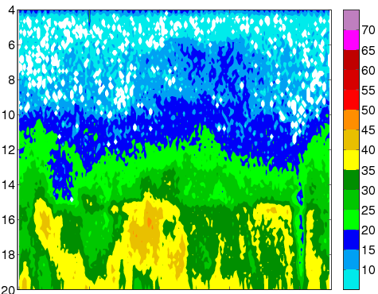
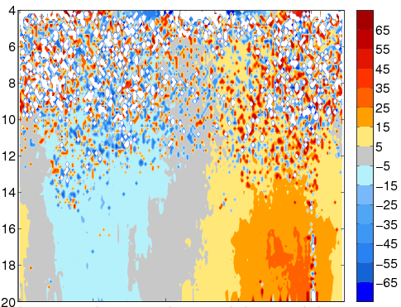
Hurricane
Karl (2010)
1-scan SO
Example
[dBZ]
[ms⁻¹]
Ku Inner beam Reflectivity
Ku Inner beam Vr
Range from Aircraft [km]
Range from Aircraft [km]
86.82
86.97
87.11
87.26
87.44
86.82
86.97
87.11
87.26
87.44
Distance [km]
Distance [km]
Vr SO
[ms⁻¹]
Height above Surface [km]
Azimuthal Angle [deg]

Slide 11
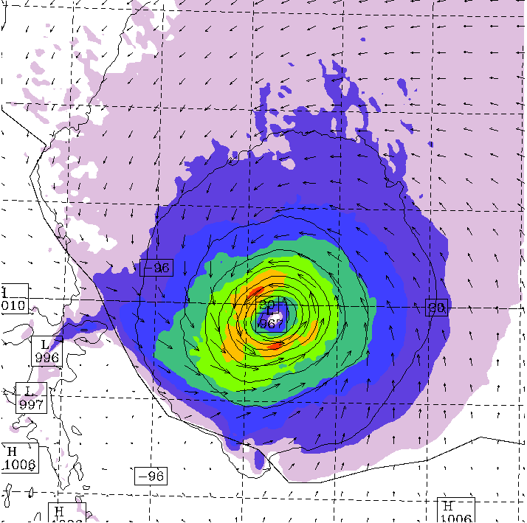
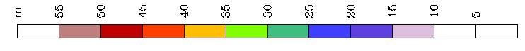
Real Data Assimilation
Example
10-m Max Surface Wind Speed
0700 UTC 17 September 2010
Hurricane Karl (2010)
  GRIP data
  Inner Ku beam (larger vertical component in Vr)
Assimilating Vr SO with center position and MSLP
  cycling
Assimilating HIWRAP GH data proves promising
  Forecasts assimilating Vr better track, intensity, and structure.
20ºN
90ºW
[ms⁻¹]
Notes:
Data thinning required
Data >0.5° from center (keep only that with strong cyclonic vortex signal); and
Data <0.05° from center (reduces dual-vortex problem); and
Vr < 15 m/s (obs in which w/Vr ratio is likely higher)
Only inner beam is available
Observing more of w than in OSSEs
Swath of inner beam is 1/3 swath of outer beam
Observation cone narrower
QC and fallspeed issues
Tons of noise needs to be removed
QC similar to F. Zhang’s methods
Fallspeed corrected according to Marks & Houze method
Vr analysis has 12 h of spinup, hours 12-17 position assimilation, hours 18-21 position + Vr, hours 22-07 position + Vr + min SLP. Mixing coefficient is 0.8 until hour 21, thereafter 0.7. The system is given 2000 Vr obs per hour, but only a small fraction (10-20%) actually get assimilated due to a limit on the innnovation of 1.5* the error (3 m/s). VAD is similar except that the system is given VAD obs from 2k locations (so u + v from each location, which means 4k obs). I have yet to run a Vr assimilation test with 4K obs and the same mixing setup.

Slide 12
Summary
The super observation methodology described herein is effective in generating subset of radar data for assimilation into models
Assimilation of Vr of tropical cyclones from both land and airborne Doppler observations proved successful,
  reducing tropical cyclone forecast track and intensity errors.
Assimilation of Vr from high altitude HIWRAP data is promising and current area of active research

Slide 13
References
Dowell, D. C., F. Zhang, L. J. Wicker, C. Snyder, and N. A. Crook, 2004: Wind and thermodynamic retrievals in the 17 May 1981 Arcadia, Oklahoma, supercell: Ensemble Kalman filter experiments. Mon. Wea. Rev., 132, 1982-2005.
Gamache, J. F., 2005: Real-time dissemination of hurricane wind fields determined from airborne Doppler radar data. Final report on JHT project, NOAA, 38 pp. [Available online at http://www.nhc.noaa.gov/jht/2003-2005reports/DOPLRgamache_JHTfinalreport.pdf].
Sippel, J. A., S. A Braun, F. Zhang, and Y. Weng*, 2013: Ensemble Kalman Filter Assimilation of Simulated HIWRAP Doppler Velocity Data from a Hurricane. Monthly Weather Review, 141, 2683-2704.
Weng, Yonghui, Fuqing Zhang, 2012: Assimilating Airborne Doppler Radar Observations with an Ensemble Kalman Filter for Convection-Permitting Hurricane Initialization and Prediction: Katrina (2005). Mon. Wea. Rev., 140, 841–859.
Zhang, F., Y. Weng*, J. F. Gamache, and F. D. Marks, 2011: Performance of Convection-permitting Hurricane Initialization and Prediction during 2008-2010 with Ensemble Data Assimilation of Inner-core Airborne Doppler Radar Observations. Geophysical Research
Zhang, F., Y. Weng*, J. A. Sippel, Z. Meng, and C. H. Bishop, 2009: Cloud-resolving Hurricane Initialization and Prediction through Assimilation of Doppler Radar Observations with an Ensemble Kalman Filter. Monthly Weather Review, 137, 2105-2125.

Slide 14
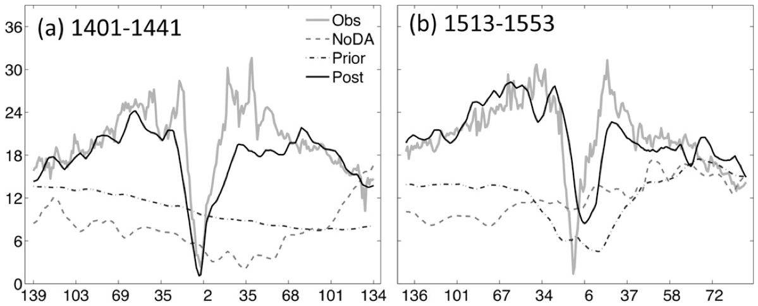
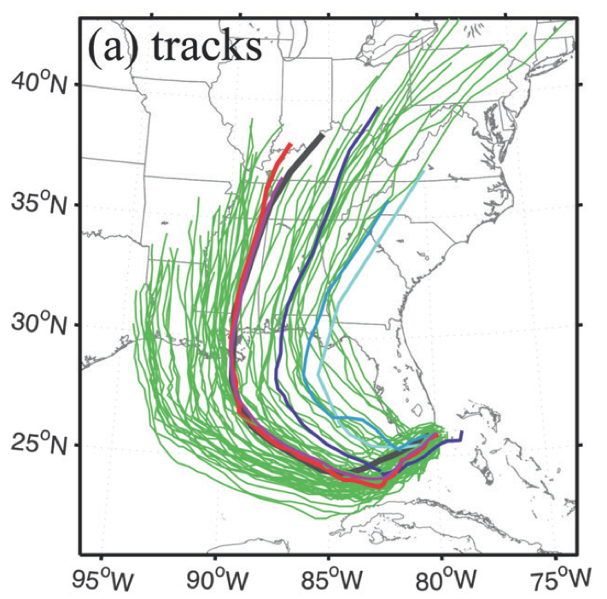
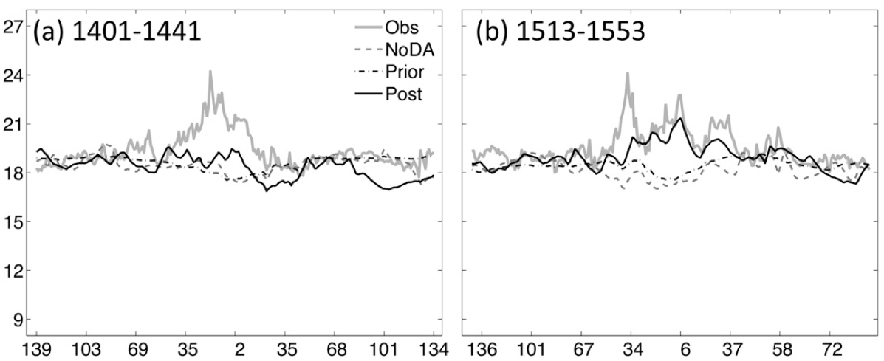
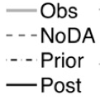
Assimilating Only Airborne Vr
In-Situ Observation Verification
(2nd Flight Leg)
Forecast Tracks
Wind Speed [ms⁻¹]
Improvement in track and vortex structure of wind (dynamic) and temperature (thermodynamic) fields.
Temperature [ºC]
(Weng and Zhang 2012)
Aircraft – Storm Center [km]
Notes:
Improved hurricane track forecasts at lead times beyond 12 h compared to NOAA’s operational forecasts and NODA
Been used in real-time since 2008
Ensemble mean represents the best estimate of the state and contains fewer errors than most individual members.
Southward bias of EnKF_DF and EnKF_EF-mean potentially caused by initial adjustment in model after all observations are assimilated, the impacts of sampling/model error, and the inhomogeneity due to interactions with land at the earlier forecast hours.
Much smaller impact on relative humidity (possibly due to weaker correlations between wind and moisture).
Ensemble standard deviations for the prior and posterior are the same order of magnitude. Standard deviation for posterior is almost equal in value to the RMSE for posterior during each cycle → ensemble spread provides good quantitative estimate of forecast error.
Verification of flight-level temperature reduction of RMSE demonstrates EnF ability to estimate flow-dependent error covariance calculated from short-term ensemble forecasts.

Slide 15
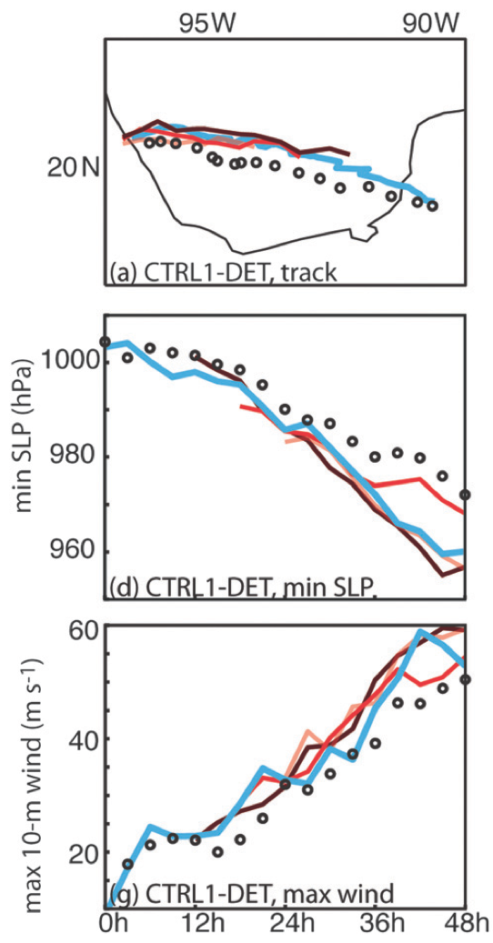
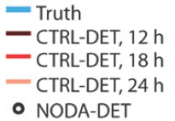
OSSE Assimilation Study
Sippel et al. 2013
  Focused on Hurricane Karl (2010)
  Generated simulated HIWRAP observations
  Assimilating observations reduces the analysis errors when comparing to NODA
    HIWRAPS geometry may not be a large concern (vertical component)
  Prolonged data assimilation cycles (more cycles) improved forecast
(Adapted Fig. 13, Sippel et al. 2013)
Notes:
GH had 14 h over storm when in Bay of Campeche. GH arrived over storm at 1800 UTC 16 September. 20 passes over the eye. Many different observation systems.
Used an OSSE
Ability to accurately characterize the error fo the assimilation system and easily assess the benefits of assimilating multiple types of observations or using different observation network configurations
Used WRF-ARW V3.1.1 – 3km nest over bay of ampeche
20 flights over the eye – GH spent 14 h over the storm
Simulated along a butterfly pattern; Observations gathered at a single time rather than over an hour (removes problem of storm movement). Beamwidth not accounted for. Earth curvature accounted for. Simulated Vr calculated by linearly interpolated u,v,w wind components in truth simulations. Below 16-km with simulated > 10 dBz. No consideration given to particle fall speed and normally distributed 3 ms-1 error was added to observations.
Performed similar experiment with P-3 geometry. Not much of a change.
HIWRAP data cen be sued for hurricane analyses and prediction → corrections to storm location, structure, and maximum intensity was realized using 12h cycling of assimilation.
When the first guess is bad, the benefit of the GH potentially long on-station ties becomes evident → more assimilation cycles to correct poor initial error covariance.
Focusing the flight pattern more on the inner core and less on the outer circulation is not beneficial to analyses or forecasts.
Keep in mind OSSE with simplified scanning strategy. Limited model error in OSSE (analysis error would be larger with real data). External data has been ignored.

Slide 16
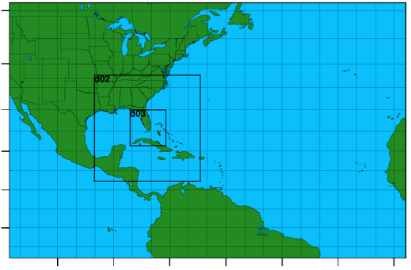
Current PSU Real-Time Data Assimilation
Model:
  WRF-ARW v3.4.1
  27km, 9km, 3km; 43 vertical
  Inner domains two-way nested; movable
Data Assimilation Method
  PSU-EnKF with 60 members
  Covariance relaxation
  Successive Covariance Localization for P-3 TDR SO
P-3 Airborne Observation characteristics (Dowell et al. 2004)
  Assumed error Vr > 1.5 ms⁻¹
  Observation – background threshold = 15 ms⁻¹
50ºN
40ºN
30ºN
20ºN
10ºN
0ºN
105ºW
90ºW
75ºW
60ºW
45ºW
30ºW
15ºW
Other observations
  All conventional GDAS observations
  TDR specific:
    Minimal sea level pressure from TC vital
    Flight-level and dropsonde data
    SOs are also assimilated in them
Notes:
ARW-WRF version 3.4.1
1) 3 mercator-projected domains: 379x244x27km, 304x304x9km,
304x304x3km. The outer domain is fixed and covers almost of the Atlantic and the North American; while the inner domains are movable by following the vortex center during the forecast and following the TCvital data during the analysis;
2) 43 vertical levels, and model top 50 mb;
3) Time step: 90 s;
4) Cumulus: Grell-Devenvi ensemble scheme for 27 km domain only;
5) Microphysics: WSM 6-class graupel;
6) PBL: YSU scheme;
7) Surface Layer: Monin-Obukov;
8) Land Surface: thermal diffusion;
9) Radiation: Rrtm/Dudhia for longwave/shortwave
10) Ck, Cd formulation for TC: Green and Zhang (2013)
11) 1D ocean model initialized with HYCOM dataset.
EnKF
1) 60 members;
2) mixing = 0.60;
3) ROI: 30 grids for up-air, while 15 grids for surface, SCL with 15 grids for
TDR;
4) 3-hr assimilation window;
NOTE: SCL technique is designed to assimilate dense observations such as from radars that contain multiscale information of the atmosphere and reduce computational costs and sampling errors. (Different ROI for a different group of observations chosen by random sampling). Theory: error correlation length scale decreases as the previously assimilated observations better define the large scales → Later observations should be assimilated with a tighter localization.
Working flow
1) Initialize the system when CLP5 or OFCL provides forecast for this storm and the storm presents to the west of 30W, or NHC announces an aircraft mission. 1 deterministic run initialized with operational GFS and its 60 perturbations are integrated for 12 hours.
2) The environment fields (out of 600km of the TCvital center) of the 12h deterministic forecast is replaced by the operational GFS analysis, then the combined field is used as the ensemble mean of the 60 members, and the perturbation is added to the combined fields to generate 60 new ensemble members.
3) All conventional observations from GDAS within 3-h window over the fine domain (900km x 900km) are assimilated in all 3 domains; minimal sea level pressure data in the correspond TCvital file, flight-level and dropsonde observations, and TDR SOs are also assimilated in them.
4) With the 1st EnKF analysis and perturbations, 3-h free ensemble forecasts are performed. The 2 inner domains of all ensemble members follow the TCvital center with the preset moving technique in WRF ARW.
5) After 2nd 3-h assimilation window, 126-h deterministic forecast initialized with the EnKF analysis is performed as the control experiment. Also, the 3-h deterministic and ensemble forecasts will be forward to another assimilation cycle.

Slide 17
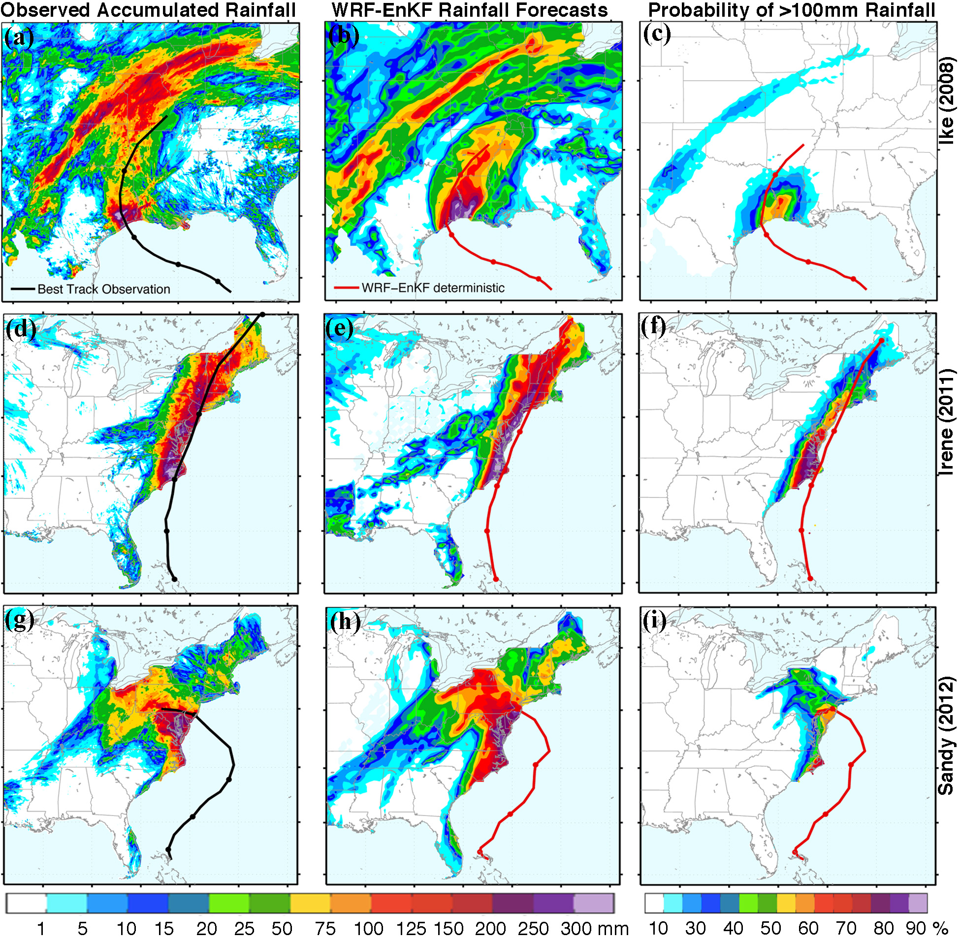
Rainfall
Forecasts with PSU WRF-EnKF

