Slide 1
Mesoscale Gravity Waves in Moist Baroclinic Jet-Front Systems Junhong Wei 09/13/2013

Slide 2
Outline
Current Project (Tracing Gravity Waves in Moist Baroclinic Waves)
Tracing with 4D background data (an update version)
Paper Revision (Mesoscale Gravity Waves in Moist Baroclinic Jet-Front Systems)
Fake Dry/Dry Experiment for EXP100
Sensitivity experiment to enhanced horizontal resolution

Slide 3
Outline
Current Project (Tracing Gravity Waves in Moist Baroclinic Waves)
Tracing with 4D background data (an update version)

Slide 4
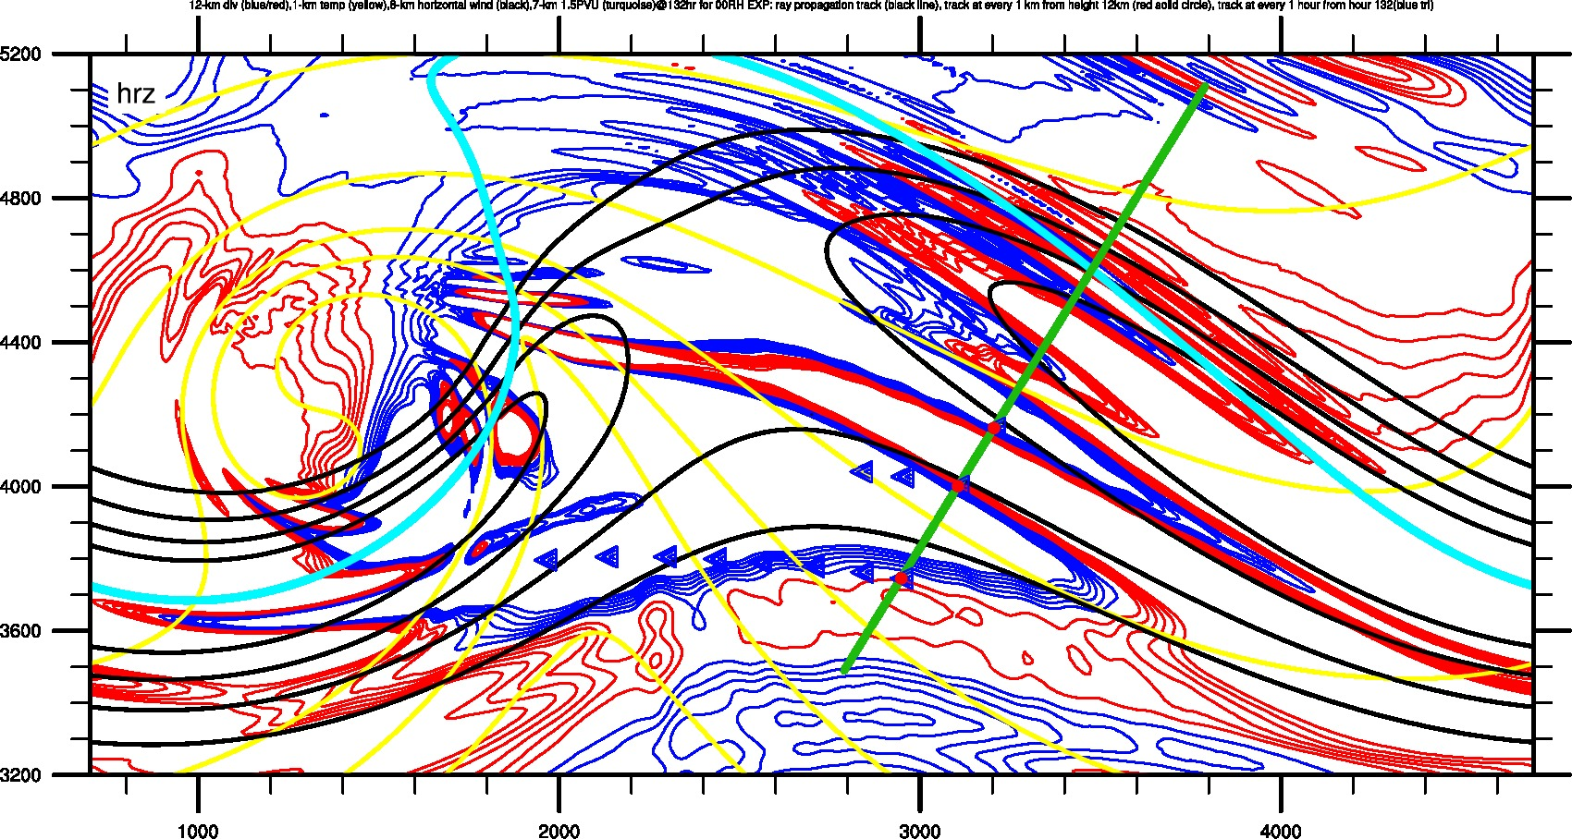
Tracing with 4D background data
WP5s-EXP00 --- 4D DATA
Red Circles represent every 1 km; Blue Triangles represent every 1 hr
Old Version

Slide 5
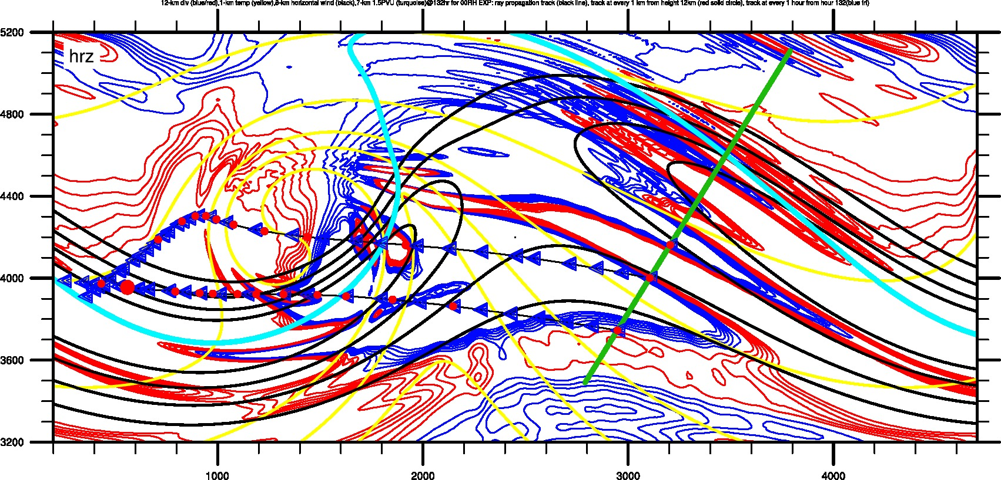
Tracing with 4D background data
WP5s-EXP00 --- 4D DATA
Red Circles represent every 1 km; Blue Triangles represent every 1 hr
Updated Version

Slide 6
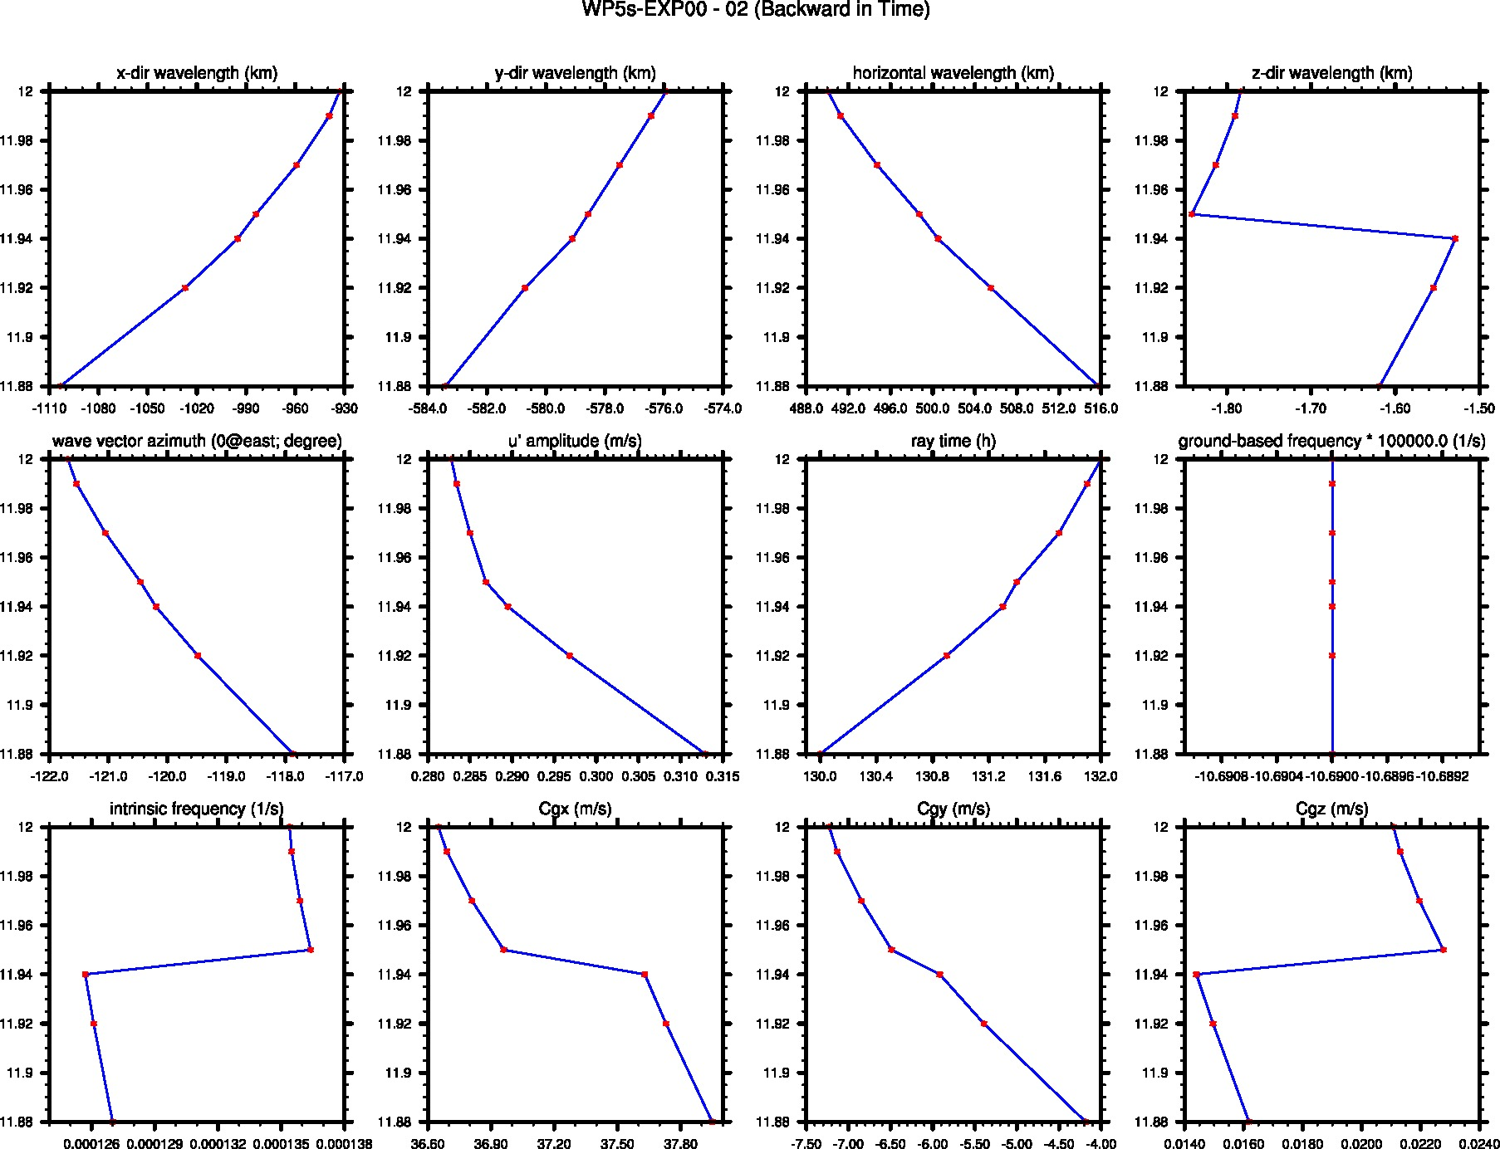
Vertical Profiles: WP5s-EXP00 (middle point)
Old Version
Red Dot is the output data from GROGRAT.

Slide 7
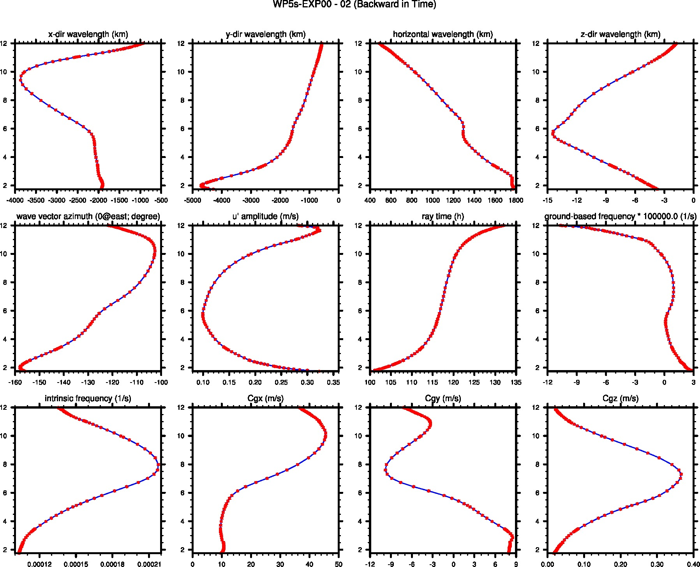
Vertical Profiles: WP5s-EXP00 (middle point)
Updated Version
Red Dot is the output data from GROGRAT.

Slide 8
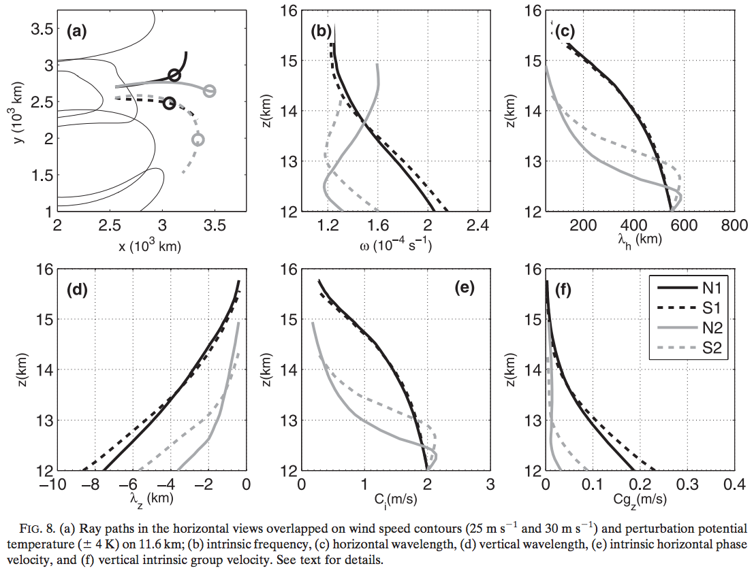
Wang et al. 2009

Slide 9
4D tracing summary
The update version is better, in that ground-based frequency varies along the ray.
The increase of both horizontal wavenumber and vertical wavenumber
Approach toward the wave capture limit in intrinsic frequency.

Slide 10
Outline
Paper Revision (Mesoscale Gravity Waves in Moist Baroclinic Jet-Front Systems)
Fake Dry/Dry Experiment for EXP100

Slide 11
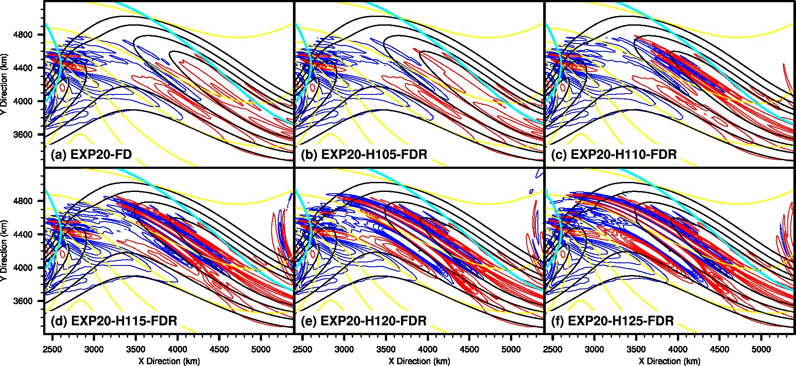
Fake Dry EXP in EXP20

Slide 12
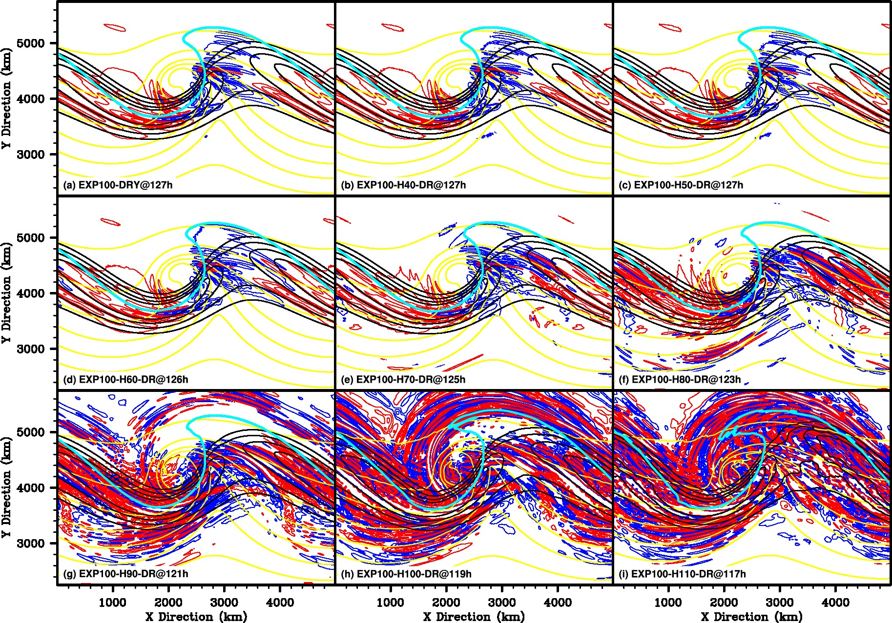
Dry in EXP100

Slide 13
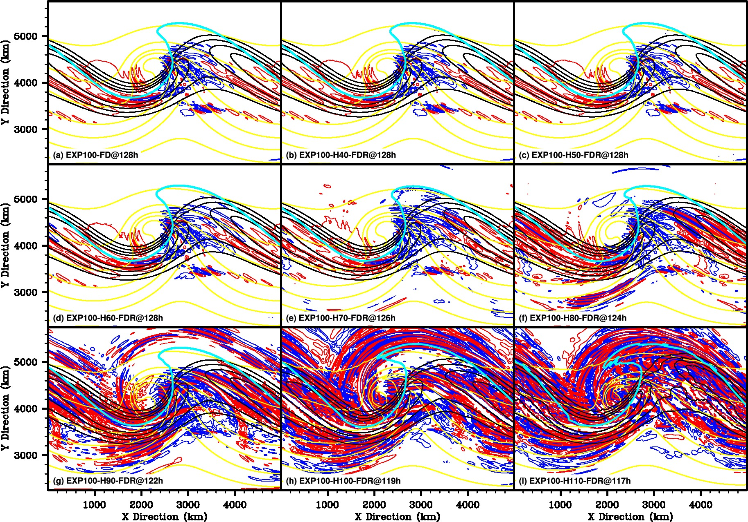
Fake Dry in EXP100

Slide 14
Fake Dry (Dry) tracing summary
Minor but noticeable difference between DRY and FD run, which suggests that the cloud formation alone can generate wave signal without the release of latent heating.
The response of gravity wave field generally depends on when the moist process is turned off. It responds as either the wave strengthening in the far away field or short-scale random wave along the jet.

Slide 15
Sensitivity experiment to enhanced horizontal resolution

Slide 16
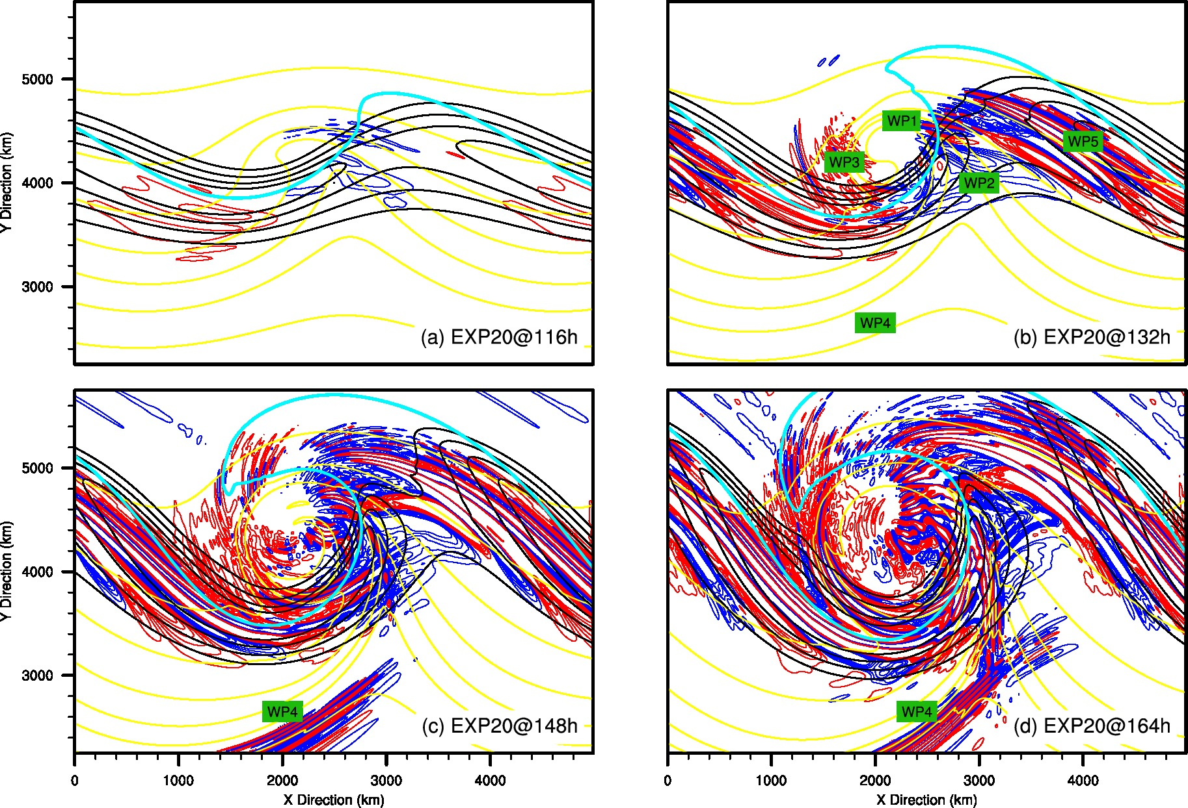
10-km BW Simulation

Slide 17
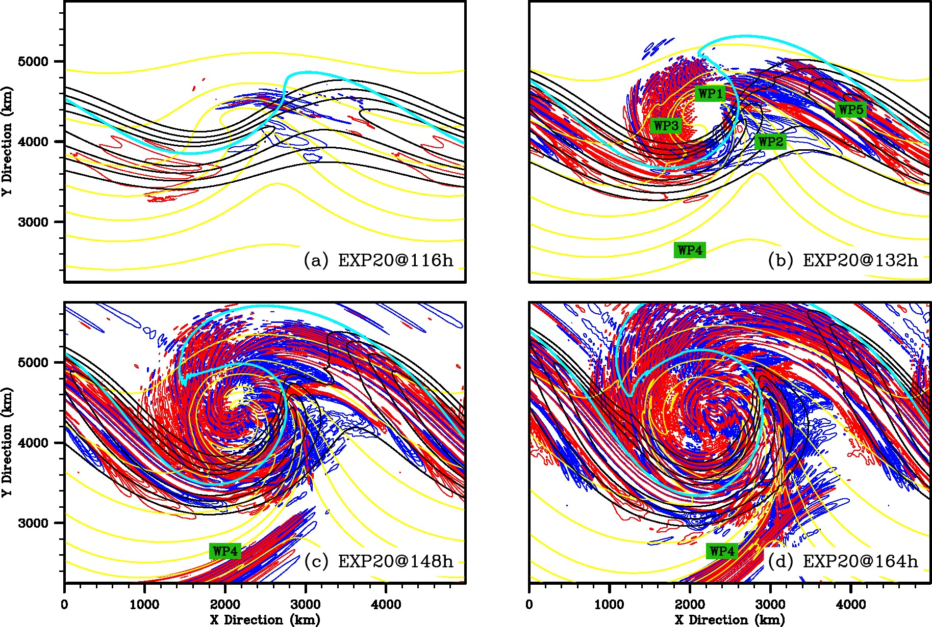
5-km BW Simulation

Slide 18
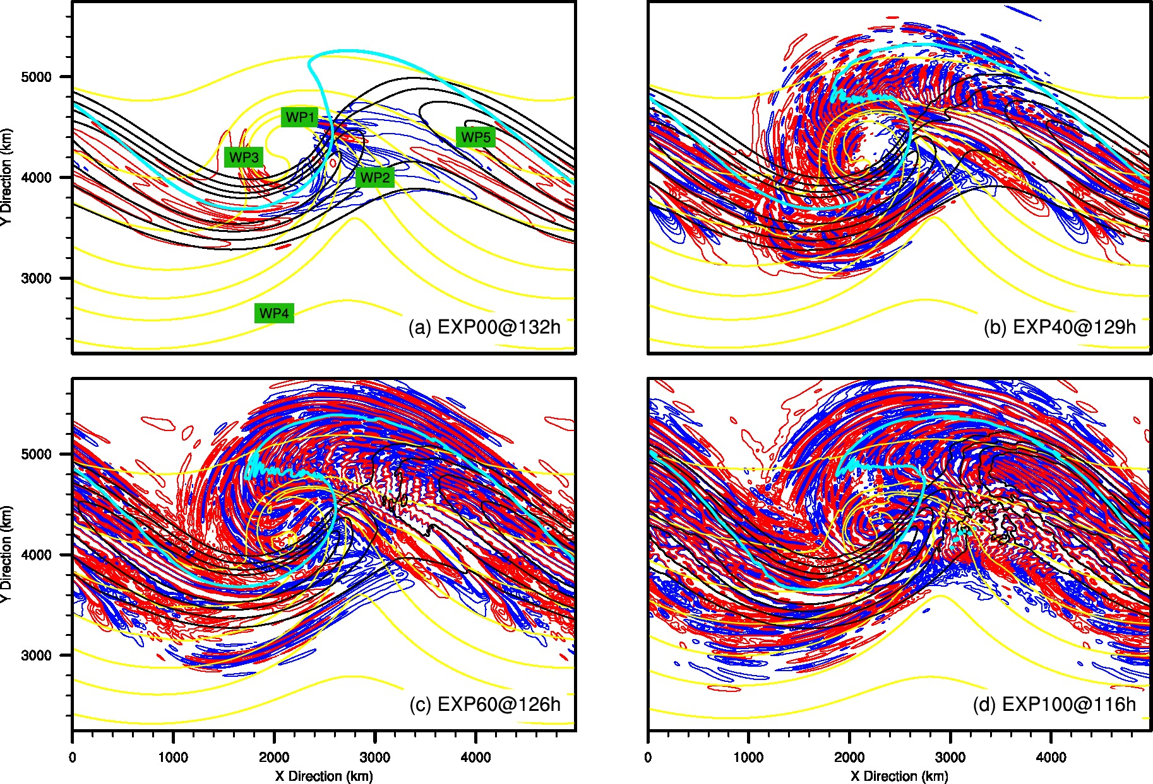
10-km BW Simulation

Slide 19
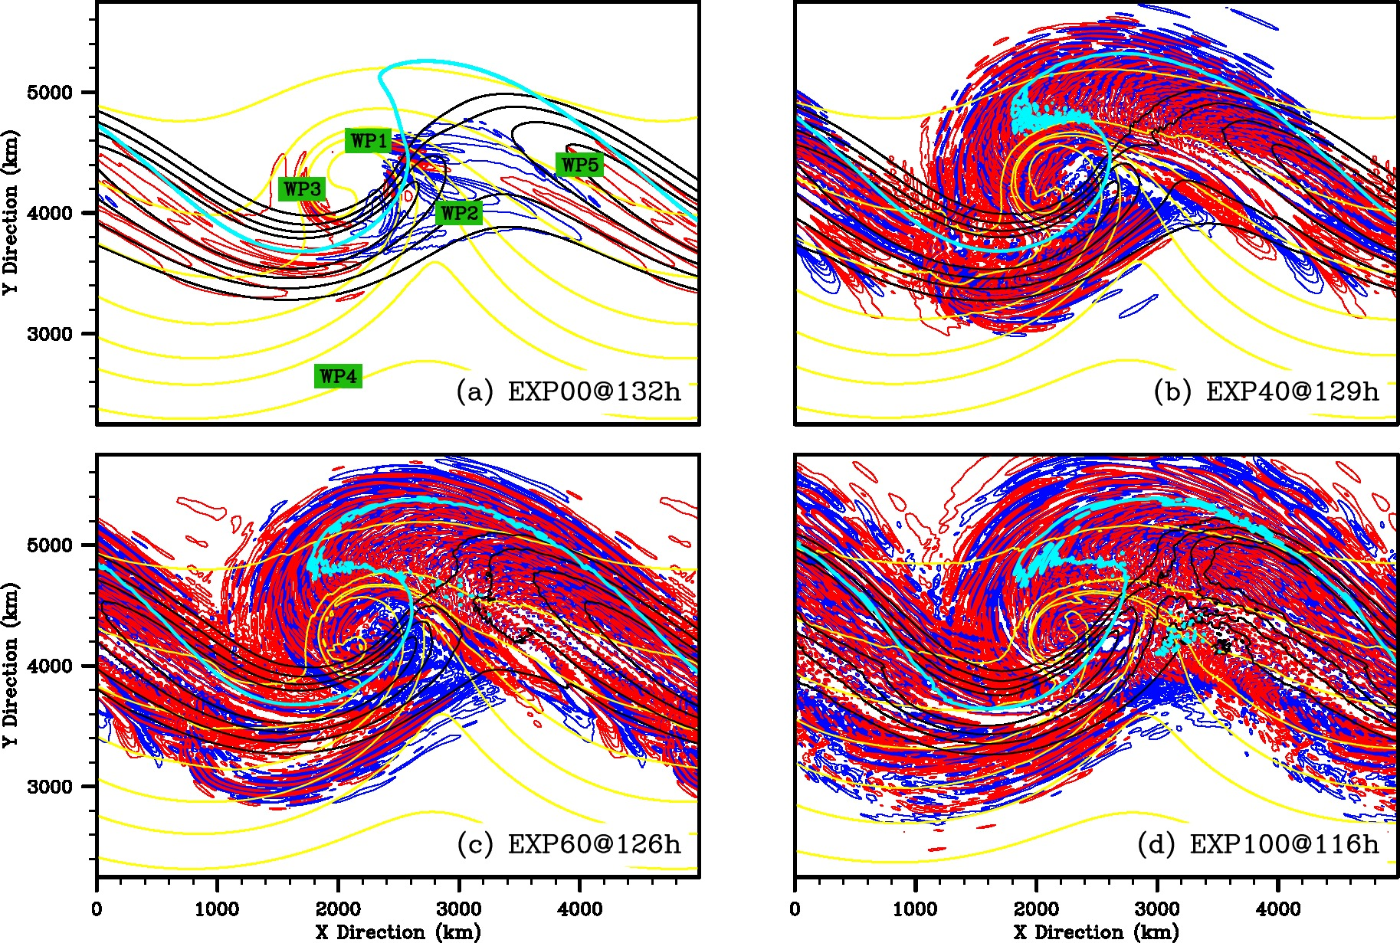
5-km BW Simulation

Slide 20
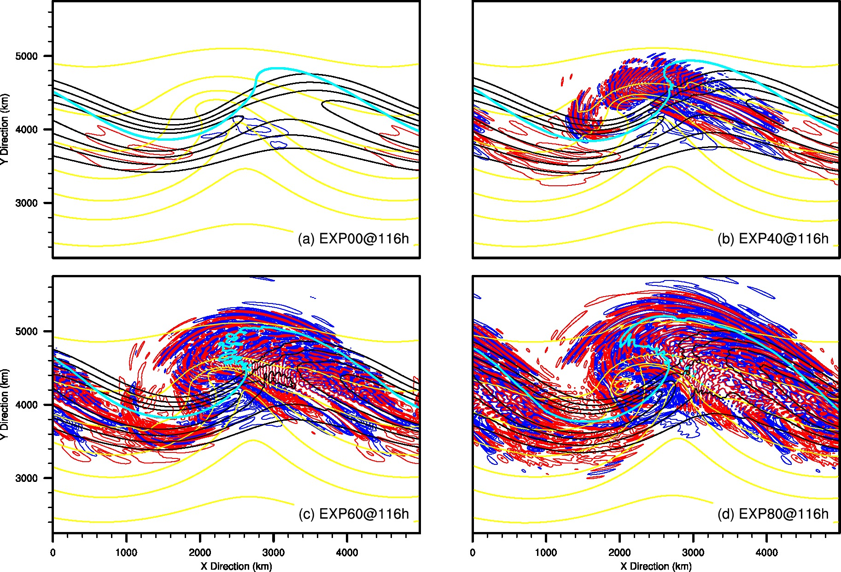
10-km BW Simulation

Slide 21
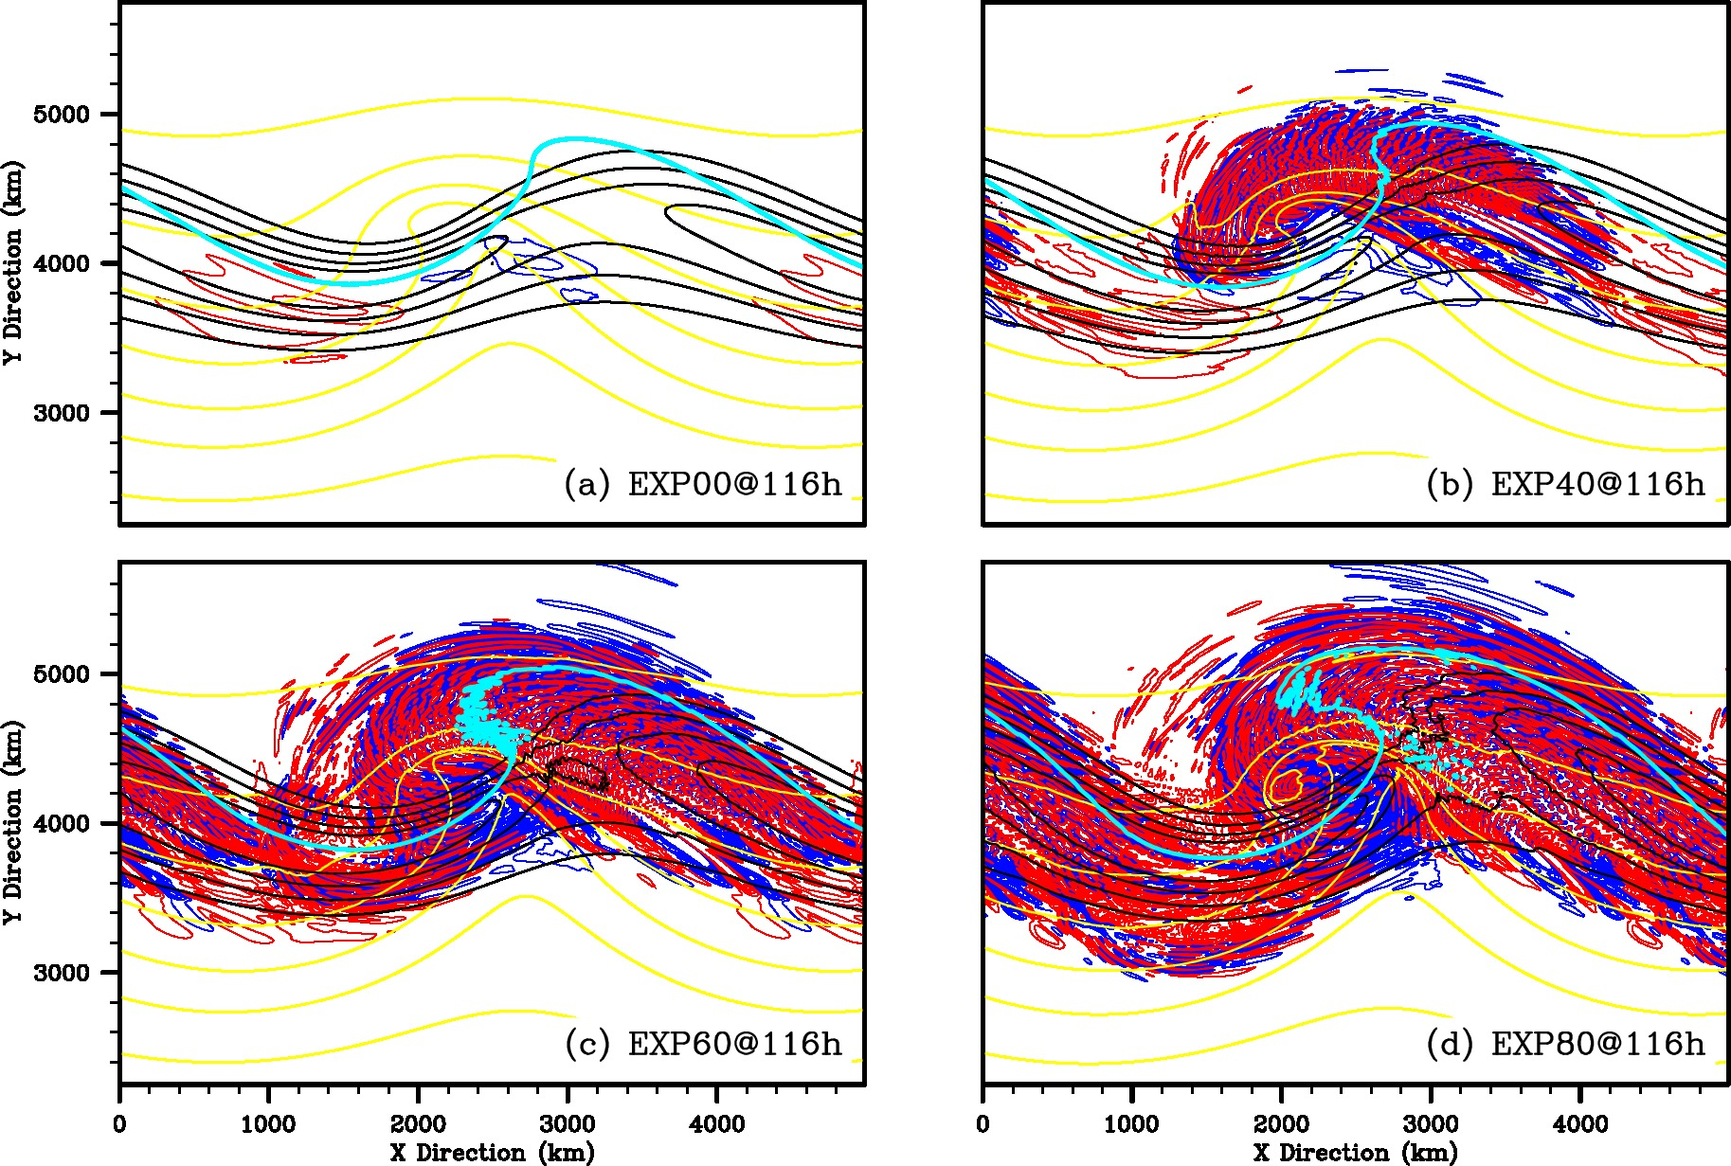
5-km BW Simulation

Slide 22
Horizontal resolution
Short-scale signal (e.g., WP6) is stronger in 5-km runs.
Additional short-scale waves

Slide 23
EXP100 Comparison
10-km EXP100
5-km EXP100
10-km EXP100-H70-FDR
10-km EXP100-H70-DR

Slide 24
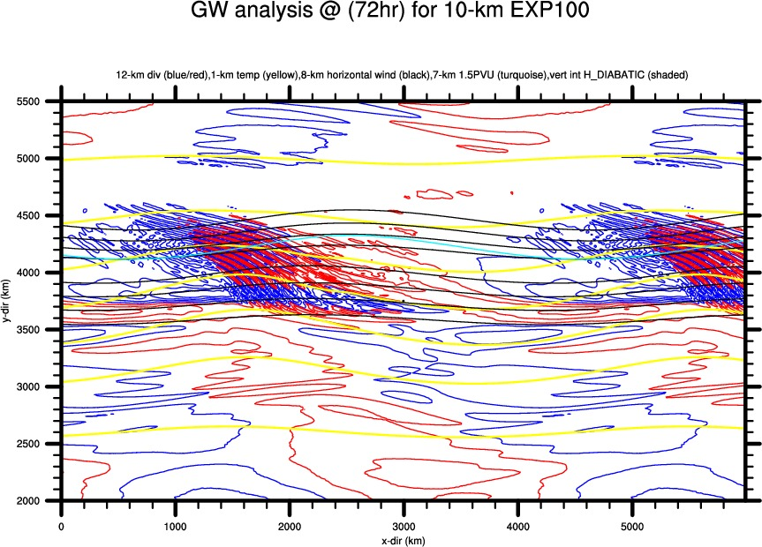
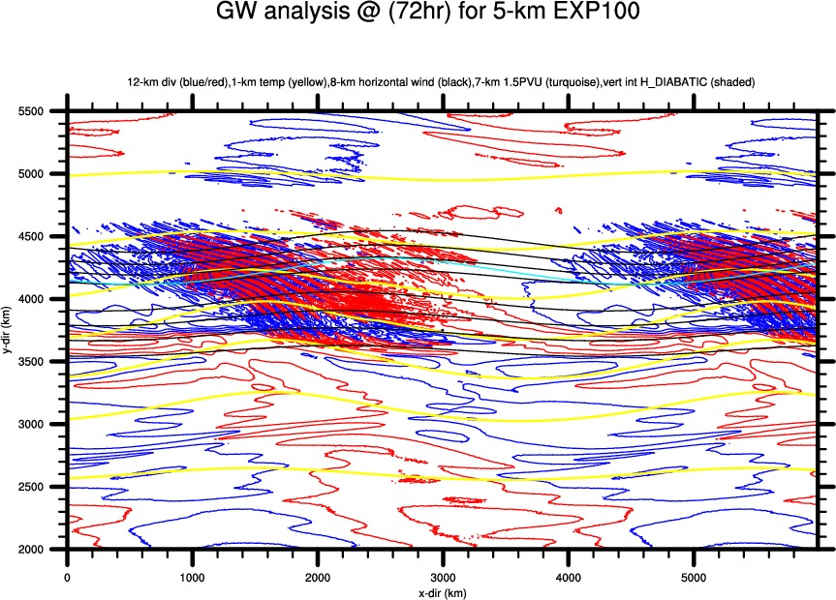
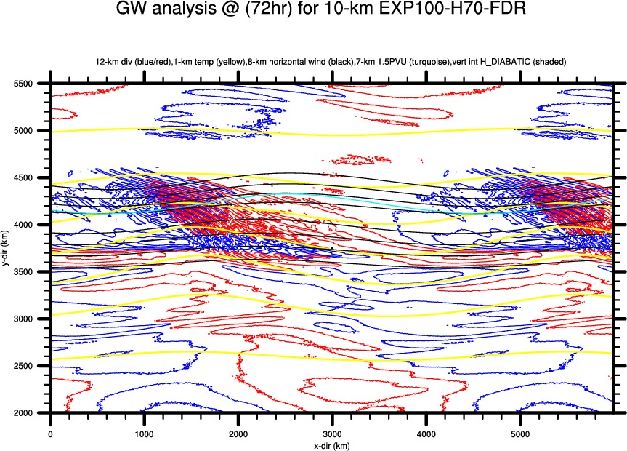
EXP100 Comparison @72h

Slide 25
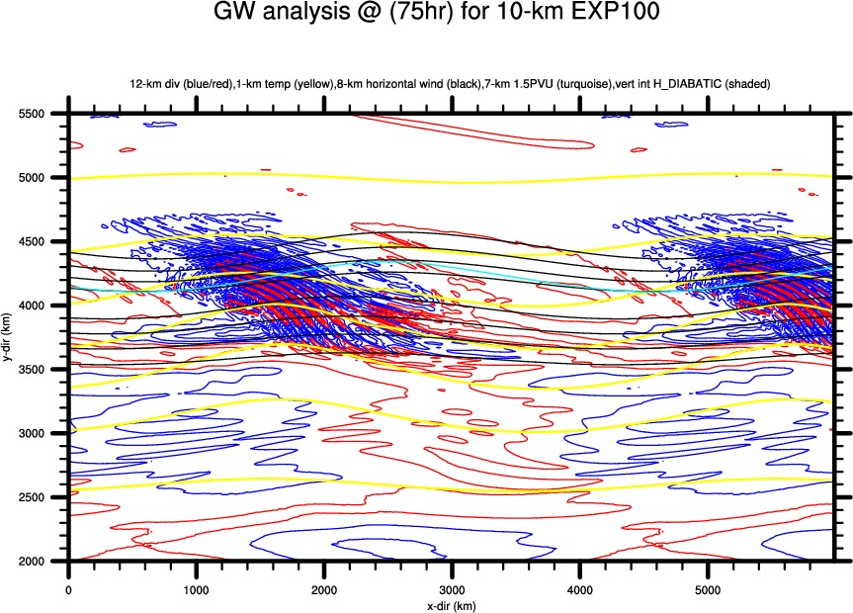
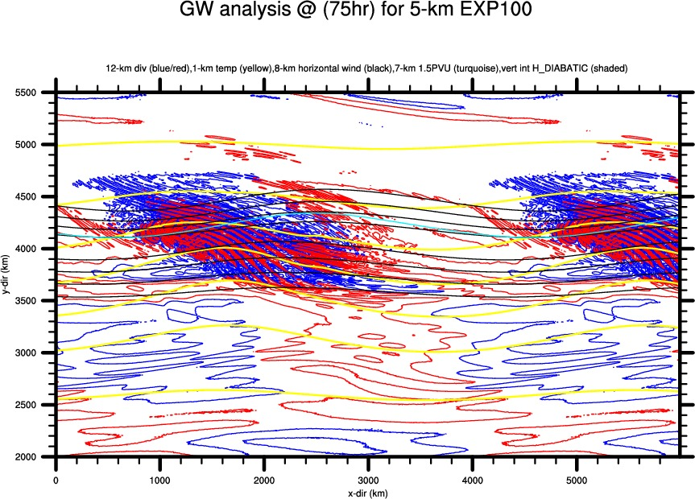
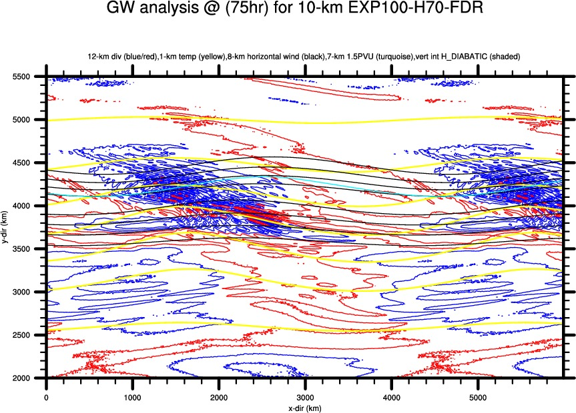
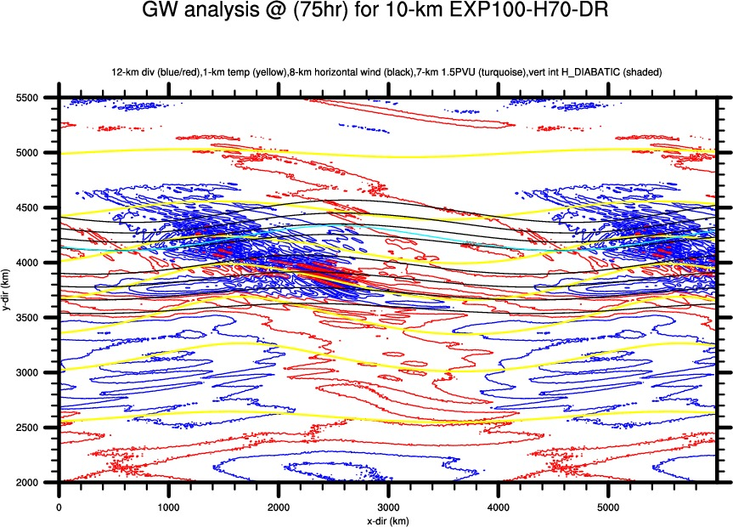
EXP100 Comparison @75h

Slide 26
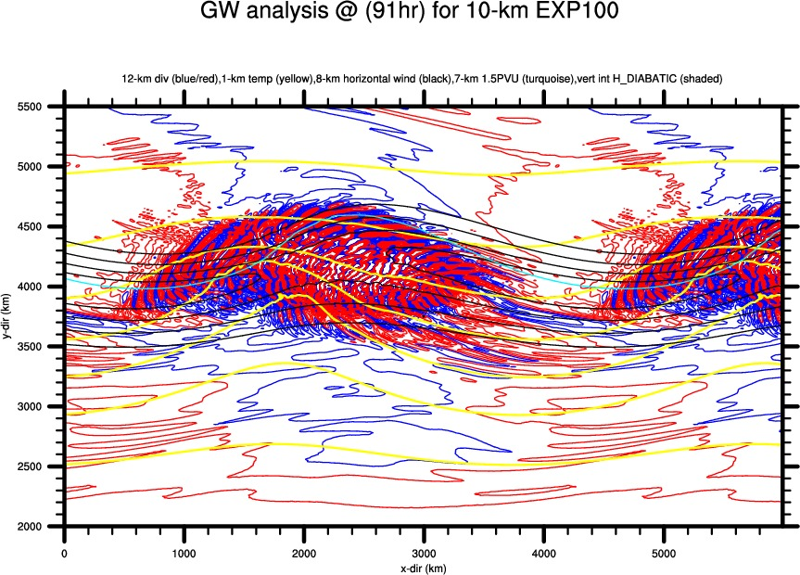
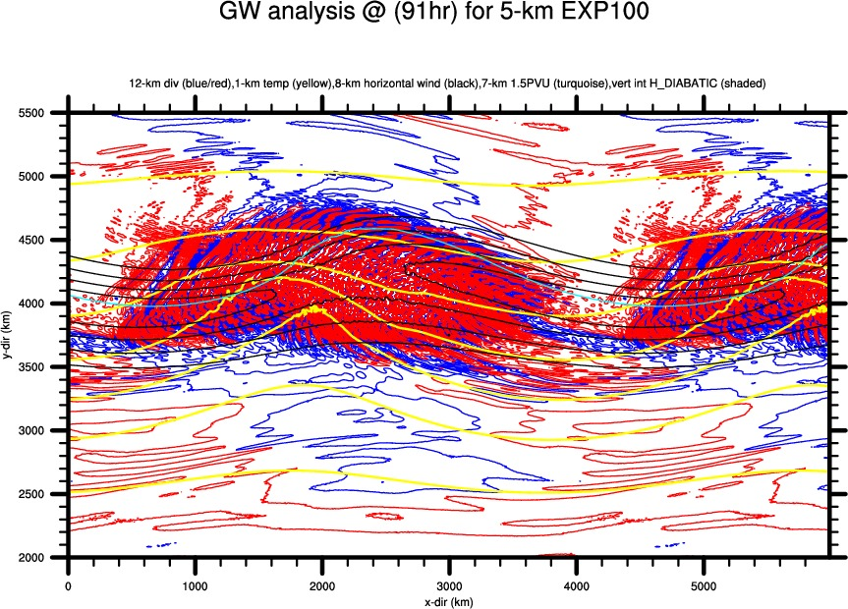
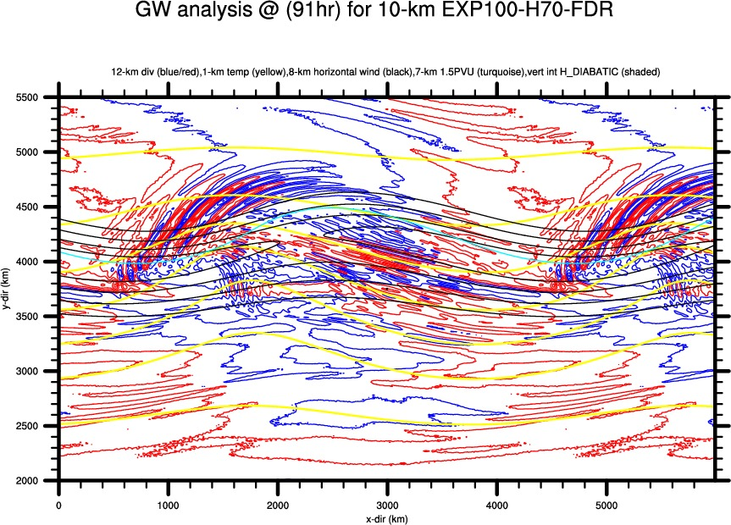
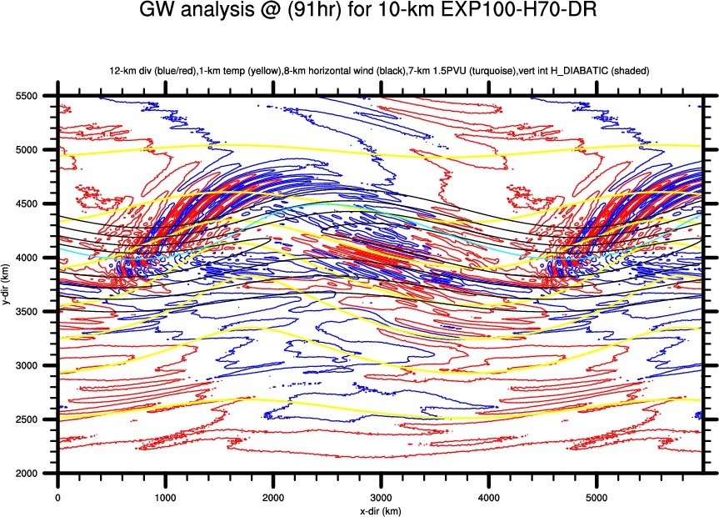
EXP100 Comparison @91h

Slide 27
Thank you!

