Slide 1
Secondary Eyewall Formation Under Vertical Wind Shear
Y. Qiang Sun
2013-09-09

Slide 2
Outline
Brief introduction and motivation
Our Data
Current Results
On going…

Slide 3
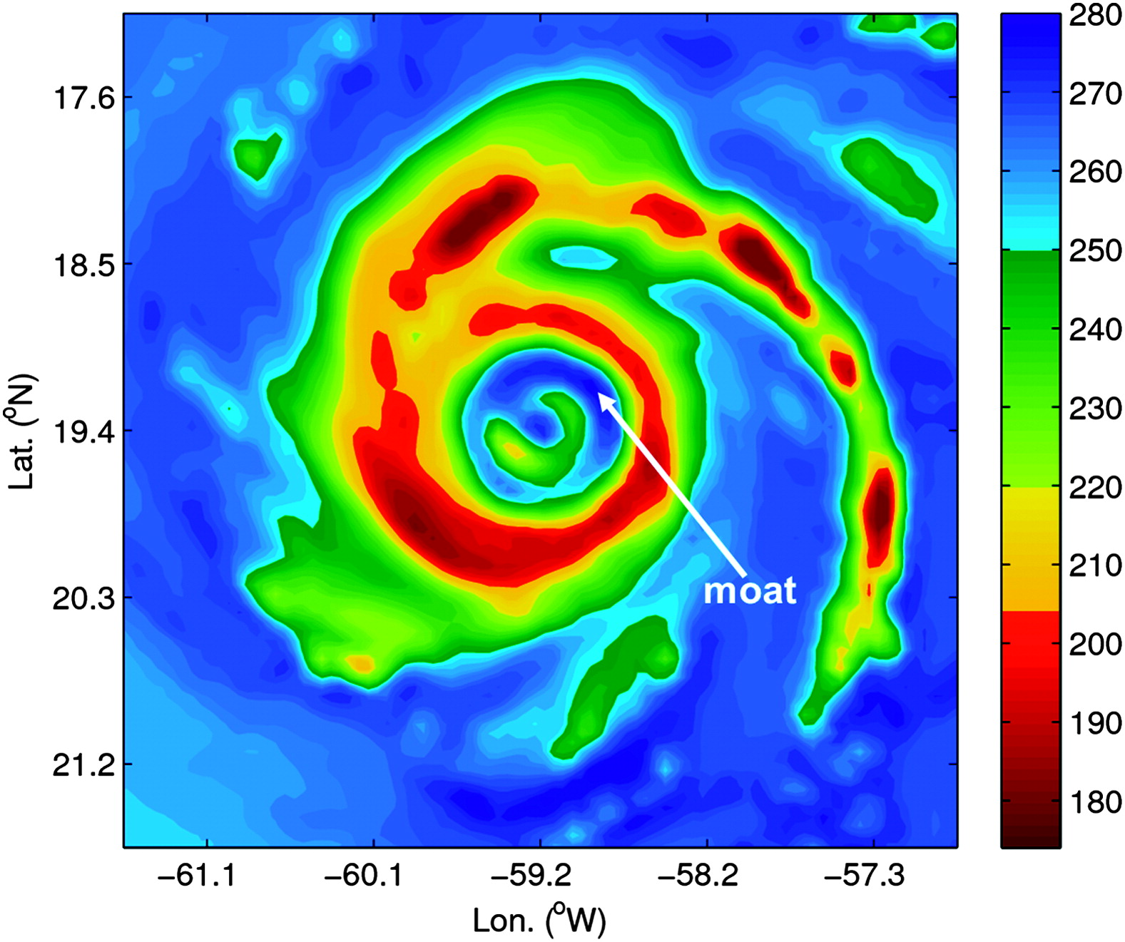
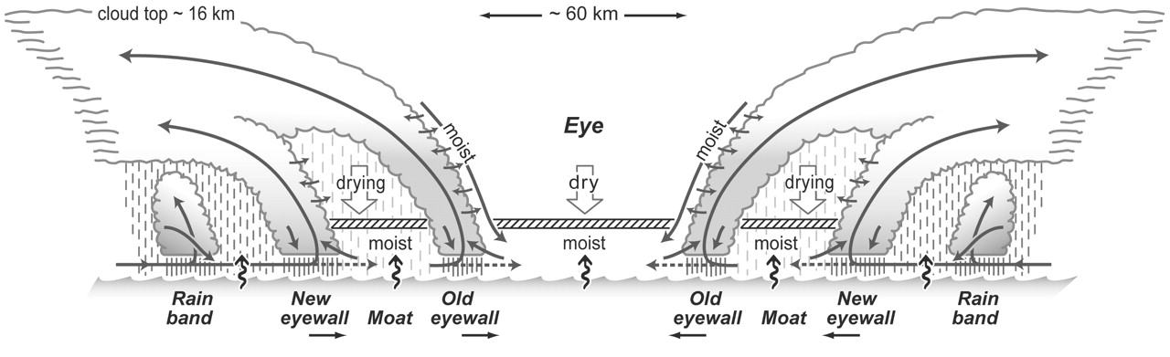
Sitkowski et al. 2011
Houze et al. 2007

Slide 4
Theories on Secondary Eyewall Formation:
Terway and Montgomery 2008 : “BSA”
Huang et al 2012 : Boundary Pathway
Rozoff et al 2012: Balanced Dynamics

Slide 5
Huang et al 2012:
AF

Slide 6
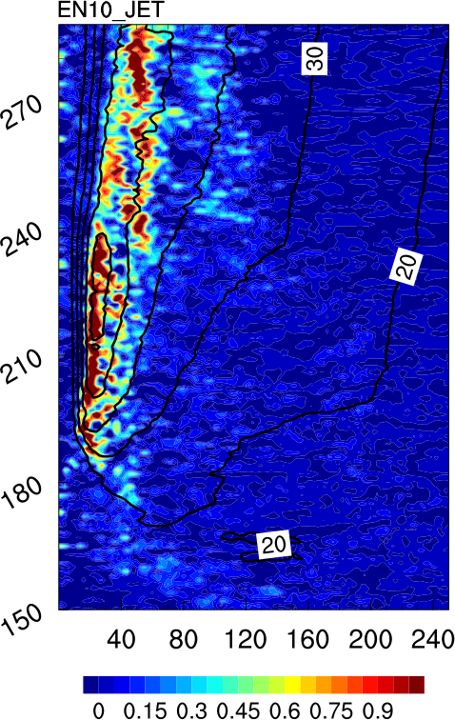
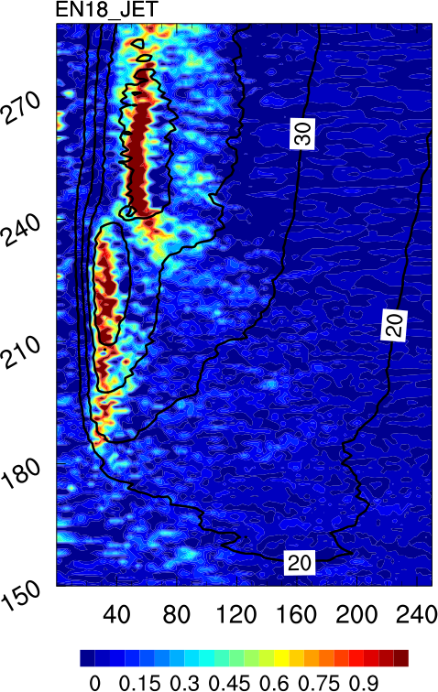
Our Data:
WRF model
Simulations with different vertical wind shear
Vertical Wind Shear : 6m/s
SST: 27 ºC

Slide 7
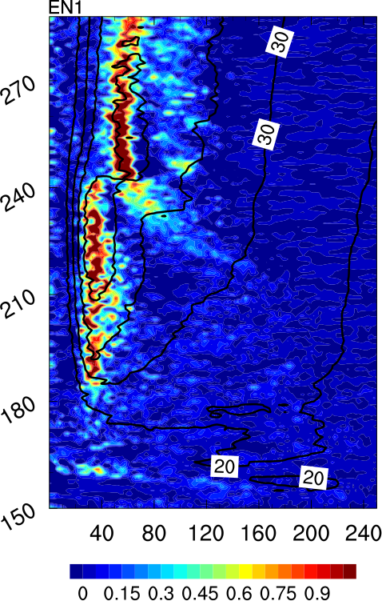
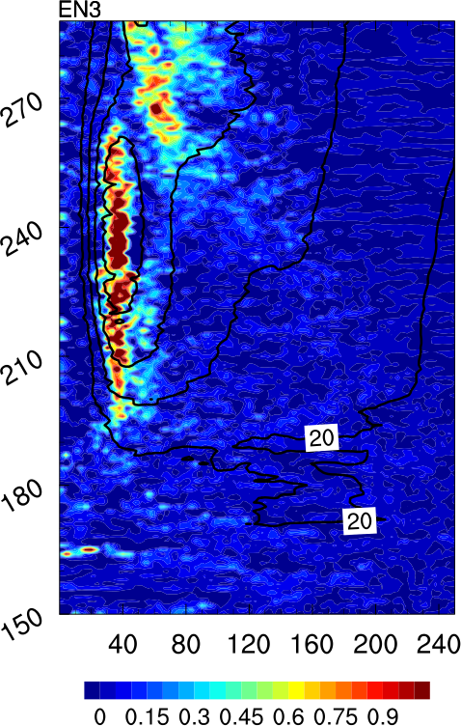
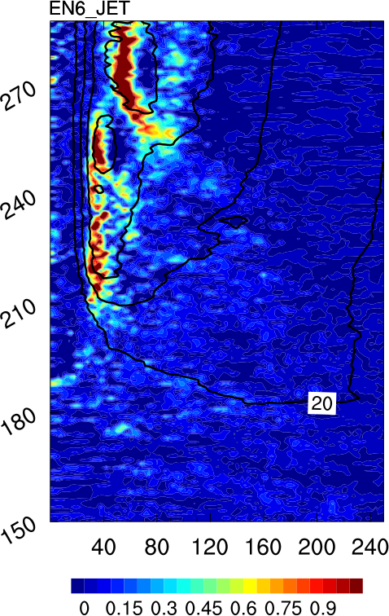
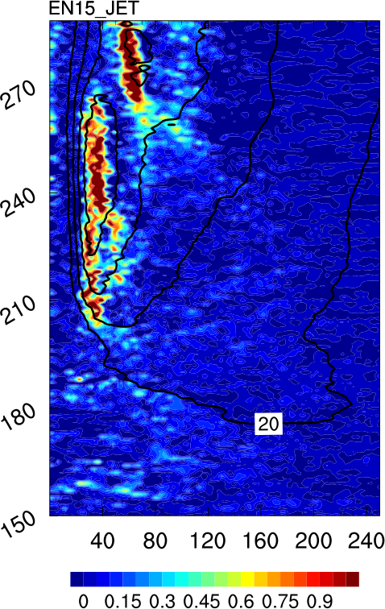
Five members that have clear ERC:
stampede
Jet

Slide 8
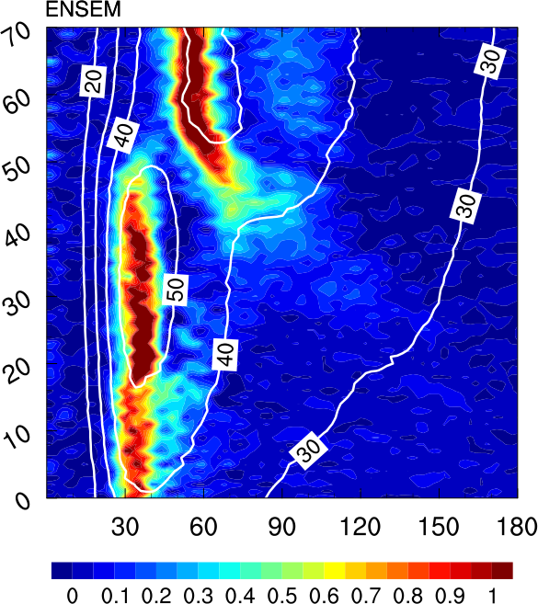

Slide 9
Vertical velocity at 5 km
We tend to think Agradient Force as a result rather than a cause.
Some earlier precursor ?
Agradient Force

Slide 11
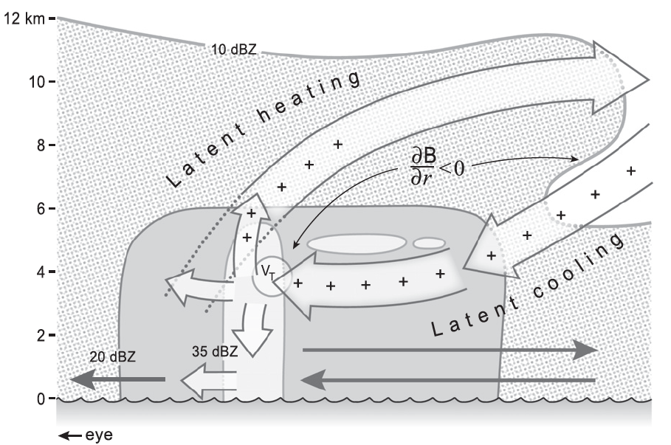
Possible Hypothesis:

Slide 12
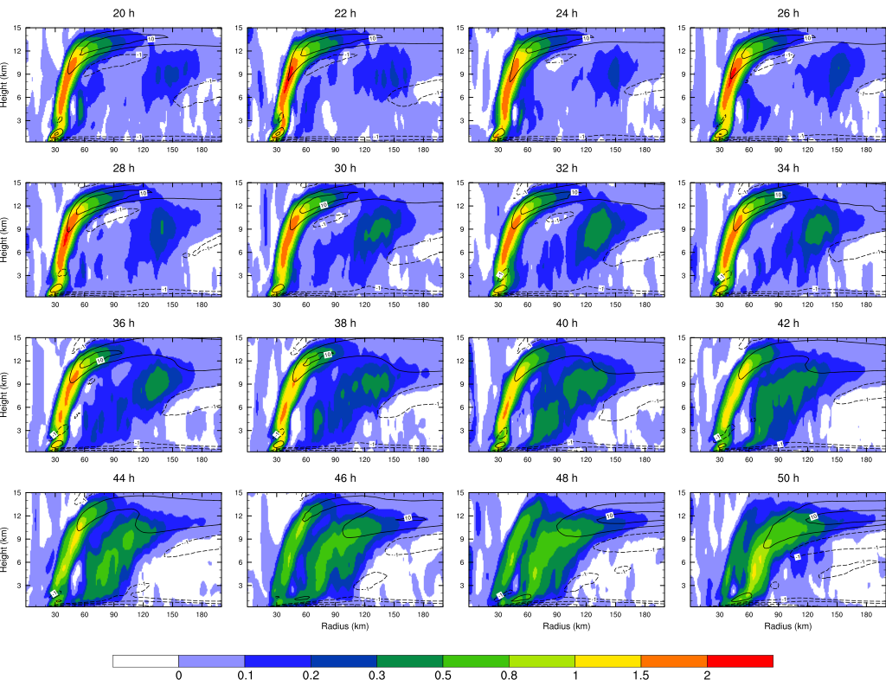

Slide 13
Thanks~

