Slide 1
Predictability and Dynamics of TC
Under Vertical Wind Shear
Dandan Tao
Group meeting 09/13/2013

Slide 2
Experimental Design
WRF version 3.1
18km, 6km, 2km; 4320km, 1440km, 720km
41 vertical levels
Physics: YSU, WSM6
Vmax = 15 m/s
Rmax = 135 km
Random moisture perturbation: ± 0.5 g/kg under 950hPa
20 members in each set:
shear condition: noflow, SH2.5, SH5, SH6, SH7.5, SH10, SH12.5
SST condition: 27°C and 29°C
Take the mean of 20 members in each set

Slide 3
SST27
SST29

Slide 4
shear_SST27
shear_SST29
tilt_SST27
tilt_SST29

Slide 5
450hPa total relative Vorticity and column integrated total diabatic heating
within 260km Radius
within 260km Radius

Slide 6
Azimuthally averaged diabatic heating
SH5_SST27
SH6_SST27
SH7.5_SST27
SH5 – SH6
SH6 – SH7.5

Slide 7
Boundary layer θe (radius vs. time) and RH within 250km (time vs. height)
SH5_SST27
SH6_SST27
SH7.5_SST27

Slide 8
SH5_SST27
SH6_SST27
SH7.5_SST27
39h
Boundary Layer θe
48h
88h

Slide 9
SH5_SST27
SH6_SST27
SH7.5_SST27
39h
500hPa RH
48h
88h

Slide 10
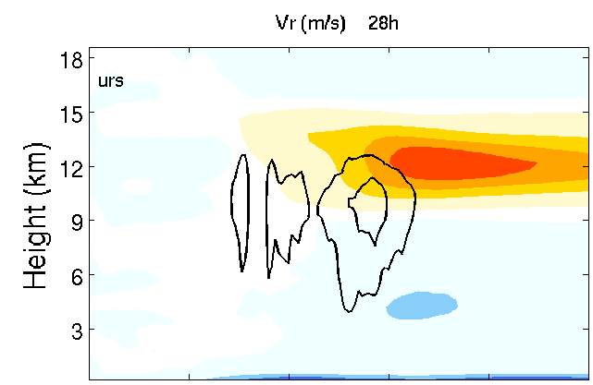
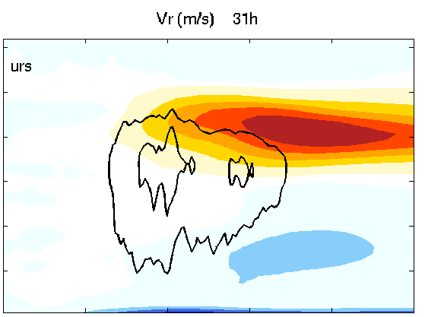
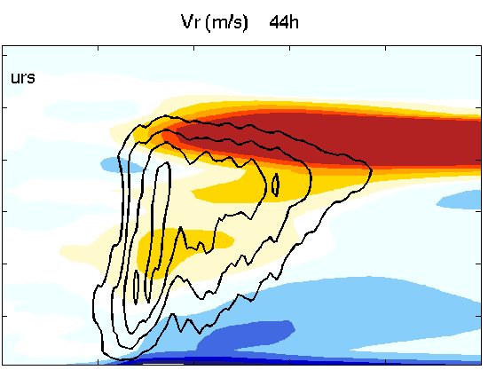
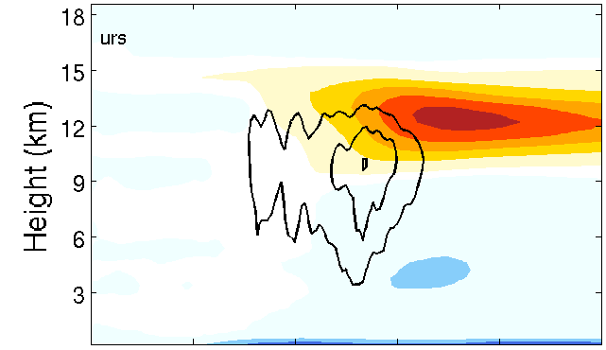
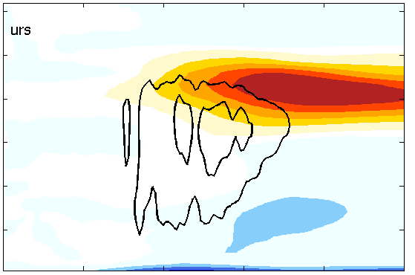
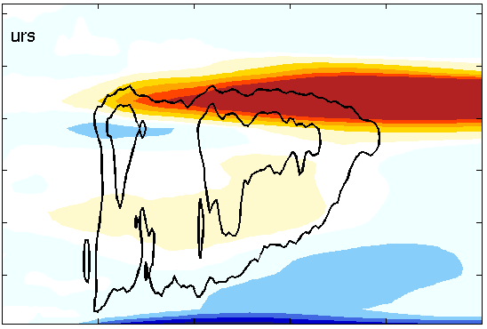
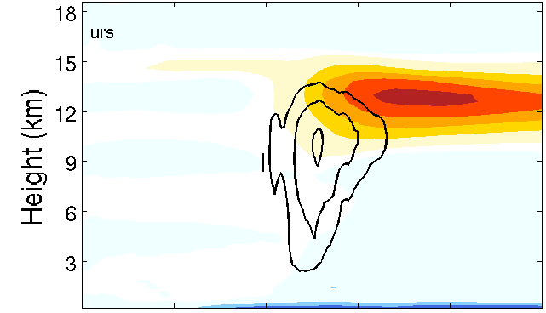
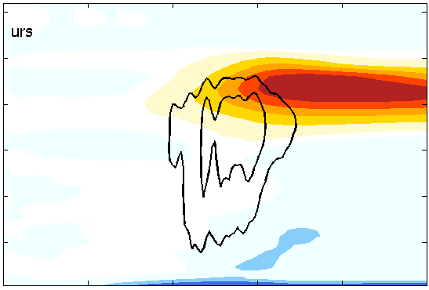
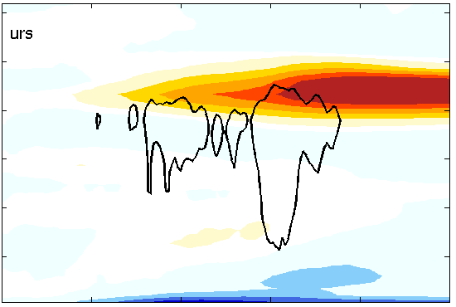
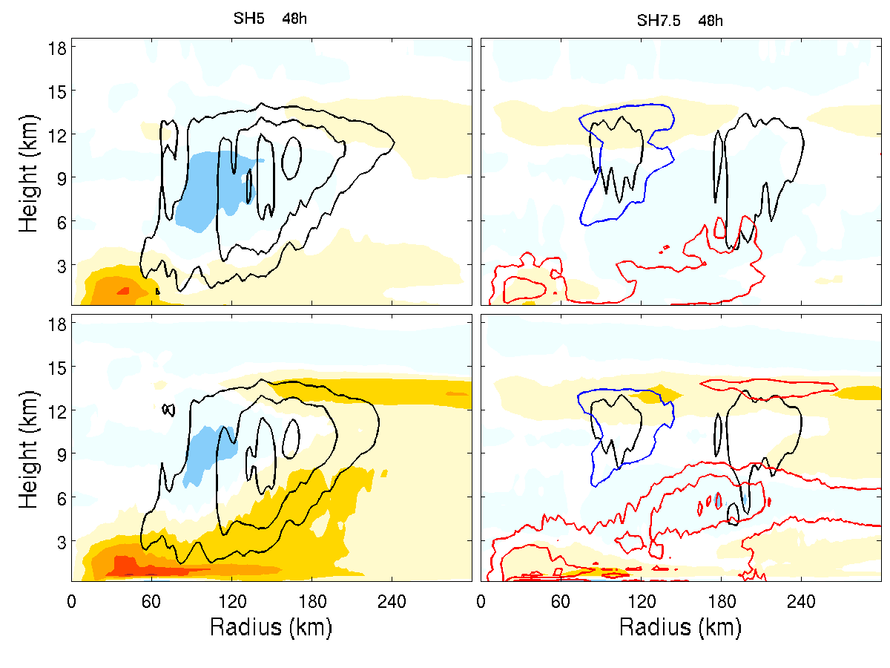
Azimuthally averaged Radial wind and Vertical wind
SH5
SH6
SH7.5

Slide 11
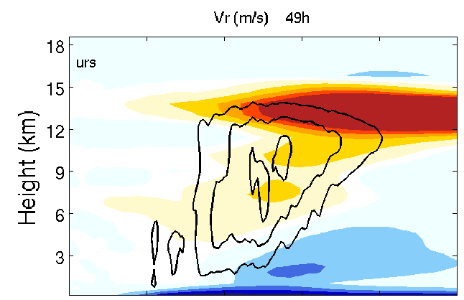
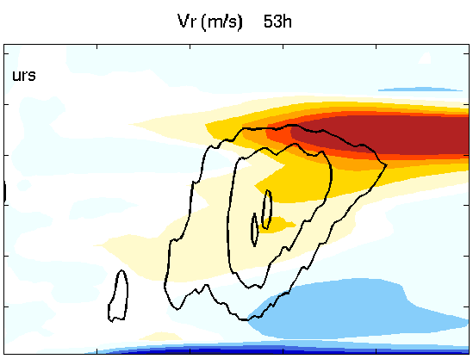
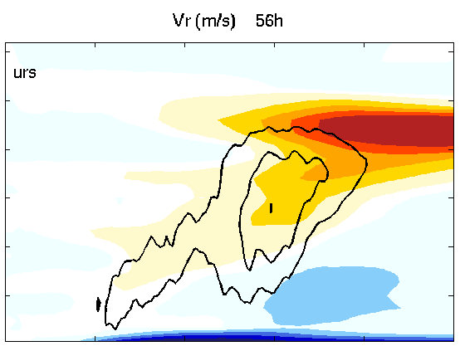
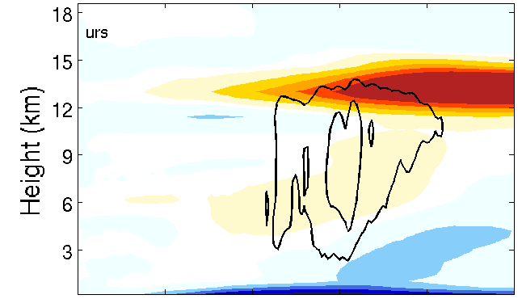
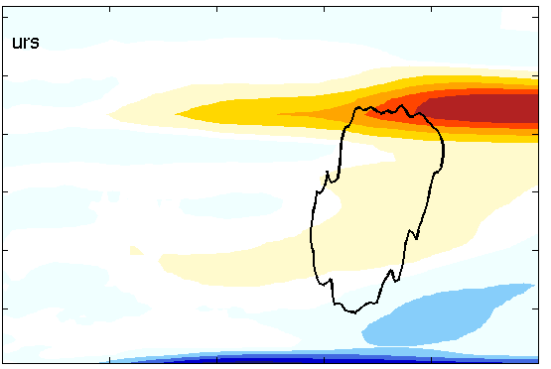
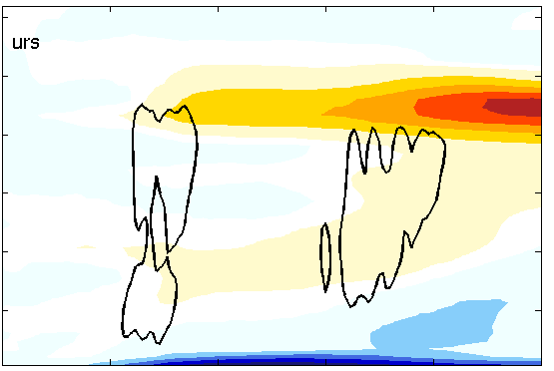
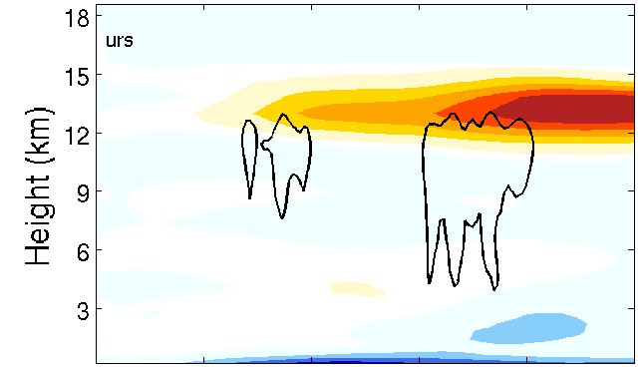
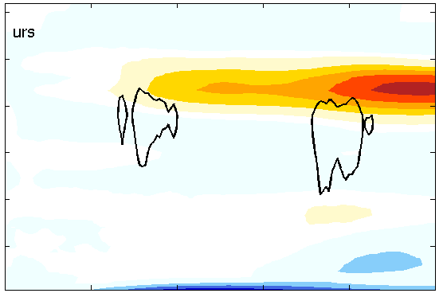
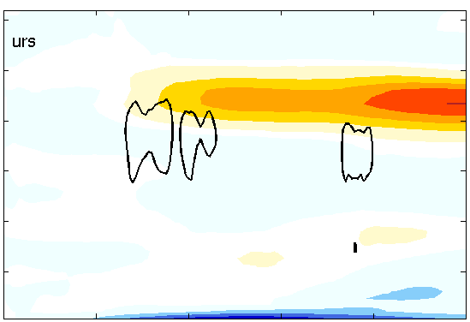
Azimuthally averaged Radial wind and Vertical wind
SH5
SH6
SH7.5

Slide 12
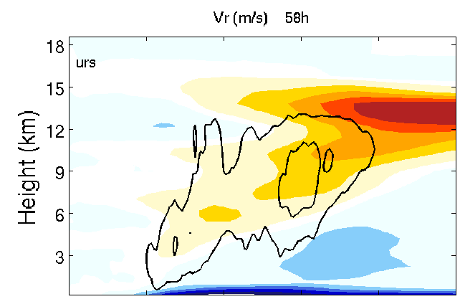
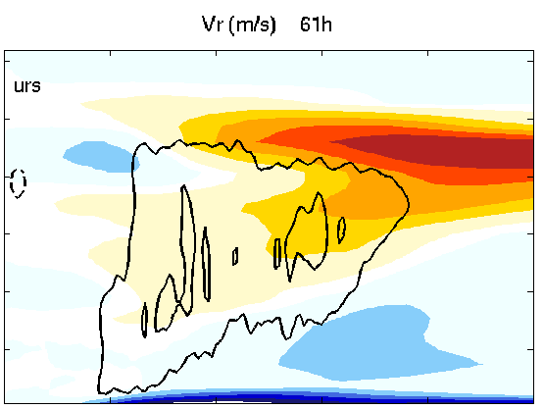
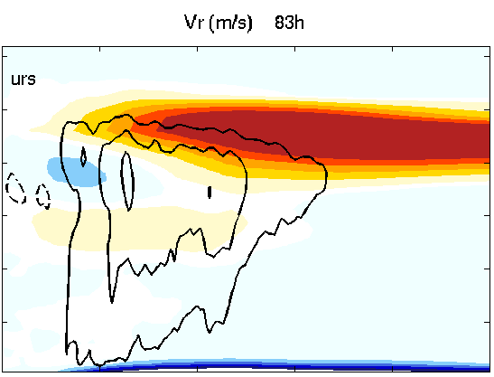
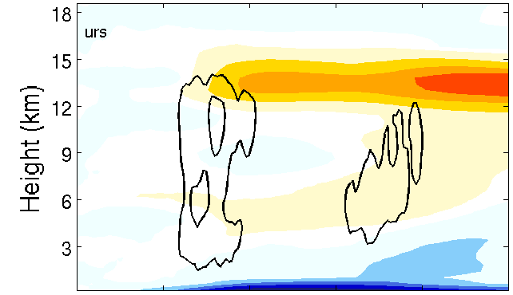
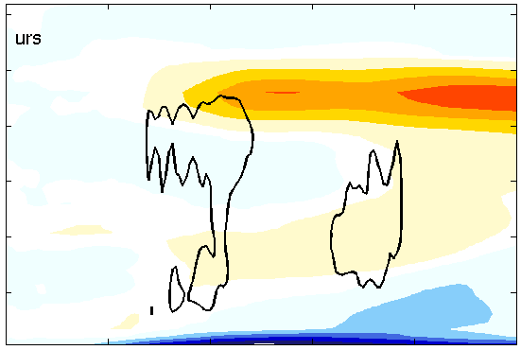
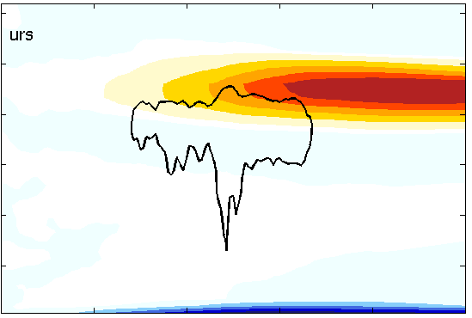
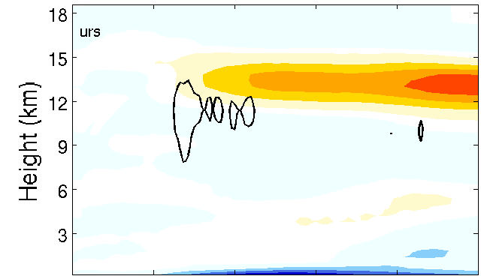
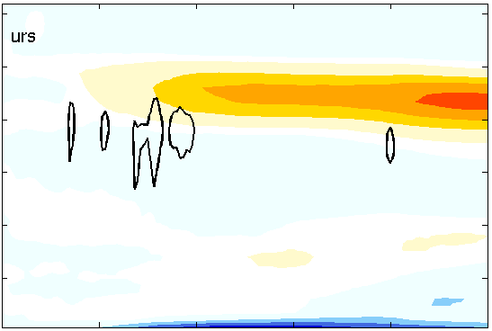
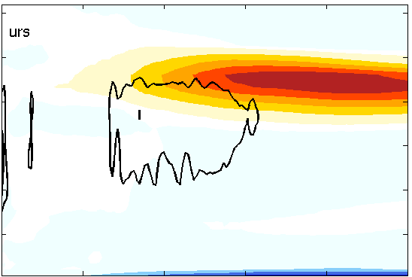
Azimuthally averaged Radial wind and Vertical wind
SH5
SH6
SH7.5

Slide 13
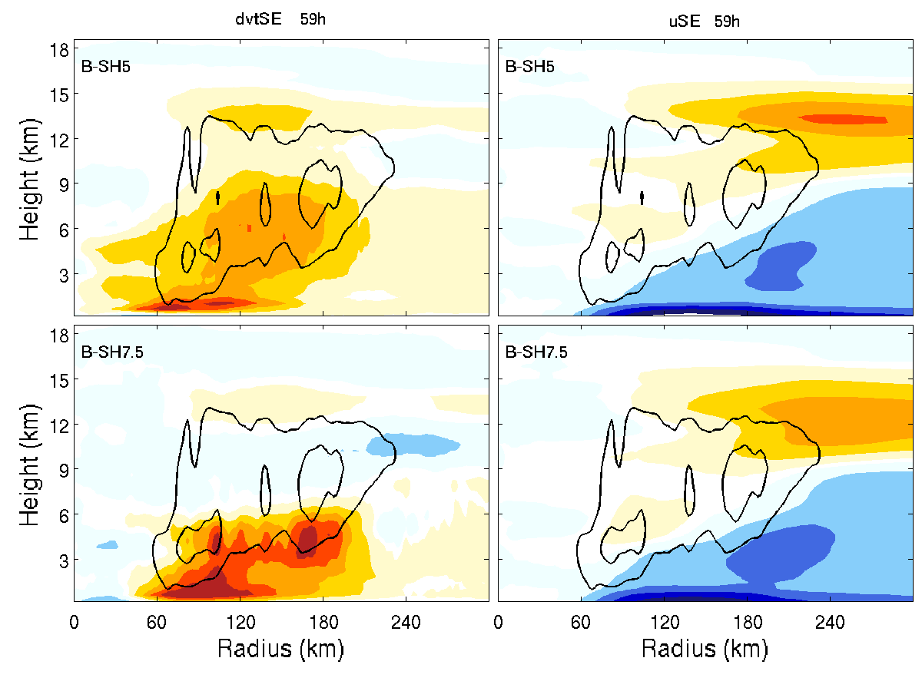
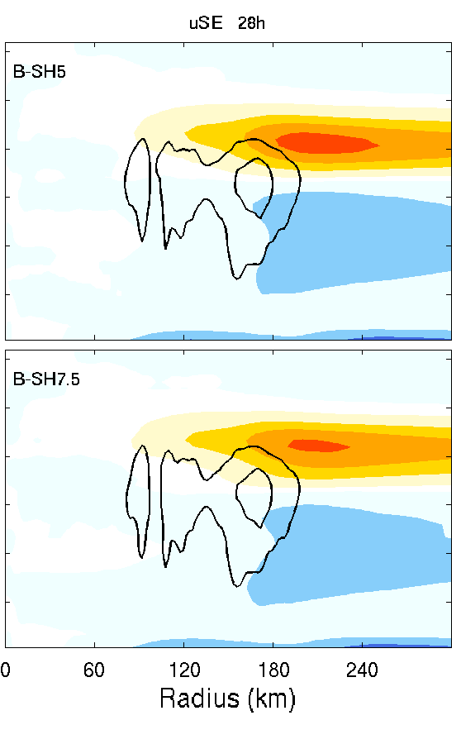
Radial flow
SE output
Q-SH5-SST27
B-SH5-SST27
Q-SH5-SST27
B-SH7.5-SST27

Slide 14
Conclusions:
Overview of intensity, tilt and shear evolution
1. The larger the shear, the larger the tilt, the longer the precession time.
2. When the shear is larger than a critical value, the TC vortex cannot develop.
3. The small difference in the shear magnitude when it is approaching the critical value can lead to big difference in RI onset time.
b. Vortex intensity and diabatic heating
1. The vortex intensity is closely related to the diabatic heating.
2. SH5 has stronger convection while compared to SH6 and SH7.5 and the location of the convection is closer to the center.
c. The factors influence the convection
c.1 The influence of dry air ventilation inflow path on the TC formation
1. The dry air effect through boundary layer inflow is not clear. The inflow is not strong enough to take in the low θe air. The updraft is mainly on the upstream of the low θe air.
2. The midlevel high RH area coincides with maxdbz area which means the midlevel moistening here is caused by convection itself. SH5 midlevel is more moistened however, it has lower BL θe. It seems the BL θe is more related to convection strength. The stronger convection, the stronger downdraft, the more dry air flushed into BL.
3. The pathway of ‘larger shear -> larger tilt -> more dry air taken into the boundary layer -> more low θe air taken into the updraft by inflow -> weaker TC’ is not working here.

Slide 15
Conclusions:
c. The factors influence the convection
c.2 Effect of vertical shear on spatial distribution/organization/intensity of convection and
related impact of system-scale convergence of absolute angular momentum
The evolution of azimuthally-averaged radial wind and vertical wind show that the SH5 has stronger and closer convection. The supply of inner core convection is very important to resist the large tilt. Weaker convection is more easier to be advected away from center. This may also because of the stronger vertical wind shear. (SH5 vs. SH6: 44h, 49h, 53h)
Background and heating impacts
Heat forcing is the dominant one. Background flow only can change the secondary circulation a little.
B-SH7.5 (large tilt and weak circulation) is not efficient to convert diabatic heating to TC kinetic energy (vortex strength), however, for SH7.5 case, it is mainly the weak and far away convection that makes the vortex harder to intensify.
Larger tilt and weaker vortex, the efficiency of diabatic heating is lower, so with the change of convection the reaction of secondary circulation/ vortex strength will be weaker (the change will be slower).

